Slide 1

Midterm + ML ethics
Bryan Wilder

Slide 2
Updates
Coming up:
Next Tuesday: paper reflection
Next Thursday: start group presentations – sign up for a date if you haven’t already!
Update:
Offering individual assessment option for second half of course
In this option, your group can designate the person/people primarily responsible for each component of the upcoming assignments

Slide 3
Midterm
Overall, everyone did well!
92% average, standard deviation 3%

Slide 4
Midterm: common mistakes
Ethics question: key is substantively identify what features of domain/problem formulation may specifically introduce a risk of bias
Ok answer: “There is a risk that the algorithm will treat people of difference races unequally”
Good answer: “There may be differential measurement error in the outcome, since people with different access to healthcare or exposure to criminal justice are more likely to be identified as experiencing a relapse”

Slide 5
Midterm: common mistakes
Censoring: censoring is for time-to-event outcomes when the exact time is not observed (e.g., only know that event time is >= some value)
“The outcome is the number of days from when a person experiencing homelessness receives rental assistance until they are again homeless. Sometimes individuals move to a different city, and if so, we do not observe whether they become homeless in the future.” This is (right) censoring
“The outcome of interest is whether a patient is readmitted to a hospital within 30 days of discharge. Some patients have insurance company A and some have insurance company B. For patients with insurance company A, we always observe whether they are readmitted. For patients with insurance company B, sometimes we fail to observe readmissions that actually occurred.”
Not censoring: it is measurement error in the outcome, but not specifically in the form of inexact observation of a time-to-event

Slide 6
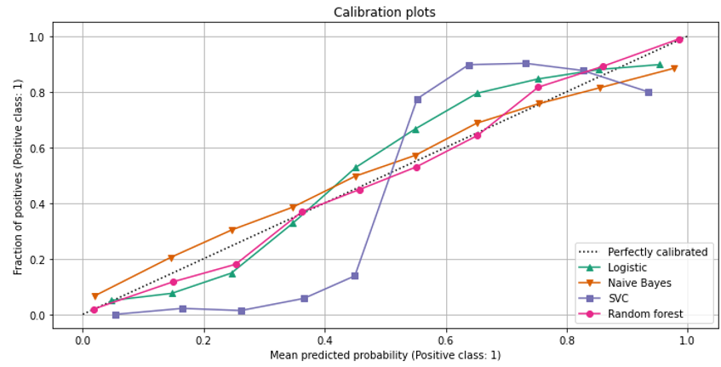
Midterm
Mea culpa: calibration
We did not take points off for reversing over/under confident

Slide 7
ML ethics
ML is increasingly widely used in high-stakes settings
Correspondingly greater need for developers of ML to develop and apply methods which are up to the challenge
Running theme: “accuracy” is a small piece of a much bigger picture
Problem formulation, choice of objectives, choice of data, how a method is used in decision-making, etc. all play a huge role

Slide 8
ML ethics
Second half of the course will explore two topics more detail
Fairness: avoiding biases or discriminatory treatment induced by algorithms
Uncertainty quantification: giving honest assessments of when models do vs don’t know

Slide 9
ML ethics
These modules ask you to implement methods
Important to acknowledge that technical methods can only address one part of the picture: depends on all of those earlier choices/features of the setting
We will use lecture time to discuss examples which take a broader perspective

Slide 10
Data and AI Ethics Issues
Privacy
Data Ownership
Bias, Equity, & Fairness
Transparency
Trustworthiness and Accountability

Slide 11
Categorization
Should we be working on this task in the first place? Are these the right goals?
Sometimes ethical issues are unavoidable for a given task
Is our solution sufficiently good that it can achieve our goals?
Robust enough, high enough accuracy across population groups, etc.
Is it developed and used in a way that respects autonomy?
Transparency, informed consent, accountability

Slide 12
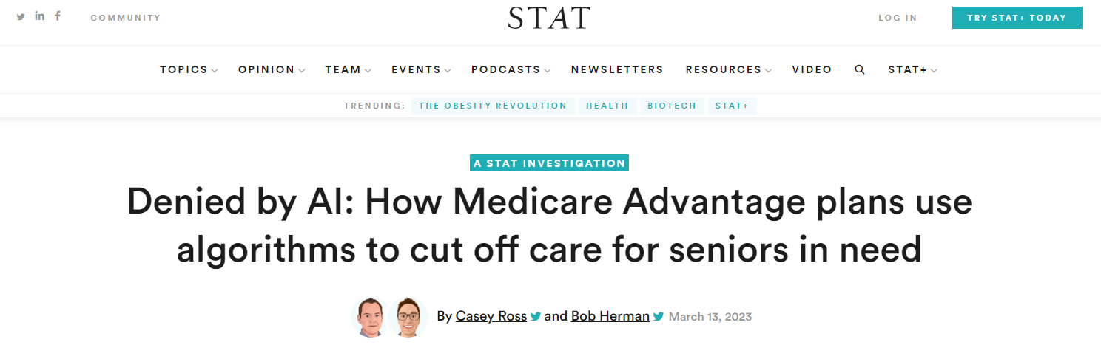

Slide 13
Example
Medicare advantage plans: privately administered version of government-provided health insurance for older patients
Insurer determines what care is medically necessary/what they will pay for, within some boundaries
Wasteful spending in medicine is a big deal: costs tons of money, drives up costs for everyone. How to tell precisely what is needed?
ML: offers/claims to predict patient’s future trajectory! Offer more personalized care

Slide 14
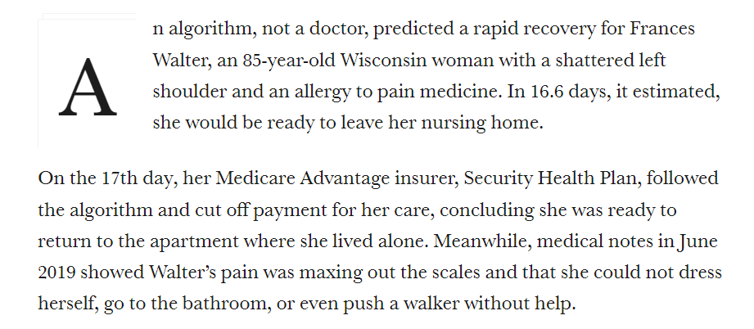
Example

Slide 15
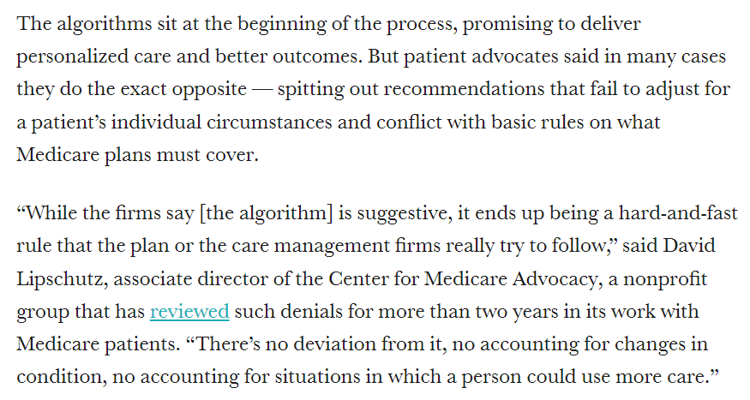
Issue 1

Slide 16
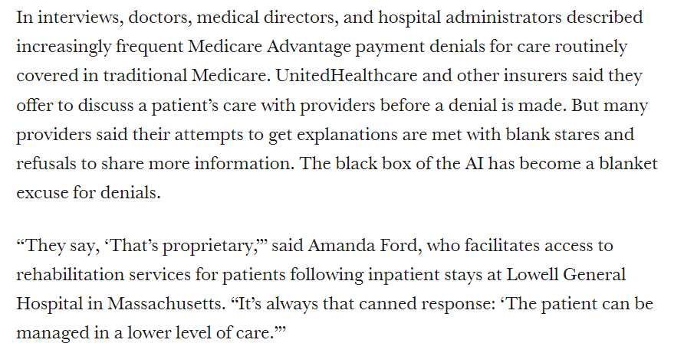
Issue 2

Slide 17
What went wrong?
Slido, #10718
Remember to enter your name

Slide 18
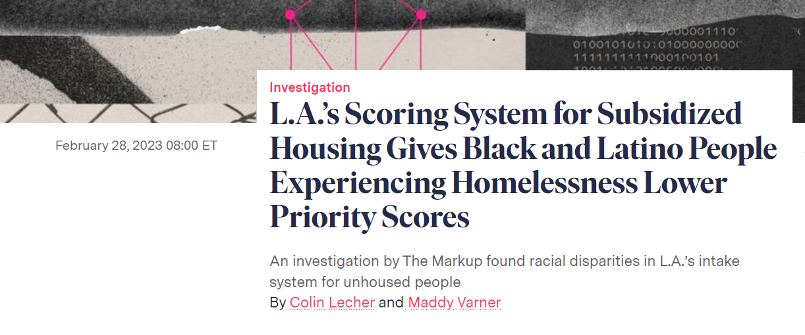

Slide 19
Housing authorities offer a range of services to people experiencing homelessness
Ranging from short-term/transitional housing to permanent housing with supportive services
They never have enough money
Goal: figure out who needs the most support
Operationalization: predict who is at greatest risk of bad outcomes (remaining homeless, becoming incarcerated, dying)

Slide 20
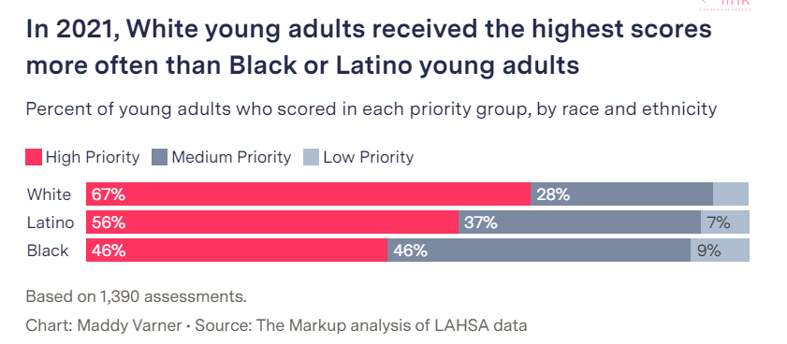

Slide 21
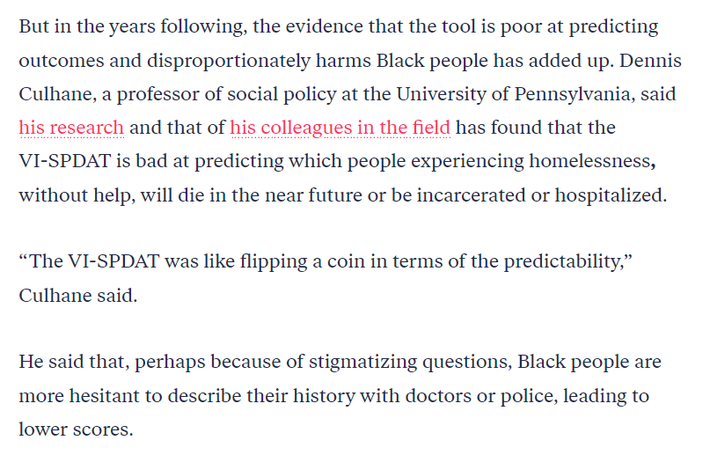

Slide 22
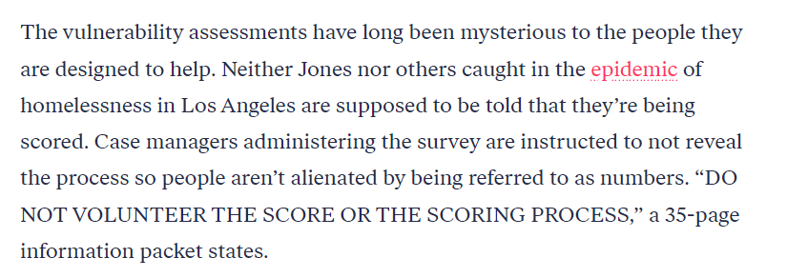

Slide 23
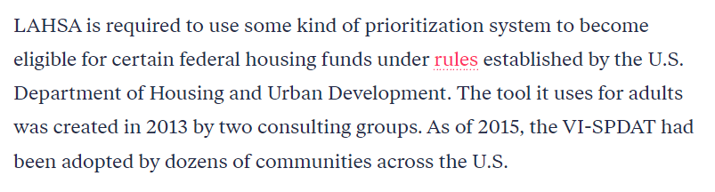

Slide 24
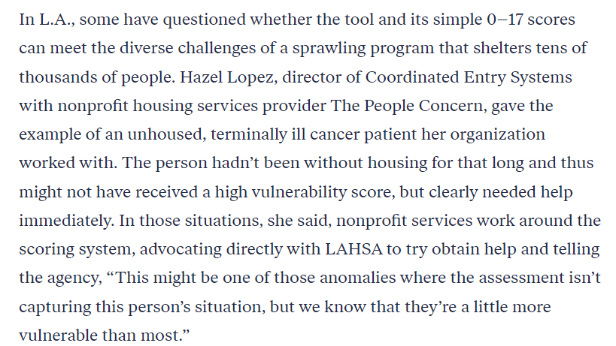

Slide 25
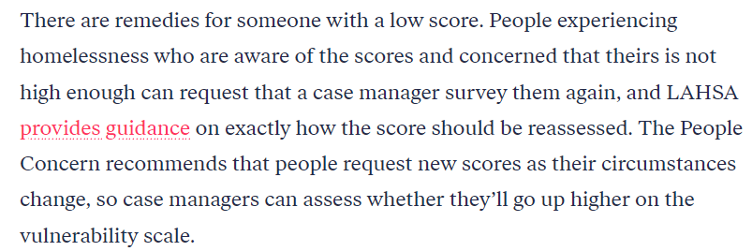

Slide 26
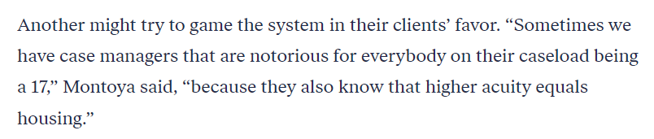

Slide 27
What went wrong?

