Slide 1

Introduction to fairness & bias in ML
Bryan Wilder

Slide 2
Updates
Coming up:
Thursday: group presentations start
20-25 min per group, cover the method/paper itself as well as lessons from applying it to your ML pipeline. What impact did it have, where were the pain points, etc?

Slide 3
Fairness & bias
One particular ethical issue related to ML: does it work well for/benefit everyone?
Or, are there particular groups of people who are disproportionately harmed by use of ML?
How does this fit into the context of broader inequities?

Slide 4
Fairness & bias
High-profile failures of ML

Slide 5
This lecture
What are we trying to achieve?
What are the main reasons our systems fail to achieve our goals?

Slide 6
What do we want?
Very hard to answer this in a satisfactory way
Many intuitive answers are mutually incompatible
Here: explore a few common choices (drawing throughout on Corbett-Davies & Goel, 2018)

Slide 7
Prelude: process vs outcomes
Common way of talking about discrimination, from US legal system
Disparate treatment: the procedure for making decisions explicitly distinguishes between people based on a sensitive attribute
Disparate impact: the procedure results in different consequences for people in different groups, in a way that it not justifiable in the service of a non-discriminatory purpose

Slide 8
Prelude
Related concept in economics literature
Taste-based discrimination: acting as if have a preference for discriminating against a particular group
Statistical discrimination: treating groups differently in utility-maximizing pursuit of a goal that is not (at face value) itself discriminatory

Slide 9

What do we want?
One intuition: “everyone treated the same”
Or, “predictions do not depend on group membership”
One way of formalizing: consider group label y, sensitive attribute s, and other features x:
$\hat{f}\left(y | x, s\right)=\hat{f}(y|x, s^{′})$ for any $s, s′$

Slide 10
Potential issue #1: proxy features
Everything is correlated
Concrete example: race as sensitive attribute. Location of residence, income, education, etc all correlate with race
Various attempts to scrub these features out of the data (e.g., train a representation from which sensitive attribute can no longer be predicted)
But, these may be legitimate features for a domain of interest (e.g. education for hiring decisions)

Slide 11
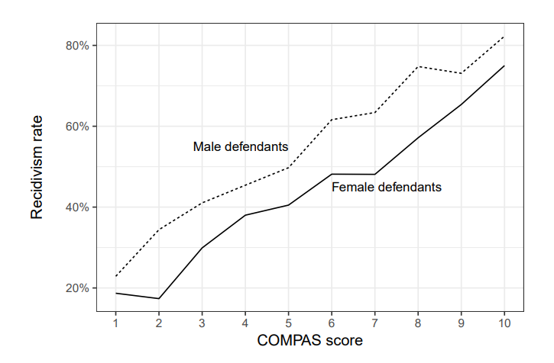
Issue #2: sensitive attributes can be predictive

Slide 12
Issue #2: sensitive attributes can be predictive
In this example, excluding gender information harms female defendants!
A female defendant with an equal chance of recidivism as a male defendant receives a worse score…
Discrimination against females?

Slide 13
Removing sensitive features
Takeaway: this is definitely not a panacea
However, in some domains there are strong constraints (regulation, norms, etc) that decisions should not depend on sensitive attribute
Important to be aware of consequences of these approaches

Slide 14
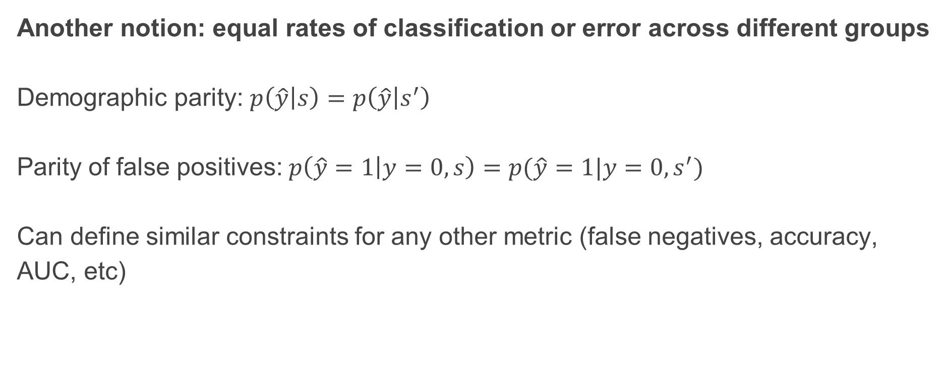
What do we want?
Another notion: equal rates of classification or error across different groups
Demographic parity: $p\left(\hat{y} | s\right)=p\left(\hat{y} | s^{′}\right)$
Parity of false positives: $p\left(\hat{y}=1 | y=0, s\right)=p(\hat{y}=1|y=0, s^{′})$
Can define similar constraints for any other metric (false negatives, accuracy, AUC, etc)

Slide 15
Equal error rates
Good feature: in some circumstances, directly maps to a notion of equal harm/benefit across groups
E.g., “false positive = person wrongly imprisoned” or false negative = “patient whose diagnosis is missed”

Slide 16
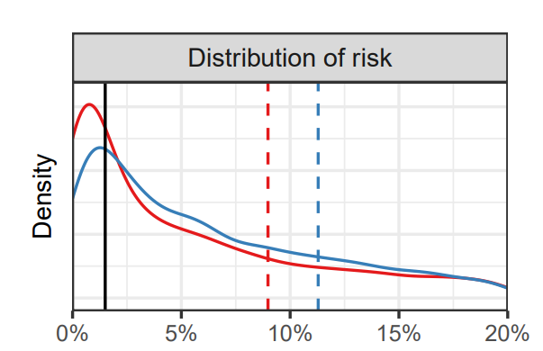

Equal error rates
Problem: can lead to decisions that are suboptimal for every group
Example: diabetes screening decisions. Predict individual risk (based on age, BMI, etc). Suggestion: screen everyone with at least 1.5% risk
Threshold: 1.5%

Slide 17
Equal error rates
Threshold: 1.5%
Optimally cost-effective threshold violates demographic parity (more Asian patients are screened due to higher overall risk)

Slide 18
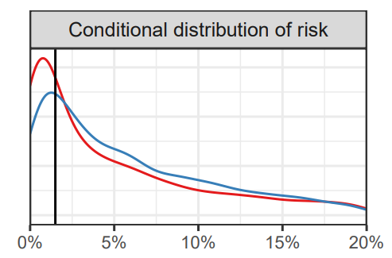
Equal error rates
(conditioned on not having diabetes)
At optimal threshold, also higher false positive rate for Asian patients

Slide 19
Equal error rates
What if we move the thresholds?
Setting different risk thresholds for White and Asian patients would allow us to achieve demographic parity or equal FPR (though not both at once)
But this also sounds bad – means some patients at higher risk do not get screened, while some get a procedure that’s not medically necessary!

Slide 20
Infra-marginality
Relevant tradeoffs happen at the margin
As we alter our threshold, when do marginal benefits = marginal costs?
Population-level error criteria measure over the entire risk distribution, measuring over people who are not impacted by a change in the threshold
When risk distributions have different shapes across groups, enforcing any criteria that is infra-marginal requires making suboptimal decisions for some individuals
Implies that an under an alternate rule, everyone would have been better off!

Slide 21
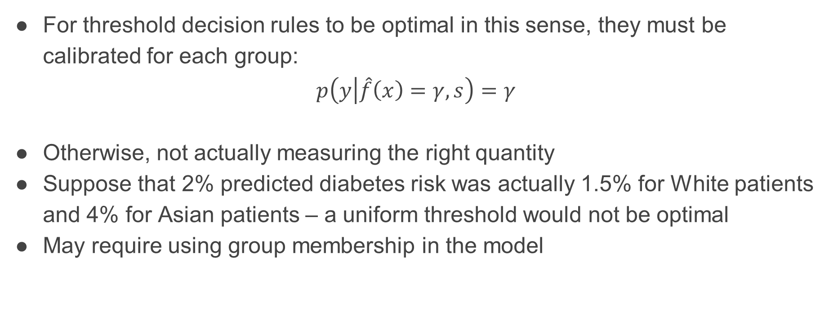
Calibration (again)
For threshold decision rules to be optimal in this sense, they must be calibrated for each group:
$$p\left(y | \hat{f}\left(x\right)=γ, s\right)=γ$$
Otherwise, not actually measuring the right quantity
Suppose that 2% predicted diabetes risk was actually 1.5% for White patients and 4% for Asian patients – a uniform threshold would not be optimal
May require using group membership in the model

Slide 22
Calibration (again)
Is calibration per group sufficient?
Consider a bank that would like to discriminate against Black applicants in lending decisions
Suppose that within a given zip code, Black and White borrowers default at similar rates, but Black borrowers tend to live in higher default rate zip codes
If the bank estimates default risk using only zip code information, their predictions are calibrated for both groups
However, credit-worthy Black applicants would be disproportionately denied loans

Slide 23
Calibration (again)
Another sense in which calibration is not sufficient: model may not be equally informative for all groups
Trivial example: model outputs base rate for everyone in one group, and the correct label for everyone in the other
Everyone receives the “optimal” decision based on available information…
…but benefit of intervention is far from equitable

Slide 24
Takeaway
There’s no free lunch
ML algorithms are ways of instantiating specific policy choices
Important to directly define the policy goals and then select methods which optimize them
Intermediate measures of whether a ML model is “fair” can often have undesirable consequences
Use “fairness” methods only when there is a clear policy motivation

Slide 25
This lecture
What are we trying to achieve?
What are the main reasons our systems fail to achieve our goals?

Slide 26
What are common reasons for failures
Models make bad tradeoffs in fitting/optimization?
Data is unrepresentative, or of unequal quality?
Measurement error?

Slide 27
Internal problems in modeling
Concern: model optimizes average loss, but can’t get everything right
Pays more attention to larger groups in the population
Solution: adjust loss function to prevent it from doing this, postprocess outputs, etc.
Lots of methods, will hear about in subsequent lectures

Slide 28
Data quality is unequal
Back to calibration example: even the Bayes-optimal predictor per group may have unequal quality
E.g., not enough samples from members of particular groups
Distribution shift (training data from one population, deployment on another)
Methods can only do so much; offering equal quality services may require gathering more data (or more high quality data)

Slide 29
Measurement error
Classic example: predicting recidivism risk
Label = whether somewhat was arrested again within N years
But arrests != crimes

Slide 30
Other examples
Test-retest issues
Other noise in timing of measurements

