Slide 1
Goal-e: Storyboards
SWDV 691 Ben Wilkins

Slide 2
Story 1
Jane wants to sign up for an account and create a goal

Slide 3
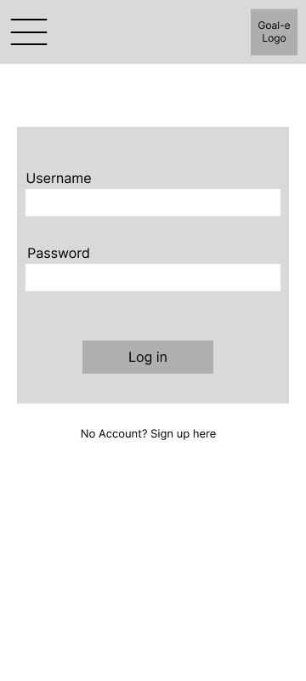

Slide 5
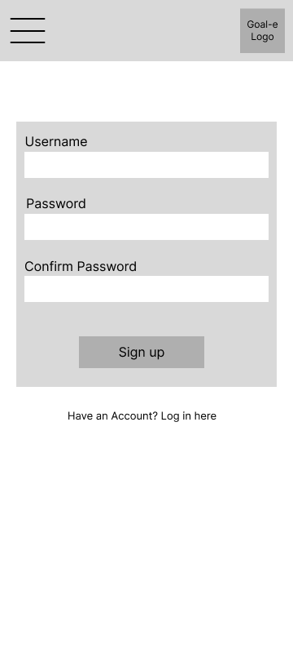

Slide 6
jane_doe
************
************

Slide 7
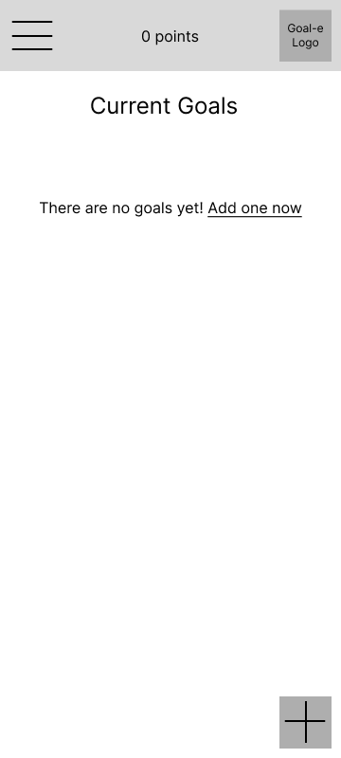

Slide 9
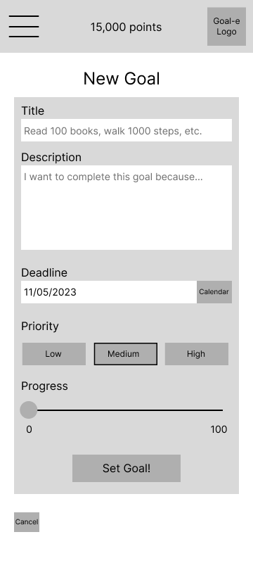

Slide 10
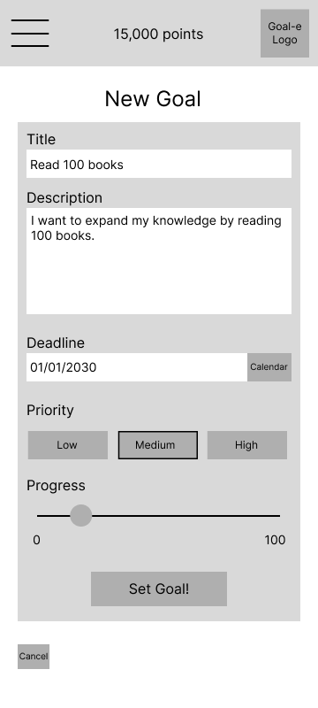

Slide 11
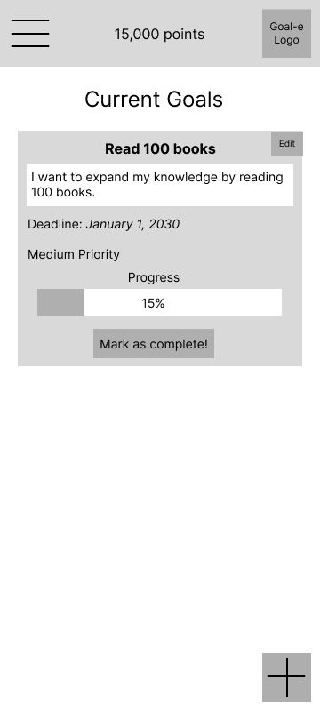

Slide 12
Story 2
John wants to log in and mark a goal as complete

Slide 14
john20
************

Slide 15
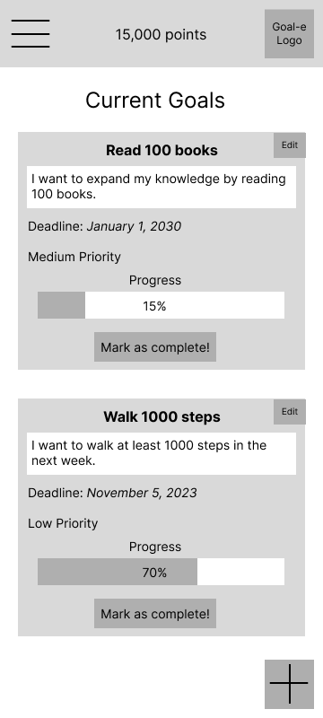

Slide 17
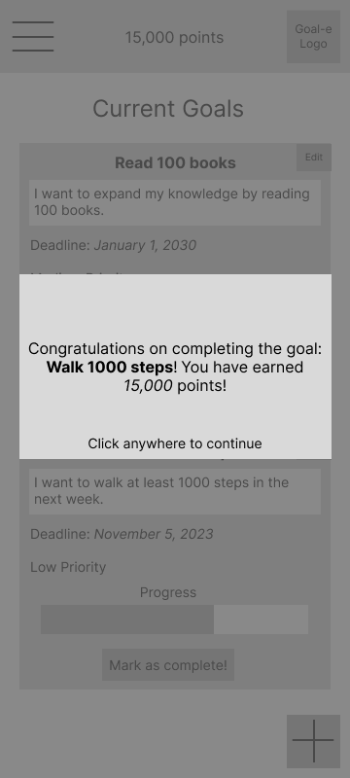

Slide 18
Story 3
Bobbi wants to check the current month’s goals

Slide 20
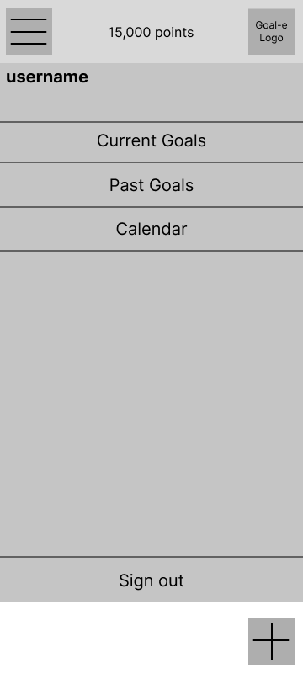

Slide 22
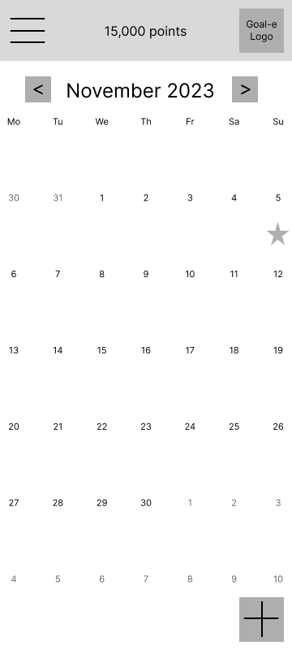

Slide 24
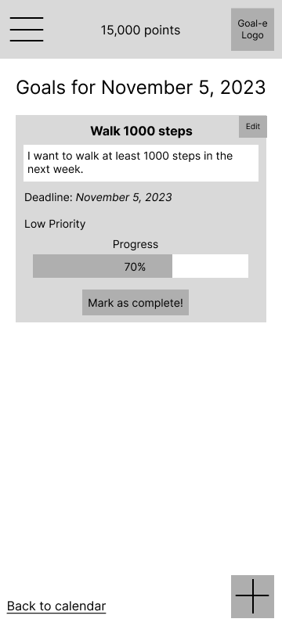

Slide 25
Story 4
Bobbi wants to check her past goals

Slide 29
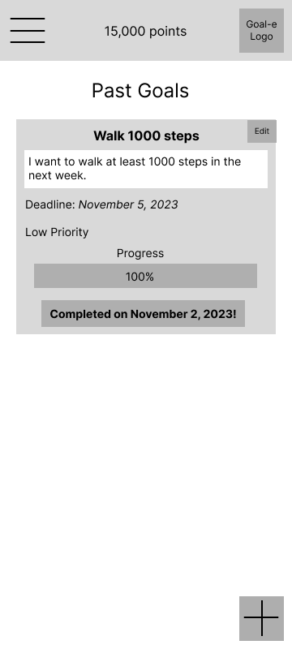

Slide 30
Story 5 (stretch goal)
John wants to check his account settings

Slide 32
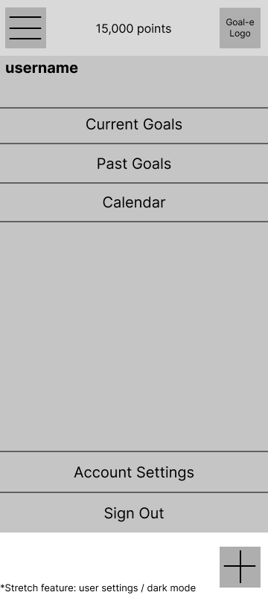

Slide 34
