Slide 1
ISO/IEC 29119 Software Testing
The New International Software Testing Standard
By Tafline Murnane and Stuart Reid
ISO/IEC JTC1/SC7 WG26 Software Testing

Slide 2
Scope
Overview of ISO/IEC 29119
Applicability
Recent developments
Timeline
Future work

Slide 3
Motivation for ISO/IEC 29119
Conflicts in definitions & procedures
  Plethora of standards to be replaced by one
    IEEE 829, IEEE 1008, BS 7925-1/-2, IEEE 1028
Missing in current standards:
  Organizational Test Policy & Strategy
  Project Test Management
  Common System & Acceptance Testing techniques
  Non-functional testing

Slide 4














ISO 29119 – Scope & Structure
Part 1
BS 7925-1
Concepts & Vocabulary
Part 4
Part 2
Part 3
Testing
Techniques
Processes
Documentation
BS 7925-2
BS 7925-2
IEEE 829
IEEE 1008

Slide 5
Part 1: Concepts & Vocabulary
Software testing concepts
  Introduction to software testing
  Relationship between testing, development & maintenance
  Implications of lifecycle models
  Approaches to testing
Testing vocabulary

Slide 6
Part 2: Testing Processes
Organisational Test Process
Test Management Processes
Static Test Processes
Dynamic Test Processes

Slide 7
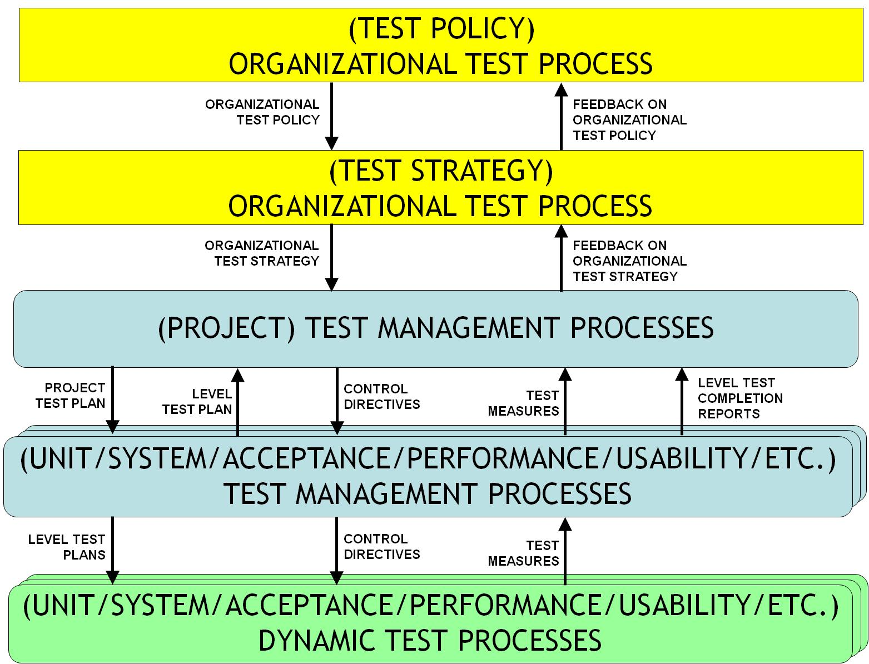
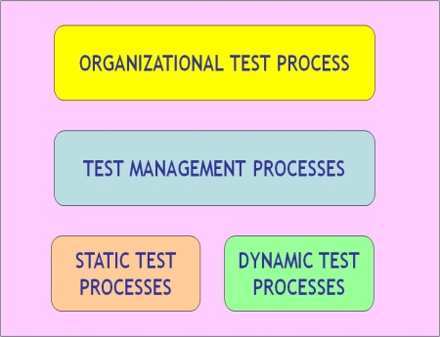
Instantiating Testing Processes

Slide 8
Organisational Test Process
Develop test specification
[Major revision required]
[No change required]
Draft
Test Specification
[No issues identified with
Test Specification]
Gain consensus on test specification
Monitor and control use of test specification
Review
test specification
[Issues identified
or
Scheduled review due
or
Major organizational change]
[Minor revision required]
Approved
Test Specification
Publish
test specification
Updated Test Specification
Update
test specification
Published
Test Specification

Slide 9
Test Management Processes
Organisational Test Process
Organisational Test Documentation
Feedback on Organisational Test Documentation
Test Management Processes
Test Plan Updates
Test Completion Report
Test Planning
Test Plan
Test Monitoring & Control
Test Completion
Test Plan,
Control Directives
Test Plan, Control Directives
Test Plan,
Test Completion Report,
Test Measures
Test Plan, Control Directives
Test Measures
Test Measures
Static Test Processes
Test Management Processes
Dynamic Test Processes

Slide 10
Test Planning Process
Understand Context
Scope
Organise
Test Plan
Development
Identify & Analyze Risks
Analysed Risks
Identify Risk Treatment Approaches
Treatment
Approaches
Design Test Strategy
Schedule, Staffing Profile
Determine Staffing and Scheduling
Test Strategy
Draft
Test Plan
Document
Test Plan
Approved
Test Plan
Gain Consensus on Test Plan
Test Plan
Publish
Test Plan

Slide 11
Test Monitoring & Control Process
Test Status Report
Test
Progress
Information
Test
Control
Information
Report
[Testing Incomplete]
Test Plan
Set-Up
Test
Measures
Monitor
Control
[Testing Complete]
Test Progress
Info
Control Directives
Measures
...Test Processes...
Dynamic/Static/Management

Slide 12
Dynamic Test Processes
(Phase) Test Management Process
(Phase)
Test Plan
Control Directives
Test Measures
Dynamic Test Processes
Test Design & Implementation
Test
Specification
Test Execution
Test Results
[No Issues Noticed]
[Issue Noticed or
Retest Result]
Test Environment Requirements
Test Environment Set-up
Test Incident Reporting
Test Environment Readiness Report
Incident Report

Slide 13
Static Test Processes
(Phase) Test Management Process
(Phase) Test Plan
Control Directives
Test Measures
Static Test Processes
Preparation
Review
Follow-Up

Slide 14
Example Test Process Description
Described using a standard template (following ISO 24774), for example:
Purpose
  The purpose of the Test Design & Implementation Process is to derive test procedures that will be executed during the Test Execution Process. Test conditions, test coverage items and test cases are created as part of this process.
Outcomes
  As a result of the successful implementation of the Test Design & Implementation Process:
    the features to be tested are decomposed into Feature Sets;
    the Test Conditions are derived;
    the Test Coverage Items are derived;
    Test Cases are derived;
    Test Sets are assembled;
    Test Procedures are derived.
Activities and tasks
  The tester shall implement the following activities and tasks in accordance with applicable organization policies & procedures with respect to the Test Design & Implementation Process.
    Identify Feature Sets (TD1) …
    Derive Test Conditions (TD2) …
    Derive Test Coverage Items (TD3) …
    Derive Test Cases (TD4) …
    Assemble Test Sets (TD5) …
    Derive Test Procedures (TD6) …
Information Items
  As a result of carrying out this process, the following information items shall be produced:
    Test specifications (test design specifications, test case specifications and test procedure specifications) and related traceability information;
    Test data requirements;
    Test environment requirements.

Slide 15
Part 3: Documentation
Organisational
  Test policy
  Test strategy
Project
  Project test plan
  Test completion report
Appendices
  examples of documents at each level of testing
Testing
  Test specification
  Test results
  Incident reports
  Test environment report
  Test status report
  Test completion report

Slide 16
Part 4: Techniques
Test case design techniques
  Static
    Inspections, walkthroughs, etc.
  Dynamic
    Black-box, white-box, etc.
  Non-functional
    Security, performance, usability, etc.
Test measurement (e.g. coverage)
Appendices
  Examples
  Effectiveness

Slide 17
Applicability
Generic standard to support all domains
  Some are more standards-oriented (safety, telecoms)
  Some will become more regulated (e.g. financial)
Needs trialing in all domains & project types
  Waterfall, iterative, agile
  New & maintenance projects
  Information systems & embedded systems
When wouldn’t you be selecting and using techniques? When wouldn’t you plan?

Slide 18
When can I start using 29119?
Typical ISO standards take over 7 years
  ISO 12207 conceived in 1988, published in 1995, represents 17,000 person hours (8.5 person years)
BS 7925-1/2 took 8 years to develop
IEEE estimates 2-4 years to develop a standard, at a cost of between $2,000 and $10,000 per page [1998]

Slide 19
Timelines
Working Draft (WD)
Committee Draft (CD)
Final Committee Draft (FCD)
Final Draft International Standard (FDIS)
Final International Standard (FIS)
Parts 2 & 3
Parts 1 & 4
FIS
FDIS
FCD
FIS
CD
FDIS
WD
FCD
CD
WD
…
May 08
May 09
May 10
May 11
May 12

Slide 20
Do you want to be involved?
Join the working group
  through your national standards body
  6 day meetings, every 6 months
  contribute between meetings
Join the national working group in your country to:
  contribute materials
  review drafts

Slide 21
Current status
Drafts of parts 1, 2 and 3 are under review
Draft of part 4 is underway
18 nations represented:
  Australia, Canada, China, Columbia, Denmark, Finland, France, Germany, Hong Kong, India, Japan, Poland, Russian Federation, South Africa, South Korea, Spain, United Kingdom, USA
Last meeting – Niigata, Japan, May 2010
Next meeting – Washington, October 2010

Slide 22
Conclusions
International standard will provide practitioners with guidelines for testing that cover all aspects of life cycle
  Consistent definitions, processes, procedures & techniques for testing
Will be adopted by IEEE, ISO, Standards Australia and other national standards bodies
Currently has representation from 18 nations & is being reviewed by software testing professionals world-wide
We need to ensure widespread applicability

Slide 23
For more information…
sreid@testing-solutions.com
  Keep up to date on our progress
http://softwaretestingstandard.org/
  ISO/IEC 29119 website
http://www.jtc1-sc7.org/
  access to official documents

