Slide 1
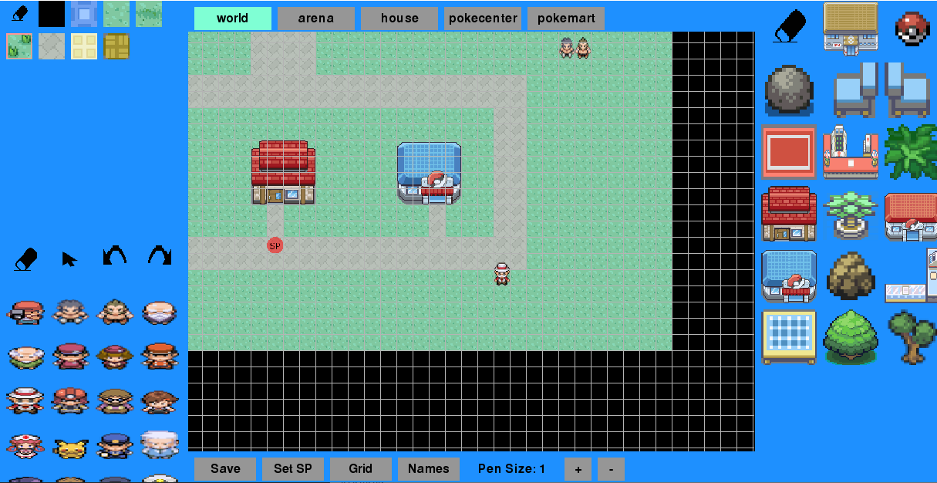
hold right mouse button and move the mouse to move the map
scroll to zoom
the current map is highlighted
press to switch the map
select to erase objects
select to erase tiles
select to draw this object
select to draw this tile
select to erase npcs
right click to show the object view
press to select an npc in the world (npc view)
spawn point
press to rotate an npc in the world
save the current map
toggles the grid
adjusts the size to draw the tiles
select to draw this npc
press the button and then on the map to set the spawn point
toggles to show names of the objects

Slide 2
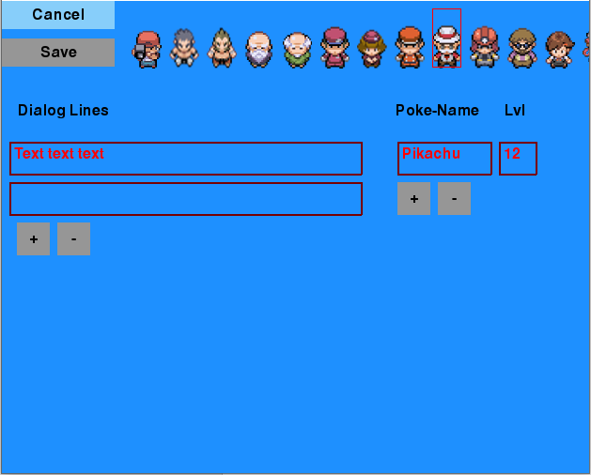
cancel the changes and goes back to the map view
changes the image of the npc
saves the changes and goes back to the map view
adds a dialog line
removes the last pokemon
removes the last dialog line
adds a pokemon
textfields to write
(or press CTRL+C, CTRL+V)

Slide 3
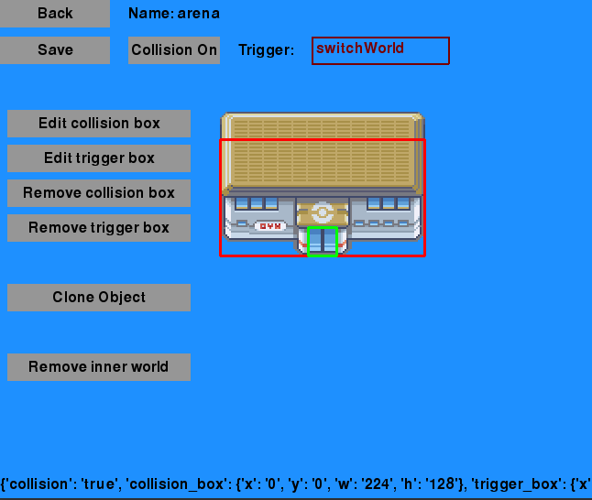
goes back to the map view
toggle if the object has collision
(„Collision On“ visible = it has collision)
saves the changes
what this object triggers
(leave empty if nothing)
press to edit/create the (red) collision box
press to edit/create the (green) trigger box
after pressing edit box, press/drag here to size the box
removes the (red) collision box
removes the (green) trigger box
creates a new object with the same attributes as this,
and goes back to the map view
(e.g. for arena1, creates arena2)
deletes the inner world
(equally creates a inner world)

