Slide 1

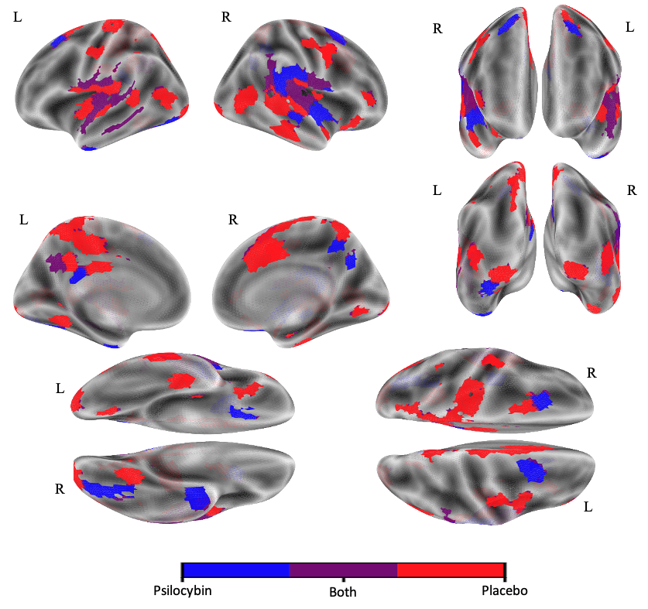




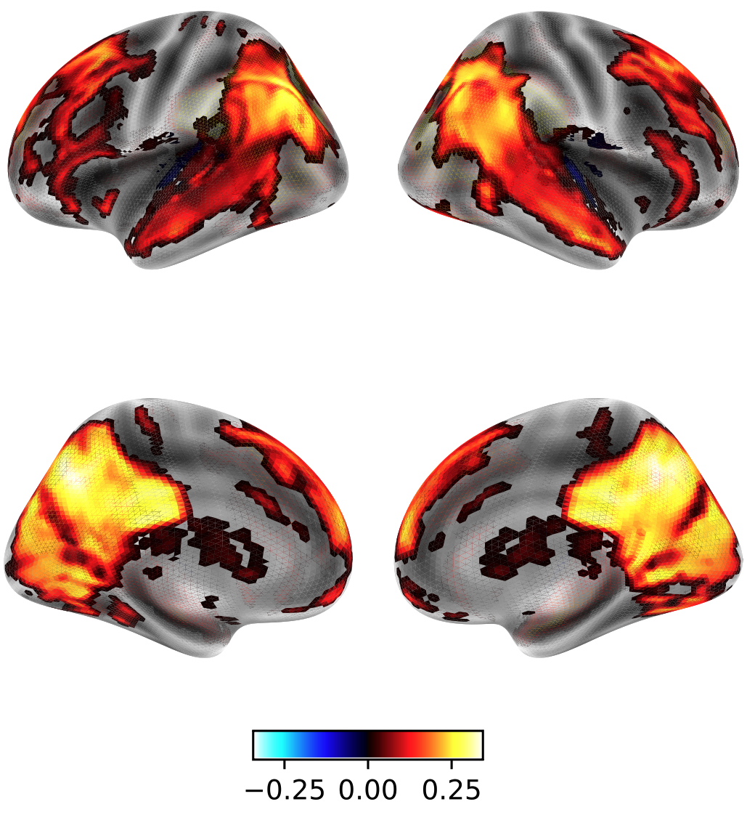
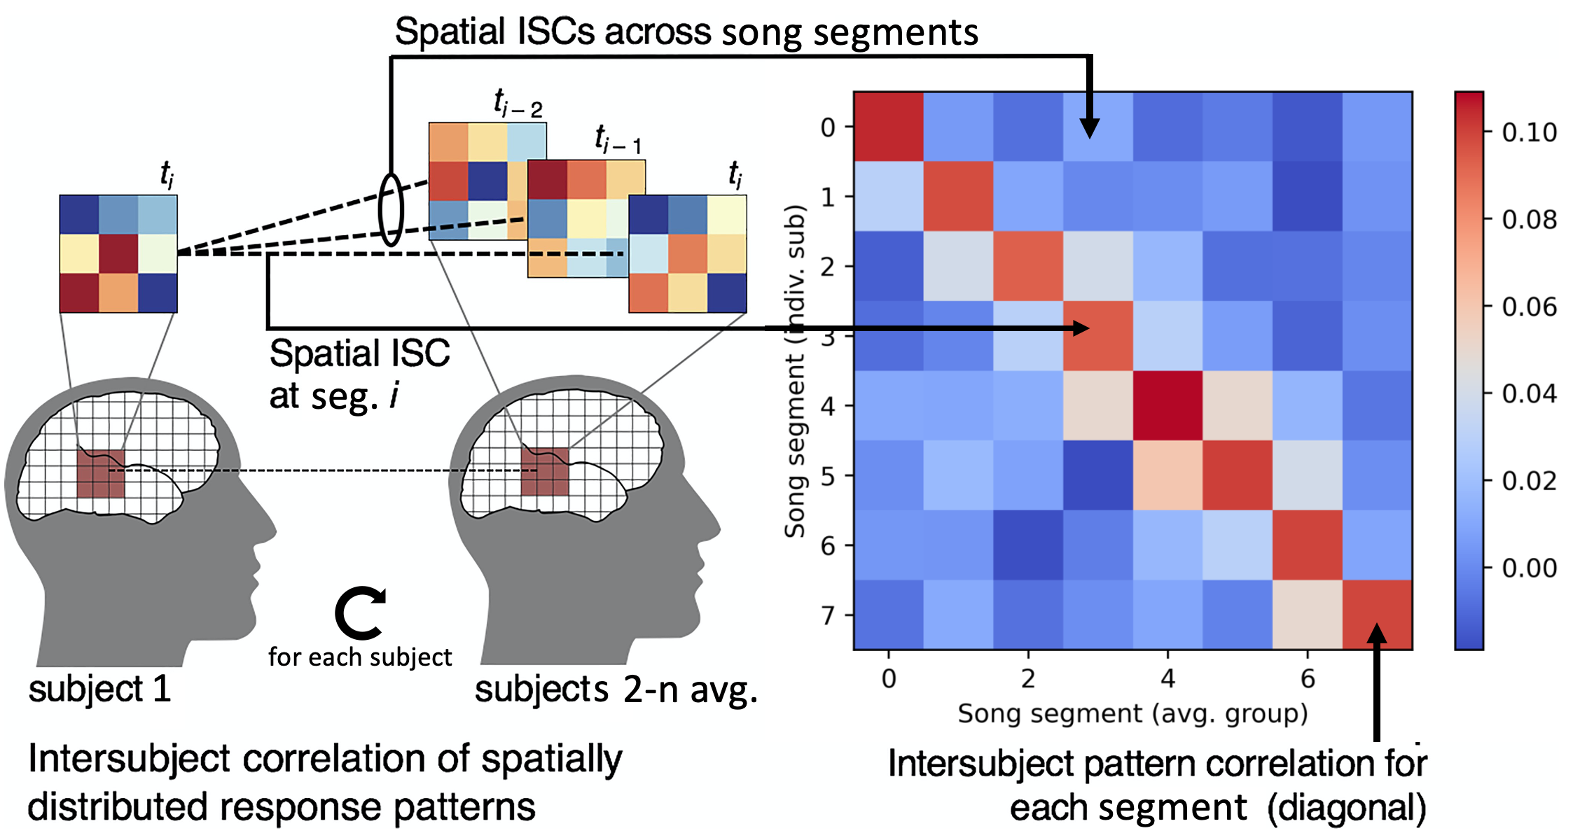
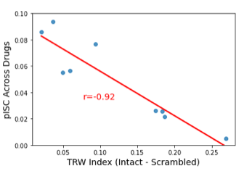
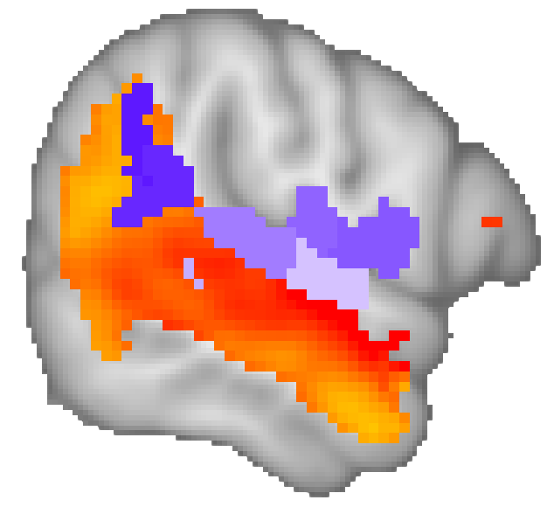
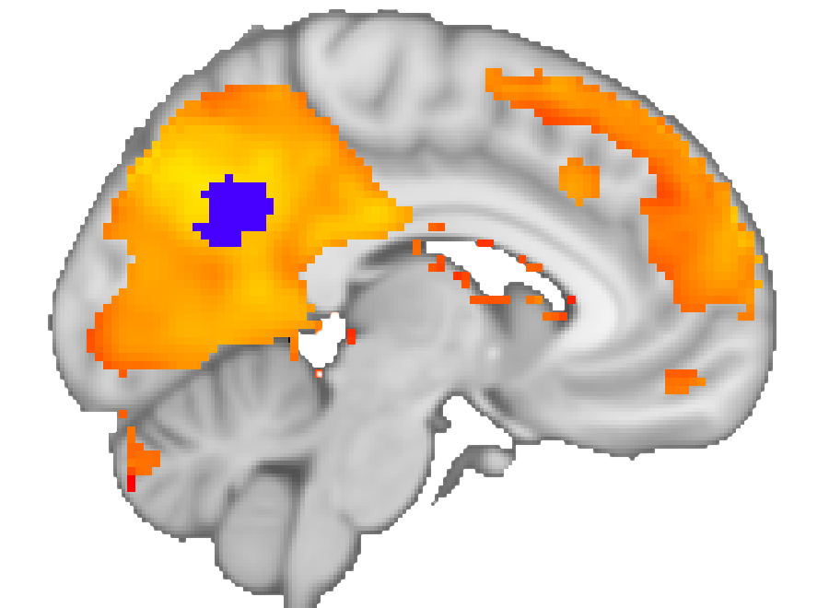
Shared Effects of Psilocybin on Brain Response to Music in High, but not Low-Level Cortex
Brian Winston^{ab}, Frederick Barrett^{abc} & Janice Chenª
ª Center for Psychedelic and Consciousness Research, Department of Psychiatry and Behavioral Sciences, Johns Hopkins University School of Medicine, Baltimore, MD, USA, ^{b} Department of Psychological and Brain Sciences, Johns Hopkins University, Baltimore, MD, USA, c Department of Neuroscience, Johns Hopkins University School of Medicine, Baltimore, MD, USA
Introduction
1. Psilocybin has both idiosyncratic and shared effects on subjects’ brain response to music
Summary
Figure 3: ROIs with significant ISC in each drug condition
In some brain regions, psilocybin has idiosyncratic effects across people; in other regions, psilocybin changed brain activity consistently across people
Among regions that synchronize within both drug conditions, multi-voxel pattern similarity across drug conditions decreased linearly according to regional temporal receptive window.
Study Design
18 subjects listened to 4 ~90s songs during fMRI under effects of placebo and 10 mg/70 kg oral psilocybin
Implications
Among regions whose patterns synchronize within both drug conditions, are the patterns similar across drug conditions?
Psilocybin may affect perception and cognition by altering patterns of brain activity in higher-level, associative cortex rather than early sensory cortex
Prominent models of the effects of psychedelics on brain activity argue that psychedelics increase noise. We provide evidence that in some regions, psilocybin alters brain activity in a structured way across people
2. Psilocybin affects brain response to music differentially across the TRW hierarchy
TRW Index Map
(Intact – Word Scramble)
Stimuli (e.g. narratives, music) that contain elements that unfold across multiple timescales are processed hierarchically
Brain regions can be classified according to their Temporal Receptive Window (TRW), which is the duration of a stimulus element a given brain region integrates (3)
fMRI data from PNI’s “Pie Man” dataset (n=36) were used to derive a TRW index. Subjects listened to the “Pie Man” story intact and scrambled at the word level (4)
Temporal ISC values in voxels with high synchronization across subjects (r > 0.2) in the intact condition were chosen. At each voxel, TRW Index = ISC_{intact} - ISC_{scrambled}
Inter-Subject Pattern Correlation (pISC)
Songs were divided into 11s segments. Average multi-voxel patterns (MVPs) in each of 400 ROIs were computed for each subject/drug/song segment
At each ROI/drug/segment, spatial correlations were calculated between each individual subject’s MVP and the remaining group’s avg. MVP
Correlations were averaged per segment/subject to yield 1 pISC value per ROI/drug (1)
Open Questions
How do these different patterns reflect changes in representational content?
Second question
In short TRW regions (e.g. A1), the placebo and psilocybin groups synchronize to a shared pattern. In long TRW regions (e.g. PCC, angular gyrus), they synchronize to different patterns.
Stay Updated!
a)
b)
c)
References
Chen, J., Leong, Y., Honey, C. et al. Shared memories reveal shared structure in neural activity across individuals. Nat Neurosci 20, 115–125 (2017).
Samuel A Nastase and others, Measuring shared responses across subjects using intersubject correlation, Social Cognitive and Affective Neuroscience, Volume 14, Issue 6, June 2019, Pages 667–685
Yulia Lerner, Christopher J. Honey, Lauren J. Silbert, Uri Hasson Journal of Neuroscience 23 February 2011, 31 (8) 2906-2915
Nastase, S.A., Liu, YF., et al. The “Narratives” fMRI dataset for evaluating models of naturalistic language comprehension. Sci Data 8, 250 (2021)
Figure adapted from (2)
PURPLE COLORBAR WITH SIMILARITY AND TRW?
Figure 5: a) The correlation between pISC across drug conditions and TRW index in regions with 1) significant pISC within drug condition and 2) with at least XX% of voxels within the TRW map is -0.92. b and c) right lateral and left medial views of pattern similarity across drug conditions

