Slide 1
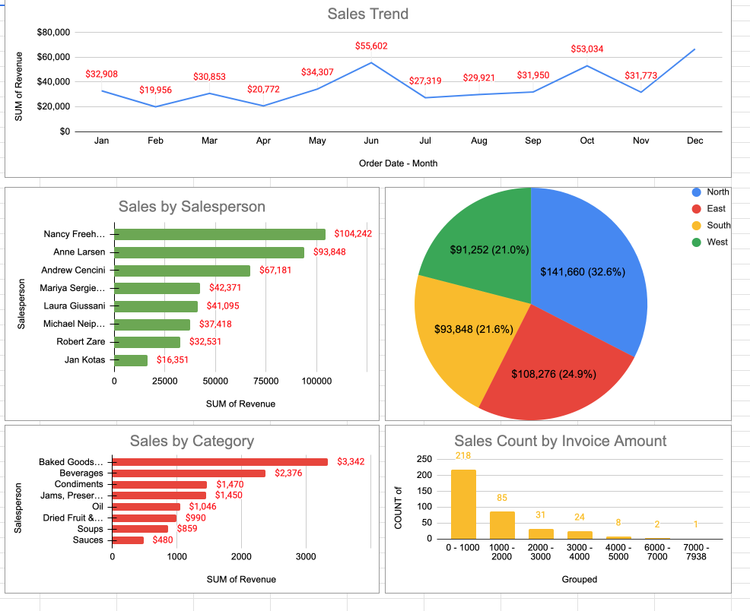
Company Sales Performance of Beverages Across USA Regions
Problem Statement:
Understanding sales trends, regional performance, and product contribution to improve revenue.
Conclusion:
Sales show strong end-year growth, with key regions and top performers driving revenue.

Slide 2
Executive Summary
Key Findings:
1. Strong revenue growth in Q4.
2. North region leads in sales contribution.
3. Baked goods and beverages dominate sales.
Recommendations:
- Strengthen underperforming regions.
- Support mid-level sales staff.
- Increase high-value transactions.

Slide 3
Business Problem & Decisions
Business Problem:
Uneven sales distribution across regions and staff.
Decisions Supported:
- Resource allocation by region
- Sales team performance improvement
- Product focus and expansion

Slide 4
Data Approach & Methodology
Data Source: Kaggle
Tools: Excel, Pivot Tables
Steps:
- Created pivot tables for revenue by salesperson
- Sorted sales performance
- Analyzed category percentages
- Compared sales reps performance
- Cleaned data (removed blanks)

Slide 5
Key Findings
- Revenue peaks in June and December
- Top 3 salespeople contribute majority of revenue
- Majority sales are low-value transactions
- Balanced but slightly North-dominant regional sales

Slide 6
Recommendations
- Train and support lower-performing sales staff
- Expand high-performing product categories
- Target growth in weaker regions
- Encourage bulk/high-value purchases

