Slide 1
How the Seize-Hold Tactic Plays Panzergruppe Guderian
A scripted baseline for game balance tests, illustrated from one game
Ben Paul Wise
November 4, 2026

Slide 2
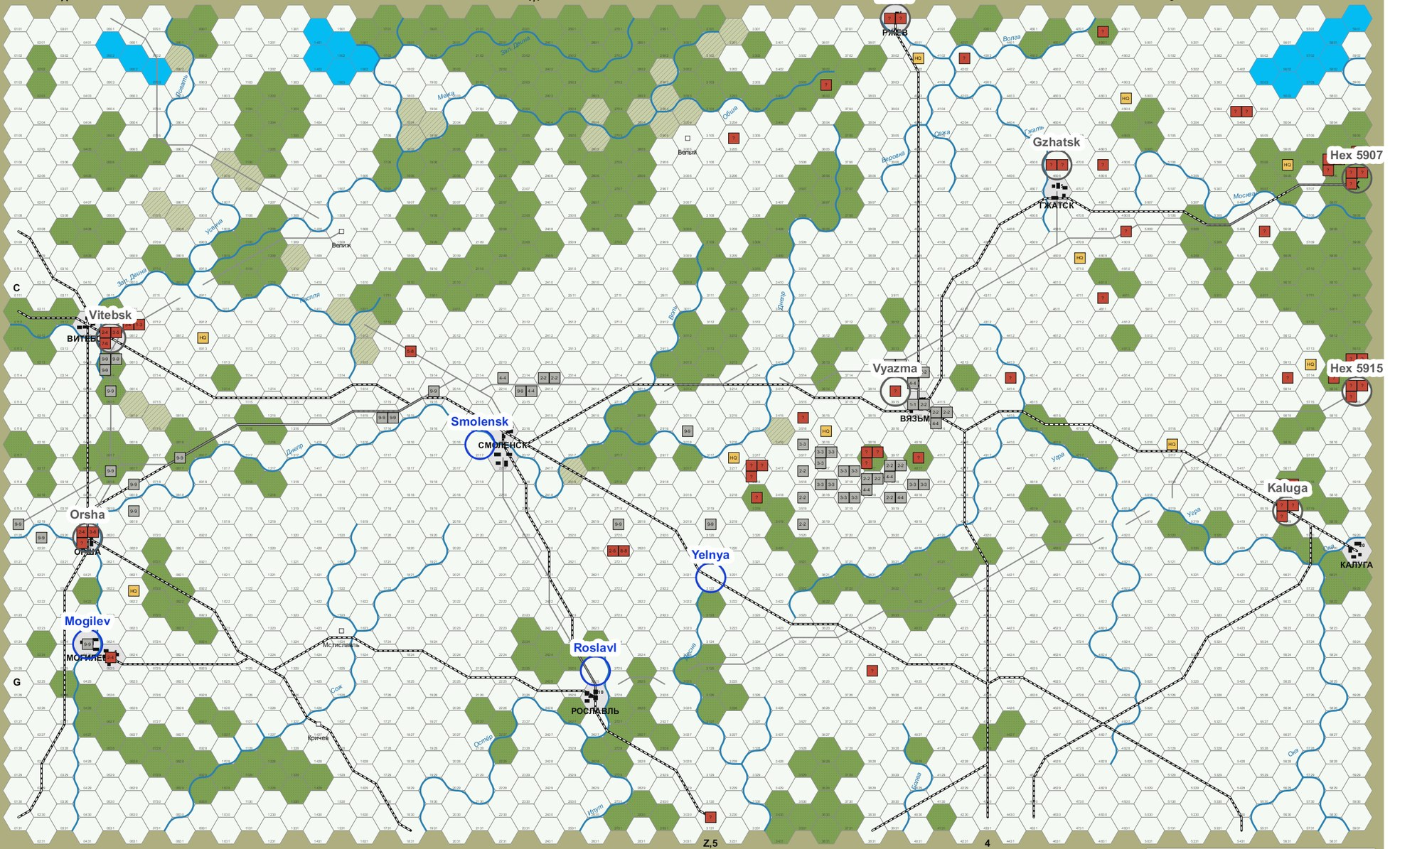
Summary
The seize tactic sends units to key locations, and combat follows where they meet the enemy.
Four steps decide the moves: regions, fringe, quotas and allocation.
The Soviet player uses the same steps, with a wider fringe and a reserve in the rear.
With both sides seizing, mean German points rise from 15.9 to 27.2.
The aim is a baseline that a real AI should beat.
Figure 1. Game 10, drawn set-up, after turn 9: German 50 points, Soviet 11. Gray squares are German, red are Soviet and yellow are Soviet Leaders. A "?" marks an untried division.

Slide 3
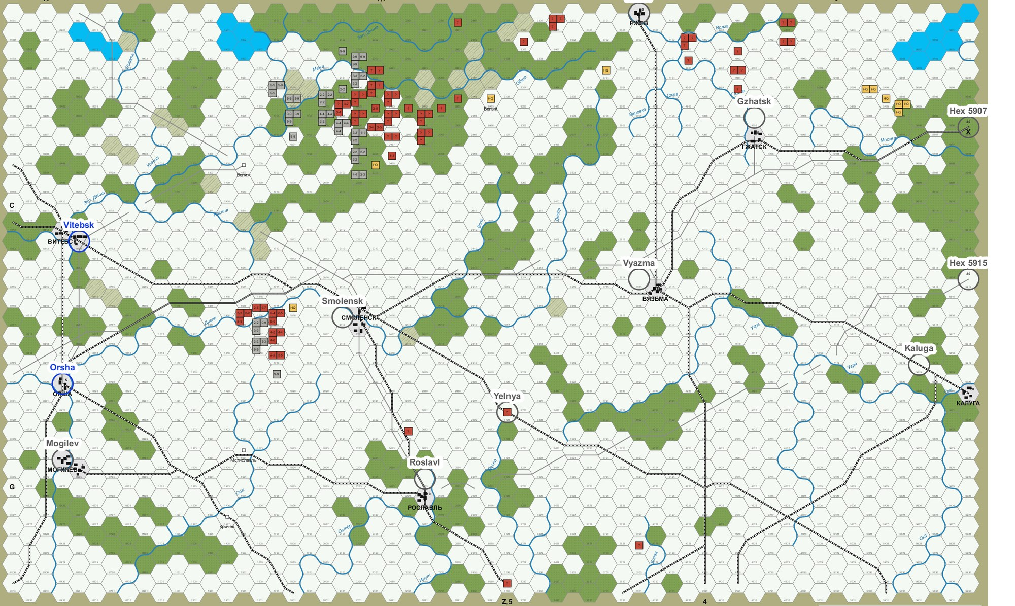
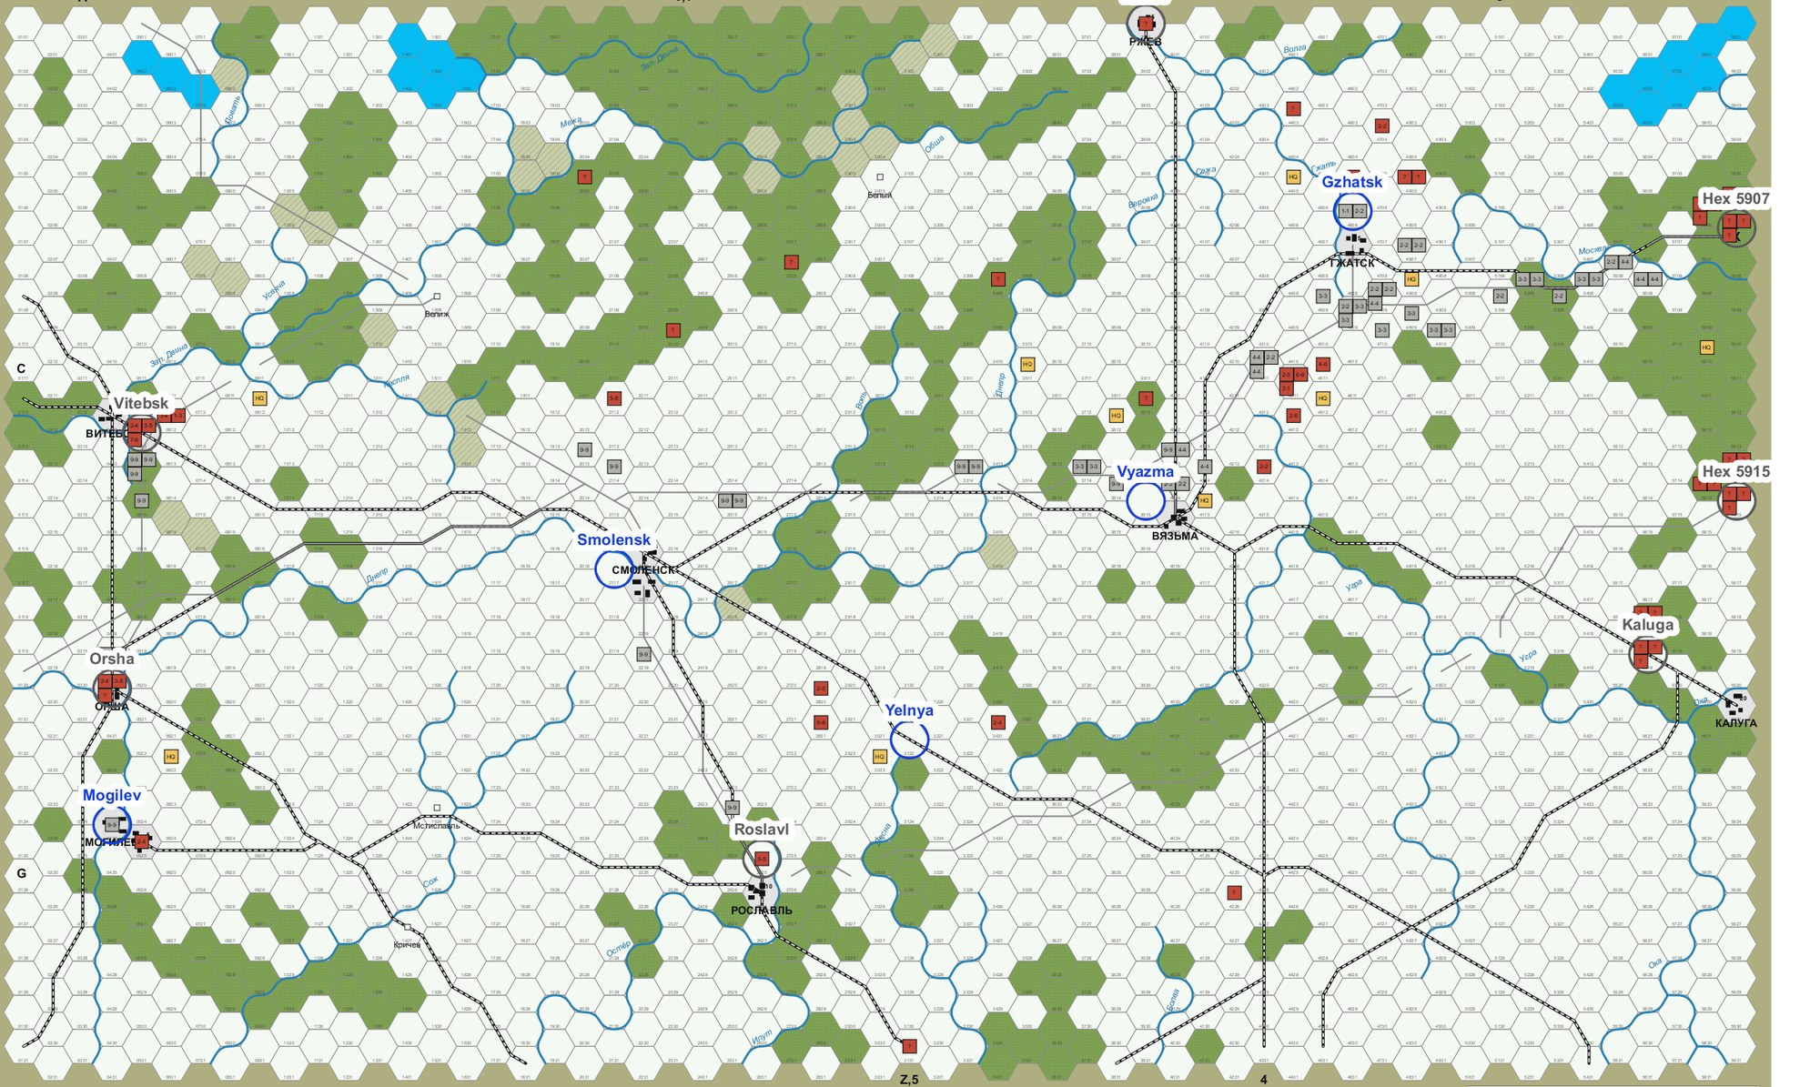
The First Agents Ignored Locations
Figure 2. One seed after turn 12. Left, attack or consolidate: German 15, Soviet 3, furthest German unit in column 22. Right, seize: German 50, Soviet 14, furthest German unit in column 56.
Attack or consolidate aims at the nearest enemy or at nearby friends, so it takes only the cities in its path. In 44 of 48 games the Germans scored exactly 15 points: Vitebsk and Orsha.

Slide 4
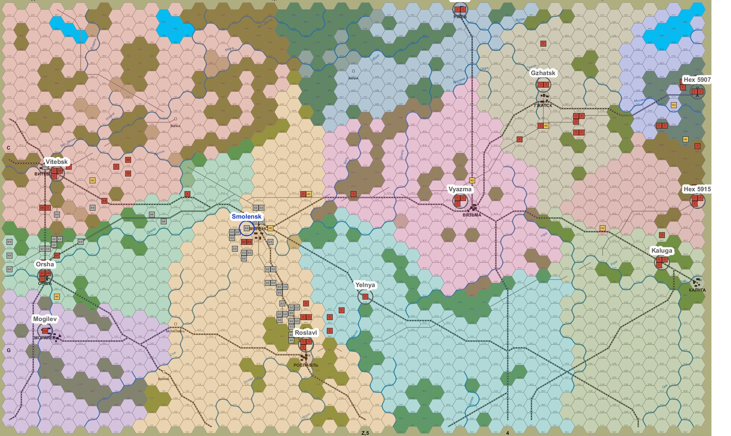
Step 1: Draw Regions Around the Unheld Cities
The locations are the twelve Victory Point hexes.
A city is held if the Germans occupy it or were the last to occupy it.
A region holds the hexes nearest its city by terrain cost.
The cost ignores enemy units and zones of control, because a path may run through the enemy.
Figure 3. Game 10, turn 5, German first movement phase. Each tint is one region. A blue name marks a held city and a gray name an unheld city.

Slide 5
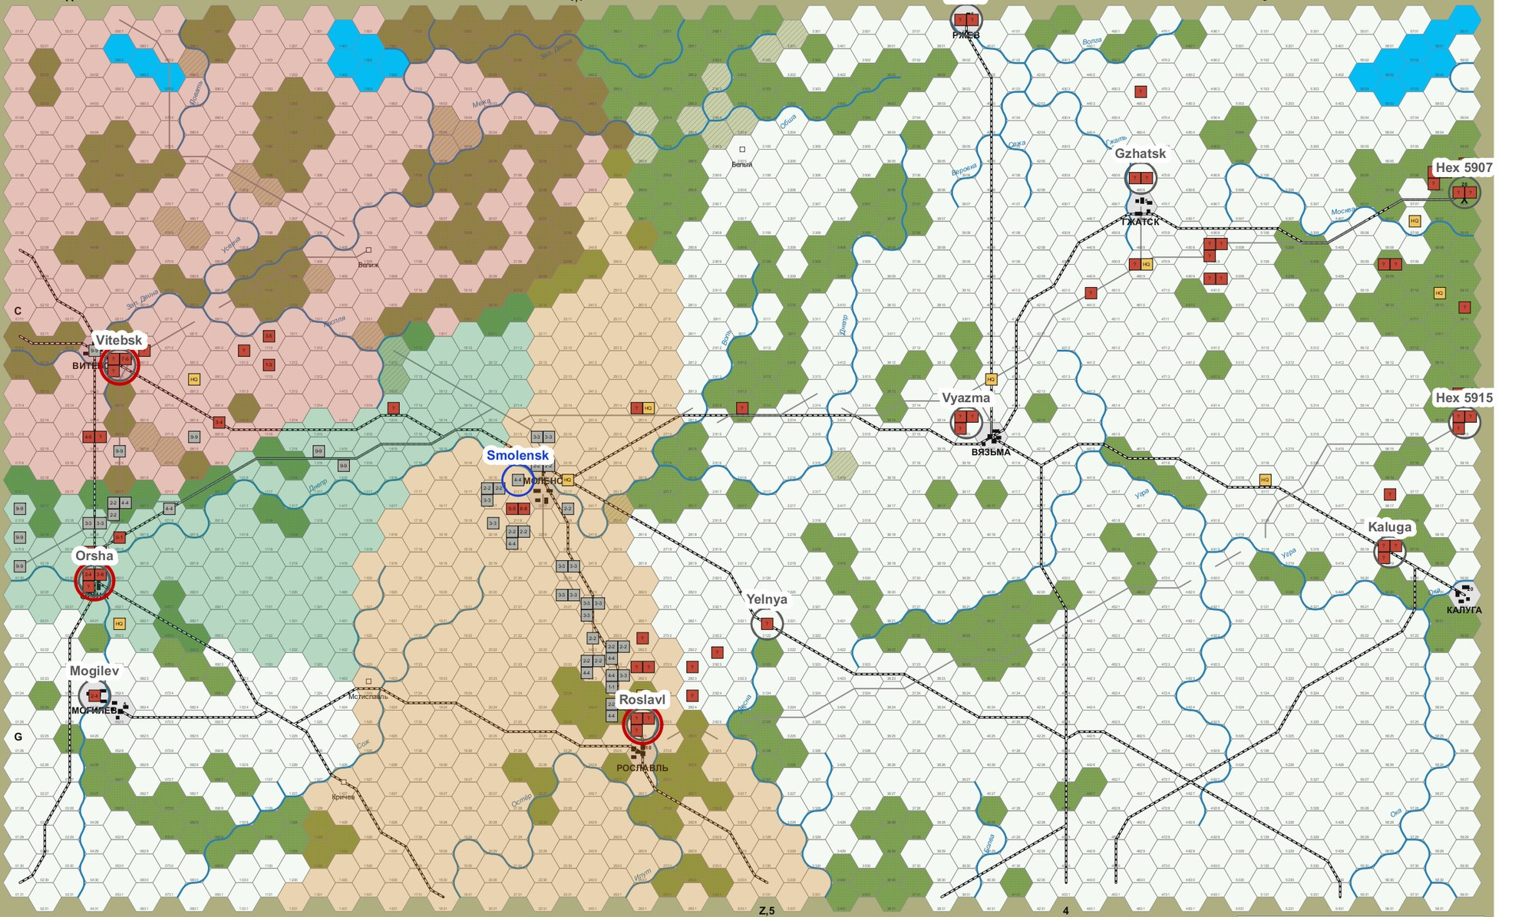
Step 2: Find the Fringe
A city is on the fringe if a German unit stands in its region.
On turn 5 the fringe is Vitebsk, Orsha and Roslavl.
In this game the fringe holds one city on turns 1 to 4 and four from turn 7.
A taken city leaves the set and the regions are redrawn, so its units move on.
Figure 4. The same moment. Red rings mark the fringe, and only the regions of fringe cities keep their tint.

Slide 6
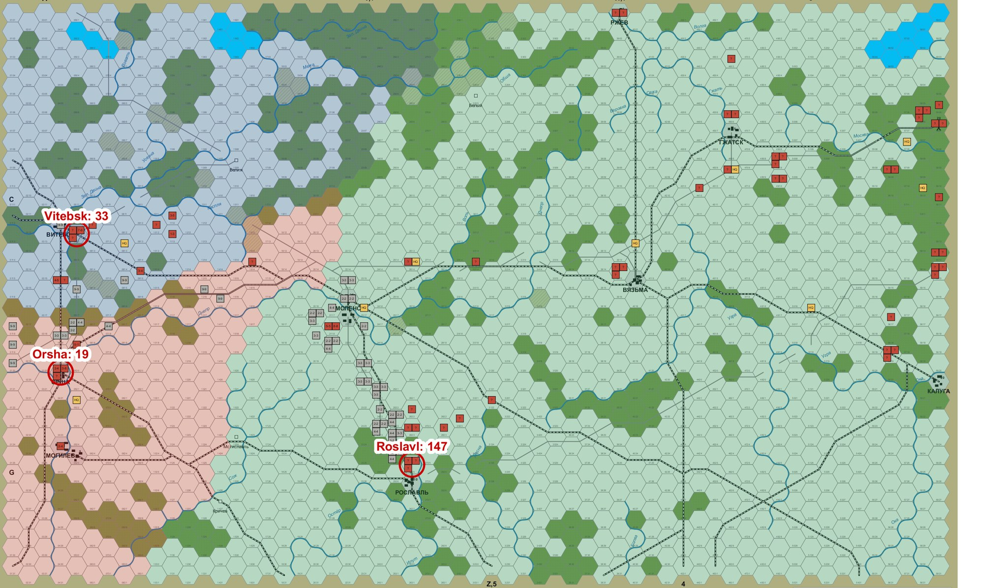
Step 3: Set a Quota for Each Fringe City
Regions are drawn again around the fringe cities alone, so every Soviet unit stands in one.
Each quota of German strength is in proportion to the Soviet strength in that region.
An untried division counts at the mean strength of its arm, since neither player knows its value.
Figure 5. The same moment. Labels give the estimated Soviet attack strength in each expanded region: Vitebsk 33, Orsha 19, Roslavl 147.

Slide 7
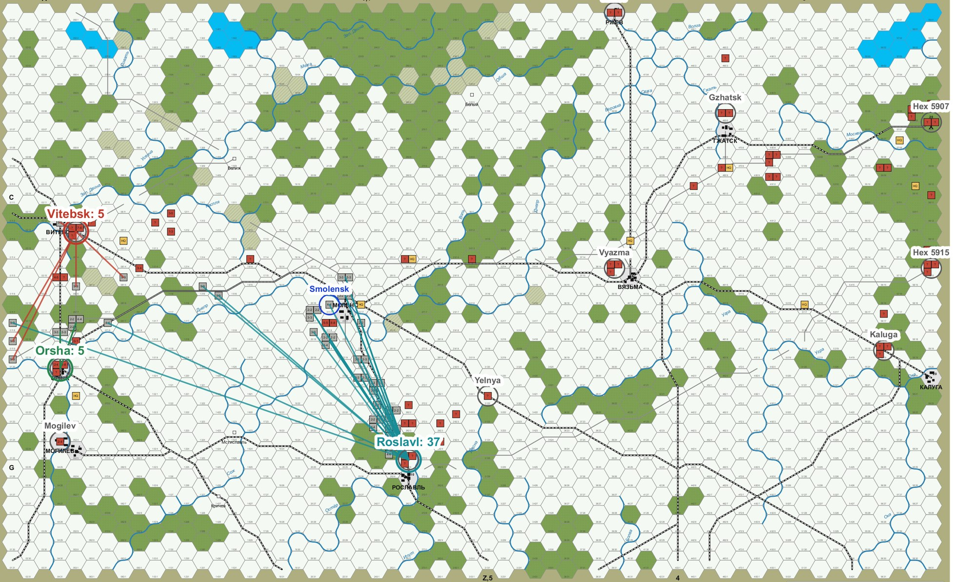
Step 4: Allocate Forces, Closest Pair First
A force that cannot move counts against its nearest fringe city.
Each fringe city with no force gets its nearest free force.
A force keeps its city while the quota has room for it.
The rest go to cities with quota left, closest pair first.
Figure 6. The same moment. Each line joins a German unit to its city. Labels give the units allotted: Vitebsk 5, Orsha 5, Roslavl 37. A force is a division that can integrate, or any other unit alone.

Slide 8
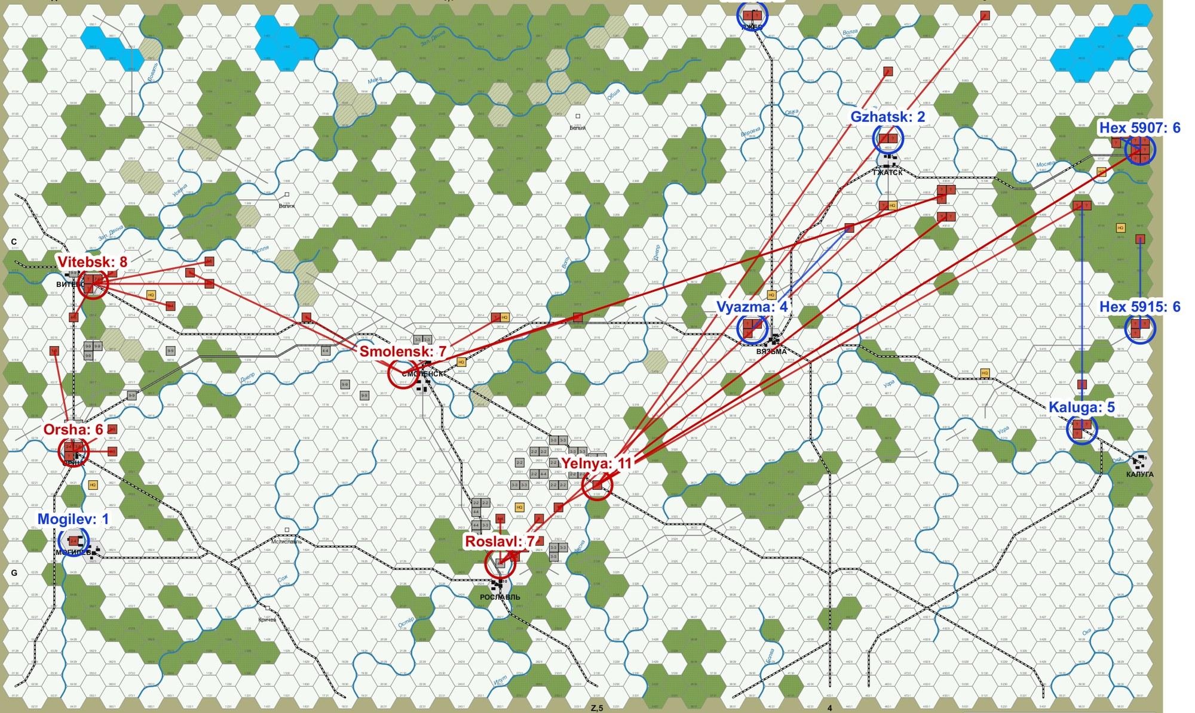
The Soviet Player Contests the Same Cities
The Soviet fringe is the German fringe plus every city the Germans hold.
Between 1/2 and 2/3 of Soviet strength goes to the fringe. This game drew 66%.
The rest goes to the other cities in proportion to their Victory Points.
A city no one has occupied counts as Soviet, as the victory rules score it.
Figure 7. Game 10, turn 6, Soviet movement phase. Red marks fringe cities and blue marks rear cities. Each line joins a Soviet unit to its city, and labels give the units allotted.

Slide 9
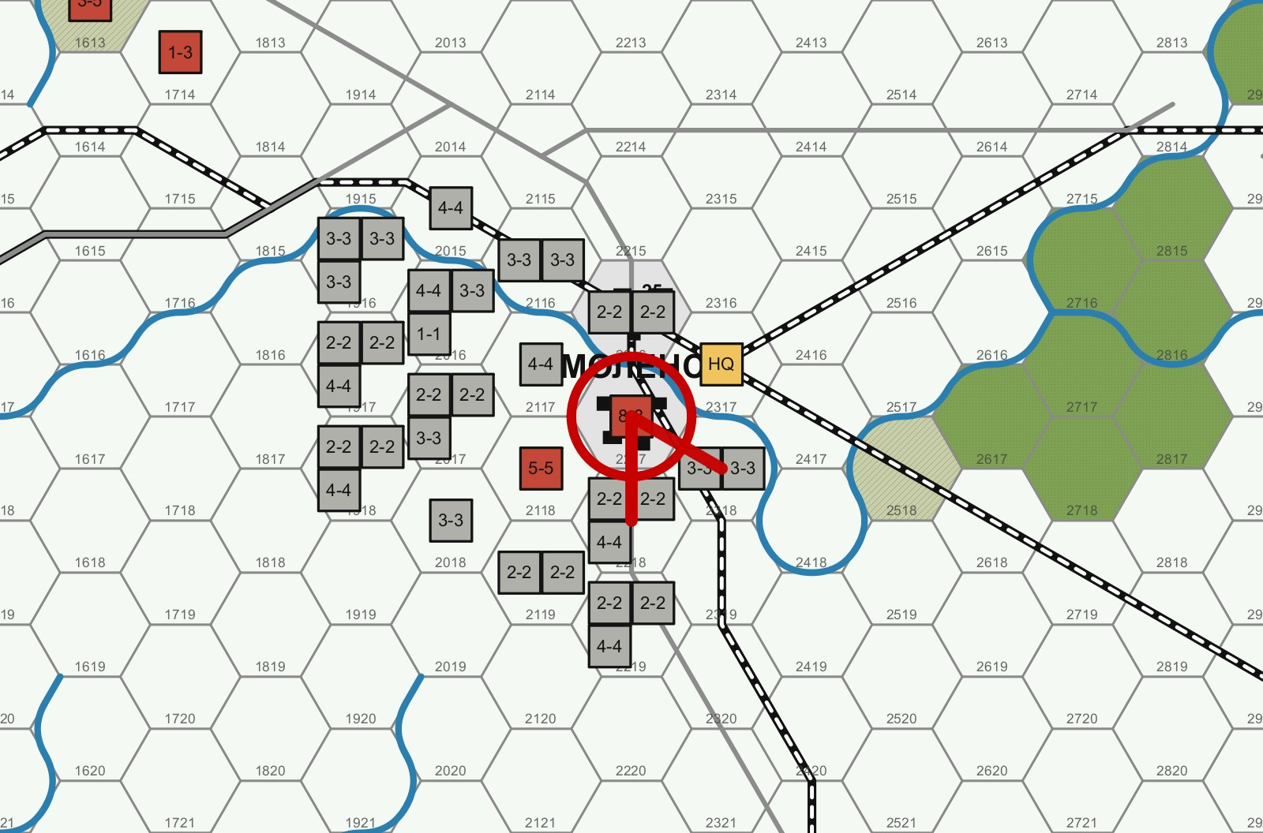
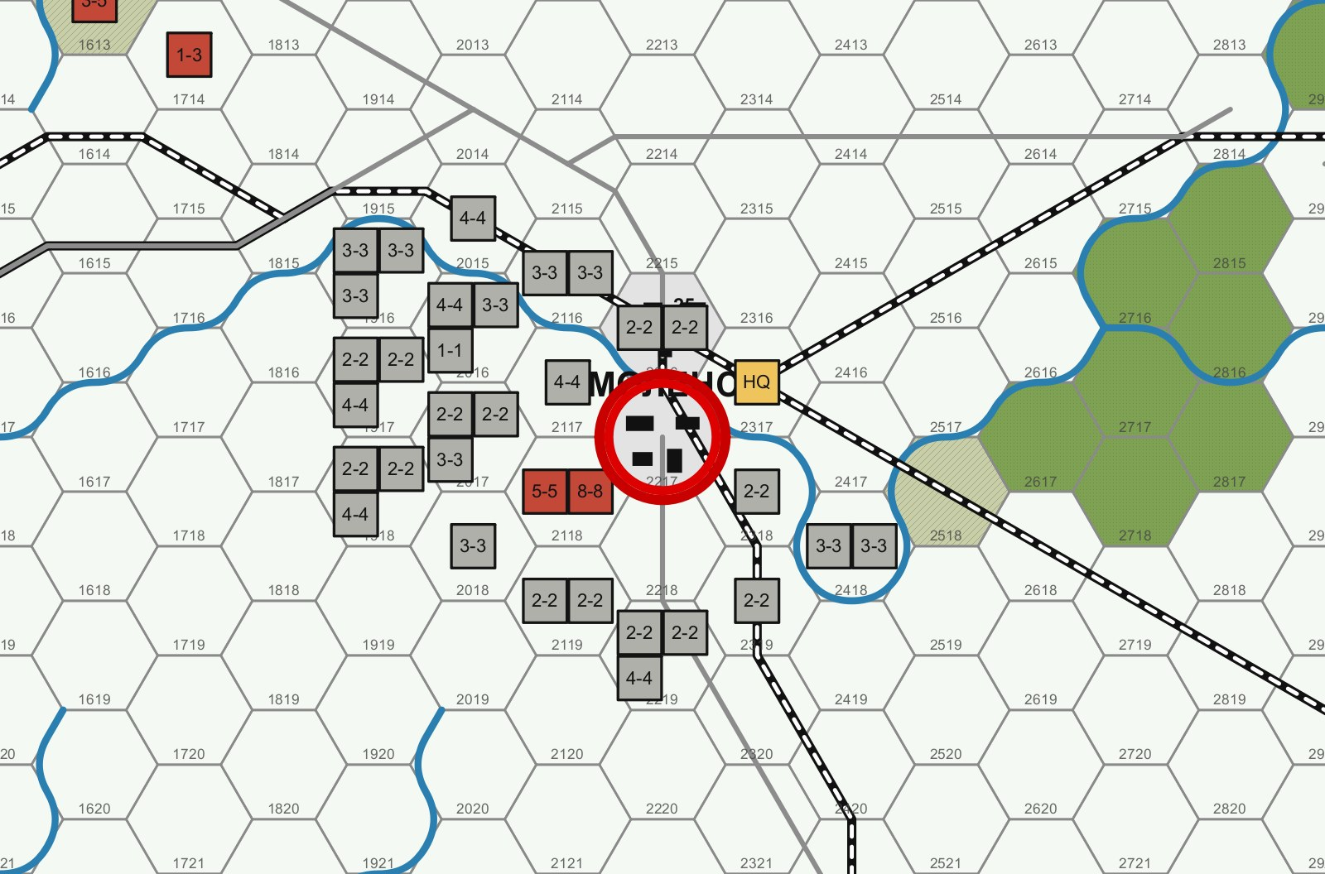
Fighting Needs Its Own Rule
Figure 8. Game 10, turn 4, hex 2217 before and after a battle at 1-1 with the result D1*/A1. Both sides retreated, and one German regiment was eliminated in the retreat.
A unit stops on entering an enemy zone of control and may not leave it (6.22, 8.13), and PGG forces no attacks.
Every enemy hex is attacked by all eligible adjacent units, at 1-1 or better as far as the agent knows.

Slide 10
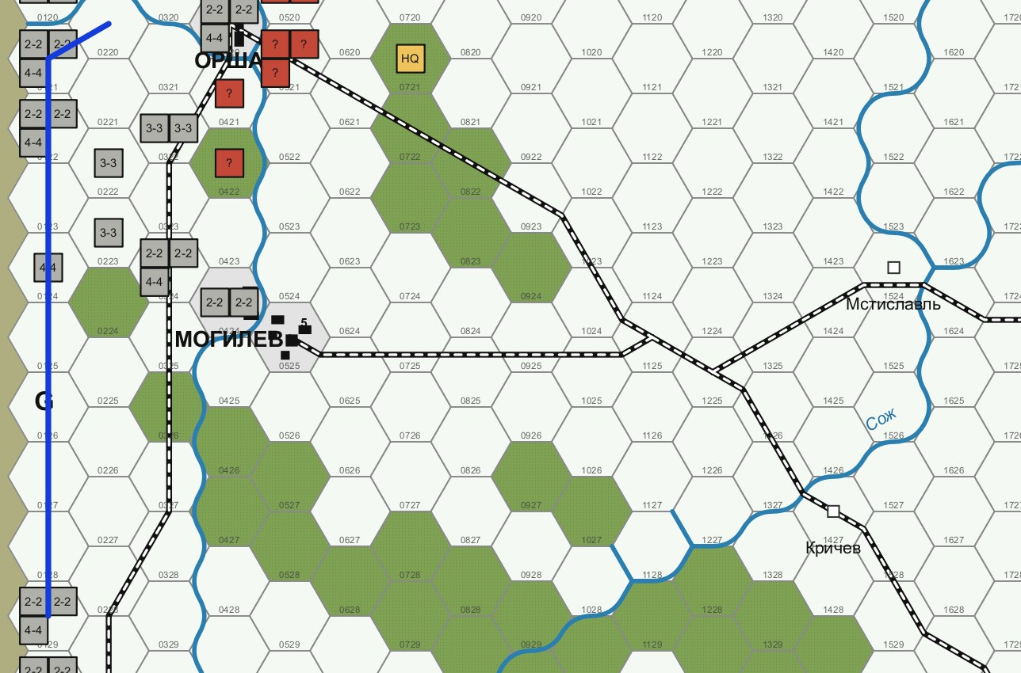
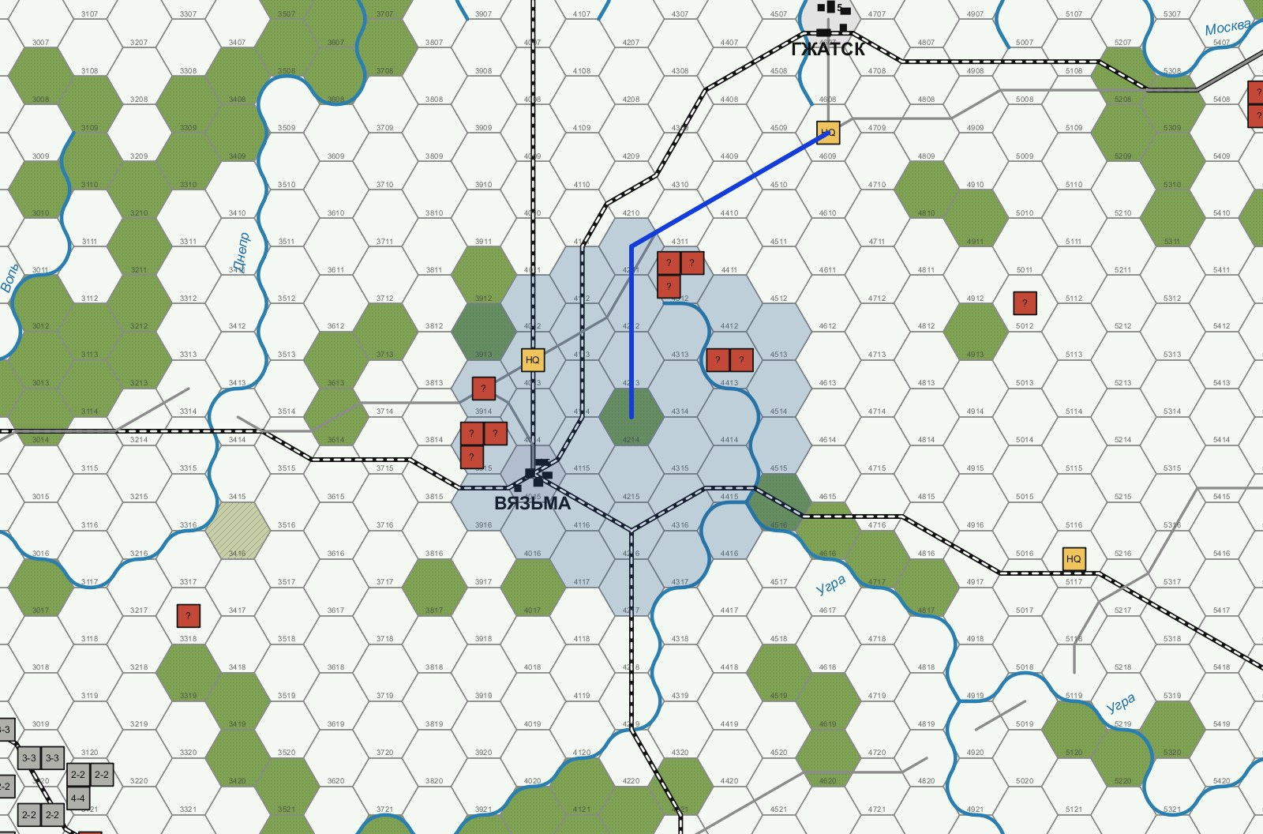
Divisions Move as One and Leaders Move Last
Figure 9. Game 10. Left, turn 3: three regiments of one division move as a stack. Right, turn 6: a Leader of radius 3 moves so that nine units, up from three, stand within the tinted radius.
A division doubles its strength when its regiments stack together alone (7.3): 60% of German attacks include a doubled division, against 2% to 4% with attack or consolidate.
A Soviet unit attacks only within a Leader's radius (10.35): Soviet units beyond it fall from 54% to 24%.

Slide 11
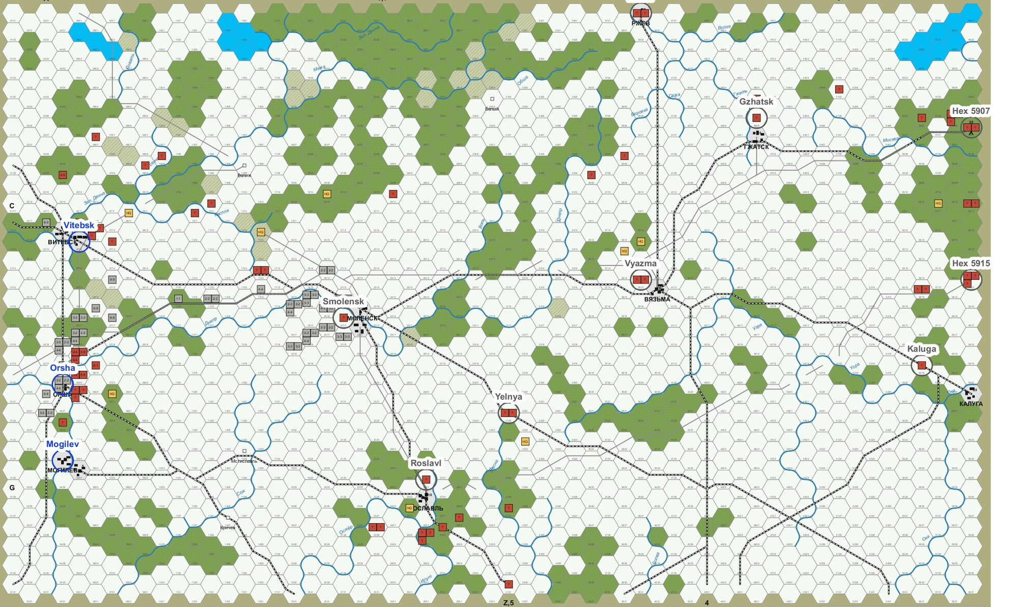
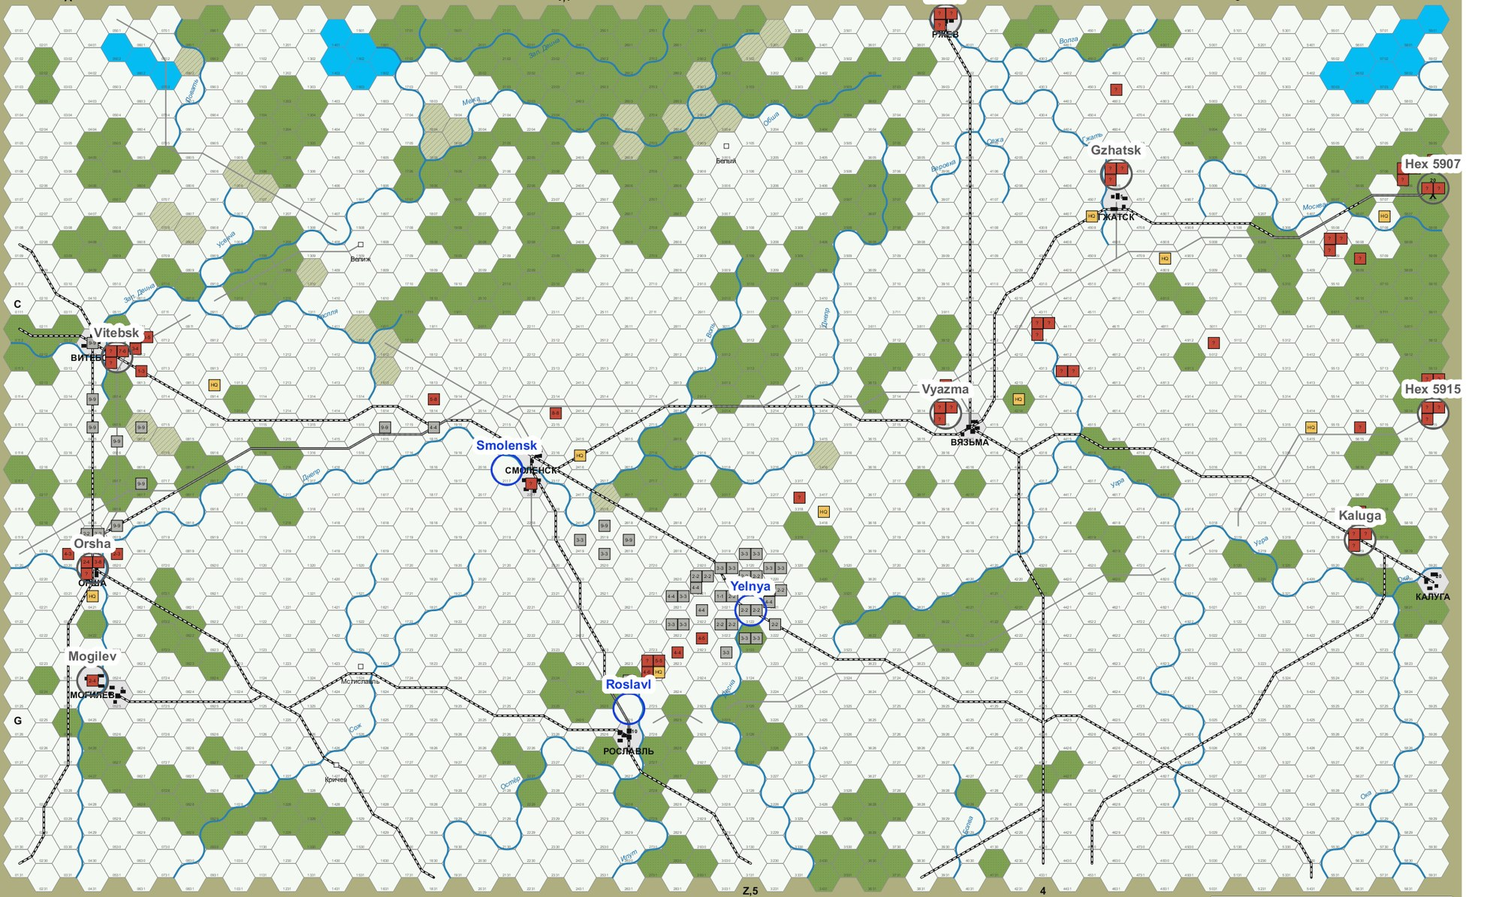
One Game over Twelve Turns
Turn 3: German 10, Soviet 2. Furthest German unit in column 21.
Turn 6: German 20, Soviet 5. Column 32.
Turn 9: German 50, Soviet 11. Column 41.
Turn 12: German 50, Soviet 14. Column 56.
The net of 36 is a Soviet Marginal Victory.
Figure 10. Game 10 after turns 3, 6, 9 and 12, reading across. A blue name marks a city the Germans hold.

Slide 12
Results by Tactic
Tactic, both sides | German points | Soviet points | Net | Soviet units beyond a Leader's radius
Attack or consolidate | 15.9 | 3.8 | 12.2 | 67%
Seize, first version | 38.3 | 15.3 | 23.0 | 54%
Seize, targets kept | 48.3 | 14.7 | 33.7 | 60%
Seize, Leaders covering | 24.6 | 19.8 | 4.8 | 22%
Seize, both | 27.2 | 16.9 | 10.2 | 24%
Table 1. Means of 12 games on the same seeds, drawn set-up, both sides on the same tactic. The standard error of a mean net is about 4 to 6 points. The radius figure for attack or consolidate comes from 2 games. The historical result was a net of 50 to 79.

Slide 13
Limits and Next Steps
Limits of the baseline
Proportional quotas even out the odds, so force is not concentrated.
Overrun, rail movement and the South-Western Front are not used.
About half the German units change target each phase, for reasons not yet found.
The net of about 10 describes these agents and rests on 12 games.
Next steps
Add overrun and rail movement as agent parameters.
Study German changes of target in pgg_trc_viewer.
Build the 1000-game runner and the isolation checks.
Carry the tactic to TRC5, with moves limited to hexes that can still trace supply.

Slide 14
Questions
Ben Paul Wise
Details: hexgames/doc/2026-11-04-seize-locations-tactic.md

