Slide 1
Variables and Data Types
Chapter 3 of Prata

Slide 2
3 components of a variable
Name
Value
Type

Slide 3
Variable Types
Integer e.g. 1
Real e.g. 2.34
Complex e.g. -0.5 + 0.833 i
Text e.g. “abc”
Logical e.g. true

Slide 4
Basic Variable Types
Integer int e.g. 1
Real float, double e.g. 2.34
Complex complex e.g. -0.5 + 0.833 i
Text char, string e.g. “abc”
Logical int, bool e.g. true

Slide 5
variable type
#include <iostream>
int main()
{
using namespace std;
int carrots;
cout <<"How many carrots do you have?" << endl;
cin >> carrots;
cout <<"Here are two more." << endl;
carrots = carrots + 2;
cout <<"Now you have " << carrots << " carrots." << endl;
return 0;
}

Slide 6
variable value
#include <iostream>
int main()
{
using namespace std;
int carrots;
carrots = 5;
cout <<"Now you have " << carrots << " carrots." << endl;
return 0;
}

Slide 7
variable name
characters, numbers, and _
Uppercase and lowercase are distinguished
First character cannot be number
Don’t use C++ keywords
int return

Slide 8
Initialization: Optional
int a = 1;
float x = 1.33333;
char greet[] = “hello”;
bool answer = false;
int a, b, c=1, d=2*5;

Slide 9
Initialization
Initialization is optional, if not done the variable will contain garbage until it is assigned a value
(C++ compilers usually put 0 for numbers)
int a = 1, b;
// a contains 1, b contains random data
…
b=2;
// a contains 1, b contains 2

Slide 10
Representing numbers on computers
High level languages define types of variables like int, float, etc…
In practice these are NOT quite the same as the mathematical concept
Computers have limitations in their ability to handle any integer or real number

Slide 11
Number Representations
Computers use discrete binary representation
A Byte has 8 bits implies 256 (2⁸) values
At most 256^{b} values can be represented by data using b bytes of storage
e.g. 1 byte 256 possible values
2 bytes 65,536
4 bytes 4,294,967,296
8 bytes 18,446,744,073,709,551,616

Slide 12
Integer Representation
Single byte:
00000010 binary = decimal integer 2
If the first bit is 1 then the number is negative (2’s complement representation)
11111110 binary = decimal integer –2
If unsigned 11111110 = decimal 254 = 256-2

Slide 13
Integer Representation
1 byte: -128 to 127 char
2 byte: -32768 to 32767 short
4 byte: -2147483648 to 2147483647
(typical default, e.g. int a; ) int
8 byte: -9,223,372,036,854,775,808 to 9,223,372,036,854,775,807 long
n byte: -2^{8n-1} to 2^{8n-1}-1

Slide 14
Unsigned Integer Representation
1 byte: 0 to 255 unsigned char
2 byte: 0 to 65535 unsigned short
4 byte: 0 to 4294967295 unsigned int
8 byte: 0 to 18,446,744,073,709,551,615 unsigned long
n byte: 0 to 2^{8n}-1
Preface it with unsigned and get a factor of 2 bigger at the cost of no negative values

Slide 15
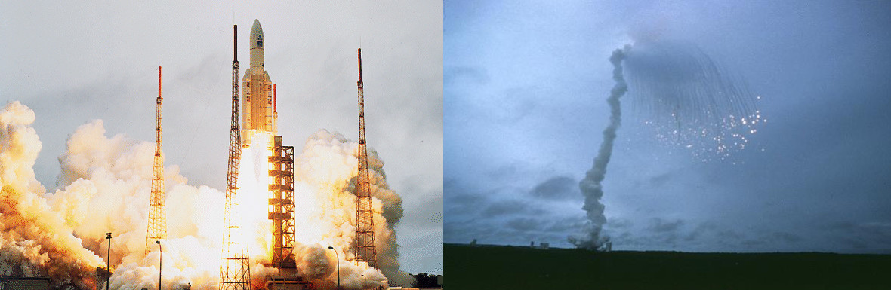
Integer overflow
Integers don’t go to inf if they get too big. They just wrap around to the other end
char a = 127;
a + 1 == -128
unsigned int a = 0;
a – 1 == 4294967295
Demo time...
Arian 5 explosion 1996
An integer overflow that cost 7 billion dollars
(Details : google it)

Slide 16
Real Number Variables:
Floating Point Representation
Scientific Notation is handy way to represent a finite number of digits of precision and the magnitude of a real number (in powers of 10)
e.g. 2.1x10² = 210
Not every real can be represented precisely (e.g. irrationals like sqrt(3) or pi)
Useful for very large or small numbers not suitable for integer representation
Notes:
Note: Ancient Greeks believe all numbers rational

Slide 17
Floating Point Representation
To handle large/small values with limited precision computers offer floating point representation (at CPU level – fast!):
(+/-)Mx2E
A fixed number of bits are allocated to represent each part (M,E)
Ordinary integers are fixed point: all bits are used to represent M and E is assumed to be 0
So the Exponent E “floats” the decimal point to the right or left so that fractions and large numbers can be represented

Slide 18
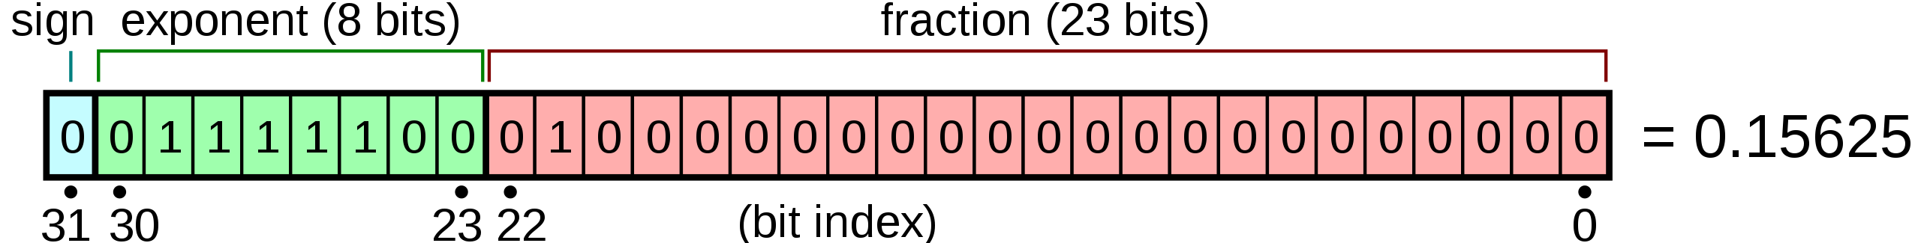
Floating Point Representation (IEEE-754)
e.g. 4 byte Floating Point (32 bits)
(typical default real, e.g. float x)
1 bit sign S, 23-bit mantissa M, 8 bit exponent E
Value = (-1)^{S}(1+M/2²³)2^{(E-127)}
Precision: 7 decimal digits
Range: 10⁻³⁸ to 10³⁷

Slide 19
Double Precision
Most machines also offer double precision:
e.g. double x
8 bytes or 64 bit floating point
1 bit sign S, 52-bit mantissa M, 11 bit exponent E
S = 0 positive, 1 negative
Value = (1+M/2⁵²)2^{(E-1023)}
Precision: 15 decimal digits
Range: 10⁻³⁰⁸ to 10³⁰⁸

Slide 20
Scientific Computing Key issue:
Numerical Accuracy
Loss of precision is also called round off error.
7 digits may seem like a lot, but if you add up
10 million numbers the error becomes huge!
Many standard computations require repeat operations that lead to roundoff
Demo time...

Slide 21
character
char ch;
ch = 'X';

Slide 22
character and integer
int main()
{
char ch;
ch = 'X';
int CH;
CH =ch;
cout << CH << endl;
return 0;
}

Slide 23
Exercise
Find out what integer represents character
'Y'.

Slide 24
character and integer
int main()
{
int CH;
CH =88;
char ch;
ch =CH;
cout << ch << endl;
return 0;
}
Output: X

Slide 25
Escape characters
\n new line
\t tab
\v vertical tab (jump a line)
\b backspace
\r “return”
\\ \
\a beep (may not work on some computers)
\?
\’
\”

Slide 26
Use escape character
int main()
{
char ch;
ch = '\\';
cout << ch << endl;
return 0;
}
Output: \

Slide 27
Use escape character
int main()
{
cout << "This is a \\ character" << endl;
return 0;
}
Output: This is a \ character

Slide 28
unsigned and signed character
It can be unsigned and signed
Depends on implementation
For gcc and Microsoft compiler
char is signed by default (-128 to 127)

Slide 29
bool
Logic type
Two values
true or false (Lowercase)
1 or 0
int main()
{
bool Accept;
Accept = true;
cout << Accept << endl;
return 0;
}
Output: 1

Slide 30
Pass other value to bool
int main()
{
int accept=12;
bool Accept;
Accept = accept;
cout << Accept << endl;
return 0;
}
Output: 1

Slide 31
Arithmetic
+
-
*
/
% (modulus)
Carrots = Carrots +2
Weight_kilo = 1200;
Weight_ton=Weight_kilo / 1000;
Weight2_kilo= Weight_kilo % 1000;
cout << Weight_ton << endl;
cout << Weight2_kilo << endl;
Output: 1
200

Slide 32
Constants
Constants are not intended to be changed, this can be indicated to the compiler using the word const (safe programming, efficiency)
Constants MUST be initialized when they are declared
const float G = 6.672e-8; // cgs
const float k_B = 1.38066e-16;
const int N_particle_families = 3;

Slide 33
Constants
It’s illegal to try to change the value of a constant in code (compiler error)
const int n_points = 20;
// Double the number of points
n_points = n_points*2; ERROR

Slide 34
#include <iostream>
int main()
{
using namespace std;
int A =31;
int B =12;
int C;
C=A/B;
cout << C;
return 0;
}

Slide 35
Exercise
What will you get if A, B, C are floating points
#include <iostream>
int main()
{
using namespace std;
int A =31;
int B =12;
int C;
C=A/B;
cout << C;
return 0;
}

Slide 36
priority of arithmetic
* / % higher than + and –
You can use () to change the priority

Slide 37
Division /
same type /
Result type unchanged
int/int = int
9/5 =1
mixed type /
Automatic conversion to same type (p 106 Prata)

Slide 38
Forced Conversion
float weight_f;
weight_f = 12.3;
int weight_i;
weight_i = weight_f;
cout << weight_i << endl;
Output : 12
int weight_i=12.7;
cout << weight_i;
Output : 12
(you may get a warning when compiling)

Slide 39
Type cast
int weight_i;
float weight_f=3.2;
weight_i = (int) weight_f;
\\ same as int (weight_f);
cout << weight_i;
Output: 3

