Slide 1
Data on the Low Level:
Pointers and Structures

Slide 2
Structures
user defined compound variable
struct soccer_player
{
string name;
short age;
float height;
int goal;
};
We declared a structure type called soccer_player

Slide 3


Initiate values
#include <iostream>
#include <string>
using namespace std;
struct soccer_player
{
string name;
short age;
float height;
int goal;
};
int main() {
soccer_player barca_1= //a variable with name barca_1, of soccer_player type.
{
"Messi",
32,
170,
25,
};
cout << barca_1.name << " has scored " << barca_1.goal << " goals this season. ";
return 0;
}

Slide 4
Initiate values
Simple variables:
int carrots={5};
Array
int week[7]={42,34,32,12,18,0,0};
Structures:
soccer_player barca_1= {"Messi", 28, 170, 25};
soccer_player barca_1
{
“Messi”,
32,
170,
25,
};
soccer_player barca_1 = {};

Slide 5
Use of values in structure
#include <iostream>
#include <string>
using namespace std;
struct soccer_player
{
string name;
short age;
float height;
int goal;
};
int main() {
soccer_player barca_1=
{
"Messi",
32,
170,
25
};
cout << barca_1.name << " has scored " << barca_1.goal << " goals this season. " << endl;
return 0;
}

Slide 6
Usage of structure as a variable
assignment
soccer_player barca_1= {"Messi", 32, 170, 25};
soccer_player barca_captain;
barca_captain = barca_1;
cout << barca_captain.name << " is" << " the captain now.”

Slide 7
Array can be included in structure
#include <iostream>
#include <string>
using namespace std;
struct soccer_player
{
string name;
int data[3];
};
int main()
{
soccer_player barca_1={"Messi",{32, 170, 25}};
cout << barca_1.data[2];
return 0;
}

Slide 8

Array of structures
int main()
{
soccer_player barca[2]=
{
{"Messi", 32, 170, 25},
{"Suarez", 33, 180, 22}
};
cout << barca[1].name;
return 0;
}

Slide 9
Pointers
3 components of a variable
Name: where it is stored
Value: what is stored
Type: how to interpret

Slide 10
Address of a variable
&variable_name
int goals;
cout << &goals; //address operator
Output: 0x7fff5e20c9e8
Looks like an integer, but is not. It is an address.

Slide 11
Pointers
A pointer stores the address of a variable
A pointer must specify what type of data is stored.
*pointer gives the value of the variable
(value operator)

Slide 12
Declare a Pointer
through *pointer_name
Example:
int *p_goals;
//declare p_goals as a pointer-to-int type.
*p_goals is a value of int, so p_goals must be a pointer to int.
int* p_goals; // int* represents the pointer-to-int type.

Slide 13
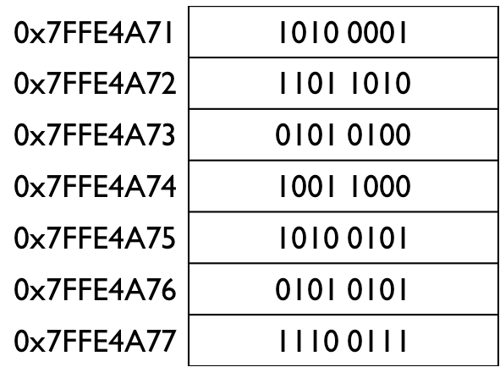
float price=4.99;
float* p_price;
p_price=&price;
cout << p_price;
Each address is a byte

Slide 14
Pointer
Variable
Name: price
Type: float
Value: 4.99
=*p_price
Name: p_price
Type: pointer-to-float (float*)
Value: 0x7fff4fdc69e8
=&price

Slide 15
Pointer danger
Created a pointer and allocated memory to store the address. But no memory to store the value is allocated yet.
float* p_price;
*p_price=4.99;
It will compile and run, but can be problematic (ranges from fine to devastating depending your system).
Don’t forget to initiate the pointer!
Where is this value put?

Slide 16
Initiate a pointer
float price=4.99;
float* p_price=&price;
float price=4.99;
float* p_price;
p_price=&price;

Slide 17
Convert numerical value to address
(if, for some reason, you really want to)
Use type cast:
int price;
price= (int) 4.99; //force 4.99 into an int type
int* p_price;
p_price= (int*) 0x7fff4fdc69e8; //force into an int* type

Slide 18
Exercise
Declare an integer A and initiate it with a value;
Declare a pointer-to-integer pA, and initiate it with the address of variable A;
Print out pA;
Print out the value stored in the address pA, is it the same as the value of A?
Extra problem:
Can you find out what address is used to store pA?

Slide 19
#include <iostream>
using namespace std;
int main()
{
float price=4.99;
float* p_price=&price;
cout << p_price << endl;
p_price =p_price+1;
cout << p_price;
return 0;
}

Slide 20
#include <iostream>
using namespace std;
int main()
{
float price=4.99;
float* p_price=&price;
cout << p_price << endl;
p_price =p_price+1;
cout << p_price;
return 0;
}
Output:
0x7fff5fbb79d4
0x7fff5fbb79d8
The type of pointer is float*, +1 moves 4 bytes.
If the type of pointer is double*, +1 will move 8 bytes.

Slide 21
Pointer allows access to memory
double price=12;
double* p_price;
p_price=&price;
cout << p_price<<endl;
cout <<*p_price <<endl;
p_price=p_price+1;
cout << p_price<<endl;
cout <<*p_price <<endl;
return 0;

Slide 22
Allocate memory using pointer and the new operator
#include <iostream>
using namespace std;
int main()
{
float* p_price=new float;
*p_price =4.99;
cout << p_price;
return 0;
}
new float:
It looks for a memory block for a float type, and returns the address.
Now the address it assigned to pointer p_price

Slide 23
#include <iostream>
using namespace std;
int main()
{
float* p_price=new float;
*p_price =4.99;
cout << p_price;
return 0;
}
The value 4.99 is stored at the address *p_price

Slide 24
Free memory with delete
#include <iostream>
using namespace std;
int main()
{
float* p_price=new float;
*p_price =4.99;
delete p_price;
return 0;
}

Slide 25
Note 1: Delete can only be used on the memory allocated by new
#include <iostream>
using namespace std;
int main()
{
float price=4.99;
float* p_price;
p_price =&price;
delete p_price;
return 0;
}

Slide 26
Note 2: Cannot delete if the value of the pointer has been changed.
#include <iostream>
using namespace std;
int main()
{
float* p_price=new float;
*p_price =4.99;
p_price = p_price+1;
delete p_price;
return 0;
}

Slide 27
Use new to create dynamic arrays
int N;
cout << "Tell me how many integers you want to store." << endl;
cin >> N;
int* p_N = new int [N];
Allocates blocks to store N int,
address of first block assigned to p_N
to free memory
delete [] p_N;

Slide 28
Access individually with pointer (1)
int main()
{
float* p_price = new float [3];
*p_price = 4.99;
p_price = p_price+1;
*p_price =5.99;
p_price = p_price+1;
*p_price =6.99;
return 0;
}

Slide 29
Access individually with pointer (2)
int main()
{
float* p_price = new float [3];
p_price [0] = 4.99;
p_price [1] = 5.99;
p_price [2] = 6.99;
delete [] p_price;
return 0;
}
A convention to make it easier
p_price[0] means *p_price
p_price[1] means *(p_price+1)

Slide 30
Pointer also works for structures along with new and delete
soccer_player* p_player
soccer_player* p_player = new soccer_player;
delete p_player;
And for array of structures
soccer_player* p_player=new soccer_player [11];
delete [] p_player;

