Slide 1
PHYS 4420: Computational Skills in Physics
“Nothing worth knowing can be taught” - Oscar Wilde
Good computer programming is a skill learned through practice. This course will focus on practical experience.

Slide 2
PHYS 4420: Computational Skills in Physics
Final grade will be based on ~15 Homework Assignments
  Lowest homework grade will be dropped
Some lectures will be in a “Lab” format, where you write code with assistance from me & TA
  This may either be “practice” code, or the homework itself.

Slide 3
PHYS 4420: Computational Skills in Physics
Discussions, announcements, online office hours, etc. will be done on the class Discord server.
Live demos, homework, labs will be done on solid, one of my research group’s servers. VS Code is recommended, but if you are comfortable with your own tools you can use those too.

Slide 4


Slide 5
Good vs. Bad Programming
Consider this “Code” fragment (it could be in one of many languages – this is C or C++)
Func1( 2*c*f, 2*e, c*m, eps*s, x*s2, 2*x*b, 0.5*x*b2 );
What does it do?

Slide 6
Good vs. Bad Programming
Func1( 2*c*f, 2*e, c*m, eps*s, x*s2, 2*x*b, 0.5*x*b2 );
Clear version of the “Program”:
// Make pancakes
Mix ( 2*cup*flour, 2*egg, cup*milk, pinch*salt, tablespoon*sugar, 2*tablespoon*butter, 0.5*tablespoon*baking_powder );

Slide 7
Some Elements of
Good Programming
Write clearly: Choose informative names
Use existing code: Don’t reinvent the wheel (or sine function)
Avoid repetition or long rambling code
Write self-contained code
Use comments: authors, dates, mathematical algorithms and even references can and should appear in comments
Format your program …

Slide 8
Some Elements of
Good Programming
The bottom line:
The intent, flow and results of your programs should be obvious to any programmer
Code that worked once is of little value if a future user (which could be you) can’t easily understand what it does!

Slide 9
Programming Languages
There is a lot of hype about what is the “best” programming language
No language is ideal for all applications
Good programming is mostly independent of the language used

Slide 10
Programming Language
Considerations:
Compatibility with existing code, co-workers
Portability (availability now and in future)
Readability
Features (ease of use)
Efficiency for your task (1 min vs. 1 month?)

Slide 11
Programming Languages
PHYS 4420 will use C/C++: Essentially the common parts of modern C and C++
We chose C/C++ because
  C/C++ are the most popular languages in use today
  C is easy to learn but also helps you directly understand how computers work (for efficient code)
  Hardware is programmed in C (e.g. GPUs, Unix, phones)
  C++ contains modern, object oriented features
  C/C++ looks good on your resume
  Popular languages are based on C/C++ (Java, C#, PHP)
Note! A well structured program should look similar in any language. It is also relatively simple to translate code into other languages once you know what you are doing.

Slide 12
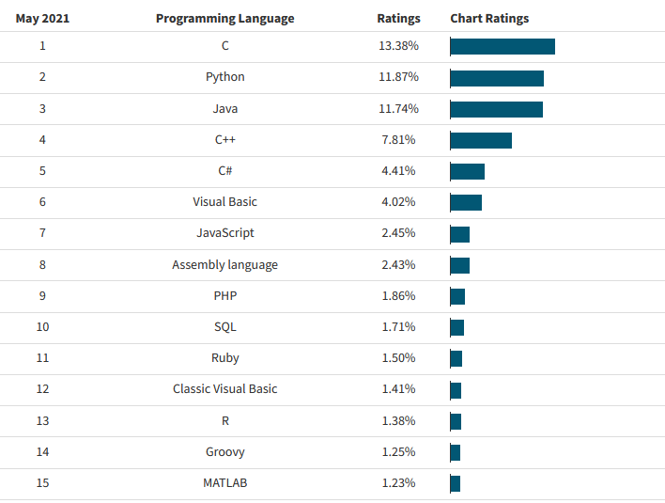
Programming Language Popularity
statisticsanddata.org

Slide 13
Programming Language Popularity
Derived from C/C++
These languages mostly
directly accept C code
Things like math, logic and code constructs come from C
statisticsanddata.org

Slide 14
Thinking Like a Computer

Slide 15
Thinking Working Like a Computer

Slide 16
Memory: Address & Content
    Naming variables is helpful!
Control Flow: Conditionals and Jumps (AKA Loops)
    GOTO is DANGEROUS!
Machine Code has only simple instructions.

Slide 17
Processes to “build” a program
Source Code
Compiler
Object code
Startup code
Linker
Library code
Executable code

Slide 18
Example 1
#include <iostream>
int main()
{
using namespace std;
cout << "Welcome to Computational Physics." << endl;
return 0;
}

Slide 19
Example 1
Ask to include a library called iostream
#include <iostream>
int main()
{
using namespace std;
cout << "Welcome to Computational Physics." << endl;
return 0;
}
Look for names (cout) in standard namespace.

Slide 20
Example 1
#include <iostream>
int main()
{
using namespace std;
cout << "Welcome to Computational Physics." << endl;
return 0;
}
Function header

Slide 21
Example 1
#include <iostream>
int main()
{
using namespace std;
cout << "Welcome to Computational Physics." << endl;
return 0;
}
Function body between curly brackets

Slide 22
Example 1
#include <iostream>
int main()
{
using namespace std;
cout << "Welcome to Computational Physics." << endl;
return 0;
}
Print out
End of the line

Slide 23
Example 1
#include <iostream>
int main()
{
using namespace std;
cout << "Welcome to Computational Physics." << endl;
return 0;
}
Every line ends with a semicolon.
Signal that everything works fine.

Slide 24
Add Comments
//This is our first example
#include <iostream>
int main()
{
using namespace std;
cout << "Welcome to Computational Physics." << endl;
return 0;
}

Slide 25
More on Comments
/*This is another way to
add block of comments*/
#include <iostream>
//You can add comment line anywhere.
//You can use multiple lines for comments.
int main()
{
using namespace std;//You can add comments here too.
cout << "Welcome to Computational Physics." << endl;
return 0;
}

Slide 26
Class Exercise 1
Write some code to print your own name.
To Compile:
g++ source.cpp -o executable
To run:
./executable

Slide 27
Example 2
#include <iostream>
int main()
{
using namespace std;
int carrots;
cout <<"How many carrots do you have?" << endl;
cin >> carrots;
cout <<"Here are two more." << endl;
carrots = carrots + 2;
cout <<"Now you have " << carrots << " carrots." << endl;
return 0;
}

Slide 28
Example 2
#include <iostream>
int main()
{
using namespace std;
int carrots;
cout <<"How many carrots do you have?" << endl;
cin >> carrots;
cout <<"Here are two more." << endl;
carrots = carrots + 2;
cout <<"Now you have " << carrots << " carrots." << endl;
return 0;
}
Declare a variable carrots as an integer

Slide 29
Example 2
#include <iostream>
int main()
{
using namespace std;
int carrots;
cout <<"How many carrots do you have?" << endl;
cin >> carrots;
cout <<"Here are two more." << endl;
carrots = carrots + 2;
cout <<"Now you have " << carrots << " carrots." << endl;
return 0;
}
Assign a value to carrots from input

Slide 30
Example 2
#include <iostream>
int main()
{
using namespace std;
int carrots;
cout <<"How many carrots do you have?" << endl;
cin >> carrots;
cout <<"Here are two more." << endl;
carrots = carrots + 2;
cout <<"Now you have " << carrots << " carrots." << endl;
return 0;
}
Add 2 to the value of carrots

Slide 31
Example 2
#include <iostream>
int main()
{
using namespace std;
int carrots;
cout <<"How many carrots do you have?" << endl;
cin >> carrots;
cout <<"Here are two more." << endl;
carrots = carrots + 2;
cout <<"Now you have " << carrots << " carrots." << endl;
return 0;
}
Print out the value of carrots

Slide 32
Exercise 2
Write a code that ask the user to input a number and print out its square.

Slide 33
Example 3
#include <iostream>
int AddTwo(int initial)
{
return (initial+2);
}
int main()
{
using namespace std;
cout <<"How many carrots do you have?" << endl;
int a,carrots;
cin >> a;
cout <<"Here are two more." << endl;
carrots=AddTwo(a);
cout <<"Now you have " << carrots << " carrots." << endl;
return 0;
}

Slide 34
Example 3
#include <iostream>
int AddTwo(int initial)
{
return (initial+2);
}
int main()
{
using namespace std;
cout <<"How many carrots do you have?" << endl;
int a,carrots;
cin >> a;
cout <<"Here are two more." << endl;
carrots=AddTwo(a);
cout <<"Now you have " << carrots << " carrots." << endl;
return 0;
}
New function called AddTwo.
Its value is an integer.
It takes an integer viable “initial” as input

Slide 35
Example 3
#include <iostream>
int AddTwo(int initial)
{
return (initial+2);
}
int main()
{
using namespace std;
cout <<"How many carrots do you have?" << endl;
int a,carrots;
cin >> a;
cout <<"Here are two more." << endl;
carrots=AddTwo(a);
cout <<"Now you have " << carrots << " carrots." << endl;
return 0;
}
The return value of AddTwo is “initial” +2.

Slide 36
Example 3
#include <iostream>
int AddTwo(int initial)
{
return (initial+2);
}
int main()
{
using namespace std;
cout <<"How many carrots do you have?" << endl;
int a,carrots;
cin >> a;
cout <<"Here are two more." << endl;
carrots=AddTwo(a);
cout <<"Now you have " << carrots << " carrots." << endl;
return 0;
}
Define two integer variables: a and carrots.

Slide 37
Example 3
#include <iostream>
int AddTwo(int initial)
{
return (initial+2);
}
int main()
{
using namespace std;
cout <<"How many carrots do you have?" << endl;
int a,carrots;
cin >> a;
cout <<"Here are two more." << endl;
carrots=AddTwo(a);
cout <<"Now you have " << carrots << " carrots." << endl;
return 0;
}
Assign a value to a from input

Slide 38
Example 3
#include <iostream>
int AddTwo(int initial)
{
return (initial+2);
}
int main()
{
using namespace std;
cout <<"How many carrots do you have?" << endl;
int a,carrots;
cin >> a;
cout <<"Here are two more." << endl;
carrots=AddTwo(a);
cout <<"Now you have " << carrots << " carrots." << endl;
return 0;
}
Pass a to AddTwo, assign
the return value to carrots.

Slide 39
Exercise 3
Write a code that contains the following two parts:
1. A function that takes a number and returns its square.
2. A main function that ask the user to input a number, and calls the above function to calculate its square, and print out.

