Slide 1
Aerospace Design:
A Purely Digital Affair
Ben Keller
Physics 715 Final Project

Slide 2
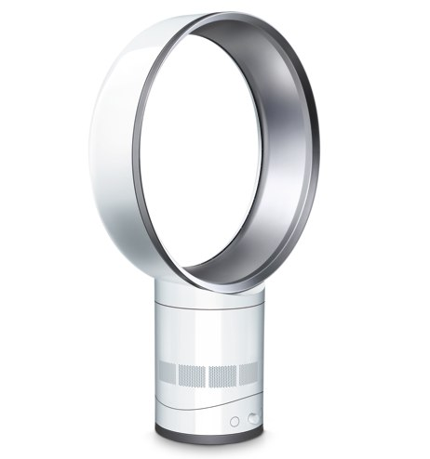

Slide 3
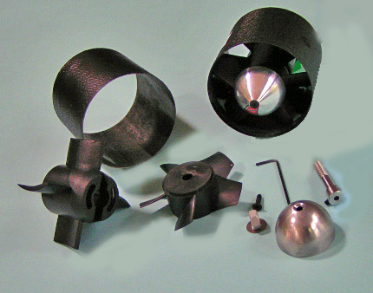

Slide 4
Build a Better Air Trap
Can an airfoil placed in a square duct improve the flow qualities through that duct?

Slide 5
How Do I Test This?

Slide 6
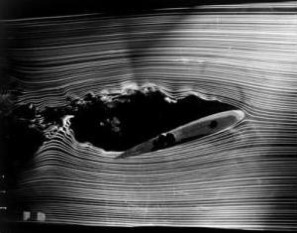

Slide 8
Computers are Discrete!

Slide 9
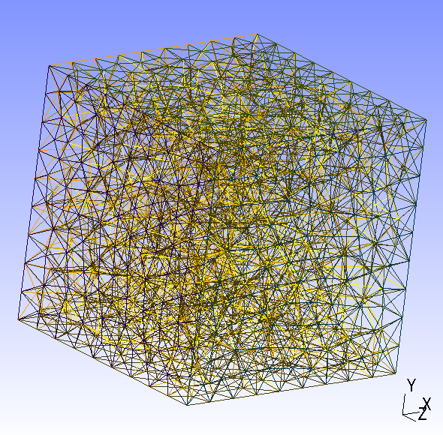

Slide 10
NACA Airfoils
Name Format NACA MPTT
M is 1st digit of maximum camber percentage
P is 1st digit of maximum camber position
TT is 1st & 2nd digit of maximum thickness percentage

Slide 11
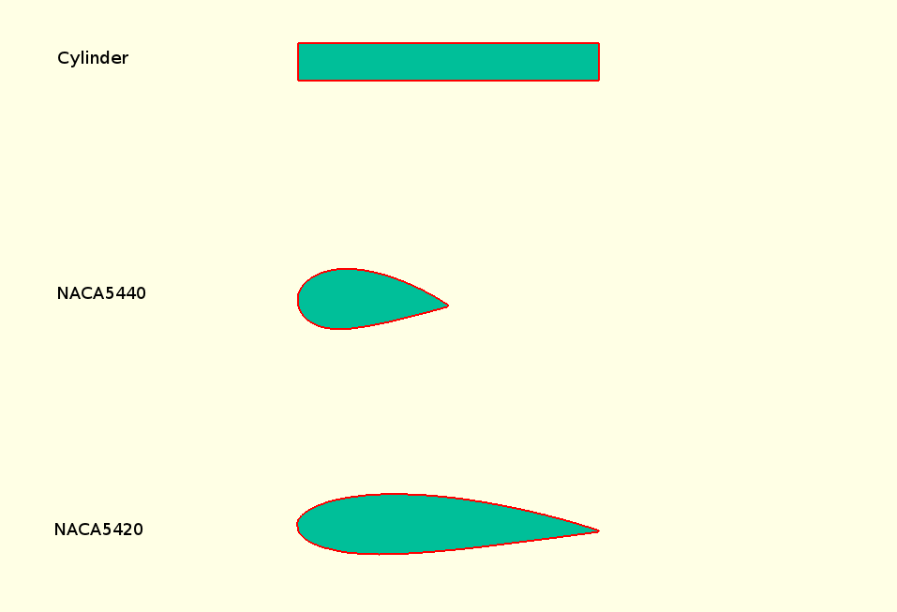

Slide 12
Turbulence Model

Slide 13
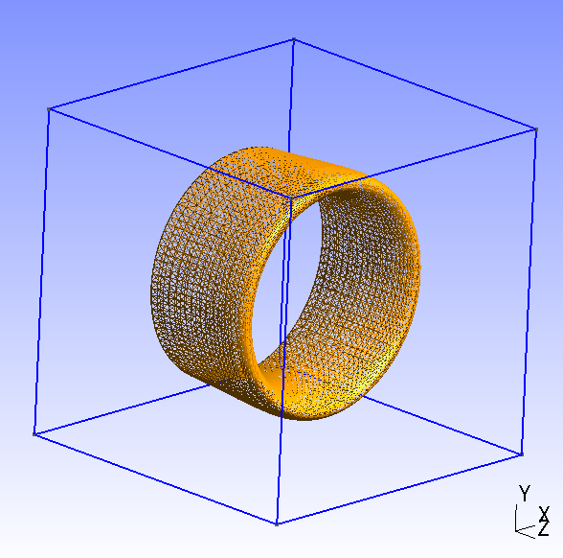

Slide 14
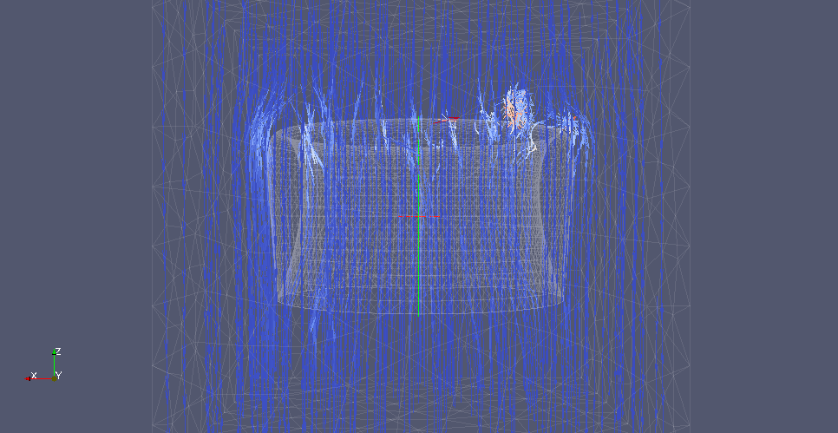

Slide 15
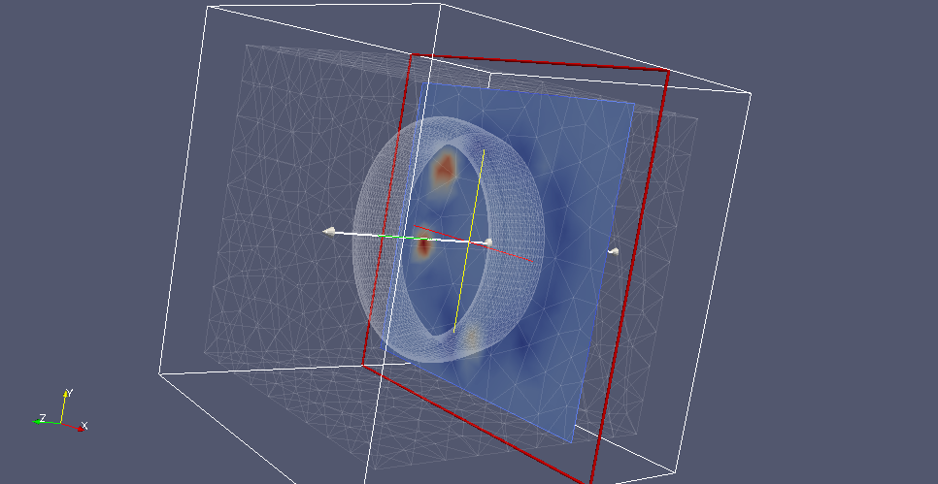

Slide 16
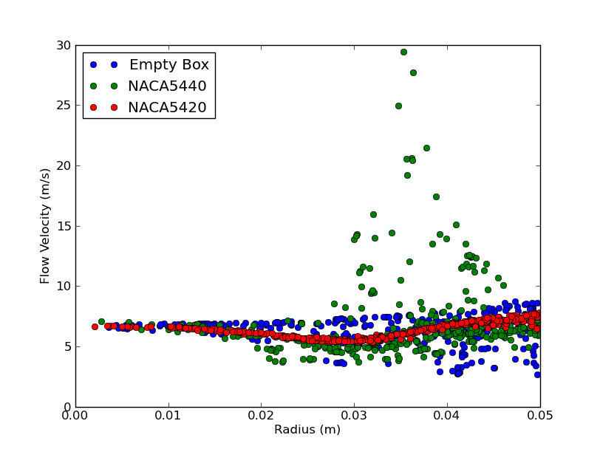

Slide 17
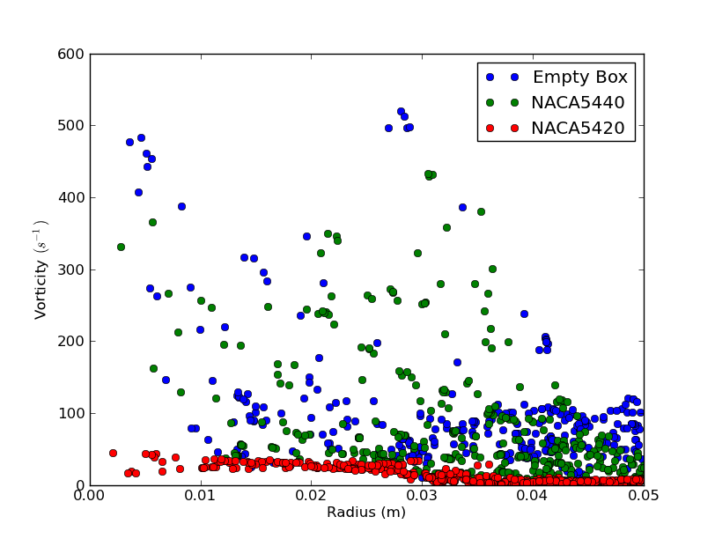

Slide 18
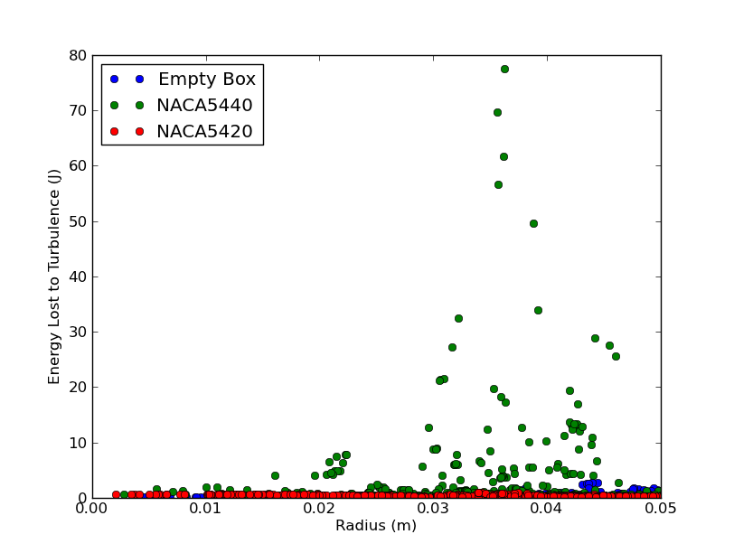

Slide 19
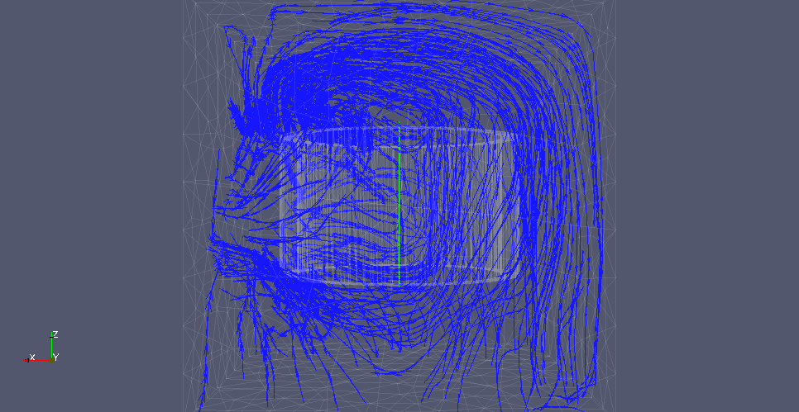

Slide 20
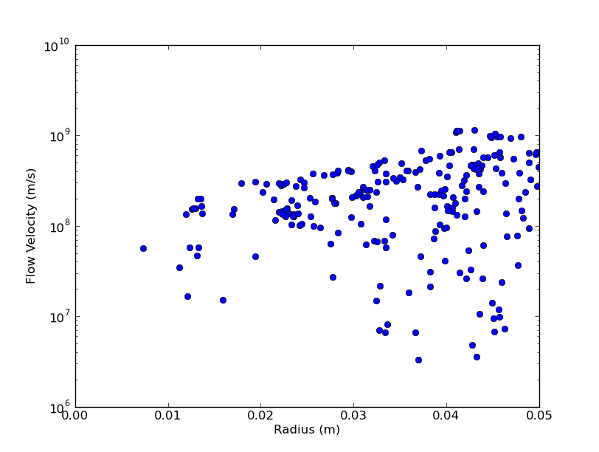

Slide 21
