Slide 1
Team 3 Presentation
Project Name : Ball’s on the tray
Team Members : SooGeun Park , Minjae Lee
Notes:
Hellow, Let’s start team 3 presentation
Our Project Name is Ball’s on the tray.
This is our game name!
Team members is SooGeun Park and Me.

Slide 2

Contents
1. Rule and Demo
2. Introduction
3. Specifications
4. Approach
5. Implementation
6. Discussion
7. Q&A
Notes:
Let’s see Contents
First, we explain game's rule, and show our demo.
And then, introduce introduction, specifications, approach, implementation, discussion and Q&A

Slide 3

Rule and Demo
Rule
1. Two-player game that lasted for 50 seconds
2. Players can get points by putting the color ball in their basket, and player who has many points wins.
3. However, if a black ball goes in the basket, it loses points(-3). (It is also possible to put a black ball in the another player’s basket.)
4. A ball of random size, position, and color is periodically created on the tray.
5. The location of the basket also changes over time.
6. Run the code and press any button, then start game.
Notes:
Rules,
This is Two-player game that lasted for 50 seconds.
Players can get points by putting the color ball in their basket, and player who has many points wins.
However, if a black ball goes into the basket, it loses points. (It is also possible to put a black ball in the another player’s basket.)
A ball of random size, position, and color is periodically created on the tray.
The location of the basket also changes over time.
Run the code and press any button, then start game.
Before detatil explain, we show our demo! Lets play!

Slide 4

Rule and Demo

Slide 5
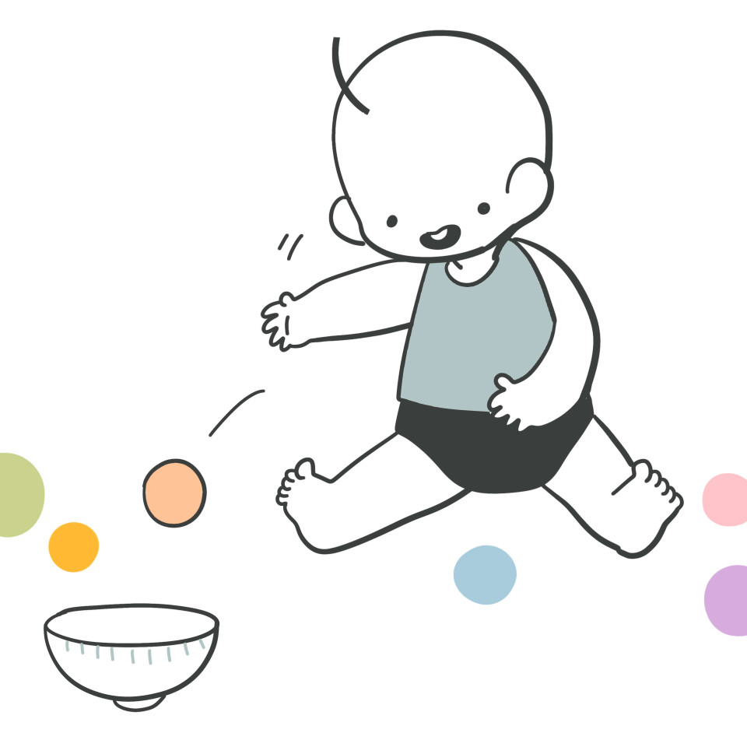
Introduction/ Motivation
Goal : Using the concepts we learned in class, Making game!!
1. First, we simply set the user’s main pleasure element as putting the ball into the basket.
2. We embodied the idea that the user's goal is to shake the trays and put the balls into the designated basket.
Notes:
Let's re start presentation
Introduction and Motivation,
First, we simply set the user’s main pleasure element as putting the ball into the basket.
And then, We embodied the idea that the user's goal is to shake the trays and put the balls into the designated basket.

Slide 6
Specifications
3D Object (Ball, Tray, Basket) Rendering
2. Set the Camera and Viewport of the Screen
3. Timer & Update the position of the ball
4. Tray ratation & Movement of the ball on the slope
5. Set the area of the tray (Balls fall out of the area)
6. Detect the ball going into the basket
7. User interface (Text object in OpenGL)
8. Music & Sound Effect with OpenGL + pygame
Notes:
Specifications
These was the things we need to implement the game.
1. 3D Object (Ball, Tray, Basket) Rendering
2.Set the Camera and Viewport of the Screen
3.Timer & Update the position of the ball
4. Tray ratation & Movement of the ball on the slope
5.Set the area of the tray (For examples, Balls fall out of the area)
6.Detect the ball going into the basket
7.User interface (Like Text object in OpenGL)
8.Music & Sound Effect with OpenGL + pygame

Slide 7
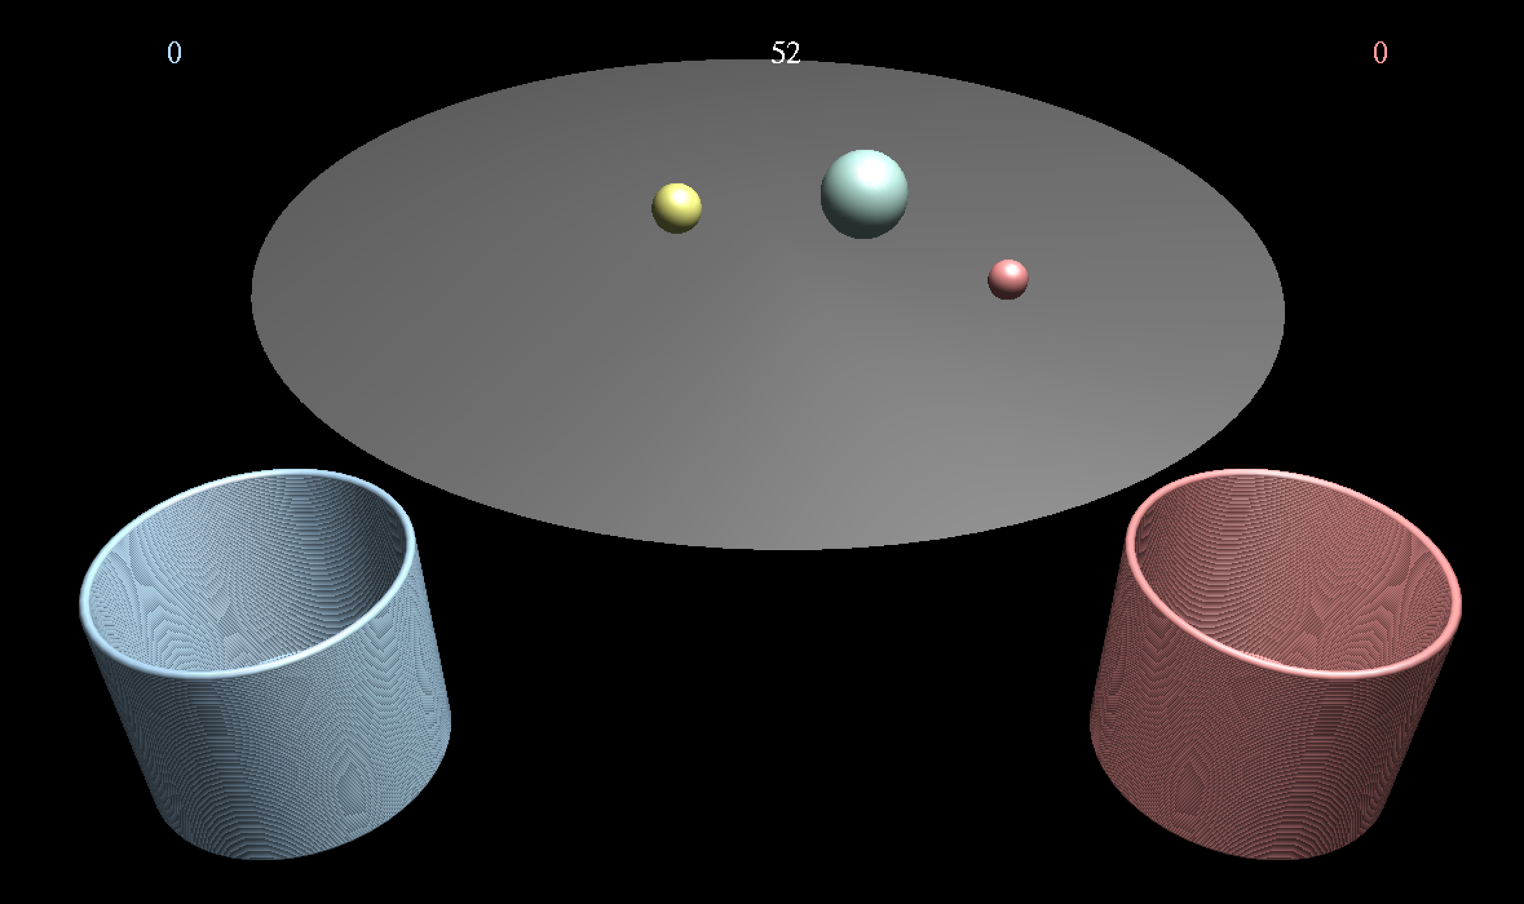

Approach
Models.py
Camera.py
Interface.py
Viewer.py
utils.py
Gamesound.py
main.py
Notes:
Approach,
This is our source code flow
At models.py we make Ball Tray Basket class and render.
At camera.py we set the camera position and movement.
At interface.py we set the player class and time and text interface.
At viewer.py we address the display and key event
At utils.py we set color, player id and Text draw function.
At gamesound.py we address various game sound.
Finally, at main.py implement viewer.run

Slide 8
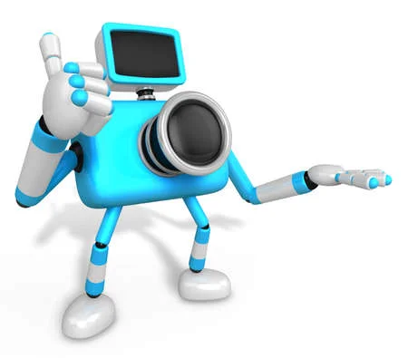
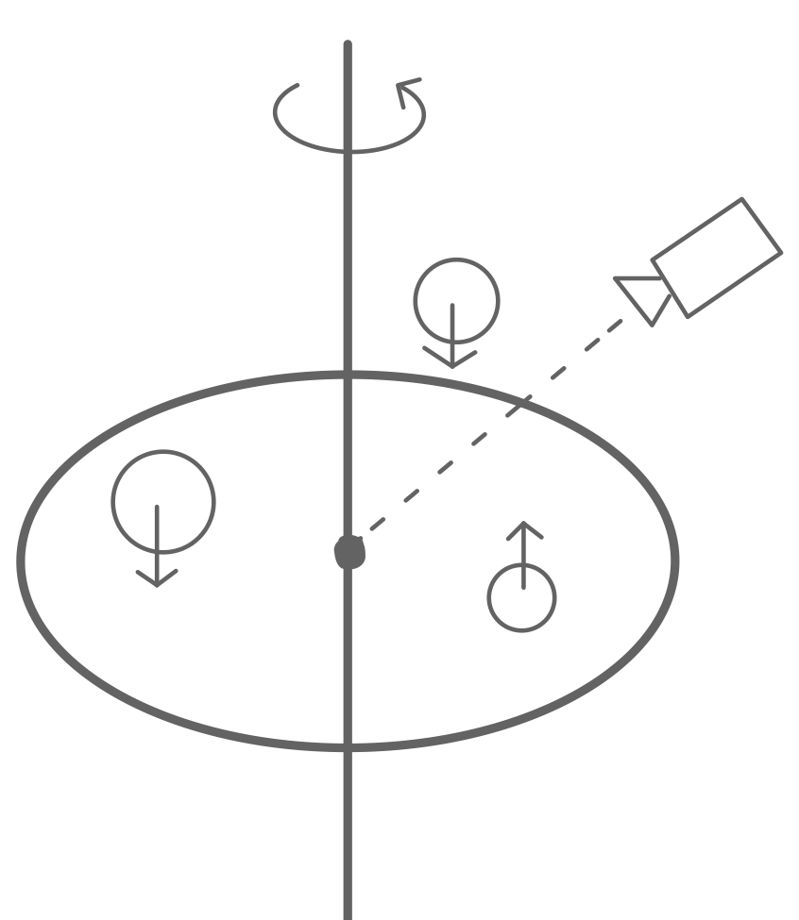
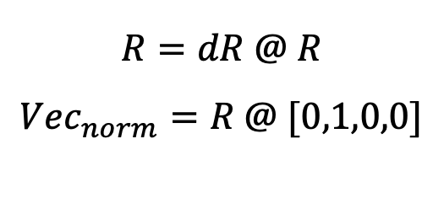
Implementation(1)
Camera setting and tray rotation
Camera_pose = [0,10,20], Look [0,0,0]
Modify tray’s rotation matrix and normal vector, when user’s input.
$$R=dR @ R$$
$$Vec_{norm}=R @ [0,1,0,0]$$
Notes:
Implementation.
We set camera pose [0,10,20] point and look [0,0,0] point.
When user input, using the defined value dtheta calculated dR and update R, and then calculate normal vector.
Using this way we can rotate the tray.

Slide 9
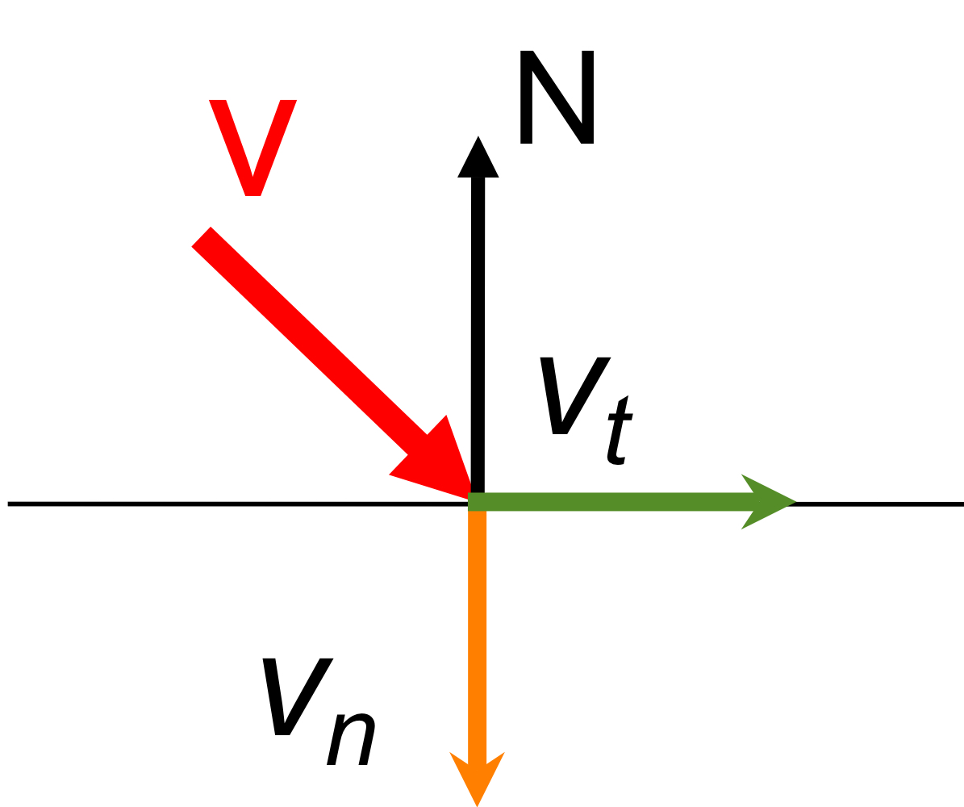
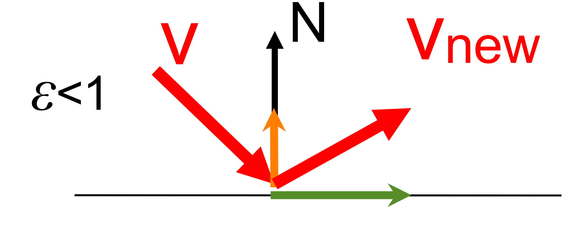
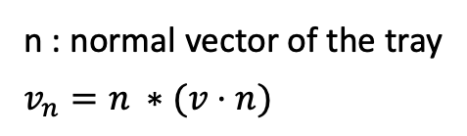
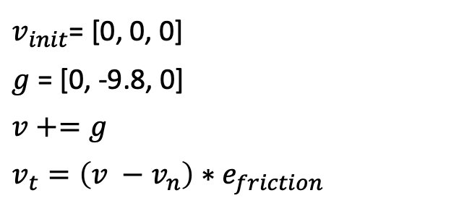
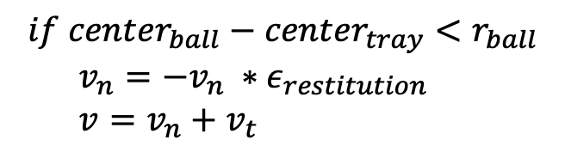
Implementation(2)
Ball’s Velocity
$v_{init}$= [0, 0, 0]
$g$ = [0, -9.8, 0]
$$v+=g$$
$$v_{t}=\left(v −v_{n}\right)∗e_{friction}$$
n : normal vector of the tray
$$v_{n}=n ∗(v⋅n)$$
Collision Detect
$$if center_{ball}−center_{tray}<r_{ball}$$
$v_{n}=−v_{n} ∗ε_{restitution}$
$v=v_{n}+v_{t}$
Notes:
Ball’s velocity,
Gravity always works on the y-axis. So we add gravitational acceleration every update.
And ball does not always fall vertically to the tray, because of the rotation tray. So we divide velocity to v_t and v_n.
Collision Detect
We define the collision when distance of the ball and tray is smaller than ball’s radius,
When collision was detect, we update vn value / using elastic coefficient. Then add vn and vt calculate velocity
Using this way we can address velocity and collision

Slide 10
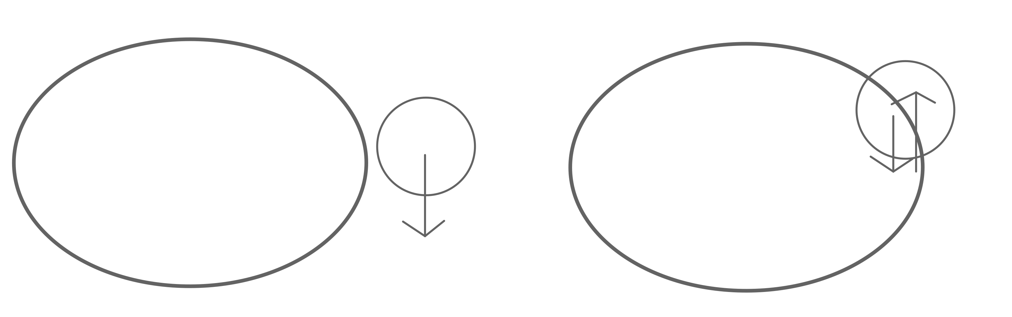
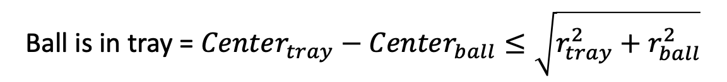
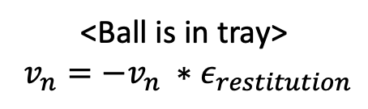
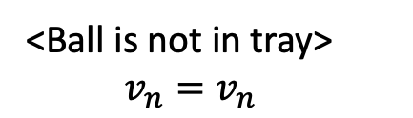
Implementation(3)
Velocity and Collision
Ball is in tray = $Center_{tray}−Center_{ball}≤\sqrt{r_{tray}^{2}+r_{ball}^{2}}$
<Ball is not in tray>
$v_{n}=v_{n}$
<Ball is in tray>
$v_{n}={−v}_{n} ∗ε_{restitution}$
Notes:
Velocity and Collision
We also had to distinguish whether the ball was in the tray or not.
Using the equation Center of tray - center of ball is less than root tray’s radius square + ball’s radius square then we think ball is in tray.
When ball is not in tray, we simply does not update vn.
And ball in in tray and collision detected, we reverse vn using elastic coefficient

Slide 11

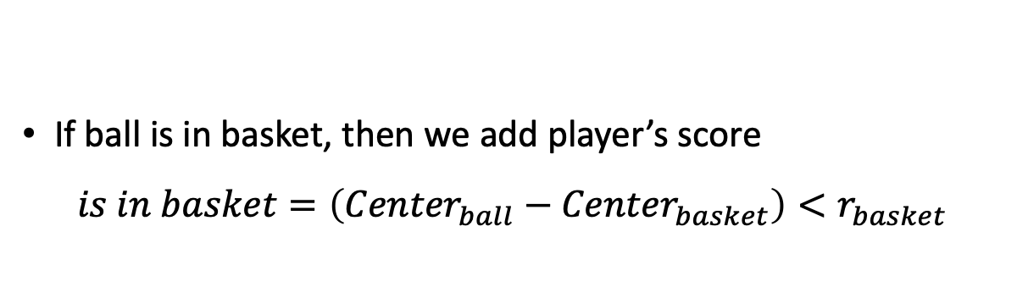
Implementation(4)
Interface (Timer and Scoring)
We make player and interface class at interface.py
We use glutBitmapCharacter for text object in OpenGL
We use threading.Timer for Timer.
If ball is in basket, then we add player’s score
$$is in basket=\left({Center}_{ball}−{Center}_{basket}\right)<r_{basket}$$
Notes:
We make player and interface class at interface.py
We use glutBitmap Character for text object in OpenGl
And we use threading dot Tmer for Timer.
If ball is in basket, then we add player’s score.
We define /is in basket/ using equation distance of ball and basket / is less than basket’s radius

Slide 12

Discussion
Future Work
Add a weight property to the ball, which can make a difference in the Velocity of each ball
2. Collision detection between balls (momentum)
3. Light & Shadowing setting
4. Various mode (random obstacle, random Gravitational acceleration, random elasticity)
Notes:
Future work.
We first plan many things but time is limited, so we remain these things future work.
First is add a weight property to the ball, which can make a difference in the velocity of each ball.
Second is Collision detection between balls also consider momentum.
Thirds is Light and shadowing setting.
Last, we thought various mode. Random obstacle like tack, fire and so on, and random gravitational acceleration or elasticity mode.

Slide 13
Q&A
Thank you for listening!
Notes:
Thank you for listening. Is there any question?

