Slide 1
weather alarm
Brian Woestman

Slide 2
sections
weather alarm
Planning
Development
Struggles
Release
Lessons learned
Code Review
Google Developer

Slide 3
Planning
weatheralarm
Entity Relationship Diagrams
Class Diagrams
Logic planning
Design ideas

Slide 4
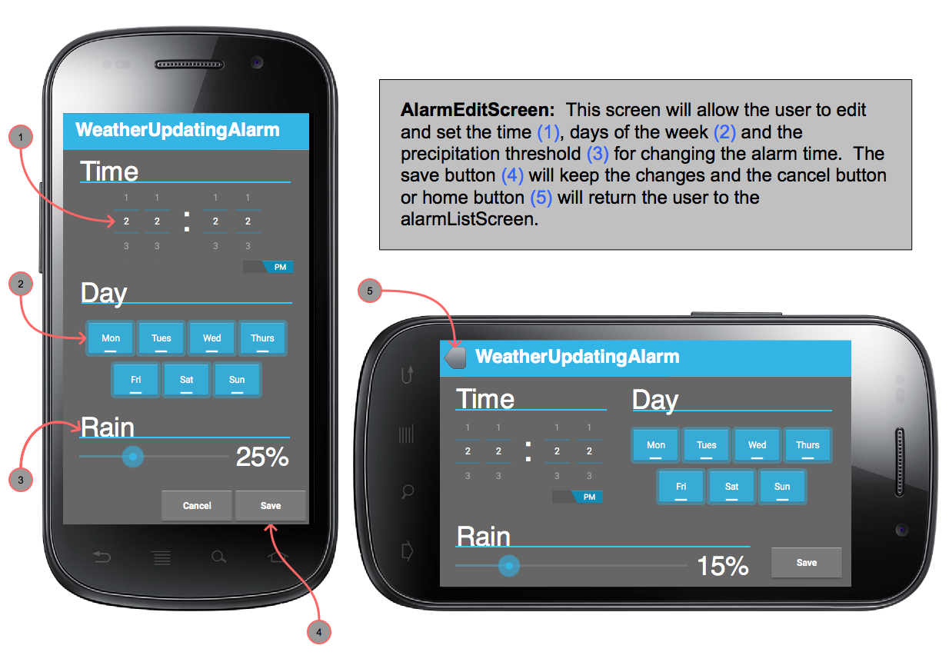
Phone edit view
weatheralarm

Slide 5
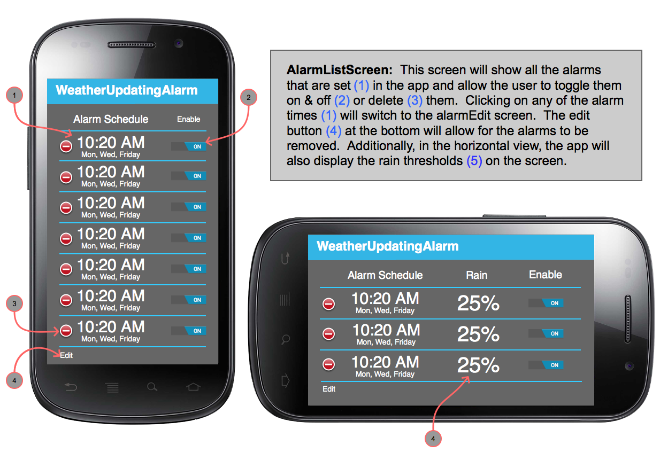
Phone list view
weatheralarm

Slide 6
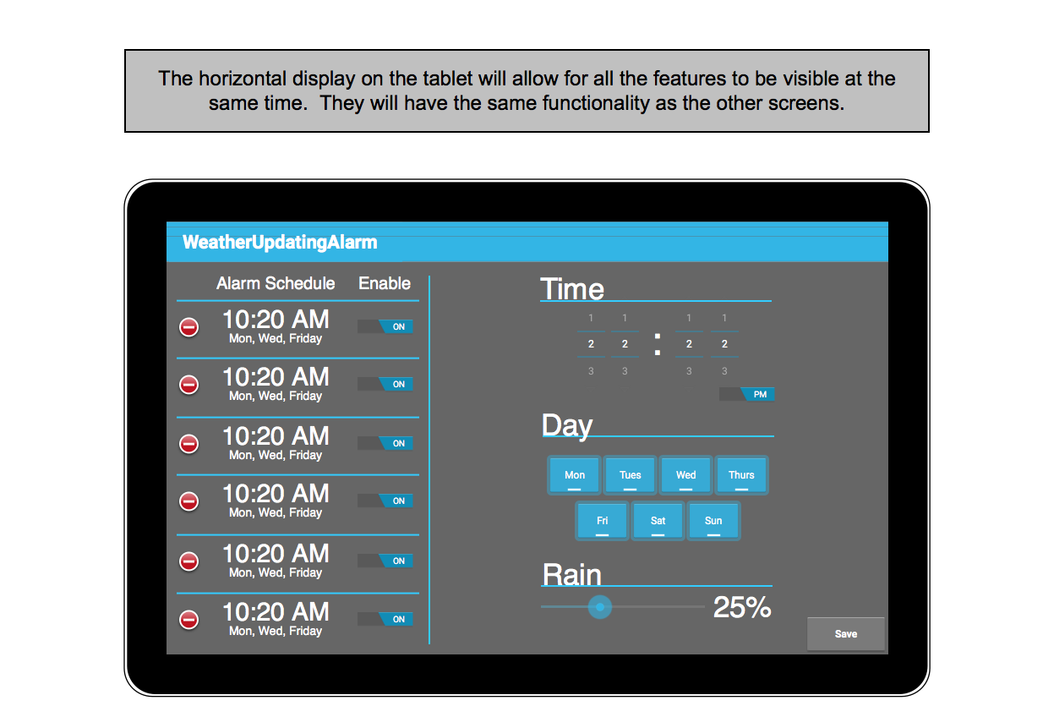
tablet view
weatheralarm

Slide 7
development
weatheralarm
Scheduling
Creating classes
Debugging
Testing on different devices

Slide 8
Struggles
weatheralarm
Keeping ahead of schedule
Unexpected variable types
Changing the database
Complicated logic
Concepts needed ahead of syllabus

Slide 9
Release
weatheralarm
Setting up Google Developer Console
Targeted Audience
Images
Signing my app
1 hour turnaround on release
Deciding if app will be free or paid

Slide 10
lessons learned
weatheralarm
Double check variable types before creating database
Research critical parts of app before it’s time to build
See if there are other similar apps that might offer insight
Do not procrastinate
Any time spent coding / conceptualizing is time well spent

Slide 11
code review & google developer

