Slide 1
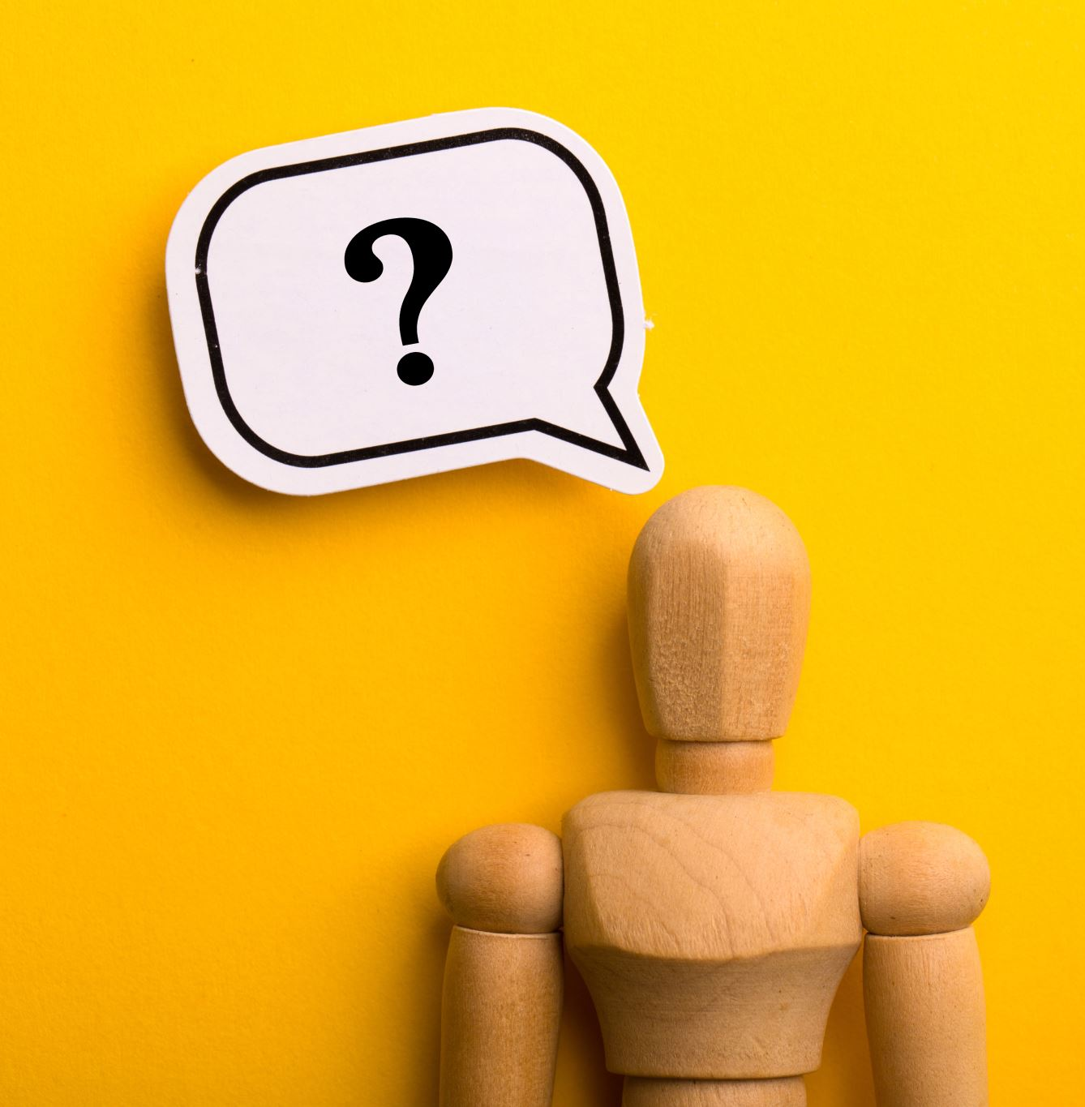
Know Me
Peek into your mind — through the story your phone tells.
Hackathon 2025 Submission
Team: Rahel Zewde | Beza Wolde | Oris Buckner IV

Slide 2
💡 The Problem
We spend hours online — but do we know what it says about our mind?
Social media reflects our thoughts, emotions, and stress patterns.
Most people lack awareness of how their digital habits affect mental well-being.
No simple, personalized tool connects digital behavior → mental health insight.

Slide 3
🚀 Our Solution: Know Me
AI-powered insight into your mental health.
Analyzes social media and phone usage patterns, posts, and engagement to reveal emotional trends.
Built with AI trained on mental health datasets validated by professionals.
Provides actionable recommendations and daily well-being insights.
Example:
"Sleep difficulty (28%), Work pressure (22%), Motivation loss (19%)."
"Emotional tone more negative between 11 PM–1 AM → late-night stress."

Slide 4
🧩 Demo Overview
How the Web App Works:
User connects social accounts.
App gathers data (with permission).
AI model analyzes sentiment, emotion, and topics.
Dashboard shows results and recommendations.

Slide 5
🛠️ Technical Overview
Frontend: React-based web app (mock backend).
Backend: Node/Express API simulating data fetch and AI processing.
AI Model: BERT/DistilBERT fine-tuned for sentiment classification.
Visualization: Chart.js or Recharts for dashboard insights.

Slide 6
📊 Model Input Example
What Data Does the AI See?
feature_name | description | example_value
platform | Social media source | Instagram
timestamp | Time of interaction | 2025-10-04 22:15
post_text | Caption or comment | 'Feeling burnt out from work lately.'
post_tags | Hashtags/topics | #workpressure #tired
sentiment_score | Numeric sentiment value | -0.72
emotion_label | Emotion detected | Frustrated
engagement_time | Time spent on post (sec) | 45
read_comments | Boolean if user read comments | True
topic_cluster | Topic detected by NLP | Work stress

Slide 7
🤝 The AI & Human Loop
Trained on trusted mental health datasets (Kaggle, research studies).
Reviewed and labeled by mental health professionals.
Provides interpretations, not diagnoses.
Creates a feedback loop: AI → Insight → Expert Validation → Improved Model.

Slide 8
💥 Impact & Relevance
Encourages early awareness of mental health struggles.
Empowers users with self-insight and coping tools.
Bridges the gap between digital life and mental well-being.
Enables partnerships with therapists, wellness apps, and social platforms.
Quote: "The first step to healing is understanding — Know Me makes that step easier."

Slide 9
🏁 Summary
Know Me helps users understand their mental health through the lens of their digital behavior — powered by responsible AI and human empathy.
Call to Action: Know yourself. Care for yourself. Know Me.

