Slide 1
HW1 Question 3
Ben Wolfe

Slide 2
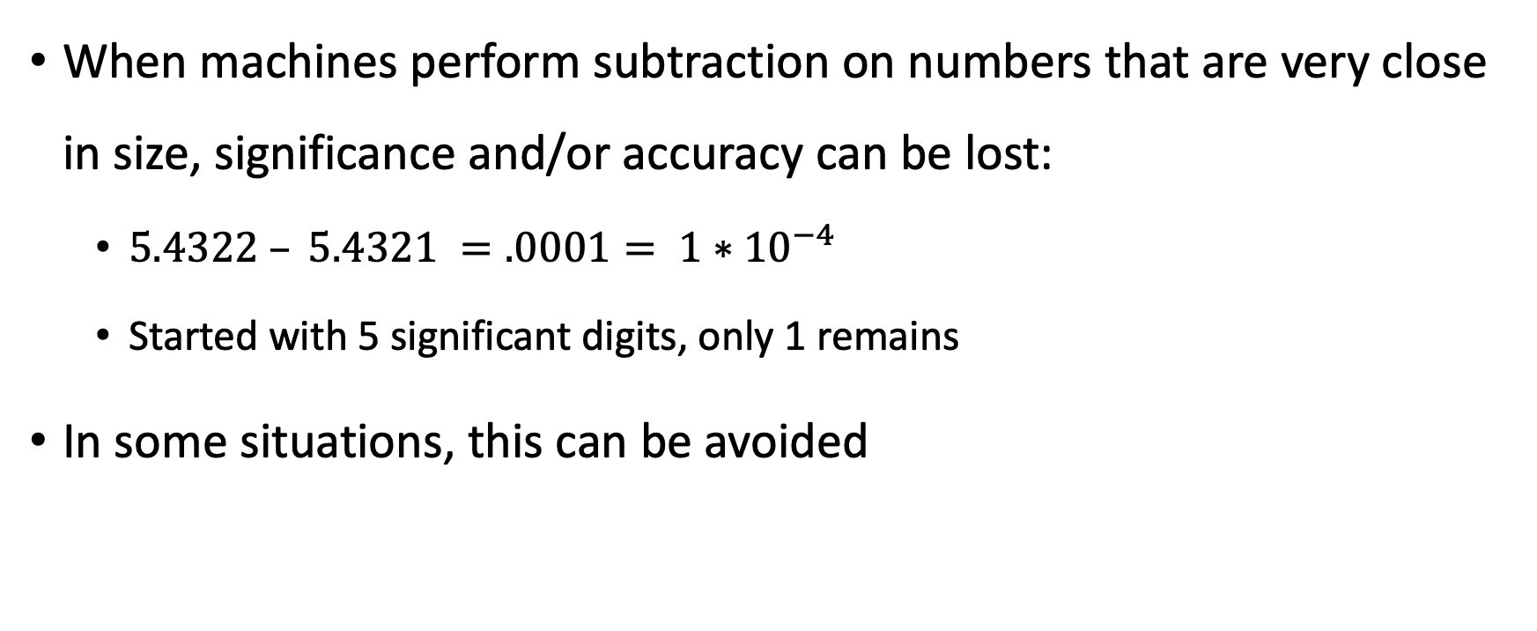
Concept Overview: Loss of Significance
When machines perform subtraction on numbers that are very close in size, significance and/or accuracy can be lost:
$5.4322 – 5.4321 =.0001= 1∗{10}^{−4}$
Started with 5 significant digits, only 1 remains
In some situations, this can be avoided

Slide 3
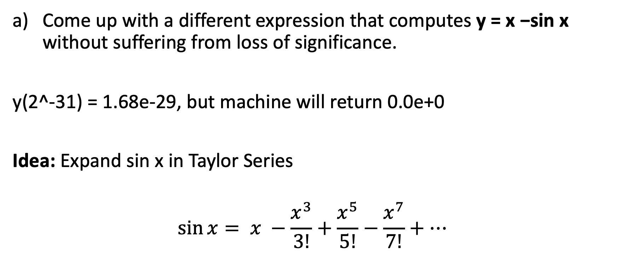
Our Problem
Come up with a different expression that computes y = x −sin x without suffering from loss of significance.
y(2^-31) = 1.68e-29, but machine will return 0.0e+0
Idea: Expand sin x in Taylor Series
$$\sin{x}= x −\frac{x^{3}}{3!}+\frac{x^{5}}{5!}−\frac{x^{7}}{7!}+…$$

Slide 4
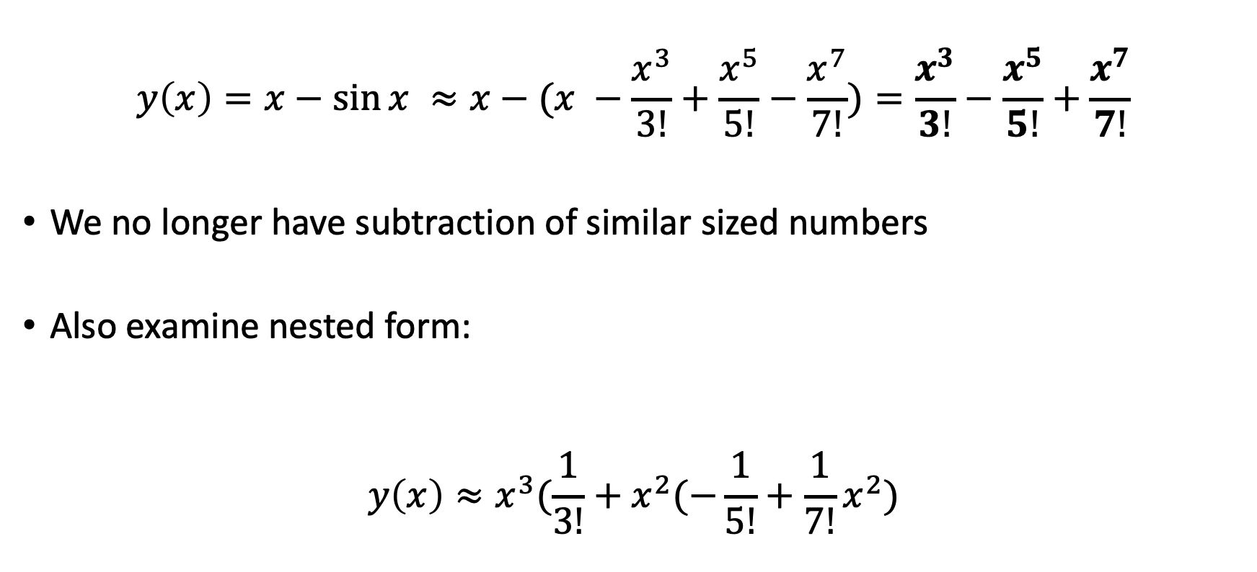
Part a) Continued
$$y\left(x\right)=x−\sin{x ≈x−(x −\frac{x^{3}}{3!}+\frac{x^{5}}{5!}−\frac{x^{7}}{7!}})=\frac{x^{3}}{3!}−\frac{x^{5}}{5!}+\frac{x^{7}}{7!}$$
We no longer have subtraction of similar sized numbers
Also examine nested form:
$$y\left(x\right)≈x^{3}(\frac{1}{3!}+x^{2}(−\frac{1}{5!}+\frac{1}{7!}x^{2})$$

Slide 5
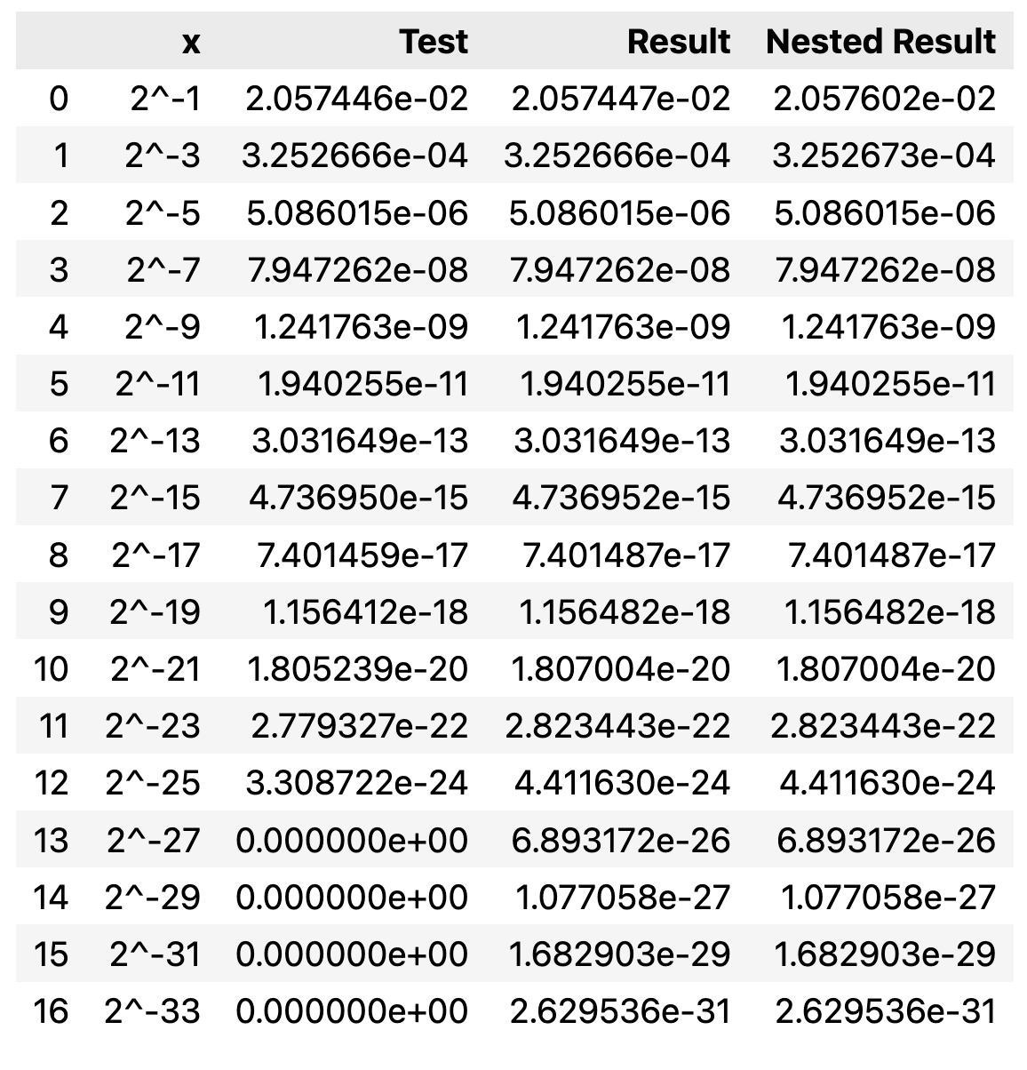
Part b): Results

Slide 6
Part c): Discussion
This method does not have loss of significance because subtraction of close numbers does not occur as was the case for the original function
Truncation error from Taylor Series
Cannot always limit loss of significance

Slide 7
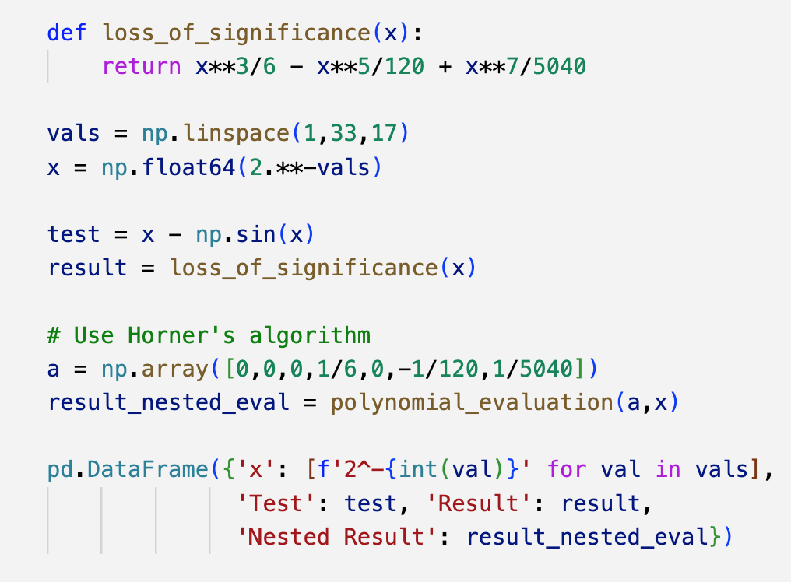
Appendix: Code

