Slide 1
…
A control-oriented Python package emulation numeric types for polytopes, ellipsoids, and subspaces.

Slide 2
Features
Numeric Type Emulation
Visualization
H-representation and V-representation
Degeneracy
Inter-object integration
Third-party integration (matplotlib/cvxpy)
Lazy evaluation/loading

Slide 3
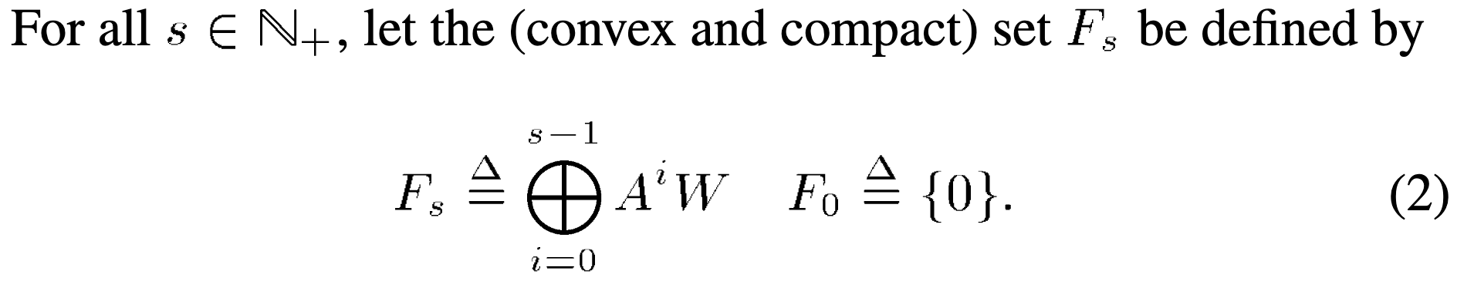
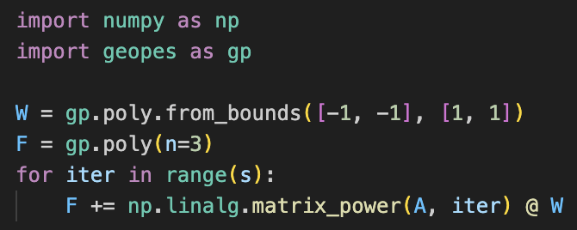
1. Numeric Type Emulation
Math operators write like code
Goal: To write your code as you would write your math

Slide 4
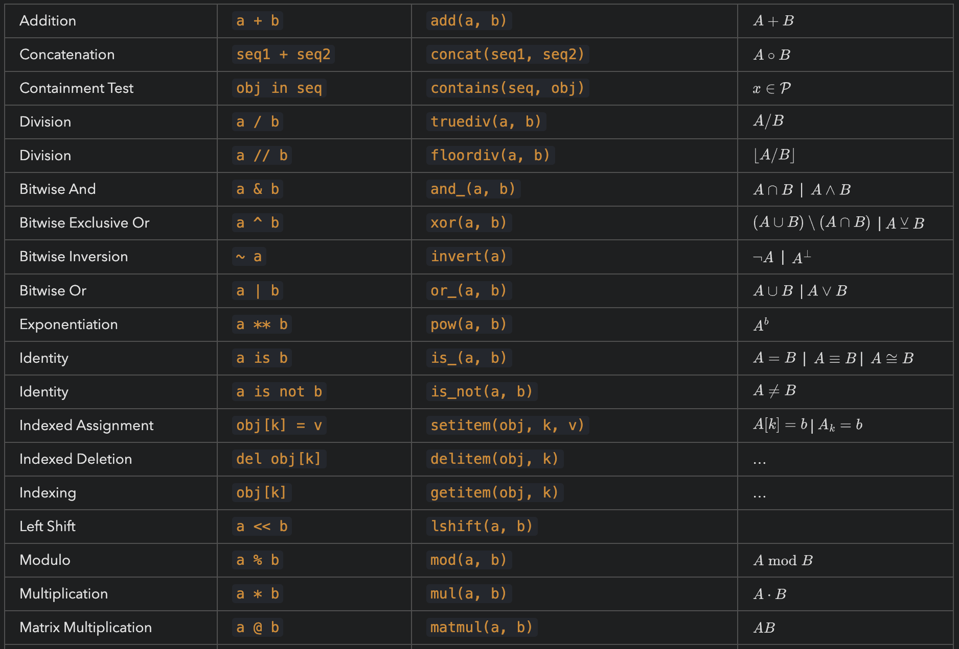
1. Numeric Type Emulation
Operation
Symbol
Method
Math

Slide 5
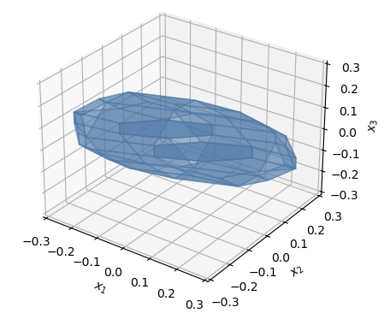
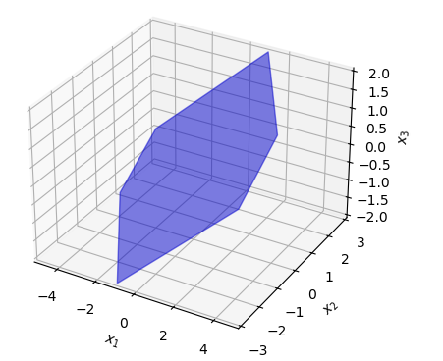
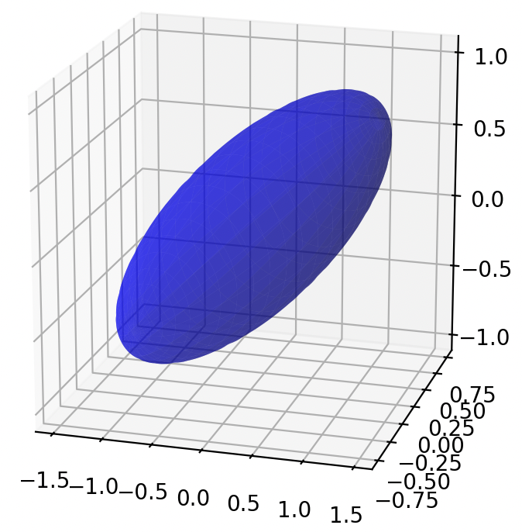
2. Visualization
n = 1
n = 2
n = 3
Challenge: Plotting polytopes in 2D/3D requires ‘sorting’ the vertices/associating each vertex with its corresponding halfplane

Slide 6
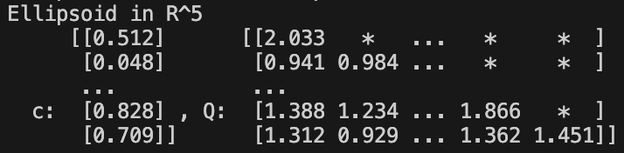
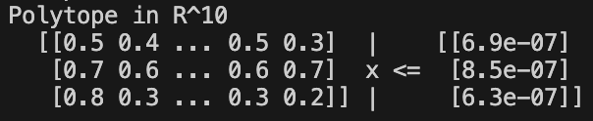
2. Visualization
Also, extensive pretty printing and printing formats for the different classes.

Slide 7
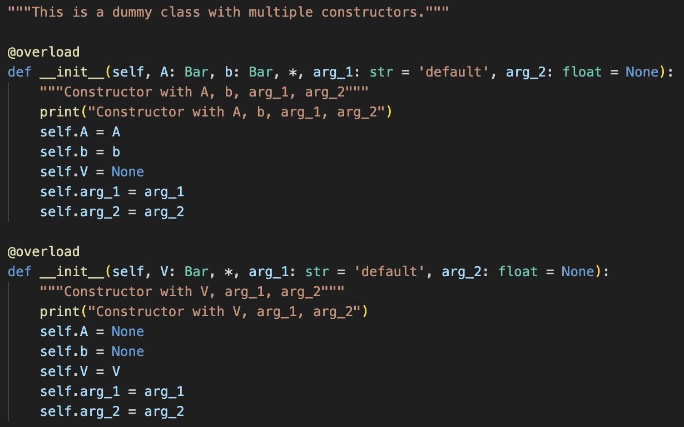
3. H-representation and V-representation
A polytope can be represented as either an H-representation or a V-representation: upon creation, the other representation is not explicitly computed (because this can be computationally very expensive).
Achieved by operator overload of __init__ method

Slide 8
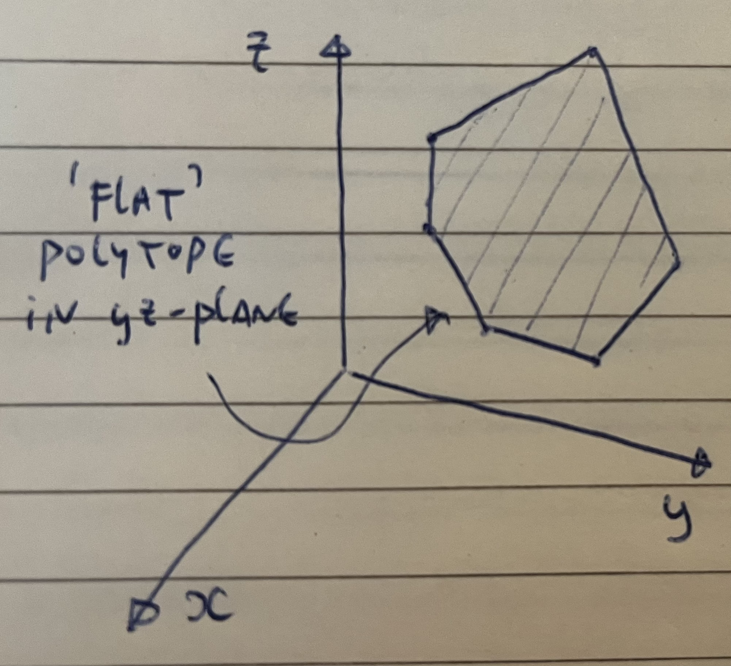
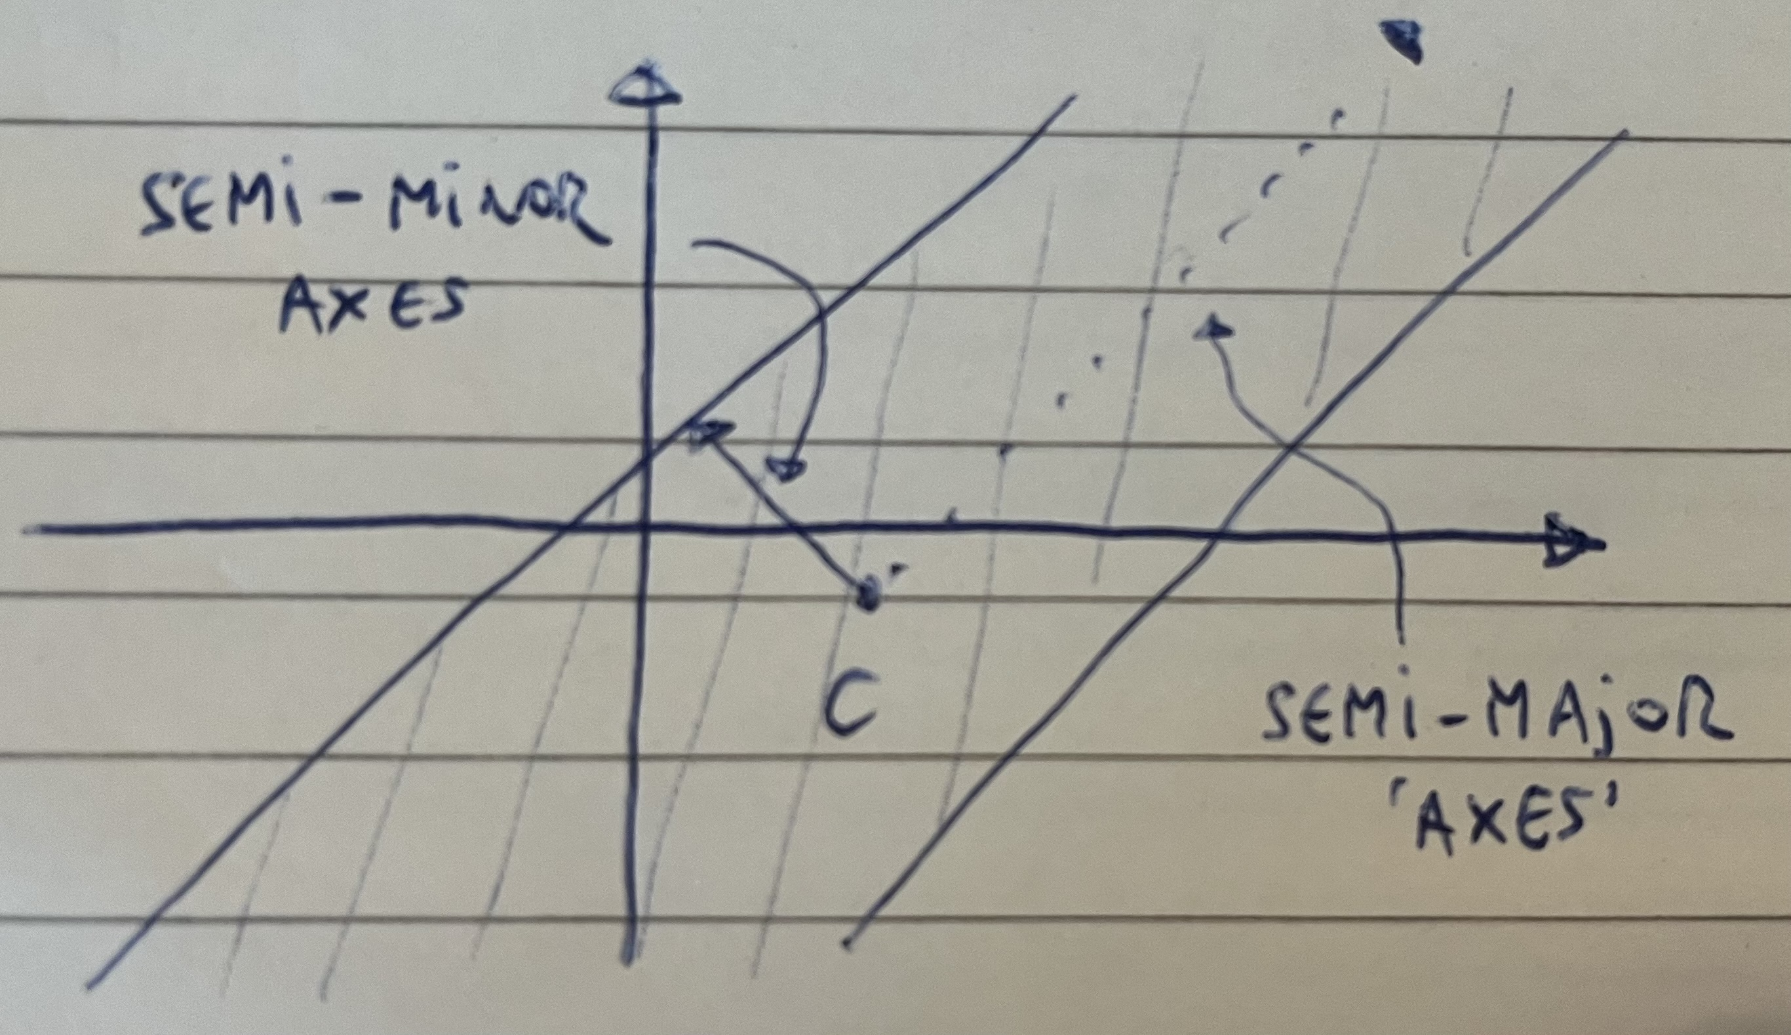
4. Degeneracy
Type-0 degeneracy
(no volume, ‘flat’)
Type-∞ degeneracy
(infinite volume, ‘unbounded’)
The package can deal with two types of degeneracy.
Challenge: There are an increasing number of edge-cases to consider when dealing with degeneracy

Slide 9
5. Inter-object integration
The toolbox allows the user to do operations between objects of different classes seamlessly.
Intersection ellipsoid with subspace -> ellipsoid
Projection of polytope on subspace -> polytope
Over/under-approximating an ellipsoid with a polytope
Over/under-approximating a polytope with an ellipsoid
⋮

Slide 10
6. External libraries integration
The toolbox has special integration features with external libraries.
cvxpy: used for internal optimization and external convex optimization problems formulation.

Slide 11
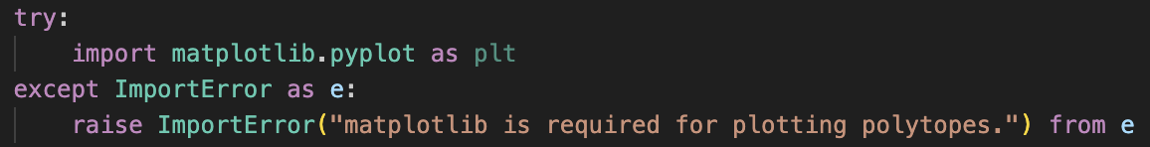
7. Lazy evaluation/loading
Certain properties (i.e., poly.vol) are expensive to calculate. These properties are not calculated at object initialization, but only when the ‘attribute’ is accessed (and then, they are saved to the object).
  Same for H-repr and V-repr of a polytope.
Certain packages (e.g., matplotlib/cvxpy) are optional dependencies. These are only imported when called.
  Might create a marginal speed-up.
  The least possible amount of dependencies -> improves longevity.

Slide 12
Why am I seeking collaborators?
I want to know which features are desirable (meaning development should be prioritized) from the users: you
I want your input/expertise/experience on a wide number of design choices (>50 as of now) in the software architecture.
I want your (mathematical) expertise when it comes to certain algorithms concerning polytopes, subspaces, and ellipsoids.
I would need to split the (ever-growing) workload of writing all functionalities to make this toolbox fully-fledged.

Slide 13
What do you get in return?
Well… not much! But:
A fun (hopefully, satisfactory) side-project in Python. Extensive (CV-worthy) expertise in Python package coding.
Experience in collaborating with others on a software project.
In the long run, a useful toolbox you can also use in your own projects/publications.
Added to the list of contributors for ….
If it comes to it (no guarantees): one of the authors on the (conference) publication promoting/launching GeoPES.

Slide 14
How much do I need to be involved?
Depends entirely on you. You could:
Not writing a single line of code, maybe have two chats about interesting math you read/suggestions for functionality.
I have some old MATLAB/Python code lying around somewhere; you can have a look at that. Otherwise, don’t call me again!
Sounds fun! I don’t know if I can make any commitment on time, though… I might read through some of the design decisions, leave some thoughts, attend a future meeting, but no promises.
Might actually be quite nice to join, also to gain a lot of coding experience; I’d be down to have some more indepth discussion, see if there’s certain functionality/subtask I’d be interested in writing.
…

Slide 15
Initialization
reduce
user args
init method
dispatching
setting properties
returning object
A, b
__init__
_init_hrepr
self.A, self.b
poly
Operation
initialize poly
return
object
False
poly(…)
poly
given poly
check flags
select algo
compute function
return results
in_place?
poly
self.is_
if … else
mink_sum
verts
True
setting properties
return
object
self.A, self.b
None

