Slide 1
GeoPES
A control-oriented Python package emulation numeric types of polytopes, ellipsoids, and subspaces.

Slide 2
Features
Numeric Type Emulation
Visualization
H-representation and V-representation
Lazy evaluation/loading
Inter-object integration
Third-party integration (matplotlib/cvxpy)

Slide 3
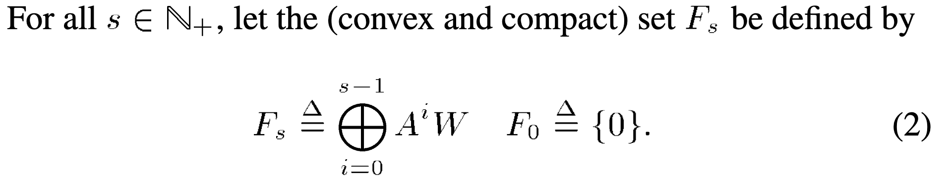
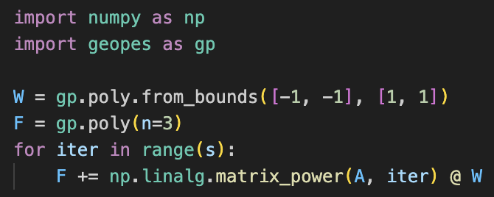
1. Numeric Type Emulation
FIXME: Add table for operators/types
Math operators write like code
Goal: To write your code as you would write your math

Slide 4
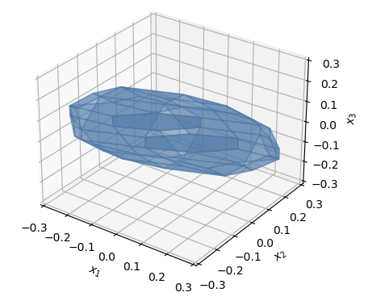
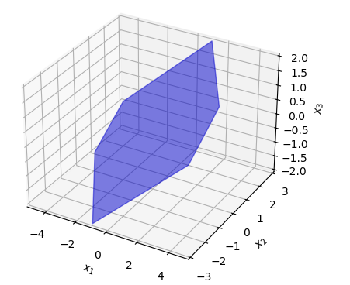
2. Visualization
n = 1
n = 2
n = 3
Challenge: Plotting polytopes in 2D/3D requires ‘sorting’ the vertices/associating each vertex with its corresponding halfplane

Slide 5
2. Visualization
Also, extensive pretty printing and printing formats for the different classes.

Slide 6
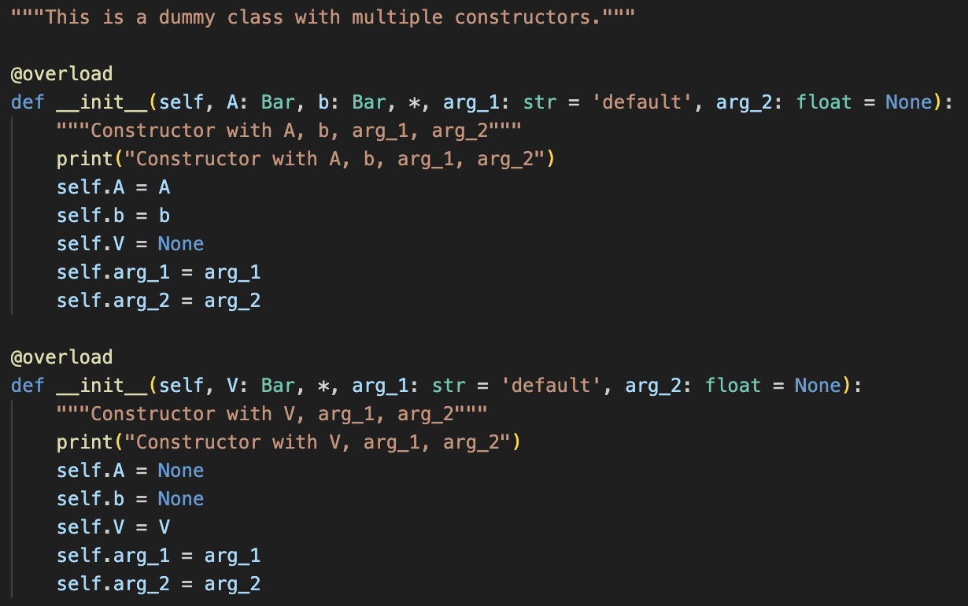
3. H-representation and V-representation
A polytope can be represented as either an H-representation or a V-representation: upon creation, the other representation is not explicitly computed (because this can be computationally very expensive).
Achieved by operator overload of __init__ method

Slide 7
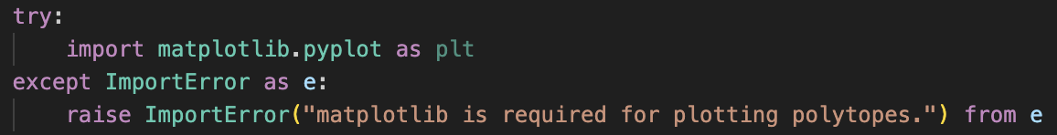
4. Lazy evaluation/loading
Certain properties (i.e., poly.vol) are expensive to calculate. These properties are not calculated at object initialization, but only when the ‘attribute’ is accessed (and then, they are saved to the object).
  Same for H-repr and V-repr of a polytope.
Certain packages (e.g., matplotlib/cvxpy) are optional dependencies. These are only imported when called.
  Might create a marginal speed-up.
  The least possible amount of dependencies -> improves longevity.

Slide 8
5. Inter-object integration
The toolbox allows the user to do operations between objects of different classes seamlessly.
Intersection ellipsoid with subspace -> ellipsoid
Projection of polytope on subspace -> polytope
Over/under-approximating an ellipsoid with a polytope
Over/under-approximating a polytope with an ellipsoid
⋮

Slide 9
6. External libraries integration
The toolbox has special integration features with external libraries.
cvxpy: used for internal optimization and external convex optimization problems formulation.

