Slide 1
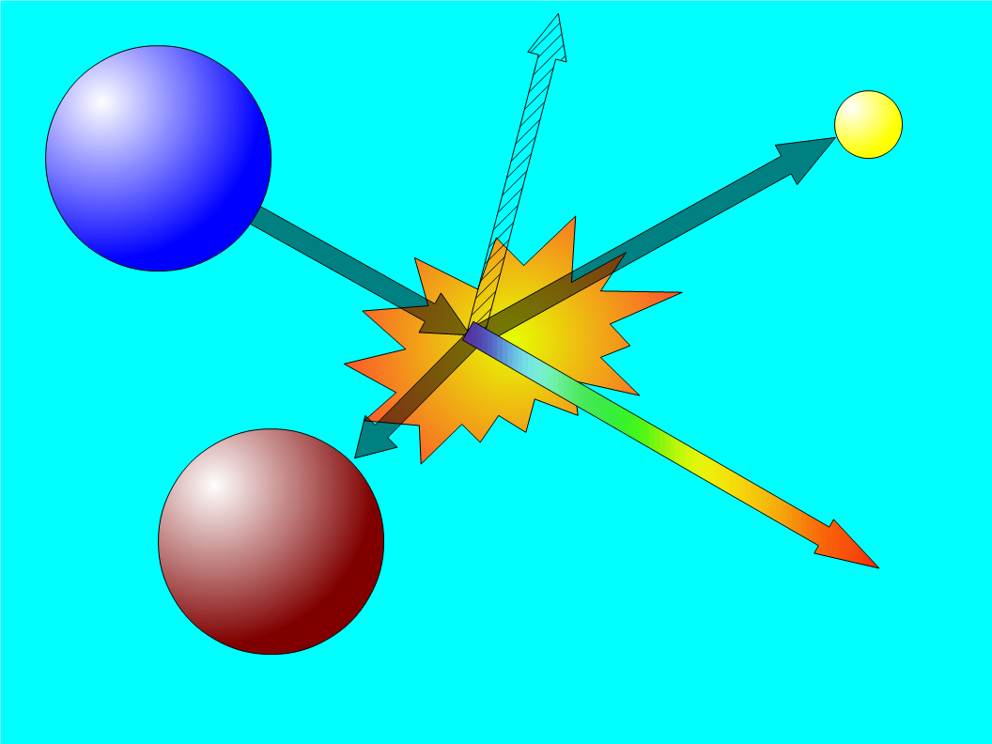
Status of the Neutron
Radiative Decay Experiment
RDK II Collaboration
R. Alarcon¹, M. Bales², C. Bass³, E. Beise⁴, H. Breuer⁴, J. Byrne⁵, T. Chupp², K. Coakley³, R. Cooper⁶,
M. Dewey³, C. Fu³, T. Gentile³, H. Mumm³, J. Nico³,
B. O'Neill¹, A. Thompson¹, F. Wietfeldt⁷
¹Arizona State University
²University of Michigan
³National Institute of Standards and Technology
⁴University of Maryland
⁵University of Sussex
⁶Indiana University
⁷Tulane University

Slide 2
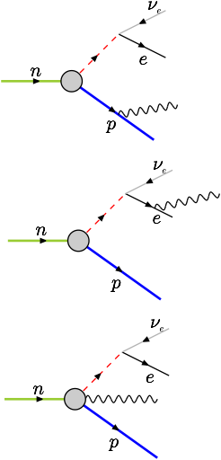
Radiative Decay Measurement
n→p⁺+e⁻+νe+γ+782keV
Measure neutron radiative decay branching ratio and energy sprectrum to 1% uncertainty
  10% uncertainty in RKD I
Test QED neutron radiative corrections
Challenges
  Long lifetime τn=(881.5±1.5)s
  Small branching ratio
  Large γ background

Slide 3
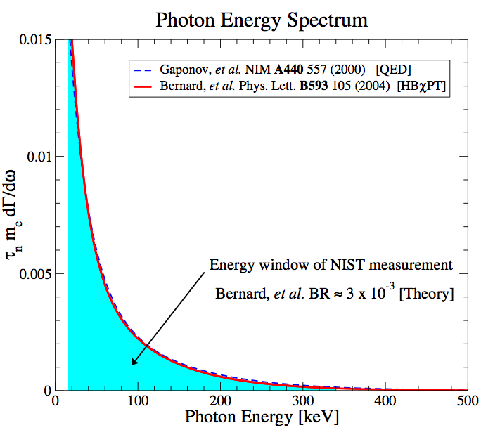
Motivation
RDK I^{1,2}
  (3.09±0.30[syst.]±0.11[stat.])×10⁻³
RDK II
  Goal 1% uncertainty
Beyond 0.5%
  Non-leading order terms
    Proton bremsstrahlung
    Recoil corrections
  Polarization (n, γ, etc.)
  Gardner & He³
Yield (arbitrary units)
¹Cooper, R. et al. PRC 81, 035503 (2010)
²Nico, J. S. et al. Nature 444, 1059–1062 (2006)
³arXiv:1101.1128v1

Slide 4
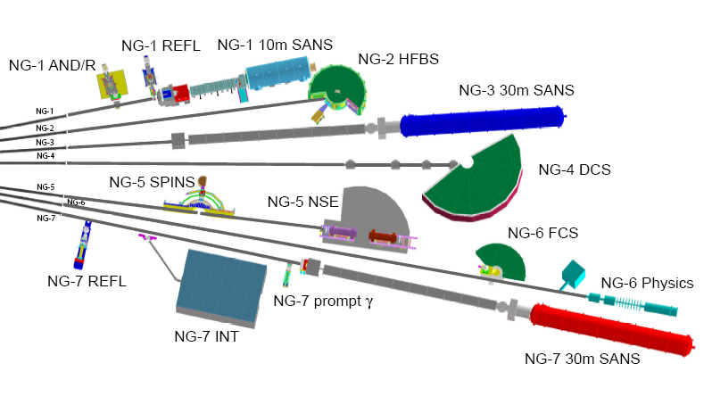
NIST Beam Line

Slide 5
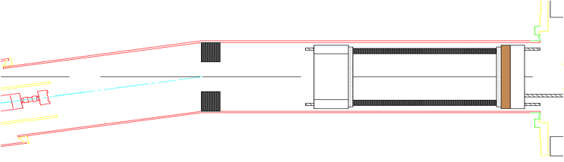
Experimental Setup
Pb shield
12 element BGO+APD array
Neutron beam
HV Mirror
(not shown)
SBD
bAPD array (not shown)
5T magnetic field
Neutrons decay along beam
Protons and electrons are confined in cyclotron orbits by magnetic field and guided into silicon detector
Electrostatic mirror turns around “wrong-way” protons
Protons are accelerated into the silicon detector
Waveform base data acquisition

Slide 6
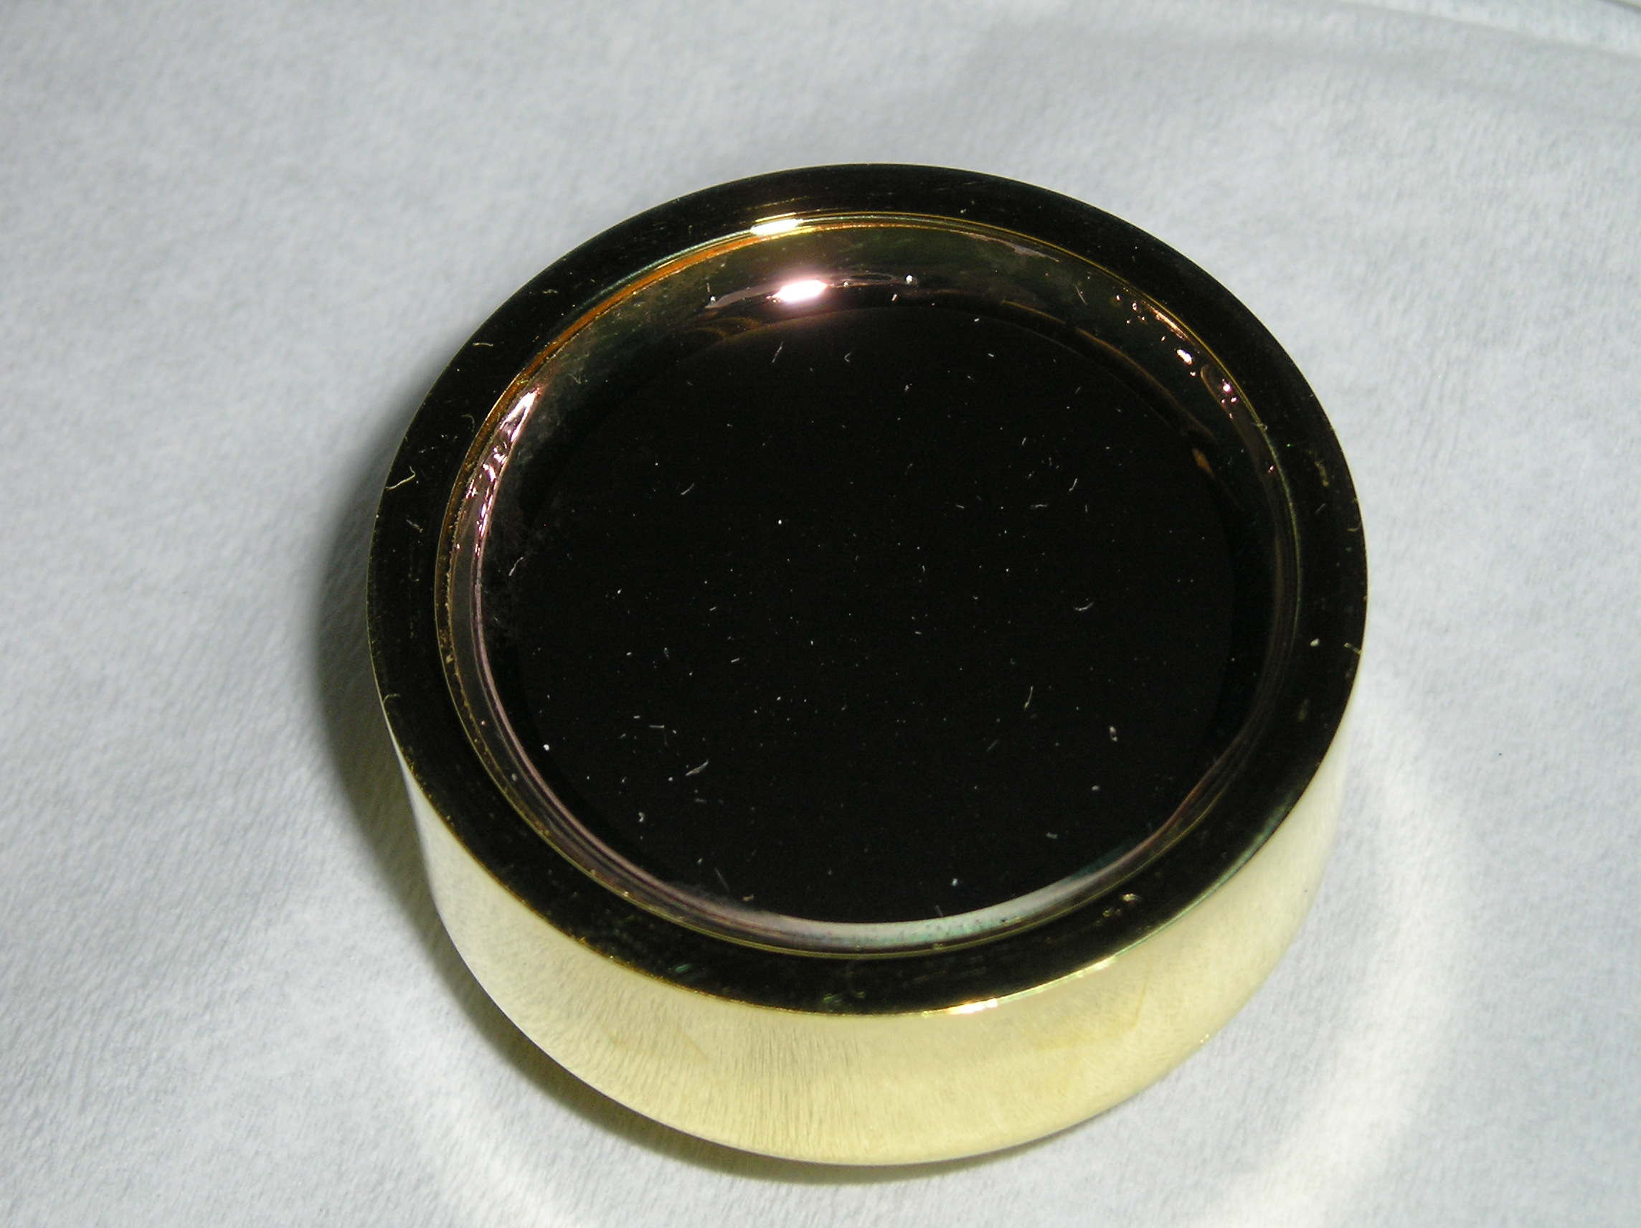
Electron-Proton Detector
Surface Barrier Detector (SBD)
  1-1.5mm thick
  600mm² area
  At -25kV bias

Slide 7
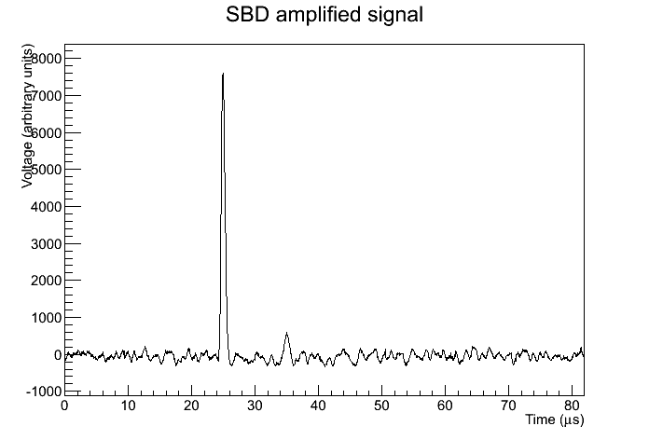
Electron-Proton Detector
Electron
Proton

Slide 8
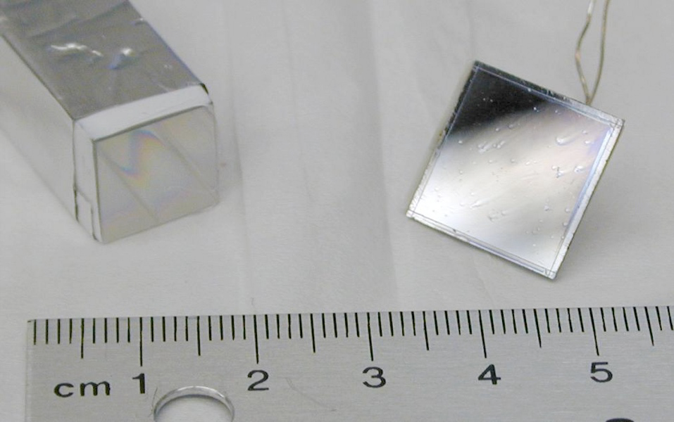
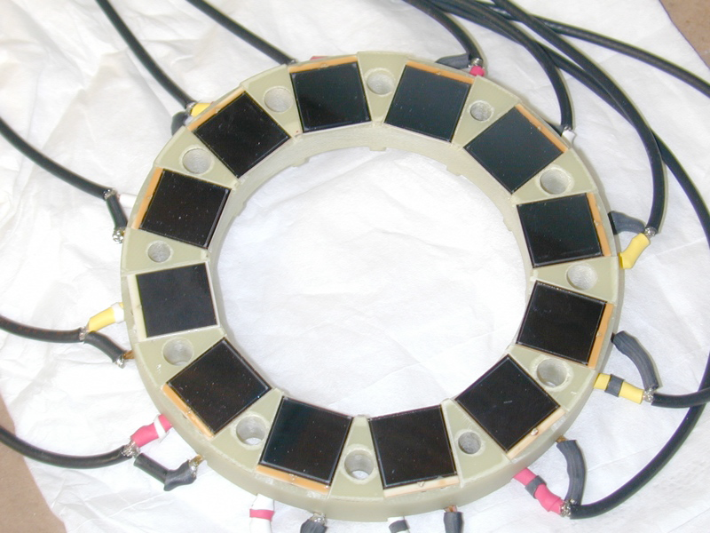
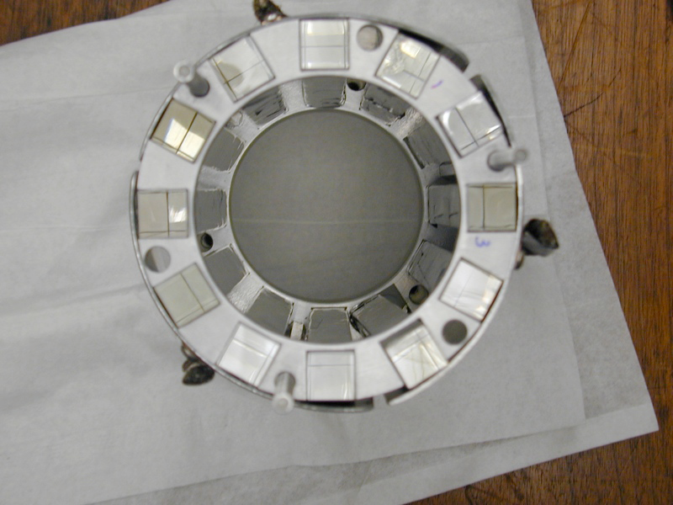
Scintillator Detector
Bismuth germanate (BGO) scintillator crystals coupled to avalanche photo-diodes (APD)
  12 Detectors
  200x12x12mm³ BGOs
  14x14mm² APDs
  ~10keV – endpoint

Slide 9
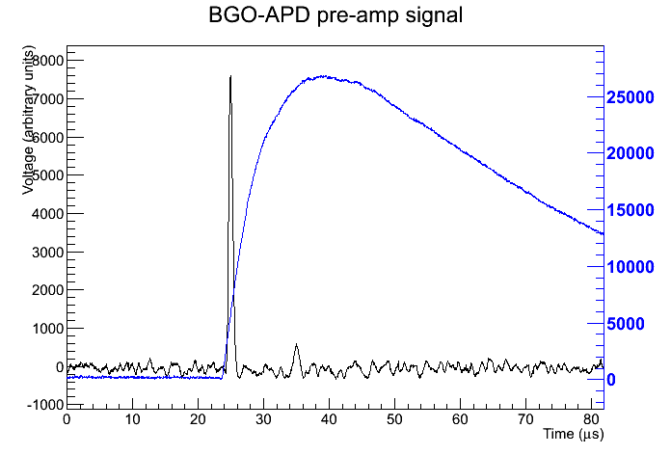
Scintillator Detector

Slide 10
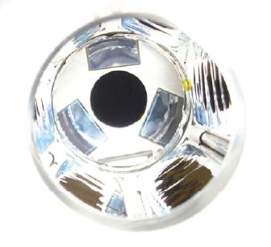
Direct Detector
Large area bare (non scintillating) avalanche photo-diode (bAPD) to extend the energy range
  3 detectors
  28x28mm²
  ~500eV – ~20keV
bAPD

Slide 11
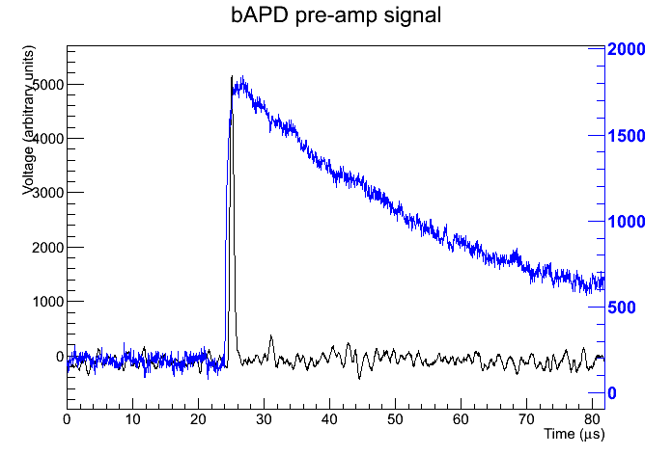
Direct Detector

Slide 12
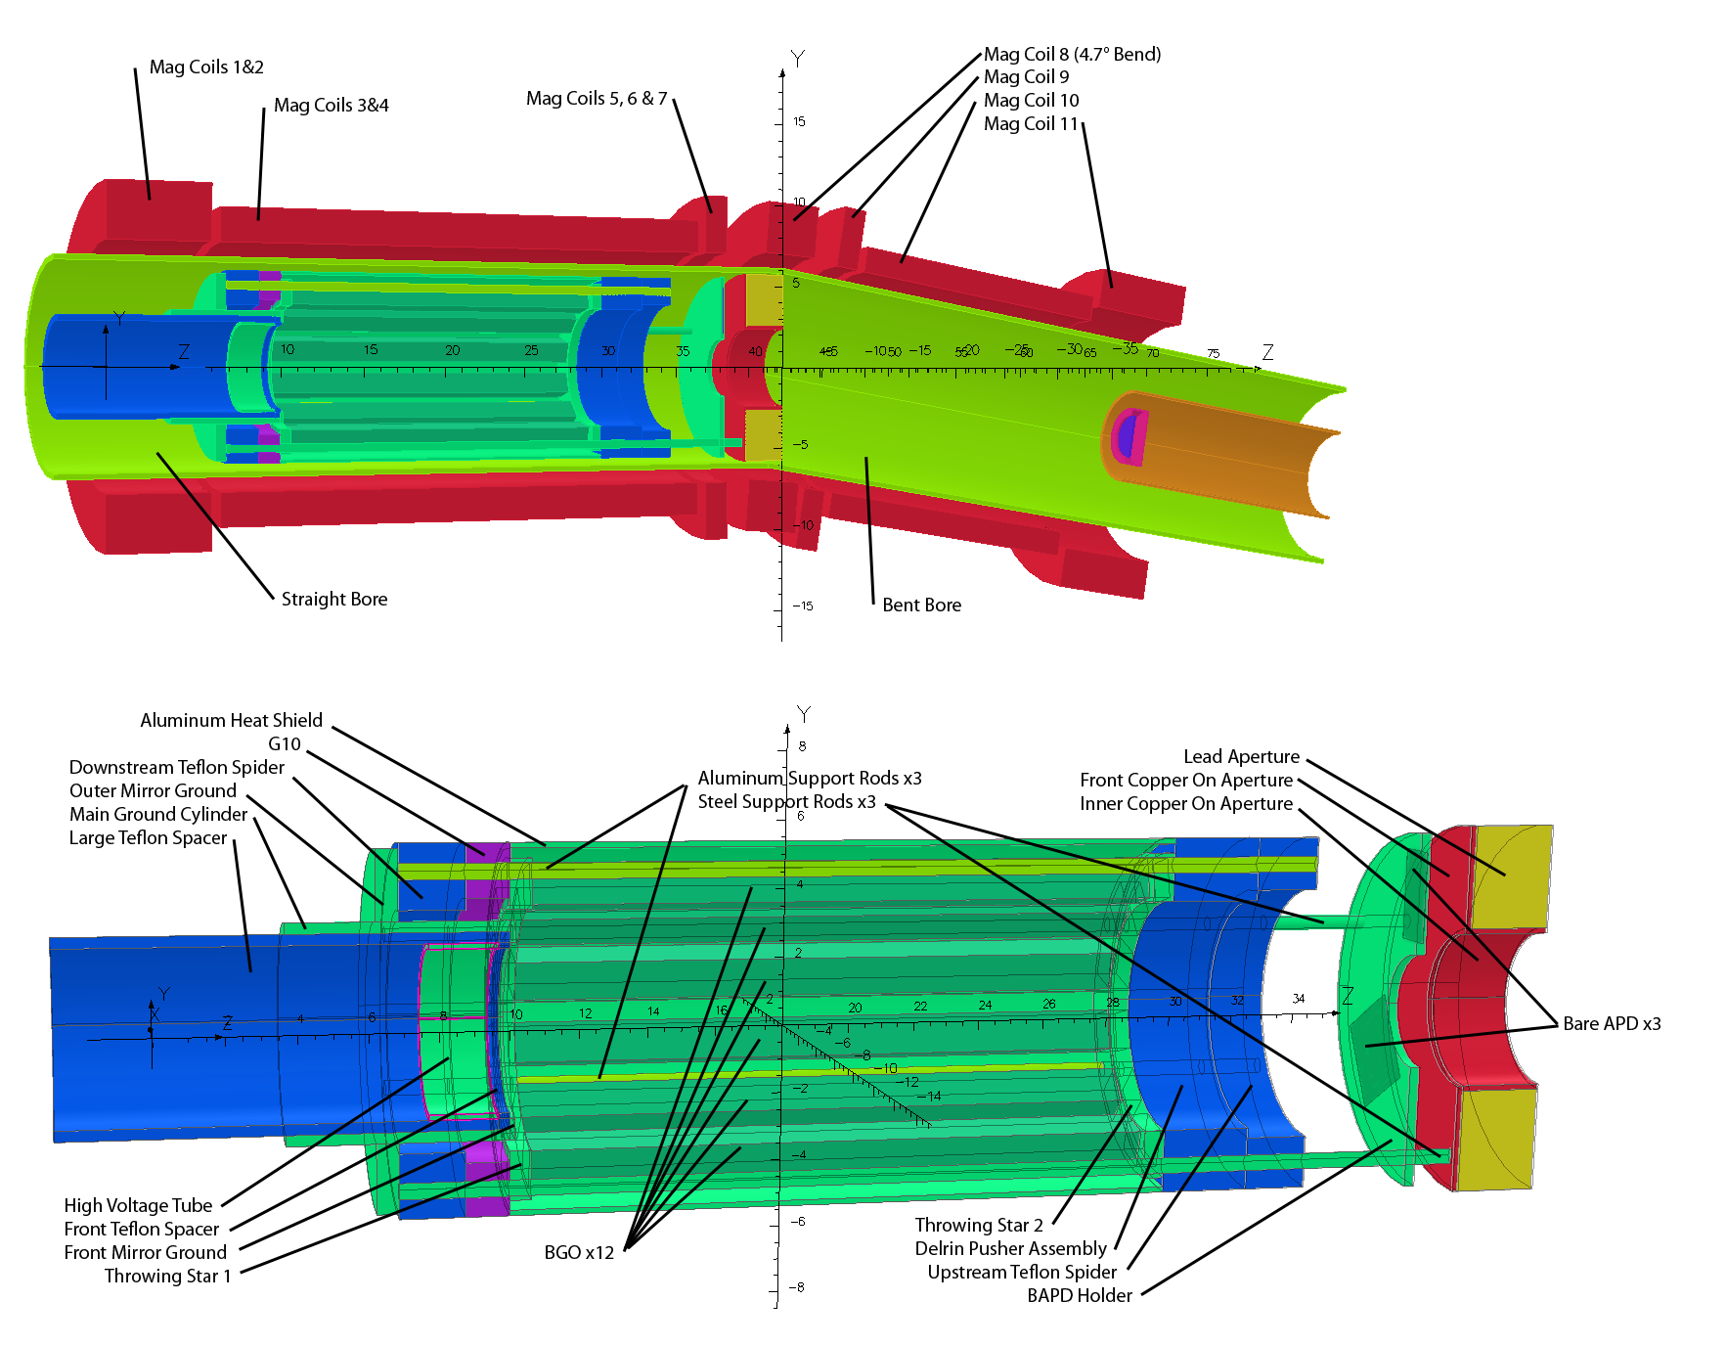
Simulation
Critical to extracting results:
Monte Carlo
  Geant4
  MCMP
EM Field
  Biot-Savart
  TOSCA

Slide 13
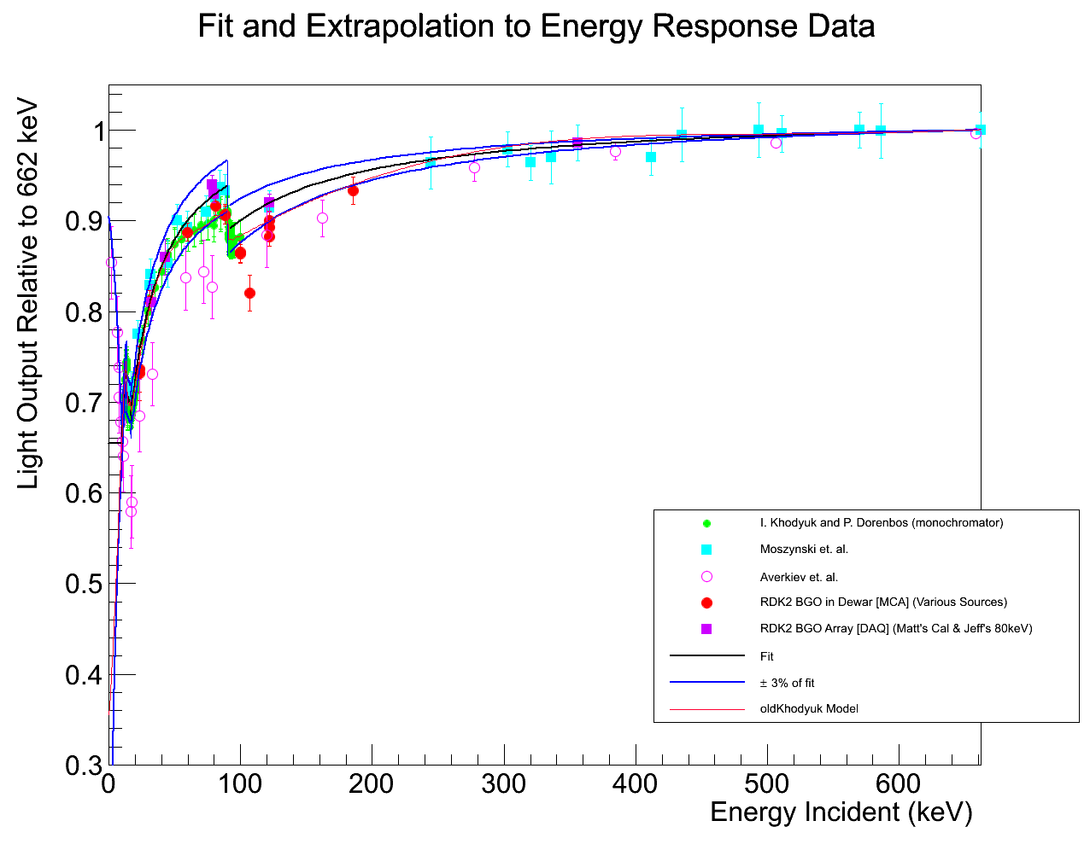
BGO Light Output

Slide 14
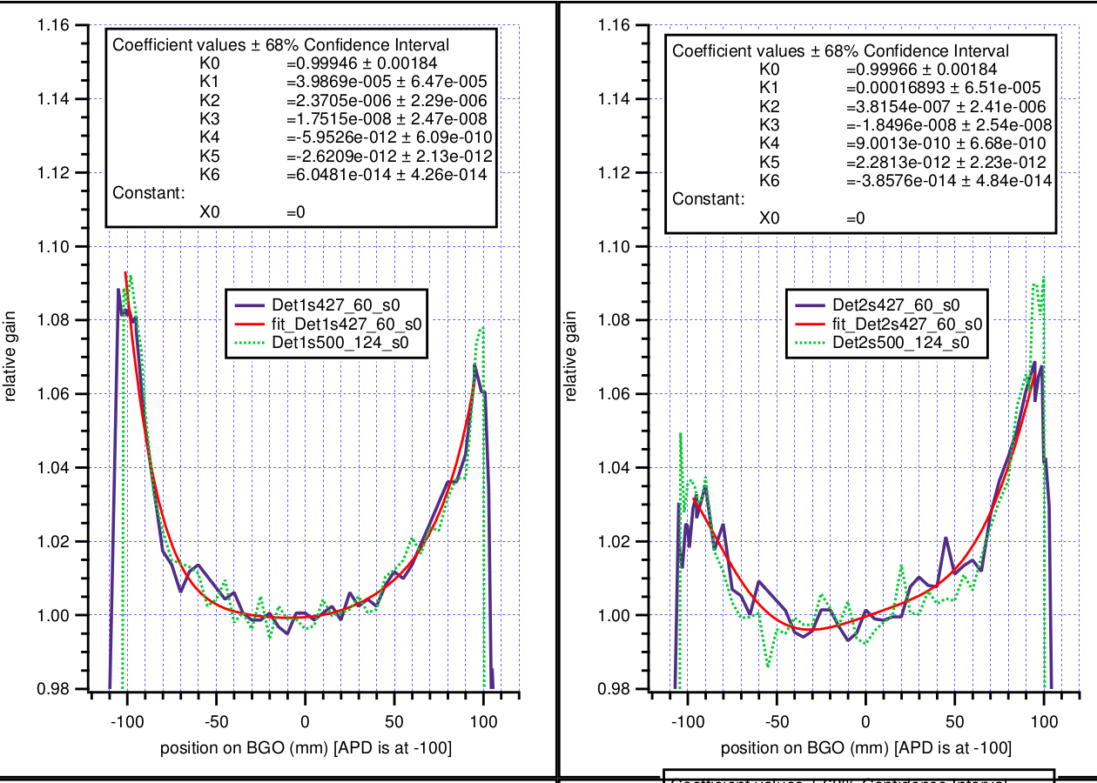
BGO Light Output

Slide 15
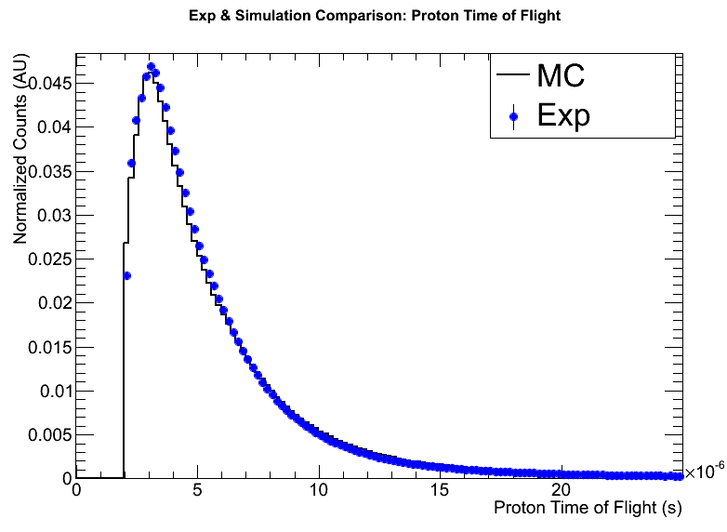
Electron-Proton ToF
Preliminary

Slide 16
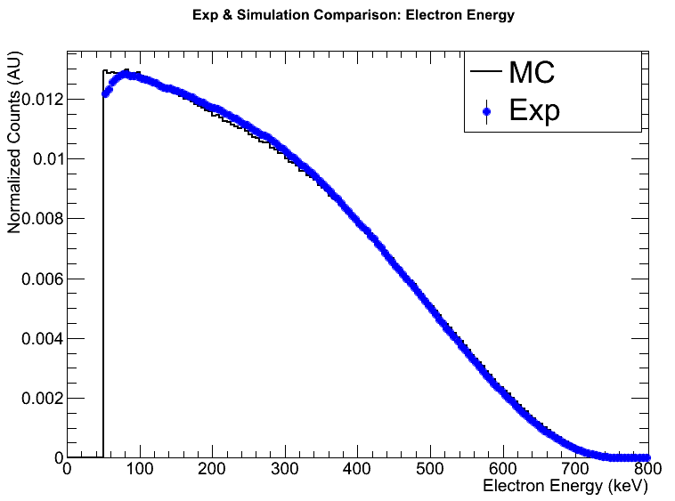
Electron Energy
Preliminary

Slide 17
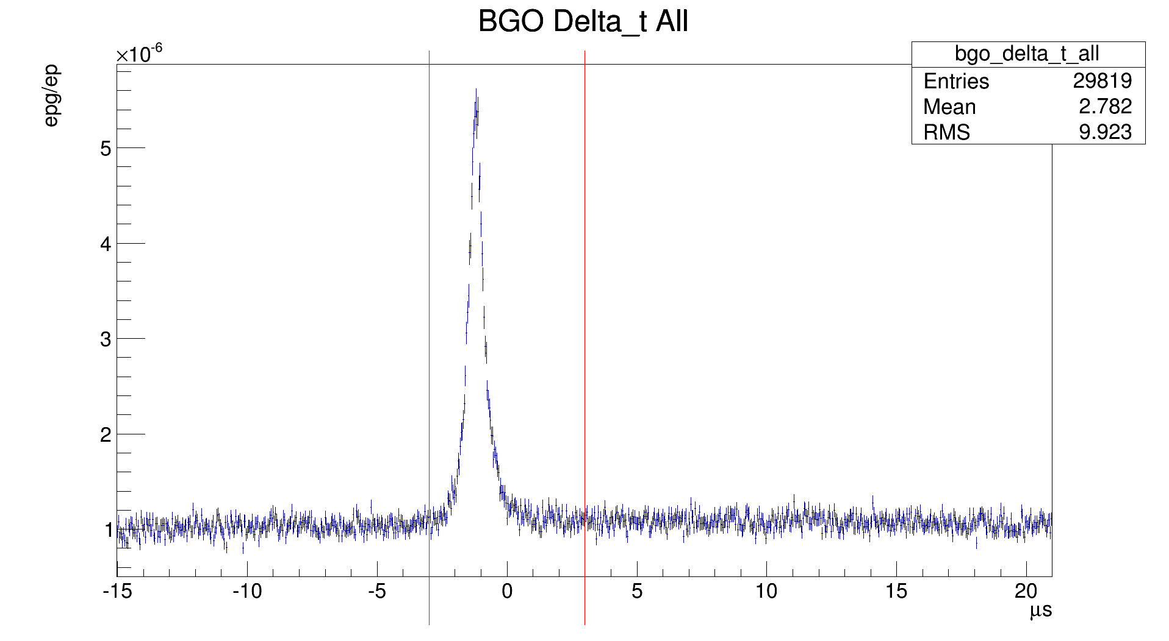
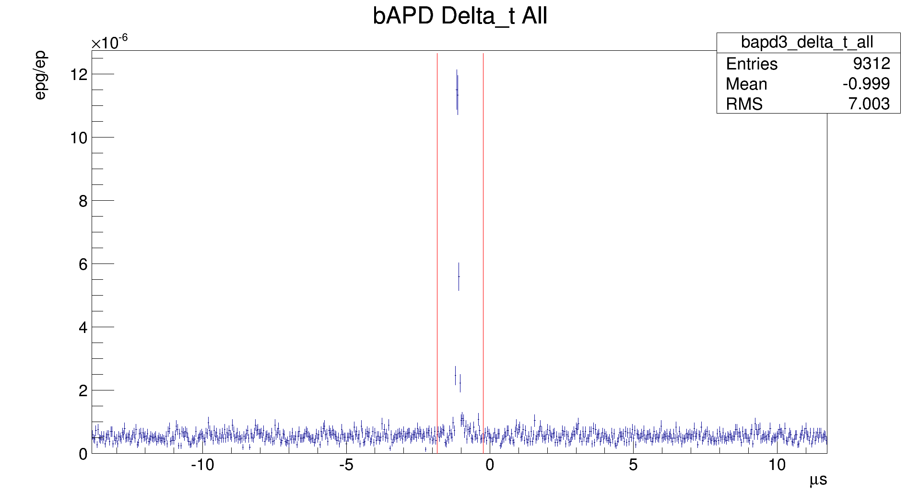
Photon Timing
Radiative decay peak
Preliminary
Yield
Arbitrary units
BGO-APD bAPD
Notes:
Proton momentum along B-field

Slide 18
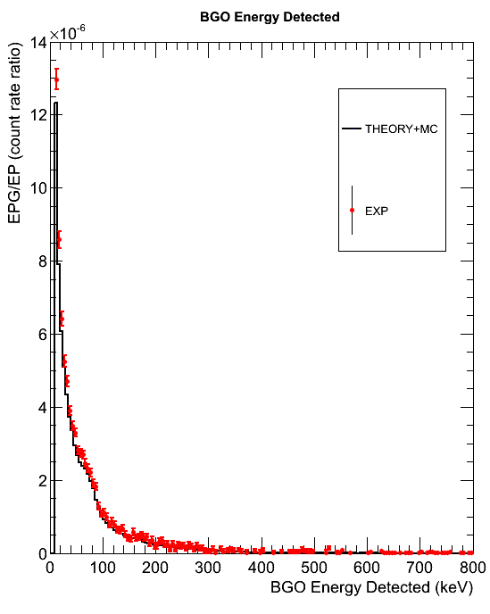
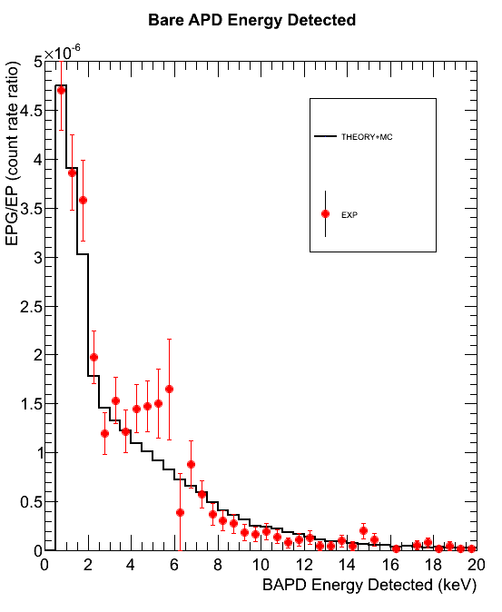
Photon Energy
Preliminary

Slide 19
Conclusion
Achieved high statistical precision on EPG/EP
  BGO: (8.826 ± 0.081) · 10⁻⁵
  BAPD: (3.07 ± 0.38) · 10⁻⁵
Expanded energy range below 1keV and up to the endpoint (approx 780keV)
Work continues on systematic errors
  Monte Carlo
Goal of ~1% total uncertainty on branching ratio and energy spectrum

Slide 21
Runtime Metrics
On beam from July 2008 to November 2009
Off beam calibrations from January 2010 to July 2010
 | All voltages | Full mirror
Run time | 164.4d | 97.8d
Live time | 147.1d | 87.5d
Total triggers | 9.7·10⁷ | 6.8·10⁷
Run data | 6.4TB | 4.4TB
Total data | 25TB

Slide 22
Improvements in RDK II
Twelve BGO+APD detectors
Three bare APD (bAPD) detectors
Neutron counter
In situ calibration runs
Improved statistics: O(0.1%) for BGOs
Greater energy range
  <10keV to the endpoint on BGO
  <1keV to ≈10keV for bAPD

Slide 23
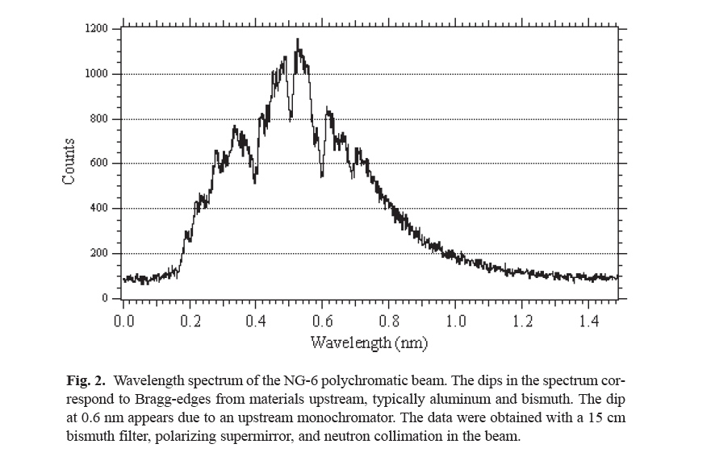
NIST Beam Line

Slide 24
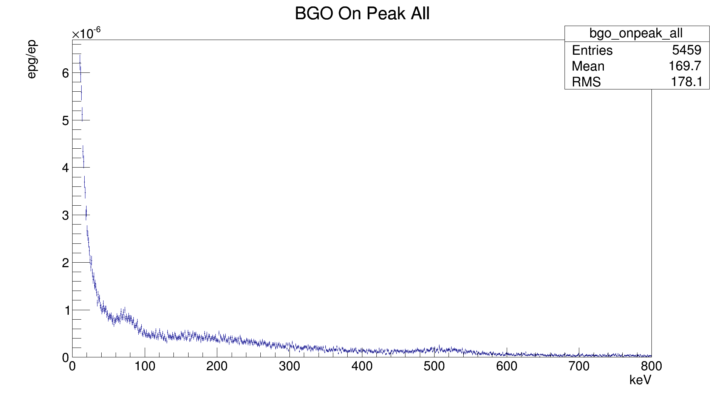
RDK II Results
Preliminary

Slide 25
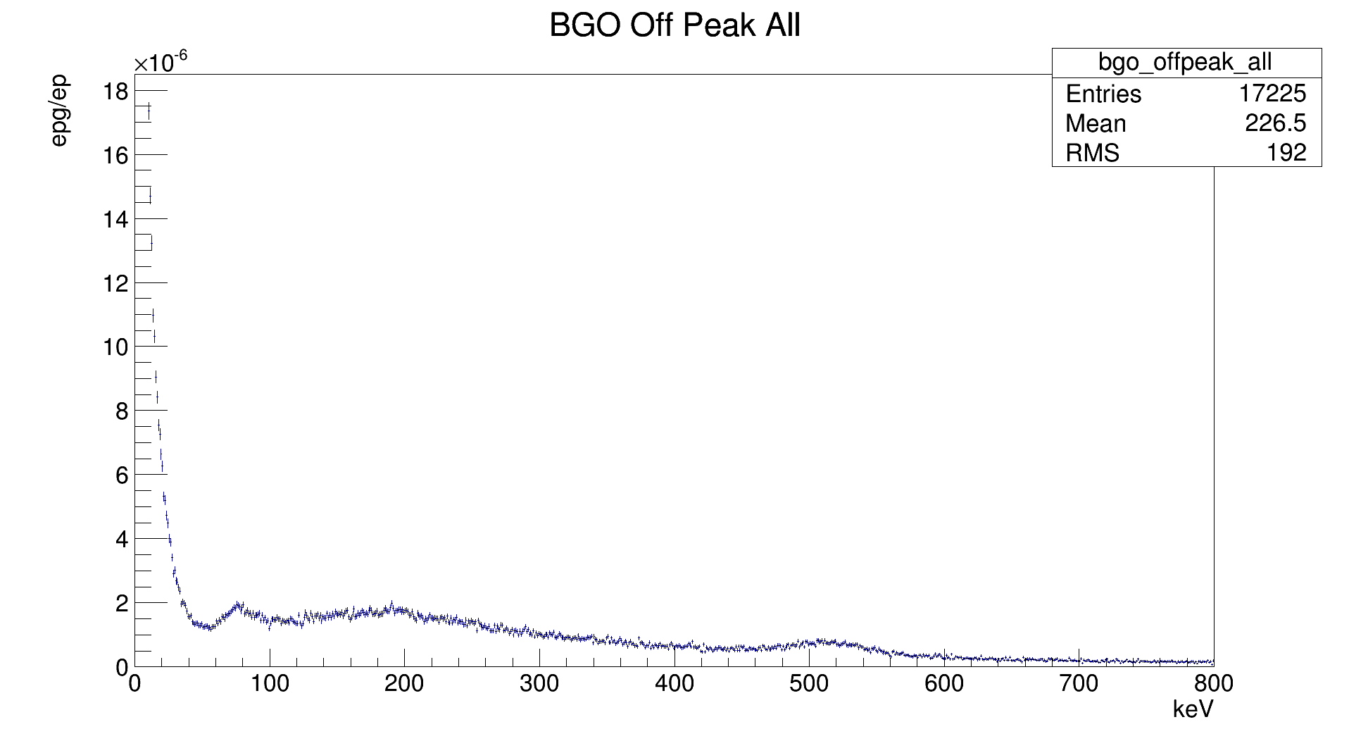
RDK II Results
Preliminary

Slide 26
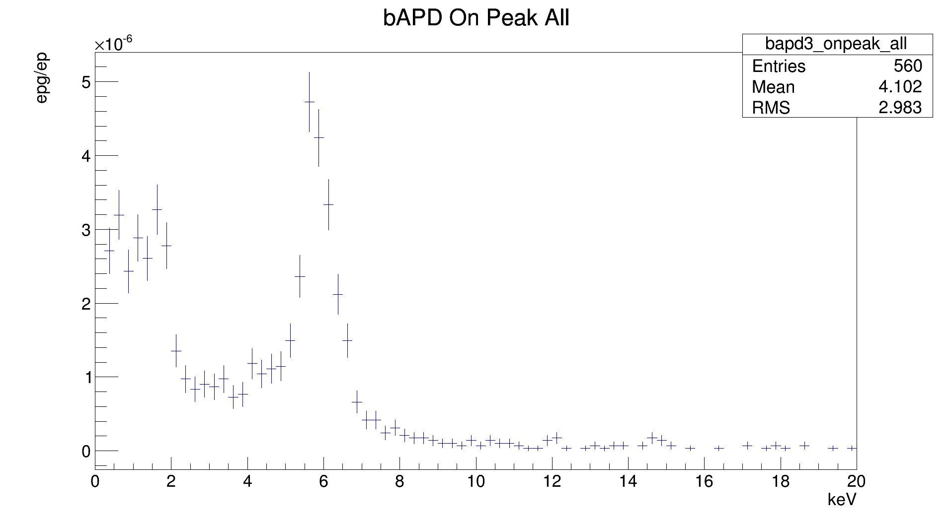
RDK II Results
Preliminary

Slide 27
RDK II Results
Preliminary

Slide 28
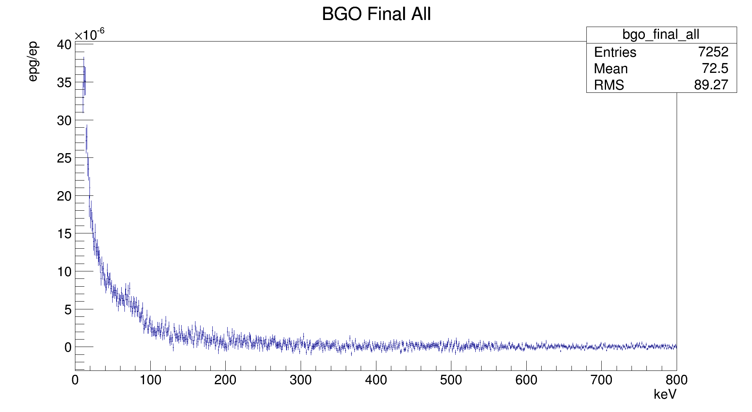
RDK II Results
Preliminary

Slide 29
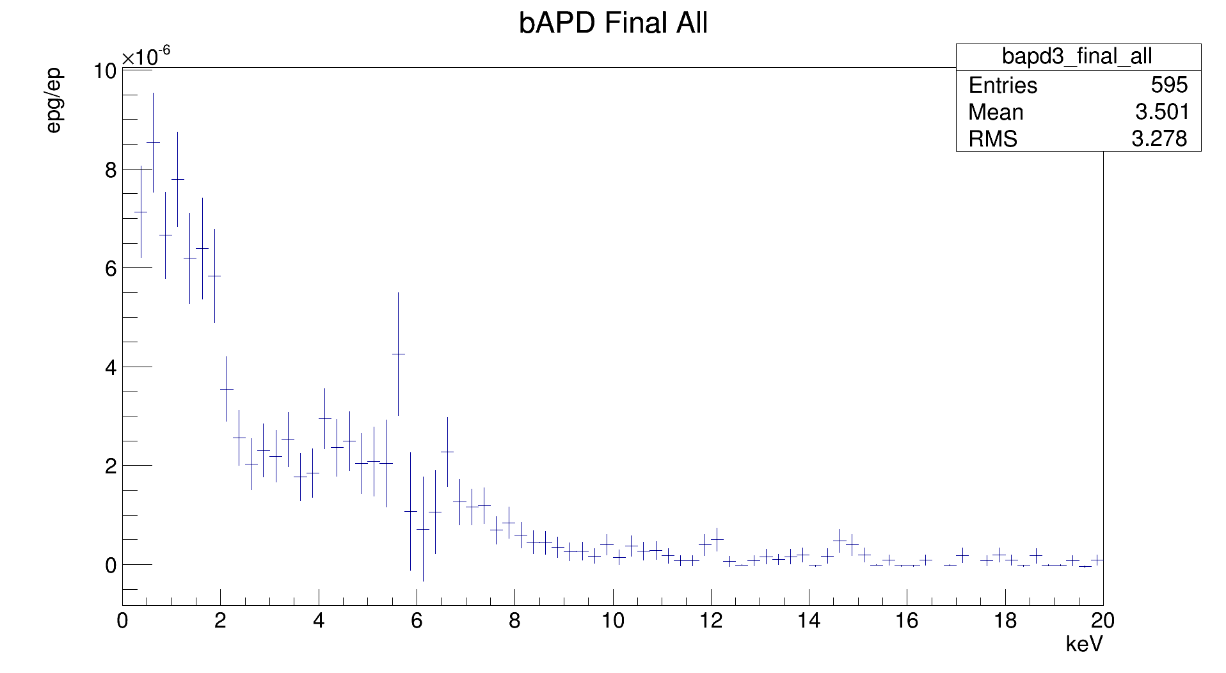
RDK II Results
Preliminary

Slide 30
Motivation
Measurement and year | Neutron lifetime (s) | Measurement type
Byrne 1996 | 889.2±3.0[syst.]±3.8[stat.] | Beam, Penning trap
Arzumanov 2000 | 885.4±0.9[syst.]±0.4[stat.] | Bottle, UCN gravitational trap
Nico 2005 | 886.3±1.2[syst.]±3.2[stat.] | Beam, Penning trap
PDG World Average | 885.7±0.8
Seberov 2005 | 878.5±0.7[syst.]±0.3[stat.] | Bottle, UCN gravitational trap
Radiative corrections
Electron energy spectrum
Angular correlation
Correlated background

Slide 31
Previous Measurements: ILL
Beck et al., Institut Laue-Langevin (ILL) 2002
Electron-delayed proton-photon triple coincidence measurement
Electron detector: plastic scintillator
Proton detector: microchannel plate (MCP)
Photon detector: Six CsI(T1) scintillators
Result: BR for 35-100keV less than 6.9∙10⁻³
Predicted: 1.1∙10⁻³

Slide 32
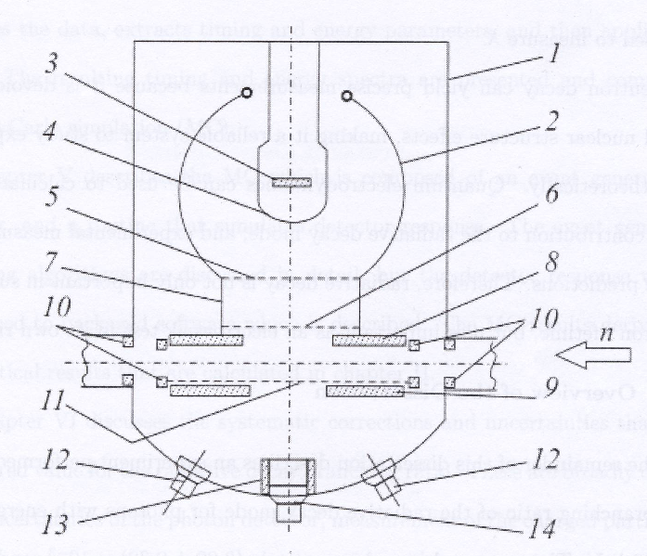
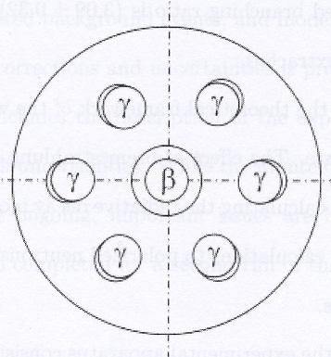
Previous Measurements: ILL
Beck et al., Institut Laue-Langevin (ILL) 2002
Branching ratio for 35-100keV less than 6.9∙10⁻³

Slide 33
Previous Measurements: RDK I
Nico et al., National Institute of Standards and Technology (NIST) 2005
Triple coincidence measurement
Electron-proton detector: surface barrier detector (SBD)
Photon detector: bismuth germanate (BGO) scintillator + avalanche photo-diode (APD)
Result: BR for 15-340keV = 3.09±0.32·10⁻³
Predicted: 2.85·10⁻³

Slide 34
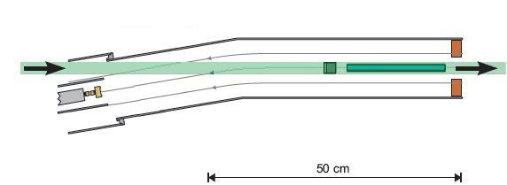
Previous Measurements: RDK I
B-field line
BGO+APD (below beam)
Cold neutron beam
(<20meV peaked at 2-5meV)
Shield
Electrostatic mirror
1400V (varies)
SBD
-25kV
Nico et al., National Institute of Standards and Technology (NIST) 2005
Branching ratio for 15-340keV = 3.09±0.32·10⁻³

Slide 35
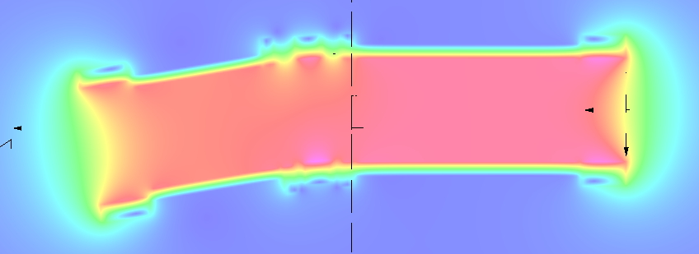
Previous Measurements: RDK I
4.6T superconducting magnet
9.5º bend

Slide 36
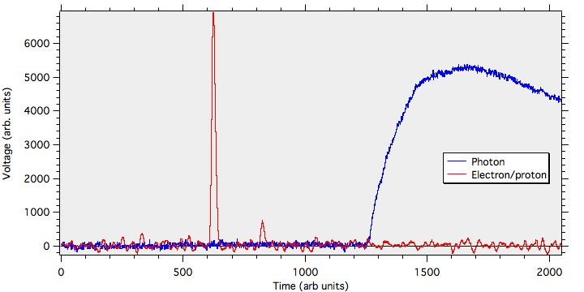
Primary Detector

Slide 37
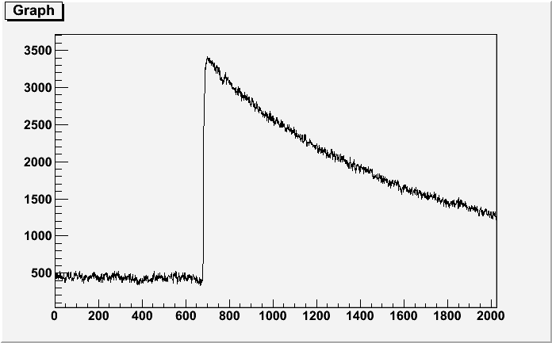
Direct Detector

Slide 38
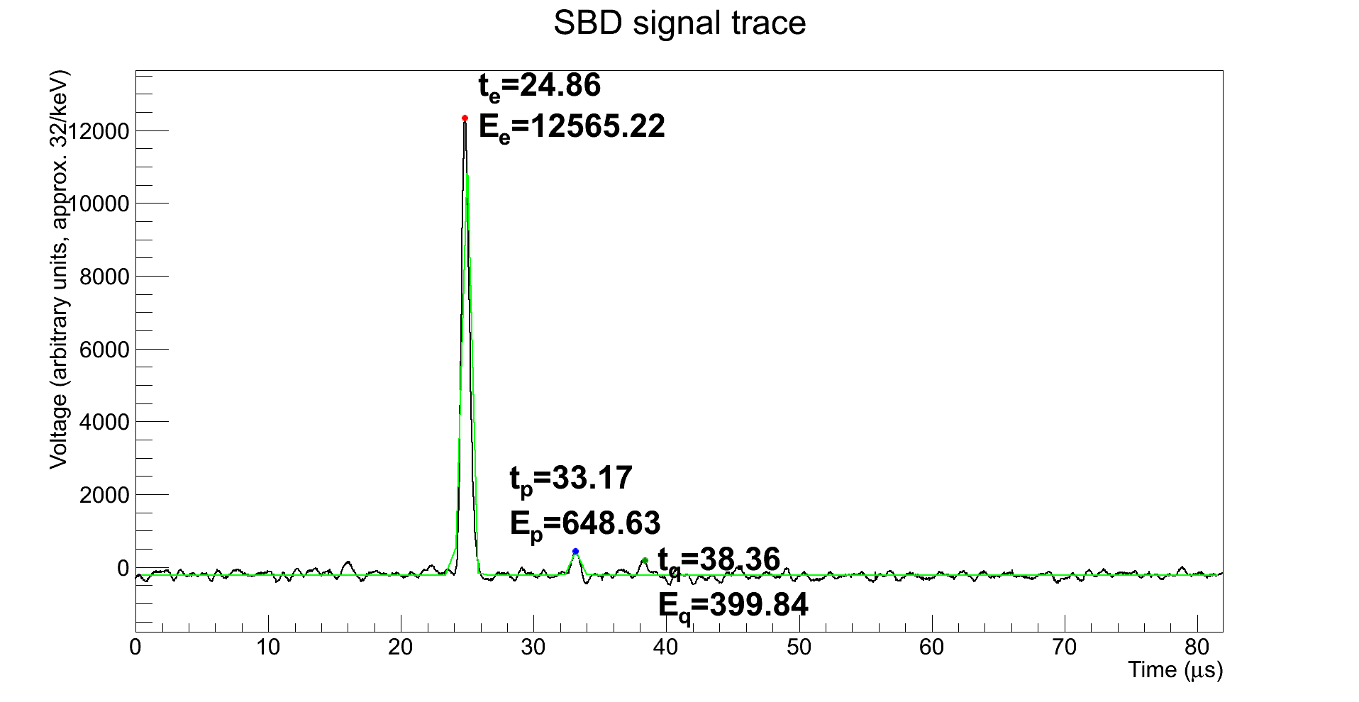
Electron-Proton Detector

Slide 39
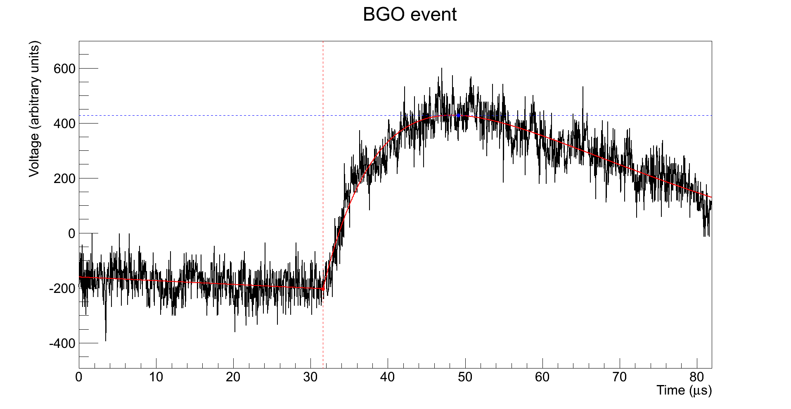
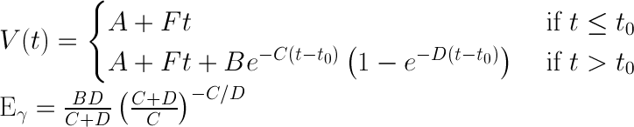
BGO – Full Signal Fit
Eγ = 654.6
≈ 20 keV
t0 = 31.61 μs

