Slide 1
RDK II Workstation

Slide 2
CPU
Intel Xeon E5-2600 vs AMD Opteron 6200
¹ http://www.tomshardware.com/reviews/xeon-e5-2687w-benchmark-review,3149-5.html
² http://cpubenchmark.net/high_end_cpus.html

Slide 3
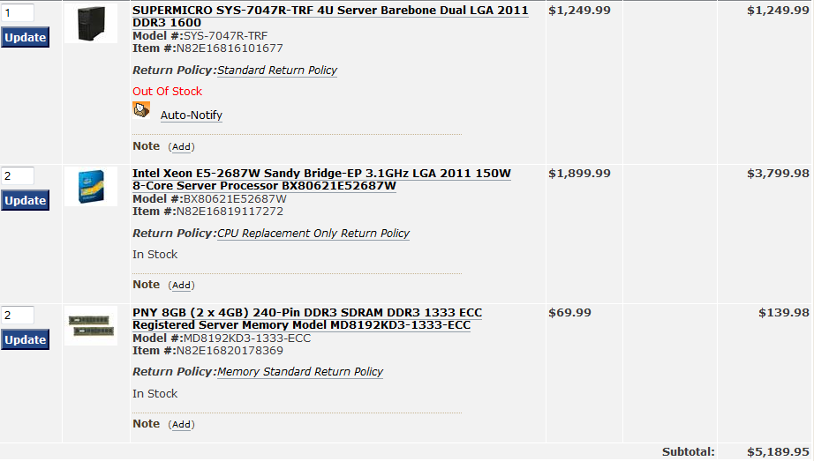
DIY – Option 1
Approx 640 GFLOPS

Slide 4
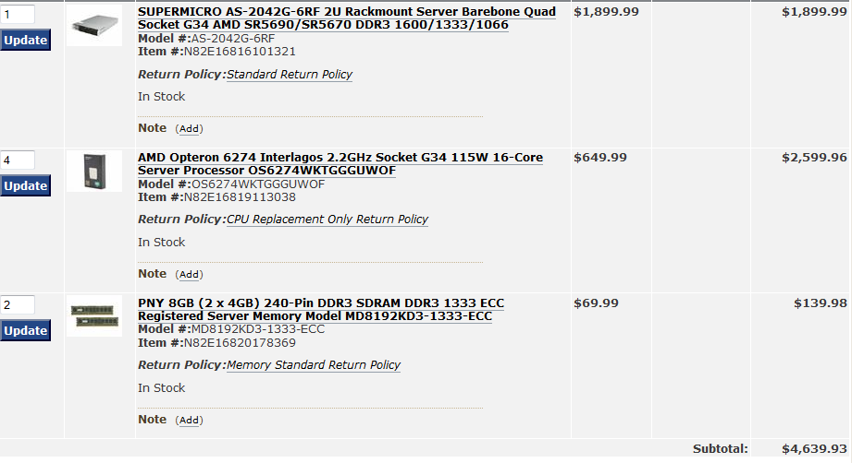
DIY – Option 2
No RAID 5
Approx 400 GFLOPS

Slide 5
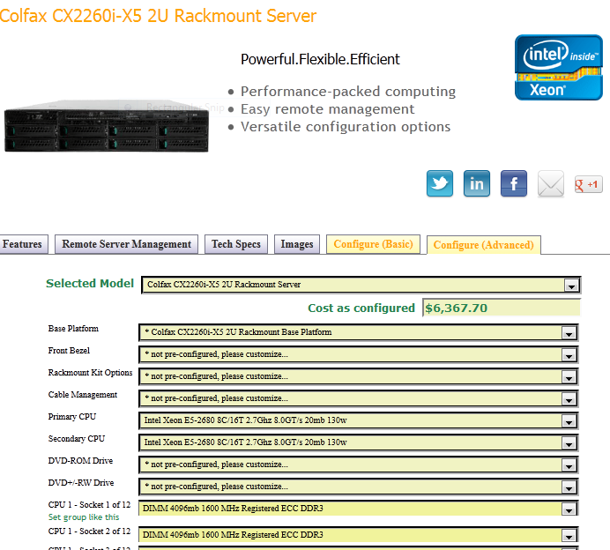
Premade – Option 1

Slide 6
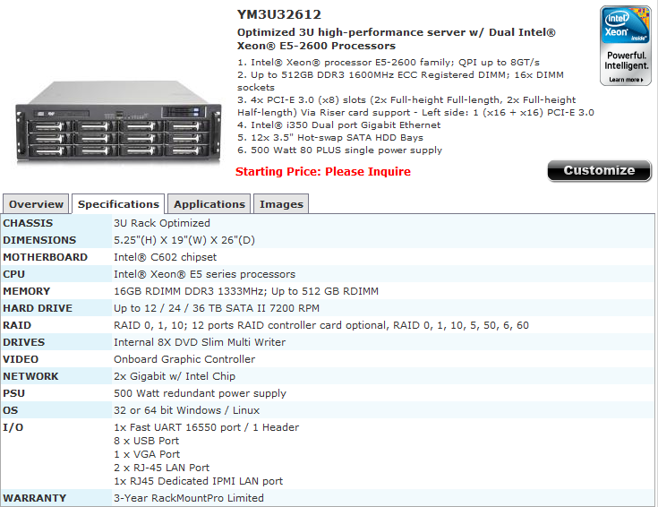
Premade – Option 2

Slide 7
Storage
OS/analysis: 500GB-1TB
Raw data: four or five 3TB HDD
  JBOD
    No redundancy/performance boost
  Raid 0
    N times speed, one disk failure can loose data on all
  Raid 1
    Mirrored drives, half capacity
  Raid 5
    N times speed, single disk redundancy, N-1 capacity

Slide 8
Operating System
Linux
  Red Hat based distribution
  Scientific Linux 5/6?
Virtual machine
  Vmware – Slightly better performance, $200
  VirtualBox – Free
  Windows?
  MacOS?

Slide 9
Software
Root
Geant4
Opera/TOSCA
Igor

