Slide 1
Analysis of RDK II Data
Collaboration Meeting
March 14, 2012

Slide 2
Outline
Signal analysis
Event selection
Background subtraction
Results

Slide 3
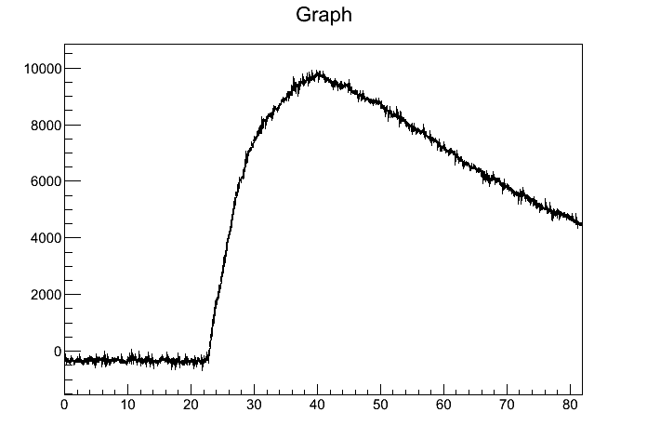
Signal Analysis – Criteria
The peak
  rises at least 300 units above the minimum
  is after the minimum
  is at least 5.12μs before end of trace
  is at least 6.4μs (bAPD) or 7.68μs (BGO) after beginning of trace
  is less than 300 units away from the average of neighboring points (same for minimum)
Minimum chi²/dof of linear regression over signal at least 4900
Voltage (arbitrary units)
μs

Slide 4
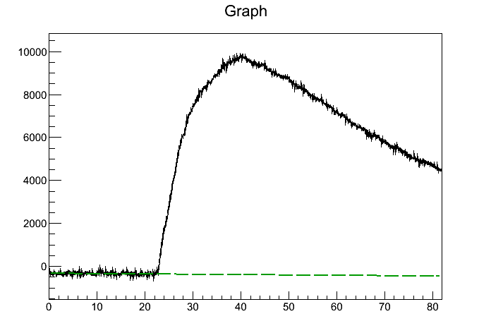
Signal Analysis – Baseline
Linear regression on the range 0≤t≤i for all i
Calculate Ax+B and chi² for each fit
Save the results for later
Voltage (arbitrary units)
μs

Slide 5
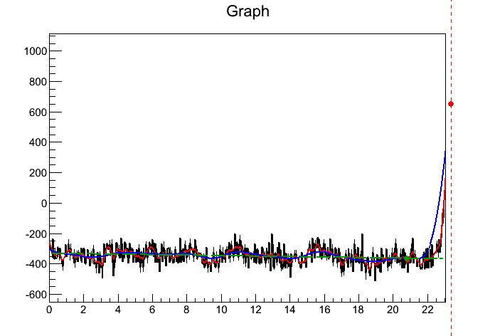
Signal Analysis - Smoothing
Weighted sum derived from local polynomial regression method
  Narrow width for timing
  Wide width for “energy”
Voltage (arbitrary units)
μs

Slide 6
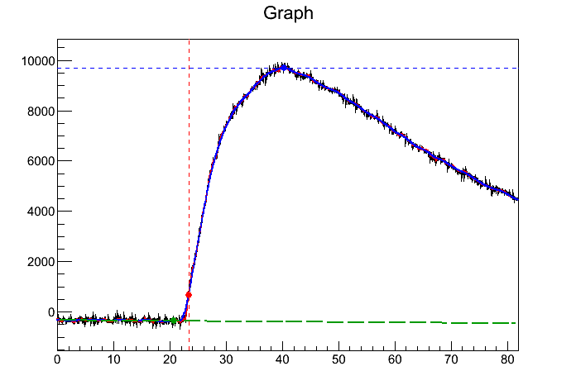
Signal Analysis – Parameters
Determine tγ and Eγ
  Floating baseline
  Max above baseline
  Rise 10% of peak above baseline
Voltage (arbitrary units)
μs

Slide 7
Signal Analysis – Parameters
Start at peak
Use stored fits
Trace back until chi²/dof<7000
Trace back until smoothed < 10% of peak
Voltage (arbitrary units)
μs

Slide 8
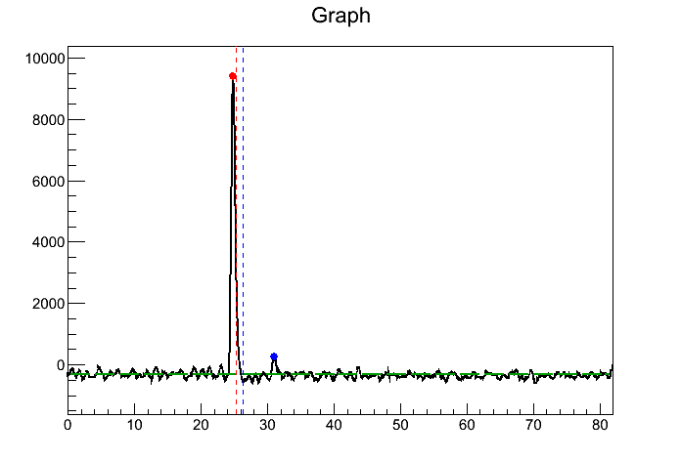
Signal Analysis - SBD
Electron time and “energy” from peak channel
Proton time and “energy” from next highest peak after electron peak reaches a dip
Subtract average baseline from energies
Voltage (arbitrary units)
μs

Slide 9
Event Selection
Only one explicit criteria for ep events
  tp-te<26μs
Criteria to look into
  End of electron signal, tdip
  50% fall time, thalf

Slide 10
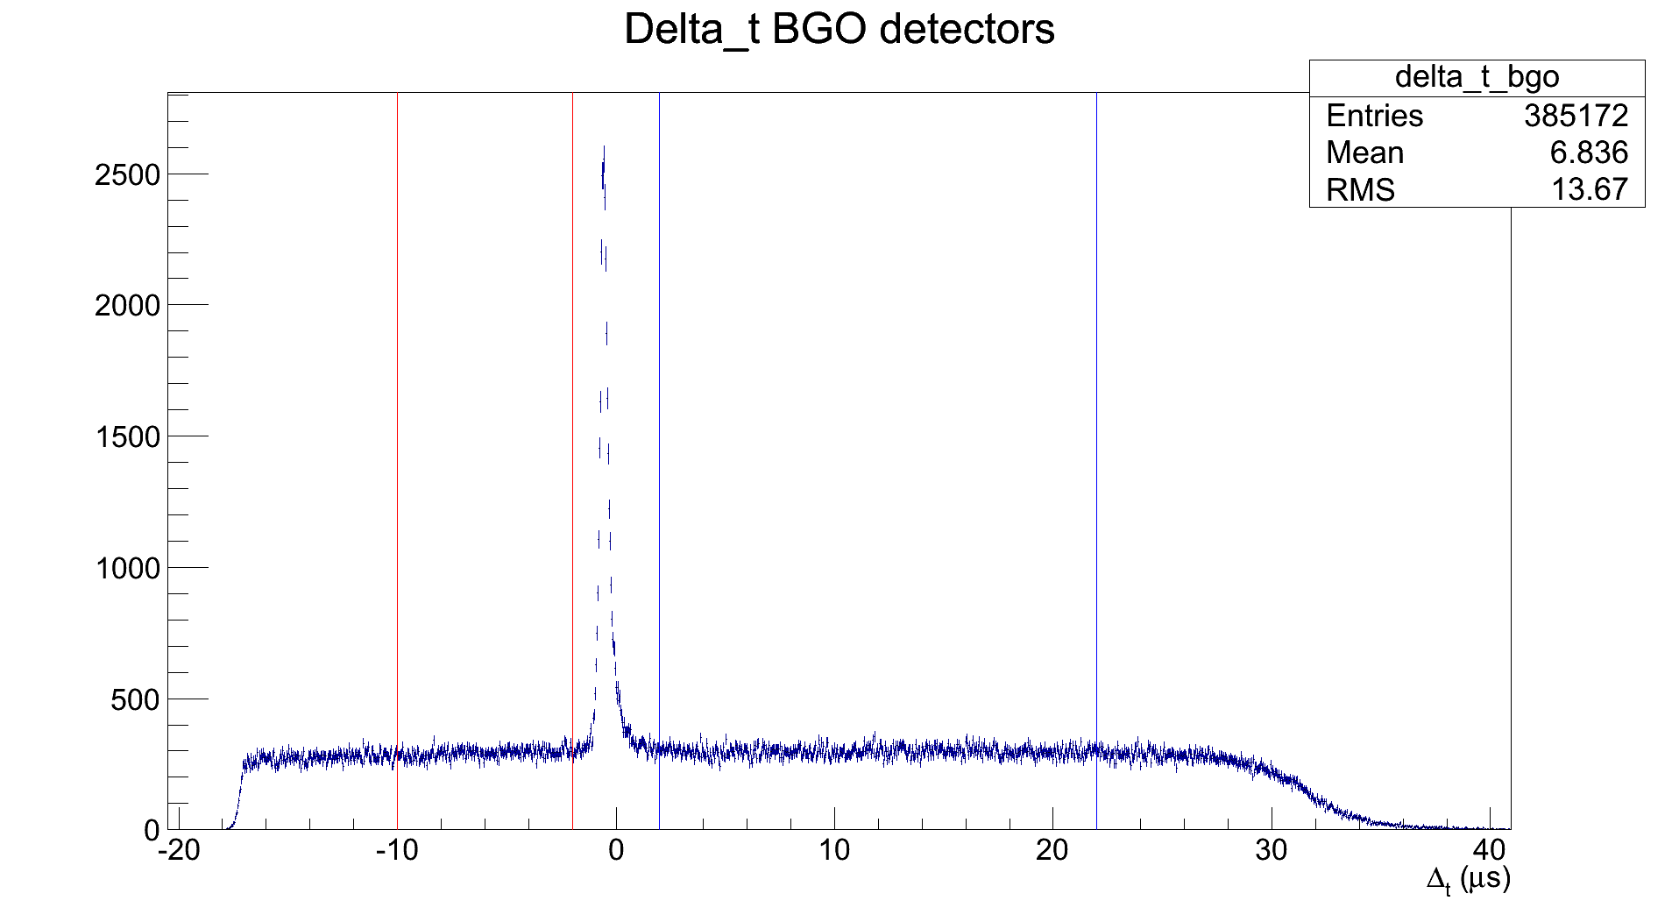
Background Subtraction - BGO

Slide 11
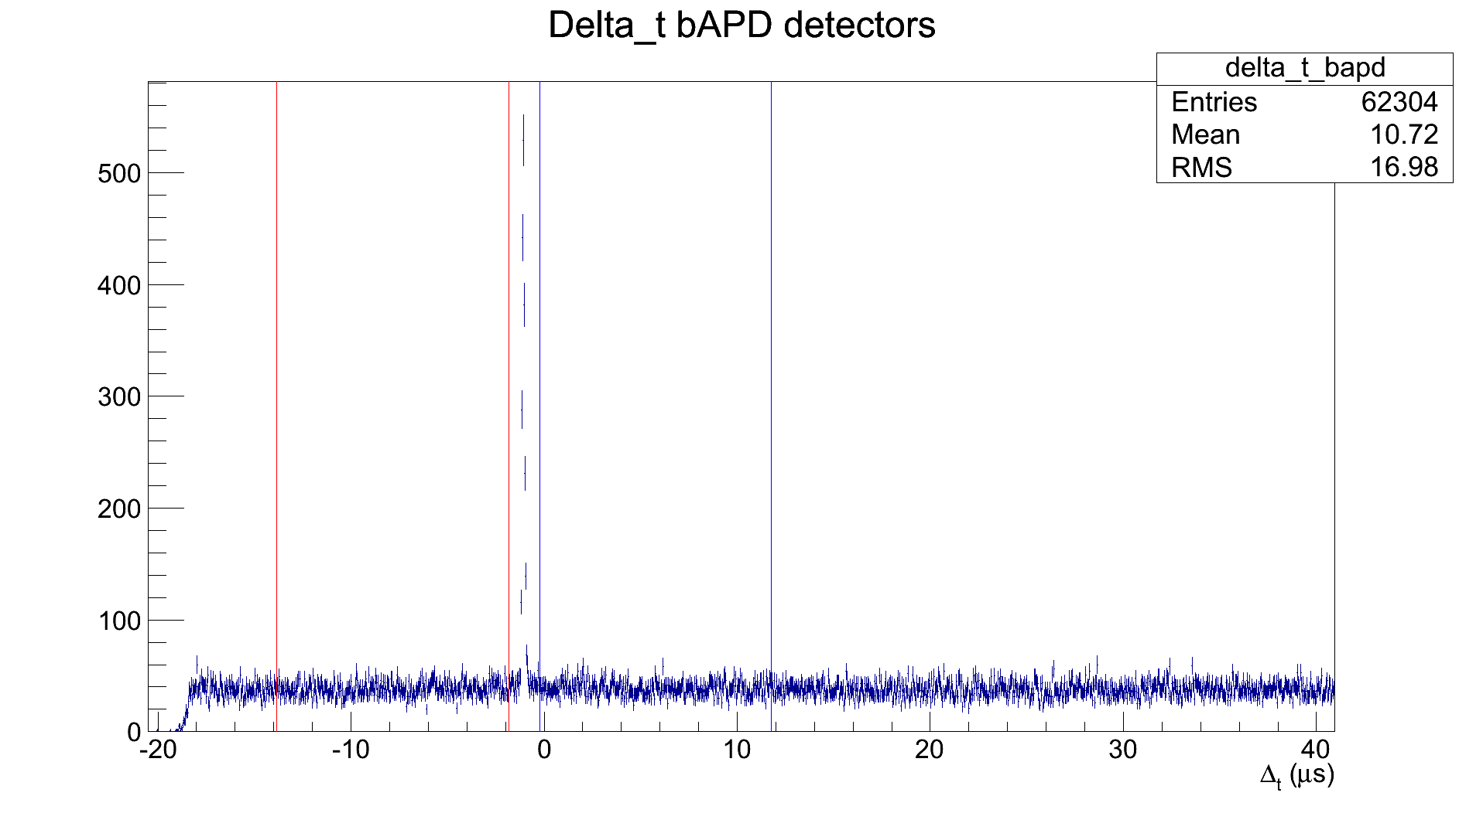
Background Subtraction - bAPD

Slide 12
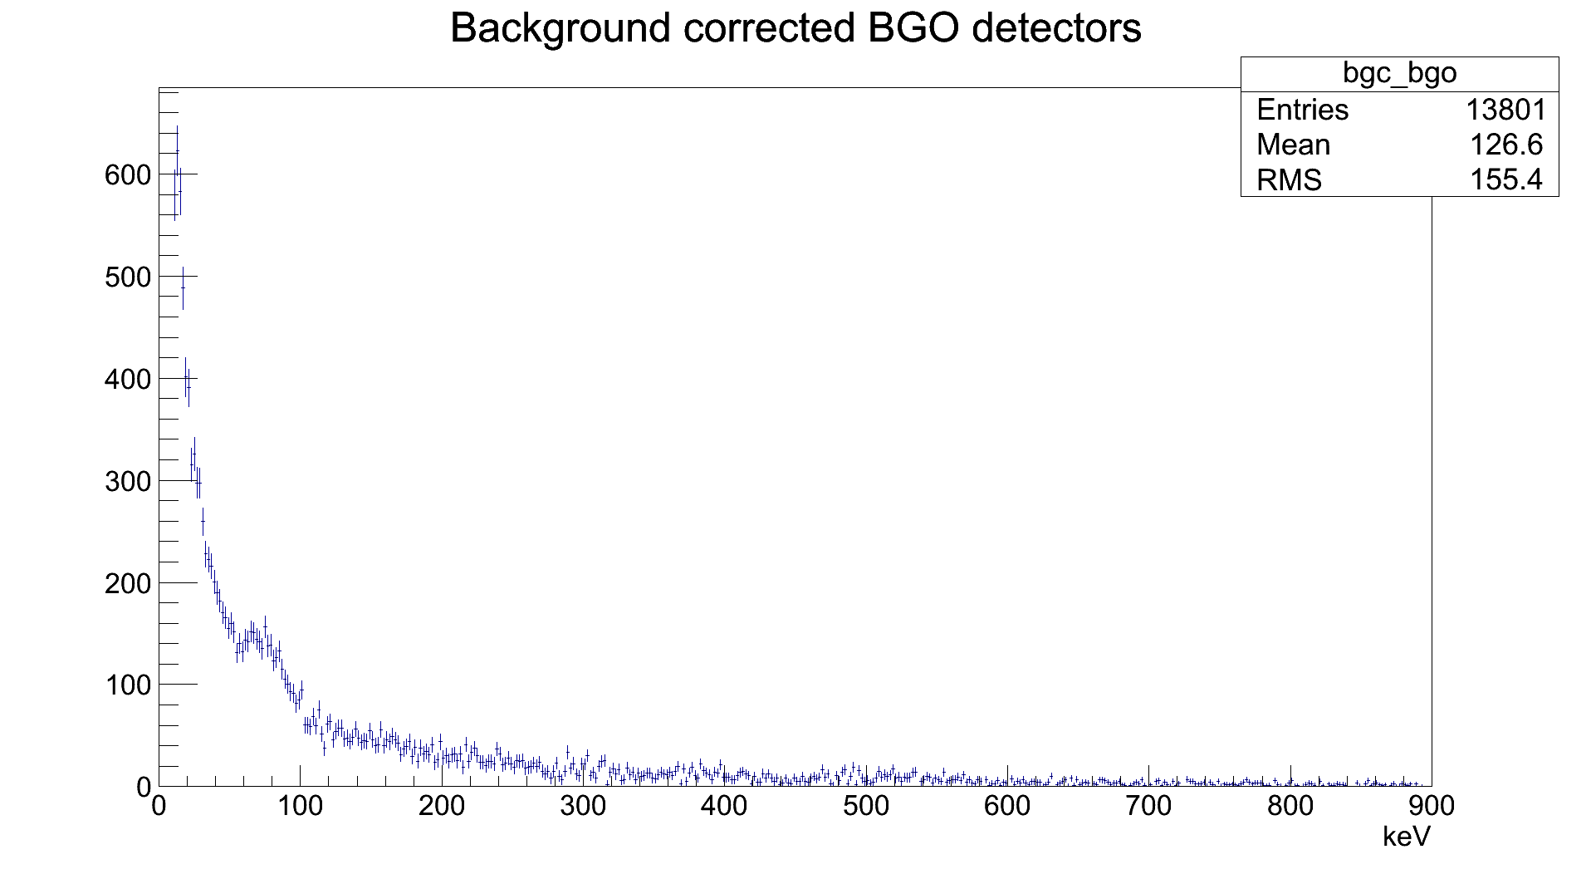
Results - BGO
Normalized by bin size (2keV)

Slide 13
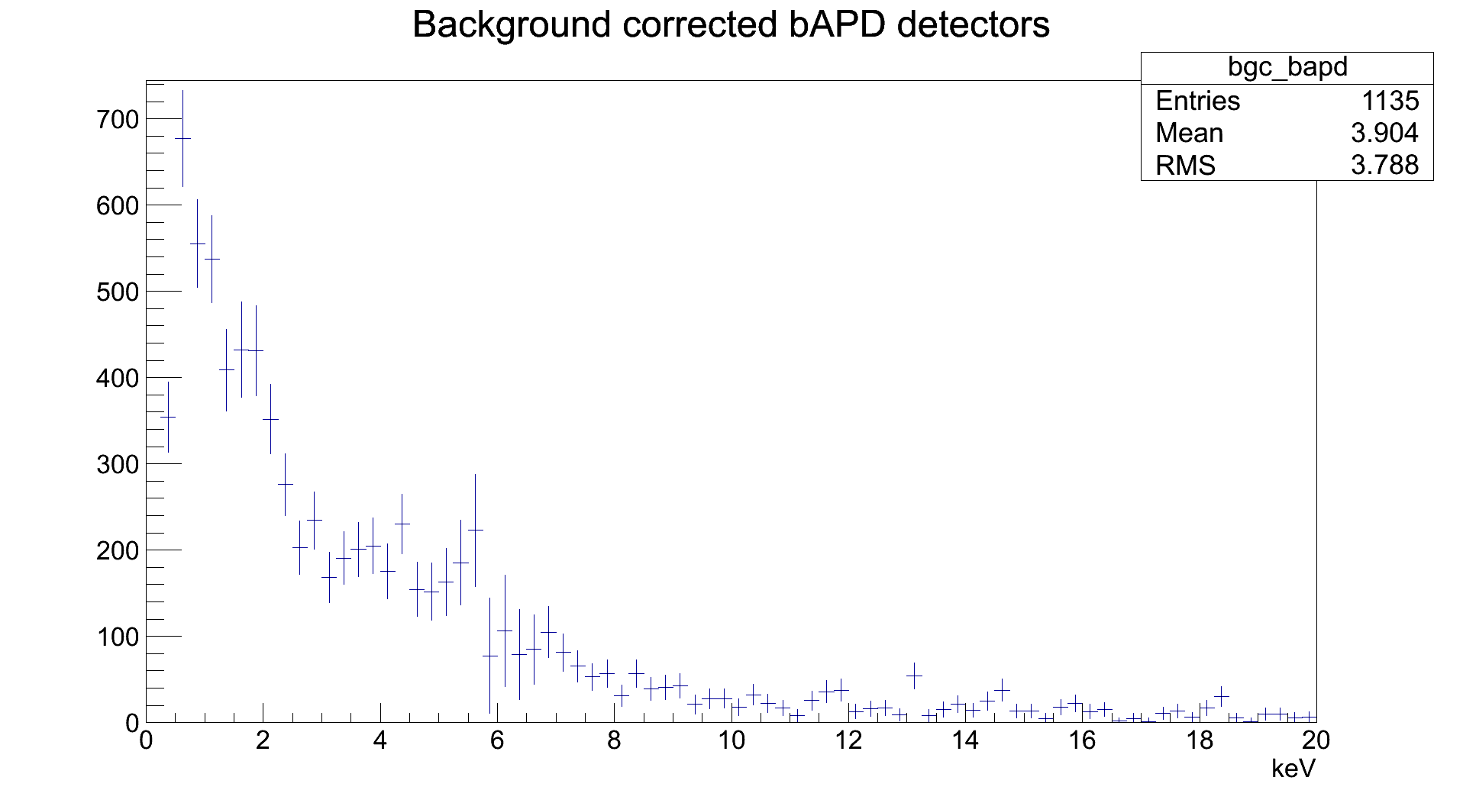
Results - bAPD
Normalized by bin size (0.25keV)

Slide 14
Results
Ratio epg/ep
  BGO
(1.129±0.010) · 10⁻⁴
  bAPD
(8.811±0.257) · 10⁻⁵

