Slide 1
Systematic Uncertainties in RDK II
Collaboration Meeting
March 14, 2012

Slide 2
Outline
Physical
  APD
  BGO
  Mirror
Electronic
  SBD
  APD
  Data collection
Software
  Calibration Fits
  Analysis

Slide 3
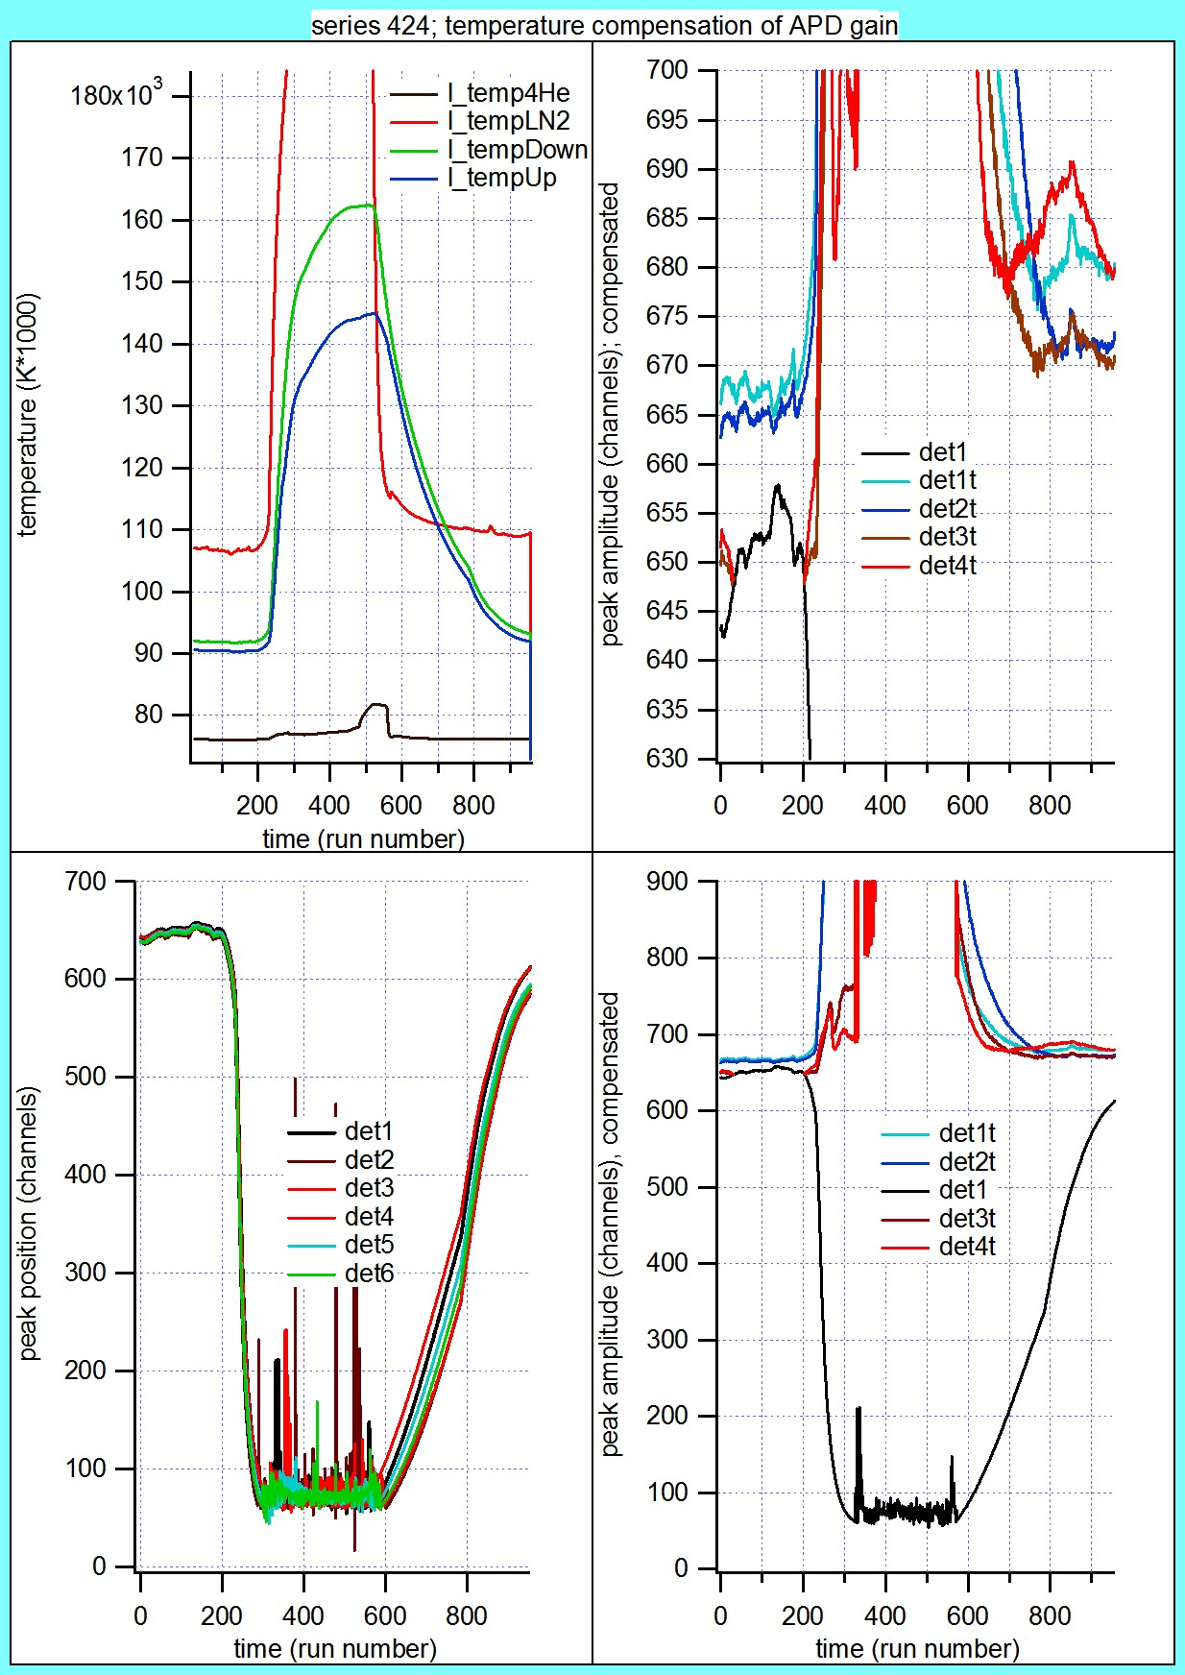
APD
Temperature dependent gain
Lag in temperature sensors
Approx. 6% per K
Solved by Herbert Breuer

Slide 4
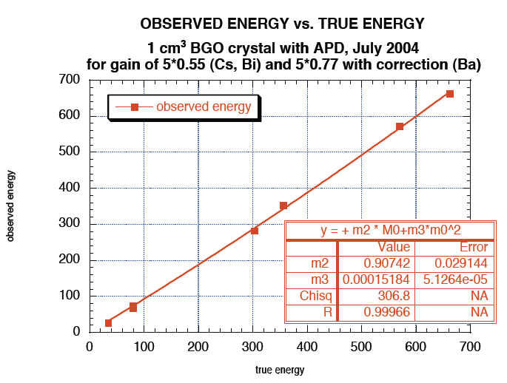
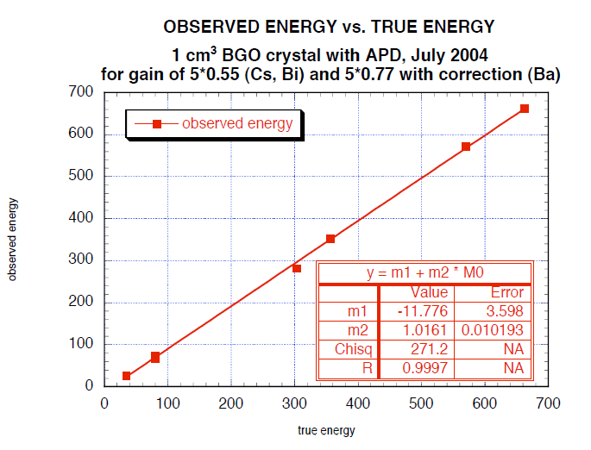
BGO
Two models of non-linearity
Linear with offset
Quadratic w/o offset
Average 1.4% diff above 100keV

Slide 5
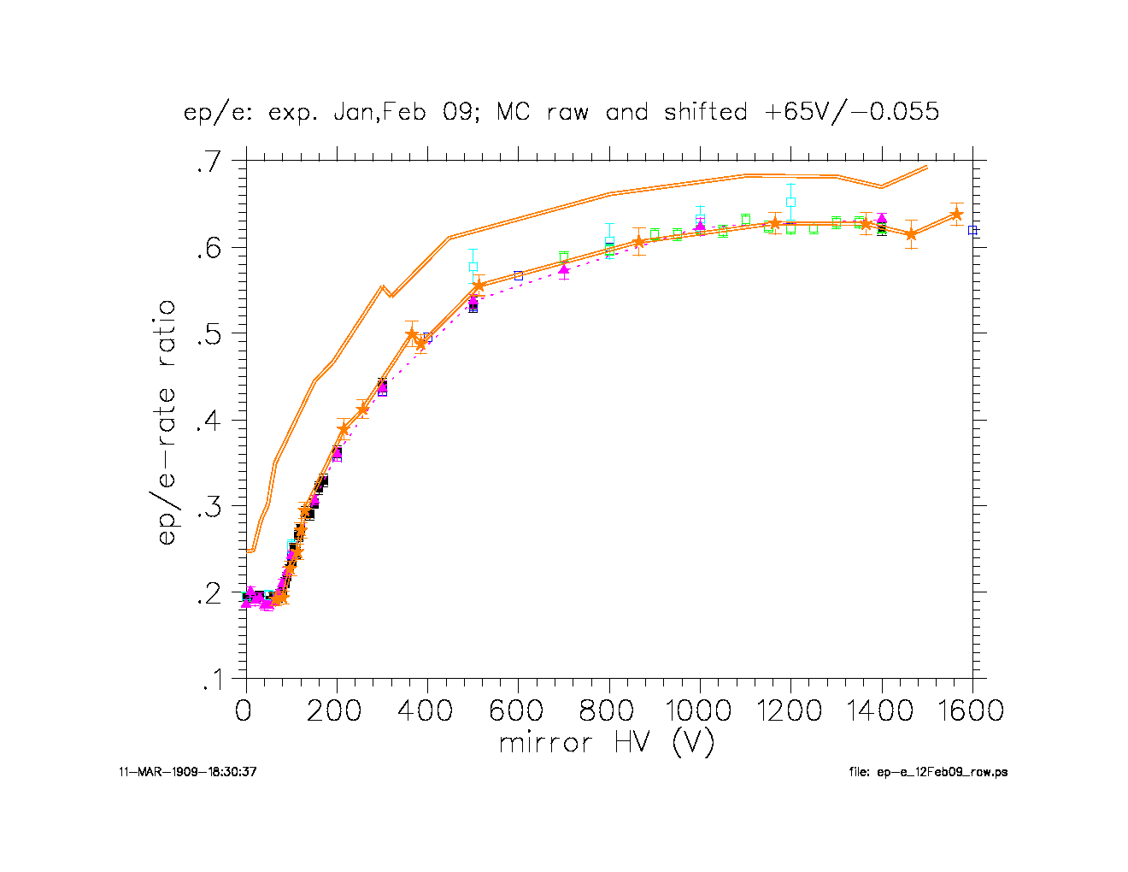
Electrostatic Mirror
Low voltage anomaly
Charged insulator near mirror
No effect at full mirror
Disregard low mirror voltage runs

Slide 6
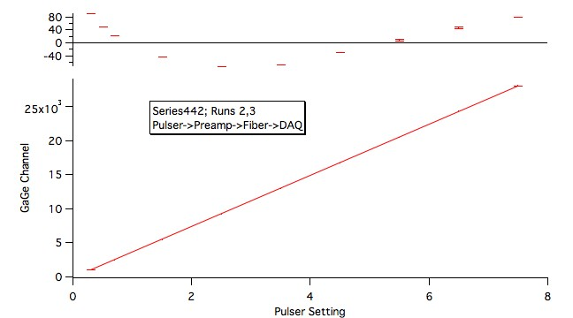
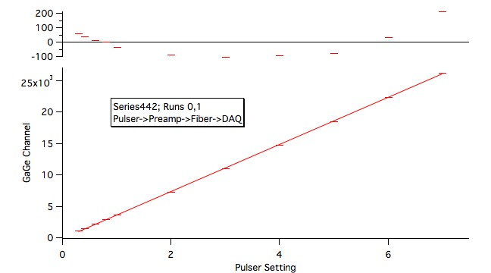
SBD Electronics
Non-linearity
Pulser test by Jeff and Herbert
Approx 0.5% residuals
Effect on little b
No effect on BR?

Slide 7
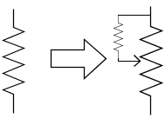
APD Electronics
Voltage offset
  Calibration trigger
  Peak height
Modified to minimize voltage offset
How stable?

Slide 8
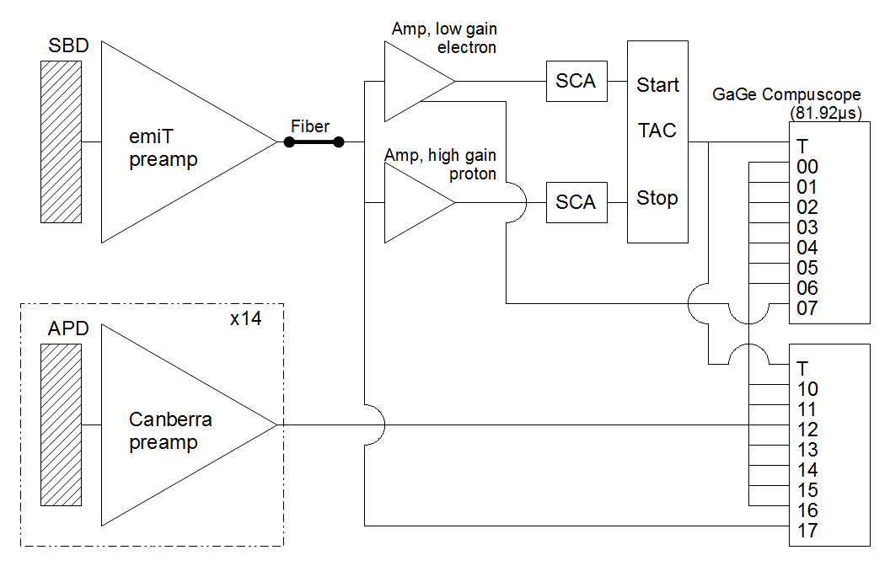
Data Collection
Synchronization issues
Dead time

Slide 9
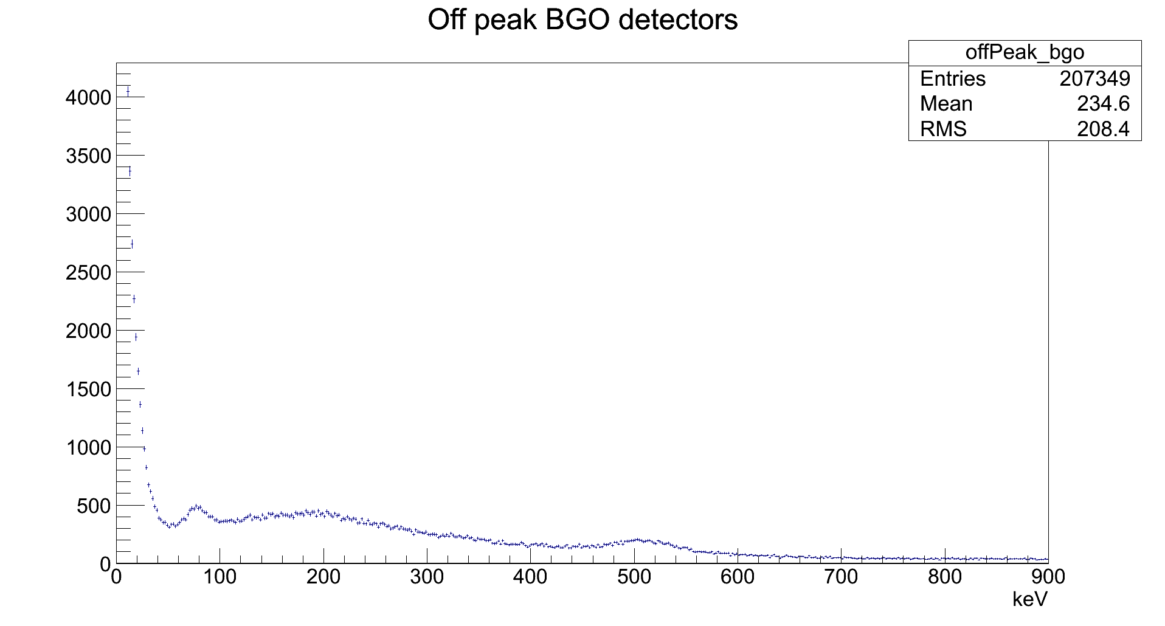
Calibration Fits
Singles mode
Scale energies to 511 keV peak
Stat. uncertainty
  0.39% (BGO)
  0.60% (bAPD)
BGO temperature corrected

Slide 10
Analysis
Two independent algorithms
Estimate of uncertainty from noise
Differences
  bAPD
    Time: (64.8±32.0)ns
    Energy: (0.85±2.19)%
  BGO
    No comparison yet

