Slide 1
RDK II Analysis
Collaboration Meeting
10/22/13
Benjamin O'Neill, PhD
Arizona State University

Slide 2
Table of Contents
SBD
  Peak search
  Gaussian fit
BGO/bAPD
  Smoothed
  Full signal fit
Calibration
Cuts
  SBD
    Timing
    Energy
    Signal shape
  BGO/bAPD
    Energy
    Timing
    Background sub.

Slide 3
Table of Contents
SBD
  Peak search
  Gaussian fit
  Quasi-proton
BGO/bAPD
  Smoothed
  Full signal fit
Calibration
Cuts/Data set
  SBD
    Timing
    Energy
    Signal shape
  BGO/bAPD
    Energy
    Timing
    Background sub.

Slide 4
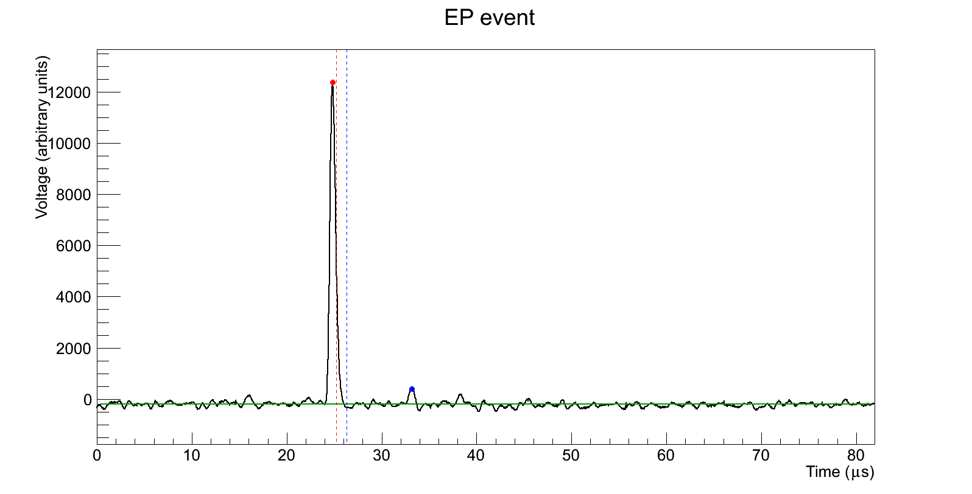
SBD – Peak Search
te = 24.80 μs
Ee = 12579
tp = 33.16 μs
Ep = 611.6
thalf = 25.20 μs
tdip = 26.28 μs

Slide 5
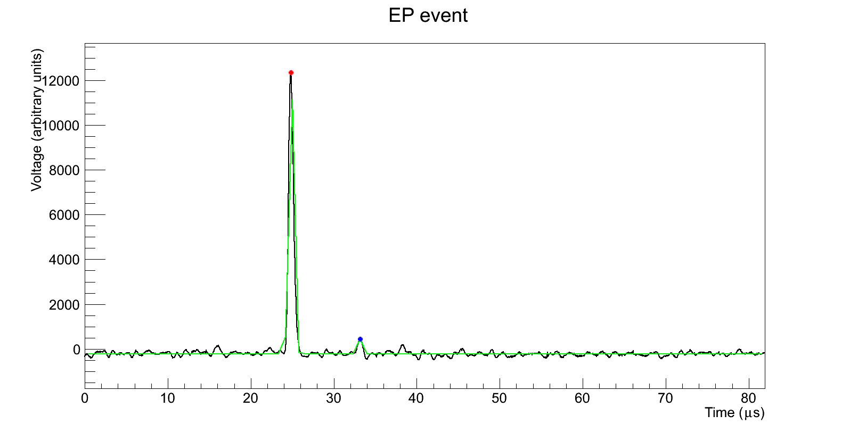
SBD – Signal Fit
te = 24.86 μs
Ee = 12565
σe = 0.29 μs
χ² = 2.94 · 10⁷
tp = 33.17 μs
Ep = 648.6
σp = 0.25 μs
A = -211.8

Slide 6
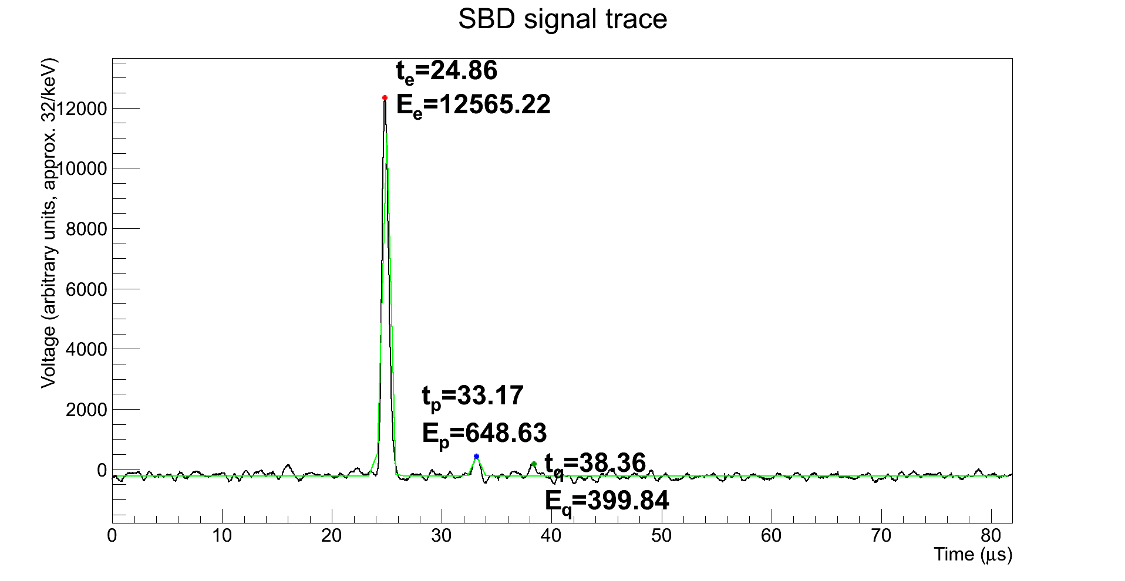
SBD – Signal Fit

Slide 7
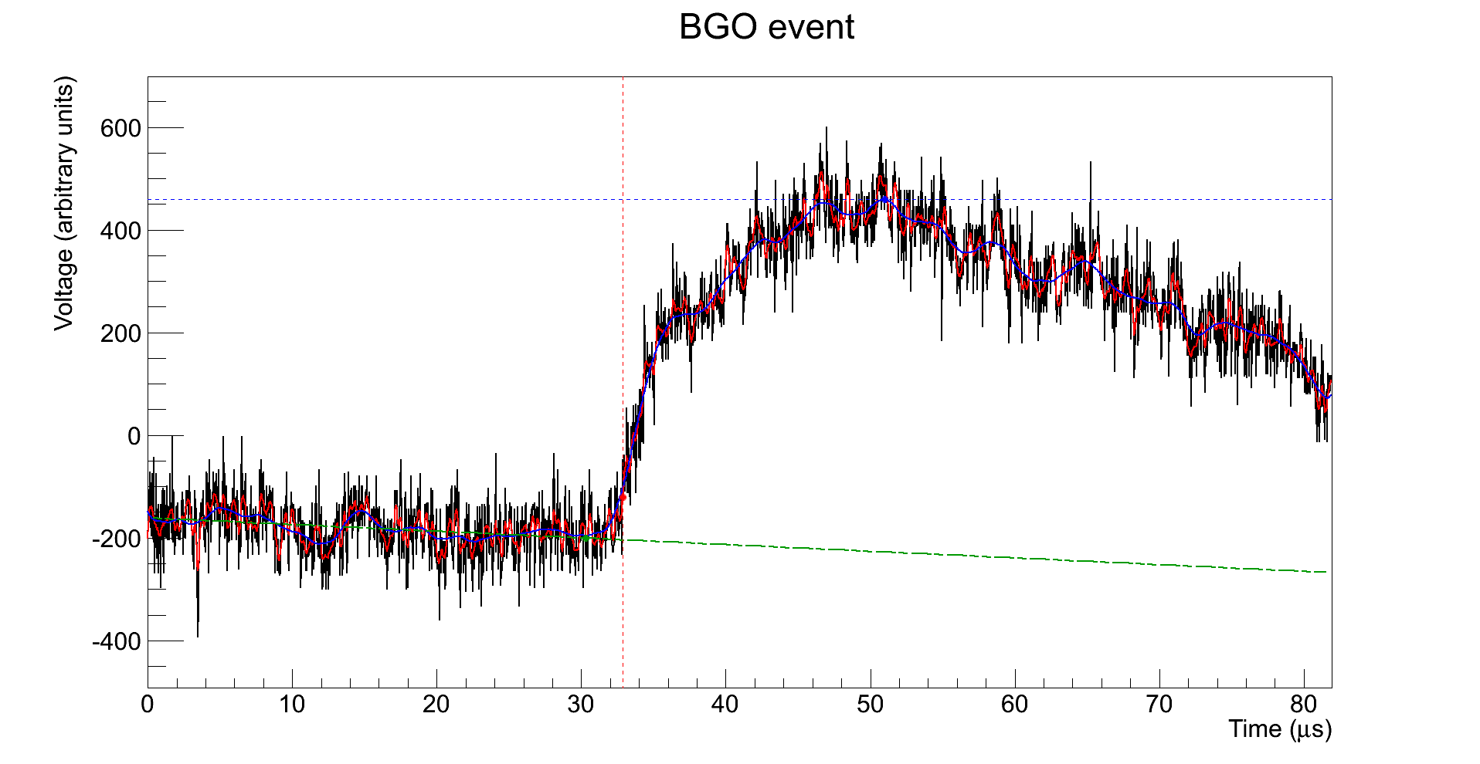
BGO – Smoothed
Eγ = 687.7
t0 = 32.88 μs

Slide 8
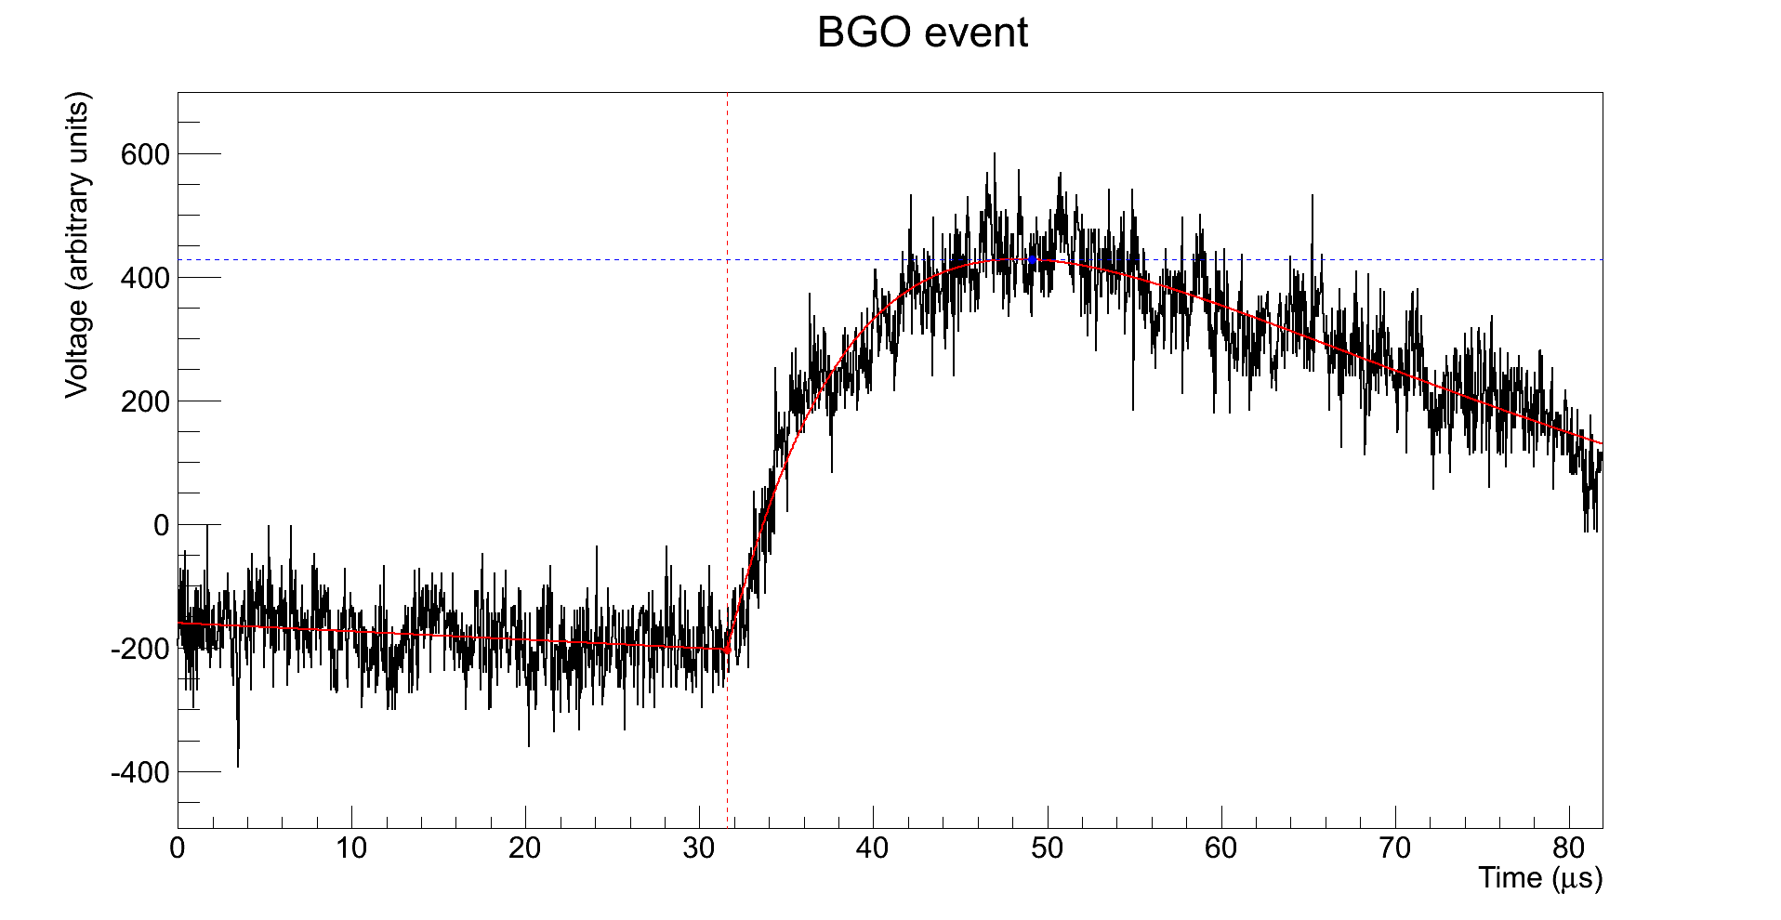
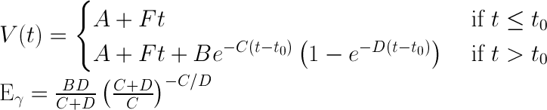
BGO – Full Signal Fit
Eγ = 654.6
≈ 20 keV
C ≈ 1 ∙ 10⁻³
D ≈ 5 ∙ 10⁻³
t0 = 31.61 μs

Slide 9
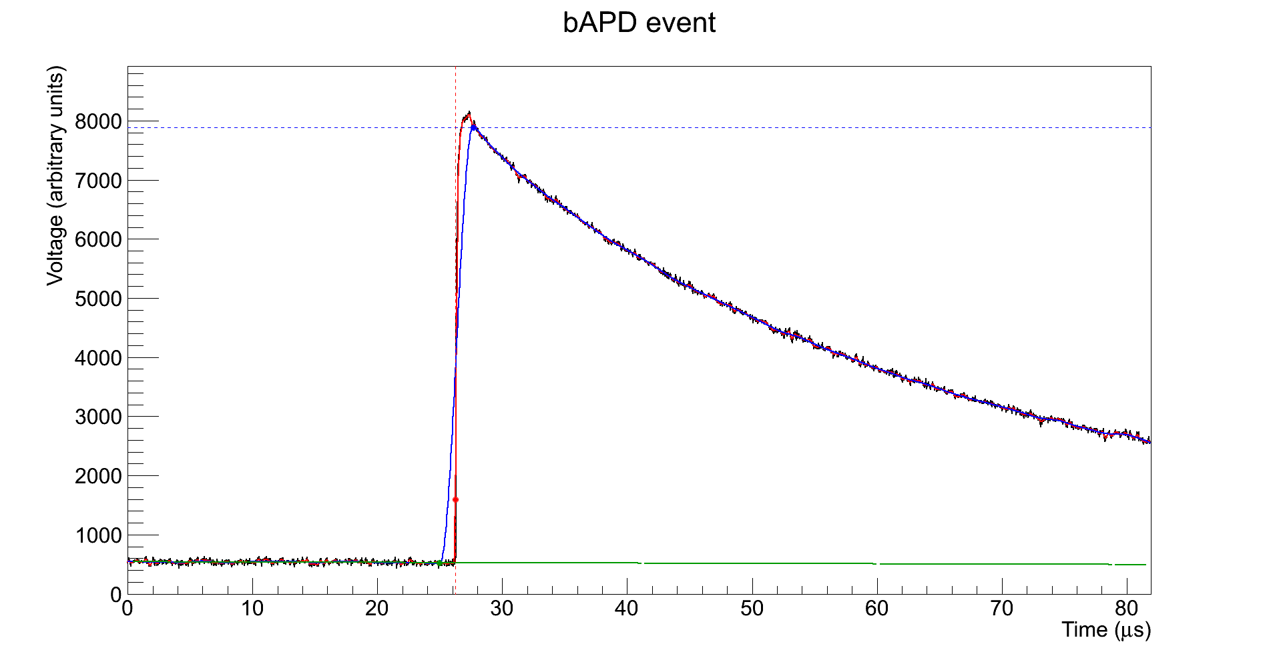
bAPD – Smoothed
Eγ = 7361.3
t0 = 26.24 μs

Slide 10
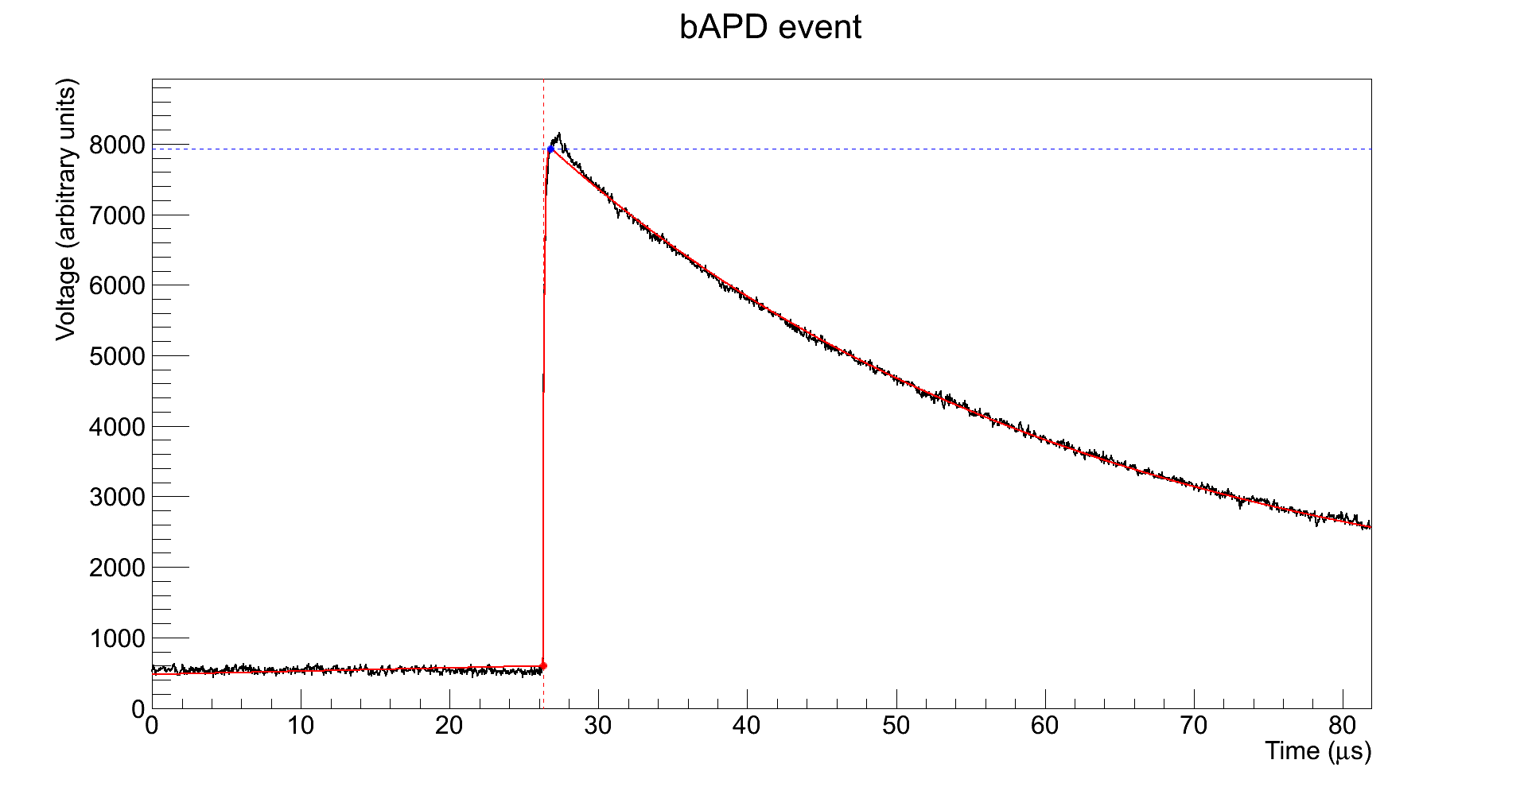
bAPD – Full Signal Fit
Eγ = 7326.3
≈ 10 keV
C ≈ 1 ∙ 10⁻³
D ≈ 1
t0 = 26.28 μs

Slide 11
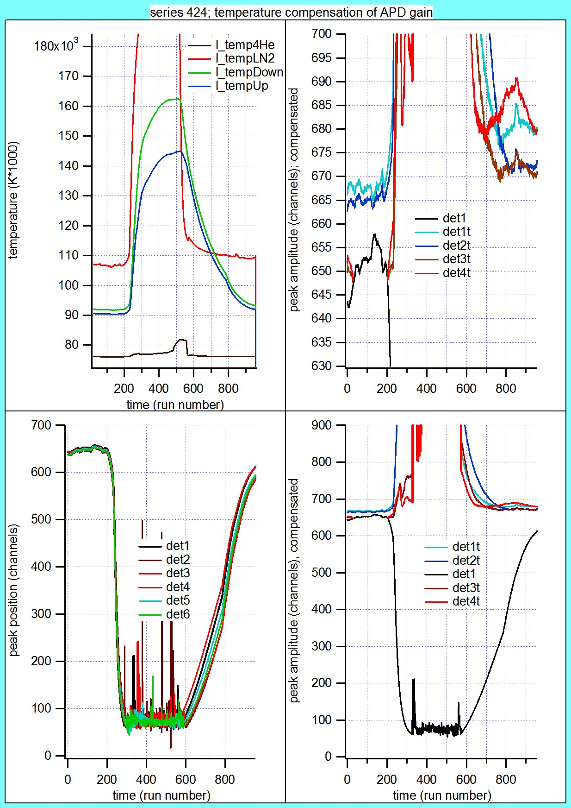
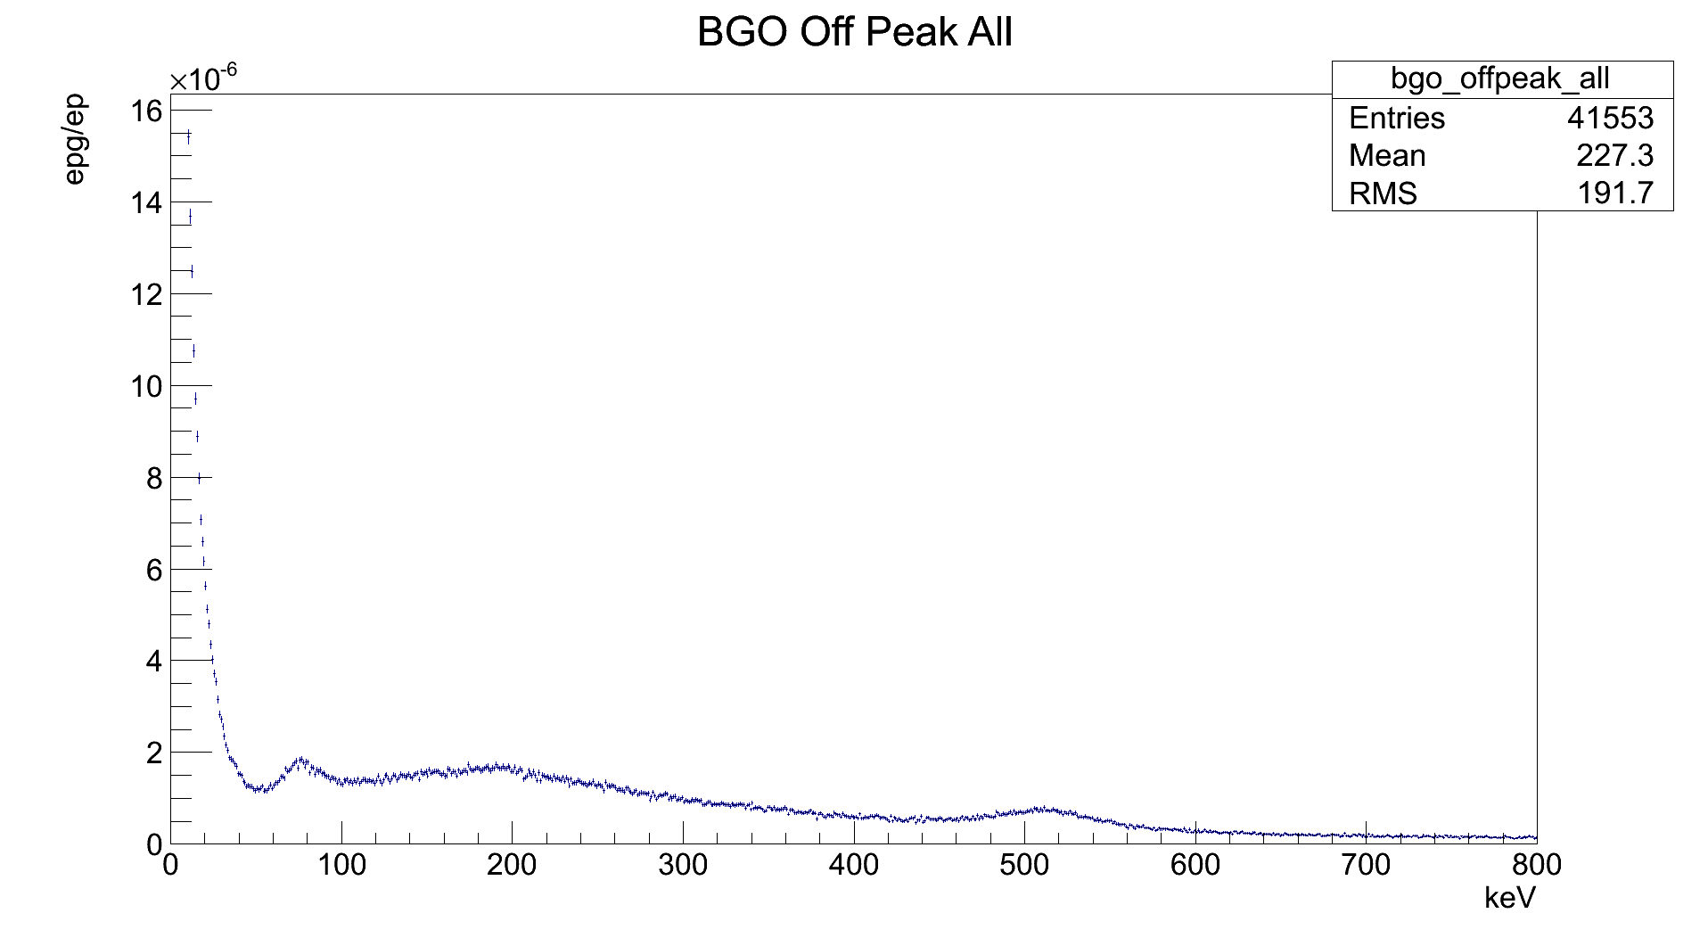
Calibration – BGO
511 keV
Positron annihilation

Slide 12
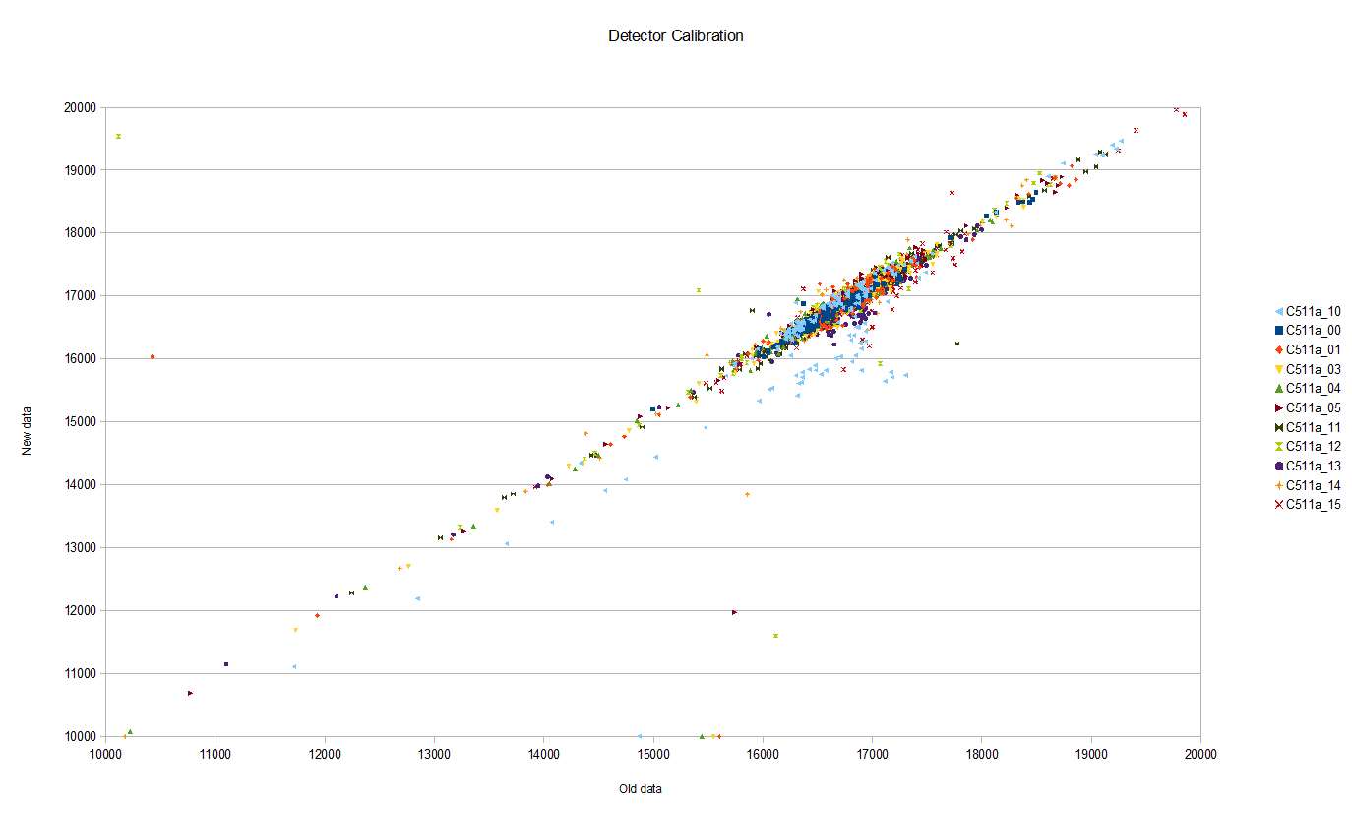
Calibration – BGO
511 Peak fits from new fitting
Herbert's calibration points
Approx. 120 unit shift or 0.75% change

Slide 13
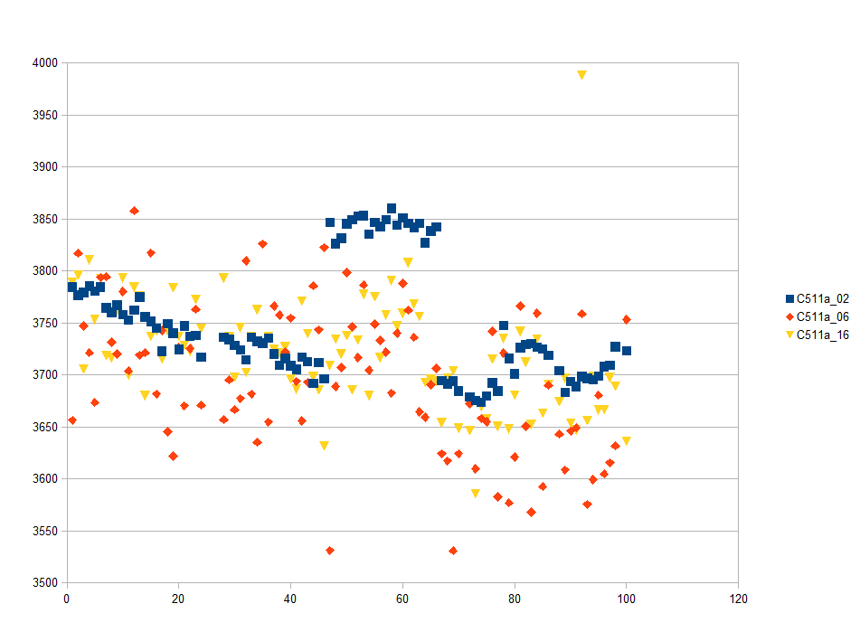
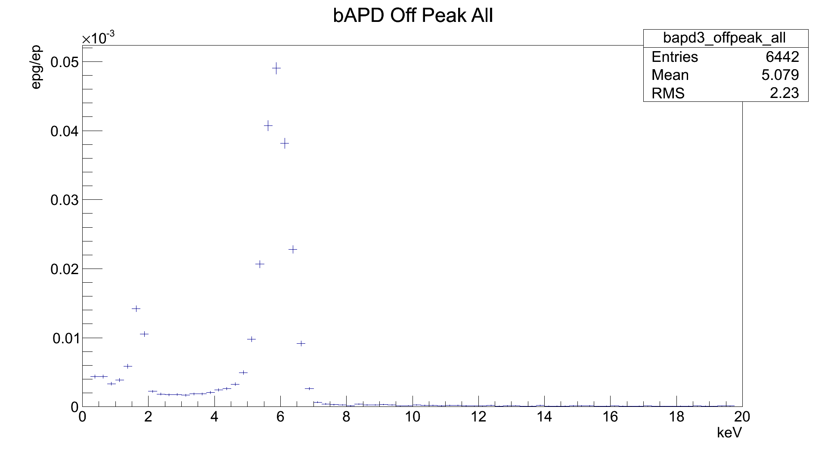
Calibration – bAPD
Peak position
5.9 keV
Iron X-ray

Slide 14
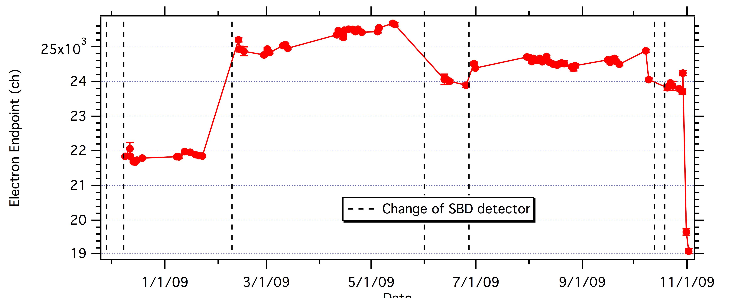
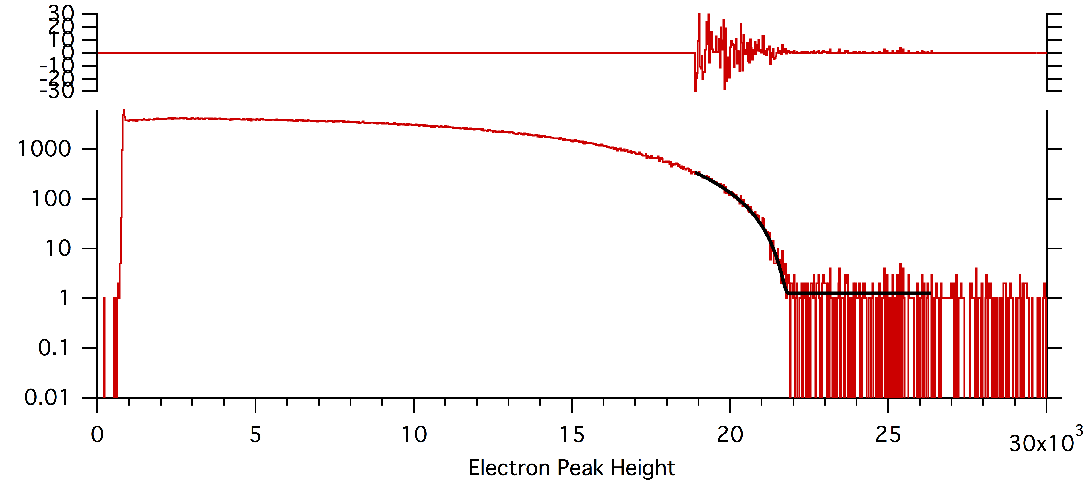
Calibration – SBD
782 keV
Electron endpoint

Slide 15
Data Set Changes
Eliminated series with too few events (<100k)
  S108, S154, S213, S314
Double peak e-p TOF
  S256, S258, S260, S262, S263, S265, S267
Oddly shaped electron spectrum (SBD dying)
  S318, S319, S321

Slide 16
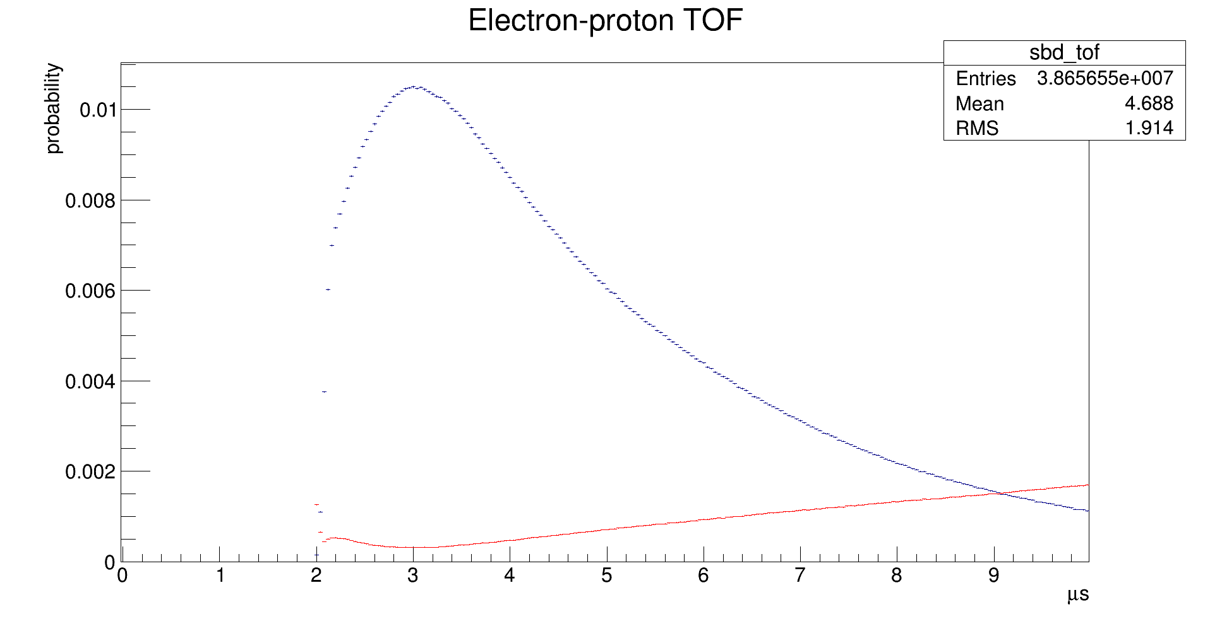
SBD – Timing Cuts
2 μs < tp - te < 10 μs
Proton (blue) and quasi-proton (red)
spectra after all EP cuts

Slide 17
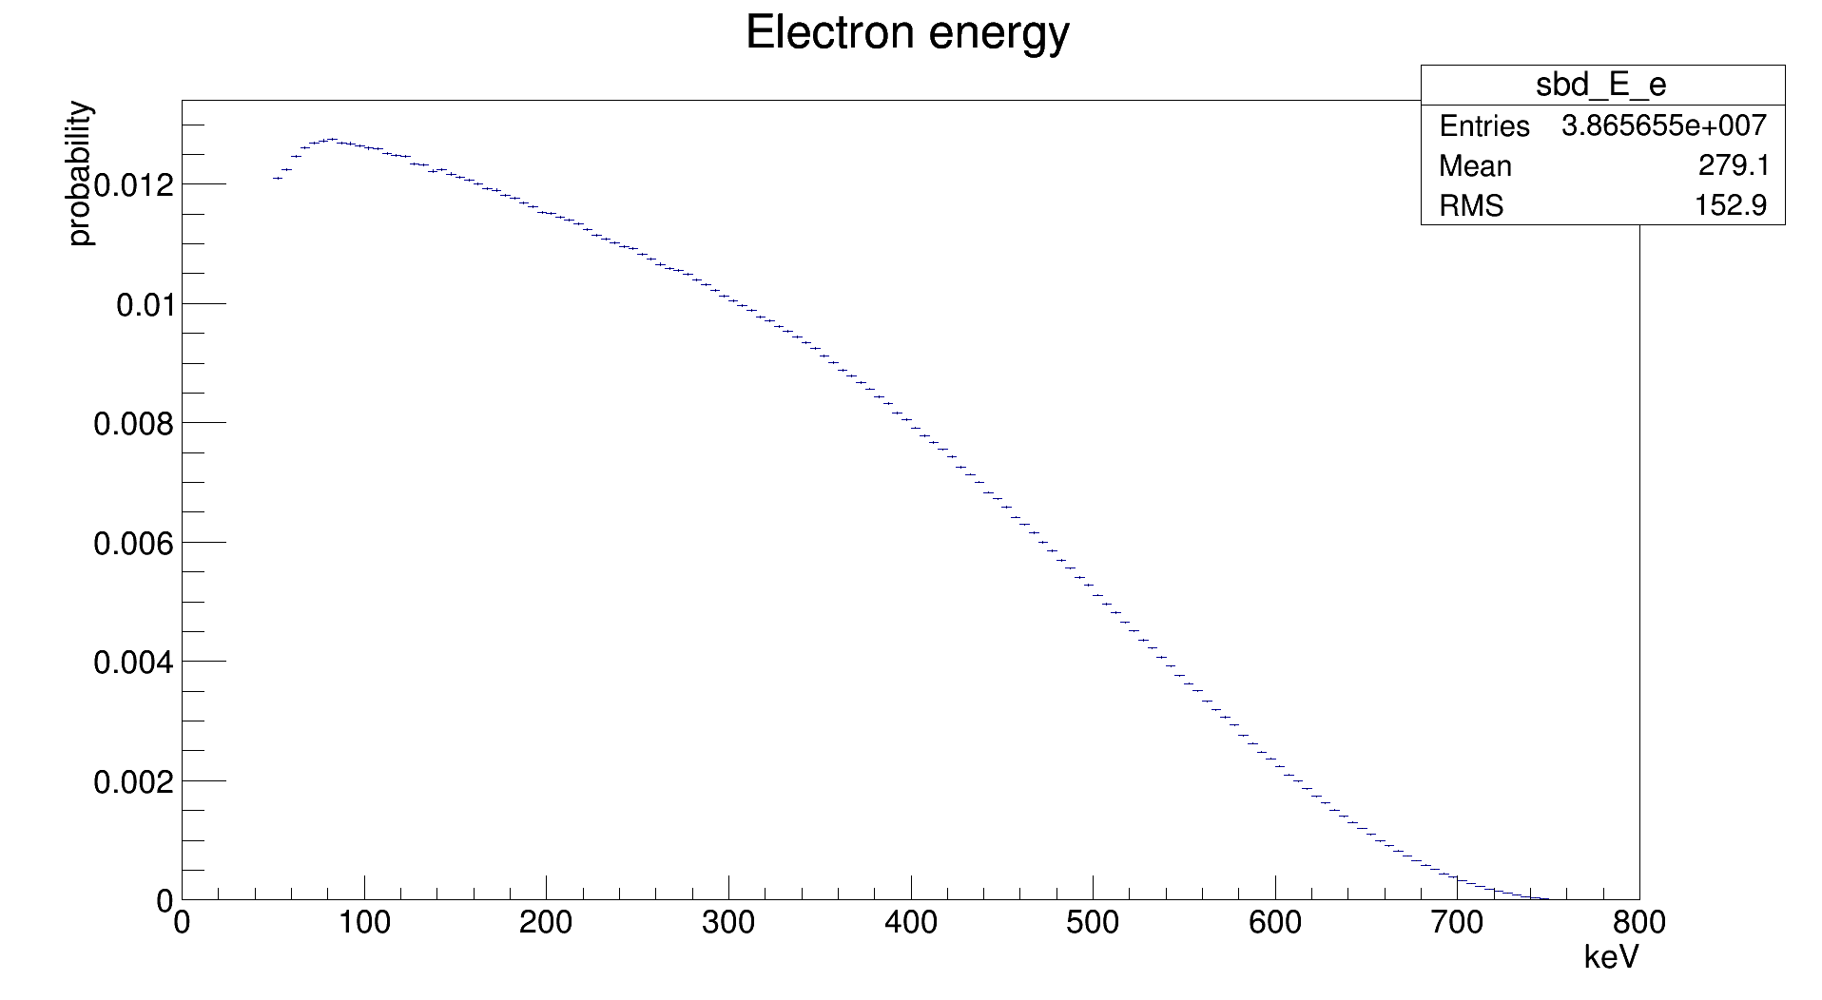
SBD – Energy Cuts
50 keV < Ee < 800 keV

Slide 18
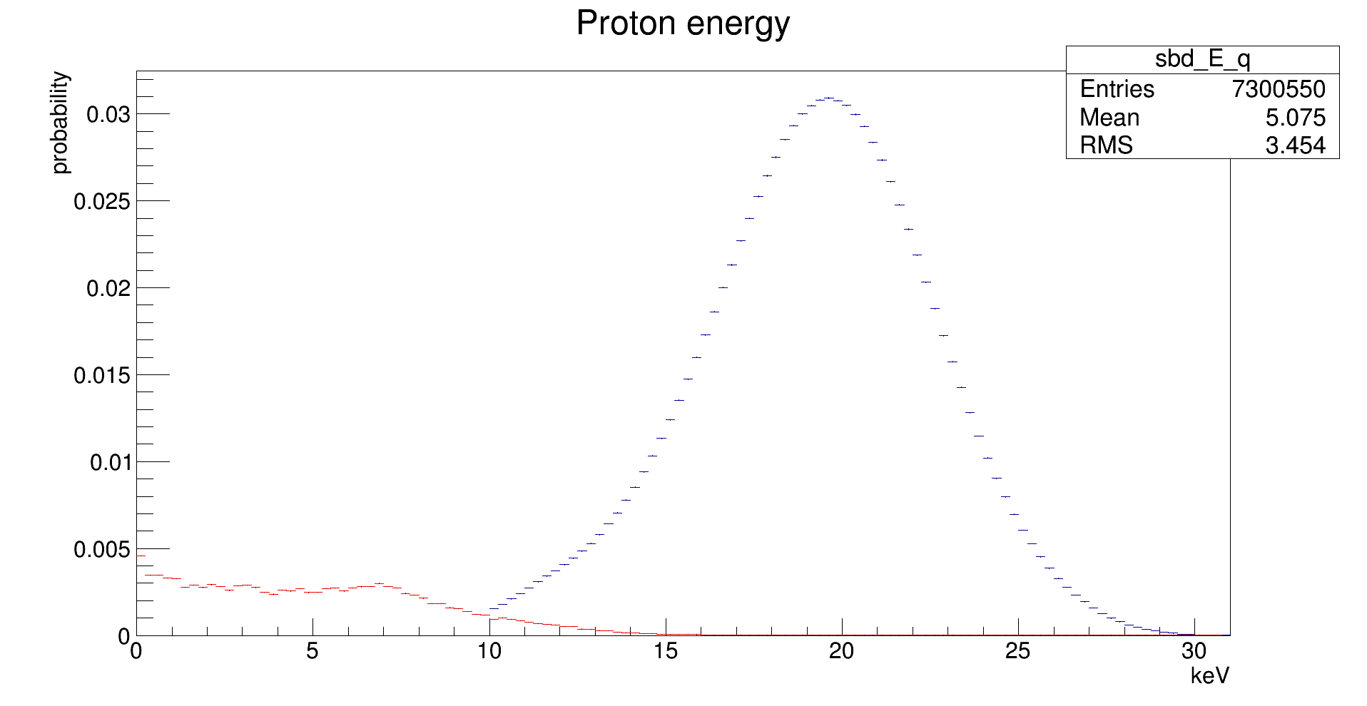
SBD – Energy Cuts
10 keV < Ep < 31 keV
Proton (blue) and quasi-proton (red)
spectra after all EP cuts

Slide 19
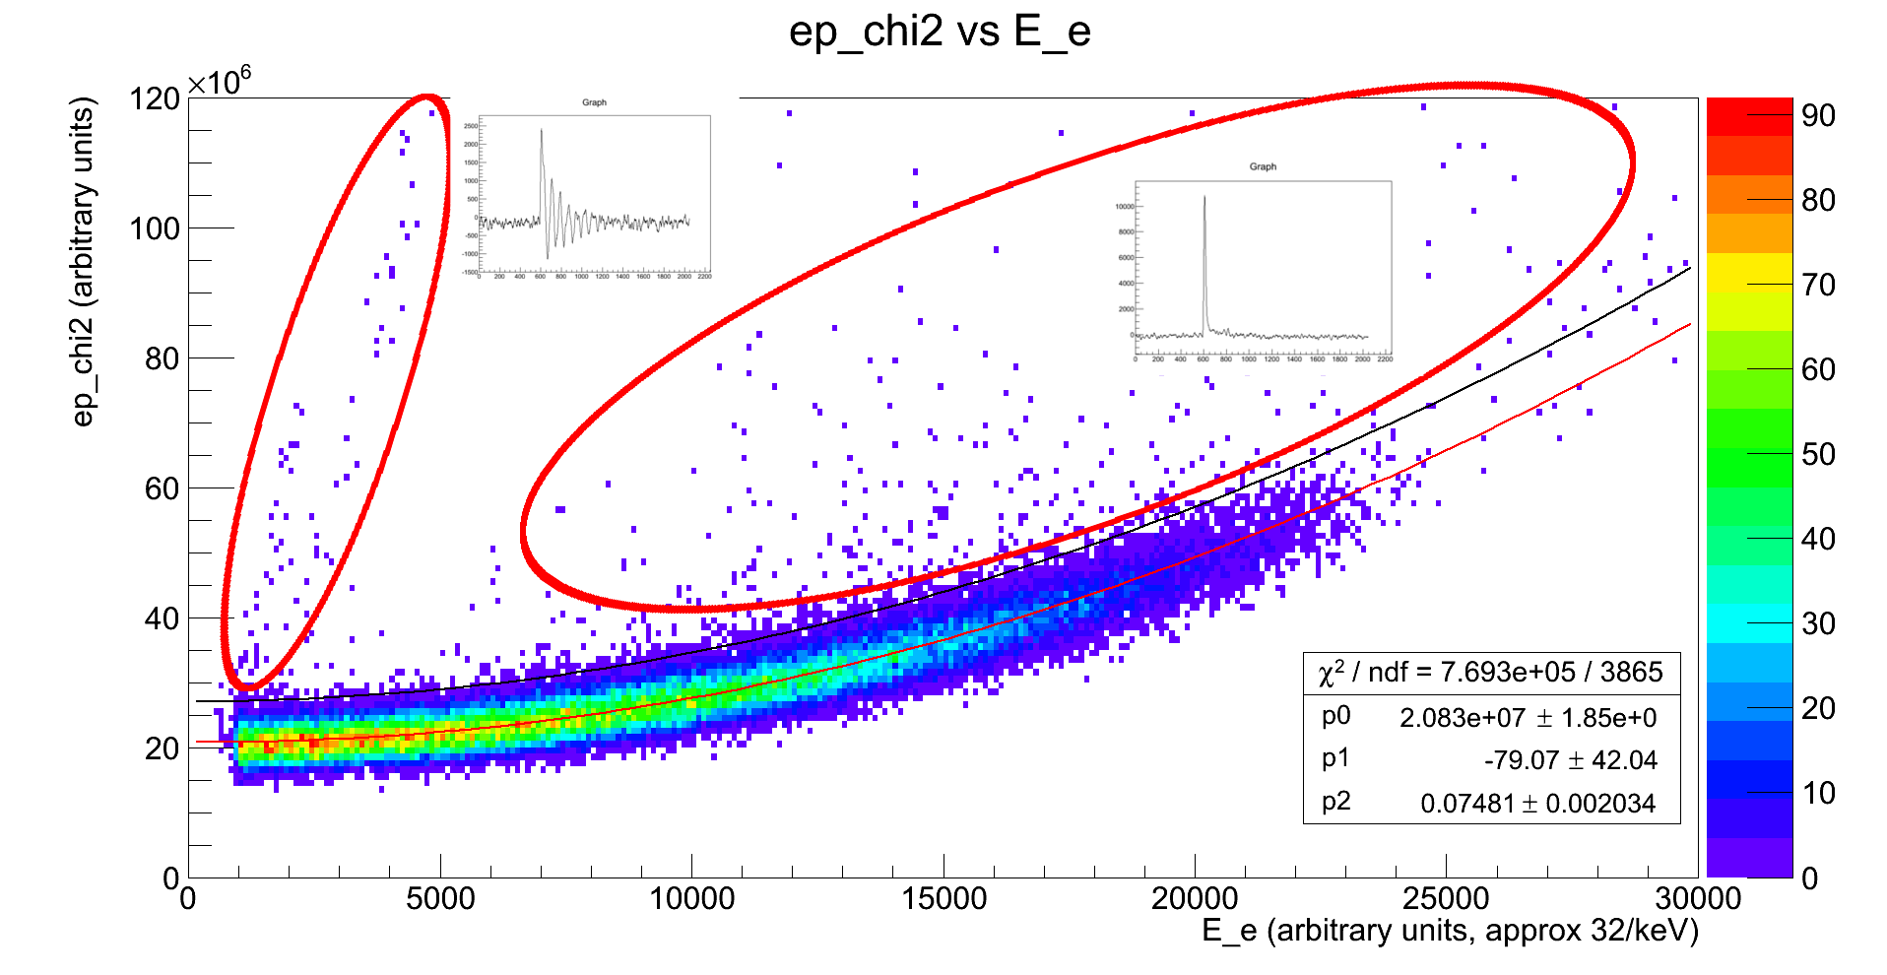
SBD – Signal Shape
Series 256 data

Slide 20
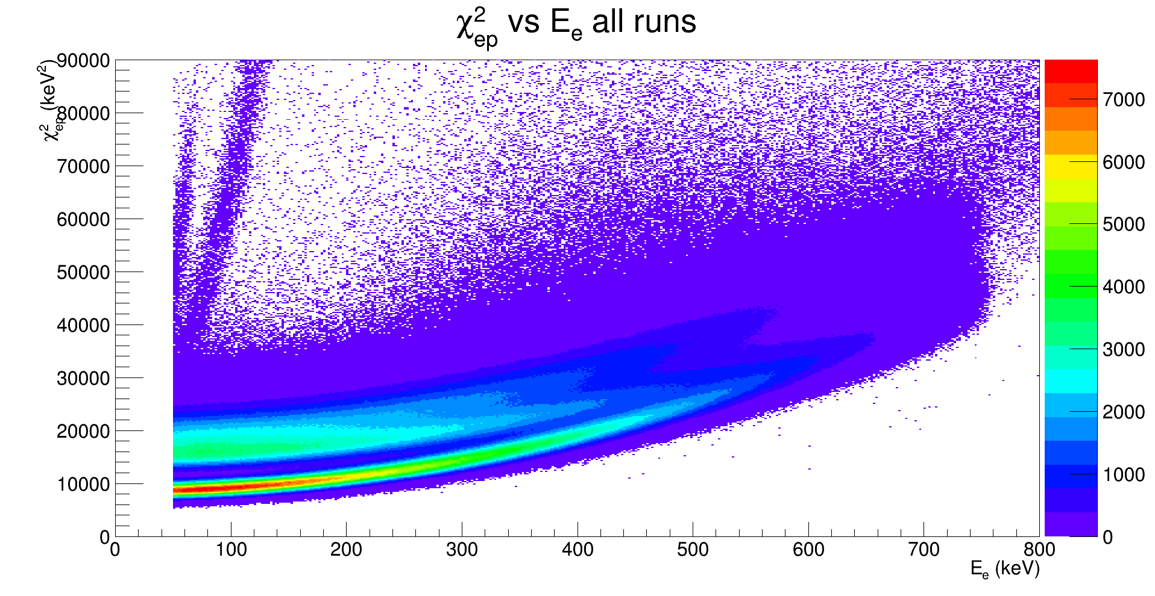
SBD – Signal Shape

Slide 21
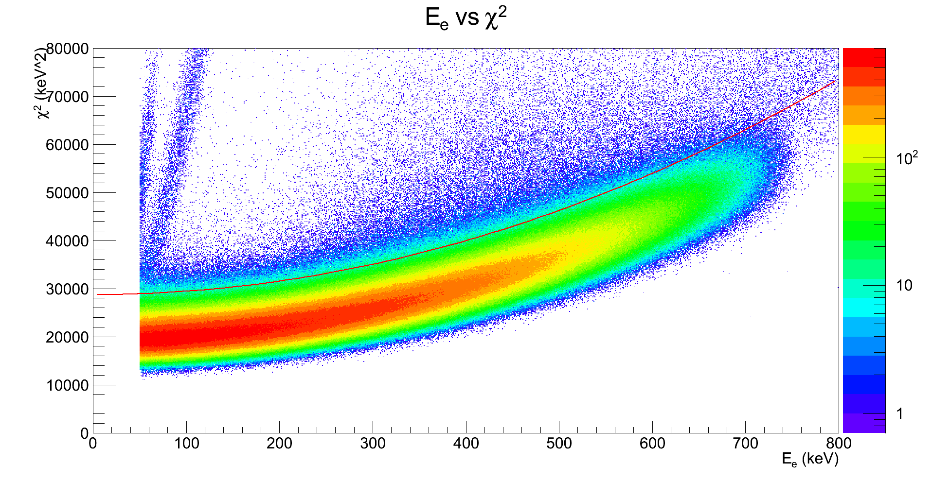
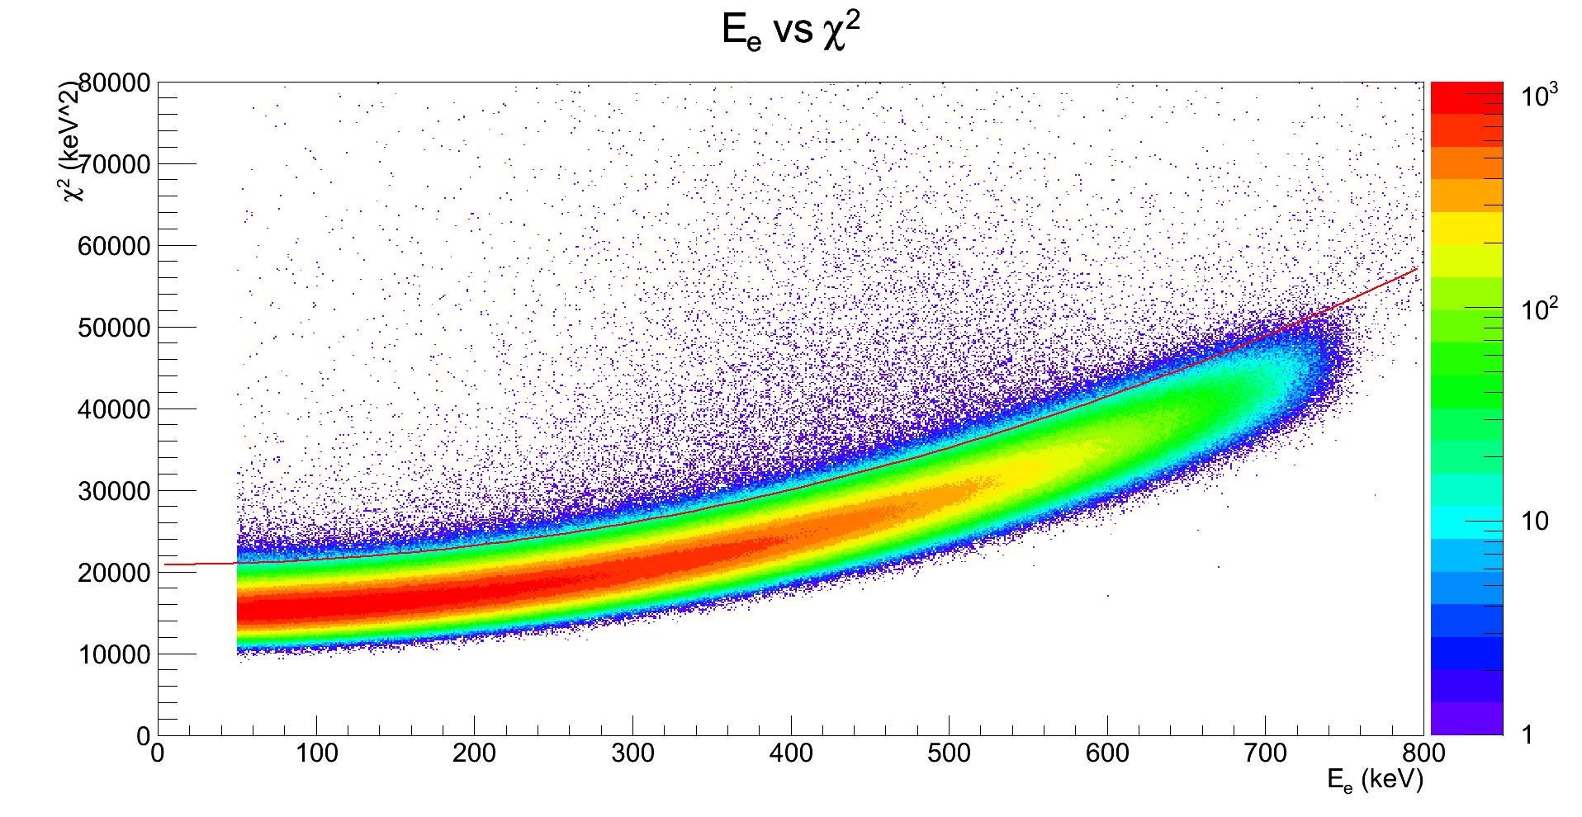
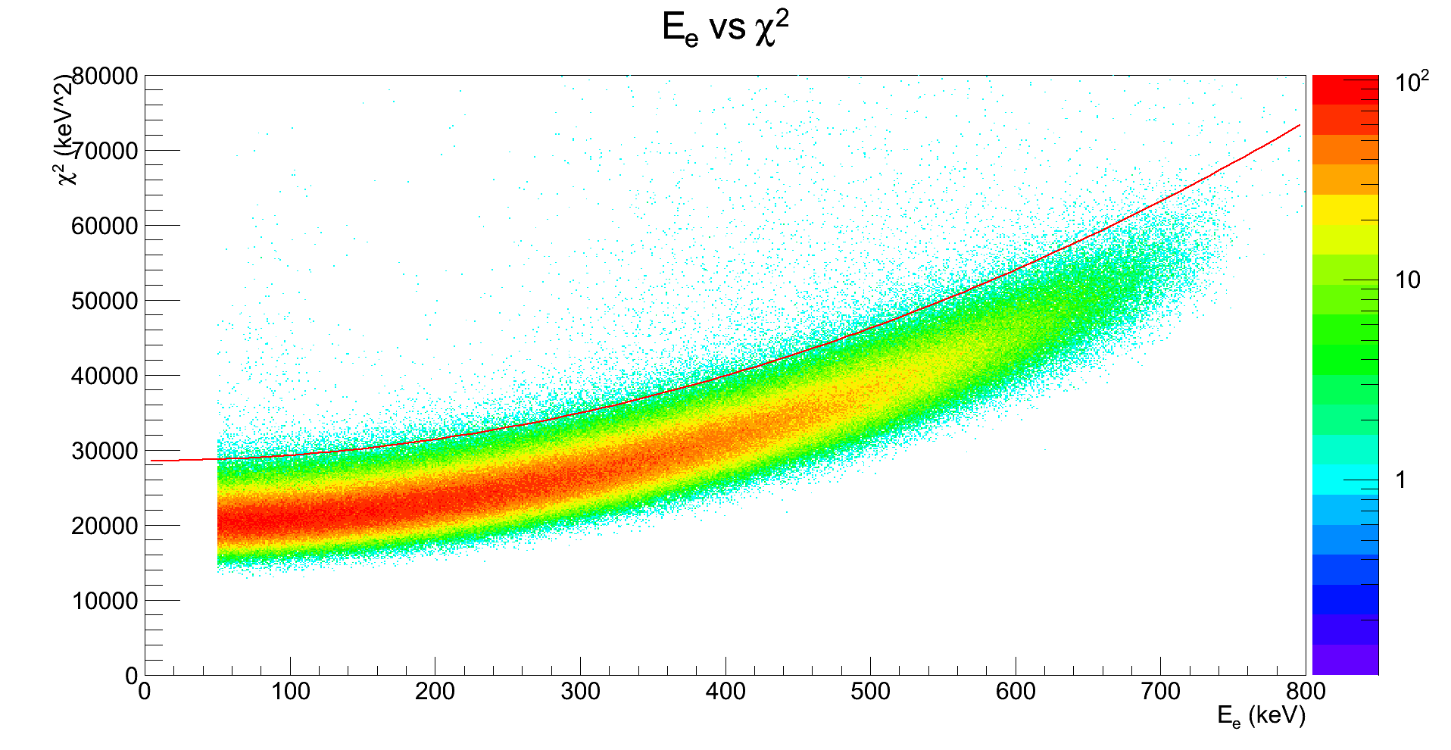
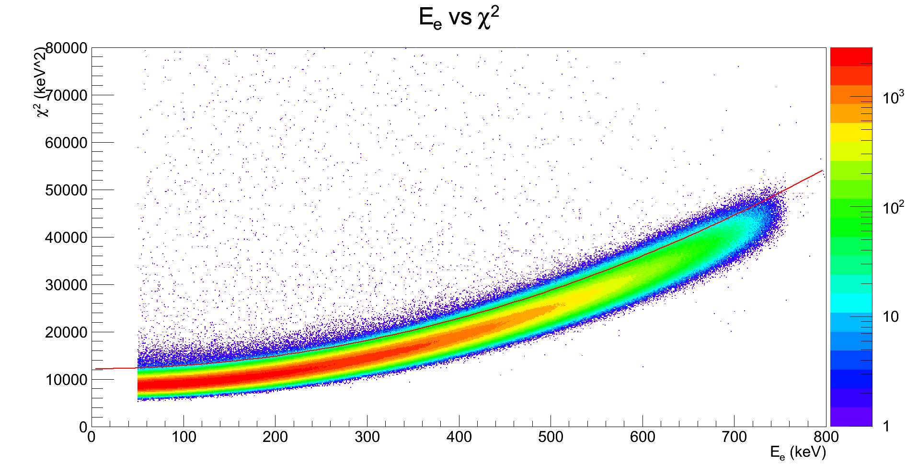
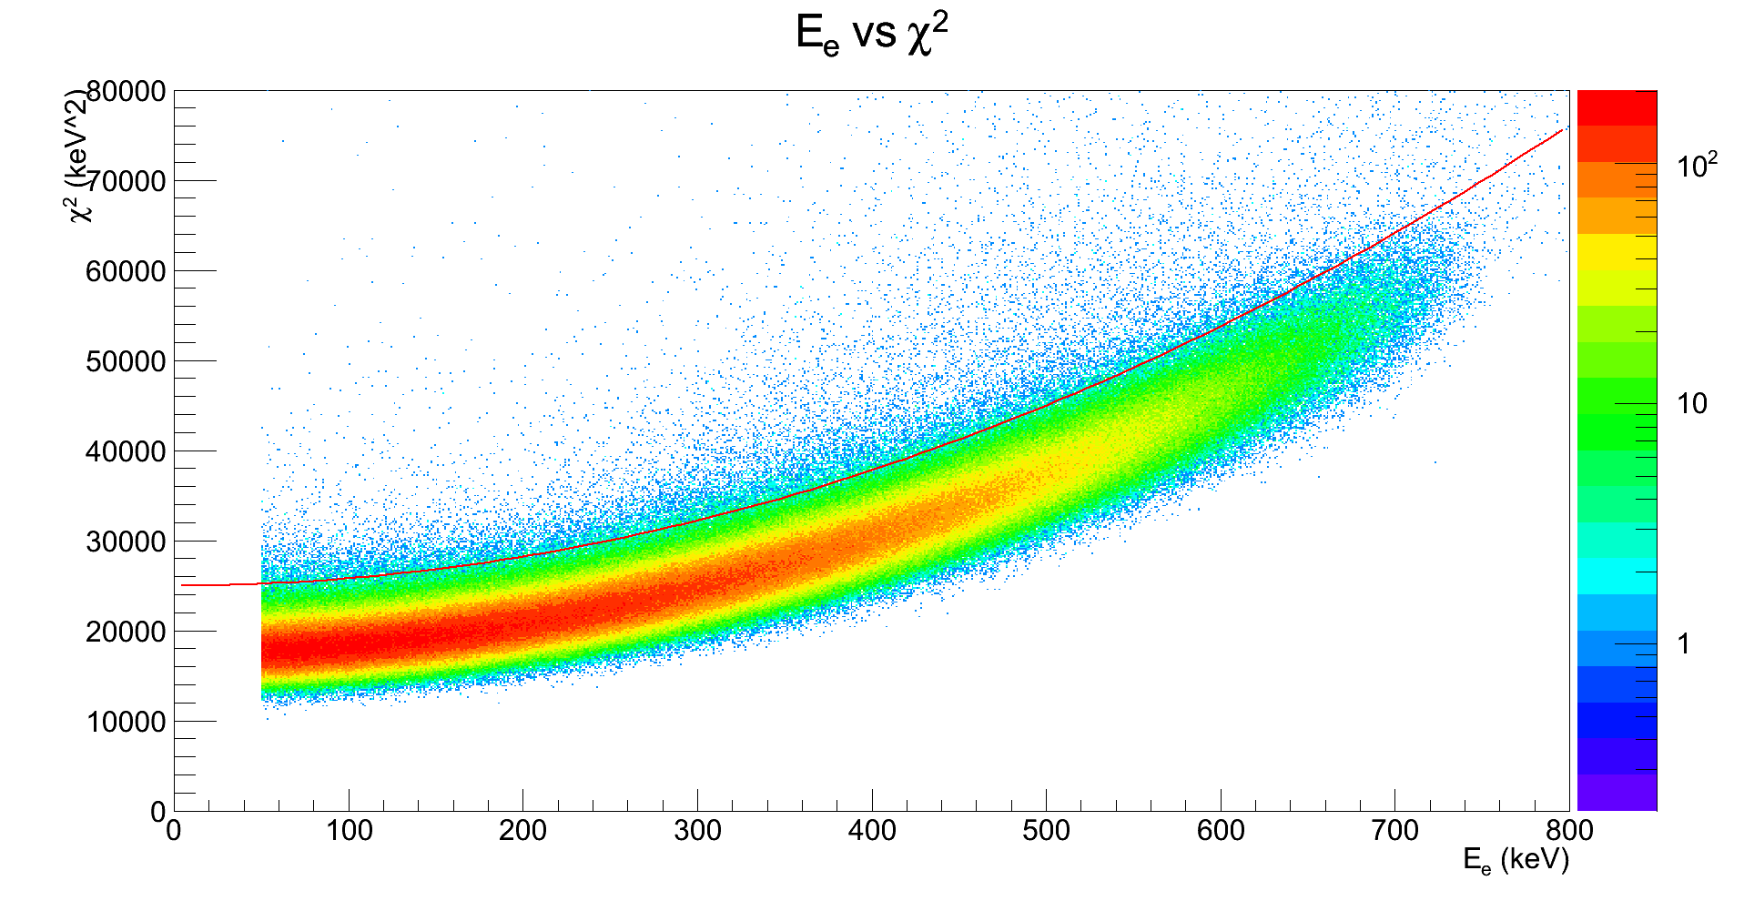
SBD – Signal Shape
42-117A
S60-69 & 225-306
42-117C
S70-101
42-117C
S201-224
47-113B
S102-197 & 307-309
48-162B
S310-327

Slide 22
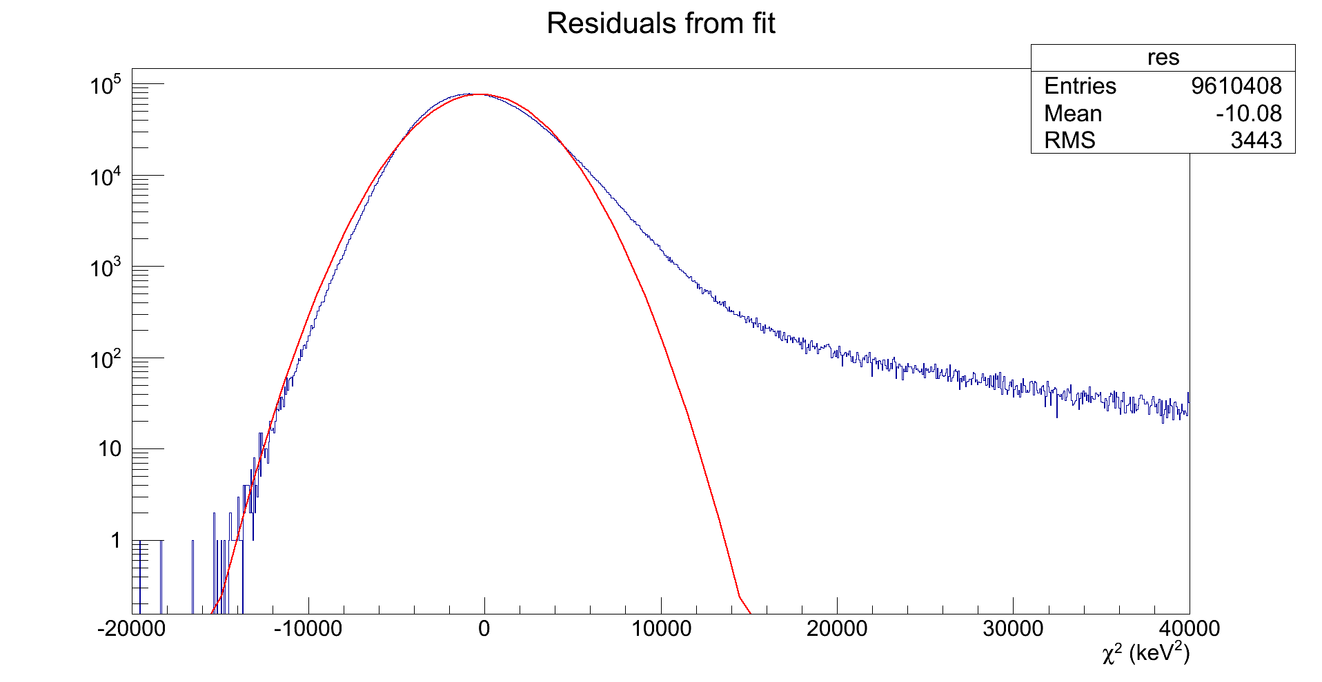
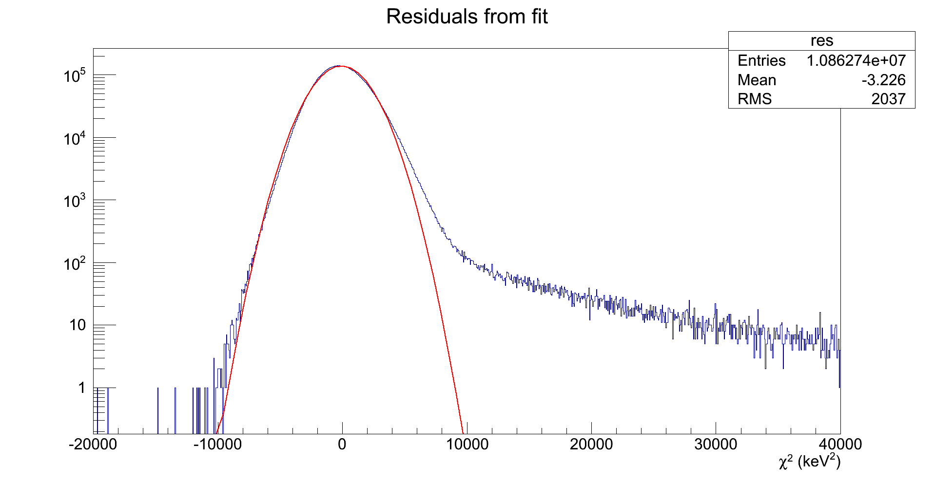
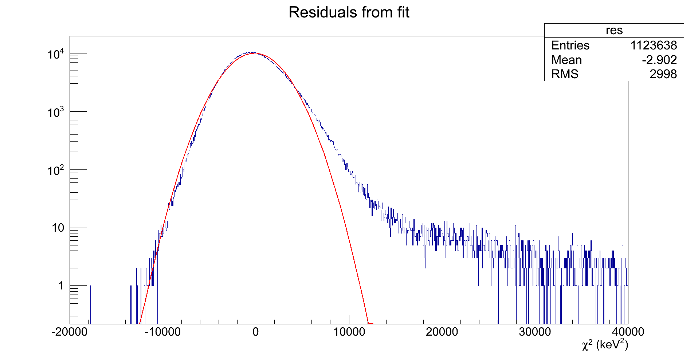
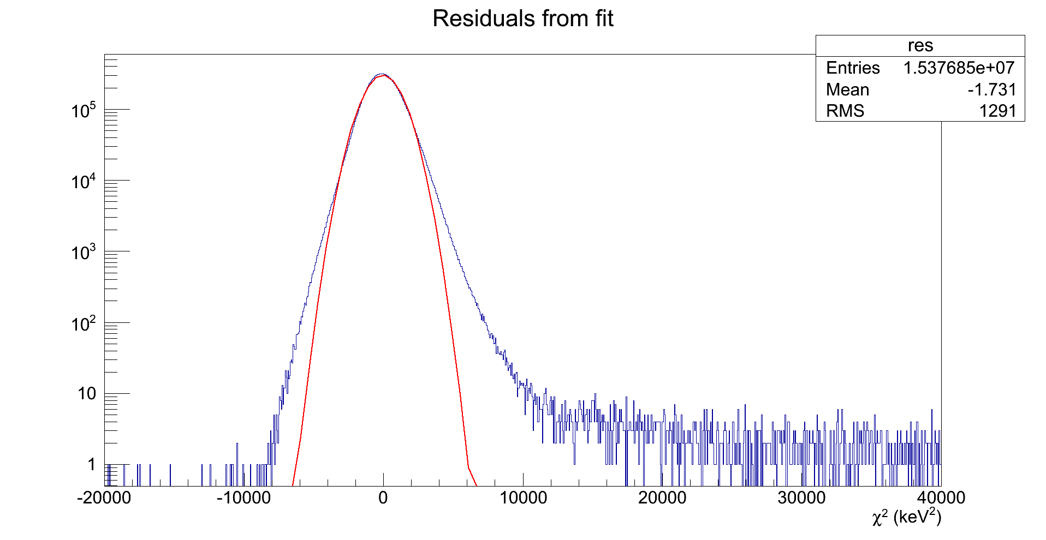
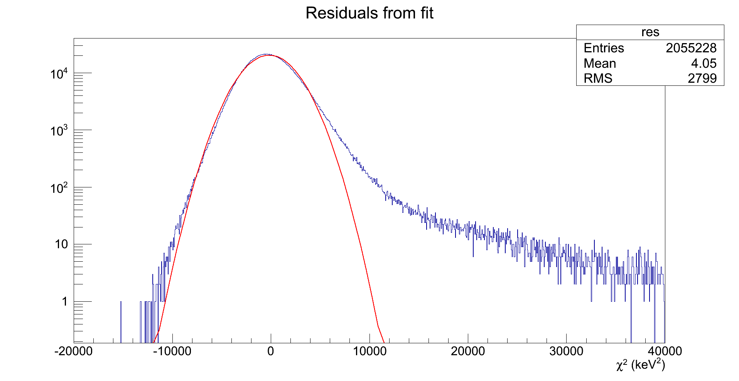
SBD – Signal Shape
42-117A
S60-69 & 225-306
42-117C
S70-101
42-117C
S201-224
47-113B
S102-197 & 307-309
48-162B
S310-327
3σ upper bound
Approx. 0.36% of events cut

Slide 23
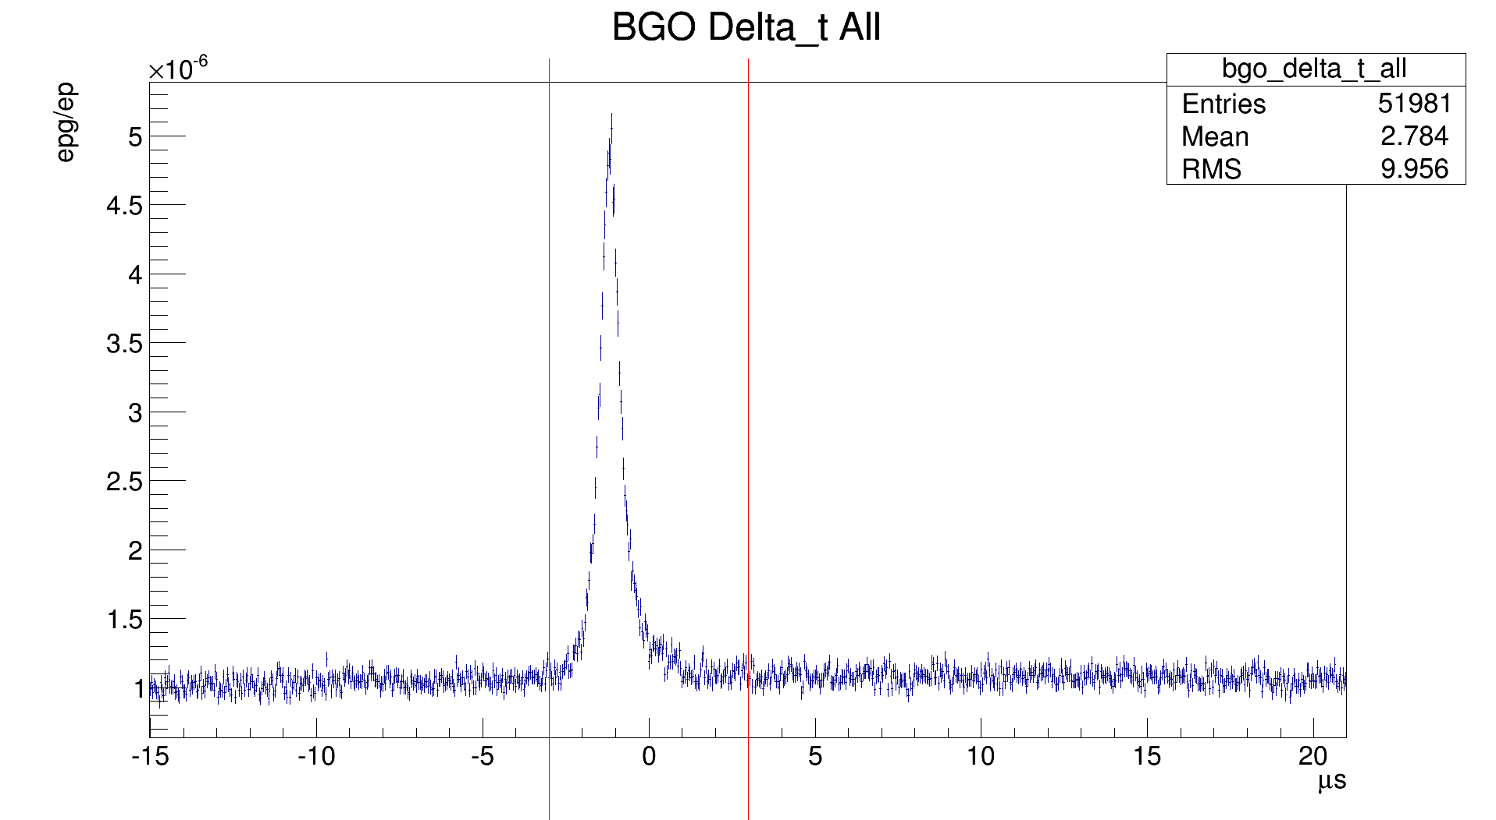
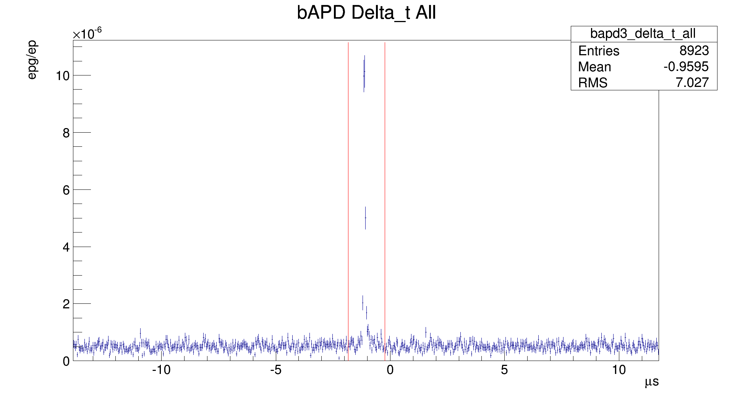
BGO/bAPD – Timing Cuts
-1.84 μs < Δt < -0.24 μs
-3 μs < Δt < 3 μs

Slide 24
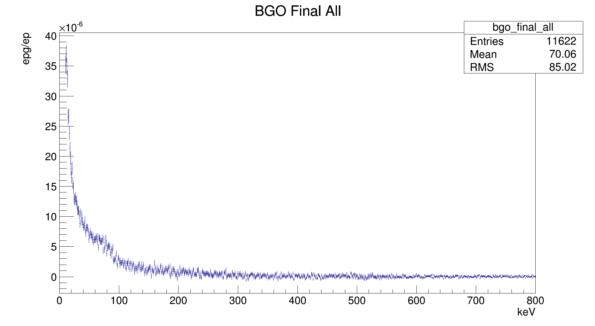
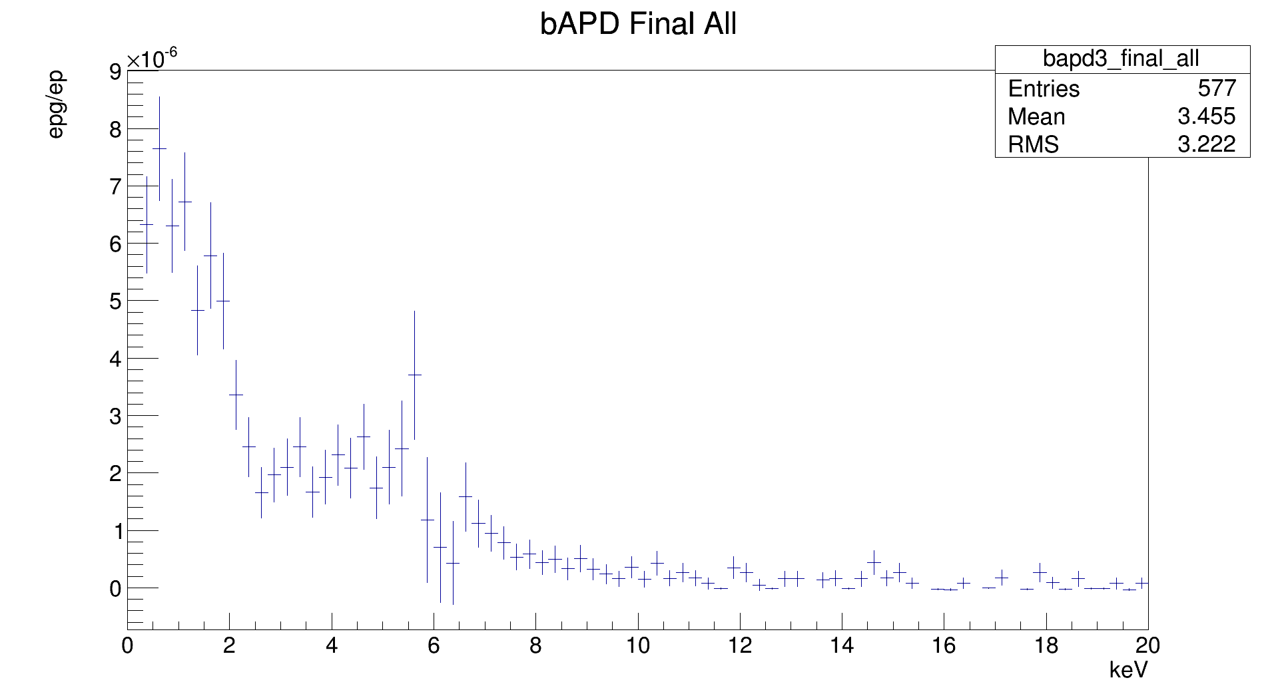
BGO/bAPD – Background Sub.
bAPD sum of 3 det.
epg = (9.22 ± 0.38) · 10⁻⁵
ep
BGO weighted average
Epg = (8.826 ± 0.081) · 10⁻⁵
ep

Slide 25
SBD – Signal Shape
Set 1

Slide 26
SBD – Signal Shape
Approx. cutoff
Set 1
σ=2919

Slide 27
SBD – Signal Shape
Set 2a

Slide 28
SBD – Signal Shape
Approx. cutoff
Set 2a
σ=1871

Slide 29
SBD – Signal Shape
Set 2b

Slide 30
SBD – Signal Shape
Approx. cutoff
Set 2b
σ=2647

Slide 31
SBD – Signal Shape
Set 3

Slide 32
SBD – Signal Shape
Approx. cutoff
Set 3
σ=1215

Slide 33
SBD – Signal Shape
Set 4

Slide 34
SBD – Signal Shape
Approx. cutoff
Set 4
σ=2367

