Slide 1
RDK II Analysis
Collaboration Meeting
4/24/13
Benjamin O'Neill, PhD
Arizona State University

Slide 2
Table of Contents
SBD
  Peak search
  Gaussian fit
BGO/bAPD
  Smoothed
  Full signal fit
Calibration
Cuts
  SBD
    Timing
    Energy
    Signal shape
  BGO/bAPD
    Energy
    Timing
    Background sub.

Slide 3
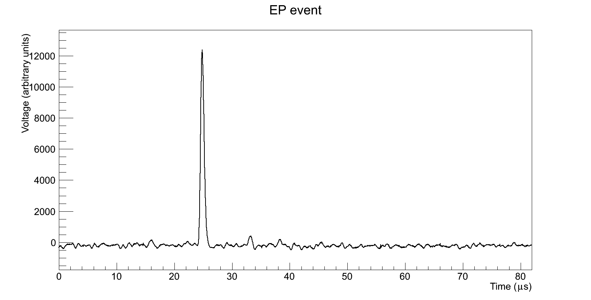
SBD – Typical Signal

Slide 4
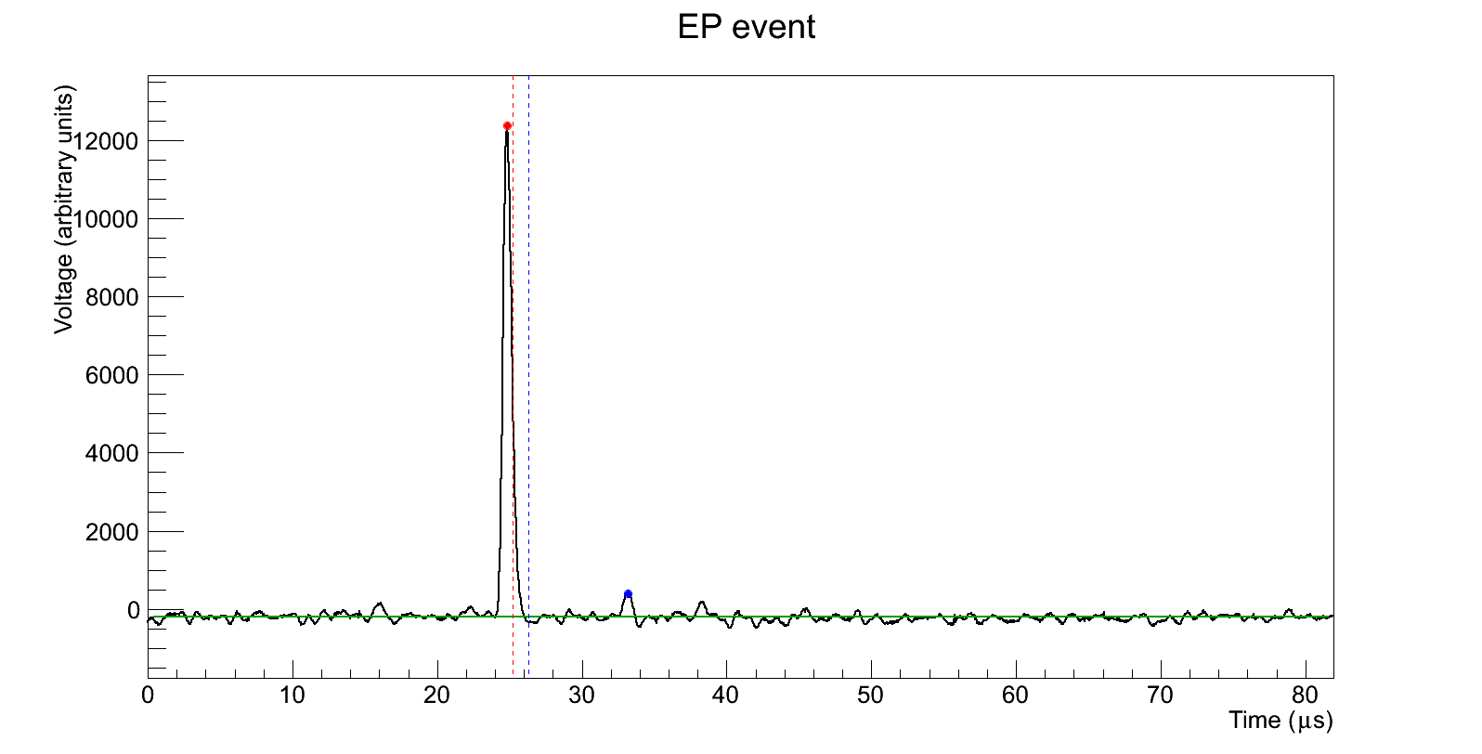
SBD – Peak Search
te = 24.80 μs
Ee = 12579
tp = 33.16 μs
Ep = 611.6
thalf = 25.20 μs
tdip = 26.28 μs

Slide 5
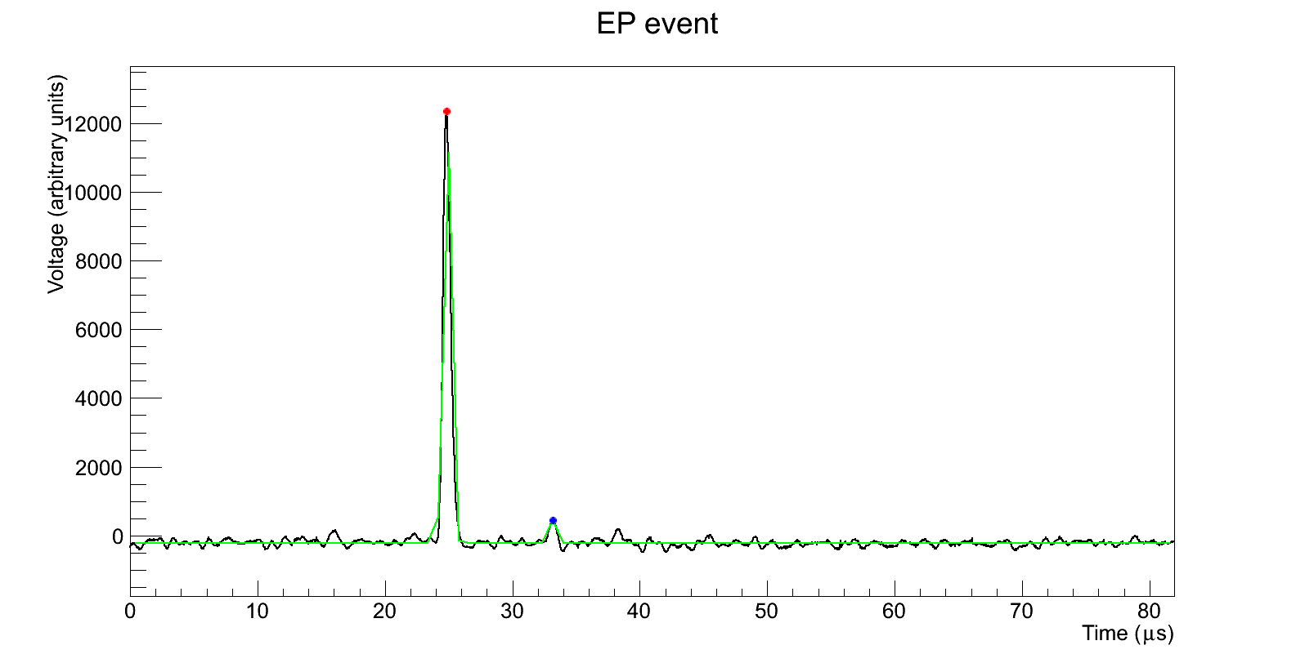
SBD – Signal Fit
te = 24.86 μs
Ee = 12565
σe = 0.29 μs
χ² = 2.94 · 10⁷
tp = 33.17 μs
Ep = 648.6
σp = 0.25 μs
A = -211.8

Slide 6
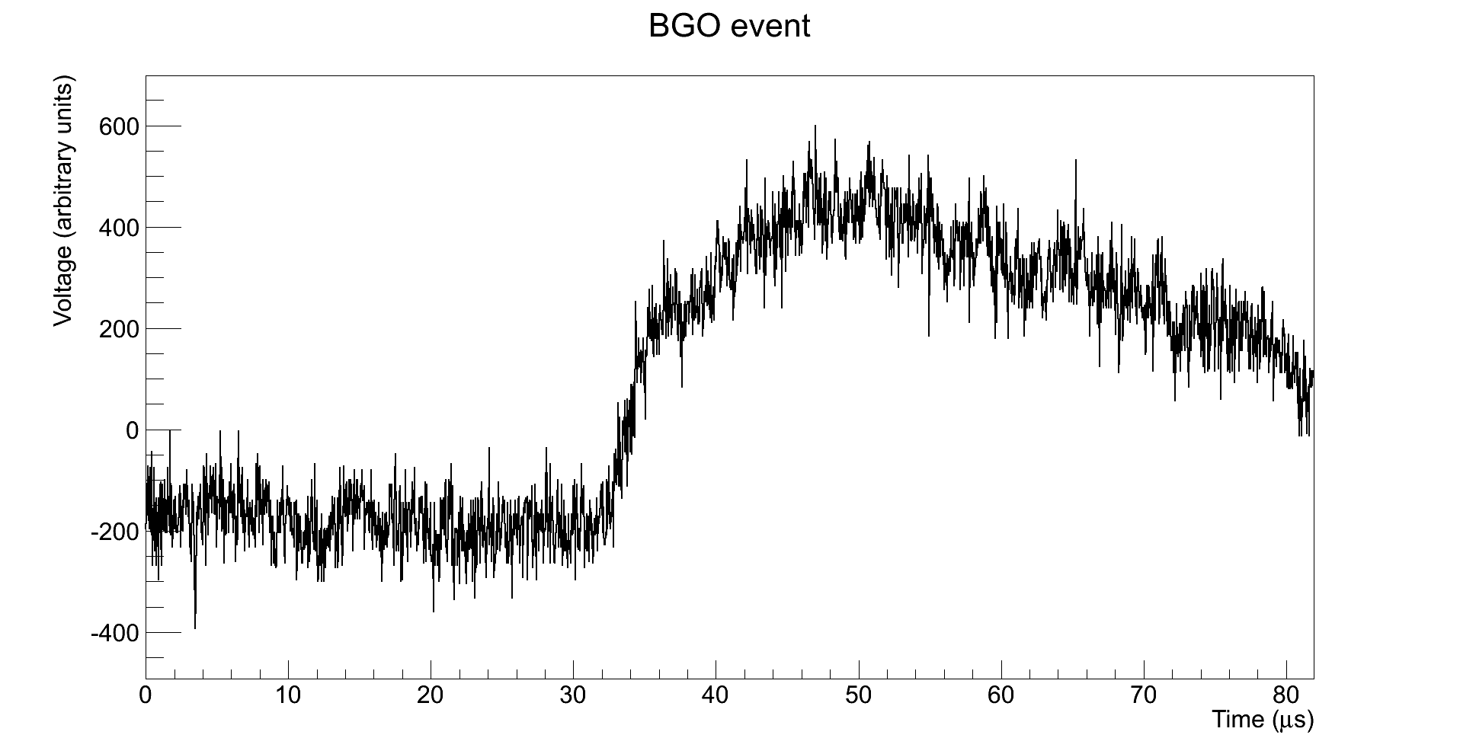
BGO – Typical Signal

Slide 7
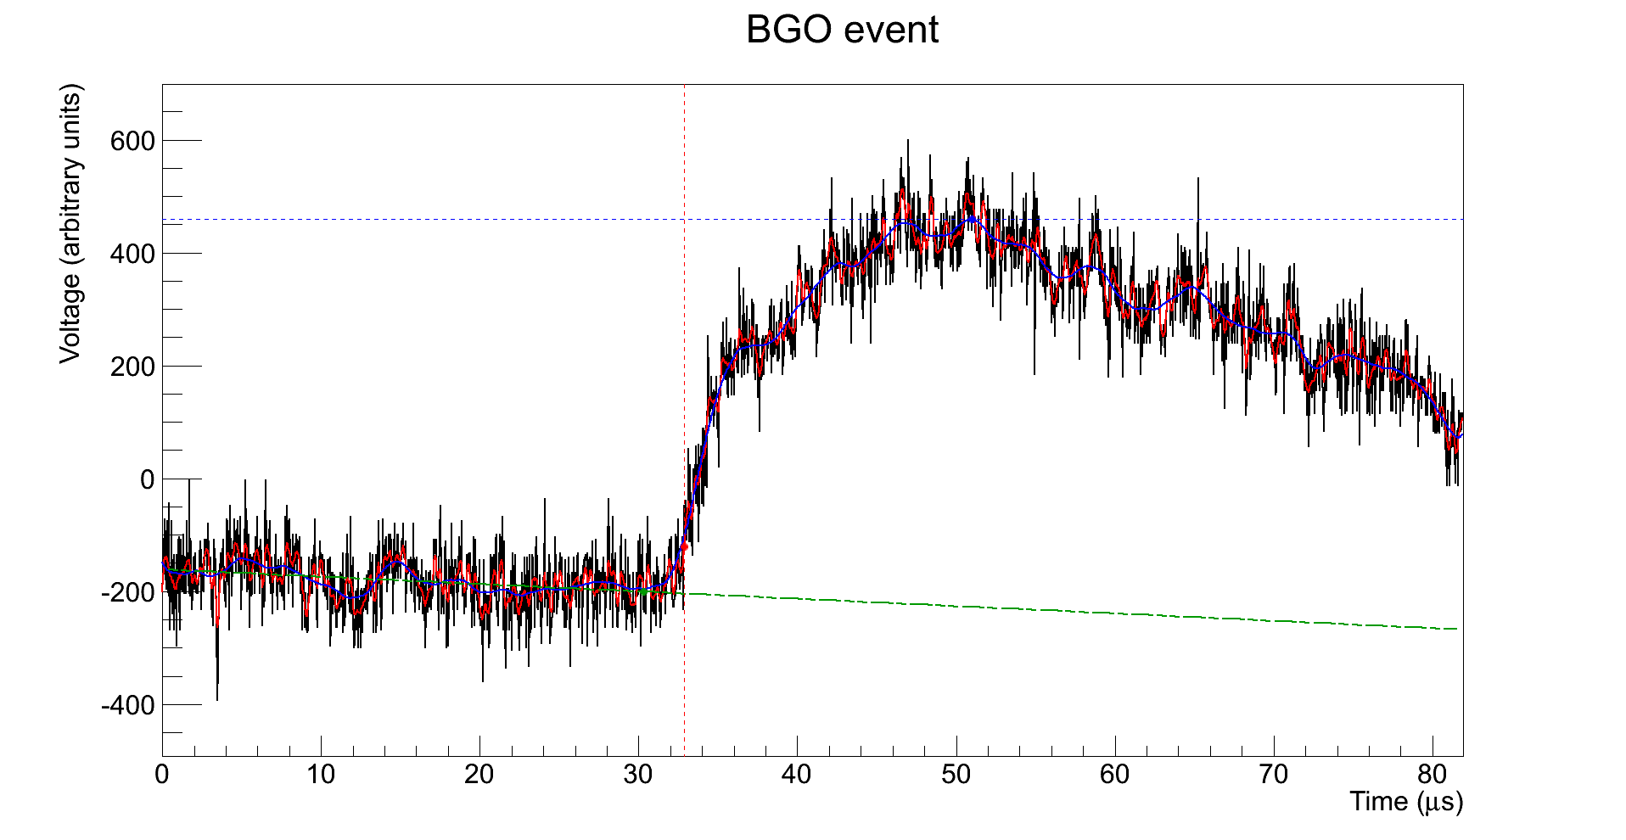
BGO – Smoothed
Eγ = 687.7
t0 = 32.88 μs

Slide 8
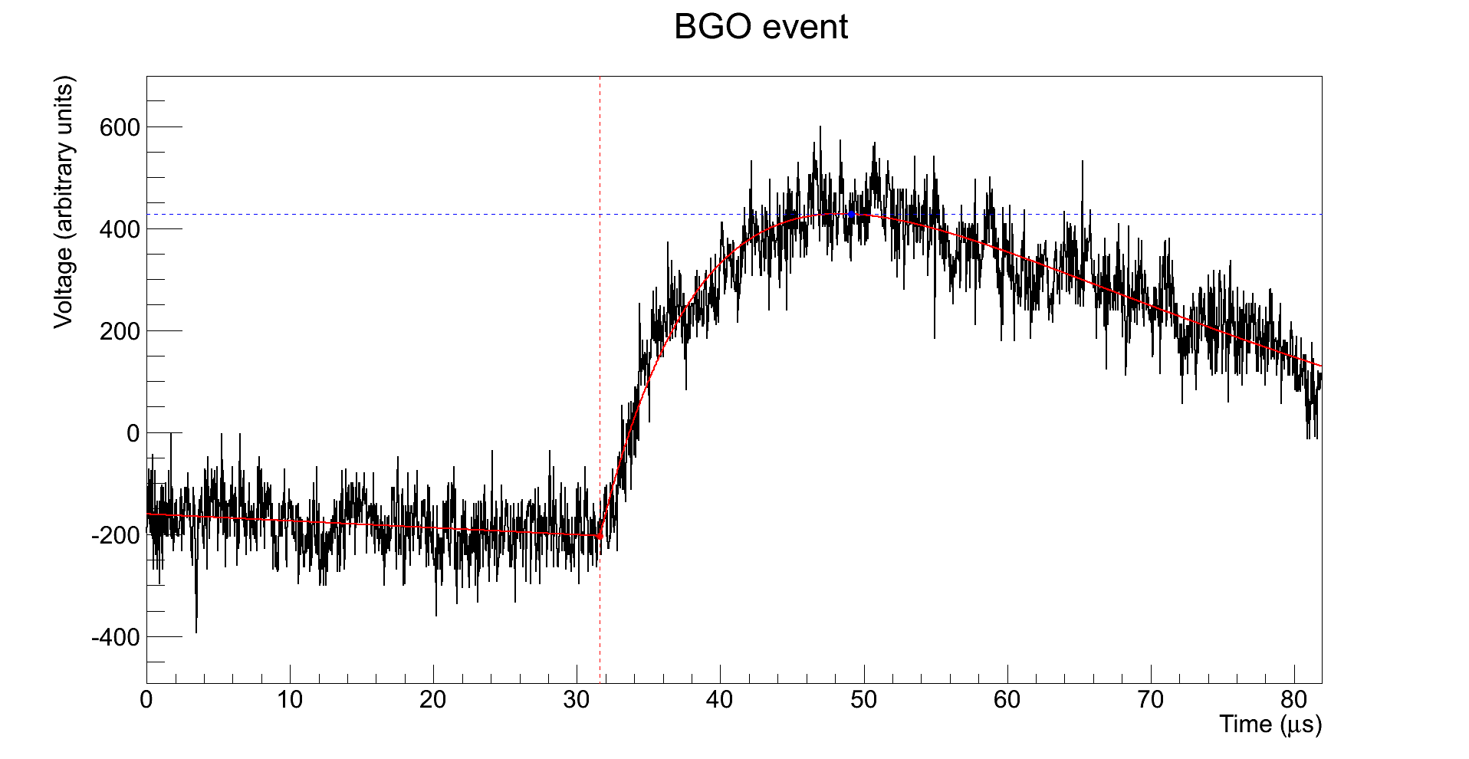
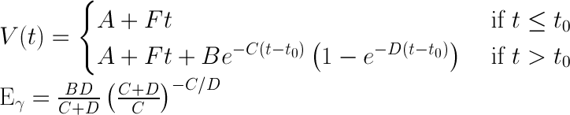
BGO – Full Signal Fit
Eγ = 654.6
≈ 20 keV
C ≈ 1 ∙ 10⁻³
D ≈ 5 ∙ 10⁻³
t0 = 31.61 μs

Slide 9
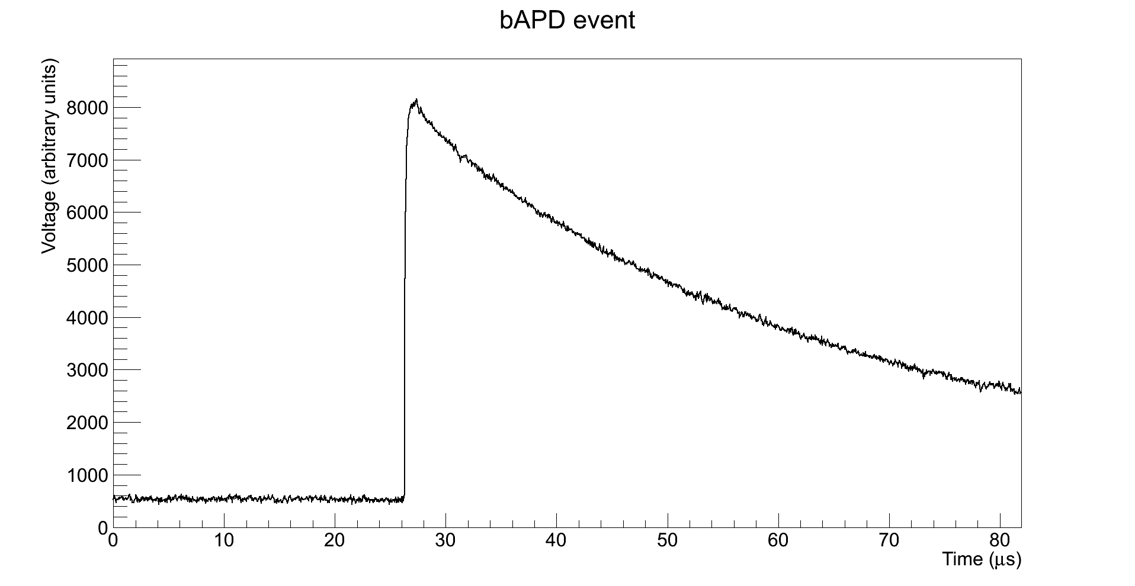
bAPD – Typical Signal

Slide 10
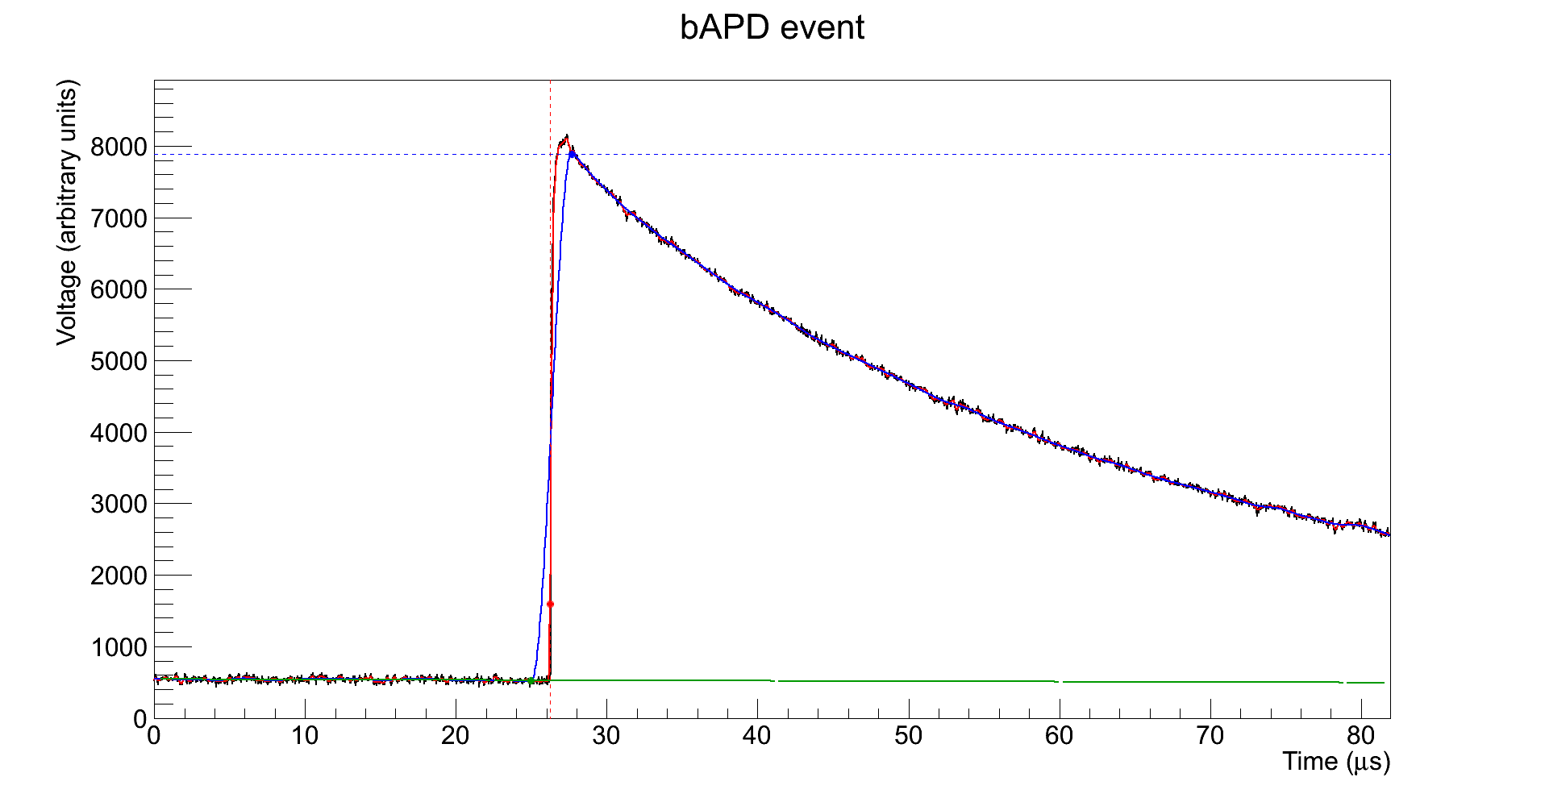
bAPD – Smoothed
Eγ = 7361.3
t0 = 26.24 μs

Slide 11
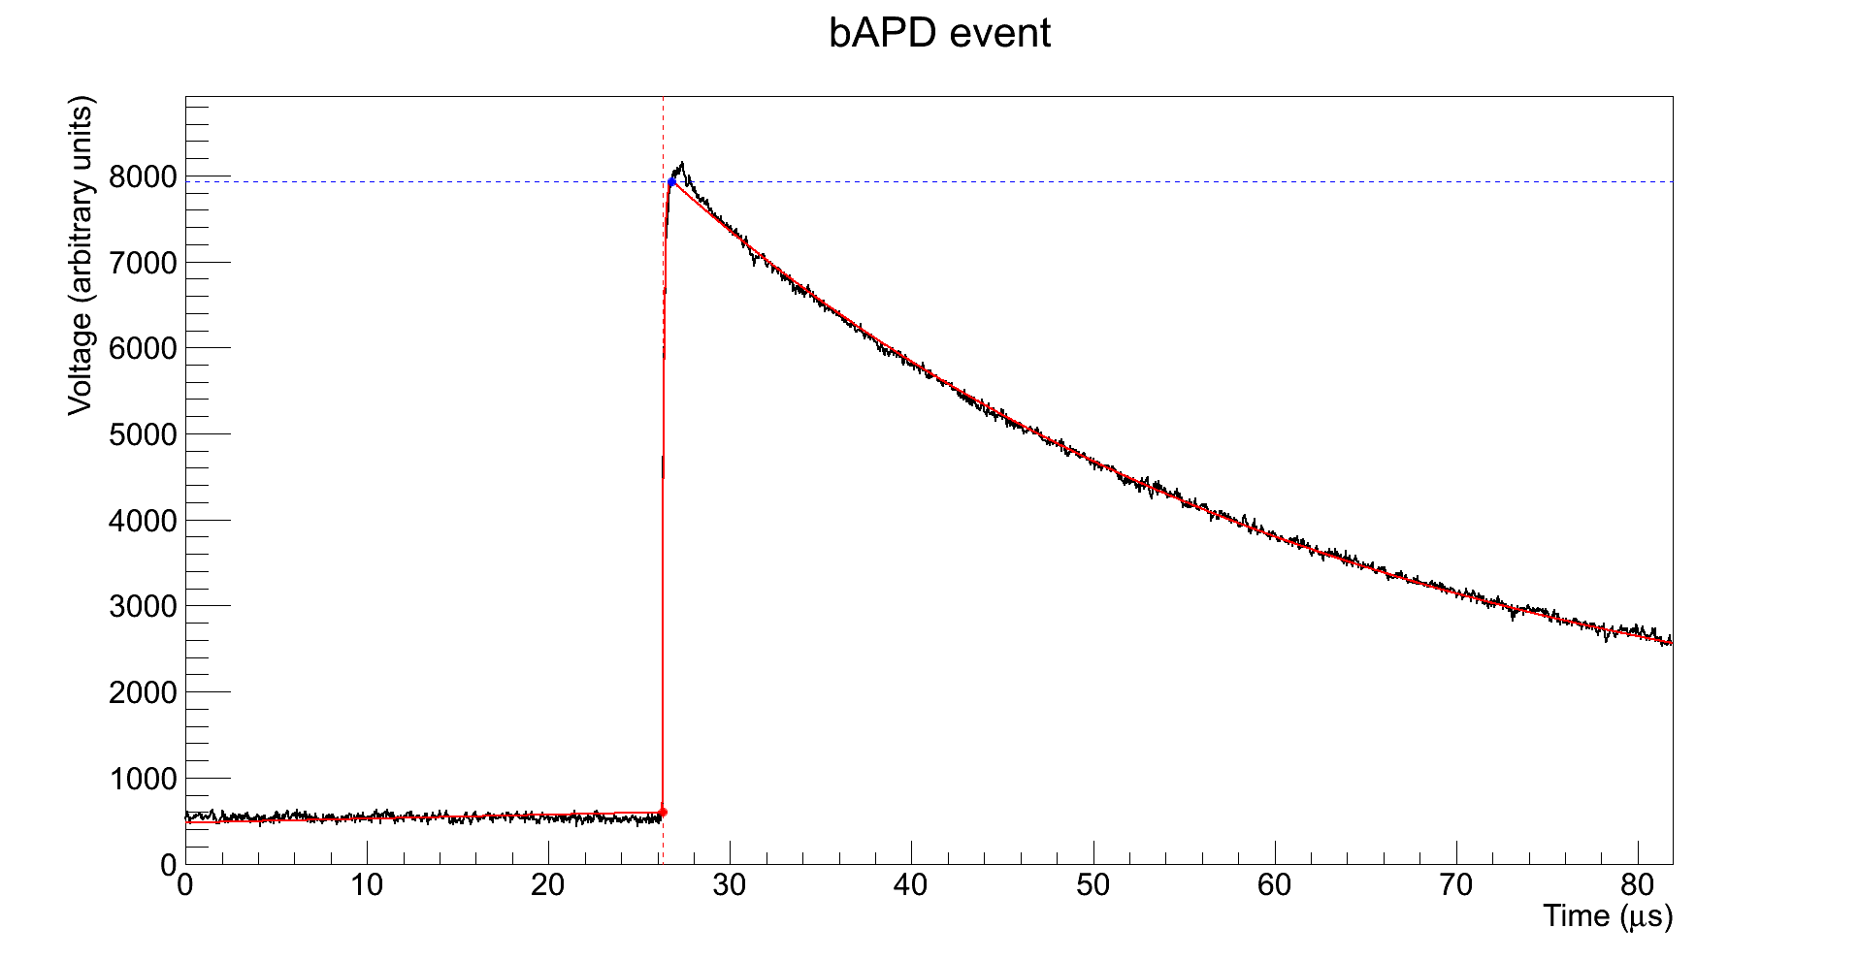
bAPD – Full Signal Fit
Eγ = 7326.3
≈ 10 keV
C ≈ 1 ∙ 10⁻³
D ≈ 1
t0 = 26.28 μs

Slide 12
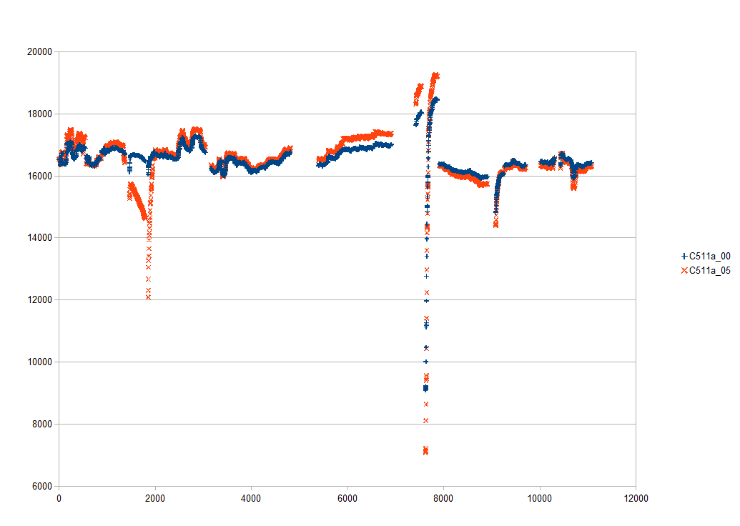
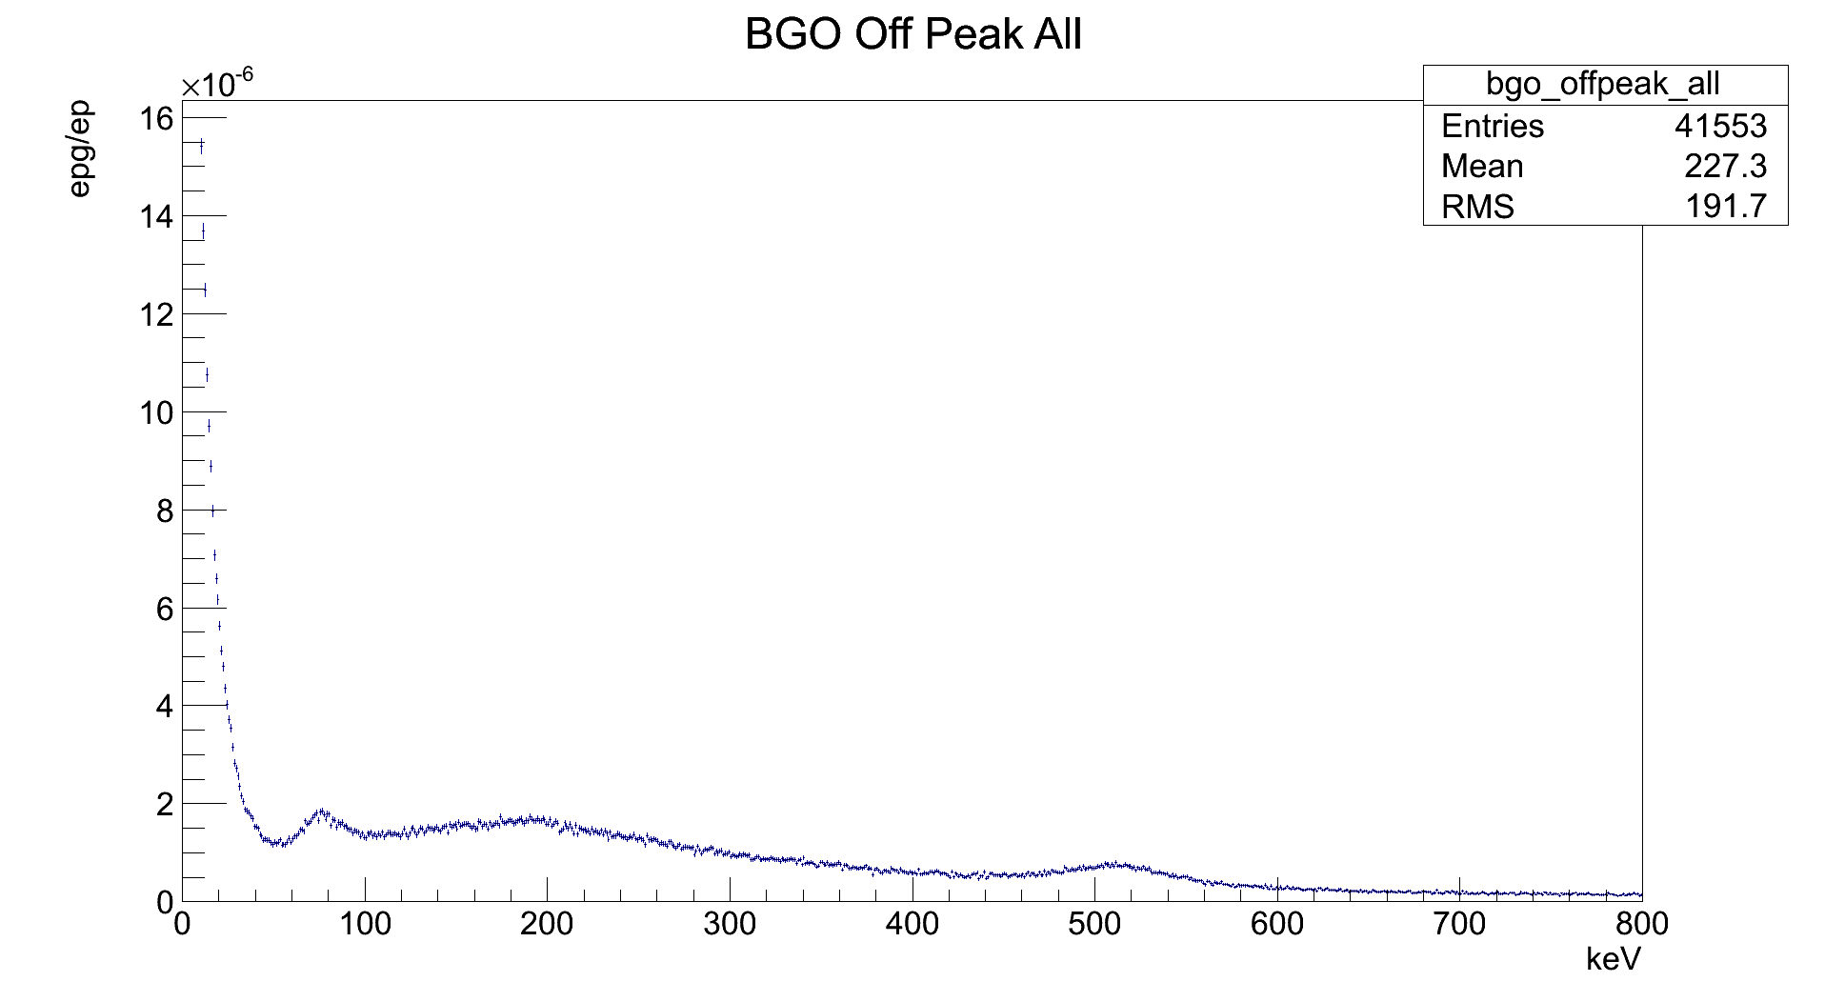
Calibration – BGO
Peak position
511 keV
Positron annihilation

Slide 13
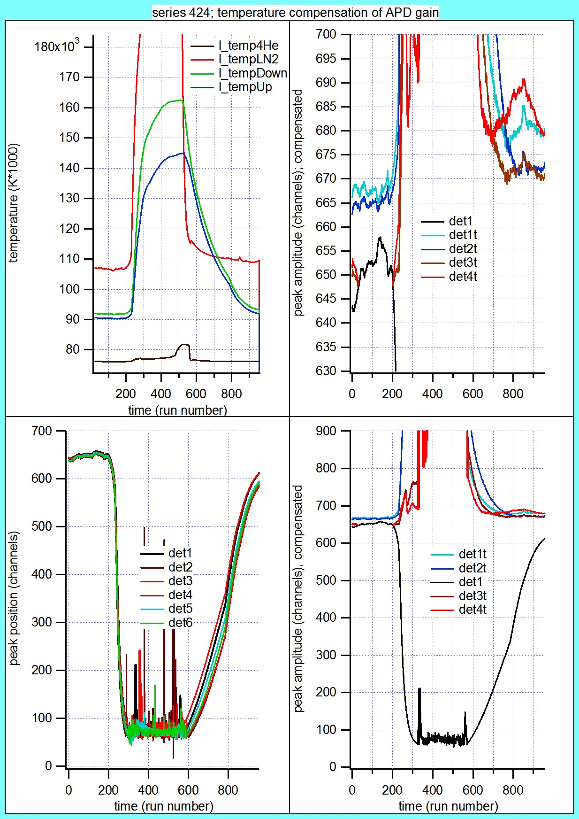
Calibration – BGO
511 keV
Positron annihilation

Slide 14
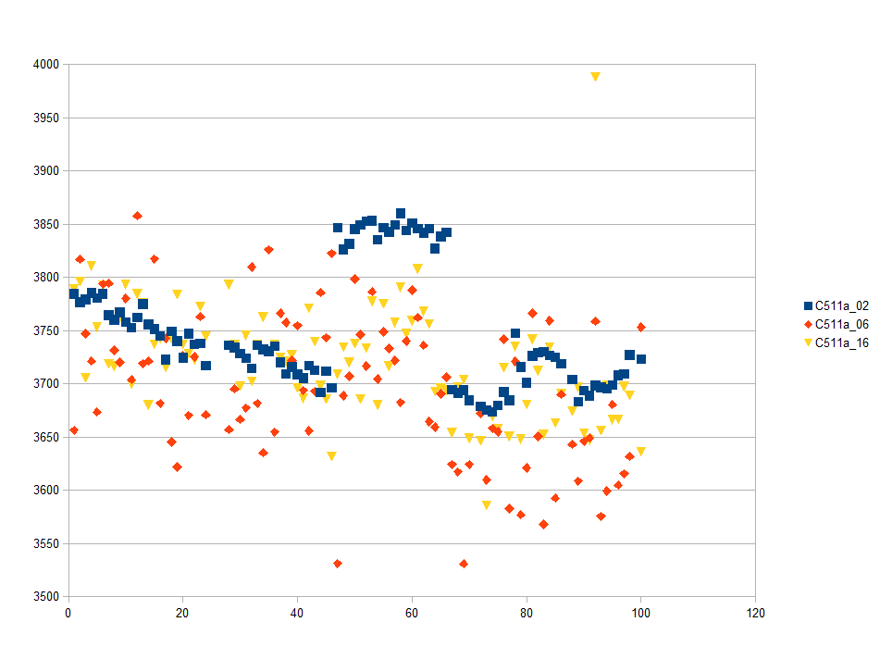
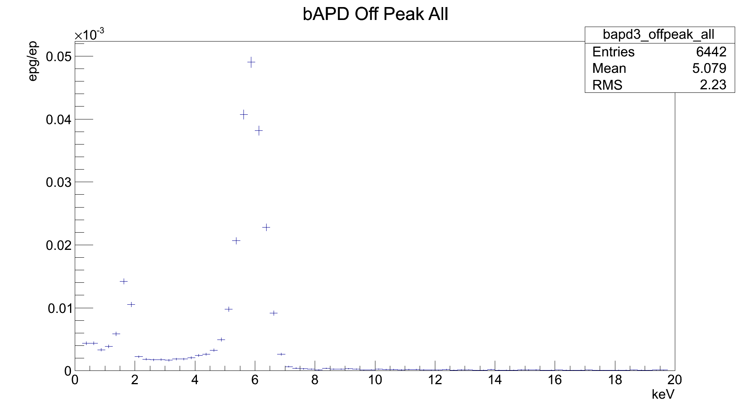
Calibration – bAPD
Peak position
5.9 keV
Iron X-ray

Slide 15
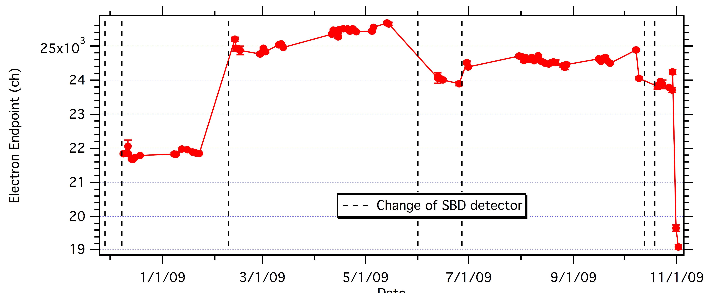
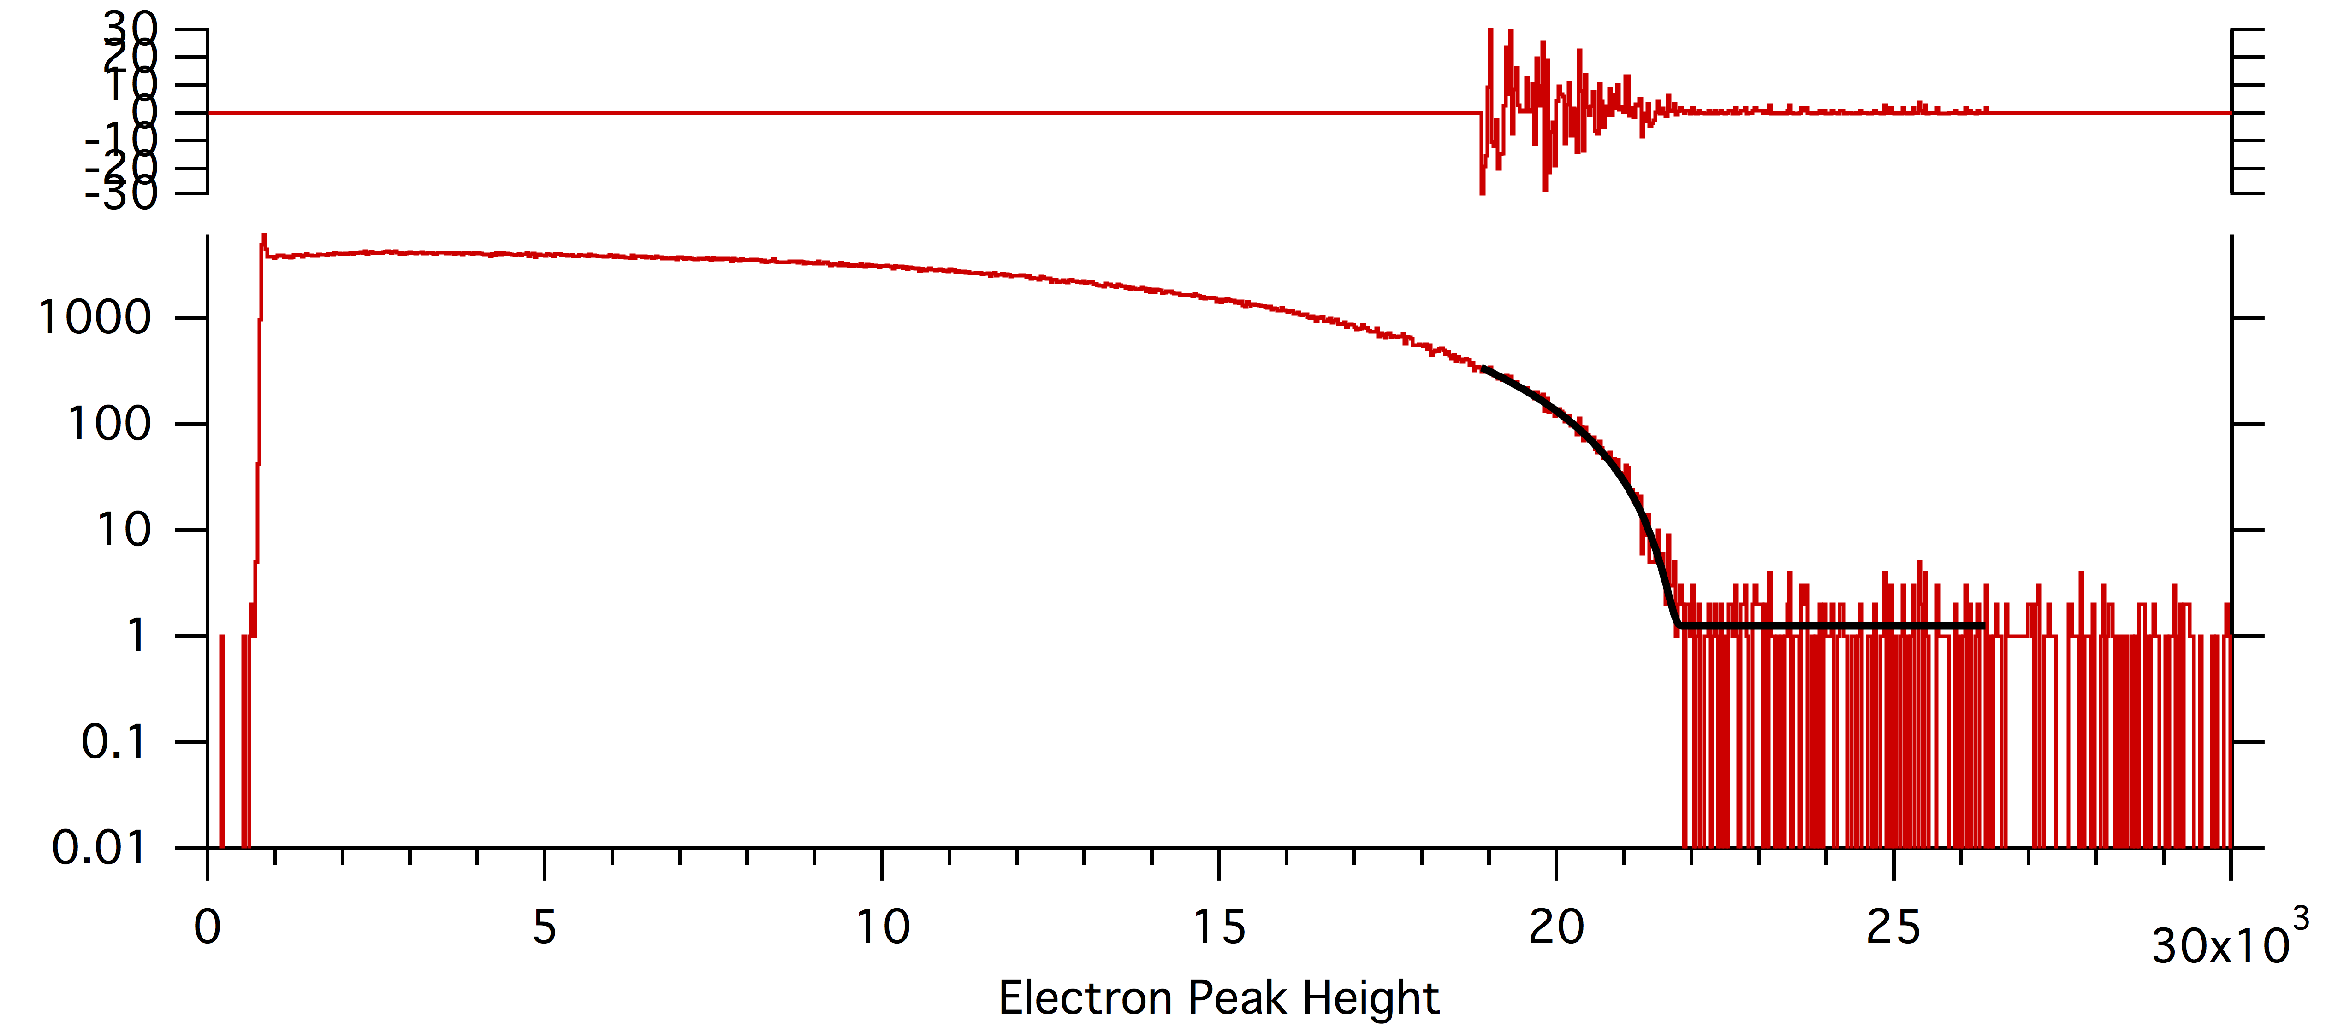
Calibration – SBD
782 keV
Electron endpoint

Slide 16
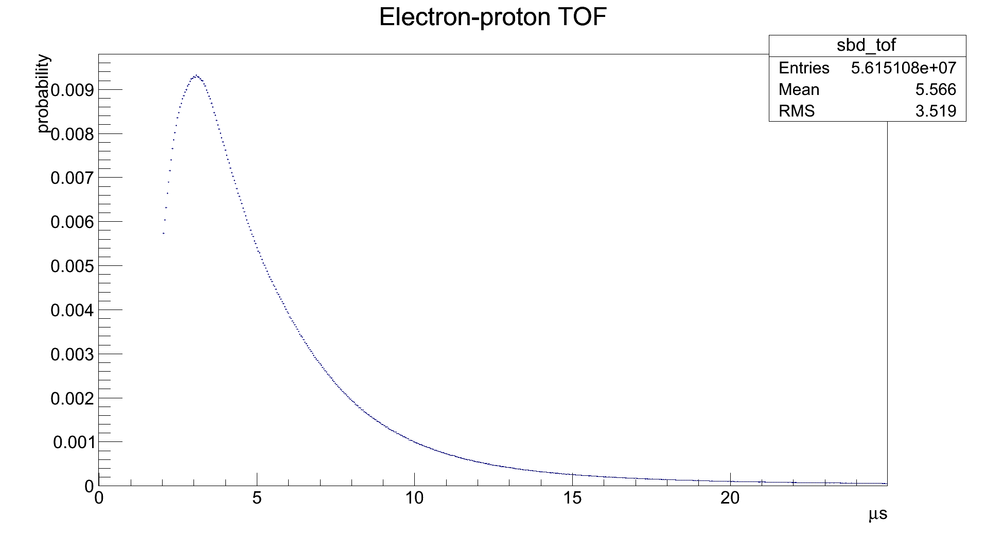
SBD – Timing Cuts
2 μs < tp - te < 25 μs

Slide 17
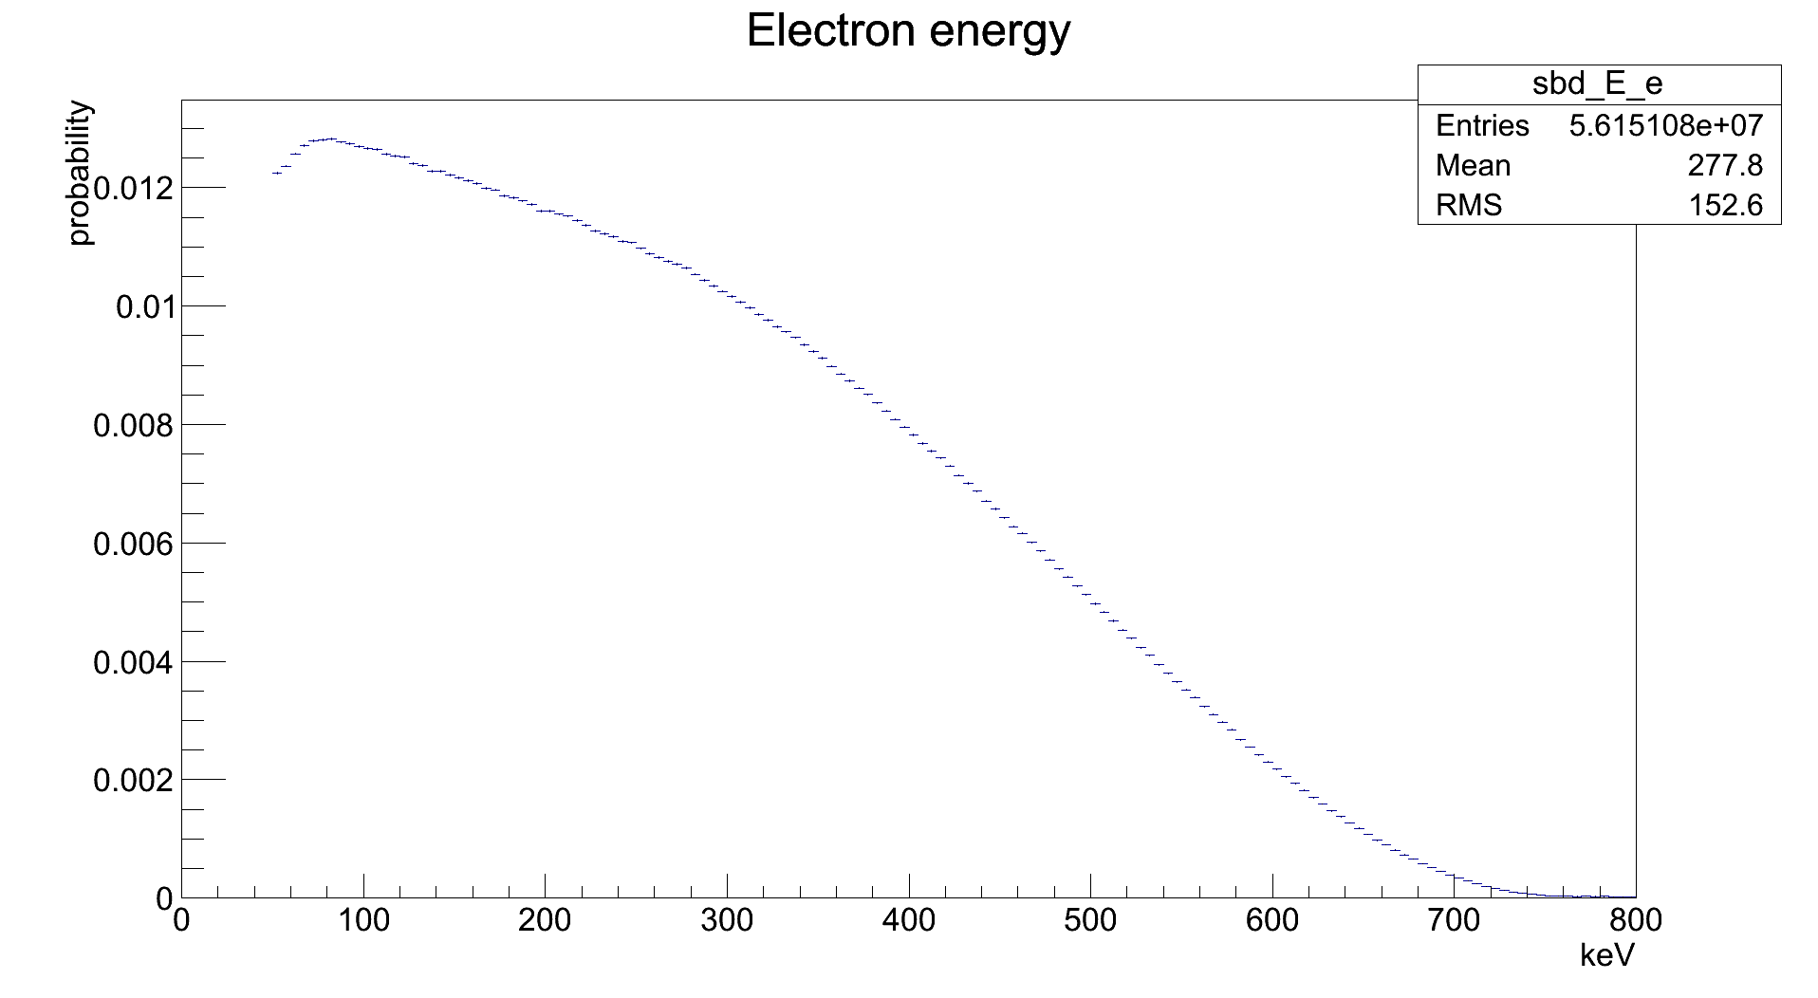
SBD – Energy Cuts
50 keV < Ee < 800 keV

Slide 18
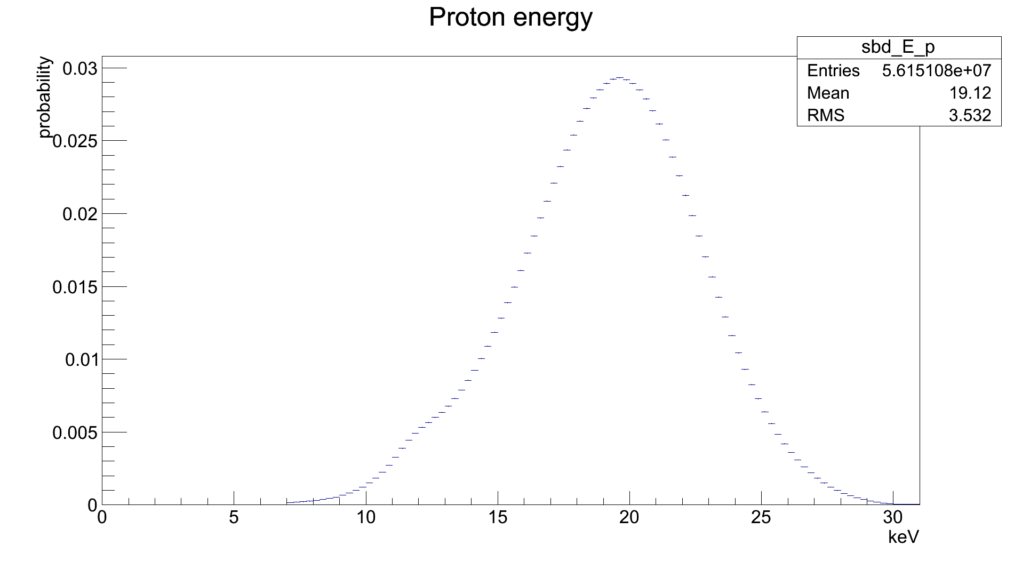
SBD – Energy Cuts
7 keV < Ep < 31 keV

Slide 19
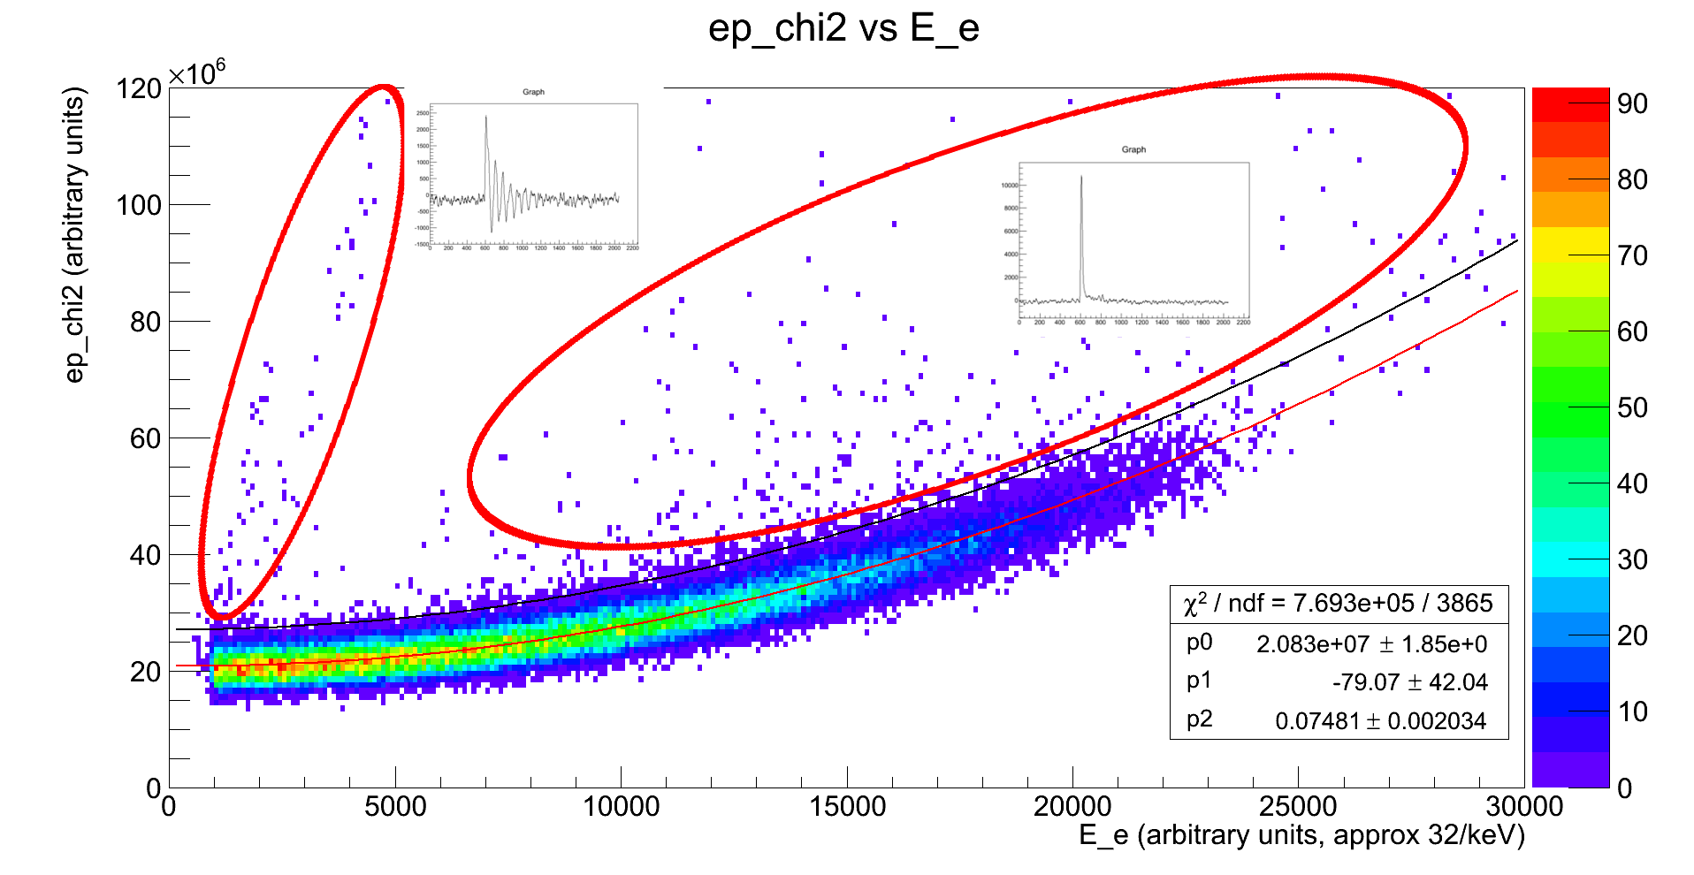
SBD – Signal Shape
Series 256 data.
Not yet implemented.

Slide 20
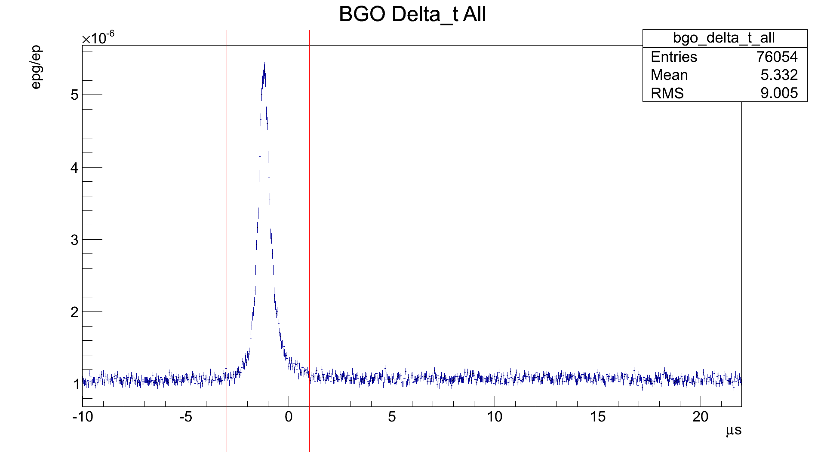
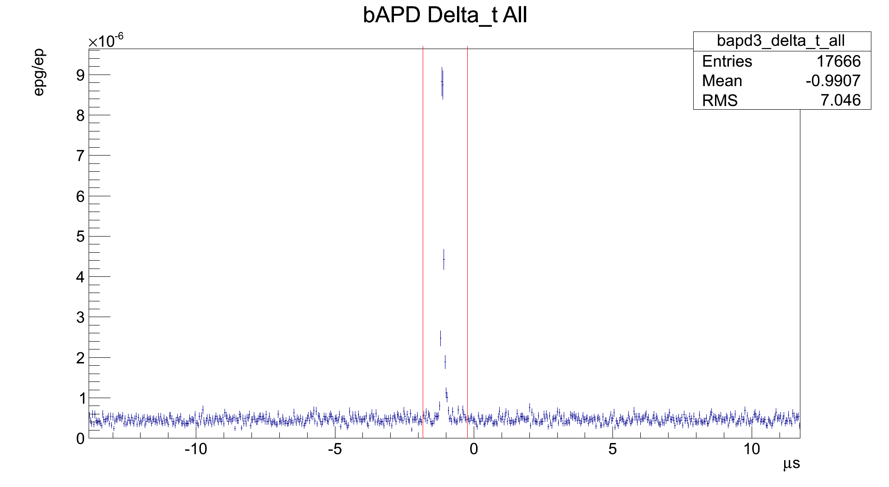
BGO/bAPD – Timing Cuts
-1.84 μs < Δt < -0.24 μs
-3 μs < Δt < 1 μs

Slide 21
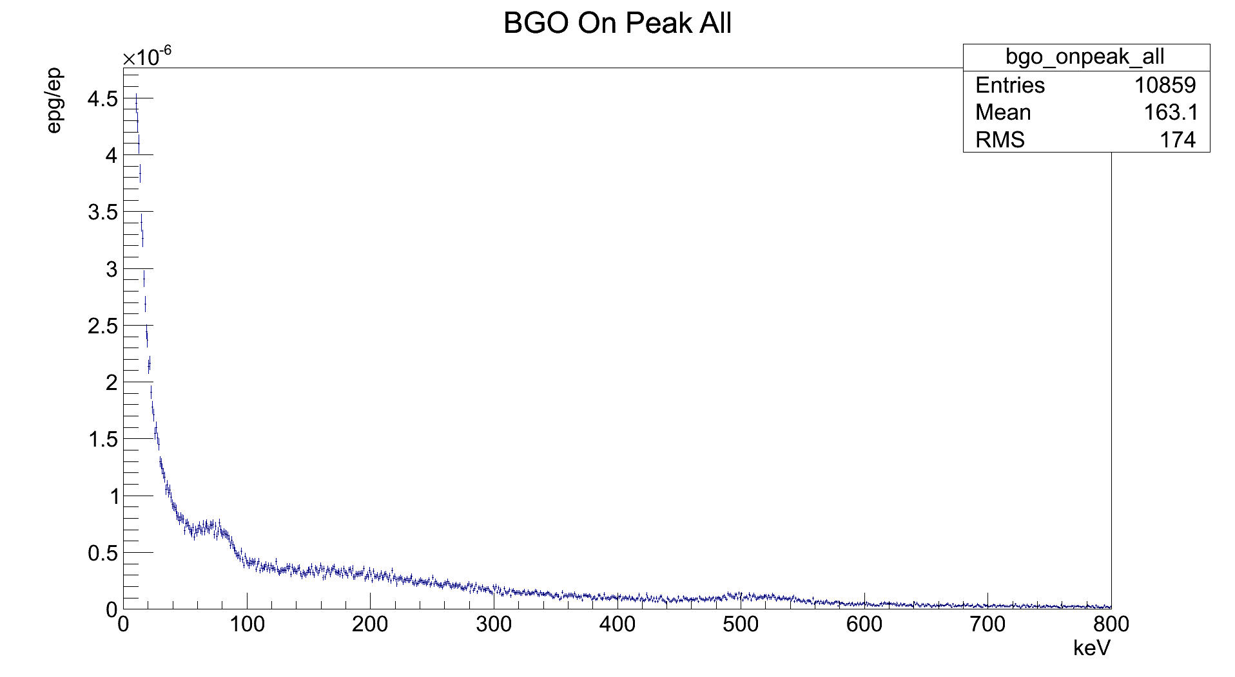
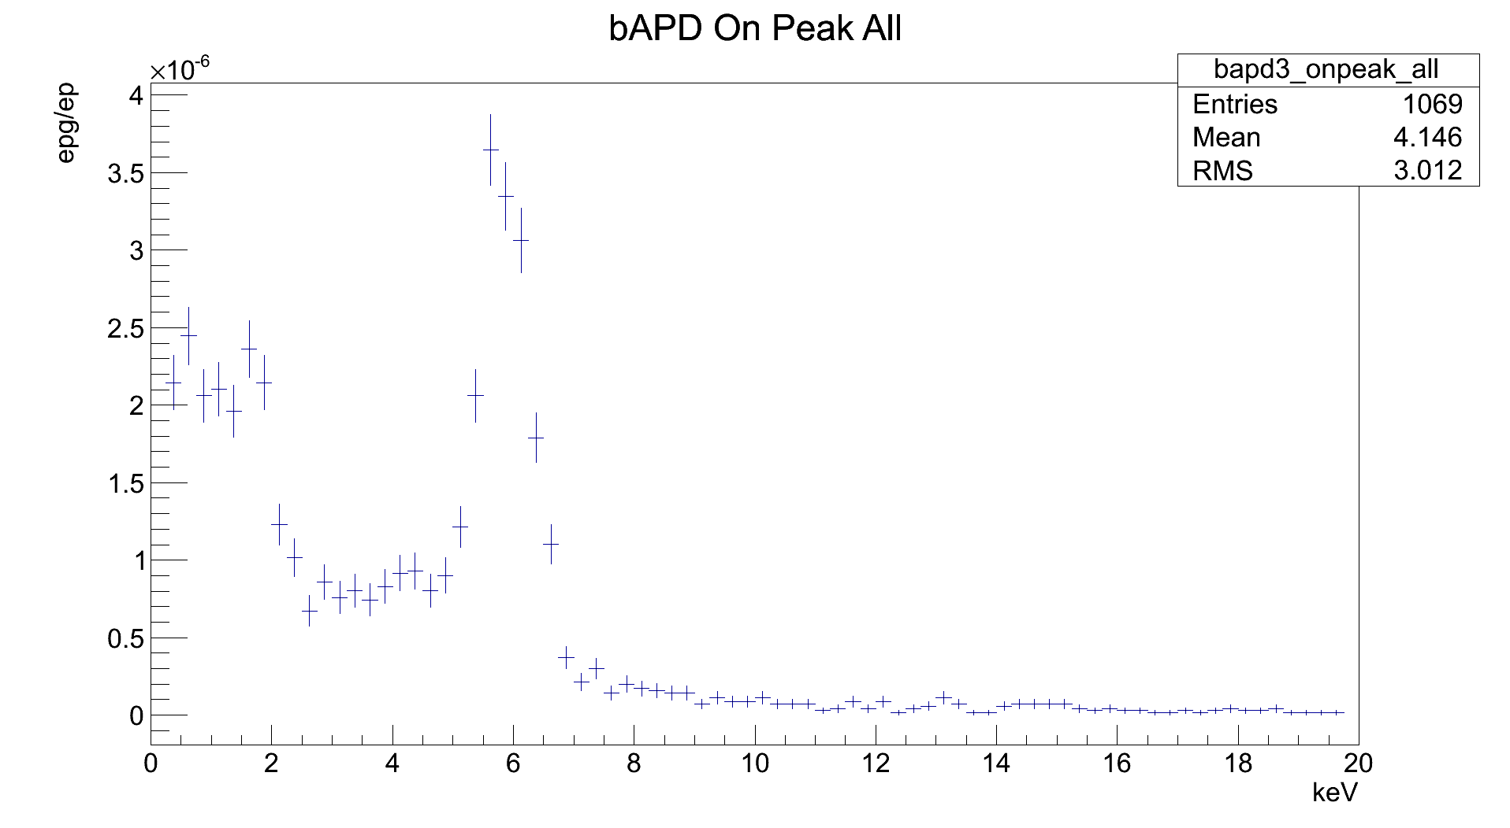
BGO/bAPD – Energy Cuts
0.25 keV < Eγ < 20 keV
10 keV < Eγ < 800 keV

Slide 22
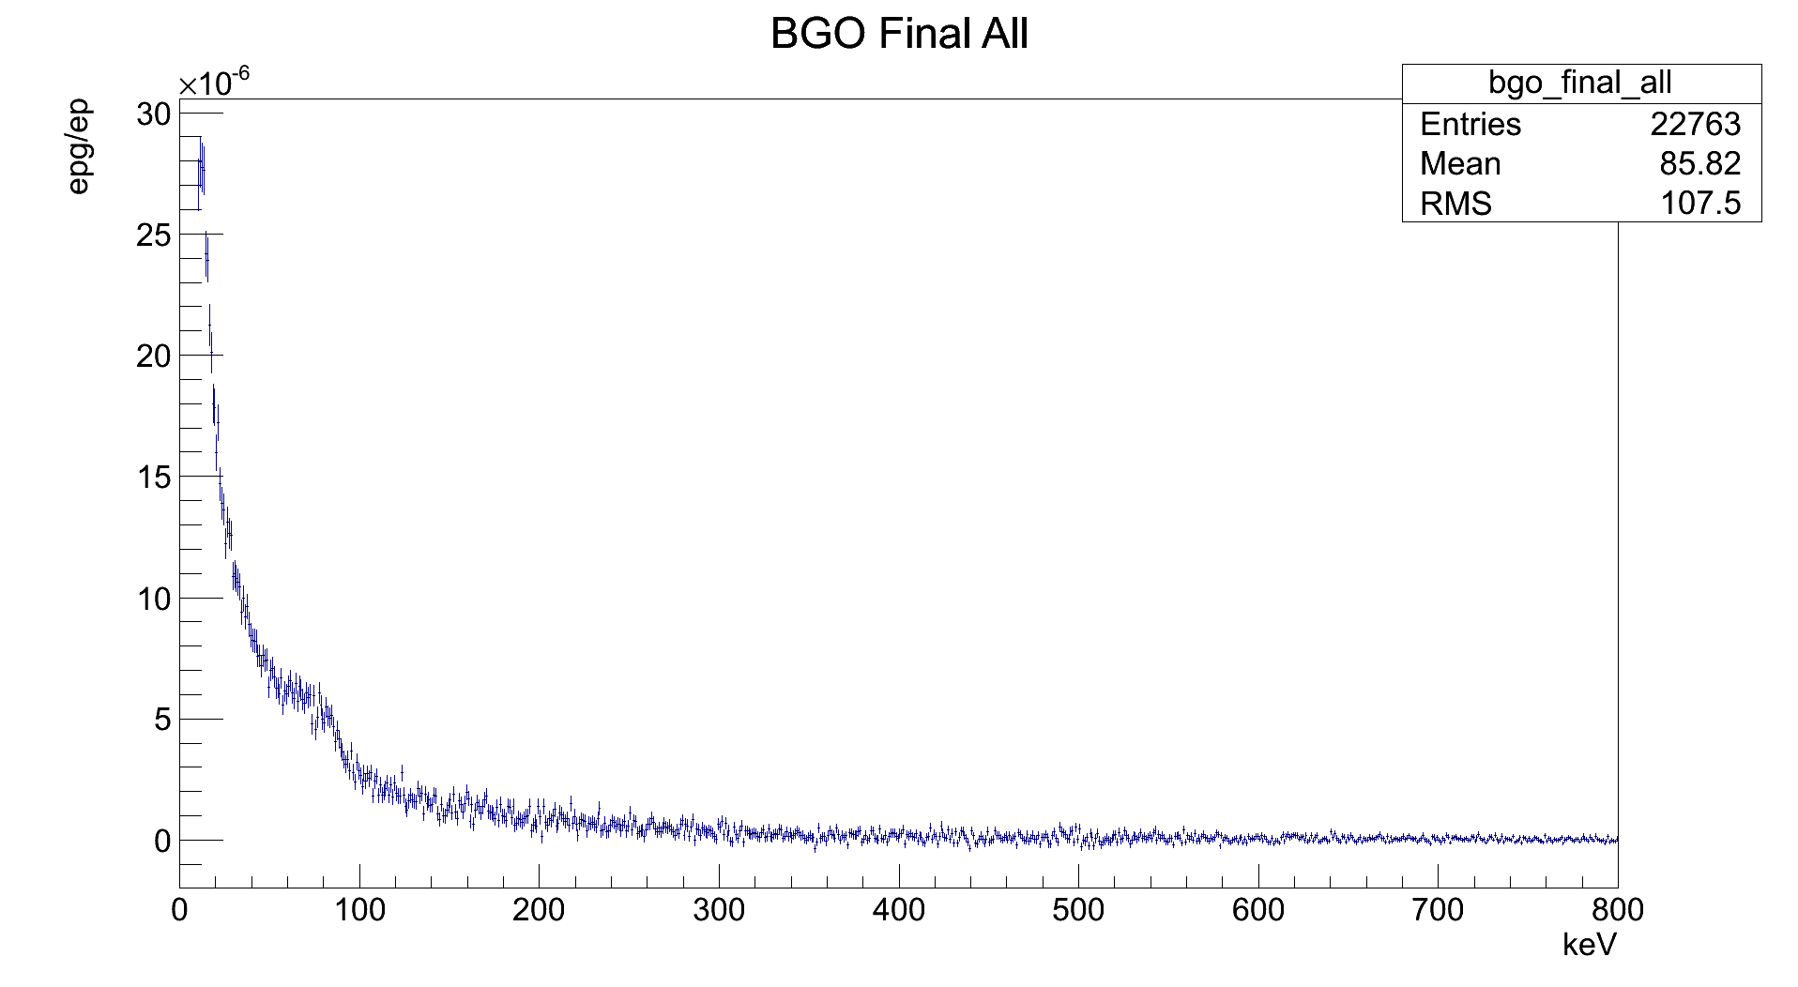
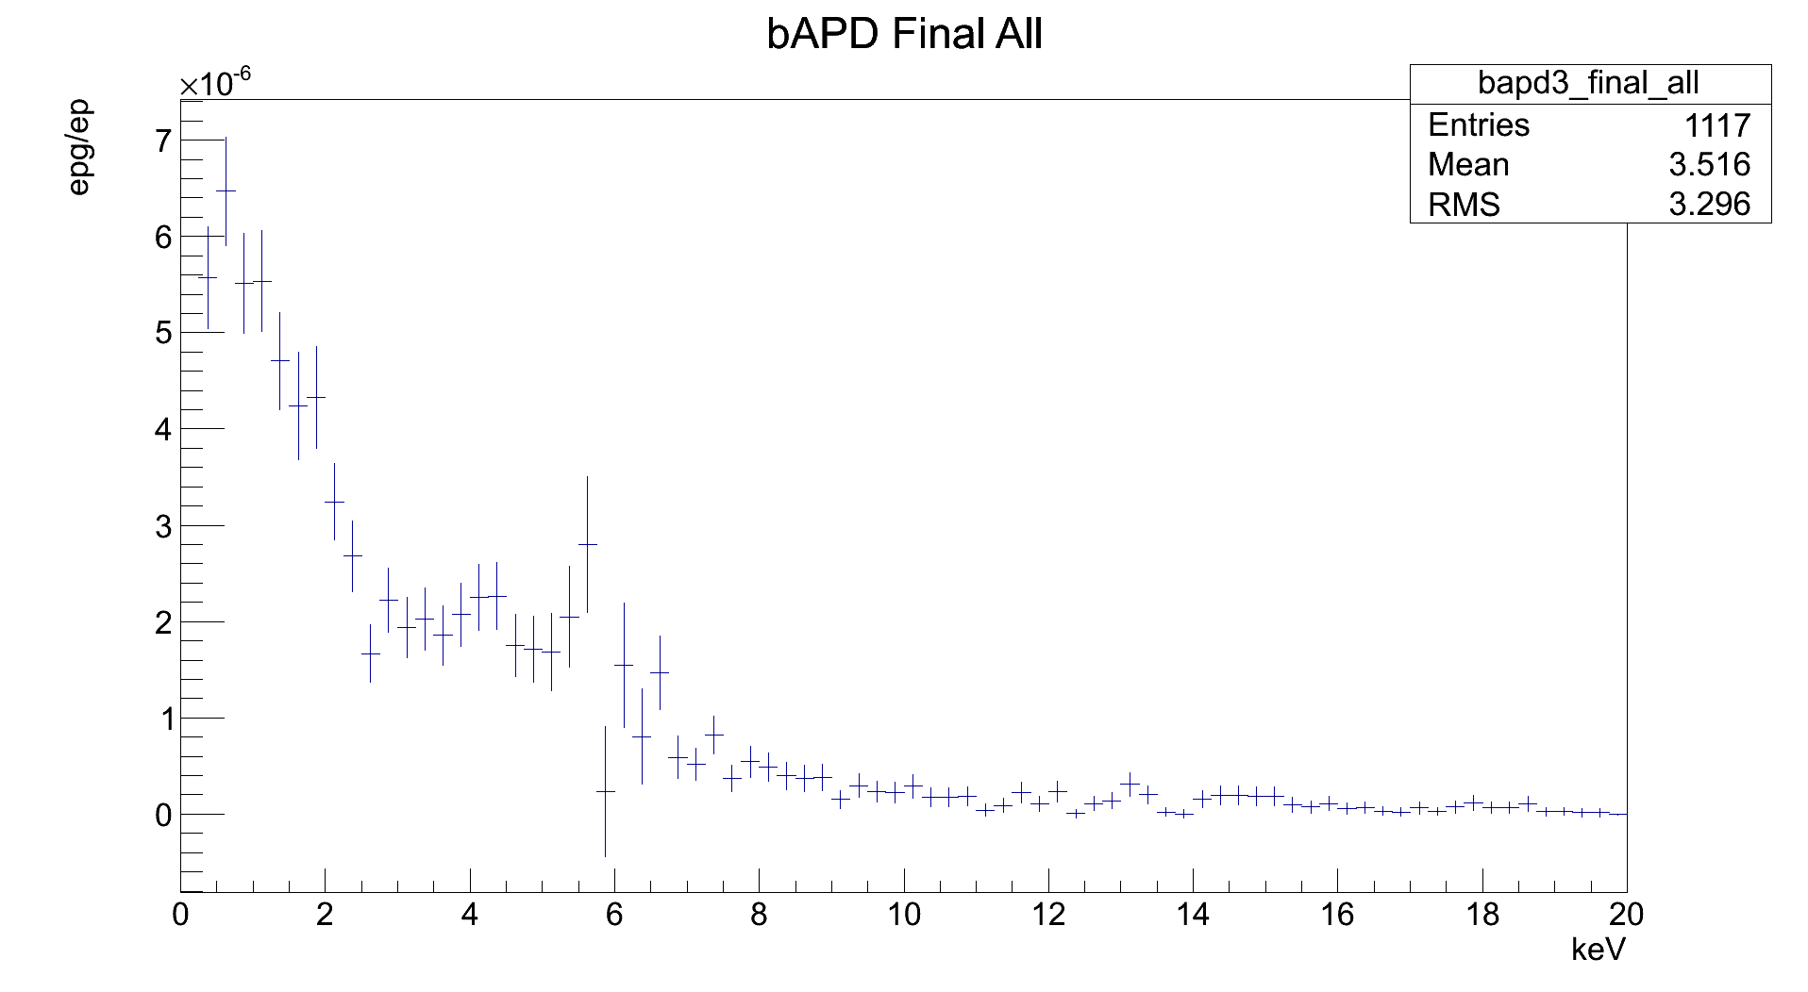
BGO/bAPD – Background Sub.
bAPD sum of 3 det.
epg = (8.23 ± 0.25) · 10⁻⁵
ep
BGO weighted average
epg = (8.893 ± 0.059) · 10⁻⁵
ep
Exp-MC = 18.95%
MC

Slide 23
What's Next
Finish chi2 cuts
  Series-by-series fits?
Recalibrate BGO
  Calibration based on old analysis
Check bAPD fits

