Slide 1
Precision Measurement of the Radiative Decay Mode of the Free Neutron
Benjamin O'Neill
PhD Defense
November 16, 2012

Slide 2
Motivation
Neutron discovered in 1932 by James Chadwick
Shortly thereafter discovered to be unstable
  n→p⁺+e⁻+νe
Classical EM and QED predict radiative decay
Leading order calculations can be done in QED
Observed in nuclear beta decay as early as 1953
First observed in free neutrons in 2005

Slide 3
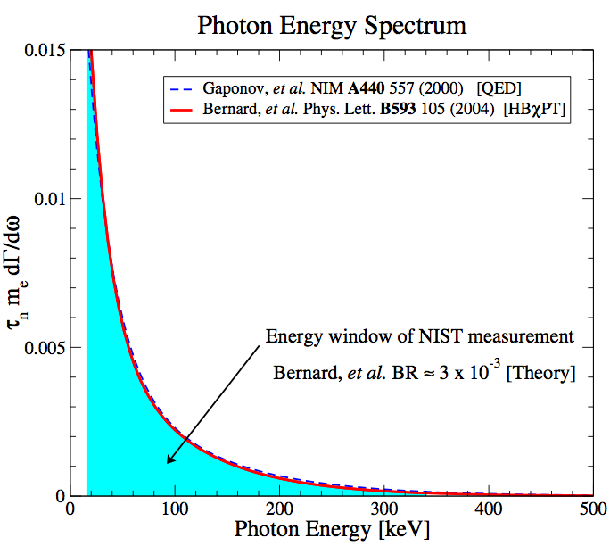
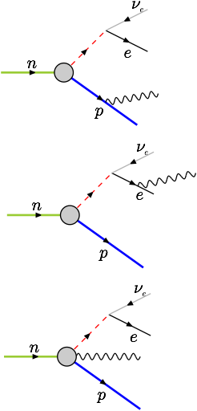
Motivation
n→p⁺+e⁻+νe+γ
782 keV free energy
RDK I branching ratio^{1,2}
(3.09 ± 0.32) x 10⁻³
¹Nico, J. S. et al. Nature 444, 1059–1062 (2006)
²Cooper, R. L. et al. PRC 81, 035503 (2010)

Slide 4
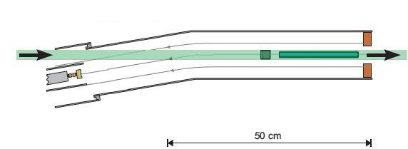
First Observation: RDK I
B-field line
BGO+APD (below beam)
Cold neutron beam
(<20meV peaked at 2-5meV)
Shield
Electrostatic mirror
1400V (varies)
SBD
-25kV
Nico et al., National Institute of Standards and Technology (NIST) 2005
Branching ratio for 15-340keV = (3.09±0.32)·10⁻³
4.6T superconducting magnet
9.5º bend

Slide 5
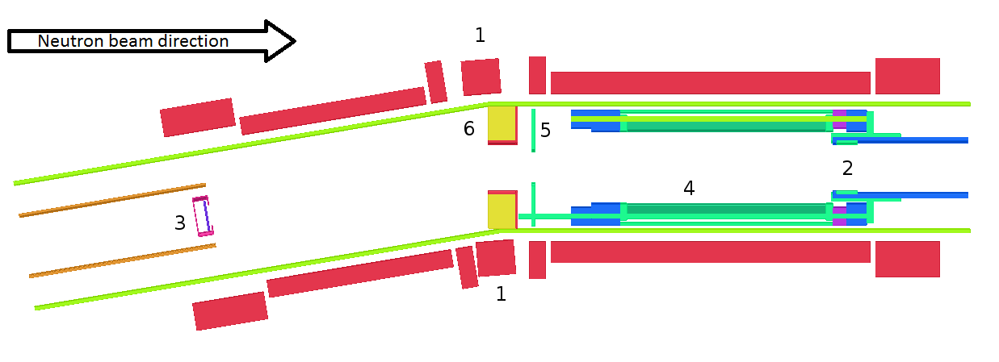
RDK II Experimental Setup
Pb shield
12 element BGO+APD array
bAPD array
HV Mirror
SBD
Improve accuracy to O(1%) on BR
New detectors
  12 BGO+APD
  3 bAPD (installed later)
Expanded energy range
  BGO: <10keV to endpoint
  bAPD: <1keV to ≈10keV
Improved statistics: 0.6% for BGO, 2.9% for bAPD

Slide 6
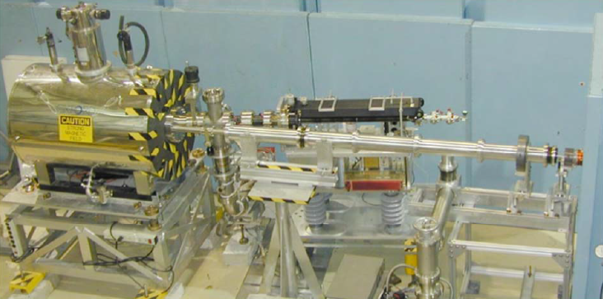
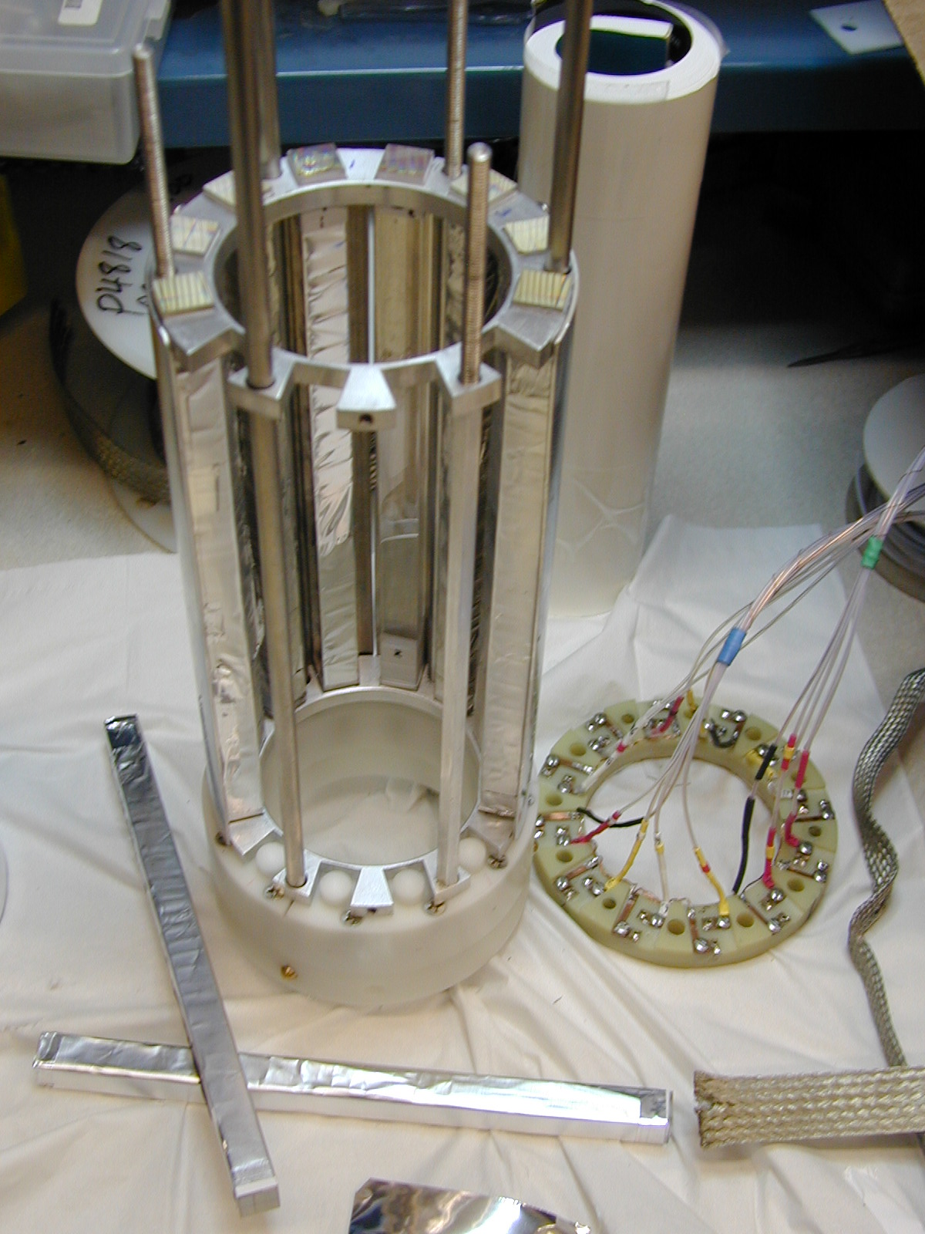
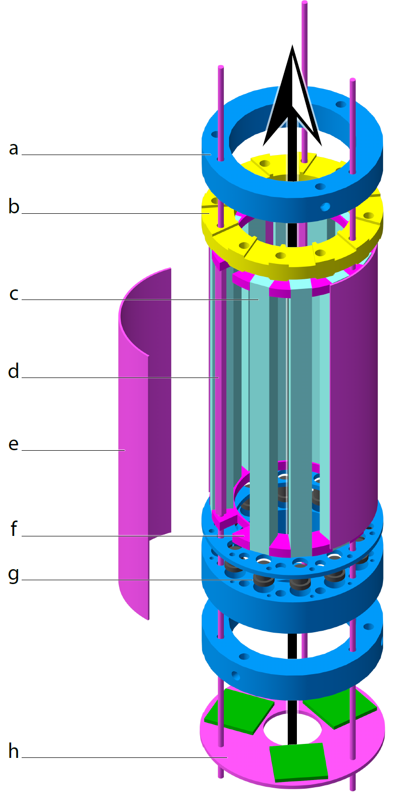
RDK II Experimental Setup

Slide 7
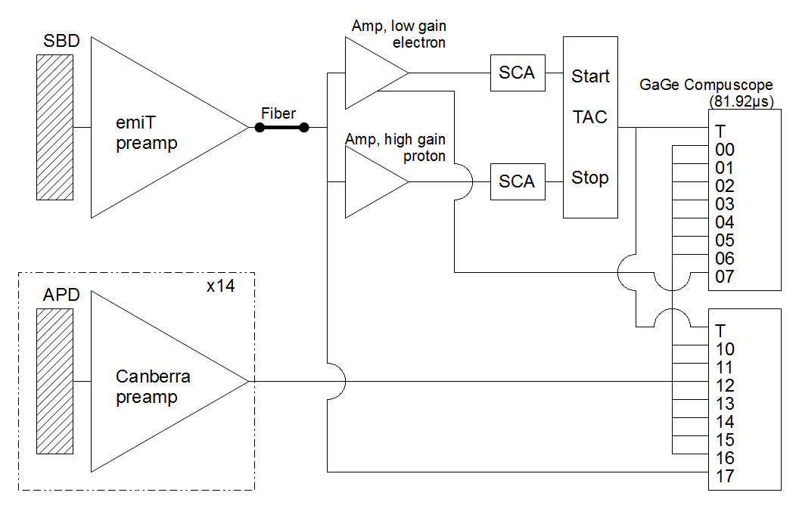
RDK II Data Acquisition
Electron start, proton stop trigger
SBD electrically isolated
Waveforms recorded
  Less hardware noise
  Distinguish false triggers
  Check on hardware

Slide 8
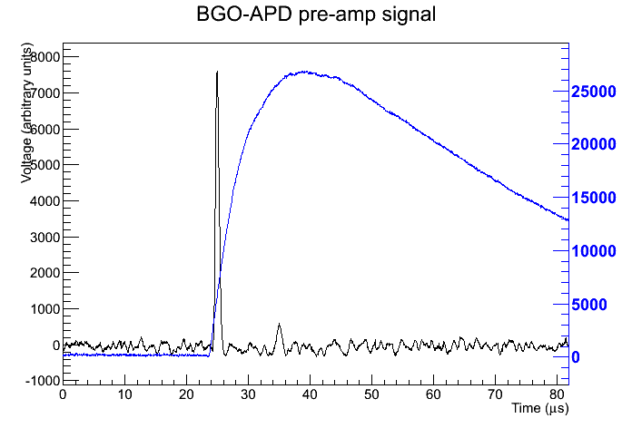
RDK II Signal
Electron
energy
and time
Photon energy
Photon time
Proton energy and time

Slide 9
RDK II Signal Analysis
Two independently developed algorithms – Jeff Nico at NIST
Criteria
  Peak height at least 300 units above minimum
  Peak precedes the minimum – no trailing edges
  Peak not at edges of trace window – full signal trace
  Peak is below 30000 units – saturation level
  No spikes – some pathological signals
Baseline
Smooth
Determine energy and time

Slide 10
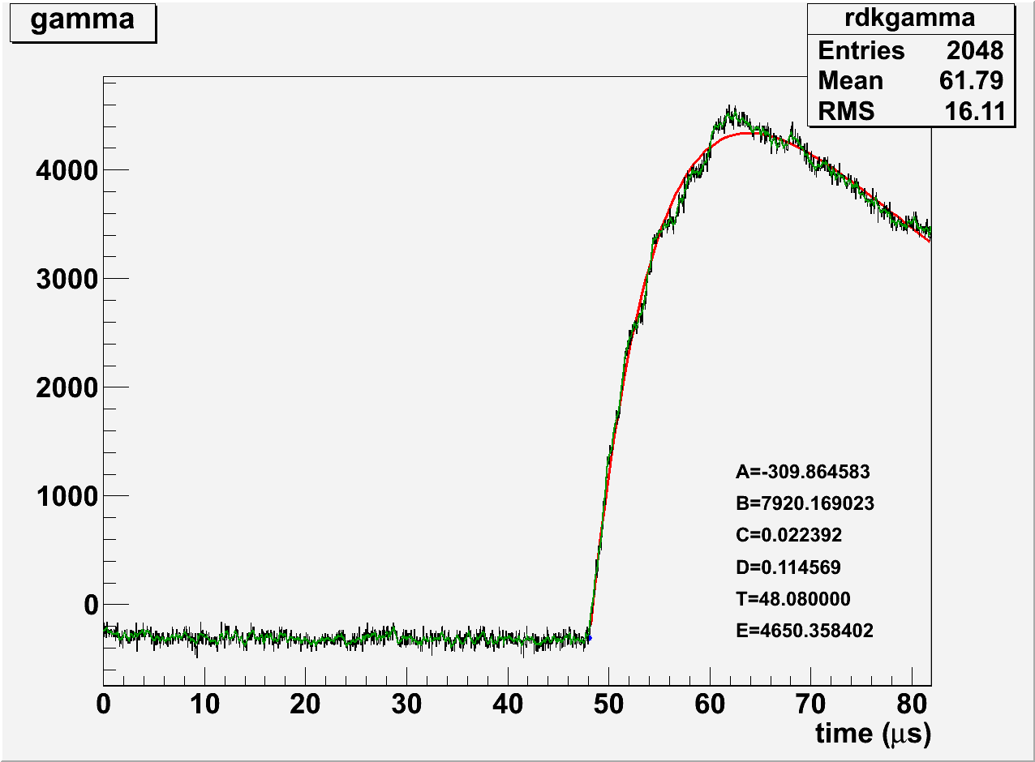
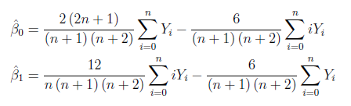
RDK II Signal Analysis

Slide 11
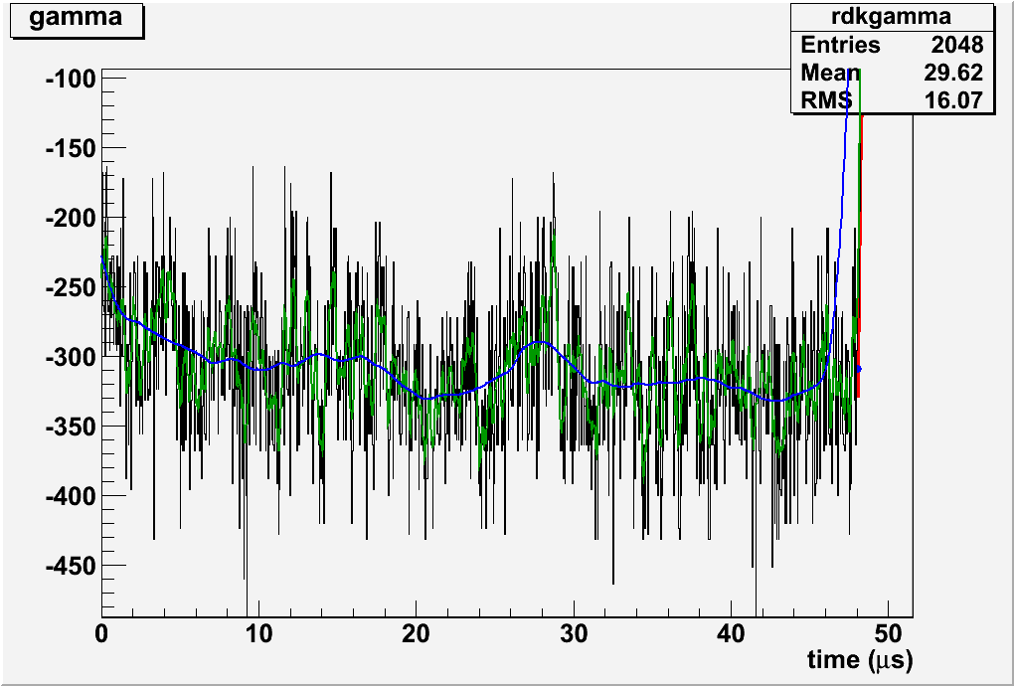
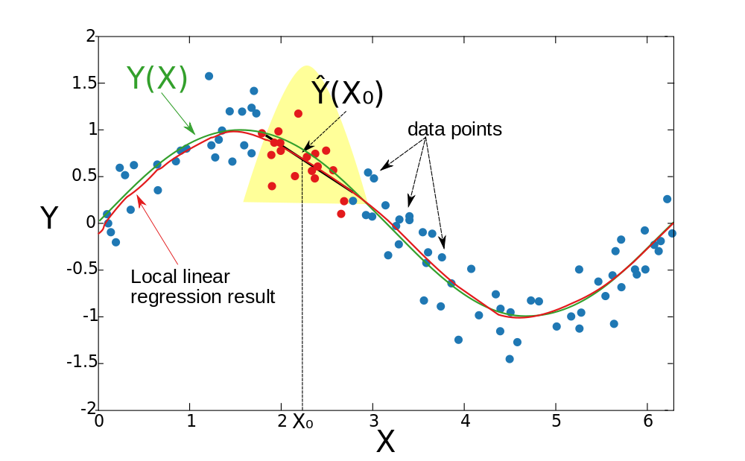
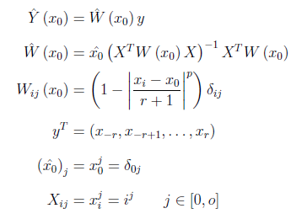
RDK II Signal Analysis
Green – Narrow smoothing (timing)
Blue – Wide smoothing (energy)

Slide 12
RDK II Signal Analysis

Slide 13
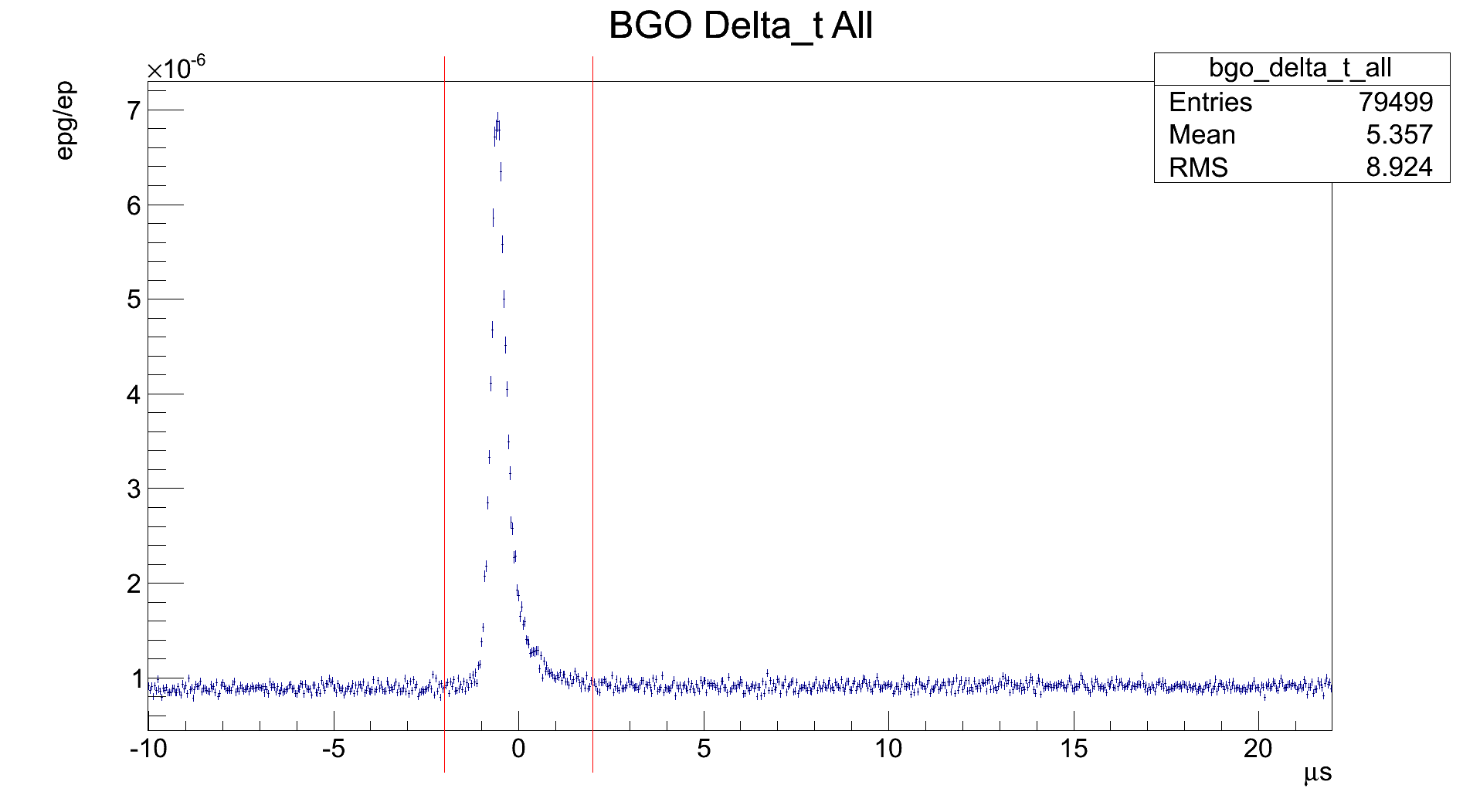
RDK II Current Results
On-peak window
Off-peak windows
Triple coincidence peak
Photon timing relative to electron
BGO

Slide 14
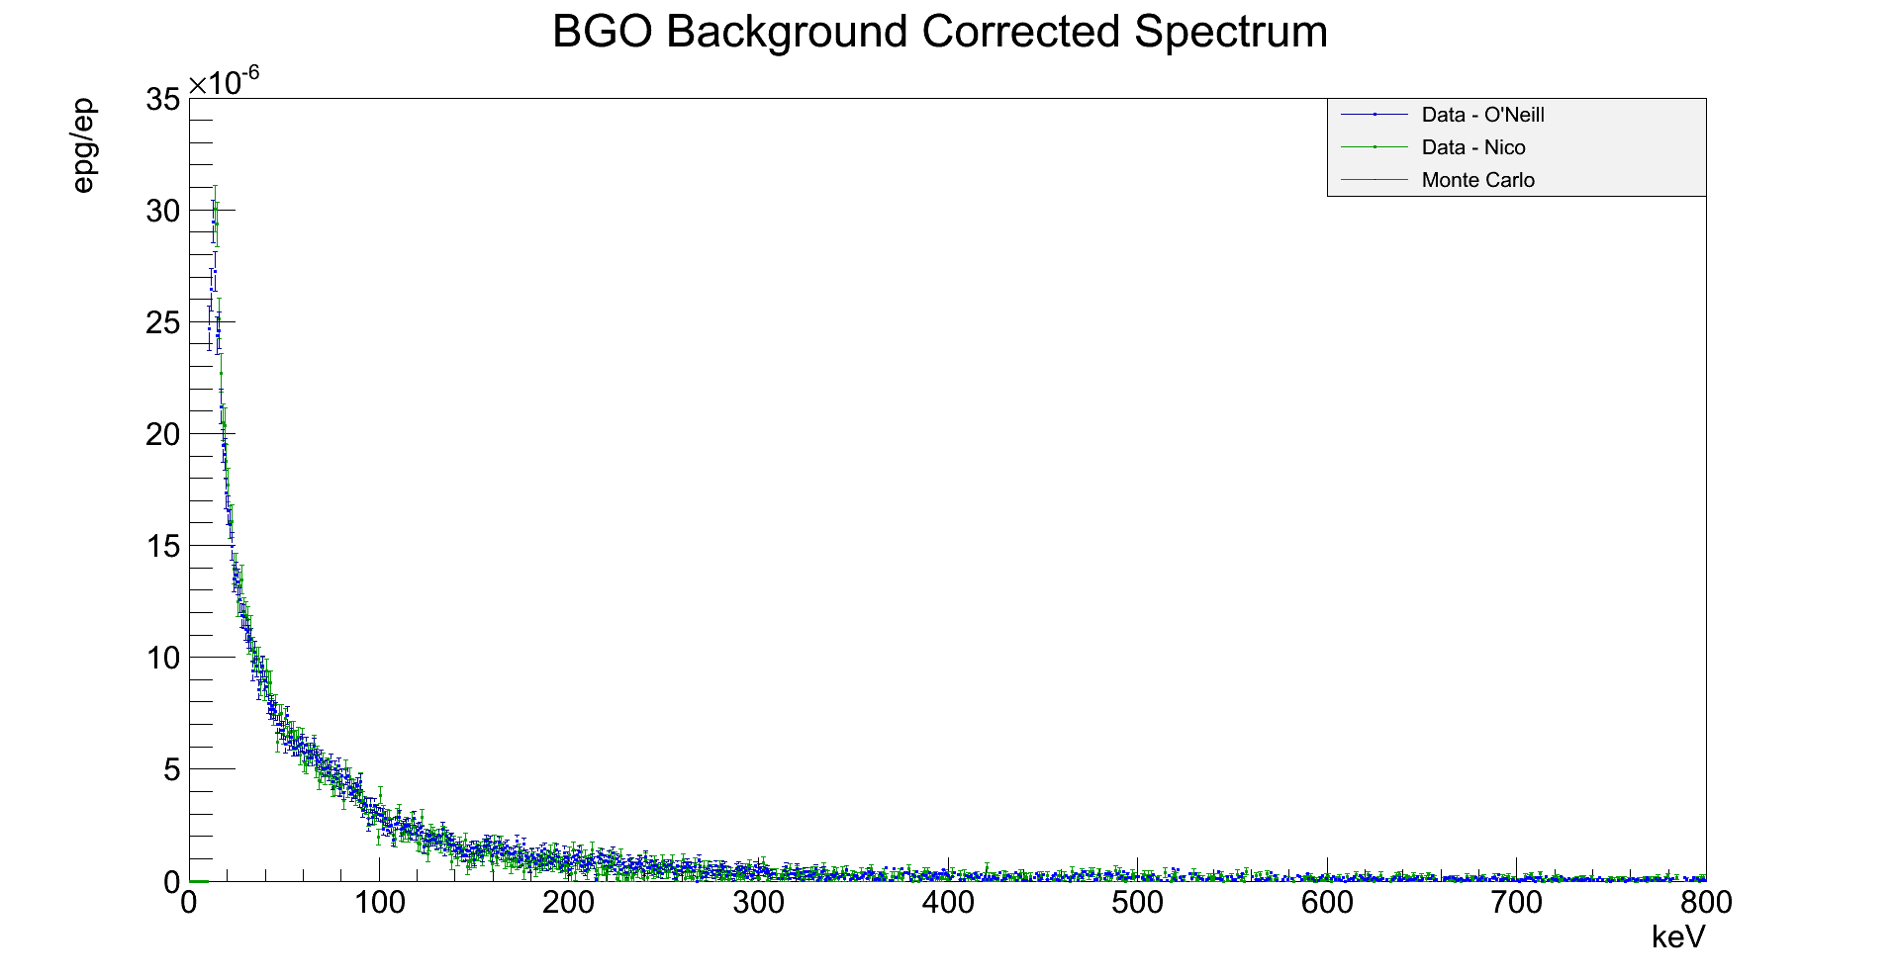
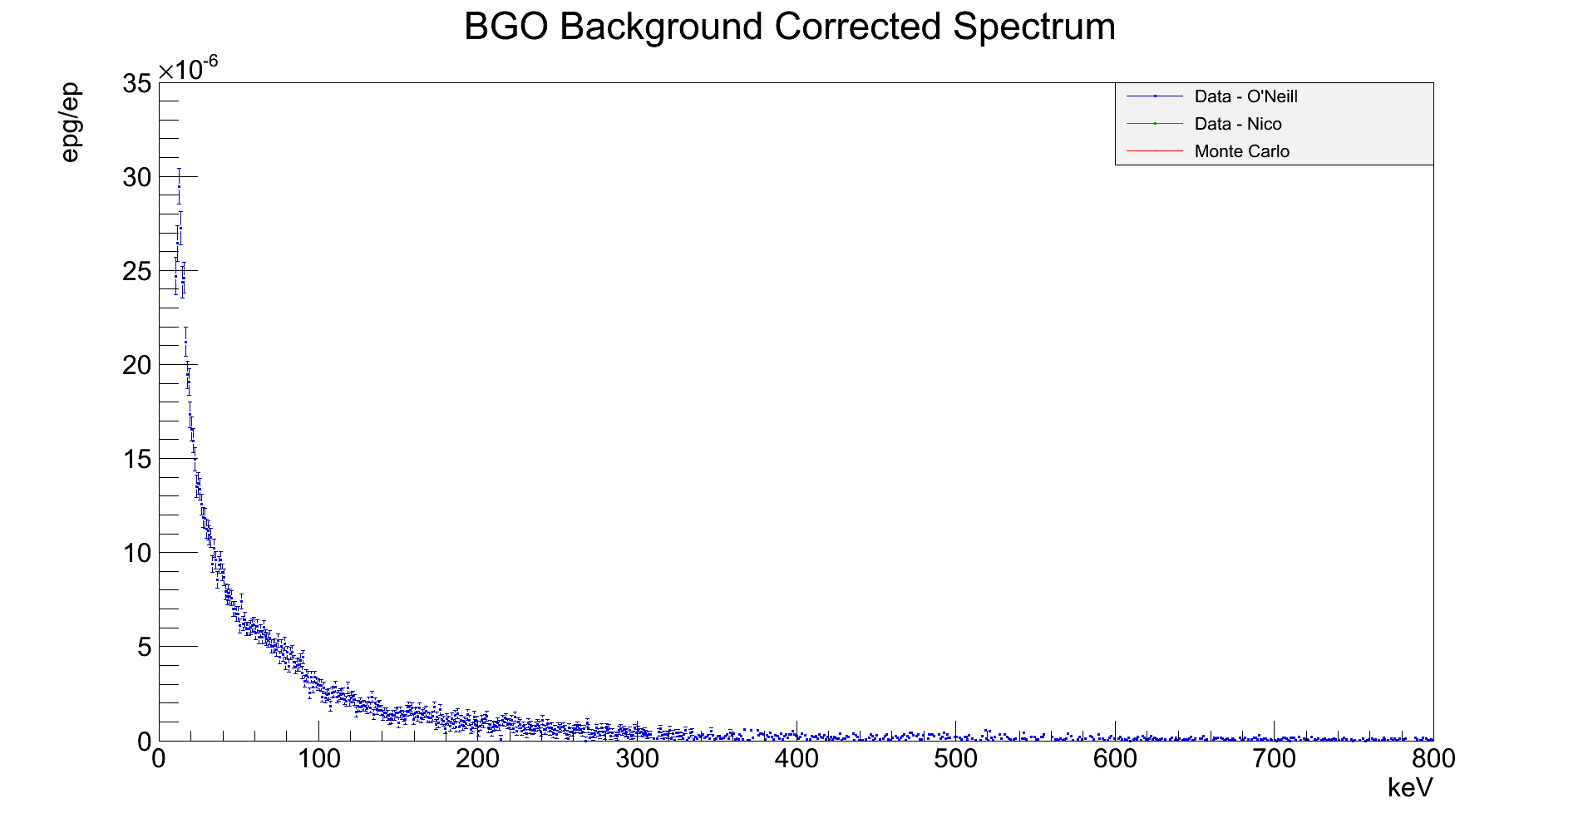

RDK II Current Results
Bismuth X-ray
80 keV
Photon energy
Repg/Rep=(10.650±0.064)·10⁻⁴
0.1% agreement between independent analyses

Slide 15
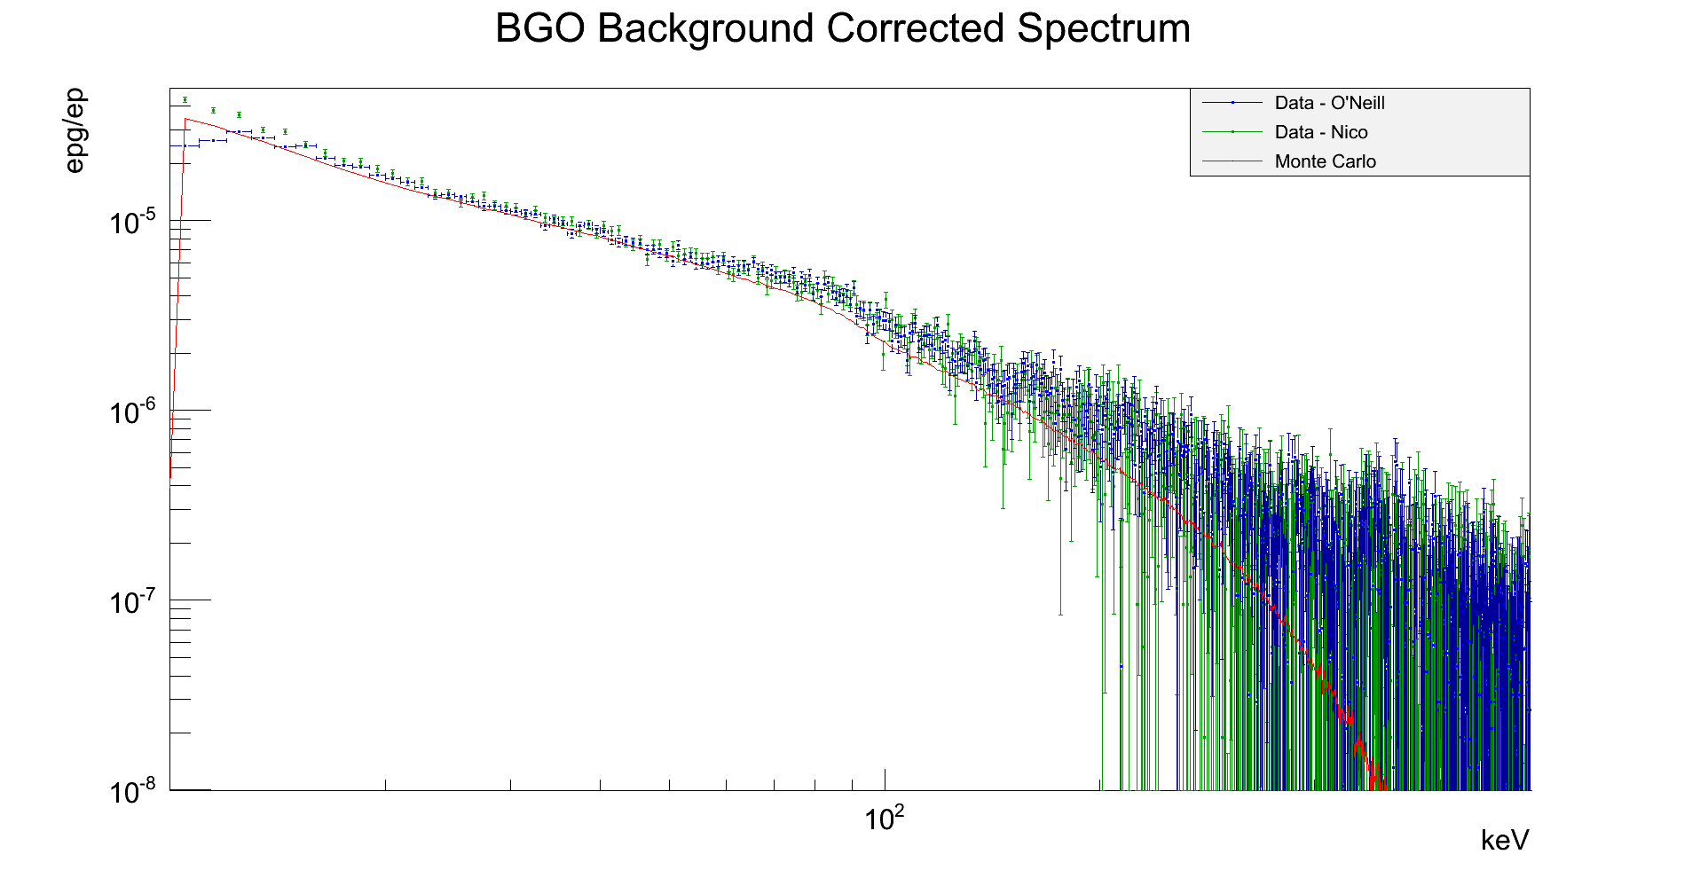
RDK II Current Results
Bismuth X-ray
80 keV
Photon energy

Slide 16
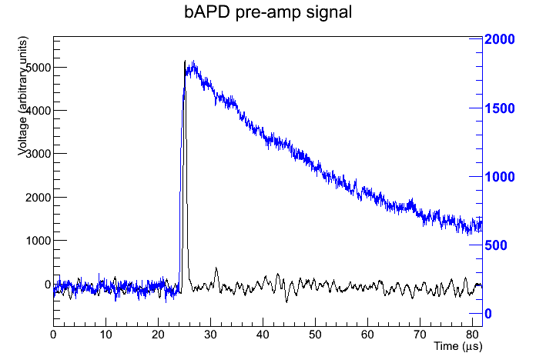
RDK II Signal
Photon energy
Photon
time

Slide 17
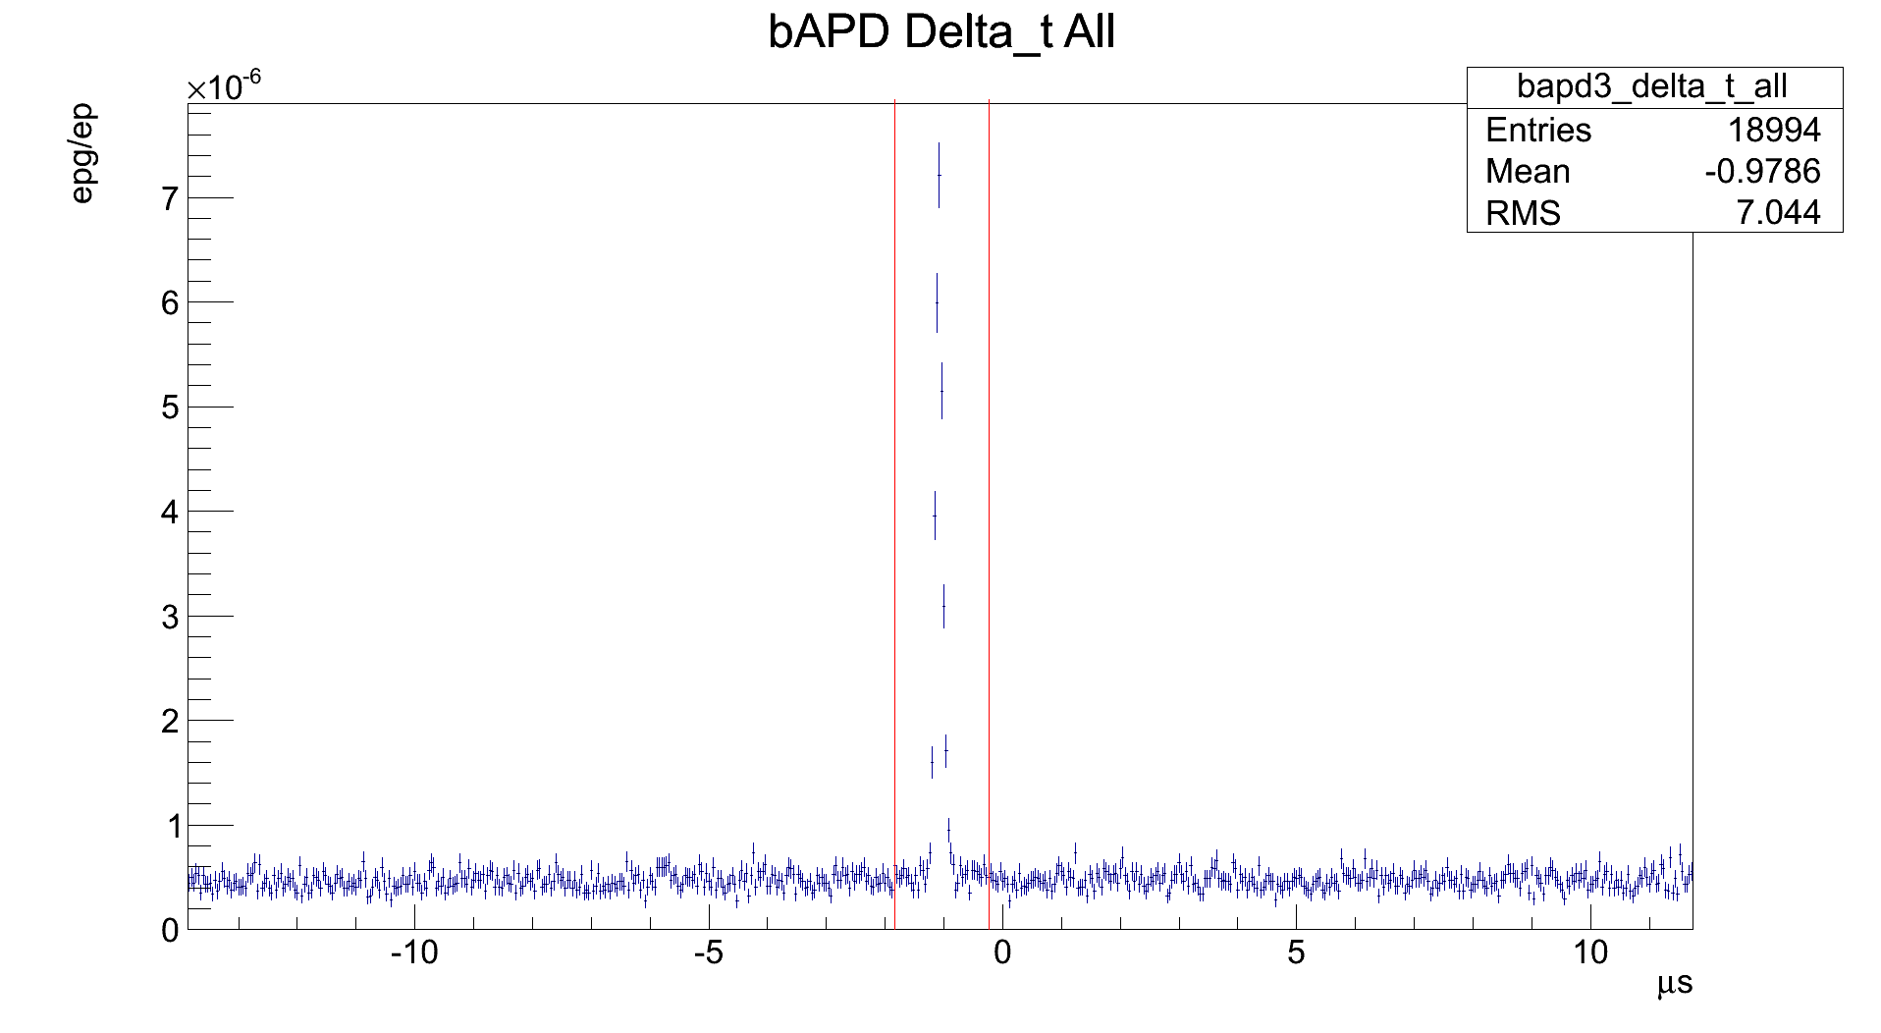
RDK II Current Results
On-peak window
Off-peak windows
Triple coincidence peak
Photon timing relative to electron
bAPD

Slide 18
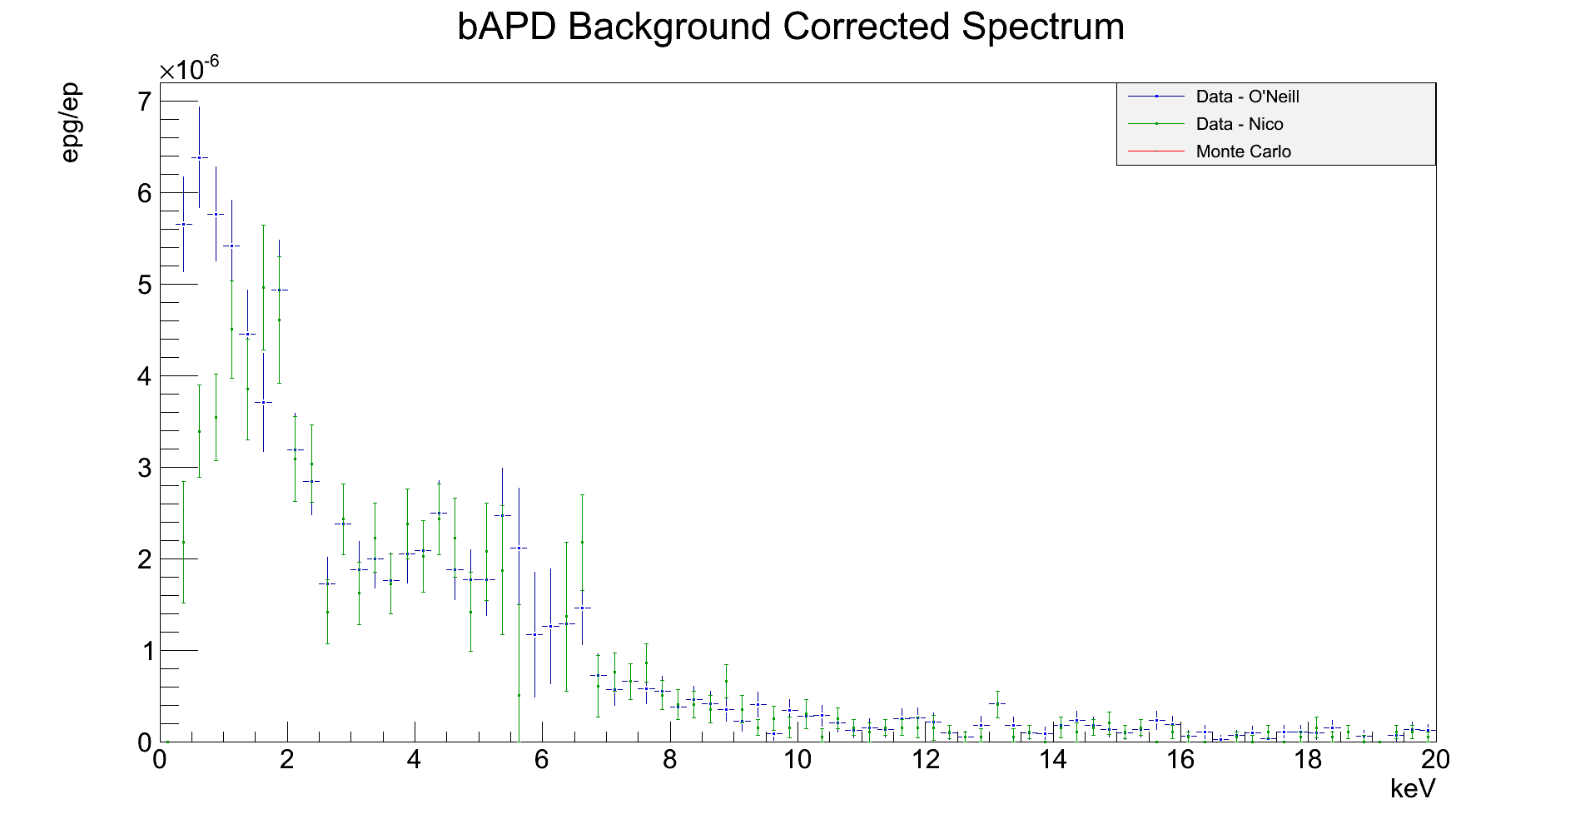
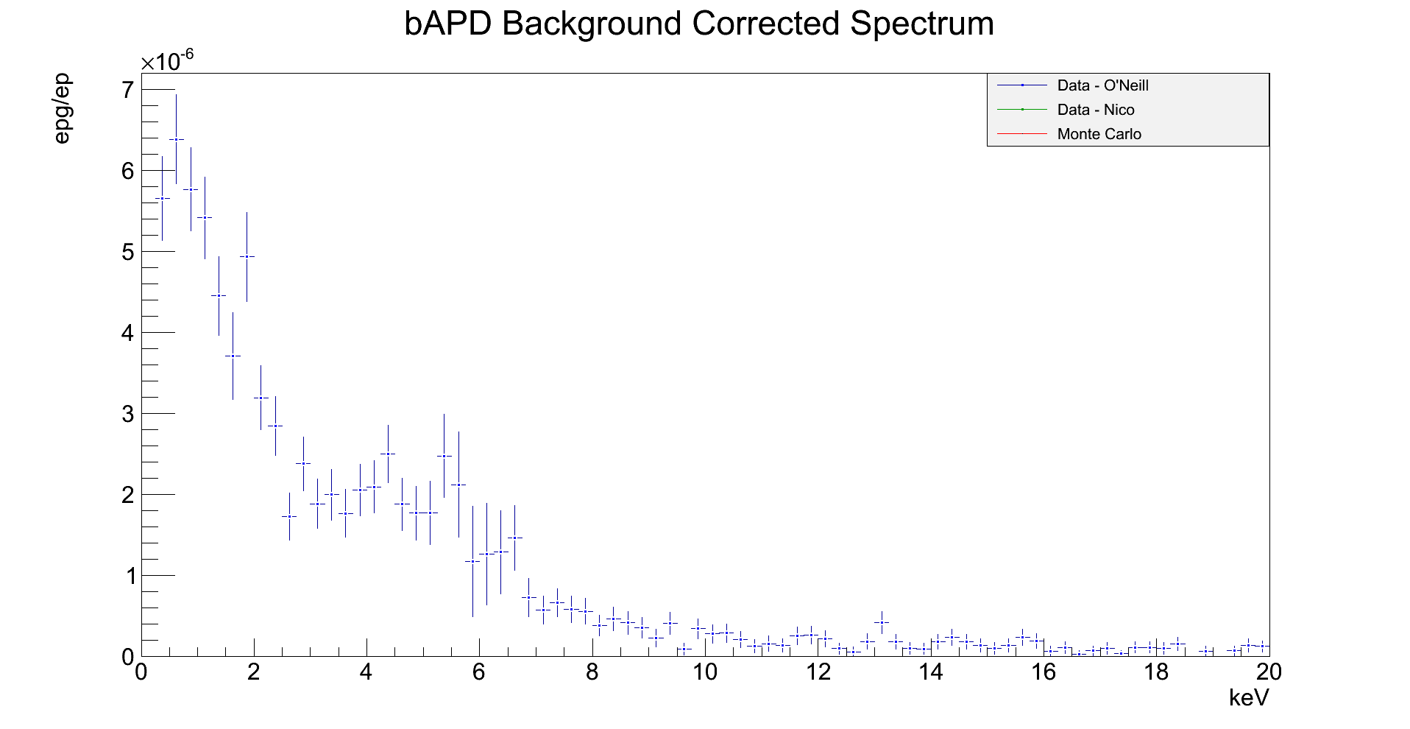
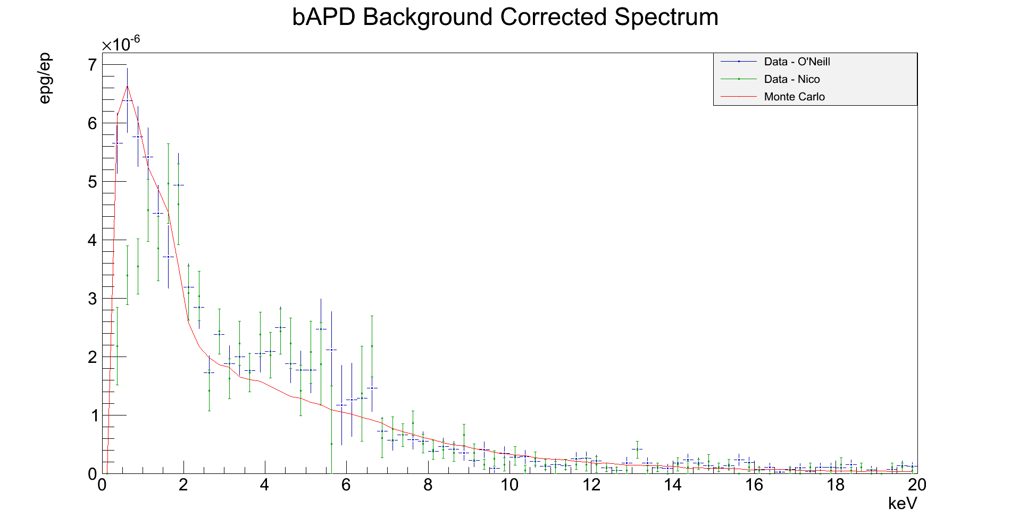
RDK II Current Results
Photon energy
Repg/Rep=(8.512±0.243)·10⁻⁵

Slide 19
RDK II Monte Carlo
Repg/Rep proportional to the branching ratio
Complex detector
  Effective solid angle of the SBD
  Detector response
  Secondary reactions
Geant4 – Matthew Bales at Univ. of Michigan
Chi-squared fit to determine branching ratio

Slide 20
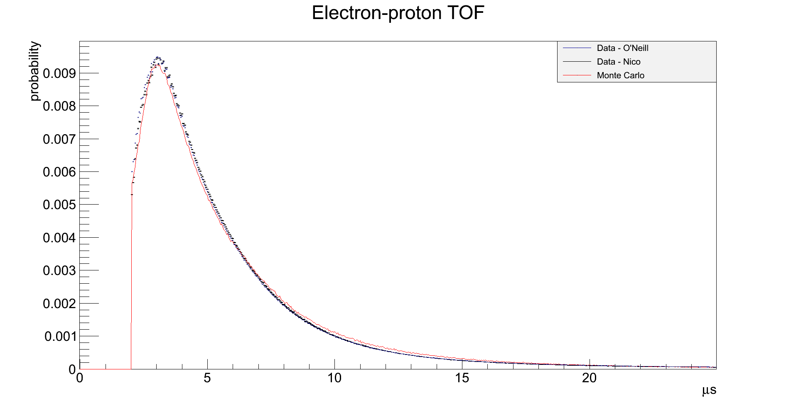
RDK II MC Benchmark
Proton timing relative to electron
Notes:
Proton momentum along B-field

Slide 21
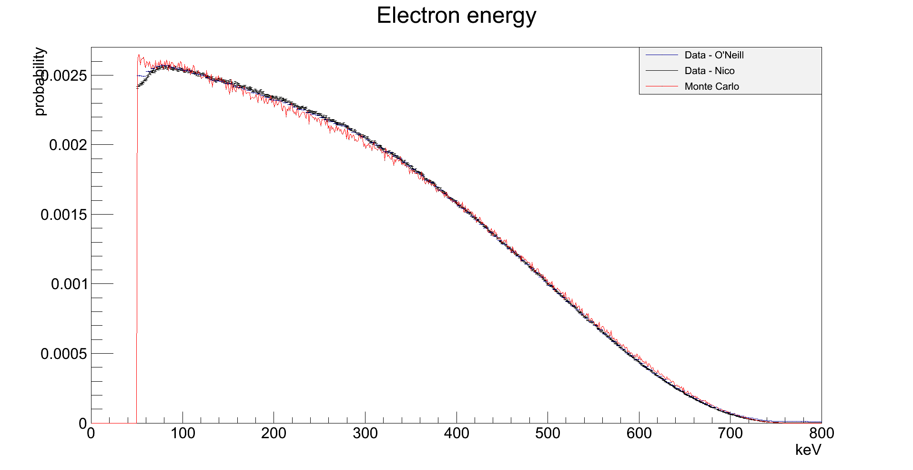
RDK II MC Benchmark

Slide 22
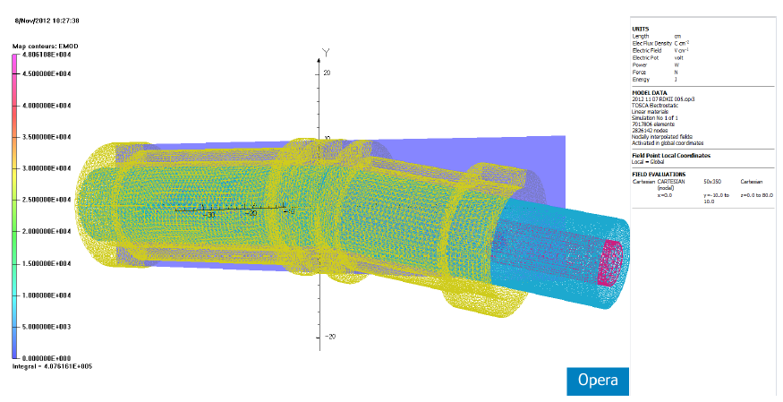
Ongoing Work

Slide 23
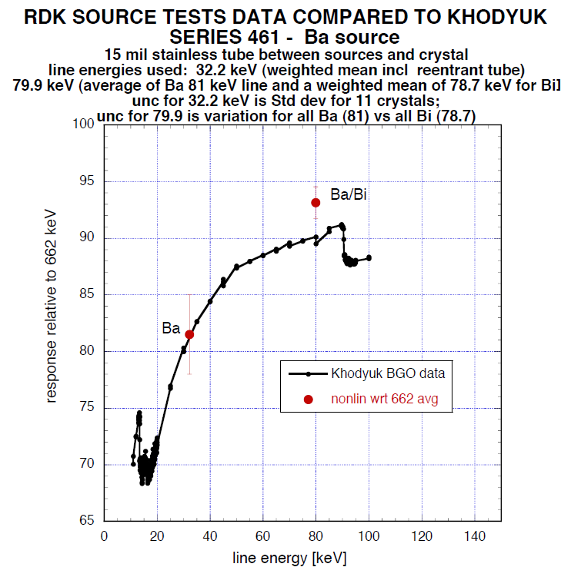
Ongoing Work

Slide 24
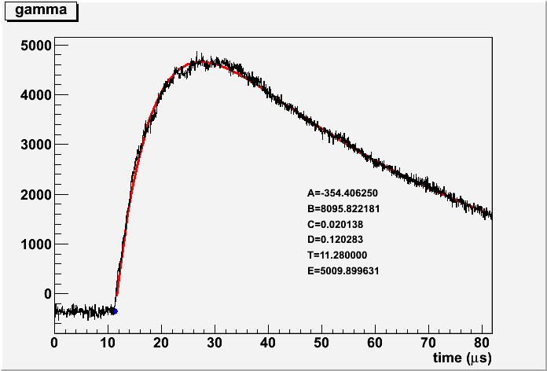
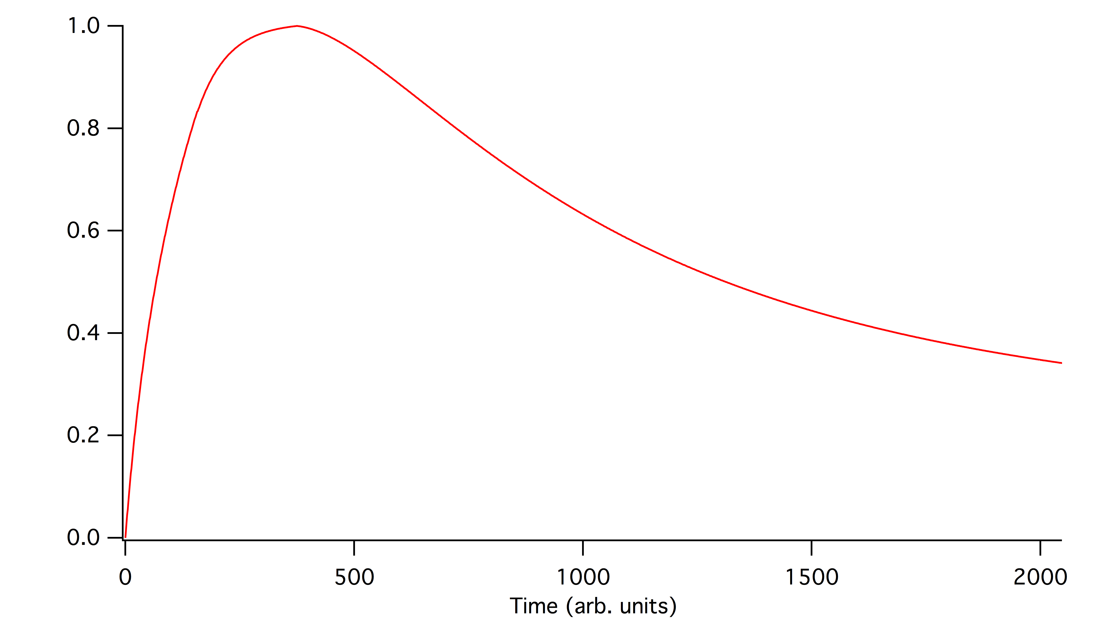
Ongoing Work
y=A+Be^{-C(x-t)}(1-e^{-D(x-t)})
while x>t
Template used in RDK I
CPU limited
2-3 keV shift in energy

Slide 25
Conclusions
Achieved 0.6% statistics on BR
Expanded energy range down to 250 eV and up to the endpoint (approx 780 keV)
Work continues on systematic errors
  Analysis and calibrations
    BGO non-linearity
    Photon signal fit
  Monte Carlo
    New field calculations
  Goal of O(1%) systematic error on BR

Slide 26
RKD II Collaboration
Arizona State University
  R. Alarcon, B. O'Neill
National Institute of Standards and Technology (NIST)
  C. Bass, K. Coakley, S. Dewey, C. Fu, T. Gentile, P. Mumm, J. Nico, A. Thompson
Tulane University
  K. Pulliam, F. Wietfeld
University of Maryland
  E. Beise, H. Breuer
University of Michigan
  M. Bales, T. Chupp, R. Cooper
University of Sussex
  J. Byrne

Slide 27
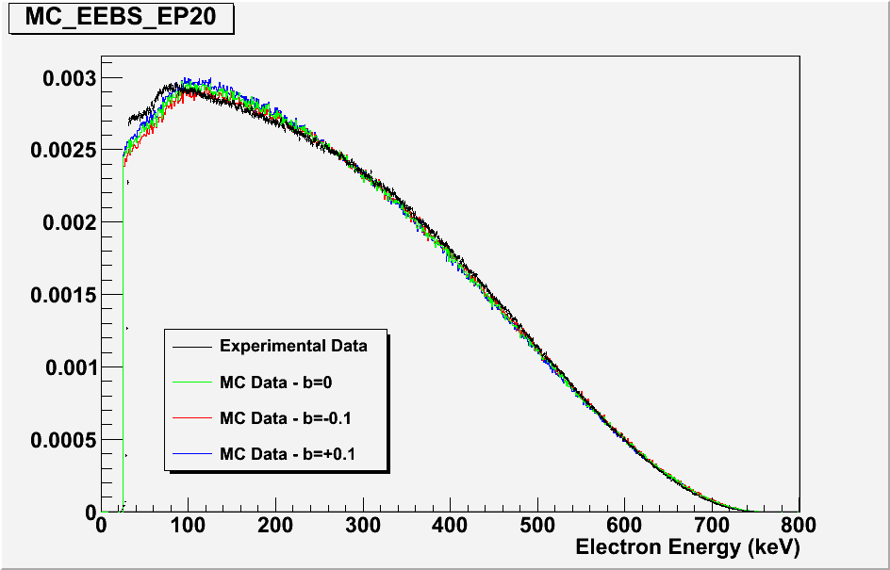
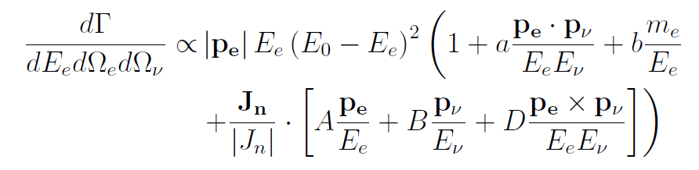
Little b

Slide 28
Runtime Metrics
On beam from July 2008 to November 2009
Off beam calibrations from January 2010 to July 2010
 | All voltages | Full mirror
Run time | 164.4d | 97.8d
Live time | 147.1d | 87.5d
Total triggers | 9.7·10⁷ | 6.8·10⁷
Run data | 6.4TB | 4.4TB
Total data | 25TB

Slide 29
Previous Measurements: ILL
Beck et al., Institut Laue-Langevin (ILL) 2002
Electron-delayed proton-photon triple coincidence measurement
Electron detector: plastic scintillator
Proton detector: microchannel plate (MCP)
Photon detector: Six CsI(T1) scintillators
Result: BR for 35-100keV less than 6.9∙10⁻³
Predicted: 1.1∙10⁻³

Slide 30
Previous Measurements: RDK I
Nico et al., National Institute of Standards and Technology (NIST) 2005
Triple coincidence measurement
Electron-proton detector: surface barrier detector (SBD)
Photon detector: bismuth germanate (BGO) scintillator + avalanche photo-diode (APD)
Result: BR for 15-340keV = 3.09±0.32·10⁻³
Predicted: 2.85·10⁻³

Slide 31
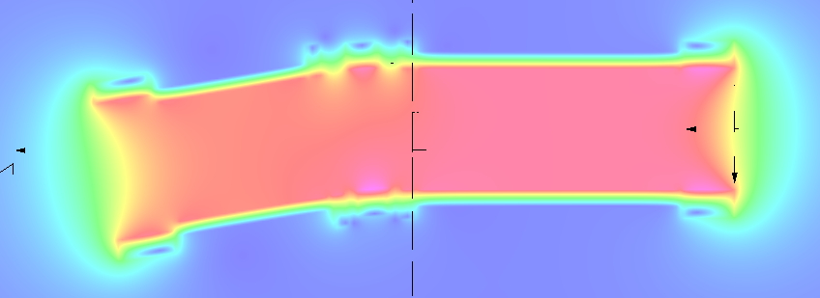
Previous Measurements: RDK I
4.6T superconducting magnet
9.5º bend

Slide 32
Improvements in RDK II
Twelve BGO+APD detectors
Three bare APD (bAPD) detectors
Neutron counter
In situ calibration runs
Improved statistics: O(0.1%) for BGOs
Greater energy range
  <10keV to the endpoint on BGO
  <1keV to ≈10keV for bAPD

Slide 33
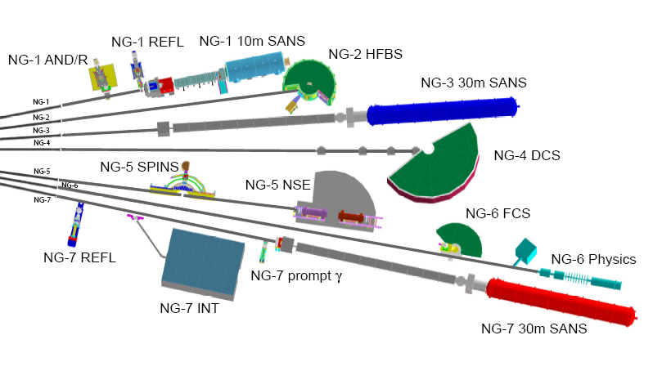
NIST Beam Line

Slide 34
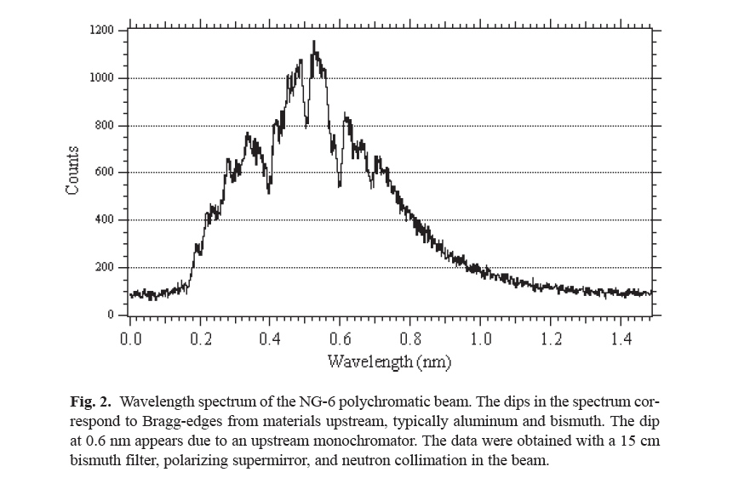
NIST Beam Line

Slide 35
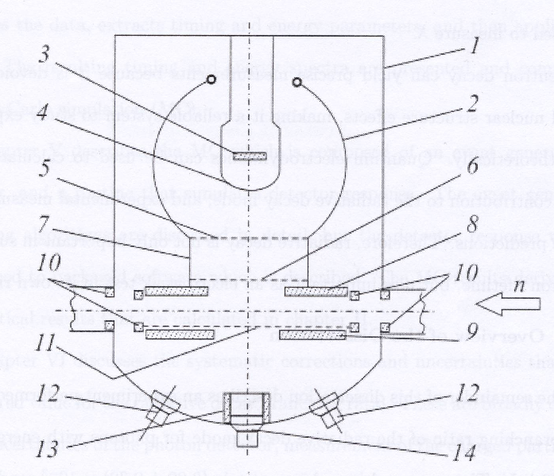
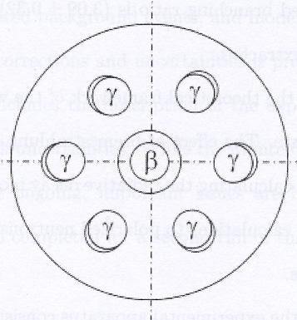
Previous Measurements: ILL
Beck et al., Institut Laue-Langevin (ILL) 2002
Branching ratio for 35-100keV less than 6.9∙10⁻³

Slide 36
Motivation
Measurement and year | Neutron lifetime (s) | Measurement type
Byrne 1996 | 889.2±3.0[syst.]±3.8[stat.] | Beam, Penning trap
Arzumanov 2000 | 885.4±0.9[syst.]±0.4[stat.] | Bottle, UCN gravitational trap
Nico 2005 | 886.3±1.2[syst.]±3.2[stat.] | Beam, Penning trap
PDG World Average | 885.7±0.8
Seberov 2005 | 878.5±0.7[syst.]±0.3[stat.] | Bottle, UCN gravitational trap
Radiative corrections
Electron energy spectrum
Angular correlation
Correlated background

Slide 37
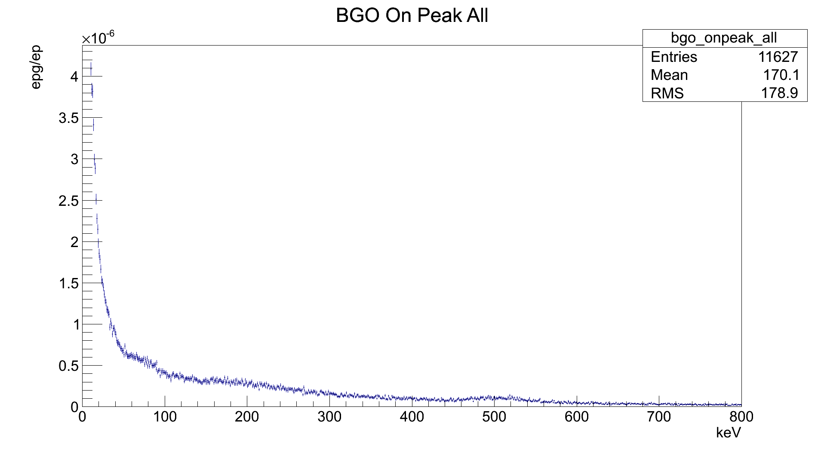
RDK II Current Results
Bismuth X-ray
80 keV
Calibration peak
511 keV
Photon energy

Slide 38
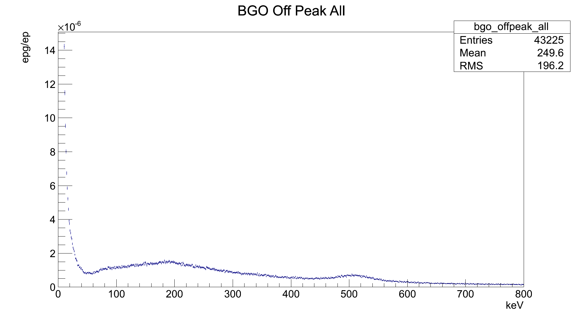
RDK II Current Results
Calibration peak
511 keV
Photon energy

Slide 39
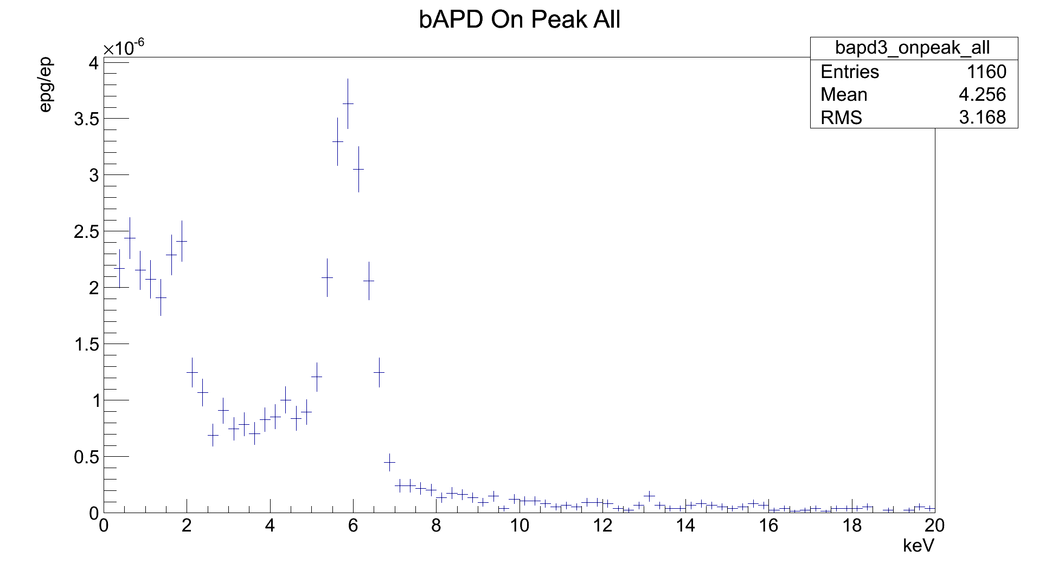
RDK II Current Results
Calibration peak
5.9 keV
Photon energy

Slide 40
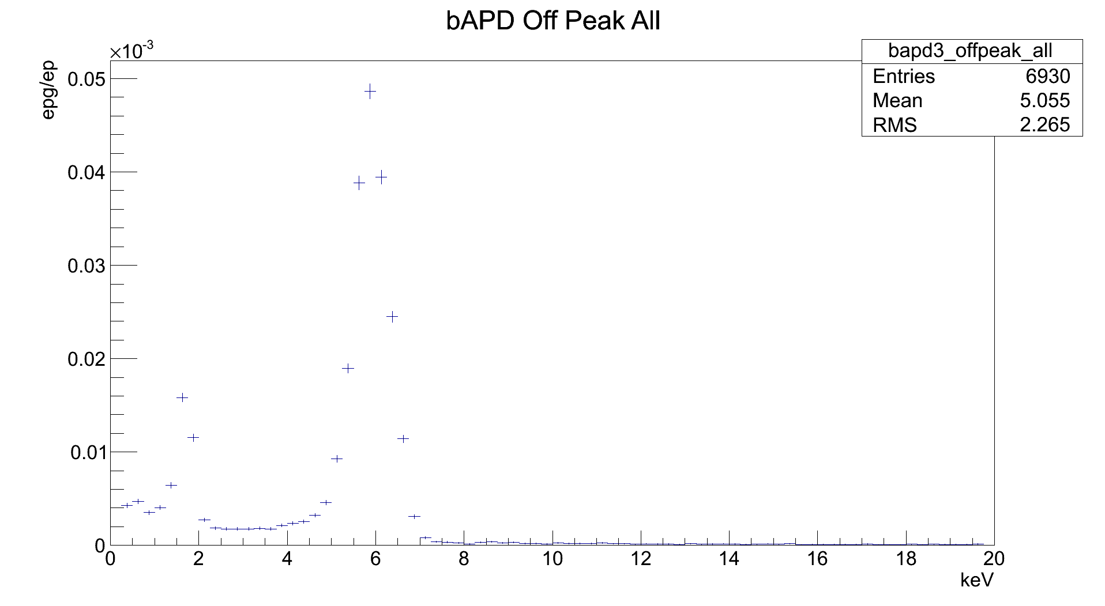
RDK II Current Results
Calibration peak
5.9 keV
Photon energy

Slide 41
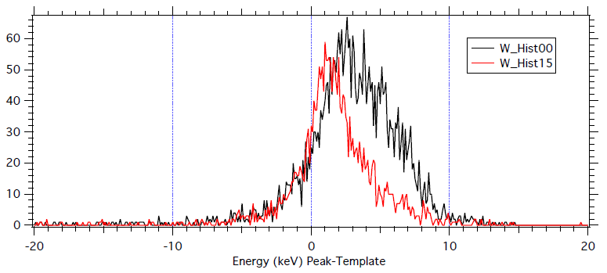
Ongoing Work

