Slide 1
Precision Measurement of the Radiative Decay Mode of the Free Neutron
Benjamin O'Neill
PhD Candidacy Oral Examination
April 6, 2011

Slide 2
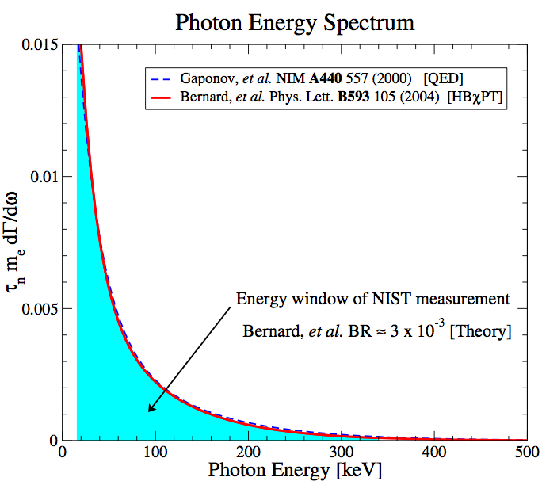
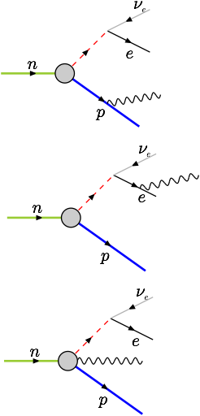
Motivation
n→p⁺+e⁻+νe+782keV
RDK I branching ratio¹
3.09 ± 0.32 x 10-3
¹Nico, J. S. et al. Nature 444, 1059–1062 (2006)

Slide 3
Motivation
Measurement and year | Neutron lifetime (s) | Measurement type
Byrne 1996 | 889.2±3.0[syst.]±3.8[stat.] | Beam, Penning trap
Arzumanov 2000 | 885.4±0.9[syst.]±0.4[stat.] | Bottle, UCN gravitational trap
Nico 2005 | 886.3±1.2[syst.]±3.2[stat.] | Beam, Penning trap
PDG World Average | 885.7±0.8
Seberov 2005 | 878.5±0.7[syst.]±0.3[stat.] | Bottle, UCN gravitational trap
Radiative corrections
Electron energy spectrum
Angular correlation
Correlated background

Slide 4
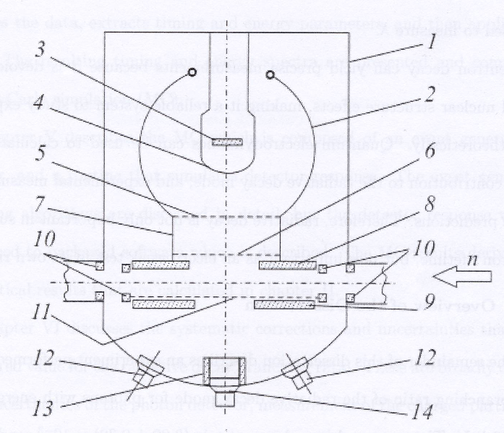
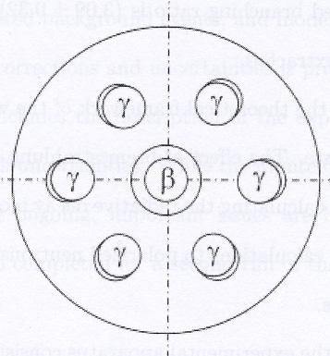
Previous Measurements: ILL
Beck et al., Institut Laue-Langevin (ILL) 2002
Branching ratio for 35-100keV less than 6.9∙10⁻³

Slide 5
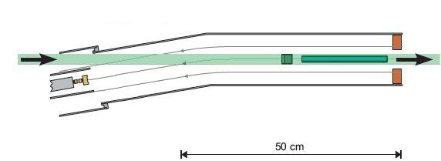
Previous Measurements: RDK I
B-field line
BGO+APD (below beam)
Cold neutron beam
(<20meV peaked at 2-5meV)
Shield
Electrostatic mirror
1400V (varies)
SBD
-25kV
Nico et al., National Institute of Standards and Technology (NIST) 2005
Branching ratio for 15-340keV = 3.09±0.32·10⁻³

Slide 6
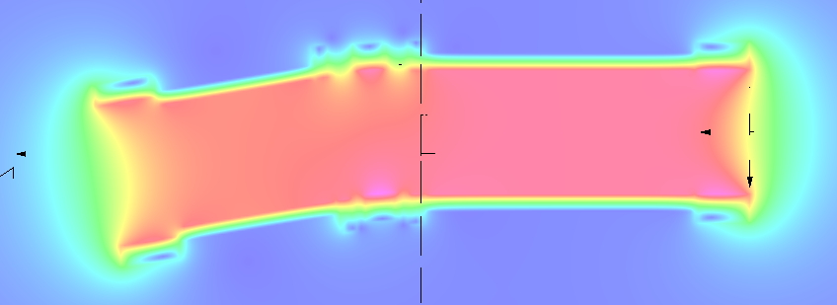
Previous Measurements: RDK I
4.6T superconducting magnet
9.5º bend

Slide 7
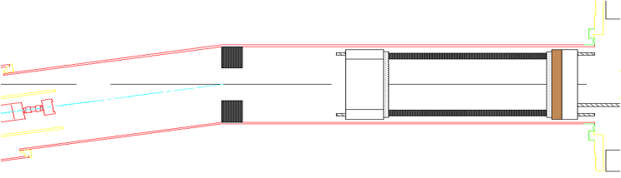
RDK II Experimental Setup
Pb shield
12 element BGO+APD array
Neutron beam
bAPD array
(not shown)
HV Mirror
(not shown)
SBD
Improve accuracy to O(1%) on BR
New detectors
  12 BGO+APD
  3 bAPD (installed later)
Expanded energy range
  BGO: <10keV to endpoint
  bAPD: <1keV to ≈10keV
Improved statistics: O(0.1%) for BGO

Slide 8
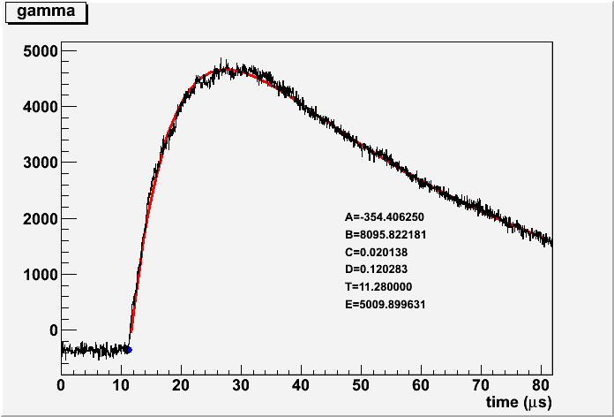
RDK Signal
y=A+Be^{-C(x-t)}(1-e^{-D(x-t)})
while x>t

Slide 9
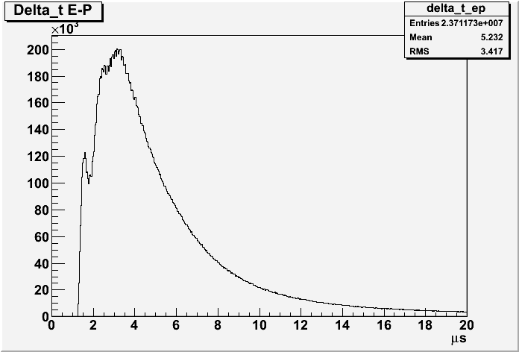
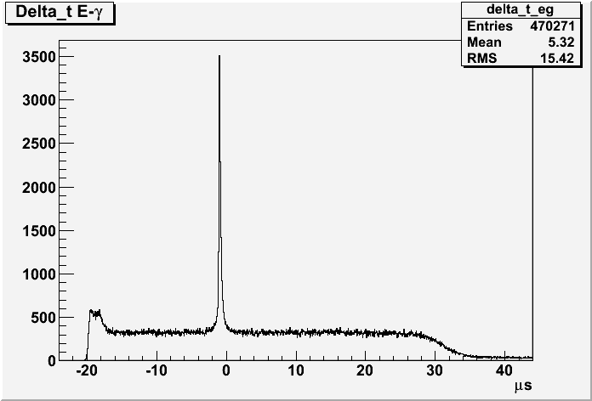
RDK II Preliminary Results
Triple coincidence peak
Proton timing
Photon timing
Notes:
Proton momentum along B-field

Slide 10
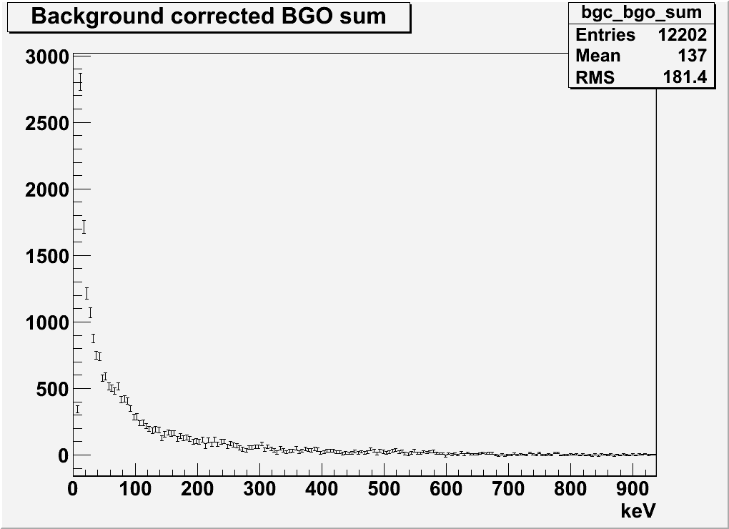
RDK II Preliminary Results
Photon energy

Slide 11
Status
Achieved O(0.1%) statistics on BR
Expanded energy range down to 1keV and up to the endpoint (approx 780keV)
Work continues on systematic errors
  Analysis of Calibrations
    Detector response
    Temperature dependence
    Non-linearity
  Monte Carlo
  Goal of O(1%) systematic error on BR

Slide 12
RKD II Collaboration
Arizona State University
  R. Alarcon, B. O'Neill
National Institute of Standards and Technology (NIST)
  C. Bass, K. Coakley, S. Dewey, C. Fu, T. Gentile, P. Mumm, J. Nico, A. Thompson
Tulane University
  K. Pulliam, F. Wietfeld
University of Maryland
  E. Beise, H. Breuer
University of Michigan
  M. Bales, T. Chupp, R. Cooper
University of Sussex
  J. Byrne

Slide 13
Runtime Metrics
On beam from July 2008 to November 2009
Off beam calibrations from January 2010 to July 2010
 | All voltages | Full mirror
Run time | 164.4d | 97.8d
Live time | 147.1d | 87.5d
Total triggers | 9.7·10⁷ | 6.8·10⁷
Run data | 6.4TB | 4.4TB
Total data | 25TB

Slide 14
Previous Measurements: ILL
Beck et al., Institut Laue-Langevin (ILL) 2002
Electron-delayed proton-photon triple coincidence measurement
Electron detector: plastic scintillator
Proton detector: microchannel plate (MCP)
Photon detector: Six CsI(T1) scintillators
Result: BR for 35-100keV less than 6.9∙10⁻³
Predicted: 1.1∙10⁻³

Slide 15
Previous Measurements: RDK I
Nico et al., National Institute of Standards and Technology (NIST) 2005
Triple coincidence measurement
Electron-proton detector: surface barrier detector (SBD)
Photon detector: bismuth germanate (BGO) scintillator + avalanche photo-diode (APD)
Result: BR for 15-340keV = 3.09±0.32·10⁻³
Predicted: 2.85·10⁻³

Slide 16
Improvements in RDK II
Twelve BGO+APD detectors
Three bare APD (bAPD) detectors
Neutron counter
In situ calibration runs
Improved statistics: O(0.1%) for BGOs
Greater energy range
  <10keV to the endpoint on BGO
  <1keV to ≈10keV for bAPD

Slide 17
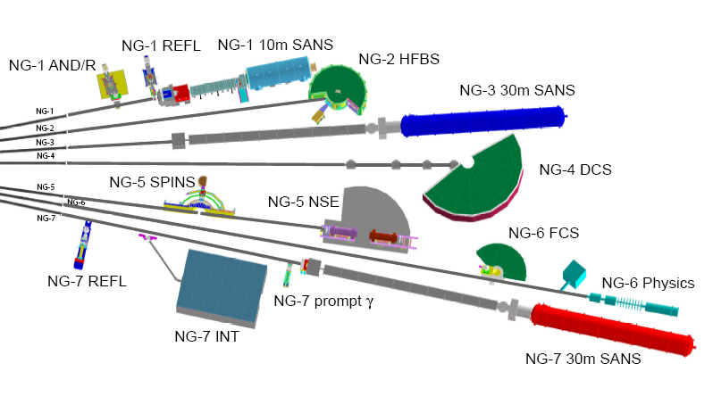
NIST Beam Line

Slide 18
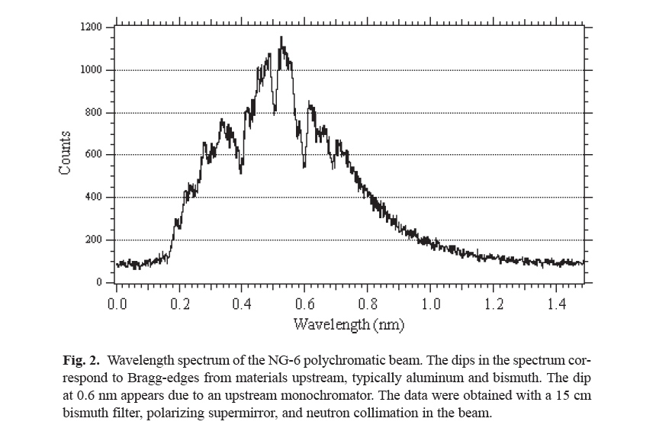
NIST Beam Line

Slide 19
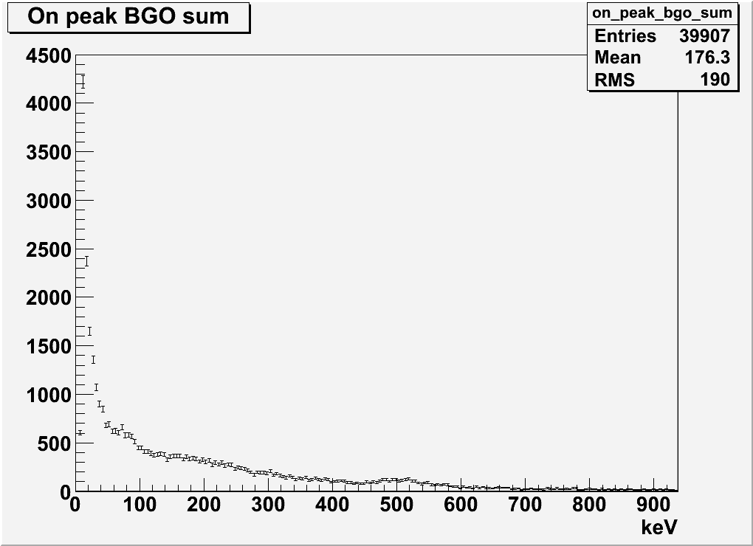
RDK II Results

Slide 20
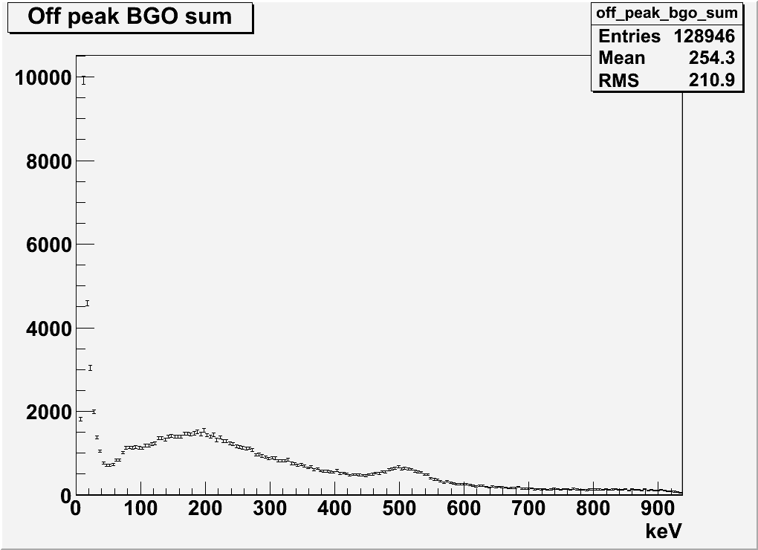
RDK II Results

Slide 21
RDK II Results
Notes:
Combine with slide 8

