Slide 1

Aviation Merit Badge – Session 1
Aviation basics • How flight works • What pilots see in the cockpit

Slide 2
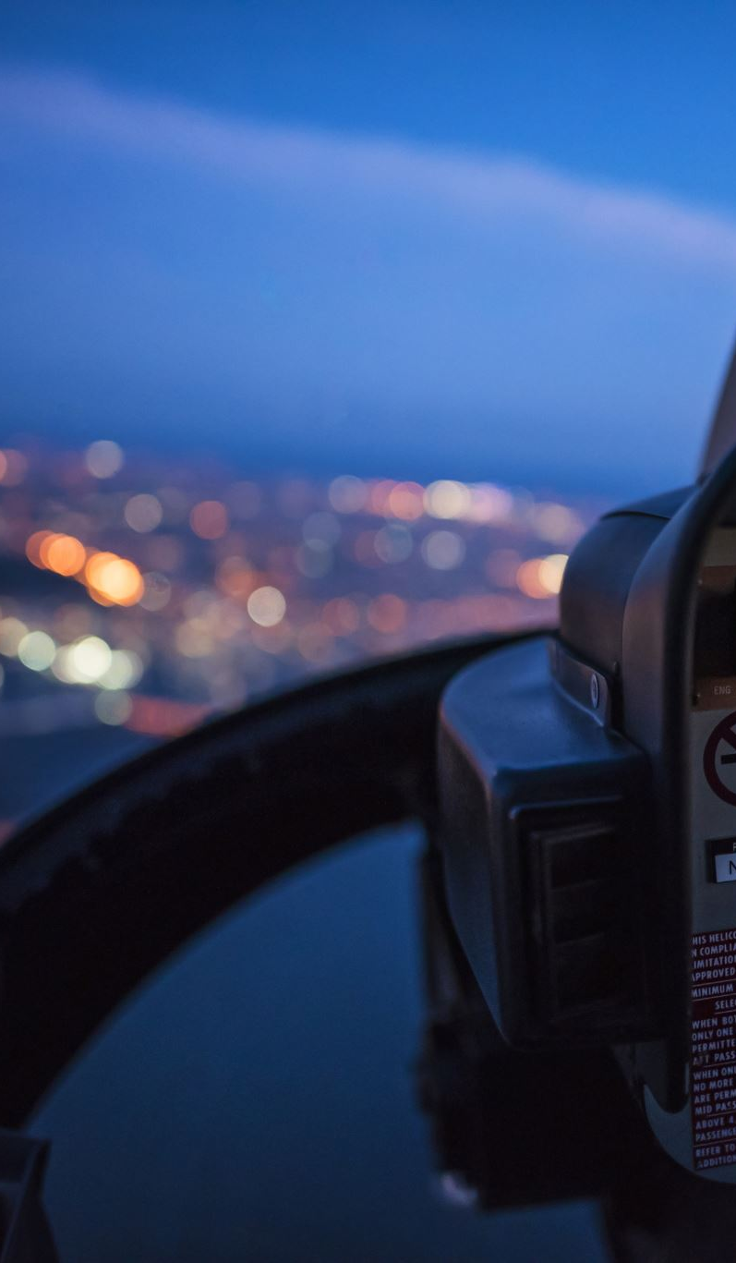
Today’s goals
What counts as an aircraft
Fixed wing vs rotary wing
Engines: piston vs turbine vs jet
Four forces of flight
Lift + airfoils (Bernoulli + downwash)
Control surfaces (pitch/roll/yaw)
Cockpit instruments (what they tell the pilot)
Notes:
Keep this fast. Mention that Session 2 is hands-on with model/drone flight.
If running short on time later: compress history and keep time for forces/lift/controls/instruments.

Slide 3
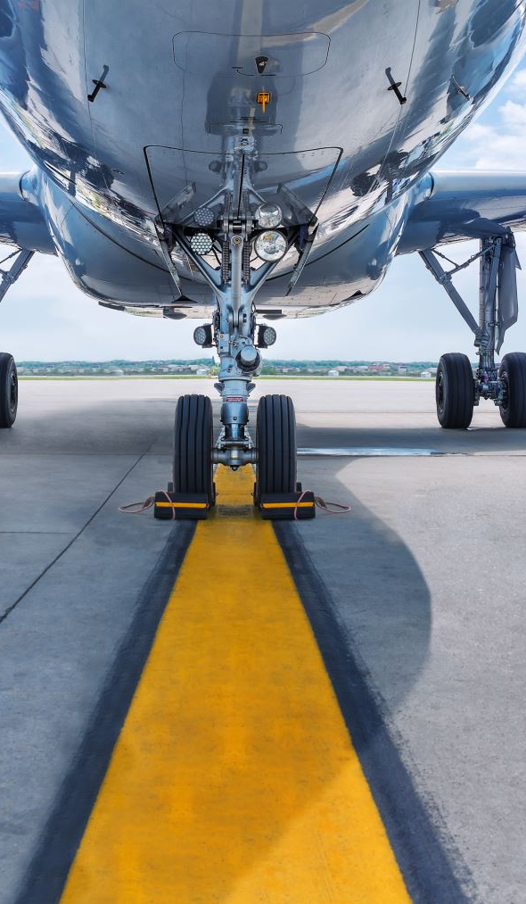
What is an aircraft?
A machine that flies by being supported by air
It can create lift with wings…
…or lift/thrust with rotors
Notes:
Ask: name 3 aircraft you’ve seen and one thing it’s used for.

Slide 4
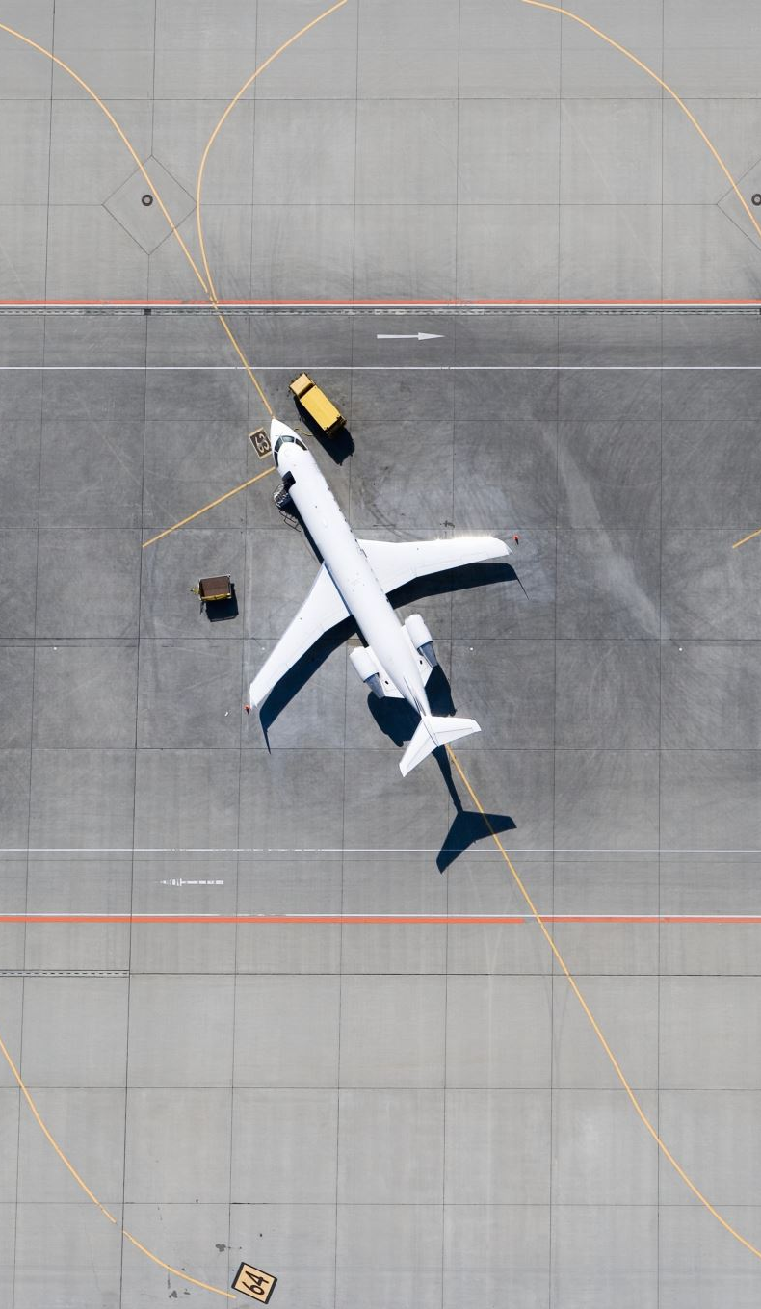
Kinds of aircraft (examples)
Fixed-wing airplane (training, transport, cargo)
Rotary-wing (helicopter) (EMS, rescue, lifting)
Other: glider • balloon • jet airliner • drone/UAS
Notes:
Have scouts categorize examples quickly. Keep it concrete.

Slide 5
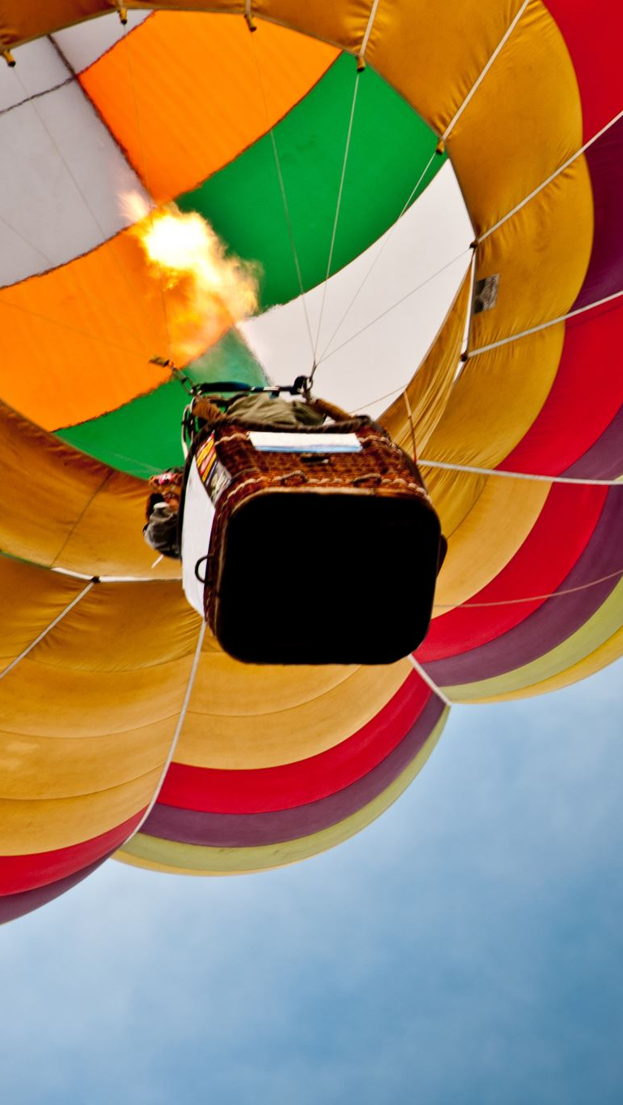
A short history of flight (3 moments)
Balloons: first human flight (buoyancy)
Wright era: powered + controlled flight
Turbines/jets: speed, altitude, long-distance travel
Notes:
Story-driven, not date-driven. Ask: what enabled long-distance travel?

Slide 6
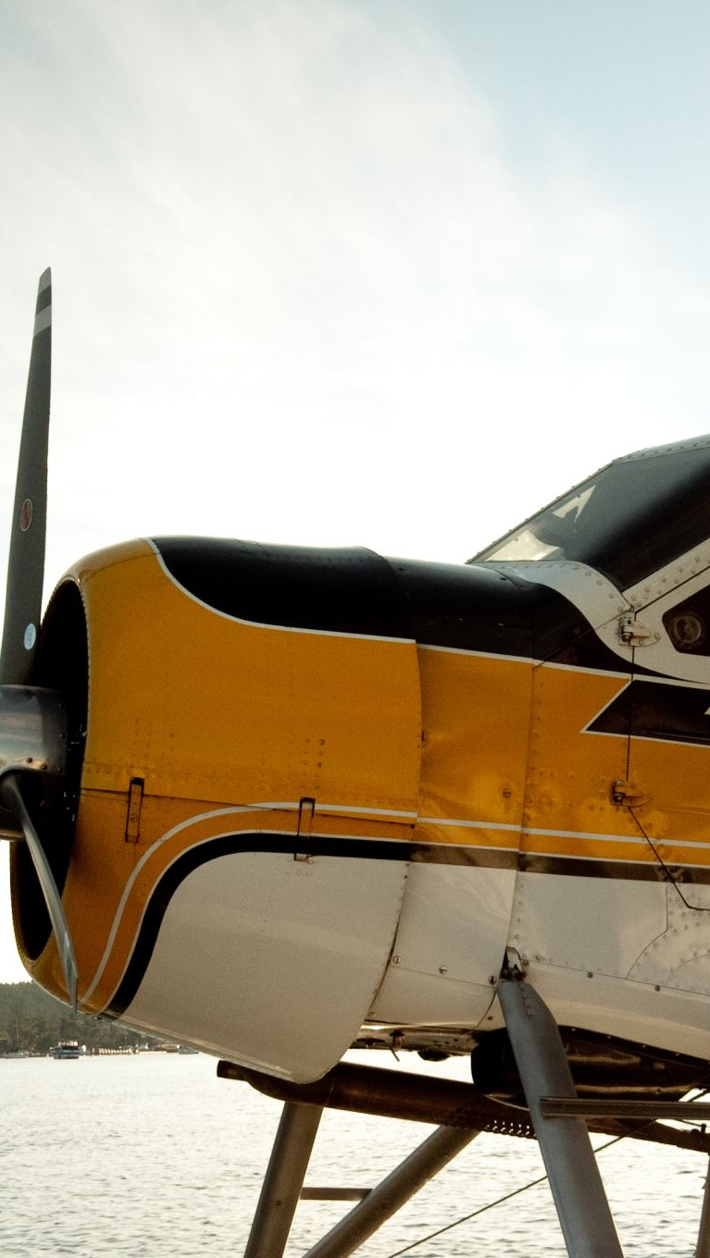
Fixed wing vs rotary wing
Fixed wing: needs forward motion to make lift
Efficient for long distance
Rotary wing: rotors can hover
Great for point-to-point access
Notes:
Common misconception: helicopters still generate lift; it’s just from rotor blades.

Slide 7
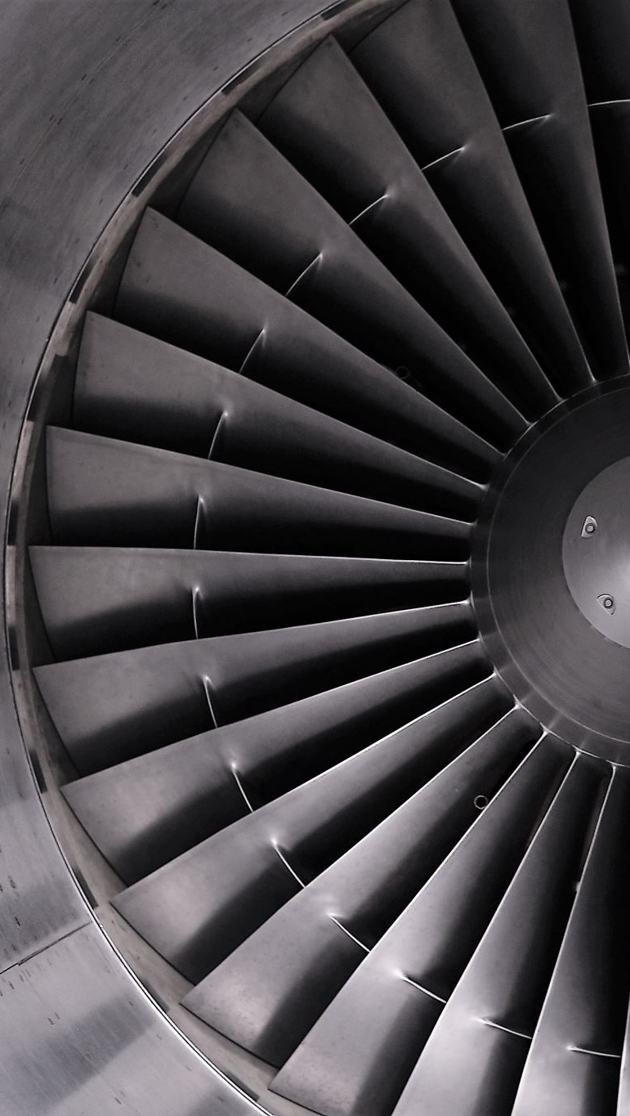
Engines: big picture
Piston + prop: like a car engine turning a propeller
Turbine: hot gases spin turbine blades
Jet (turbofan): pushes air back to make thrust
Notes:
Keep it conceptual; avoid deep thermodynamics.

Slide 8
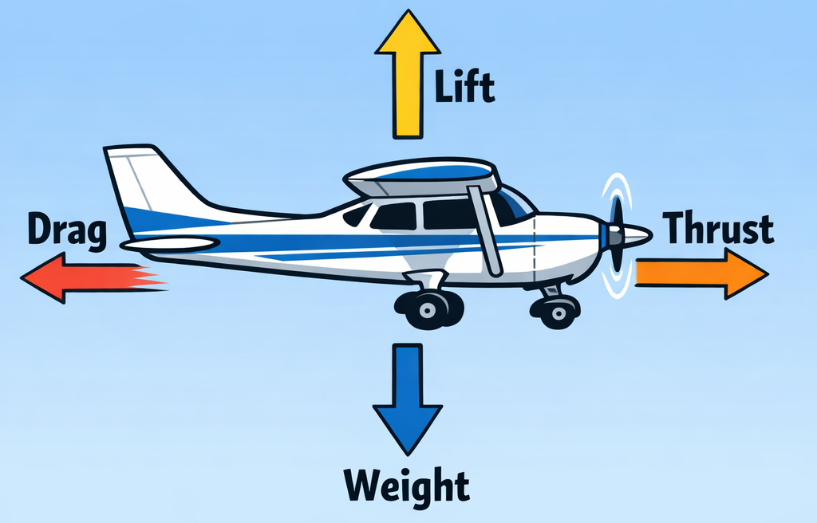
The 4 forces of flight
Notes:
Draw the arrows on a simple airplane sketch. In level cruise: lift≈weight, thrust≈drag.

Slide 9
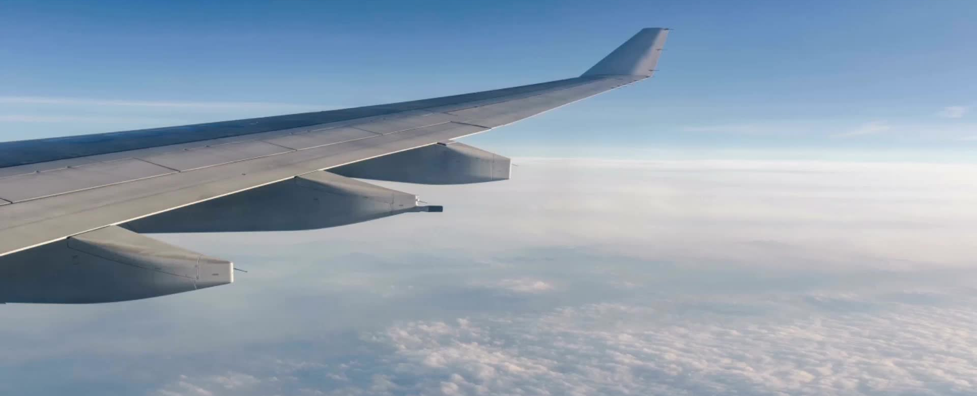
Lift: how wings make it
Air moves around an airfoil
Pressure differences help create lift
Wings also push air downward (downwash)
Notes:
Use paper-strip demo. Phrase it: pressure + downwash.

Slide 10
Angle of attack (AOA) + stall
AOA = angle between wing and airflow
Too high AOA → stall (lift drops, drag rises)
Rule of thumb: many wings stall around ~15–20° AOA
Notes:
Clarify: 15–20° is a common rule-of-thumb, not universal; depends on airfoil, flaps, contamination, loading.
Key point: stalls are caused by AOA, not speed alone.

Slide 11
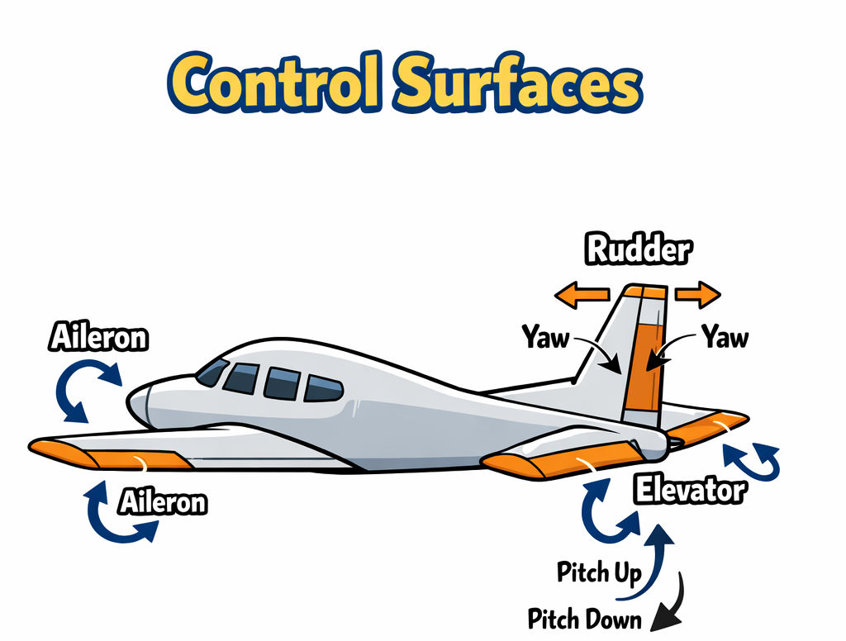
Notes:
Use hand/airplane model to show roll/pitch/yaw. Mention coordinated turns (bank + appropriate rudder).

Slide 12
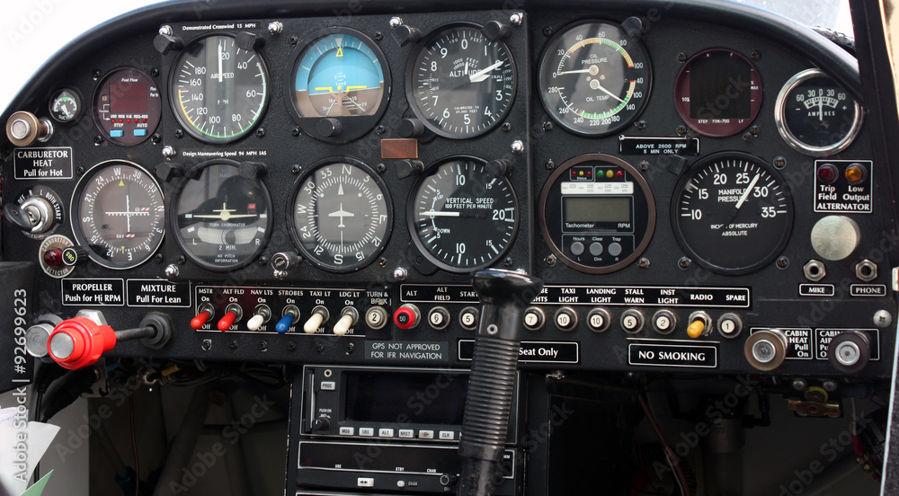
Cockpit instruments (single-engine)
Notes:
Explain what each tells the pilot; emphasize cross-checking multiple instruments.
Airspeed • Altimeter • Attitude
Heading • Turn/Bank • Vertical speed
Compass • Navigation • Communication
(course deviation indicator)
Engine indicators (RPM, temps, pressures, fuel)

Slide 13
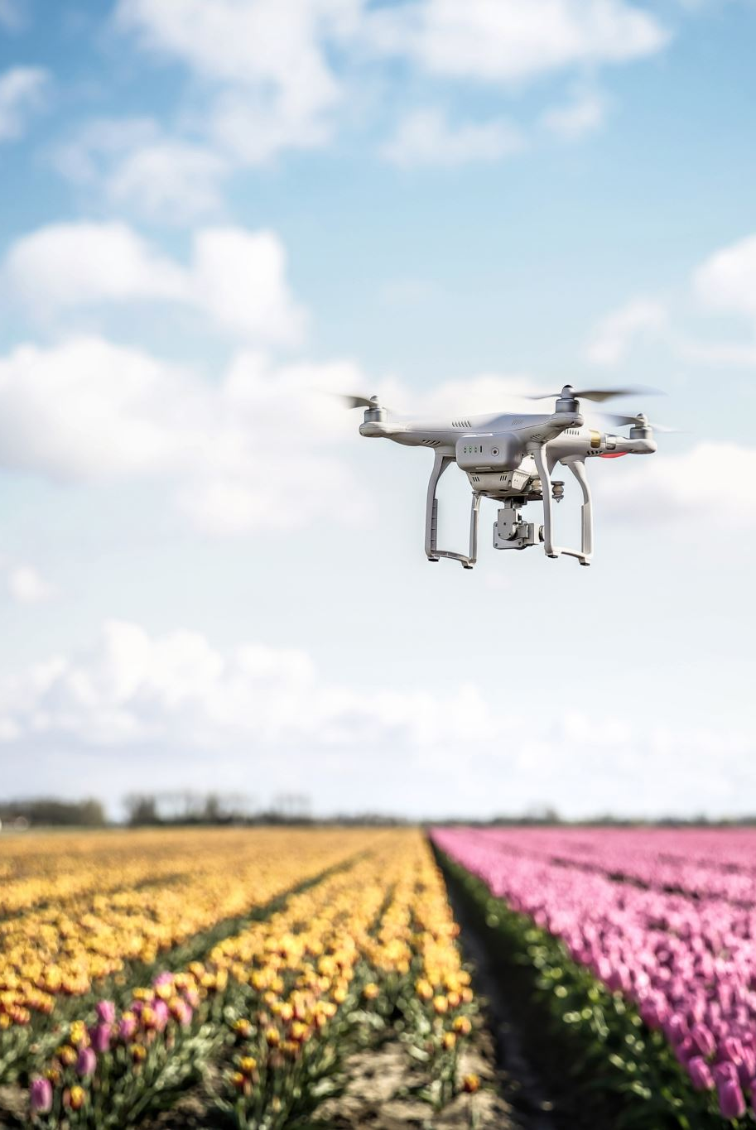
Wrap-up + next steps
Session 2: safety-first flight principles in action
Drone option: complete FAA TRUST before next session
Bring questions and your handouts
Notes:
Mention follow-up airport/tower/ARTCC visits if you’re offering them.

