Slide 1
Digital Systems
Physics 5430
Chapter 4 Wiatrowski
Gate ASM Synchronous Counters

Slide 2
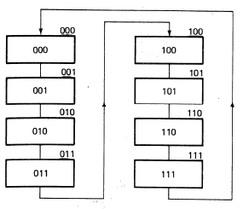


ASM Counters (synchronous)
Avoids output races that
occur with Asynchronous
Ripple Counters.
Current State is held in
the state flip flops.
Outputs = Current State
So only need Next State
lines on the ROM.
Replacing ROM with GATES.

Slide 3
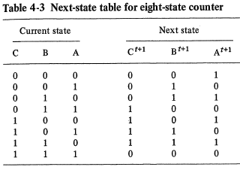
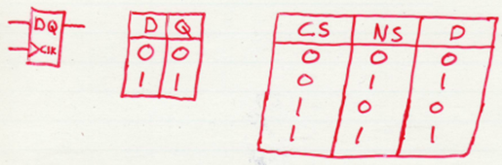
ASM Counters
Tables show D value
required to change
Current State to
Next State.

Slide 4
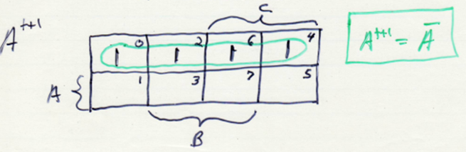








ASM Gate Circuits
Need 3 gate circuits to replace
the 3 ROM Next State outputs
C^{t+1}, B^{t+1}, A^{t+1}.
Use K-maps.
K-map for Next State output A^{t+1}

Slide 5
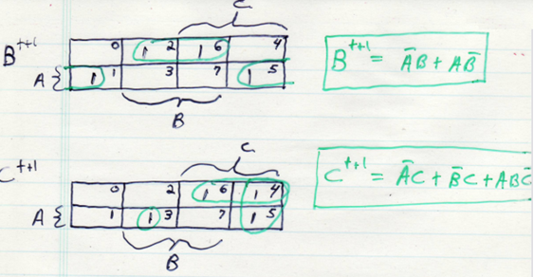
ASM Gate Circuits
K-maps for Next State
outputs B^{t+1} and C^{t+1},

Slide 6
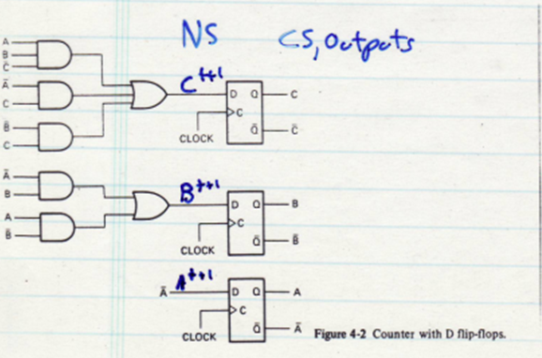
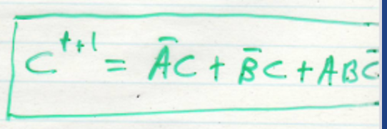
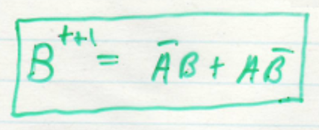
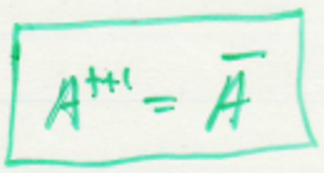
Complete ASM 8-Bit Counter Circuit
Next State outputs go to Current State flip flop D inputs
(just like ROM Next State outputs usually do)
Flip flop Qs are the Current State (and the ASM outputs)

Slide 7
Complete ASM 8-Bit Counter Circuit
See page 123 in Wiatowski.
Note: This 3-bit counter uses 3 FFs and seven gates.
The MSB circuits require more and more gates!
ASM counters with > 4 FFs are too complex using D FFs.

Slide 8
Solution for large ASM synchronous counters is:
Use J-K flip flops.
Counter-intuitive (doubles the number of next state circuits!)

Slide 9
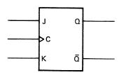
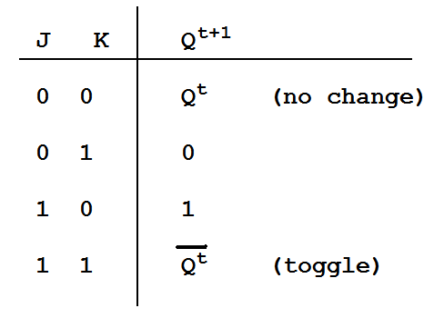
The J K Flip-Flop

Slide 10
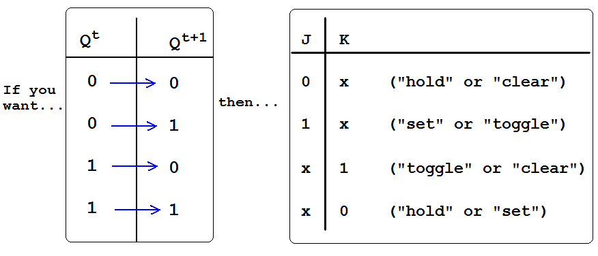
(clear)
(set)
00
01
10
11
11
01
00
10

Slide 11
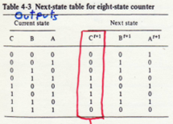
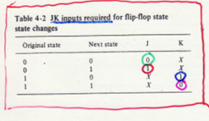
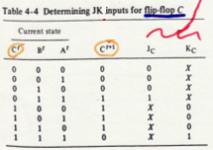








8-state JK ASM counter

Slide 12
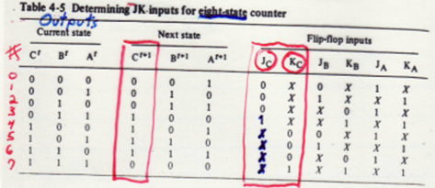
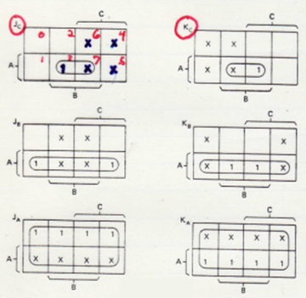

J_{c} = K_{c} = AB
J_{b} = K_{b} = A
J_{a} = K_{a} = 1

Slide 13
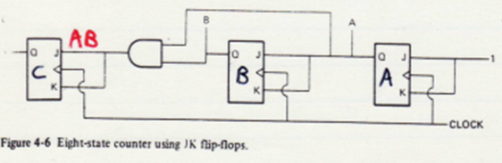
JK Flip Flop 3-bit 8-state ASM counter
J_{c} = K_{c} = AB
J_{b} = K_{b} = A
J_{a} = K_{a} = 1
Using JK FFs yields a very simple circuit that uses one gate, instead of the seven gates needed with D FFs.
The reason is JKs always have don’t cares in the Next State table and the resulting K-maps, which yields simpler circuits.

Slide 14
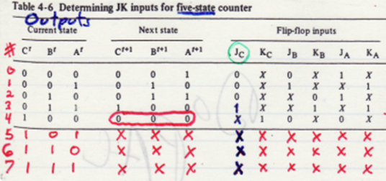
Design a 5-State JK ASM Counter
Counts from zero to four.
The unused states should be “don’t cares” to simplify the circuit.

Slide 15
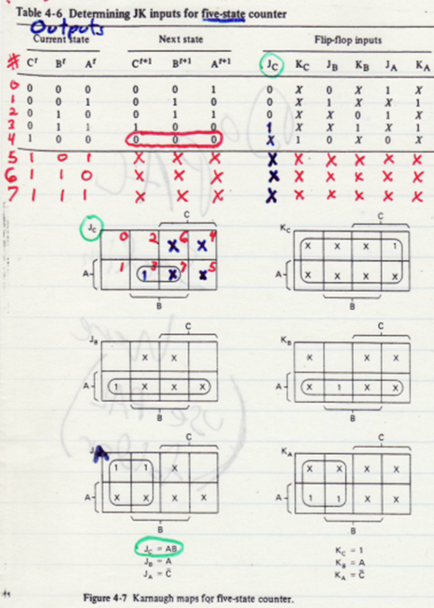
5-State JK Counter
J_{c} = AB
J_{c} = AB
K_{c} = 1
J_{b} = K_{c} = A
J_{a} = K_{a} = C
should be Ka = 1

Slide 16
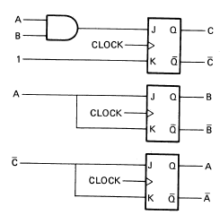
Complete 5-State JK ASMCounter
J_{c} = AB
K_{c} = 1
J_{b} = K_{b} = A
J_{a} = K_{a} = C
JK FFs should NOT be used with ROM ASM – doubles the number
of ROM outputs, and there are not any NEXT State circuits to simplify!

Slide 17
Textbook Material skipped
We are going to skip pages 129 through 135. Although the material will not be on the test, it does have some useful information on handshaking, etc, so you are encouraged to read it on your own.

Slide 18
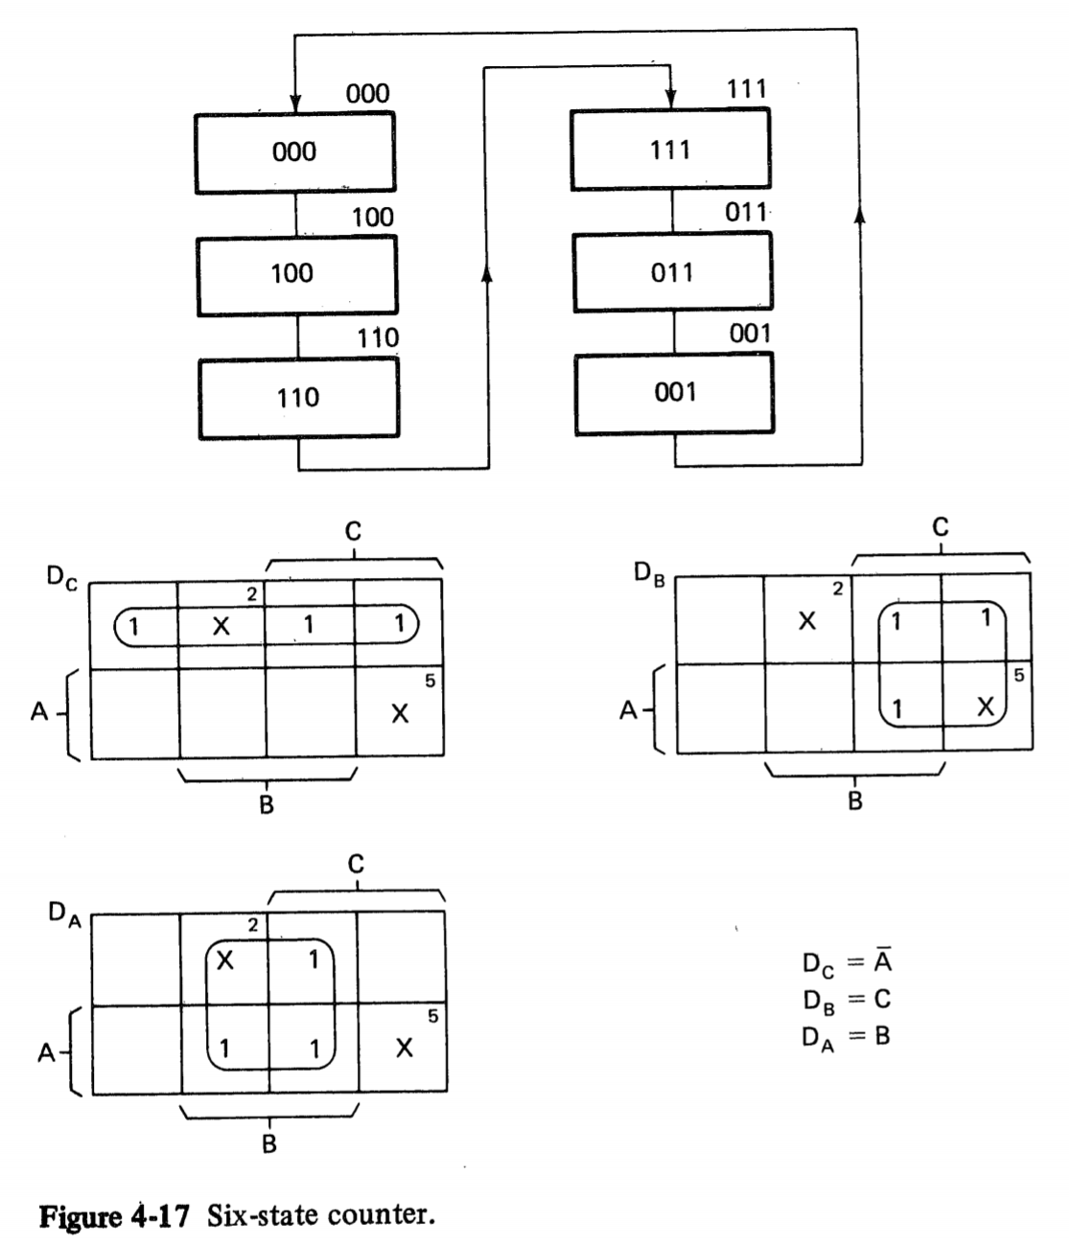

Hang Up States
Note that this 6-state D-FF counter does not count sequentially.
Don’t need to make a truth table. Can put next state (NS) values from ASM chart directly into K-maps. For example, for state 0, put the next state values 100 into square 0 of Dc, Db and Da in that order.
States 2 and 5 are not used.
Assign don’t cares to their next states by putting Xs in squares 2 and 5.
Simplifies circuitry by allowing larger K-map circles.
0
6
4
0
1
3
7
Next State
0

Slide 19
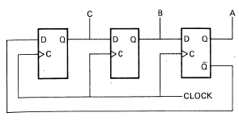
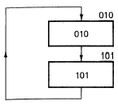
Hang Up Problem
ASMs with less states
than the maximum can
have hang up states.
When ASM is 1st powered
up, can start in any state.
Noise can also cause it
to glitch into unused state.
Hang up occurs if unused state goes back to
itself or to other unused states that
don’t lead back to desired states.
Three ways to determine next state: circuit, equations, K-maps.

Slide 20
Using circuit to determine next state
Label FF Qs with the
current state 010.
Follow those values
and any Q’ outputs
through the circuit
and label the FF Ds.
The FF Ds are the
next state:
What is the next state?
0
1
0
1

Slide 21
Using circuit to determine next state
Label FF Qs with the
current state 010.
Follow those values
and any Q’ outputs
through the circuit
and label the FF Ds.
The FF Ds are the
next state:
DcDbDa = 101.
1
0
0
1
1
0
1

Slide 22
Using EQUATIONS to determine next state
Next State Equations
D_{c} = A’
D_{b} = C
D_{a} = B
What is the next state?
Current State Next State (D_{c} D_{b} D_{a})
CBA A’ C B
010 1 0 1
State 2 goes to state 5

Slide 23
Use K-Maps for next state
When you circle or ignore a “don’t care” in the K map, you are essentially assigning it to be a 1 or a 0. If you use it as a 1 and circle it, then your system hardware will reflect this assumption. Ignore it, and it’s a 0.
If you take your K-map don’t care assignments and put them back in the truth table (in other words, change your don’t cares into the 0’s and 1’s), then you can see how your “current states” will cycle to your “next states”.
But you can do it “in your head” by just looking at the K-maps (see the next slide).

Slide 24
Use K-Maps for next state
Where does state 2 go?
Look at square 2 in the
Dc K-map. It represents
current state CBA = 010.
The square has a 1 in it
because it is circled.
This means Dc = 1 for
state 2.
Where does state 101 go?
Where does state 010 go?
0
6
4
0
1
3
7
Next State
0

Slide 25
Where does state 2 go?
Look at square 2 in the
Dc K-map. It represents
current state CBA = 010.
The square has a 1 in it
because it is circled.
This means Dc = 1 for
state 2.
Square 2 in the Db map
has a 0 in it. Db = 0
Square 2 in the Da map
has a 1 in it. Da = 1.
So next state DcDbDa
is 101.
Where does state 101 go?
0
6
4
0
1
3
7
Next State
0
DcDbDa = 010
Where does state 010 go?
DcDbDa = 101

Slide 26
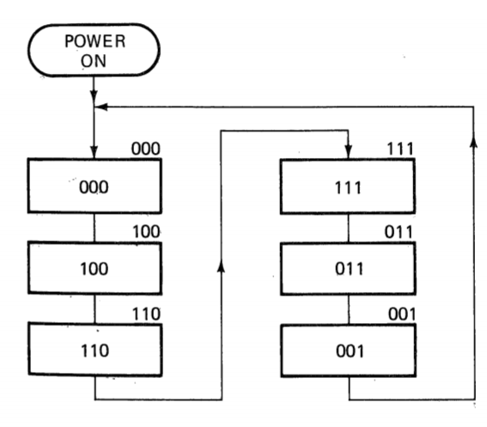

System Initialization
To prevent unused states from
being entered on start up,
specify first state on ASM
chart, and employ hardware
to make this happen.

Slide 27
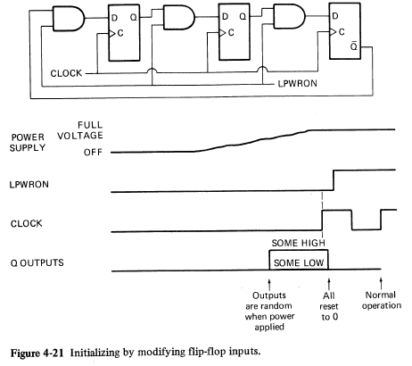


Use LPWRON with Enable gates to set the FF D inputs low at startup.
LPWRON starts LOW,
then changes to HIGH
after a delay.
LOWS get clocked
into the FFs, which
starts ASM in state 0.
Must have a circuit
create LPWRON.
Could just use the far
left AND gate, and
wait for 3 clocks to
clear FFs.

Slide 28
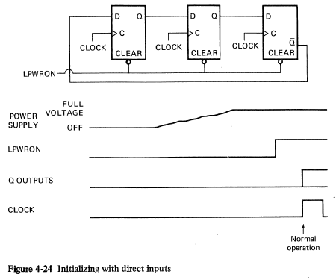
Use LPWRON with ASYNC CLEAR to clear the FFs at startup.
This is how FPGAs exit a hang up state
(must have ASYNC RESET code and specify asm SAFE ATTRIBUTE).

Slide 29
Self Clearing Logic
Even if ASM starts in
state 0, it could glitch
Into an unused hang up
state. Need auto-fix.
State 5 goes to state 2,
State 2 goes to state 5.
Use K-maps to make
state 5 go to a different
state. There are 3 ways to do it.
Try all 3 ways.
What are the new
equations for each way?

Slide 30
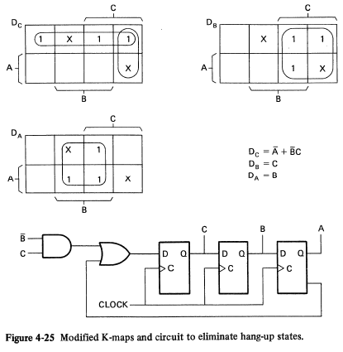




Self Clearing Logic
Even if ASM starts in
state 0, it could glitch
Into an unused hang up
state. Need auto-fix.
Circle X in Dc square 5.
Now state 5 goes to
square 110 (6) instead
of square 010 (2).
Dc = A’ + B’C
Costs two extra gates:
Change Db square 5:
Db = A’C + BC
Costs three extra gates!
Change Da square 5:
Da = B + AC
Costs two extra gates.

Slide 31
Self Clearing Logic
How else could be circle
to fix the hang up?
Circle X in Db square 2.
Now state 2 goes to
square 111 (7) instead
of square 101 (5).
Db = C + A’B
Two extra gates.

Slide 32
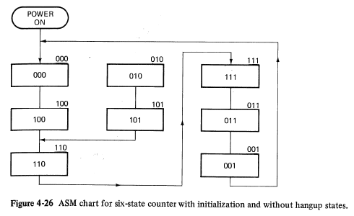



Self Clearing Logic
Changed Dc square 5 to a 1,
so it goes to state 6 instead
of state 2..
Now all unused states
eventually lead to desired
states.
Don’t design ASMs with hang up states!
I think some electrical engineers do. Perhaps that is why turning electronic devices OFF and back ON fixes them when they are hung up. Software hangups are fixed on powerup
because all CPUs and microcontrollers go to the instruction
at address zero on power up.

