Slide 1
Digital Systems
Physics 5430
State Counter and
“The Traffic Light ASM from Hell”

Slide 2
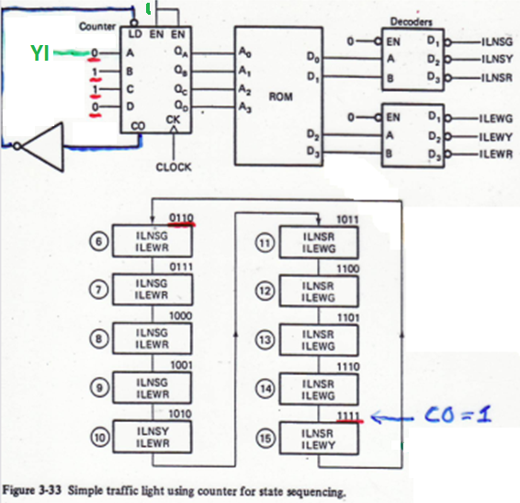
State Sequencing with Counter
Replace state reg with
state counter.
Counter sequences ASM
through states in order.
4-bit counter matches 16
States, but we only have 10.
So must load counter with
6 every time it tries to roll
over to count 0.
Tie active-high CO to
active-low LD through an
Inverter.
For LIMITED branching (out of state 15 only) to either state 6 or state 7,
can connect input YI to counter load line A. Or other inputs to other load lines.

Slide 3
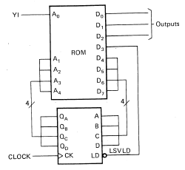



Flexible Branching with State Counter
Connect counter outputs to
ROM address lines as before.
Connect 4 ROM outputs to
the 4 counter inputs.
Connect a ROM output to
the counter load pin (LD).
LSVLD is a NEXT STATE output,
so acts like delayed output.

Slide 4
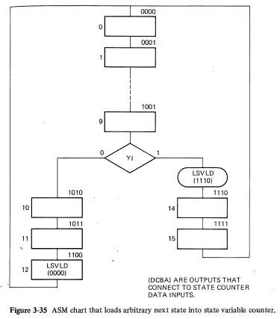
Flexible Branching ASM Chart
Counter sequences through states 0 to 9.
State 9 has an input YI.
If YI = 0, counter keeps sequencing to states 10, 11, 12. In state 12, ROM loads 0 into the counter, so goes to state 0 next.
If YI = 1, ROM loads 14 into the counter, so goes to 14 next. Then counts to 15 and rollsover to 0.

Slide 5
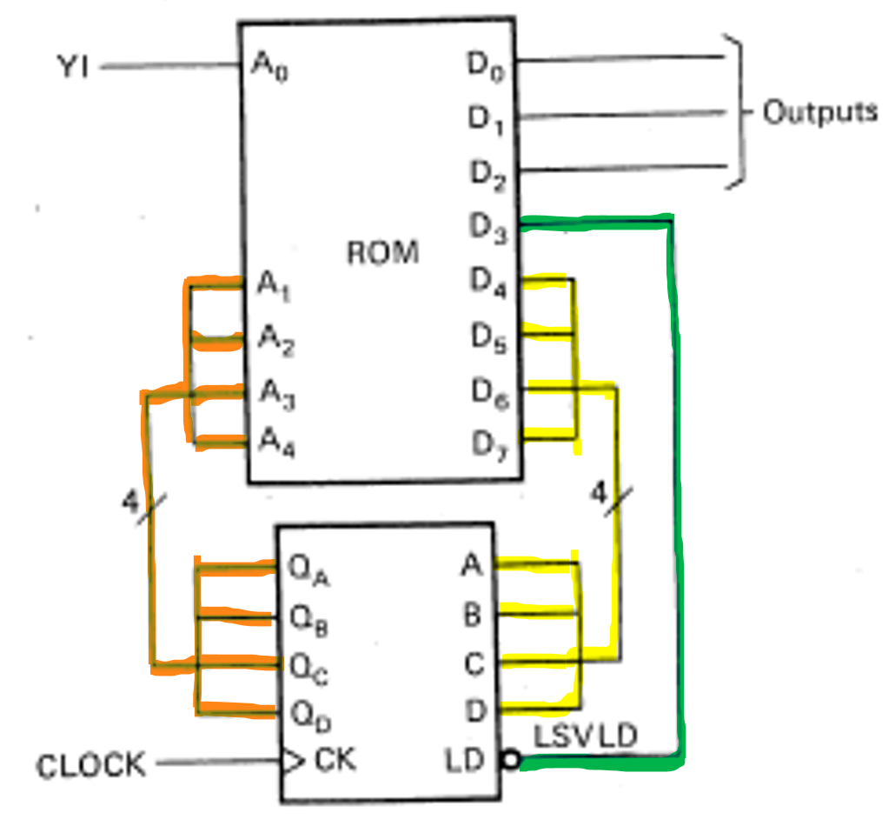
Flexible Branching Circuit
Using a state counter is much more difficult than a state register.
More importantly, this design uses 5 ROM outputs for the ASM next state instead of 4 without a state counter!
Why would we ever use a state counter?

Slide 6
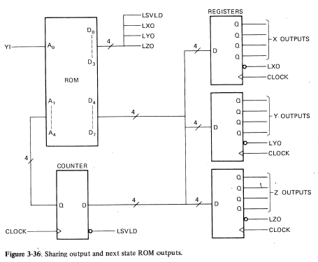

Why would we ever use a state counter?
Answer
It makes sense if you also use the group
of 4 state counter ROM outputs for other things. For example, output registers.
You can think of them as a data bus.
LSVLD, LXO, LYO, and LZO are load signals.

Slide 7
State Counter with Shared Data Bus
Use data bus and the load signals to load
the registers or state
counter one at a time.
Requires extra states to load registers.
ASM chart branching may require extra states. (Can’t change
states and load outputs at same time.)

Slide 8
State Counter with Shared Data Bus
ASM has 8-bit ROM, 12 outputs
and up to 16 states.
Standard ASM with 8-bit ROM
would only have 4 outputs with
up to 16 states.
It would need a 16-bit ROM
to have12 outputs.
How many ROM outputs does
the state counter save
(not counting the ones the
registers save)?
How many ROM outputs would
using a 1 to 4 decoder for the
load signals save?
ANSWER: It saves 4 - 1 = 3.
D4-D7 minus LSVLD
ANSWER: It saves 4 - 3 = 1,
or 4 – 2 = 2 if tie EN to gnd. But don’t need to save any more (8-bit ROM)

Slide 9
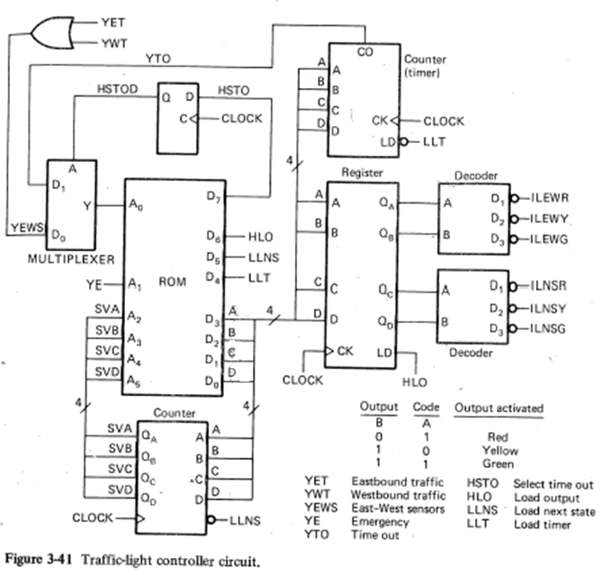







“Traffic Light ASM from Hell”
1.25 s clock

Slide 10
Traffic Light Controller Design Features
This design uses:
MUX inputs, and a direct input.
Decoders on the outputs.
A timer,
A state counter,
Registers on the outputs.
Does not show registers on the inputs (no need to take a “snapshot” of the lines as discussed previously.) However, all inputs are assumed to be synchronized with the clock (using a FF).

Slide 11
“Traffic Light ASM from Hell”
NS is busy street.
EW has traffic sensors.
Has emergency input.
Goes to NSG/EWR
when over.
Timer has adjustable
delay times.

Slide 12
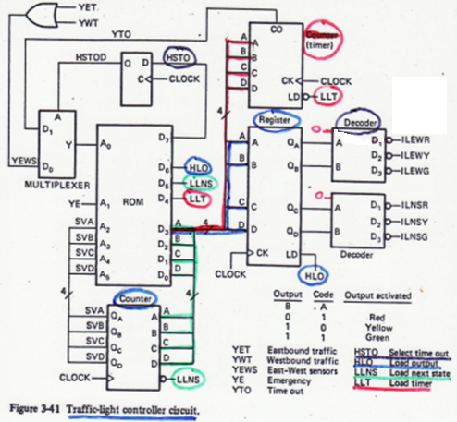
Traffic Light Controller (cont’d)
Data bus connected to state
counter, timer, and output
register. Load signals are:
LLNS, LLT, and HLO.
So extra states will be needed to
use the data bus for 3 things.
ASM chart branching by loading
state counter.
Active-low decoders allow 4 ROM
outputs to control six lights.
Yemer is not multiplexed.
E/W sensor (YEWS) and timer
output (YTO) are multiplexed.
HSTO = 0 selects YEWS
HSTO = 1 selects YTO.

Slide 13
More Traffic Light Controller Specs
East/West inputs are OR’ed together.
The MUX select line (HSTO) must be asserted early.
Note that LOAD’s are color-coordinated in the previous figures.
Decoders are always enabled. (Notice the unused output D0 on the decoders.)
Uses 1.25 second clock: 16 states = 20 s; 4 states = 5 s
Register stores both decoder’s binary select values.

Slide 14
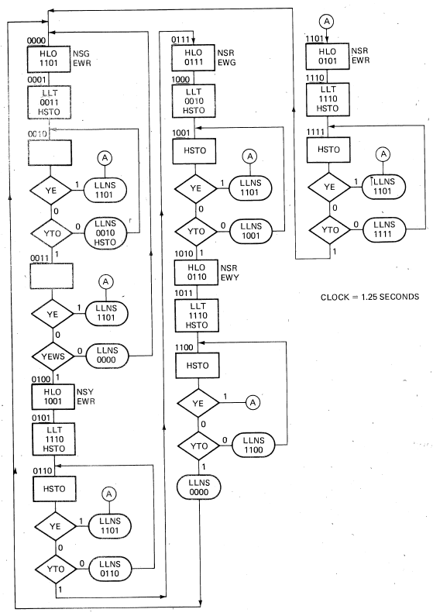

Traffic Light Controller ASM Chart
3 thru 15

Slide 15
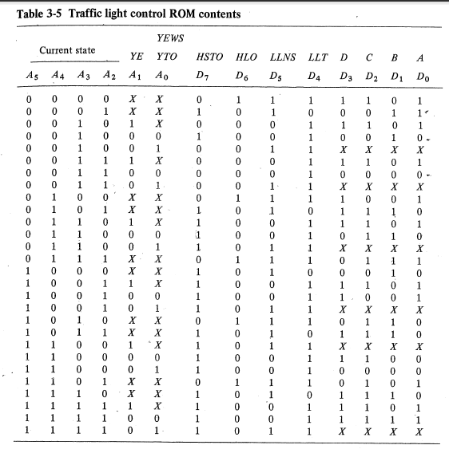






Traffic Light Controller ROM Table

