Slide 1
Digital Systems
Physics 5430
Chapter 3 Part 1 – Busses,
Multiplexing ASM Inputs

Slide 2
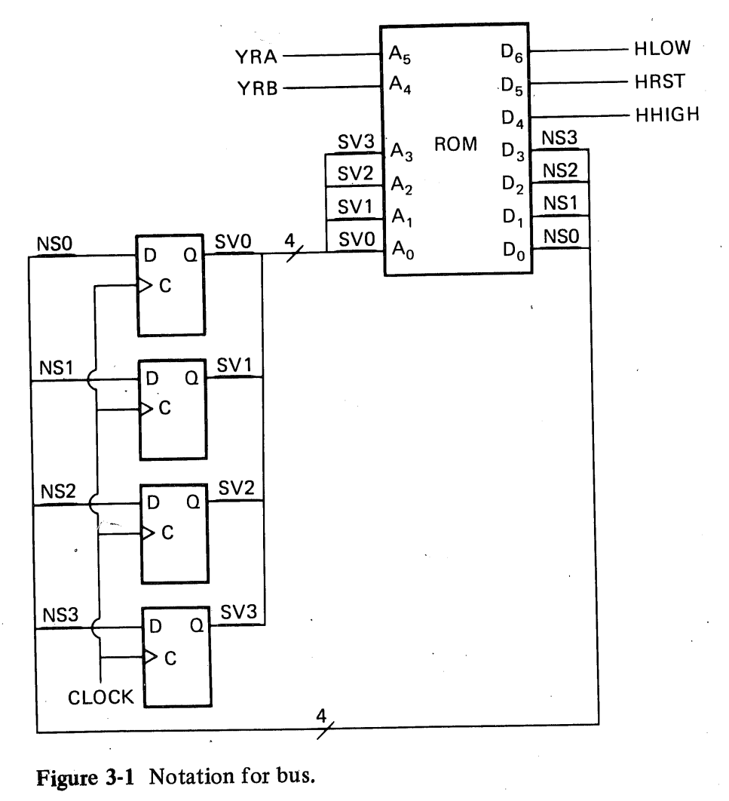
Bus Notation
TYPO: ROM has MSB of address
and data pins at the top. Always
put LSB at top.
Showing all the signal lines clutters the schematic.
Instead, use a single line for bus, split out the inputs and outputs
at the ends of the bus. Label bus with number of signal wires,
e.g., use /4.

Slide 3
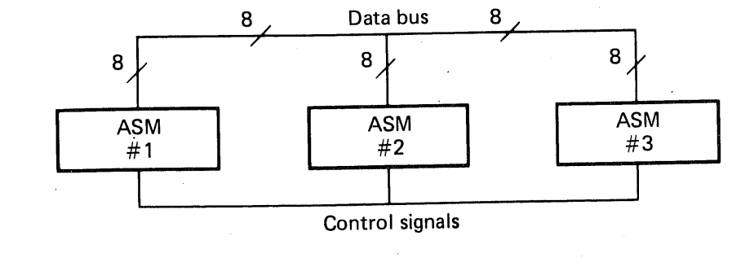
Bi-directional Data Bus
Data is passed between 3 ASMs.
Control signals specify which ASM is the transmitter.
All three ASMs are simultaneous receivers.
Two popular methods are:
Wired-AND (used in the IEEE-488 GPIB bus and the I²C bus)
Tristates

Slide 4
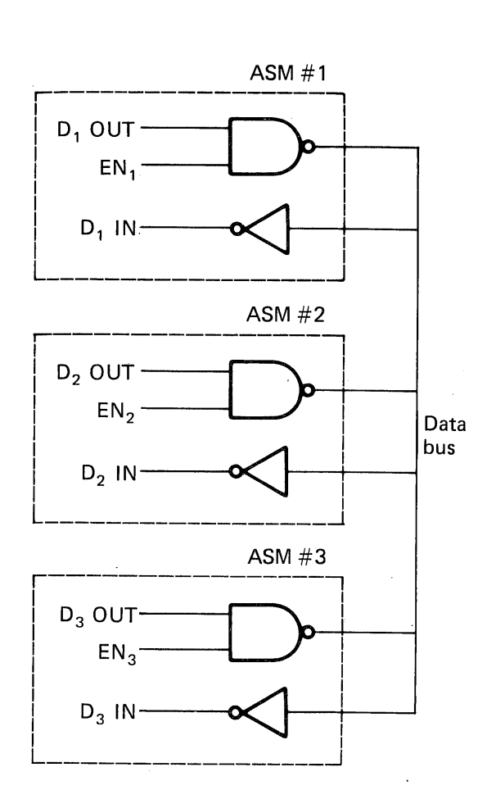
Wired-And Data Bus
All inputs (e.g., D1 In) are connected
to the bus through inverter/buffers.
Only one output is gated onto the bus
at a time. An enable signal (e.g., EN1)
Is applied to the OC NAND gate.

Slide 5
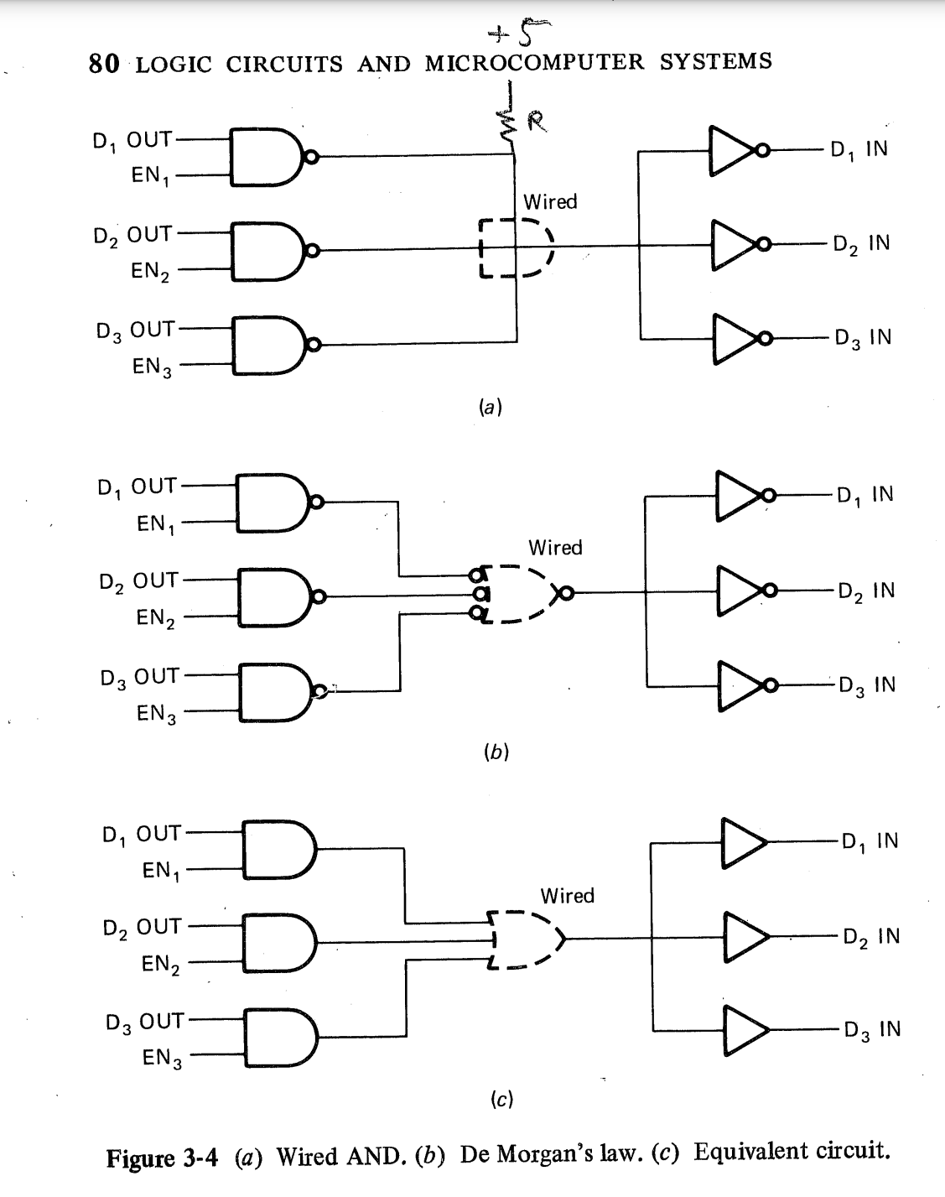
Wired-AND Data Bus (continued)
Redraw Circuit with Inputs
and Outputs grouped
DeMorgan’s Law
Equivalent Circuit

Slide 6
Wired-AND Data Bus (continued)
Wired-AND data bus ends up with transmitters Ored to receivers.
Each transmitter can put its data on the bus if it is enabled.
Disadvantage is slower propagation of signal through the gates.

Slide 7
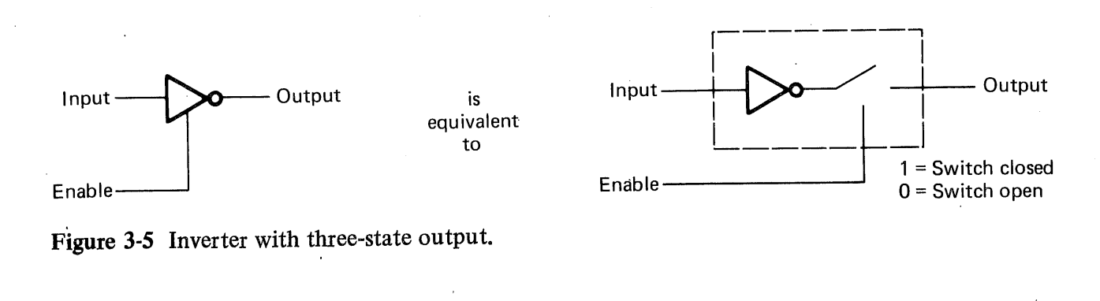
Tristate Bus
Faster signal propagation than Wired-AND bus.
Tristate Inverter

Slide 8
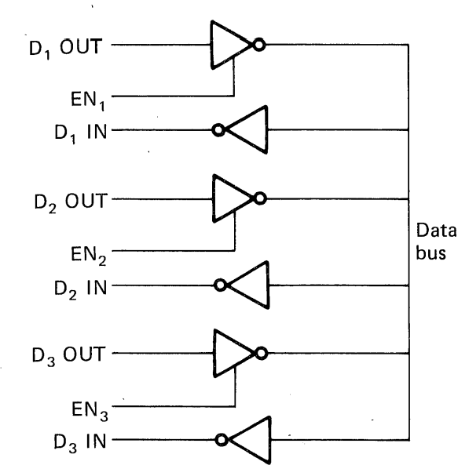


Tristate Bus
With Enables set to (1,0,0),
D1 OUT is connected to the bus.
D2 OUT and D3 OUT are
disconnected from the bus.
Note: This circuit of inverters provides the same functionality as the previous Wired- AND bus.

Slide 9
Scale of Integrated Circuits
Standard circuits and algorithms are used repeatedly in digital electronics. These are MASS PRODUCED which (1)Lowers production costs, and (2)Lowers DESIGN costs, since the cost is shared by millions of IC’s.
Chips are categorized according to complexity (the number of gates per chip).
SSI (Small Scale Integration) 1-20 gates per chip.
MSI (Medium Scale Integration) 20-100 gates/chip.
LSI (Large Scale Integration) 100-1000 gates/chip.
VLSI (Very Large Scale Integration) >1000 gates/chip.
Generally, TTL is used for SSI and MSI. CMOS is used for LSI and VLSI. CMOS is simpler, with a smaller area, and low power.

Slide 10
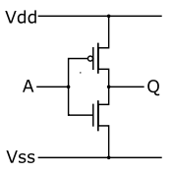
CMOS Circuits
Complementary Metal Oxide Semiconductor
“Complementary” because the transistors come in n-type and p-type pairs.
What does the following CMOS circuit do?

Slide 11
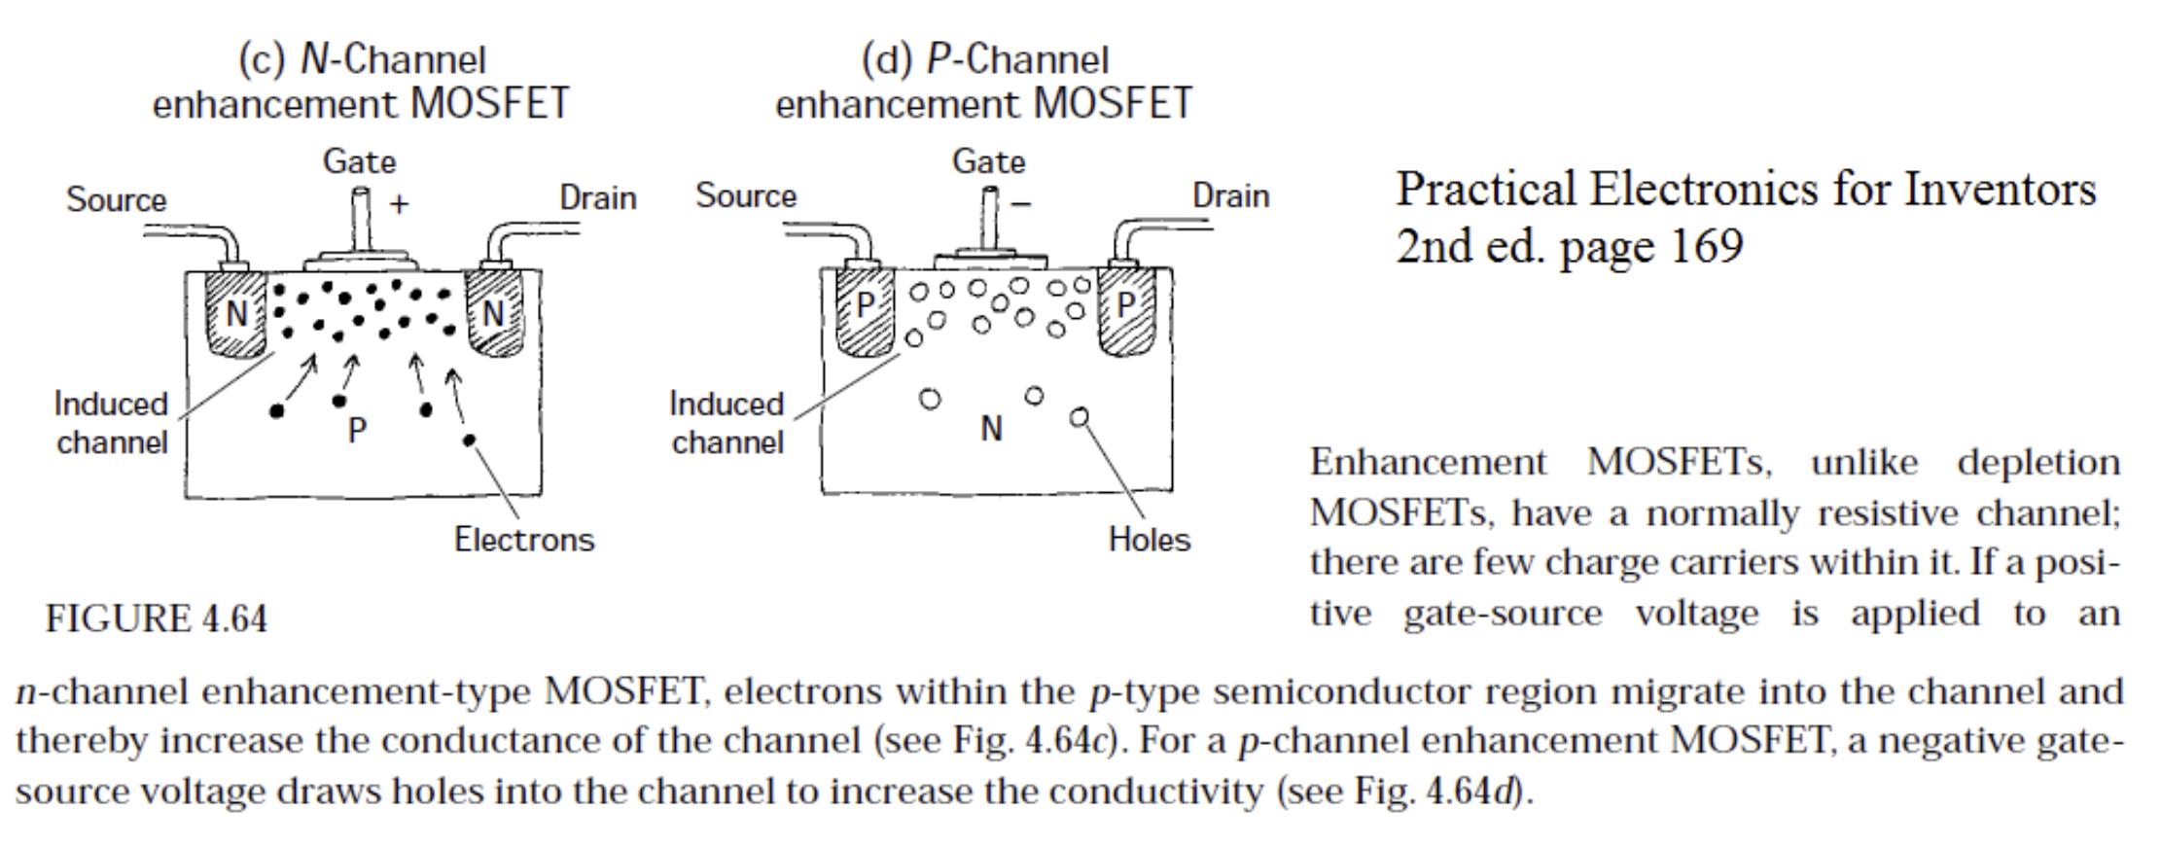























8-7 MOS Technology

Slide 12
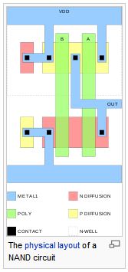
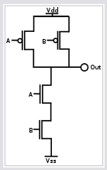
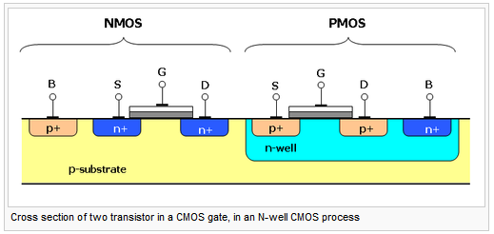
CMOS NAND Gate

Slide 13
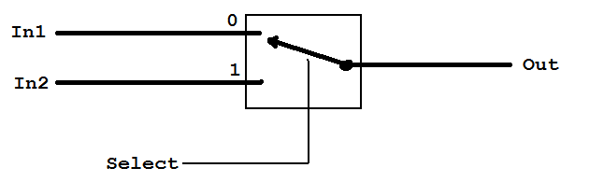
A Simple Multiplexer

Slide 14
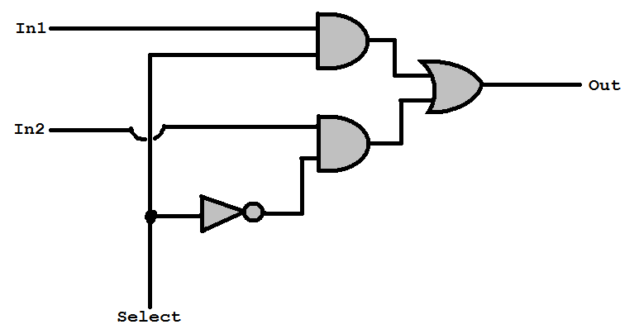
A Simple Multiplexer

Slide 15
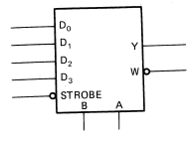
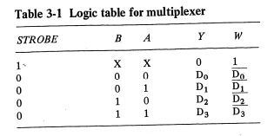
4 to 1Multiplexer
Select lines BA connect 1 of the 4 inputs to output Y. B is MSB.
W is Y bar.
Strobe is active-low enable.
Y = 0 when disabled.
A = 0, B = 0 selects D0
A = 0, B = 1 selects D1
B = 1, A = 0 selects D2
B = 1, A = 1 selects D3

Slide 16
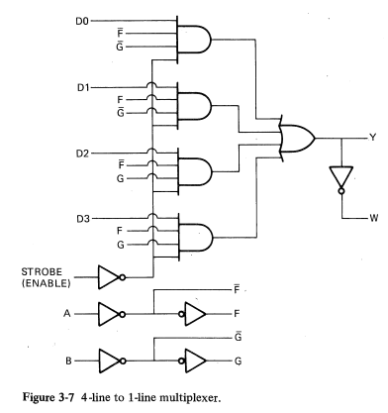
4 to 1Multiplexer Internals
Uses four enable gates
(4-input AND gates)
F = A, F’ = A’
G = B, G’ = B’
F = 0, G = 0 selects D0
F = 0, G = 1 selects D1
F = 1, G = 0 selects D2
F = 1, G = 1 selects D3

Slide 17
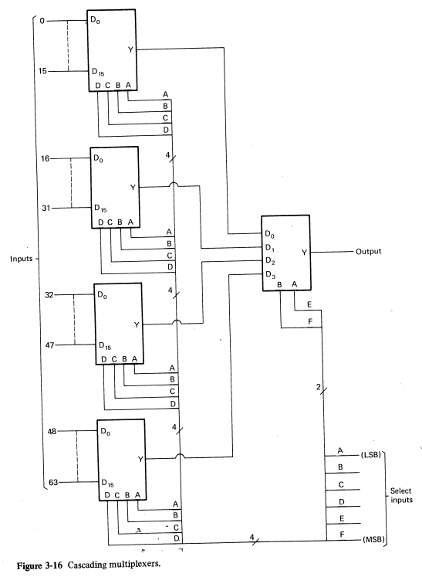
Large Multiplexers
2 to 1, 4 to 1, 8 to 1, and 16 to 1
muxes are commonly available.
Can cascade muxes to make
a larger one.
64 to 1 made from four 16 to 1
cascaded into a 4 to 1.
Has 6 select lines: 2⁶ = 64

Slide 18
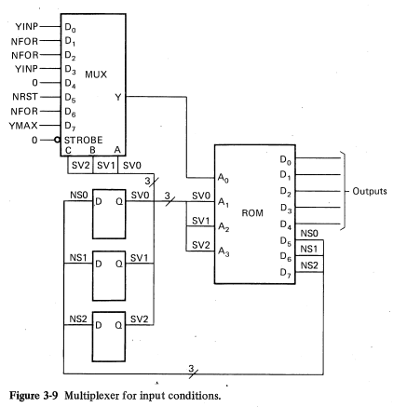
Using MUX in an ASM
8 to 1 mux connects four ASM inputs into ROM’s address pin A0.
Mux select lines CBA tied to state variables.
ONLY 1 input can be tested in each state!
State 0 - YINP
State 1 - NFOR
State 2 - NFOR
State 3 - YINP
State 4 - no input
State 5 - NRST
State 6 - NFOR
State 7 - YMAX

Slide 19
Using MUX in an ASM
ONLY 1 input can be tested in each state
(i.e., one decision diamond per state).
Need extra state every time need to test two inputs in same state, but can’t test them at same time. ASM is also slower (has to step through more states). May need more FFs due to added states.
With mux: 16 x 8 ROM
Without mux: 128 x 8 ROM
(have to type 128 rows into ROM table,
even when using FPGA)

Slide 20
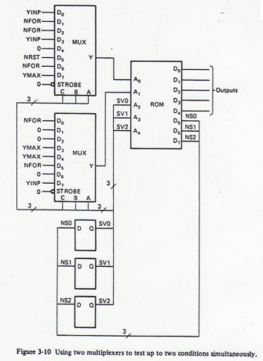
Testing 2 Inputs at Same Time
Use two multiplexers.
Each MUX feeds one address line.
ROM is twice the size (32 x 8).
Smaller than 128 x 8 without muxes.
If have complex ASM – 10 inputs
(2 or 3 tested at the same time)
big savings in ROM size using 2 or 3 muxes.
Assume still has <= 8 states (3 FFs).
10 inputs, 3 tested simultaneously:
With muxes: 64 x 8 ROM
Without muxes: 8192 x 8 ROM
Type 8192 lines into ROM table!!!

Slide 21
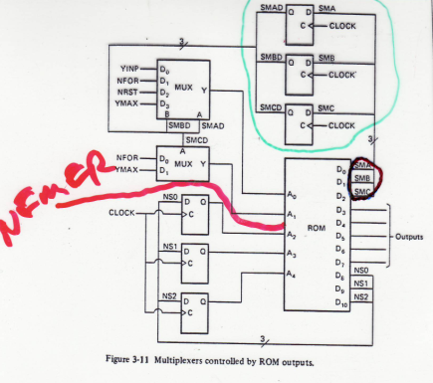
MUX ASM with Large Number of States
If the ASM has 7 state FFs, need 2⁷=128 input MUX! But may only use just a FEW of the 128 inputs.
Therefore, connect MUX select inputs to ROM OUTPUT instead of states. Then the ROM can be programmed to select any input in any state.
Multiple MUX’s of different sizes can be used, with some often-used inputs connected directly to the ROM (see the NEMER line [in the figure to the right] that needs to be checked in all states).
NOTE: Need flip-flops in MUX select lines. Why?

Slide 22
MUX ASM with Large Number of States
NOTE: Need flip-flops in MUX select lines. Why?
ANSWER: The changing input to the ROM could change the outputs of the ROM, changing the select lines, changing the input… Could cause a runaway cycling situation with NO CLOCK needed. FF’s synchronize the select lines with the clock. This delays the action of the select line signals one clock pulse, so must be asserted early.

Slide 23
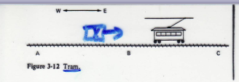
Example Multiplexing ASM Inputs
Airport tram car travels between terminals A, B, and C. It must stop within 1 second of actuating sensors at A, B, C; so using 1s clock. It stops 10 seconds (10 states) at each station. Override button keeps it stopped longer at a station as long as conductor is pressing it.

Slide 24
Example Multiplexing ASM Inputs
Using a 4-to-1 Mux for inputs A,B,C, and OVERRIDE, so ASM chart tests one input per state. We will have 44 states. That requires 6 FFs and address lines (2⁶=64), plus one address line for the MUX output. Using ROM outputs for the MUX select lines requires two extra ROM outputs. So we are saving ROM inputs at expense of extra ROM outputs.

Slide 25
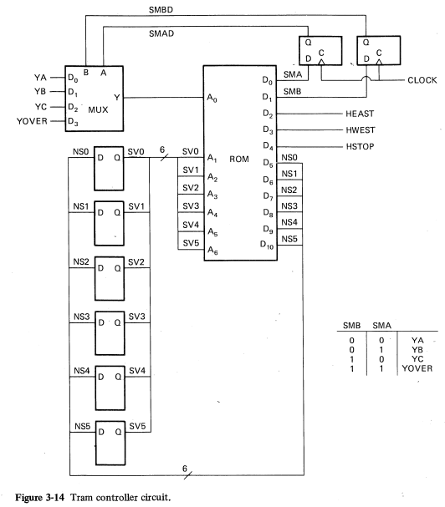
Circuit for Tram with MUX
4 to 1 MUX has 2 select
lines tied to ROM outputs
through FFs.
Notice signal labels:
SMBD =
select mux B delayed
Must activate select lines
one state early.
If used state variables for
select lines, would need
64 to 1 MUX.

Slide 26
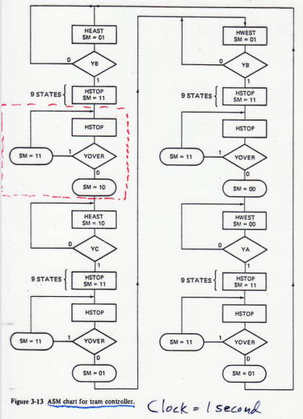

Airport Tram ASM chart
SMB and SMA are asserted
one state early.

Slide 27
Circuit for Tram with MUX
MUX saves 3 address lines,
so ROM is 2⁷ = 128 x 11
Without mux 2¹⁰ = 1024 x 9
Circuit saves both ROM and
MUX size.
# ROM bits
With MUX: 128 x 11 = 1408
No MUX: 1024 x 9 = 9216
We can use DeCODERS to
lower # ROM outputs to 8.
END

