Slide 1
Digital Systems
Physics 5430
Wiatrowski Chapter 3 Decoders, Registers, Counters

Slide 2



Decoders
4 to 1 decoder routes a single input to one of four outputs.
BA are the select lines.
Input and outputs are ACTIVE LOW.
Enable is the input, must be tied low.
If enable is high, all outputs are off (high).
Only one output on at a time (mutually exclusive).
Must have one on at all times if enabled.

Slide 3
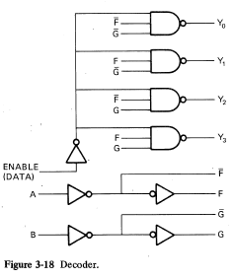
Mirror image of multiplexer.
Uses four enable gates
(one for each output).
Can also get:
1 to 2 (1 select line)
1 to 8 (3 select lines)
1 to 16 (4 select lines)

Slide 4
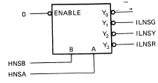
Decoders in ASM’s
Can get 3 outputs from 2 ROM pins.
Tie Enable to GND.
Useful for a traffic light design.
Notice active-low lights!
Unused output could be used for
blinking NS off in YNITE mode.

Slide 5
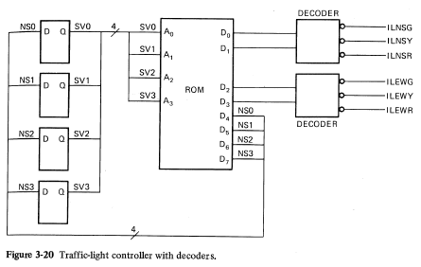
Use 2 decoders.
Saves 2 ROM outputs.
Two decoders is a perfect match for traffic light ASM because :
Three lights per direction.
Only one of the three is on at a time.
Unused output can be selected to turn off all 3 lights.
However, in general, mutually exclusive restriction (one on at a time)
could require more states.

Slide 6
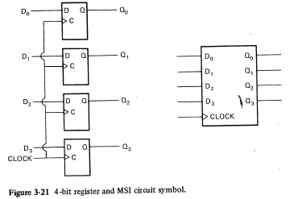
Registers
A register is a group of flip flops with a common clock input.
Usually have multiples of 4 D FFs.
Usually used as the state register for ASMs.

Slide 7
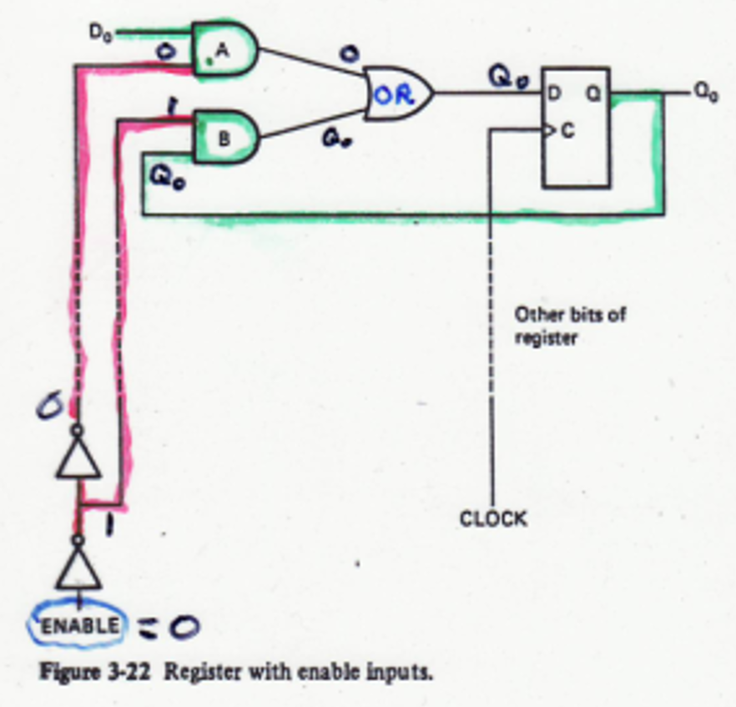
Register with Enable
Enable = 0: register keeps
old value.
Enable = 1: normal operation.
Acts like a digital camera with
one pixel.
Each FF in the register has
this circuit (multiple pixels!)
Can control Enable with ASM
output.
What chip does the circuit in the dotted box act like?
A 2 to 1 MUX. The Enable is the select line, selects D₀ or Q₀.

Slide 8
Register with Enable
Enable = 0: register keeps
old value.
Enable = 1: normal operation.
Can control Enable with ASM
output.
Common uses in ASM: 1) Take “picture” of ASM inputs for MUX.
2) Expanding ROM outputs.
3) In FSMD (finite state machine with data path)

Slide 9
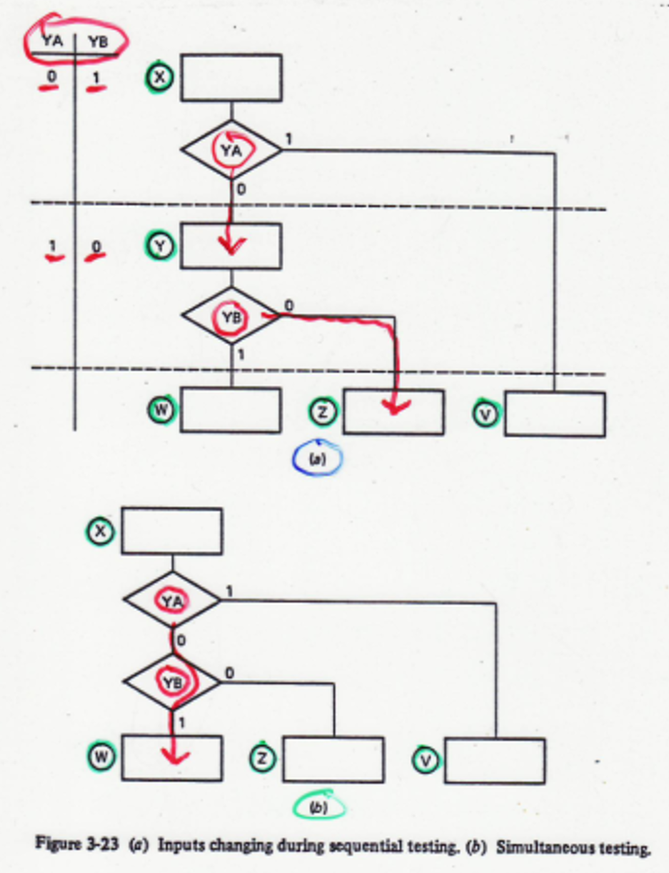
ASM Problem with One MUX and 2 inputs
Can only check one input
at a time.
If the inputs change between states (which is likely), you won’t be able to compare both inputs at the same time like you should.
Sequential testing goes to Z.
Inverted YA/YB goes to V.
Never goes to W.
Simultaneous testing goes to W.

Slide 10
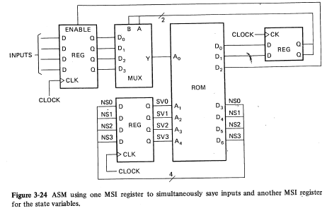
Solution to ASM – MUX Problem
Also notice the
State Register.
Take “snapshot” of inputs with ROM output D2.
Then cycle through them using the MUX in multiple ASM states.
ROM sees values relative to each other at same time.
However, takes more states, and misses input changes during cycling.

Slide 11
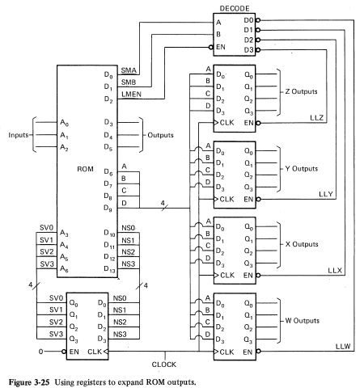
Expanding Outputs with Registers
ASM outputs can be stored in registers W, X, Y, Z.
[ 1] Can have many outputs using small ROM.
[ 2] Outputs are NOT mutually exclusive.
[ 3] Outputs remain on or off AFTER the ASM exits the state, and do not have to be asserted in every state.

Slide 12
Expanding Outputs with Registers
[ 4] Disadvantage:
ROM output (DCBA) is “loaded” into ONE register at a time as selected by decoder (SMA,SMB). Takes 4 states.
Can only change 4 outputs simultaneously at a time.
Why is LMEN used?
LMEN is used to disable all 4
register so they keep their
values after they are loaded.
Is it required?
It is NOT required, but you would
have to tie EN to GND, and keep reloading one of the registers every clock cycle by putting its values on the ABCD bus,
and selecting it with SMA/SMB.

Slide 13
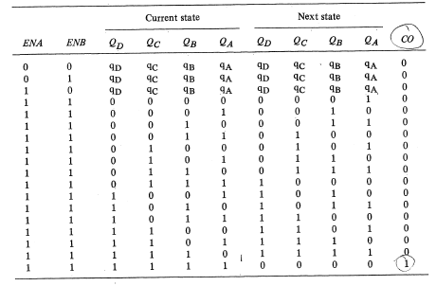












Counters
Two Enable pins so can chain counters.
Important output: CO = carry out.
Counters are actually ASMs.
When BOTH enables are high, it counts.
Else count stays the same (stays in same state).

Slide 14
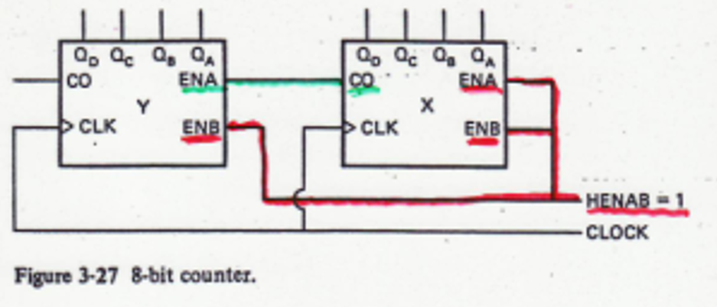
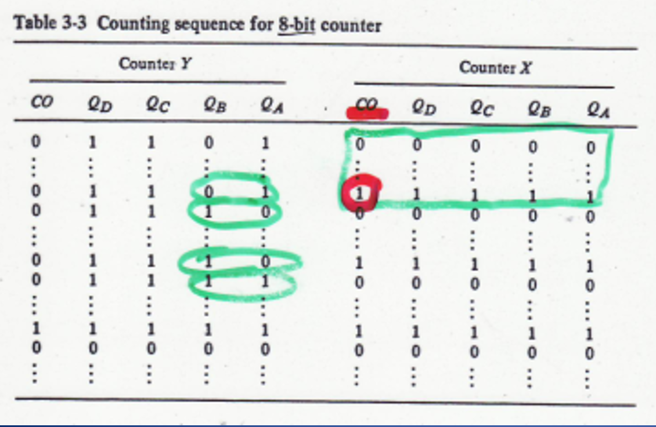
Connecting Counters
Use two 4-bit counters to make an 8-bit counter.
Counter X has both enables activated, so it counts from 0000 to 1111.
When X = 1111, CO = 1
which enables counter Y.
Counter Y counts the
rollovers of counter X.
Lower enable line controls
entire 8-bit counter.

Slide 15
Connecting Counters (contd)
Counter Y counts the
rollovers of counter X.
When X reaches 1111, CO = 1, enables counter Y for ONE count
(because CO = 0 when X rolls over to 0000).
Grouping all 8 counter bits together yields this transition from 15 to 16:
00001111 goes to 00010000.
In table 3, counter transitions from 1101111 to 11100000
Counter Y’s CO goes high when count is 11111111.

Slide 16
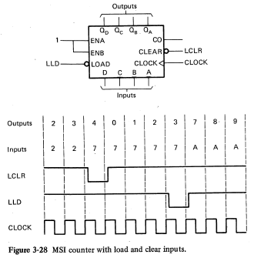









Counter CLEAR and LOAD
Counter is counting, but gets overridden by CLEAR and LOAD.
Sync active-low CLEAR zeros the counter at next clock edge.
Sync active-low LOAD transfers DCBA inputs to counter outputs
Q_{D} Q_{C} Q_{B} Q_{A} at next clock edge.
If LOAD is held low, counter acts like a register.

Slide 17
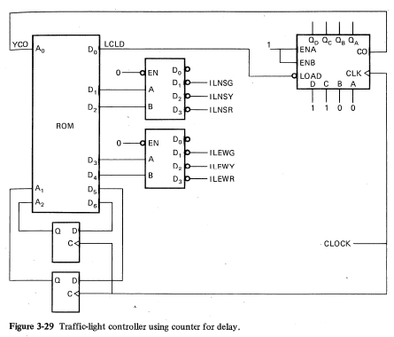
Counter used as Timer
Use counter to time
how long to stay
in state.
Connect load lines to
switches to set delay.
Connect LOAD pin to
ROM output. LCLD is a delayed output.
Connect CO pin to
ROM input. CO is a delayed output.
Tie both counter enables high so it
runs continuously.
H-L switches
5 second clock
Why are LCLD and CO delayed outputs?

Slide 18
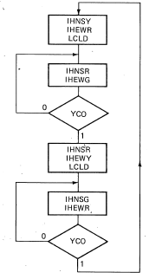
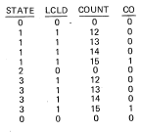

Counter used as Timer cont’d
USE SWITCHES TO SET TIMER TO 20 S DELAY
The timer counts UP, so set switches in respect to how many counts needed to reach count 15, i.e., the CO times-up signal). Using a 5 s clock, so 4 counts x 5 s = 20 s for RED/GREEN state.
So switches = 12 gives 20 s delay (12 13 14 15).
5 second clock
Only 4 states needed with timer instead of 10 without.

Slide 19
Counter used as Timer cont’d
Load timer in state 0 (NSY). LCLD is delayed
output, so load happens as enter state 1 (NSR).
Stays in state 1 until YCO goes high at count 15.
So counts 12, 13, 14, 15 (20 seconds). CO is
delayed output; ASM goes to state 2 after
count 15 is over.
Timer rolls over to count 0 as ASM enters state 2.
(ASM and timer are both “running”).
Load timer in state 2 (EWY). Delayed output, so
load happens as enter state 3 (NSG).
5 second clock

Slide 20
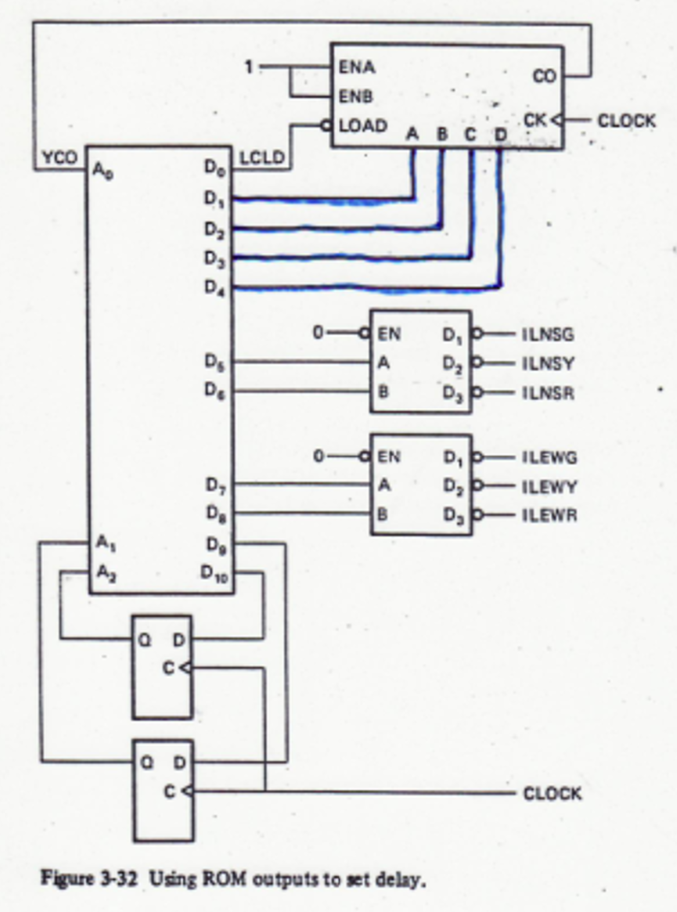
Using ROM outputs to set delay
If need different delays for other
states, use ROM outputs to set
various delay times.
If only need two different delay
times, and you should not be
adding four outputs to the ROM,
could use two timers with switches.
Connect each timer’s CO to a ROM
input, and look at that input in the
delayed state.

Slide 21
END

