Slide 1
PikaReed
By Bryan Pikaard and Calab Reeder

Slide 2
Motivation behind creating PikaReed
There is a lack of places that cater to new novelists
Experienced writers cannot share their feedback or comments easily
Provide a platform for new writers to:
Share their work
Learn from fellow writers
Learn from website resources

Slide 3
Committed Features
Completed
user_registration, user_login, change_password, change_email, change_username, writer_resources, write_chapter, chapter_comments, chapter_corrections, content_moderation, public_library, filter_novels, search_bar, user_library, user_library_bookmarks, novel_review, novel_rating, random_novel, platform_feedback, trusted_users
Incomplete
reset_password and change_avatar

Slide 4
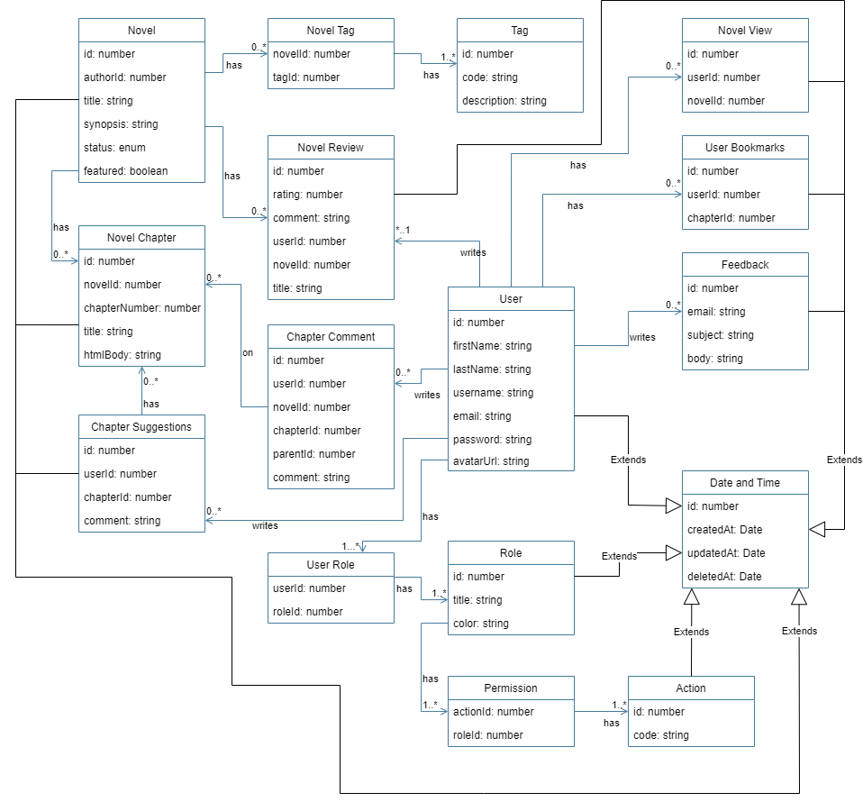
Class Diagram
Most tables extend Date and Time
Added more parameters
Added Bookmarks, Feedback, and View Tables

Slide 5
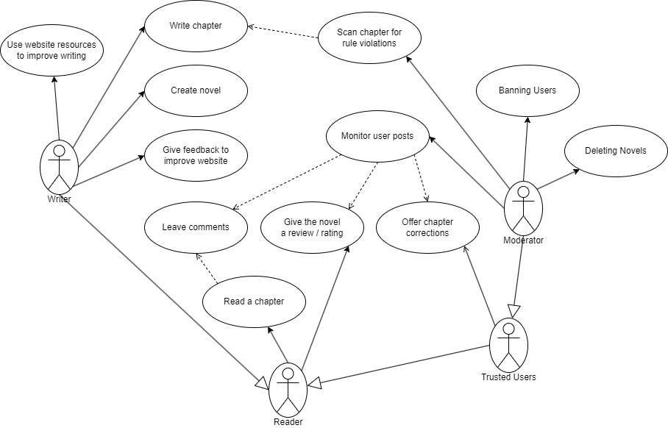
Use Case Diagram
Literally the same -->

