Slide 1
Path Planning for Ellipsoidal Robots with Minimal Collision Detection
Brennan Proudfoot

Slide 2
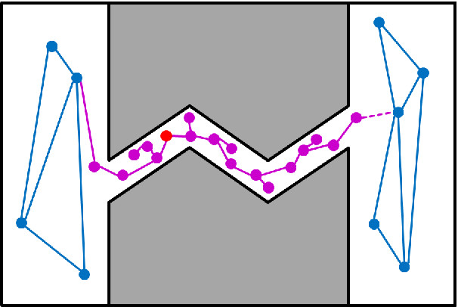
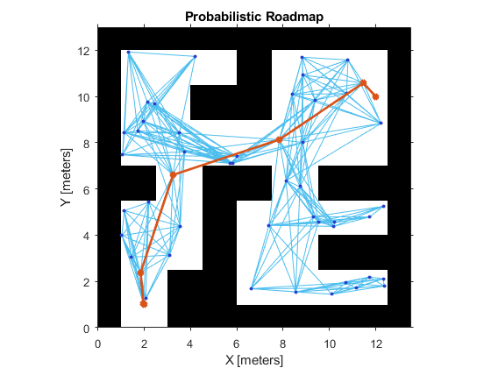
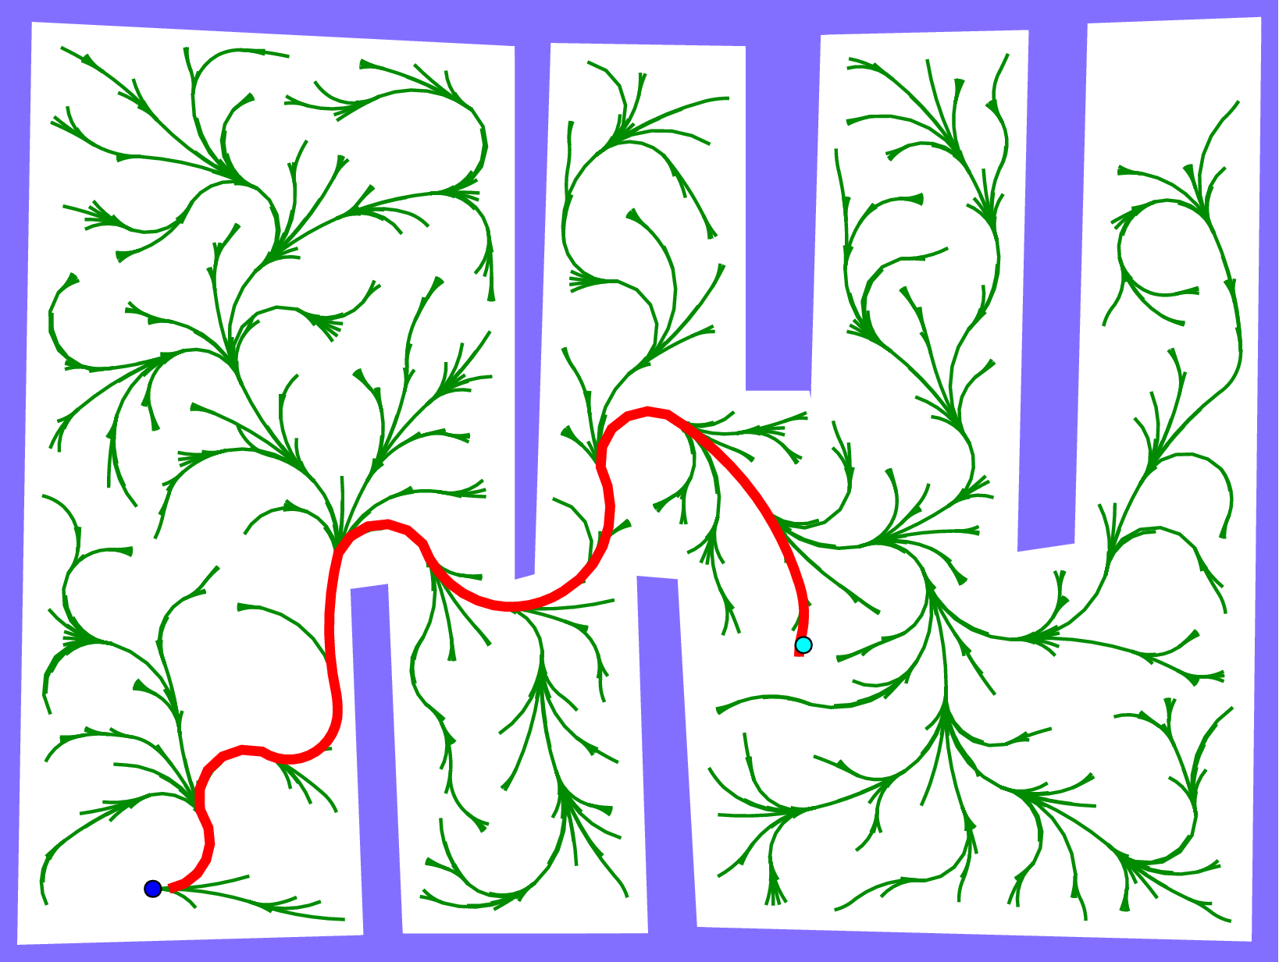
Motivation
Narrow passage problem
Collision checking expensive

Slide 3
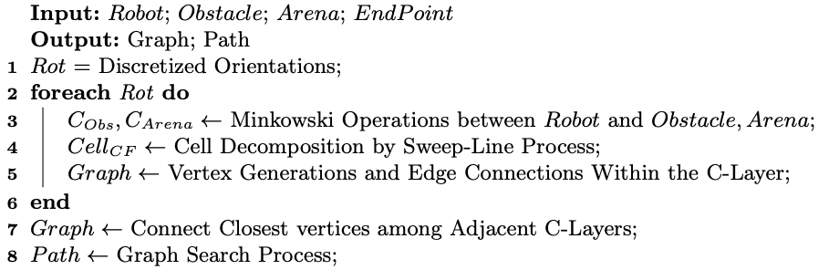
Highway Roadmap Algorithm

Slide 4
Highway Roadmap Algorithm

Slide 5









Closed Form Minkowski Operations to grow obstacles

Slide 6
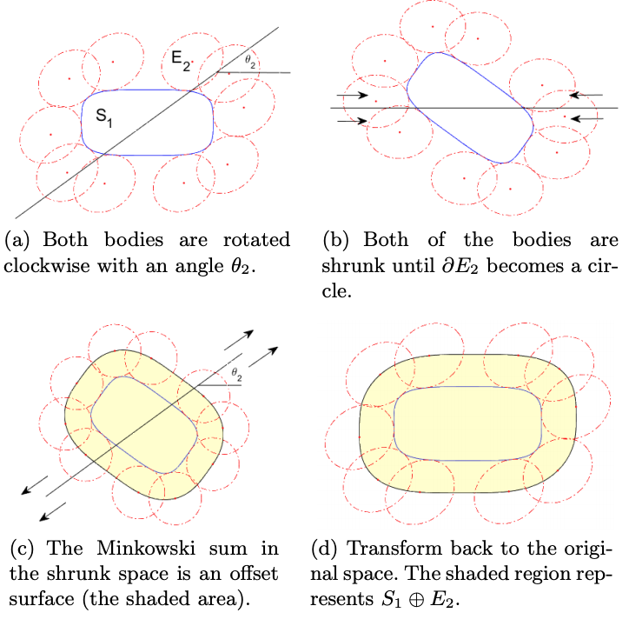
Closed Form Minkowski Operations to grow obstacles

Slide 7
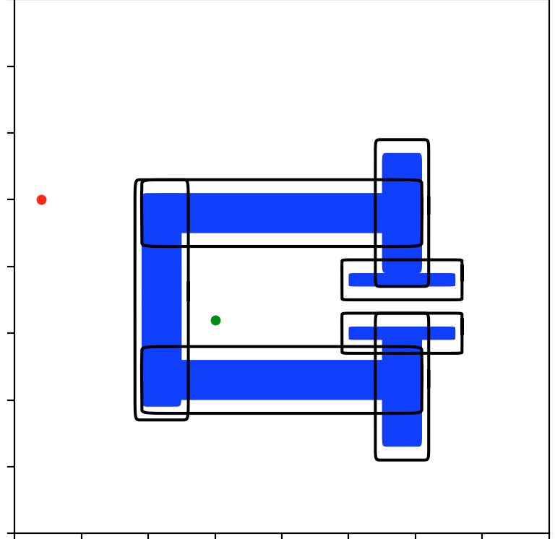
Closed Form Minkowski Operations to grow obstacles

Slide 8
Highway Roadmap Algorithm

Slide 9
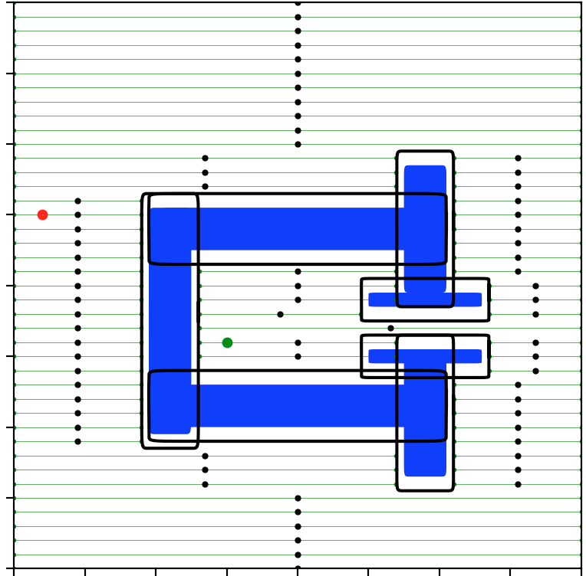
Sweep Line Cell Decomposition
Objective: Characterize free space in map
Send sweep lines across map
Store free line segments

Slide 10
Highway Roadmap Algorithm

Slide 11
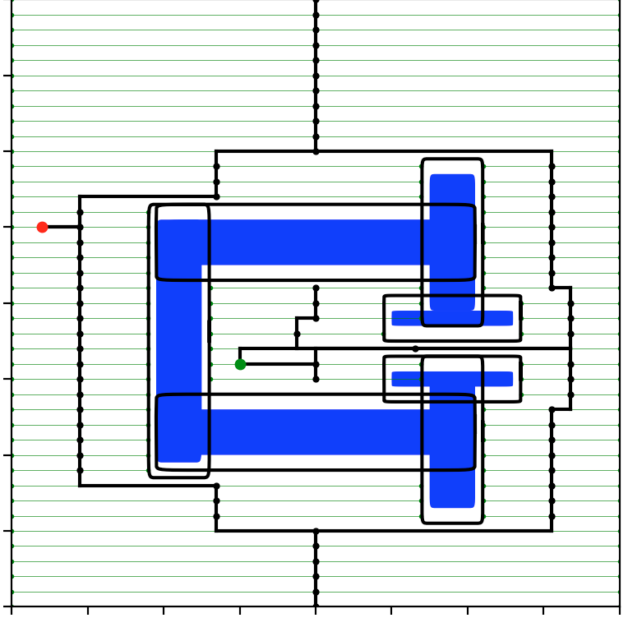
Vertex Generation + Connection within C-Layer
Vertex is midpoint of free line segments
Connect if segments overlap

Slide 12
Highway Roadmap Algorithm

Slide 13
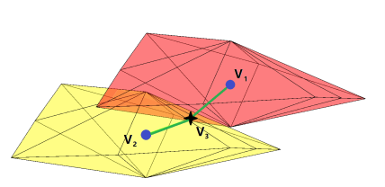
Connection between C-Layers
Enclose in larger ellipse
If overlap between C-Layers, connect vertices

Slide 14
Highway Roadmap Algorithm

Slide 15
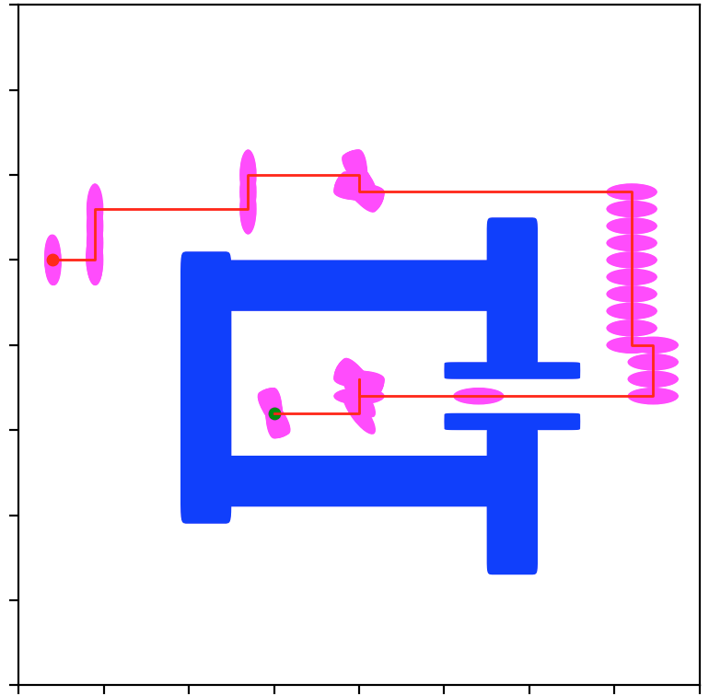
Graph Search
Dijkstra’s!

Slide 16
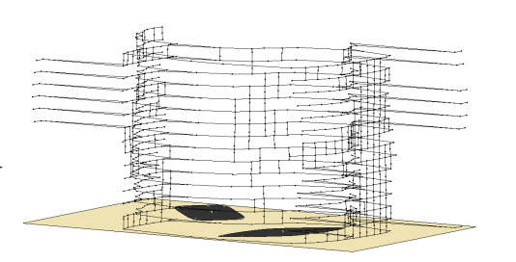
Key Points
Very minimal collision checking
Deterministic

Slide 17
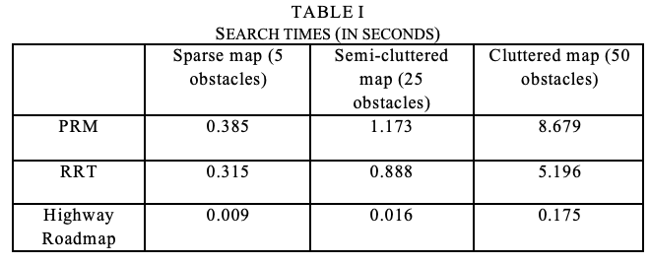
Results

