Slide 1



Personalized Learning Recommendation System
A Python and Machine Learning project
Submitted by : MD.ALFAYEN MONDAL
Student code : BWU/BCA/24/073
Department : Bachelor of computer applications(hons)
Subject: Machine Learning
Code: BCA57205
Notes:
Greet the sir. Say: 'Good morning sir. My project is the Personalized Learning Recommendation System. It is built in Python using machine learning, and it suggests what a student should study next and which learning resource suits them.' Mention your name, roll number, subject and code.

Slide 2

Introduction
Students learn at different speeds, in different styles and with different interests. This project is a machine learning system that reads a student's learning profile and recommends the next topic to study, along with matching resources.
Input: study hours, attendance, scores, interest, learning style
Model: Decision Tree Classifier (scikit-learn)
Output: recommended topic and ranked resources
12
input features per student
98%
accuracy on test data
4
interest areas covered
Notes:
Explain in simple words: every student is different. Some study 1 hour, some 5 hours. Some like videos, some like notes. This project looks at a student's profile (study hours, scores, interest, learning style) and uses a Decision Tree model to predict the best next topic. Then it picks matching learning resources. Point to the three boxes on the right: 12 input features, 98% accuracy, 4 interest areas.

Slide 3




Problem Statement
One-size-fits-all learning fits very few students.
Students are unsure what to study next
Our question
Can a model use study behaviour and scores to recommend the right topic and the right resource?
Resources ignore learning style and difficulty level
Teachers cannot guide every student one by one
Notes:
The real-world problem: in most classes everyone gets the same material at the same speed. A student may not know what to study next, and resources do not match how the student likes to learn. Teachers cannot sit with every student. So our question on the right is: can a model look at study behaviour and scores and recommend the right topic and resource?

Slide 4
Objectives
1
Collect and prepare student data
6
Predict a suitable learning topic
2
Clean and preprocess the dataset
7
Match the topic with resources
3
Perform exploratory data analysis
8
Evaluate the model
4
Identify important features
9
Visualize patterns and results
5
Build an ML recommendation model
10
Provide an easy console application
Expected outcome: a personal topic and a ranked list of resources for every student
Notes:
Read the ten objectives quickly, grouped as: data (1-3), model (4-6), recommendation (7), checking results (8-9) and the user interface (10). The bottom bar is the expected outcome: a personal topic and a list of resources for every student.

Slide 5



Scope of the Project
Coverage
Target users
Limitations
Topic prediction for 4 interest areas
Resource matching by style and difficulty
Model evaluation and charts
Students and self-learners
Teachers and mentors
Academic ML demonstration
Synthetic dataset, not real students
Console only, no GUI
Small resource list
No feedback loop yet
Notes:
Coverage means what the system does. Target users are who can use it. Limitations are honest: the dataset is synthetic (computer generated), the answer labels were made with rules, it runs in the console only and the resource list is small. Saying limitations openly shows maturity.

Slide 6
Existing Systems and Their Limits
Approach | How it works | Limitation
Fixed syllabus teaching | Same content and pace for everyone | No personalization; slow learners fall behind
Manual guidance by teachers | A mentor suggests what to study | Not scalable; depends on teacher time
Popular course lists | Shows the most viewed topics | Ignores the student's level and style
Collaborative filtering | Recommends what similar users liked | Needs large history (cold-start problem)
The gap: profile-based, explainable recommendations that need little user history
Notes:
These are general approaches, not specific products. Fixed syllabus: same for all. Manual guidance: good but cannot scale. Popular lists: show what is trending, not what suits you. Collaborative filtering: works like 'people like you liked this' but needs a lot of past data, called the cold-start problem. Our system works from a student's profile, so it can start with little history, and it can explain its answer.

Slide 7





Proposed System
Student Input
ML Prediction
Resource Matching
Ranking
Explanation
Profile details
Decision Tree picks topic
Style and difficulty
Highest score first
Why this topic
Key features
Automatic preprocessing
Decision Tree model
Learning-style matching
Difficulty-based matching
Recommendation reasons
Interactive menu
Notes:
Walk left to right. 1: student enters profile. 2: the Decision Tree predicts the best topic. 3: the system looks for resources of that topic and gives points for matching learning style and difficulty. 4: resources are sorted by points. 5: it explains the recommendation. Below are the key features in short.

Slide 8







Project Methodology
Tools and technologies
Development approach
Python
Pandas
1
Generate the student dataset
2
Clean and preprocess the data
NumPy
Matplotlib
3
Explore the data (EDA)
Scikit-learn
Joblib (.pkl)
4
Select the input features
5
Train the Decision Tree (80/20 split)
CSV data files
VS Code + venv
6
Evaluate, then save the model
Notes:
Left side: the tools. Python is the language, Pandas handles tables, NumPy handles numbers, Matplotlib draws charts, scikit-learn has the Decision Tree, Joblib saves the trained model as a .pkl file. Data is stored in CSV files, so there is no separate database. Right side: the development steps we followed, from making the dataset to saving the model. A Decision Tree was chosen because it is easy to understand and shows which features matter.

Slide 9





Project Internal Structure
Dataset
Clean and preprocess
EDA and features
Decision Tree
Topic + resource match
Ranked result
data/
src/
models/
visualizations/
raw/ student data
raw/ resources
processed/ cleaned
eda.py
preprocessing.py
feature_selection.py
generate_dataset.py
student.py
recommendation_model.py
recommender.py
evaluation.py
learning_recommender.pkl
model_evaluation.csv
5 EDA charts
confusion matrix
feature importance
main.py ties everything together through a 6-option console menu
Notes:
Top row is the data flow: dataset goes to cleaning, then EDA and feature selection, then the Decision Tree model, then topic and resource matching, then the final ranked recommendation. Bottom row is the folder structure: data holds CSV files, src holds the Python modules, models holds the saved model, visualizations holds all the charts, and main.py is the menu you run.

Slide 10
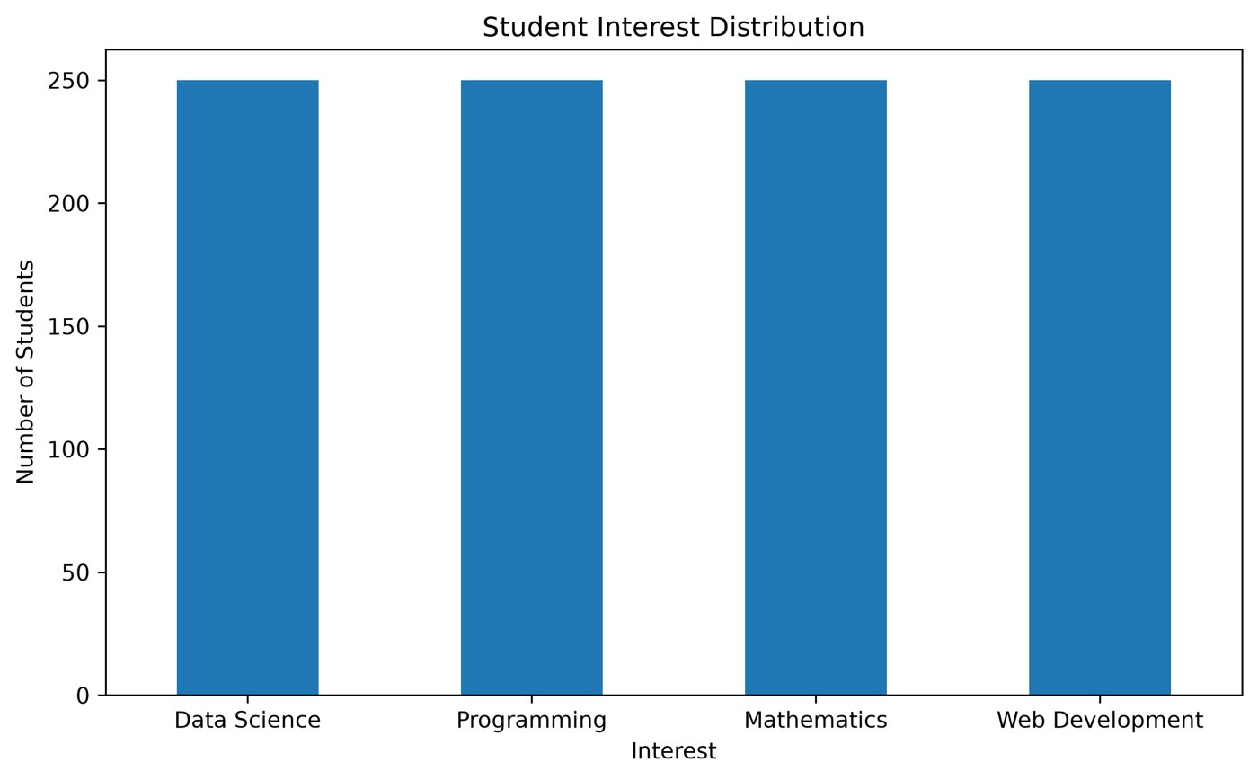
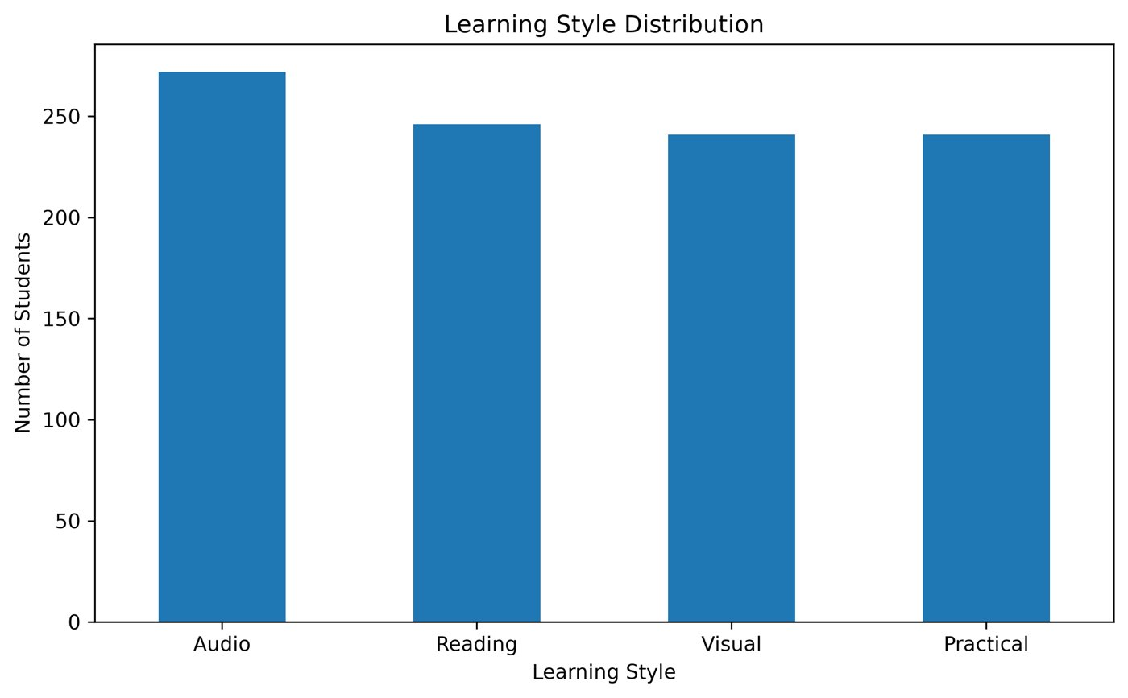
Dataset and Preprocessing
1,000
14
11
student records
columns
target topics
Cleaning steps
Check missing values and duplicates
Convert and validate numeric ranges
Remove invalid records
Save the cleaned CSV
Model input: 12 features. Target: Recommended_Topic. Student_ID is dropped.
Notes:
The dataset is synthetic, meaning it was generated by our own script, with 1,000 student records and 14 columns. There are 11 target topics. Cleaning checks missing values and duplicates, converts numbers, validates ranges and removes invalid rows, then saves a cleaned CSV. The model uses 12 input features. Student_ID is dropped because it is only an identifier. Recommended_Topic is the answer the model learns to predict. The two charts on the right show how many students fall in each interest and learning style.

Slide 11
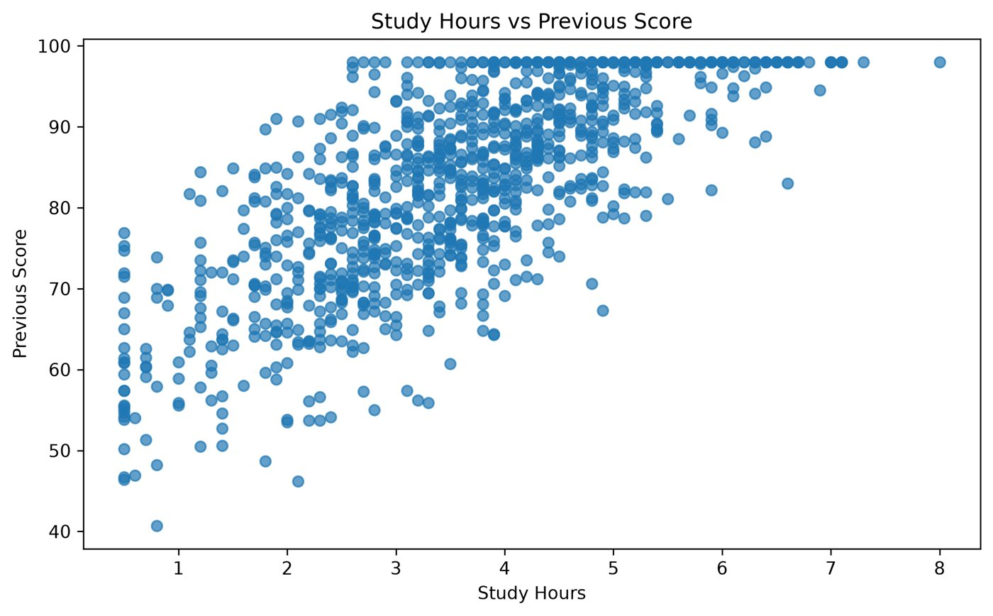
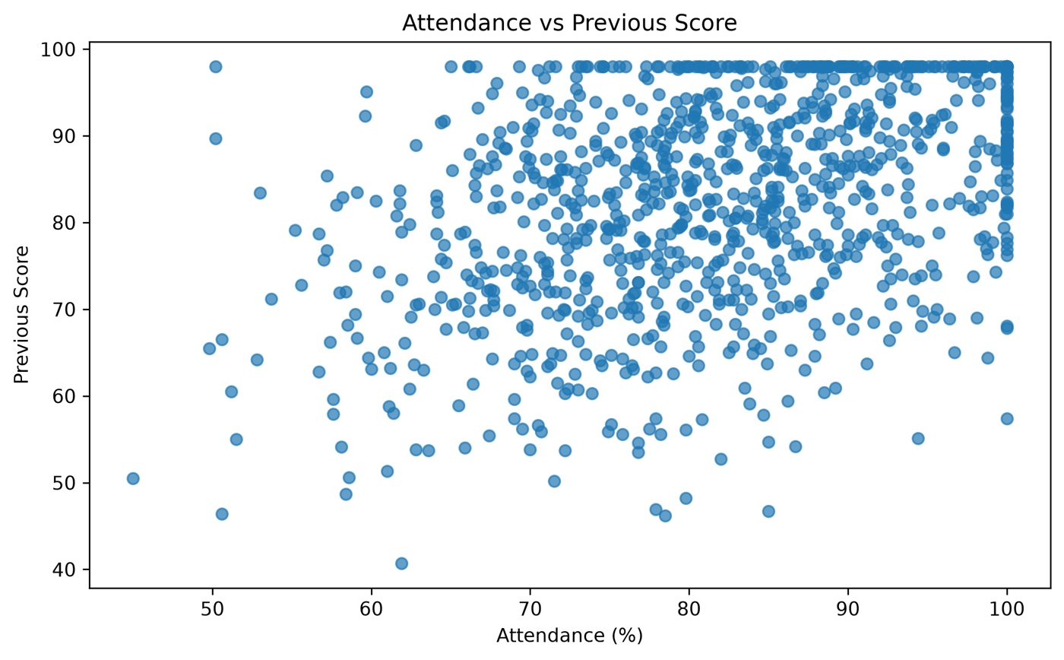
Exploratory Data Analysis
Study hours vs score
More study time goes with higher scores, a clear upward trend.
Attendance vs score
Attendance helps too, but the link is weaker and more scattered.
Notes:
EDA means looking at the data before building the model. Left chart: students who study more hours tend to have higher previous scores, a clear upward trend. Right chart: attendance also helps, but the pattern is more scattered, so the link is weaker. These patterns tell us the data is sensible before we train the model.

Slide 12
Implementation
recommender.py: resource ranking
Major modules
def calculate_score(resource):
score = 0
if resource["Resource_Type"] == resource_type:
score += 2
if resource["Difficulty"] == difficulty:
score += 3
if resource["Learning_Style"] == learning_style:
score += 2
return score
student.py
Student class and profile
preprocessing.py
Cleans the dataset
recommendation_model.py
Trains and saves the tree
recommender.py
Predicts, matches, ranks
evaluation.py
Accuracy, precision, recall, F1
main.py
Interactive console menu
Match score (max 7)
Type +2 Difficulty +3 Learning style +2
Notes:
Left: the heart of the recommendation. After the model predicts a topic, we search the resource list for that topic and give each resource points: +2 if the resource type matches the student's preference, +3 if the difficulty matches, and +2 if the learning style matches. The maximum is 7. Then we sort from highest to lowest. Right: the main files and what each one does. You can show the live demo by running python main.py and choosing option 1.

Slide 13
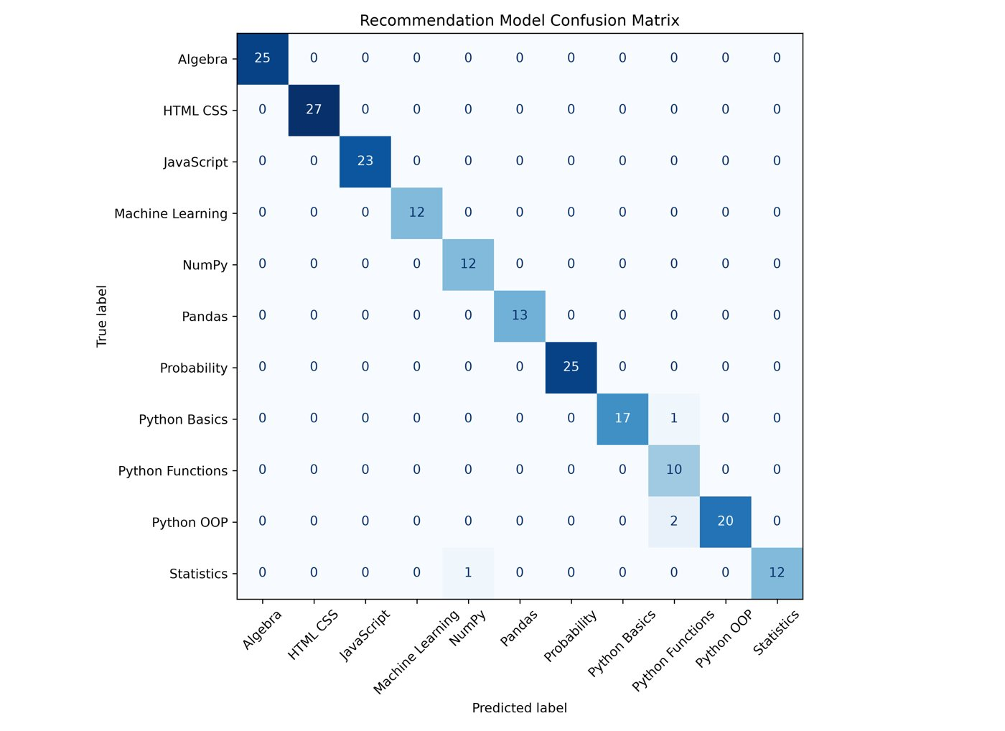
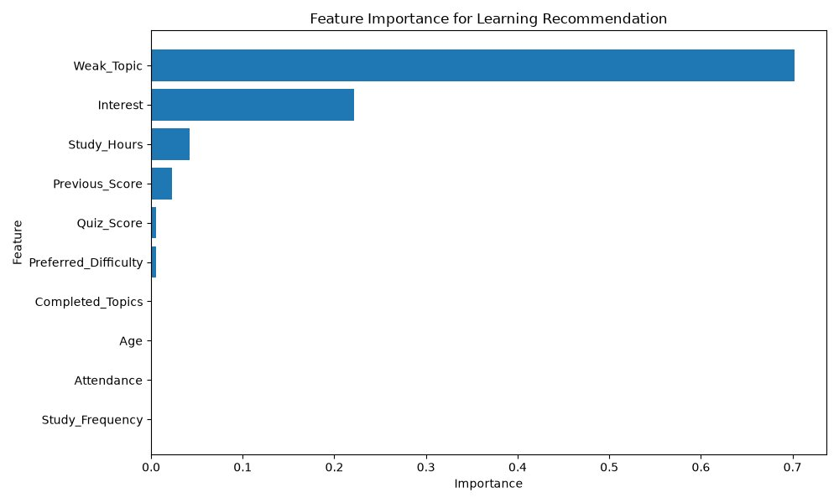
Testing and Results
98.00%
98.38%
98.00%
98.07%
Accuracy
Precision
Recall
F1-score
Confusion matrix: 196 of 200 correct
Weak_Topic and Interest matter most
Notes:
We split the data 80% for training and 20% for testing, so the model is tested on 200 students it never saw. Accuracy is 98%, precision 98.38%, recall 98% and F1 98.07%. The confusion matrix shows almost every prediction on the diagonal, which means correct. Only 4 of 200 were wrong, mostly between related Python topics. The feature importance chart shows Weak_Topic and Interest matter most. Be honest: the data is synthetic, so real-world accuracy would be lower.

Slide 14
Conclusion
Cleaned and prepared 1,000 student records
98%
Explored the data with EDA charts
Trained a Decision Tree to predict the next topic
test accuracy on 200 unseen samples
Matched and ranked resources by style and difficulty
Based on synthetic data, so real-world results will differ.
Delivered an interactive console application
Notes:
Connect back to the objectives: we prepared the data, explored it, trained a model, matched resources and built a console application. The result is 98% accuracy on test data. State the caveat clearly: the data is synthetic, so the next step is real student data.

Slide 15






Future Scope
Real student data
Web interface
More algorithms
Train on real datasets for realistic accuracy
Replace the console with a web or mobile app
Compare more ML models automatically
Student feedback
Collaborative filtering
Progress tracking
Collect ratings and keep recommendation history
Learn from what similar students found useful
Adapt recommendations as the student improves
Notes:
These are the improvements in simple words. Use real student data for realistic accuracy. Build a web app instead of the console. Compare more algorithms. Collect student feedback and keep history. Add collaborative filtering. Track progress and adapt recommendations.

Slide 16
References
Books and papers
Documentation and code
Géron, A. (2022). Hands-On Machine Learning with Scikit-Learn, Keras and TensorFlow (3rd ed.). O'Reilly Media.
Pedregosa, F. et al. (2011). Scikit-learn: Machine Learning in Python. Journal of Machine Learning Research, 12, 2825-2830.
Breiman, L. et al. (1984). Classification and Regression Trees. Wadsworth.
Ricci, F., Rokach, L., Shapira, B. (2015). Recommender Systems Handbook (2nd ed.). Springer.
scikit-learn: Decision Trees, scikit-learn.org/stable/modules/tree.html
Pandas documentation, pandas.pydata.org/docs
NumPy documentation, numpy.org/doc
Matplotlib documentation, matplotlib.org/stable
Project code, github.com/bwubca24073/personalized-learning-recommendation-system
Thank you
Notes:
Read only the headings. Then say 'Thank you sir, I am happy to answer any questions.'

