Slide 1

SQL Server Monitoring Strategies
4/01/2007
4/01/2007
4/01/2007
4/01/2007
4/01/2007
4/01/2007
4/01/2007
SQL Server Monitoring Strategies
SQL Server Monitoring Strategies
SQL Server Monitoring Strategies
SQL Server Monitoring Strategies
SQL Server Monitoring Strategies
SQL Server Monitoring Strategies
SQL Server Monitoring Strategies
Notes:
12/11/2007
‹#›
12/11/2007
‹#›
12/11/2007
‹#›
12/11/2007
‹#›
12/11/2007
‹#›
12/11/2007
‹#›
12/11/2007
‹#›
Note: Most slides include notes. Contemplate what you see on each slide, read the notes and in a few minutes you will be prepared to create your very own SQL Server Monitoring Strategy.
1

Slide 2

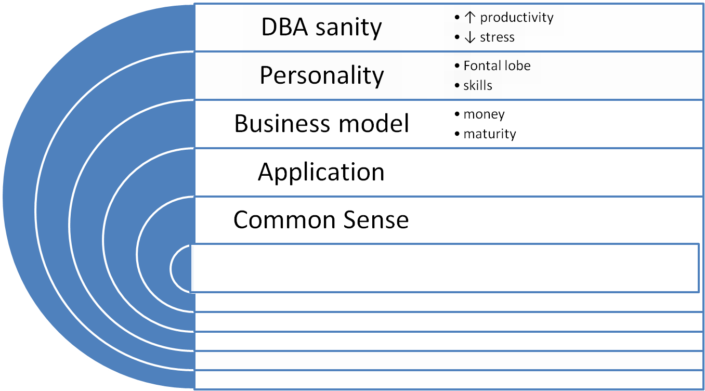

There is no Silver Bullet
4/01/2007
4/01/2007
4/01/2007
4/01/2007
4/01/2007
4/01/2007
4/01/2007
4/01/2007
SQL Server Monitoring Strategies
SQL Server Monitoring Strategies
SQL Server Monitoring Strategies
SQL Server Monitoring Strategies
SQL Server Monitoring Strategies
SQL Server Monitoring Strategies
SQL Server Monitoring Strategies
SQL Server Monitoring Strategies
2
Notes:
12/11/2007
‹#›
12/11/2007
‹#›
12/11/2007
‹#›
12/11/2007
‹#›
12/11/2007
‹#›
12/11/2007
‹#›
12/11/2007
‹#›
As with all areas of business these days, one implicit objective of successful database administration is to provide more with less.
Among the many layers of consideration in reaching this level of success is to create an ability to keep an eye on the subtle database changes and behaviors over time and at the same time remain able and available to deal with the relentless day to day demands and problems encountered. This calls for an administration environment targeted at minimizing the amount of the DBAs time spent on routine monitoring and management tasks leaving more of the DBA's work day free to deal with the urgencies of the moment and the projects necessary to the on-going success of the organization. This is when monitoring must be strategic.
2

Slide 3
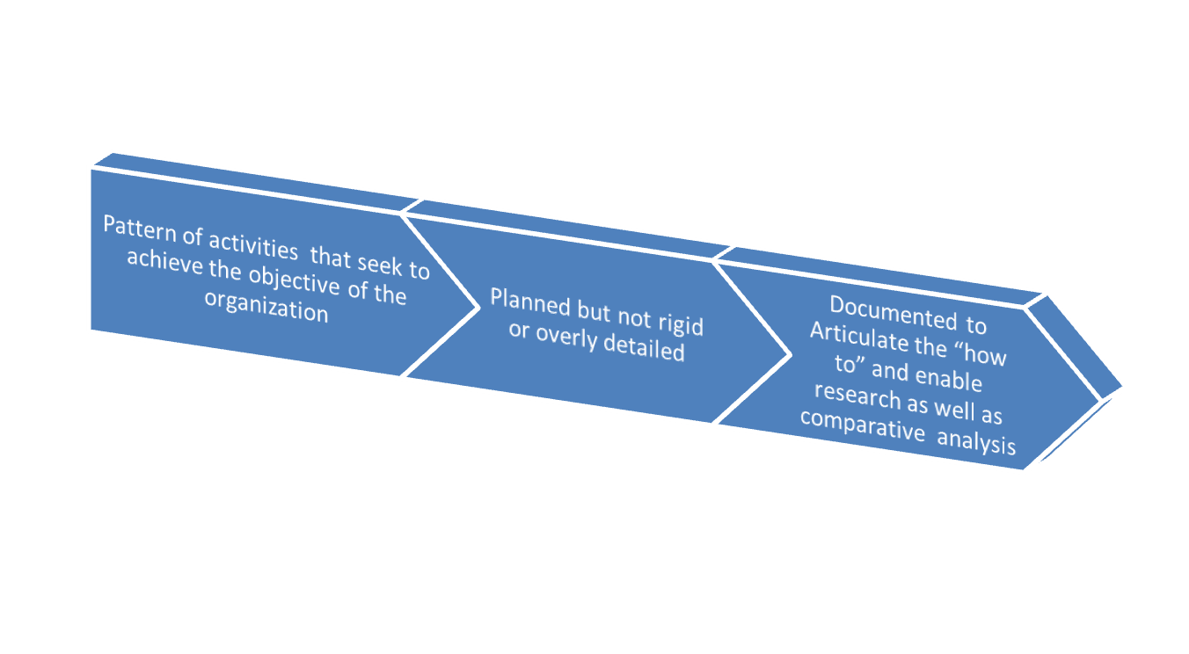
What Makes it Strategic?
4/01/2007
4/01/2007
4/01/2007
4/01/2007
4/01/2007
4/01/2007
4/01/2007
4/01/2007
SQL Server Monitoring Strategies
SQL Server Monitoring Strategies
SQL Server Monitoring Strategies
SQL Server Monitoring Strategies
SQL Server Monitoring Strategies
SQL Server Monitoring Strategies
SQL Server Monitoring Strategies
SQL Server Monitoring Strategies
3
Notes:
12/11/2007
‹#›
12/11/2007
‹#›
12/11/2007
‹#›
12/11/2007
‹#›
12/11/2007
‹#›
12/11/2007
‹#›
12/11/2007
‹#›
At a personal level, the DBA can actually use this business objective to create a better quality of life at work. Increasing productivity by moving from a large percentage of DBA time being spent on monitoring to a smaller percentage means a decrease in stress if done right. This is so because the change means moving from a reactive or fire-fighting mode to a more sane and sustainable order. One structured way to help meet this challenge is to define and build a DBA Runbook.
Make it an online Runbook. As we progress through these slides I will provide additional clarification about the difference between an online Runbook and other Runbook approaches.
A DBA Runbook is the documentation of the DBA work. Most of the information that goes into a Runbook over time is the result of DBA monitoring of the system. Ideally, it should be complete enough so that if you disappeared from the face of earth tomorrow someone could use the Runbook to carry on your good work. This Runbook must be well designed and consistent with other business goals to be effective. This requires a solid strategy around how the DBA monitoring activities will be conducted
3

Slide 4

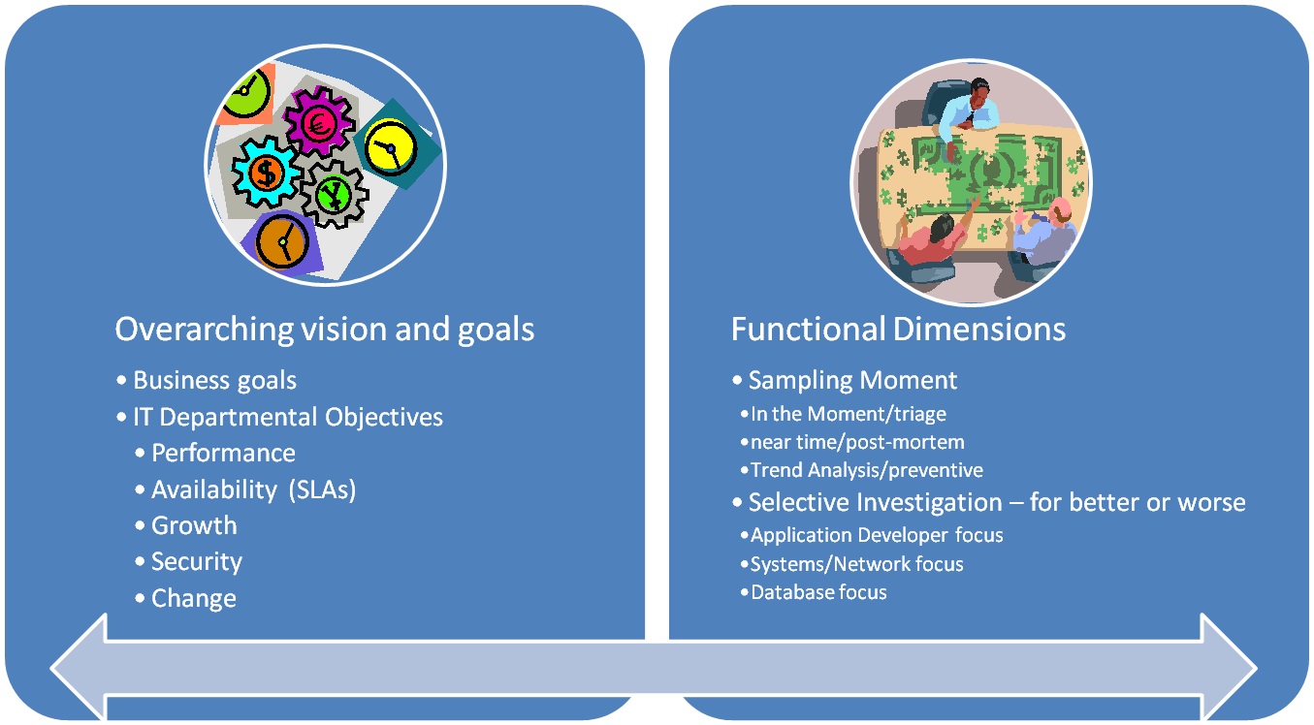
A Business Case for the Monitoring Strategy
4/01/2007
4/01/2007
4/01/2007
4/01/2007
4/01/2007
4/01/2007
4/01/2007
4/01/2007
SQL Server Monitoring Strategies
SQL Server Monitoring Strategies
SQL Server Monitoring Strategies
SQL Server Monitoring Strategies
SQL Server Monitoring Strategies
SQL Server Monitoring Strategies
SQL Server Monitoring Strategies
SQL Server Monitoring Strategies
4
Notes:
12/11/2007
‹#›
12/11/2007
‹#›
12/11/2007
‹#›
12/11/2007
‹#›
12/11/2007
‹#›
12/11/2007
‹#›
12/11/2007
‹#›
Most of us can gain the necessary support from our organizations for creating this online DBA Runbook. The first step of course is to explain to the business why it is a good idea and how it will help. Once the business has accepted that explanation it is possible to begin a project cycle aimed at implementing the online DBA Runbook. This should be approached like all legitimate IT projects. For far too many of us DBAs, the experience of working in project mode is foreign. It is recommended that the guidance of a trusted project oriented colleague be sought to find out exactly how it all comes together in your organization.
In general, the explanation provided to the business can become a project proposal. Then the requirements for that project can be collected, a solution designed and finally implemented. An iterative approach is certainly possible.
Each of us will have a somewhat different story line. Each of us works from a different perspective and probably in a different organization. Still, making the case to our respective businesses has some common considerations. For the online DBA Runbook to make sense to the organization, it must first have clarity to the DBA. There are two aspects to making the problem statement clear:
First, a mention of how the result of building this online Runbook is consistent with and will aid the stated goals of the business and the IT shop (assuming you work in a shop actually advanced enough to have stated IT goals). As the image on the left shows, this will usually be in the context of a “time and money” oriented statement.
Then, a statement about how the online runbook will compliment – and hopefully how it will improve - the other monitoring initiatives within the organization is needed. As the picture on the right shows, this is almost always a statement of advantage in the context of a large puzzle with multiple people working on the puzzle but with each focused on a different piece of the puzzle. It’s also appropriate to the statement that the finished puzzle is looking like big money.
The metaphor of different people focused on different parts of the larger puzzle is valid from many angles. For example, just as with security it is better to have multiple layers of defense, with monitoring, it is better to have discrete perspectives of the system. The network people, application administrators, and the developers will all have different perspectives than the DBAs. It is important for an effective monitoring strategy that each perspective is supported by the appropriate monitoring to assure that each perspective is afforded the opportunity make the organization’s technology infrastructure as reliable and robust as possible.
So while everyone is working to complete the puzzle of big money, it is almost never straight forward to quantify the actual value in terms of dollars. Smart business leaders will have no difficulty in understanding and appreciating this necessarily abstract concept. It is wise to clearly and emphatically explain to the boss that the best way to assure the success of the strategy is her wholehearted support.
4

Slide 5
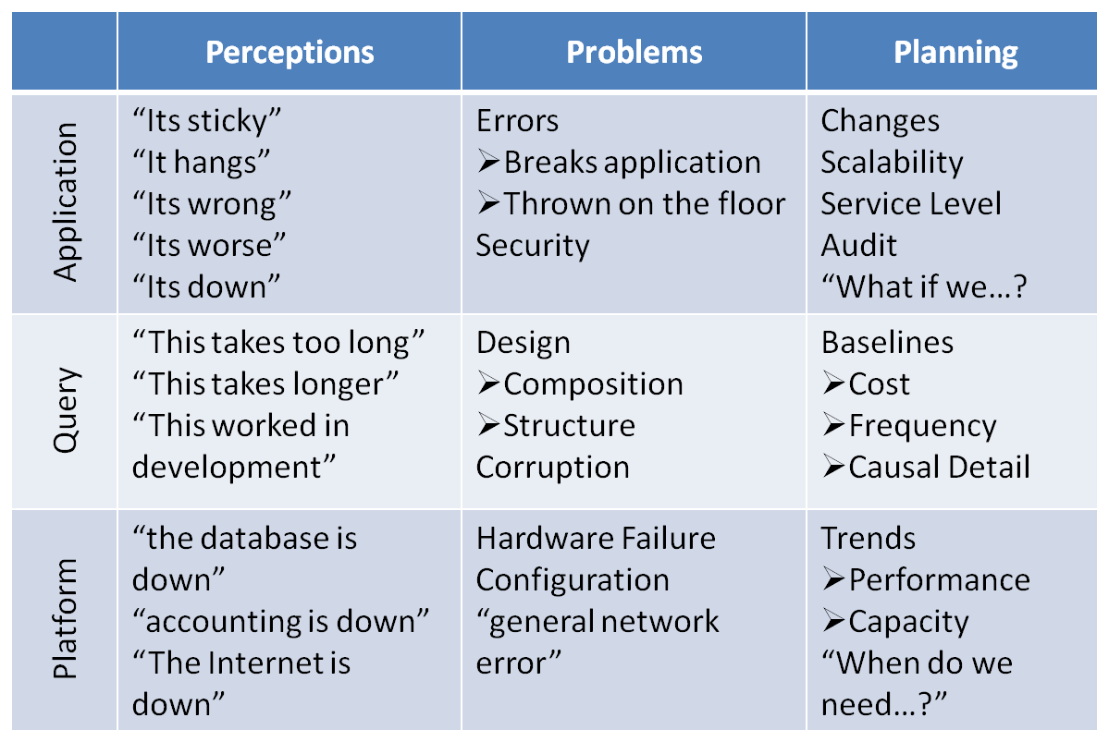
Monitoring Requirements Matrix
4/01/2007
4/01/2007
4/01/2007
4/01/2007
4/01/2007
4/01/2007
4/01/2007
4/01/2007
SQL Server Monitoring Strategies
SQL Server Monitoring Strategies
SQL Server Monitoring Strategies
SQL Server Monitoring Strategies
SQL Server Monitoring Strategies
SQL Server Monitoring Strategies
SQL Server Monitoring Strategies
SQL Server Monitoring Strategies
5
Notes:
12/11/2007
‹#›
12/11/2007
‹#›
12/11/2007
‹#›
12/11/2007
‹#›
12/11/2007
‹#›
12/11/2007
‹#›
12/11/2007
‹#›
This brainstorming slide illustrates that requirements gathering is necessary and can be quite complex for the online DBA Runbook as a Monitoring Strategy. This step is very important; in fact fundamental to the success of the strategy. If the requirements for monitoring are not accurately and completely identified, the shop remains vulnerable to missing necessary monitors. The truth is that if you have been working in the shop for a while, the monitoring requirements are probably mostly known to you already. The hard part will be in extracting all the things that have been sublimated into activities now done with little thought or fanfare to get a complete set of requirements down on paper. Be sure to invest the time and thought necessary to get this right.
Don’t hesitate to initiate corrections if something has been missed. As with any software requirements, things will change over time, so corrections and adaptations will be an ongoing aspect of the Runbook.
5

Slide 6

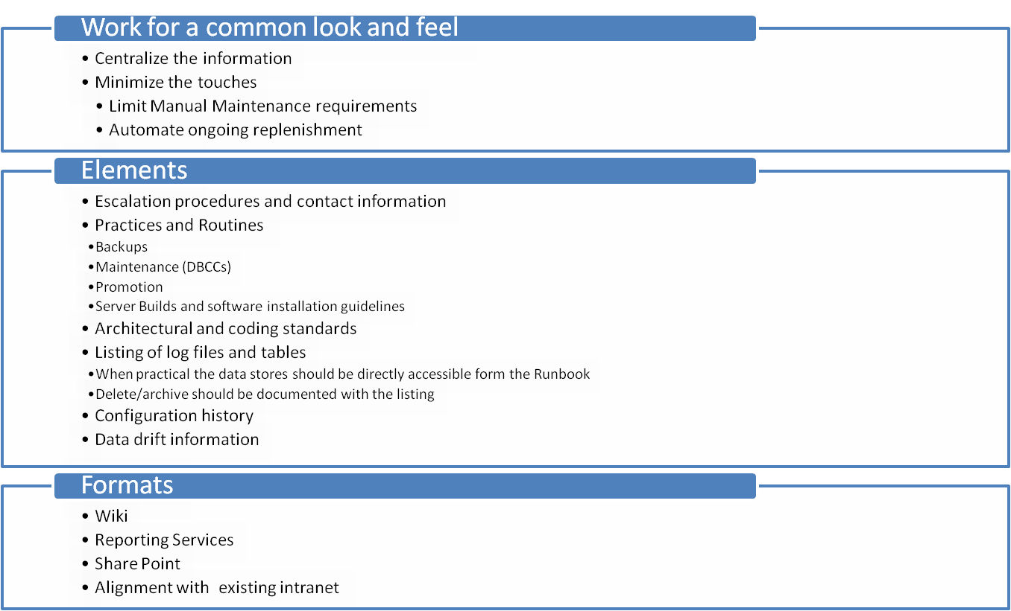
Elements of the Online DBA Runbook
4/01/2007
4/01/2007
4/01/2007
4/01/2007
4/01/2007
4/01/2007
4/01/2007
4/01/2007
SQL Server Monitoring Strategies
SQL Server Monitoring Strategies
SQL Server Monitoring Strategies
SQL Server Monitoring Strategies
SQL Server Monitoring Strategies
SQL Server Monitoring Strategies
SQL Server Monitoring Strategies
SQL Server Monitoring Strategies
6
Notes:
12/11/2007
‹#›
12/11/2007
‹#›
12/11/2007
‹#›
12/11/2007
‹#›
12/11/2007
‹#›
12/11/2007
‹#›
12/11/2007
‹#›
The online Runbook conceptually differs from other Runbook's in that it strives to automate data collection and preparation used for monitoring, easily extend access to this clean collected data to all interested parties across the enterprise, and most importantly to minimize the amount of hands on DBA time necessary for maintenance of the collected data. This last point is important. I believe the main reason that the Runbook concept is not widely used is because it simply takes a lot of time to create and maintain manuals to describe how to do the DBA work in an organization and to shuffle files around to provide the necessary access to the information.
The online Runbook is intended to organize and document information without the need to create manuals and shuffle files. Such a run book includes the documents, scripts, diagrams, and resources used to assure that administrative and automation processes are correctly performed. By setting out to organize this information as it is created and used, and in the form that it is originally stored, the run book becomes an online living documentation repository and the need to make time to maintain the Run book is minimized if not eliminated.
The online Runbook offers a more flexible alternative to many of the third party software suites that are available for SQL Server DBAs. These suites provide various collections of software tools. There is general consensus that tool collections are a preferred alternative to unplanned or reactive database administration. However, the tool suites invariably require that the business defined work of the DBA be altered to accommodate the design decisions of the software suite. More often what happens is the business purchases the suite, the DBA struggles with the components that don’t fit the business, and eventually those components fall into disuse. For this reason I believe that evaluation and purchase of the individual tools from any third party vendor is more effective than the purchase of that vendor’s suite of tools, no matter how attractively the bundle is packaged and priced. In the end the time lost trying to use tools that don’t fit will be a greater cost than any piecemeal licensing costs.
The upfront costs to create an online run book are also going to be greater than the cost to produce a static document to serve the same purpose. There may be hardware to purchase and software to license or even develop. However, the cost to maintain the online version - and more importantly the cost of not properly maintaining the static document based run book - will outweigh the online run book costs in the long term and larger picture. This goes to say that the more time that can be invested in the design and automation of the online Runbook, the greater the long term dividends of the effort.
The primary benefit of documenting all database meta-information is that it enables knowledge sharing. Knowledge about the organization's database operations is almost always shared among multiple employees anyway. And in fact, mission-critical processes and tasks will almost always form a major portion of this information. Documenting it ensures that this information is available to all concerned employees round the clock.
Procedural escalation information for all operational and emergency tasks must be documented. If a task cannot be performed due to the unavailability of an employee, a suitably qualified employee must be able to use the documented information to properly complete the task.
It is also necessary to document resource information including member and supplier contact information and hardware and software component specifications. A history of administrative details such as security settings and details on how monitoring data is collected and presented should also be included.
Yet another benefit of documenting information is that it facilitates business continuity. By documenting information, the organization can prepare better for diverse contingencies and ensure that day-to-day operations do not stop.
Documenting information helps the organization prepare for emergency responses. To prepare for emergency responses, a recovery process should be defined. The recovery process should be documented and tested thoroughly so that it can be applied without any doubt or improvisation.
Documenting information also facilitates factual planning. You can identify organizational resource requirements. You can use the documentation of existing resources as a reference and determine resources needed to overcome particular contingencies. Using the documentation you can identify resource criticality and more easily evaluate the impact of a change or failure on the Enterprise.
Another benefit of documenting information is that it clarifies operational procedures. Information on operational procedures including detailed steps to perform tasks using relevant tools should be documented. This enables any employee using the documentation to perform a procedure easily.
Documenting information establishes consistent standards. Standards may be defined from generally accepted business practices such as coding standards. Standards may also be specifically created for an organization.
Documentation should contain the required information for the proper configuration and operation of all the organizations database servers.
One last benefit of documenting information I want to mention is the recording of baselines and benchmarks. It is necessary to establish a baseline or benchmark to identify when a system or component has exceeded its expected operational capacity. Unless the baselines and benchmarks are recorded and compared periodically to current data, identifying the need to tune, scale out, or scale up a database component becomes anecdotal. The result can be wasted investment or unplanned outages. Making sound business decisions becomes possible with well-documented baselines and benchmarks and detailed information about how the baselines and benchmarks were created.
6

Slide 7

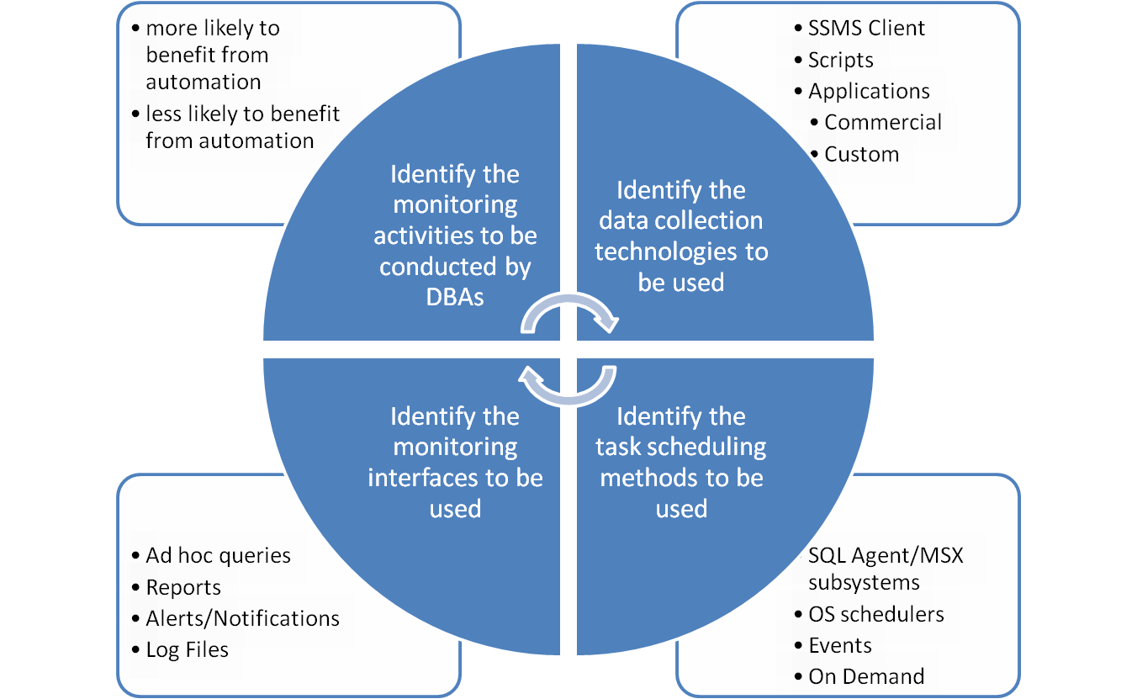
Monitoring By Design
4/01/2007
4/01/2007
4/01/2007
4/01/2007
4/01/2007
4/01/2007
4/01/2007
4/01/2007
SQL Server Monitoring Strategies
SQL Server Monitoring Strategies
SQL Server Monitoring Strategies
SQL Server Monitoring Strategies
SQL Server Monitoring Strategies
SQL Server Monitoring Strategies
SQL Server Monitoring Strategies
SQL Server Monitoring Strategies
7
Notes:
12/11/2007
‹#›
12/11/2007
‹#›
12/11/2007
‹#›
12/11/2007
‹#›
12/11/2007
‹#›
12/11/2007
‹#›
12/11/2007
‹#›
Good Candidates for automation:
Repetitive tasks
Tasks that requiring data scrubbing and storage
Events that occur regularly
Tasks that can be administered programmatically (push button)
Poor candidates for automation:
One-time (aka one-off) tasks
Tasks that take more time to automate
Tasks that require adaptive methods or with frequent unanticipated exceptions
The online DBA runbook is going to contain information in addition to monitored data. That information will often be in the form of “What to do If…” some monitored database reveals an anomaly or reaches a threshold. These escalation and forward recovery procedures are always specific to the shop. You won’t want to skip this documentation step unless you prefer the 3AM wakeup call to tell someone that the problem is not critical and you will look at it when you get in in a few hours. I believe you will find that escalation procedures are not a huge piece of the work once you get the core monitoring strategy in place.
7

Slide 8
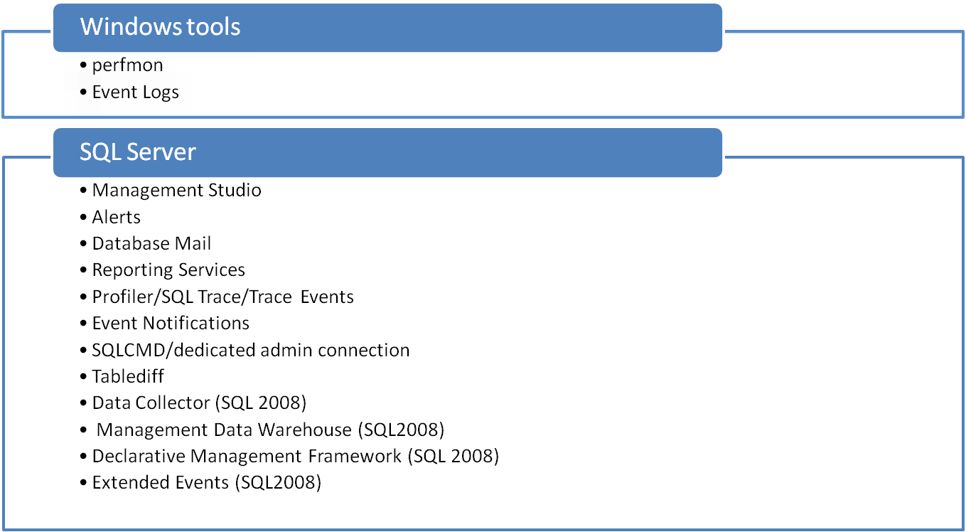

Out-of-the-box Tools
Task Manager
netmon
Dynamic Management Views
System Stored Procedures
Administrative APIs
  SMO (includes RMO & NMO)
  DMO
  WMI
  WMI Configuration Management class (SQL2008)
ODBCPing
SQLDiag
Reporting Services
4/01/2007
4/01/2007
4/01/2007
4/01/2007
4/01/2007
4/01/2007
4/01/2007
4/01/2007
SQL Server Monitoring Strategies
SQL Server Monitoring Strategies
SQL Server Monitoring Strategies
SQL Server Monitoring Strategies
SQL Server Monitoring Strategies
SQL Server Monitoring Strategies
SQL Server Monitoring Strategies
SQL Server Monitoring Strategies
8

Slide 9
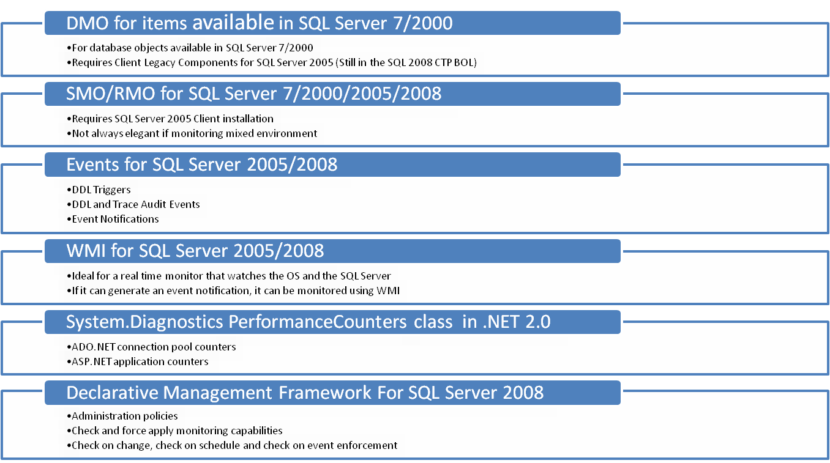
Programmable Interfaces
4/01/2007
4/01/2007
4/01/2007
4/01/2007
4/01/2007
4/01/2007
4/01/2007
4/01/2007
SQL Server Monitoring Strategies
SQL Server Monitoring Strategies
SQL Server Monitoring Strategies
SQL Server Monitoring Strategies
SQL Server Monitoring Strategies
SQL Server Monitoring Strategies
SQL Server Monitoring Strategies
SQL Server Monitoring Strategies
9

Slide 10
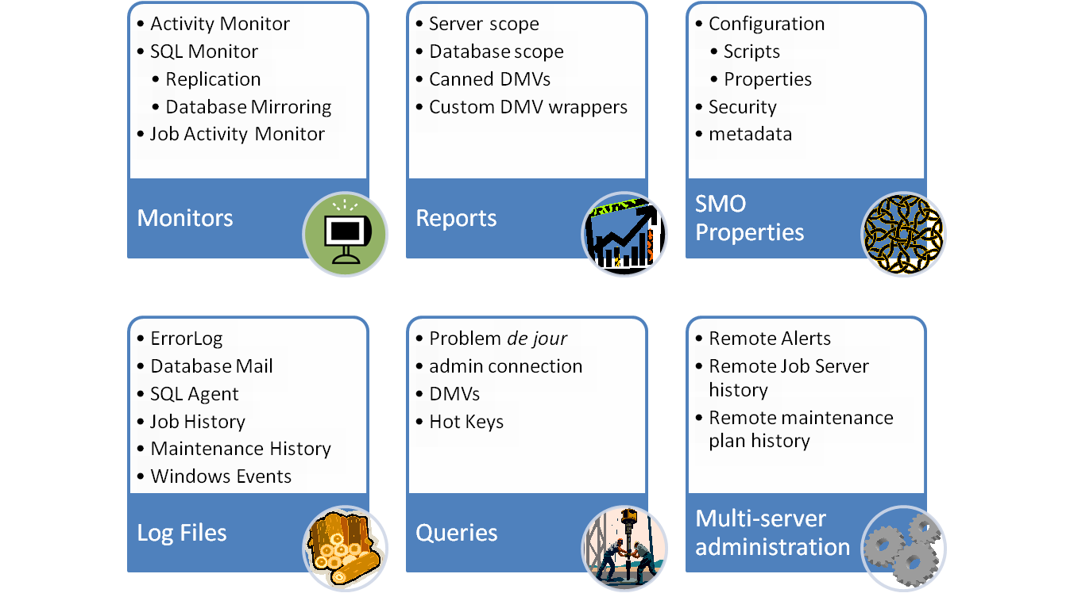
SQL Server Management Studio (SSMS)
4/01/2007
4/01/2007
4/01/2007
4/01/2007
4/01/2007
4/01/2007
4/01/2007
4/01/2007
SQL Server Monitoring Strategies
SQL Server Monitoring Strategies
SQL Server Monitoring Strategies
SQL Server Monitoring Strategies
SQL Server Monitoring Strategies
SQL Server Monitoring Strategies
SQL Server Monitoring Strategies
SQL Server Monitoring Strategies
10
Notes:
12/11/2007
‹#›
12/11/2007
‹#›
12/11/2007
‹#›
12/11/2007
‹#›
12/11/2007
‹#›
12/11/2007
‹#›
Almost all monitors are configured using SSMS. The lists above attemp to identify only direct monitoring activities that can be conducted within SSMS
12/11/2007
‹#›

Slide 11
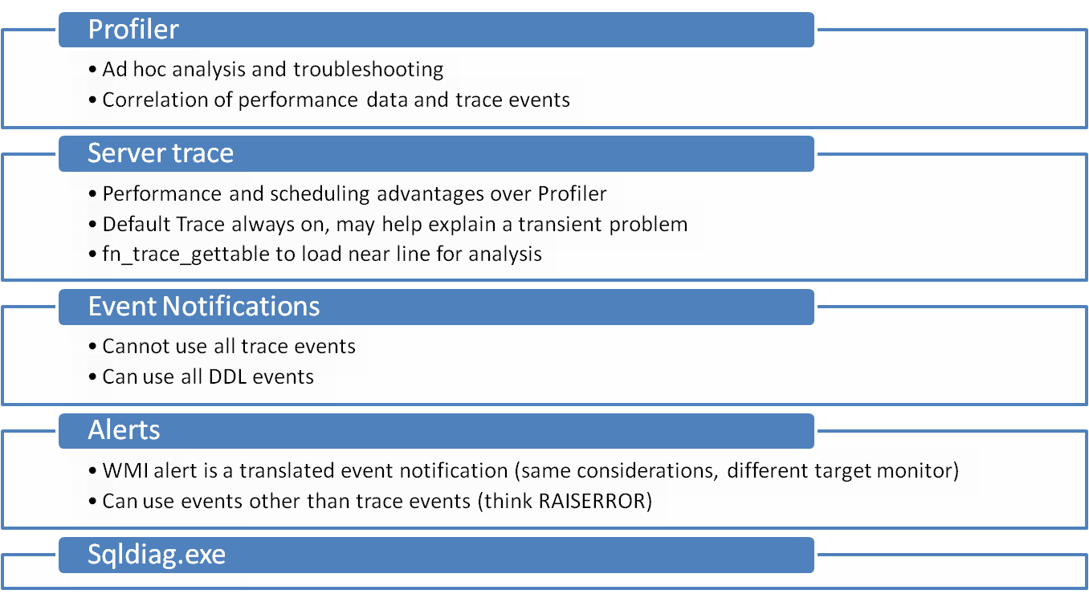
SQL Trace
4/01/2007
4/01/2007
4/01/2007
4/01/2007
4/01/2007
4/01/2007
4/01/2007
4/01/2007
SQL Server Monitoring Strategies
SQL Server Monitoring Strategies
SQL Server Monitoring Strategies
SQL Server Monitoring Strategies
SQL Server Monitoring Strategies
SQL Server Monitoring Strategies
SQL Server Monitoring Strategies
SQL Server Monitoring Strategies
11

Slide 12
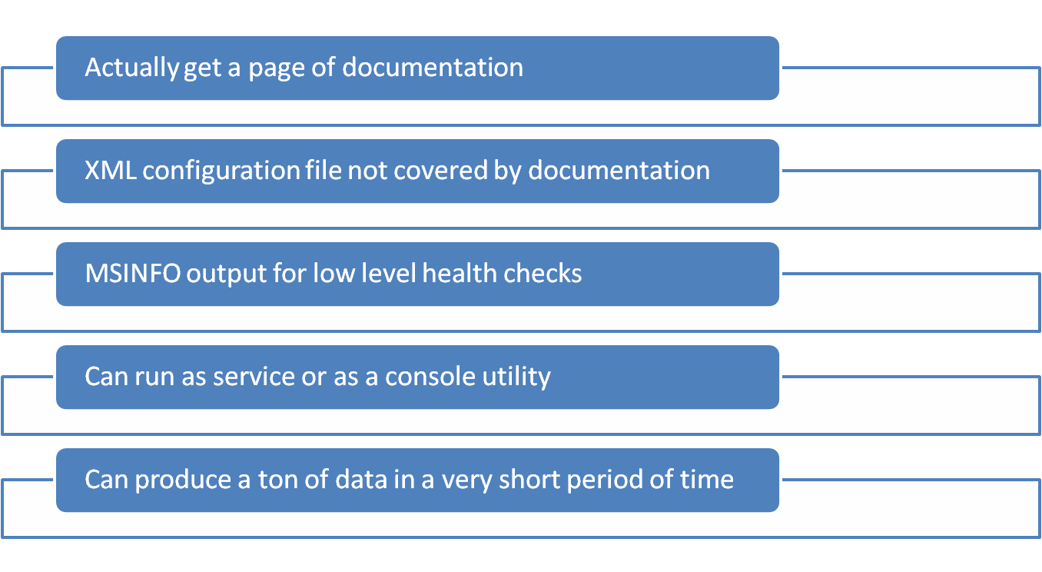
SQLDiag for SQL Server 2005
4/01/2007
4/01/2007
4/01/2007
4/01/2007
4/01/2007
4/01/2007
4/01/2007
4/01/2007
SQL Server Monitoring Strategies
SQL Server Monitoring Strategies
SQL Server Monitoring Strategies
SQL Server Monitoring Strategies
SQL Server Monitoring Strategies
SQL Server Monitoring Strategies
SQL Server Monitoring Strategies
SQL Server Monitoring Strategies
12
Notes:
12/11/2007
‹#›
12/11/2007
‹#›
12/11/2007
‹#›
12/11/2007
‹#›
12/11/2007
‹#›
12/11/2007
‹#›
12/11/2007
‹#›
C:\Program Files\Microsoft SQL Server\90\Tools\binn\SQLDIAG
12

Slide 13
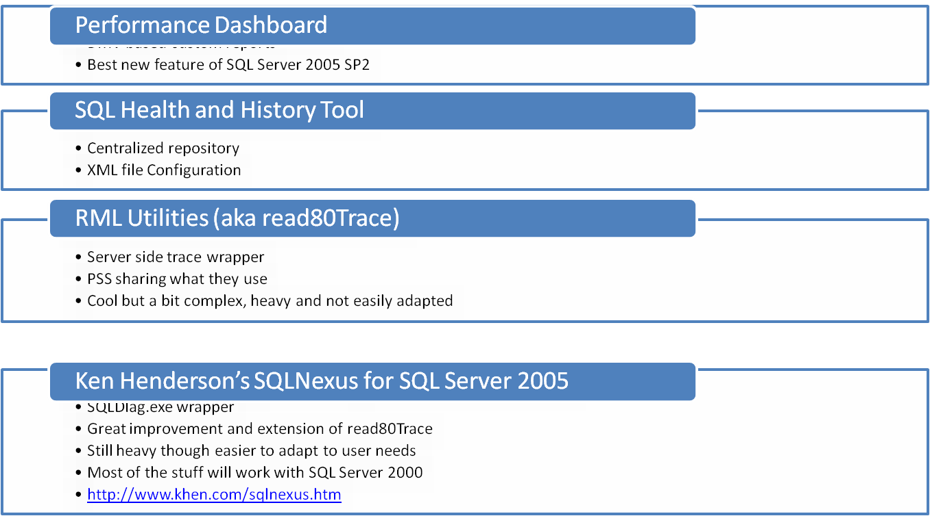
Freely Available Microsoft Tools
4/01/2007
4/01/2007
4/01/2007
4/01/2007
4/01/2007
4/01/2007
4/01/2007
4/01/2007
SQL Server Monitoring Strategies
SQL Server Monitoring Strategies
SQL Server Monitoring Strategies
SQL Server Monitoring Strategies
SQL Server Monitoring Strategies
SQL Server Monitoring Strategies
SQL Server Monitoring Strategies
SQL Server Monitoring Strategies
13
Notes:
12/11/2007
‹#›
12/11/2007
‹#›
12/11/2007
‹#›
I am uncertain why such useful tools are released as free downloads rather than as part of the product and included in the patch process. Performance Dashboard and the Health and history collector are tools that belong a part of the SQL Server product. Read80trace based stuff, while informative, produces bloated traces and is too difficult to configure to ever be a widely used tool IMHO.
12/11/2007
‹#›

Slide 14
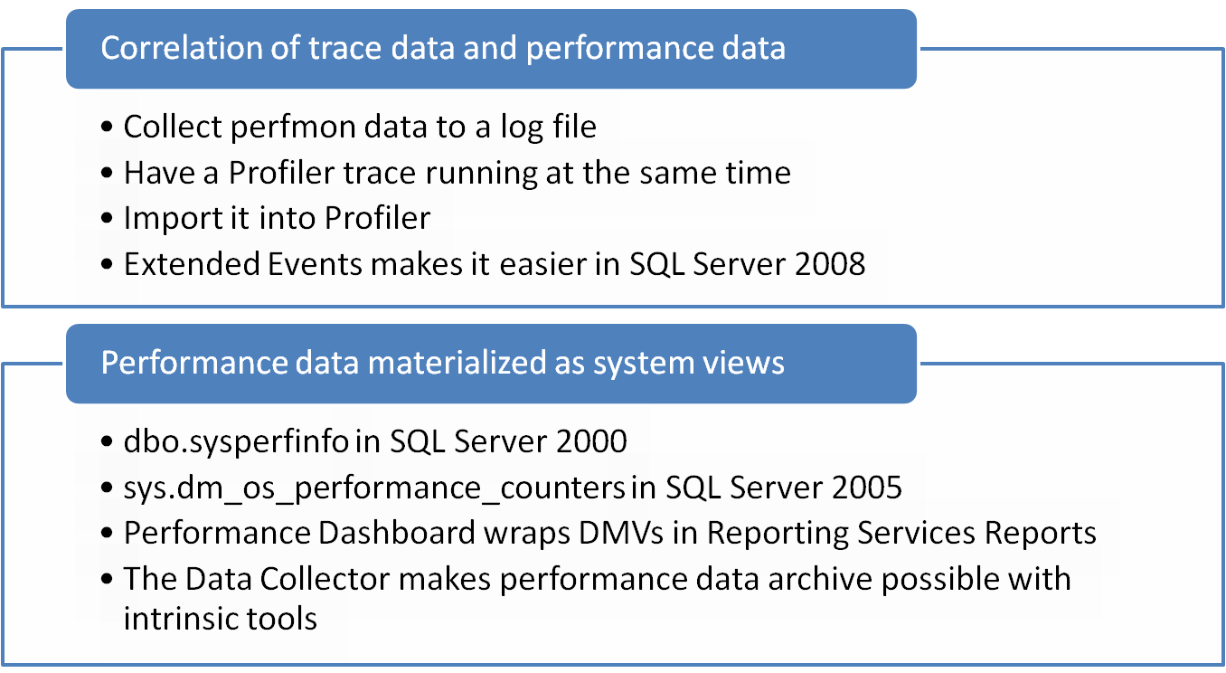
SQL Tools and Performance Data
4/01/2007
4/01/2007
4/01/2007
4/01/2007
4/01/2007
4/01/2007
4/01/2007
4/01/2007
SQL Server Monitoring Strategies
SQL Server Monitoring Strategies
SQL Server Monitoring Strategies
SQL Server Monitoring Strategies
SQL Server Monitoring Strategies
SQL Server Monitoring Strategies
SQL Server Monitoring Strategies
SQL Server Monitoring Strategies
14

Slide 15
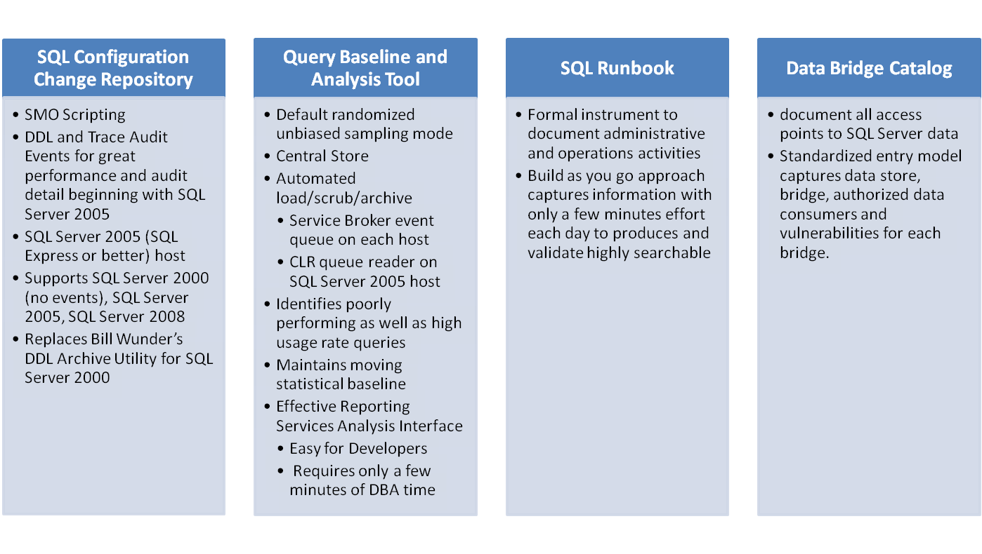
SQLClue
Knowledge and Metadata Repository for Microsoft's SQL Server
4/01/2007
4/01/2007
4/01/2007
4/01/2007
4/01/2007
4/01/2007
4/01/2007
4/01/2007
SQL Server Monitoring Strategies
SQL Server Monitoring Strategies
SQL Server Monitoring Strategies
SQL Server Monitoring Strategies
SQL Server Monitoring Strategies
SQL Server Monitoring Strategies
SQL Server Monitoring Strategies
SQL Server Monitoring Strategies
15

Slide 16
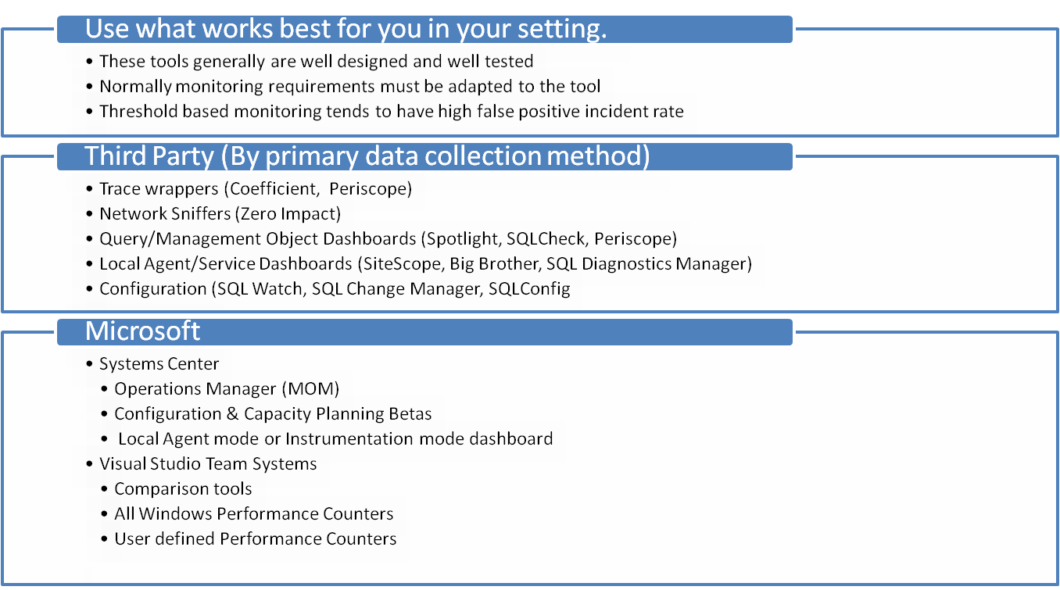
Other Commercially Available Tools
4/01/2007
4/01/2007
4/01/2007
4/01/2007
4/01/2007
4/01/2007
4/01/2007
4/01/2007
SQL Server Monitoring Strategies
SQL Server Monitoring Strategies
SQL Server Monitoring Strategies
SQL Server Monitoring Strategies
SQL Server Monitoring Strategies
SQL Server Monitoring Strategies
SQL Server Monitoring Strategies
SQL Server Monitoring Strategies
16

Slide 17
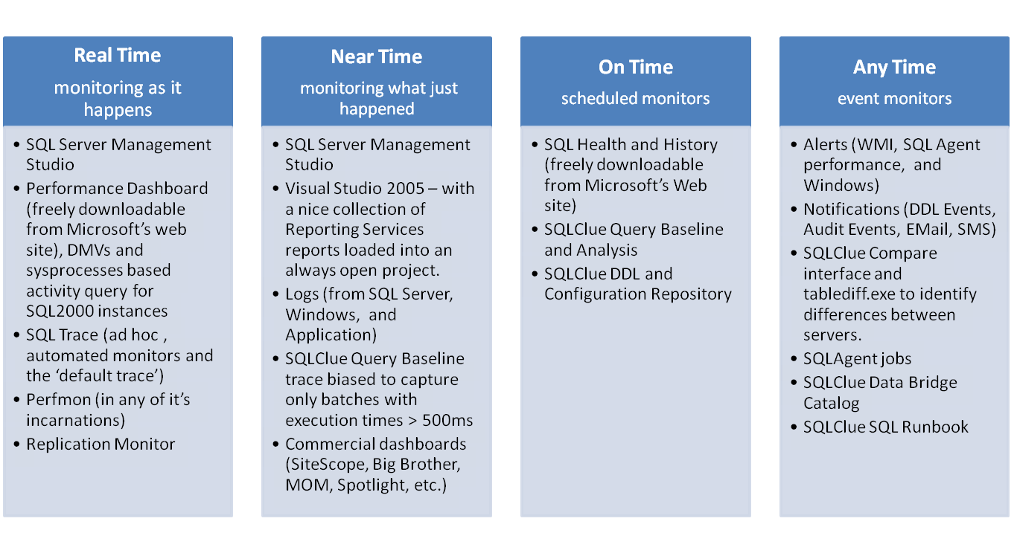
My Current Monitoring Strategy
Mixed SQL2000/SQL 2005 Environment
4/01/2007
4/01/2007
4/01/2007
4/01/2007
4/01/2007
4/01/2007
4/01/2007
4/01/2007
SQL Server Monitoring Strategies
SQL Server Monitoring Strategies
SQL Server Monitoring Strategies
SQL Server Monitoring Strategies
SQL Server Monitoring Strategies
SQL Server Monitoring Strategies
SQL Server Monitoring Strategies
SQL Server Monitoring Strategies
17
Notes:
12/11/2007
‹#›
12/11/2007
‹#›
12/11/2007
‹#›
12/11/2007
‹#›
12/11/2007
‹#›
12/11/2007
‹#›
I personally do not find Commercial dashboards like Sitescope, Big Brother or MOM particularly effective for SQL Server monitoring. One big reason is probably that these tools are typically managed by the operations staff. They lock them down to the extent that there is little value for a DBA to use them. I prefer to set up SQLH2 to collect performance and windows configuration data and to get my threshold alerts directly from the SQL Servers. I have yet to work in a shop with an effective MOM installation. SiteScope and Spotlight styled ‘Christmas tree’ monitors are best suited for NOC or generalized support folks that routinely scan many monitors for a quick visual to determine a good or bad state. I’ve not found them more helpful than intrinsic tools for troubleshooting or detailed analysis.
I also have difficulty with the practice of using up a huge chunk of screen real estate to plaster a big screen of blinking lights or a perfmon with a gazillion counters over my work for the day. It has to negatively affect productivity and in my experience, in most cases, when an anomaly does occur this is not how it is discovered.
DBAs are simply to valuable o sit and watch a graphical monitor for the next problem de jour.
12/11/2007
‹#›

Slide 18
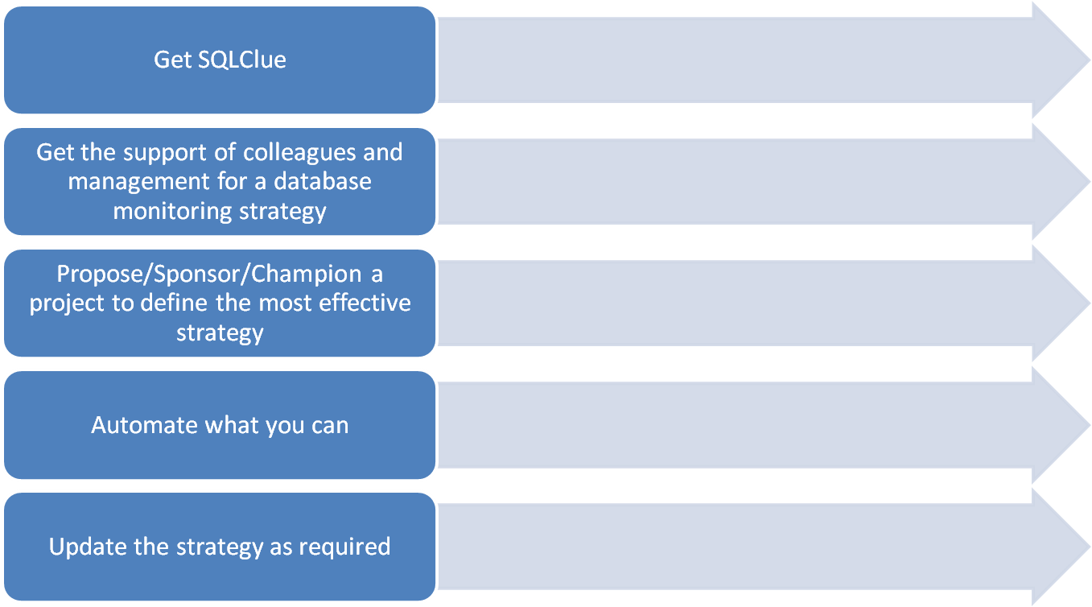
Take the Next Steps
4/01/2007
4/01/2007
4/01/2007
4/01/2007
4/01/2007
4/01/2007
4/01/2007
4/01/2007
SQL Server Monitoring Strategies
SQL Server Monitoring Strategies
SQL Server Monitoring Strategies
SQL Server Monitoring Strategies
SQL Server Monitoring Strategies
SQL Server Monitoring Strategies
SQL Server Monitoring Strategies
SQL Server Monitoring Strategies
18

