Slide 1
TEAM PROJECT
Team D
DSCI-644
Notes:
Dan

Slide 2
TEAM MEMBERS
ADARSH BALAKRISHNAN
BRANDON VIDRO
DANIEL GILROY
Notes:
Dan

Slide 3
Presentation
Formulate the specifications from the requirements
Develop an architecture for the system
Plan a remodeling of the system
Implement the new model
Verify the model’s outputs against the requirements
Document the process step by step
Manage the process step by step
Communicate the results step by step
Deliver the product in a presentation
Notes:
Dan

Slide 4
Requirement analysis and meetings with the Stakeholders
Initial model provided only achieved ~60% accuracy based on reviews
We reviewed the model and the requirements
We noted that it would matter most if ratings were positive or negative
Suggested to the stakeholders that in order to reduce the granularity of the ratings it would be best to group them into positive and negative
This would provide the ability for a live feed review of positive/negative ratings coming in from different sources like twitter, etc… to track the overall trends on applications
Stakeholders accepted
Proceeded to adjust model based on new requirements
Notes:
Dan

Slide 5
Formulate the specifications from the requirements
Given a review text of an application, the system will return a binary response (positive or negative)
Input to system would be a Service JSON API accessible for other systems to use
Output format JSON
The system would be scalable on demand
May take a day to scale up
Ideally in an hour
Notes:
Dan

Slide 6
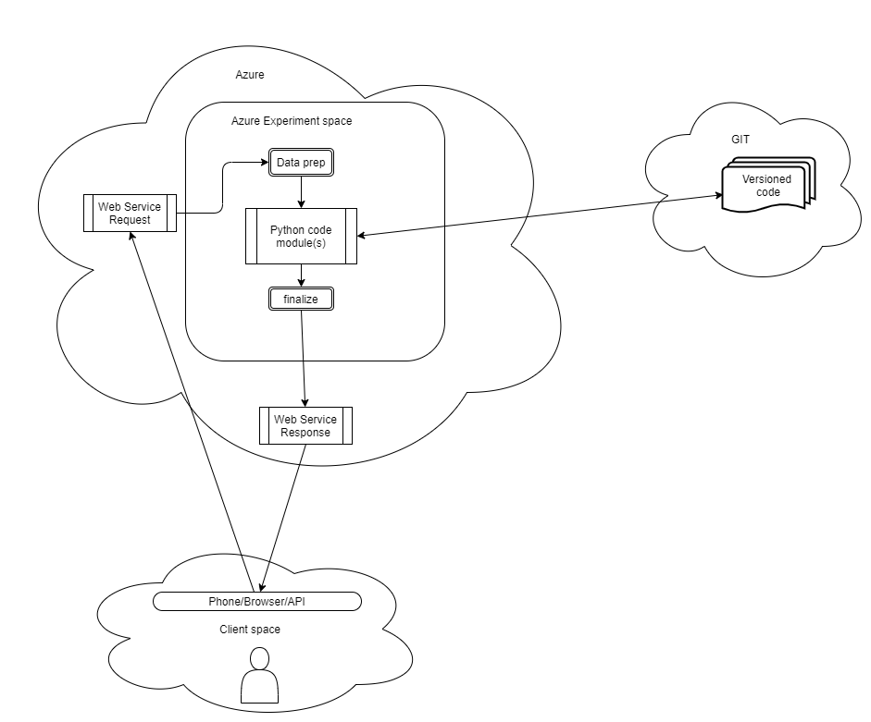
Big Picture
Notes:
Dan - Clean up, add the twitter feed and response to third party

Slide 7
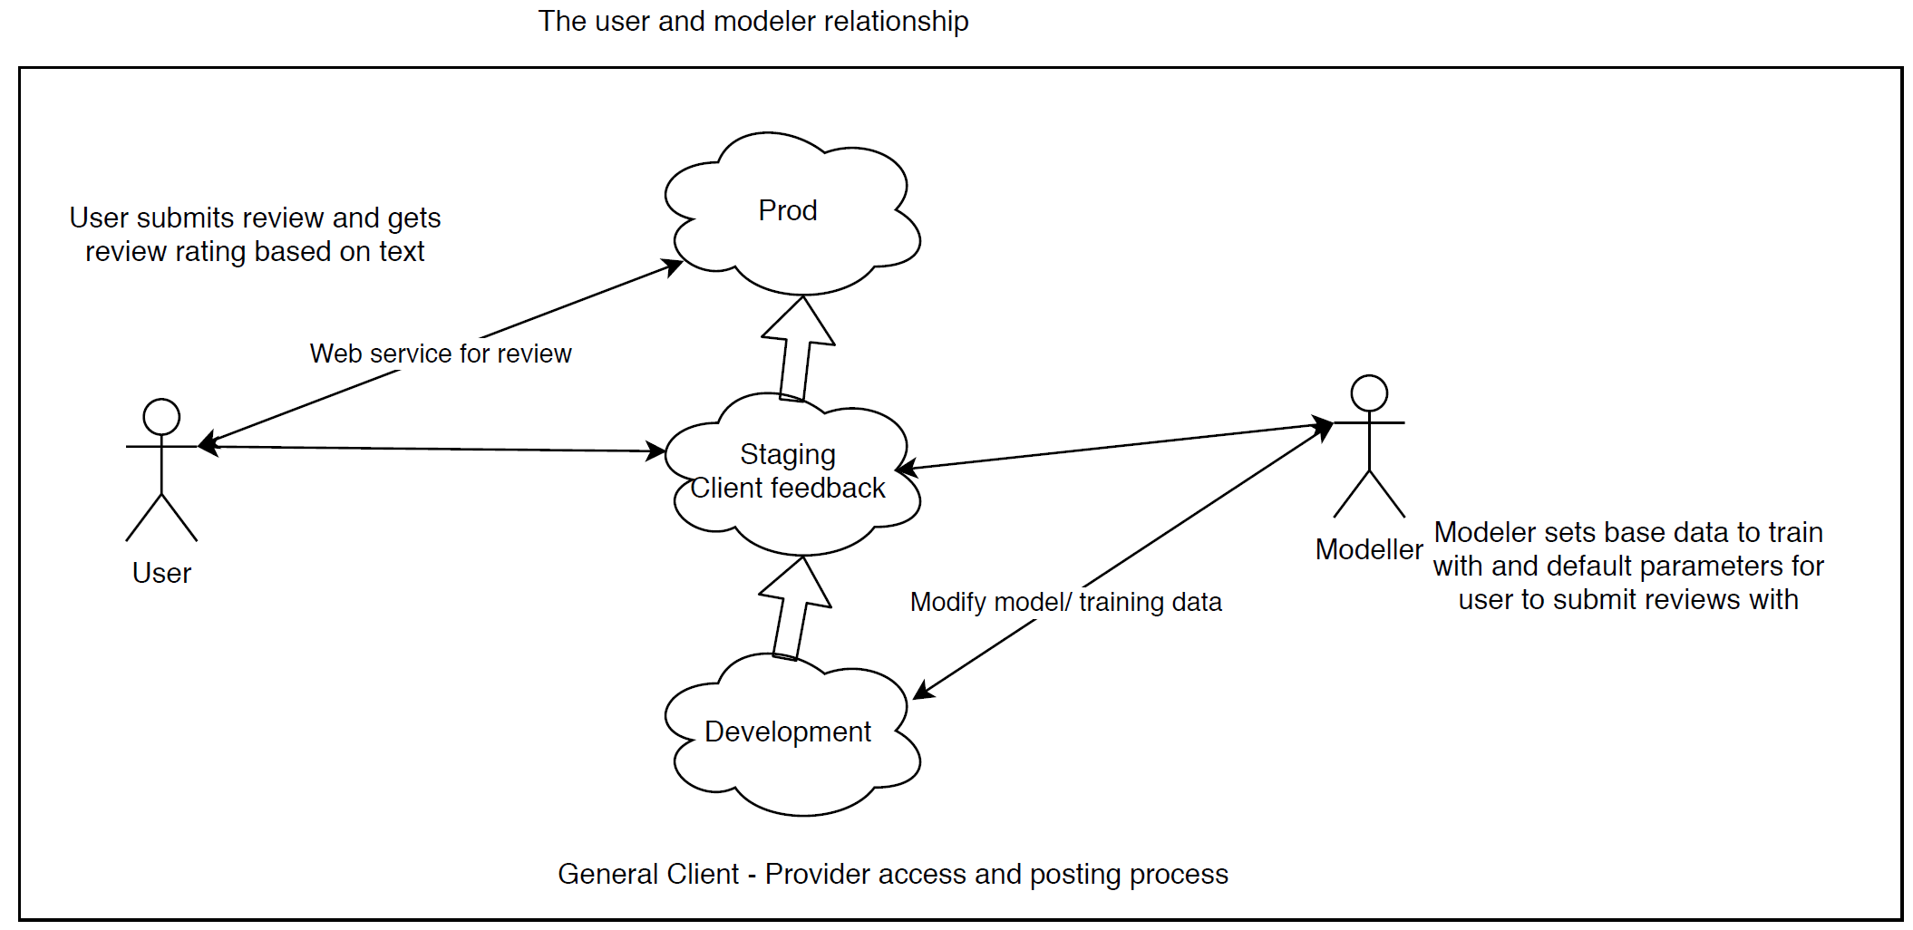
Configuration Management
Notes:
Dan

Slide 8
Building System Architecture
Decided on building the model in Microsoft Azure - Machine Learning
Attempted to create custom python scripts and insert them as Execute Python Script modules
Decided it made the most sense to use premade tools in Azure
Created scripts locally in Jupyter notebooks and PyCharm and versioned using Git (Github)
Most initial research/modelling was done locally before moving to Azure
Notes:
Adarsh

Slide 9
Plan for remodeling of the system
Perform reviews on
The classification of data
Determined N-Gram feature extraction using Tf-Idf was most appropriate (Term frequency - Inverse Document Frequency)
Bag of Words, Word 2 Vec did not do as well
Picking the best model
Logistic Regression was best compared to
Two-Class Boosted Decision Tree (slightly better than Two-Class Decision Forest)
Was comparable to Logistic Regression
Two-Class Locally-Deep Support Vector Machine
Two-Class Support Vector Machine
Two-Class Neural Network
Two-Class Averaged Perceptron
Notes:
Adarsh
Much of this was done locally in PyCharm and Jupyter prior to moving to Azure for reasons of version control

Slide 10
Notes on preprocessing text
Remove questionable data (Google User)
Reduced accuracy (79% to 75%)
Clean up text (79% to 76%)
Remove non-ascii text
Use only english words
Balancing the sample size
Reduced the accuracy of the model
Most likely if you’re not sure what to predict, default to the most frequent rating
Notes:
Adarsh

Slide 11
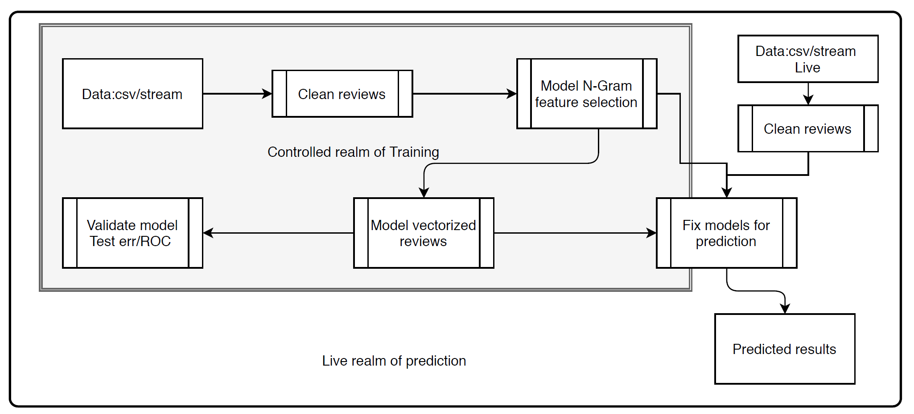
Diagram of flow
Notes:
Brandon

Slide 12
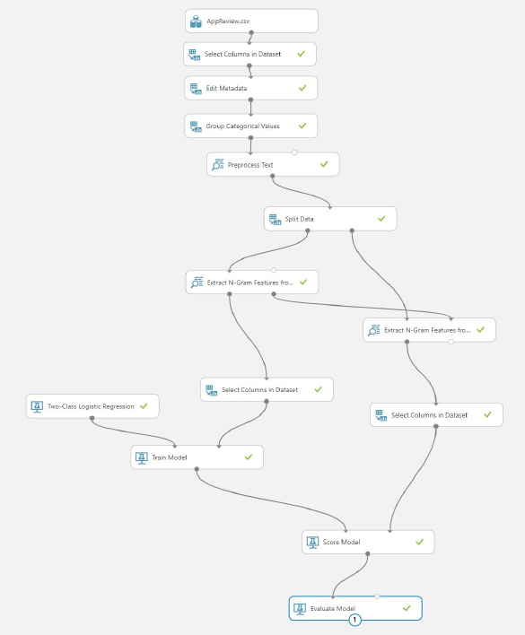
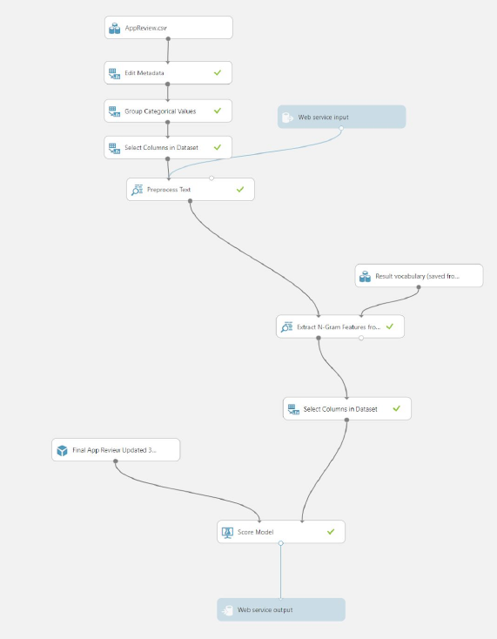
Implementation of the Model - Training vs. Prediction
Notes:
Brandon

Slide 13
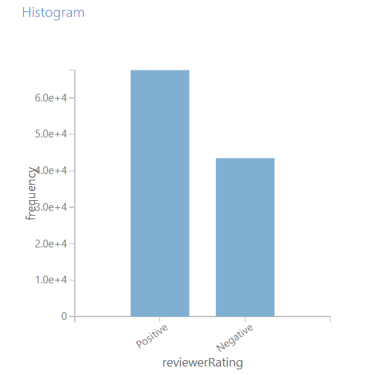
Distribution of Reviews

Slide 14
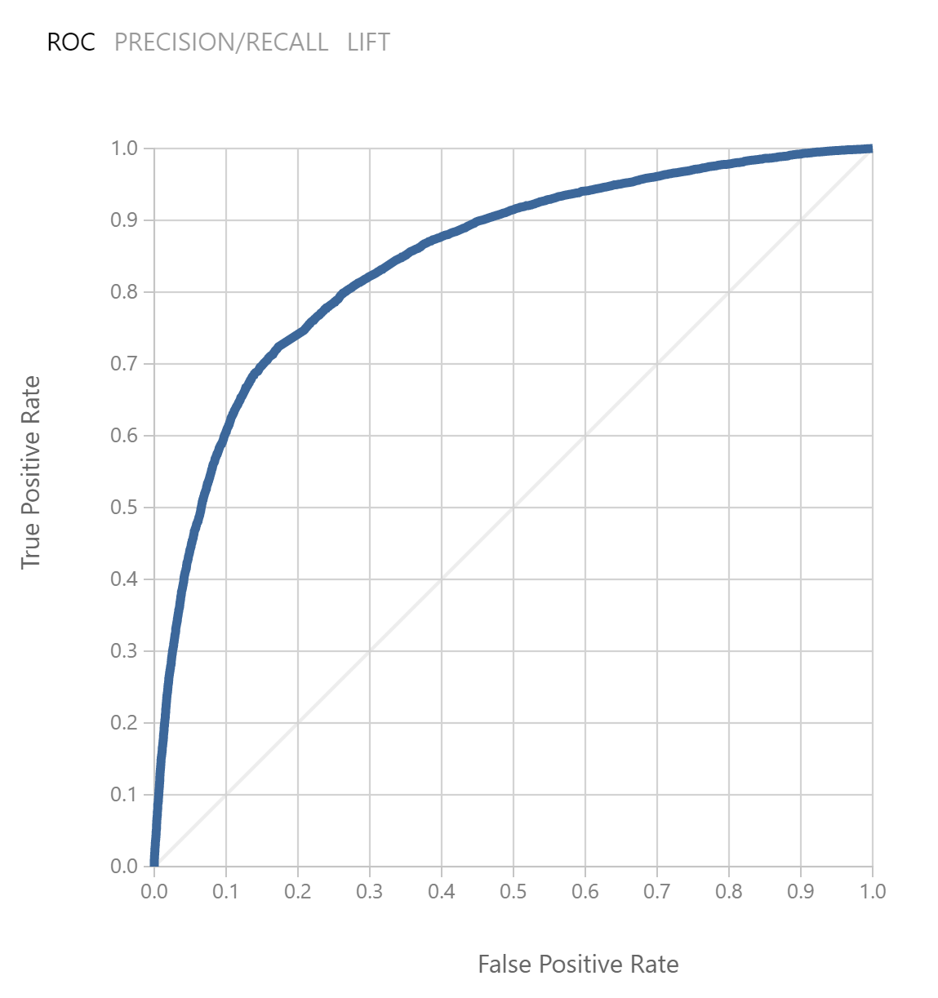
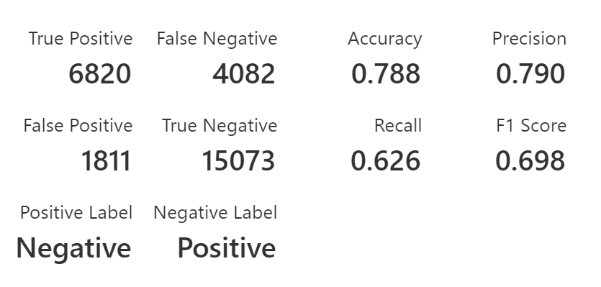
Verify the model’s outputs against the requirements
Notes:
Brandon

Slide 15
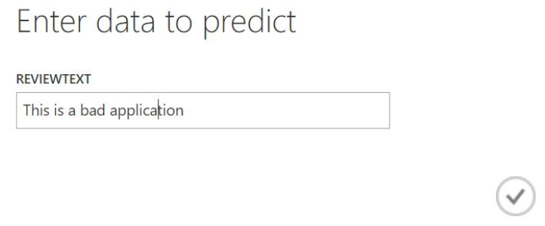
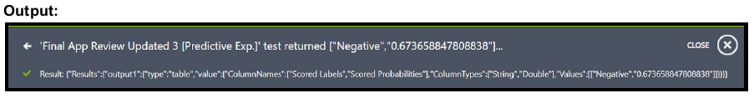
Example Model Input & Output
Input
Notes:
Brandon

Slide 16
Document the process step by step
Training
Classify data to positive/negative reviews
Filtered out questionable data
Split data for training and testing (75% used for training and 25% used for testing)
Performed n-gram feature selection
Stored n-gram feature selection for prediction
Fit Logistic regression
Stored model for prediction
Score Model/Evaluate Model
Prediction
Filter out questionable data
Apply n-gram feature selection based on stored model
Apply logistic regression model to get prediction
Notes:
Brandon

Slide 17
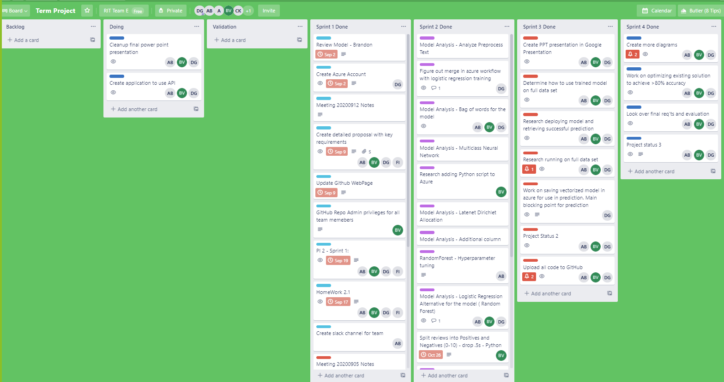
Notes:
Dan

Slide 18
Manage the process step by step
Sprint 1
Review Models
Create Azure accounts
Proposal
Setup Github
Slack channel for communication
Twice weekly meetings (8pm Tuesday, 9am Saturday) - additional meetings when necessary
Create common proposal for client
Notes:
Dan

Slide 19
Manage the process step by step
Sprint 2
Extensive individual research on approaches to modelling
Most work done locally, stored in GIT
Pycharm and Jupyter
Done locally to get an understanding of the models in use prior to using Azure wrappers
Review text processing
Review Vectorization of words
Research and preliminary investigation indicated Term frequency-Inverse document frequency (Tf-Idf) was appropriate and provide best results
Compare with Bag of Words
Initial review of Modelling led directly to Logistic regression, since we were attempting binary classification
Notes:
Dan

Slide 20
Manage the process step by step
Sprint 3
Implementation in Azure
Some attempts were made to use locally developed Python scripts in Azure, but turned towards using Azure components (see later notes on how to do this and preserve model parameters for predictions)
Tried the previously mentioned models in Azure to verify Logistic regression was the best model based on model evaluation
Previous slide (Plan for remodeling of the system)
Tried different filtering of input data
See Preprocessing Text slide for details
Created Prediction flow in azure
Validated output based on some sample input
Notes:
Dan

Slide 21
Manage the process step by step
Sprint 4
Create presentations
Review all steps in process
Work on final model optimizations
Clean up documentation on findings
Discuss retrospective
Investigate implementing model to web service API
Notes:
Dan

Slide 22
Testing and scaling going forward
Leverage data used to train model to do the following
Validation of API that it returns the expected accuracy
Obtain metrics on scaling requirements
How long does each request take to process
Get cost per instance of “service” for users
How many requests per sec are expected in the system
How much does it cost to scale up
Notes:
Dan

Slide 23
Project Management
Trello was used to track all work
It was the de facto calendar for our work
If we had any question or bit of work someone needed to do
Create a TRELLO story to track it
Better to have too much and have to clean up than forget something
https://trello.com/b/4XceHD7e/term-project
GIT
Tracked initial code when working with Python code locally
Tracked designs
Tracked documentation
https://github.com/bwvidro/dsci644_team_d
https://bwvidro.github.io/dsci644_team_d/ - GitHub Webpage
Notes:
Adarsh

Slide 24
Retrospective
Disliked
Azure
Right click can easily delete an object and no way to recover
Doing diffs between experiments is not that easy
Unlike raw python code version in GIT
A little complicated to figure some connections out
But that don’t have suggestions on how uncomplicate it
Losing a team member shortly after starting
Notes:
Dan, Adarsh, Brandon

Slide 25
Retrospective
Liked
Azure
Nice interface
Adding custom code
Nice defaults
Initial model setups
Presentations on model evaluation
Share-able workspaces
Trello
Our Team!
Notes:
Dan, Brandon, Adarsh

Slide 26
Retrospective
What we could have done better
Tracked time on user stories in trello for cost analysis and ROI
Updated Git webpage
Found a better way to version Azure changes
Notes:
Dan, Adarsh, Brandon

Slide 27
Want to pass along to others
Using custom models in Azure and storing the modelling parameters
When you fit a custom model in Azure, you will need to store the fitted model for use in prediction - see Pickling Custom Python Models in Azure
This is done via pickling the model and storing in a column in the output
import pickle
pickledModel = base64.b64encode(pickle.dumps(Model))
outputDataframe.iat[1,model_col]=str(pickledModel , 'utf-8')
Need to store as utf-8, otherwise Azure will complain.
This can then be extracted and saved as a dataset and used in prediction
pickedlModelEncoded=dataframe2.iat[0,model_col]
pickledModel=base64.b64decode(pickedlModelEncoded)
Model=pickle.loads(pickledModel)
Notes:
Dan - Side note for those that are interested

Slide 28
BREAK SLIDE - REST OF THE SLIDES NOT USED

Slide 29
BREAK SLIDE - REST OF THE SLIDES NOT USED

Slide 30
BREAK SLIDE - REST OF THE SLIDES NOT USED

Slide 31
CONSTRUCTION PHASE
Picking the best model
Logistic Regression was best compared to
Two-Class Boosted Decision Tree (slightly better than Two-Class Decision Forest)
Was comparable to Logistic Regression
Two-Class Locally-Deep Support Vector Machine
Two-Class Support Vector Machine
Two-Class Neural Network
Two-Class Averaged Perceptron

Slide 32
CONSTRUCTION PHASE
Proposing ways to further improve the accuracy of the model
Explore more pre-processing
Extract N-gram features
Normalize vectors

Slide 33
ELABORATION PHASE & PLANNING
Preprocessing Data
Filter suspect data
Cleaning data
Proposing models:
Using Python code
Using different Azure preprocessing techniques
Proposed to client to partition data into positive and negative reviews
What’s the point on such minute detail
Improving accuracy by replacing and tuning the hyperparameters
Incorporating web service based input
Publishing in Azure

Slide 34
TRANSITION PHASE
Presenting the final model

Slide 35
INCEPTION PHASE
Analyzed the initial model
Understanding Azure to process each block to improve model accuracy
Setting tools
Github
Trello board

