Slide 1
XFM Vending Machine
Joseph Olin
Michael Roark
Branden Wagner
Notes:
X to the F to the M to the V.

Slide 2
Purpose
Demonstrate how a familiar task, such as tending bar, can be handled by a low cost intelligent robot

Slide 3
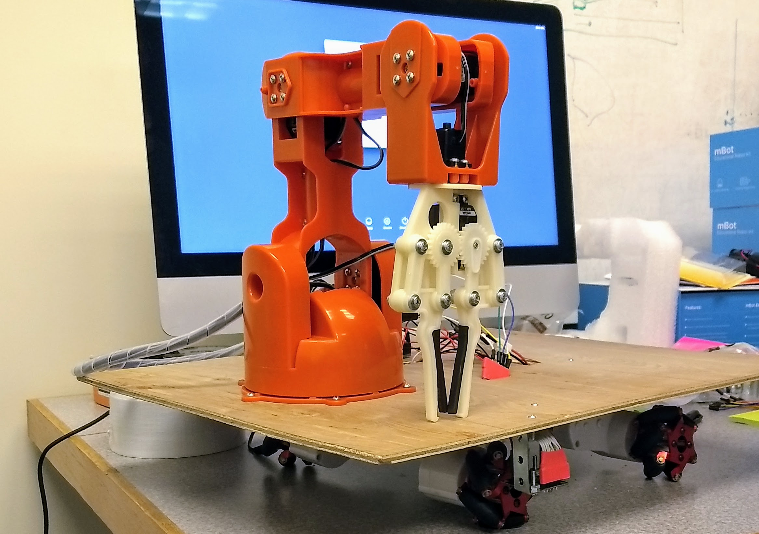
What is XFM Vending Machine?
A robot that delivers
food items to customers
sitting at a counter
Notes:
A robot that delivers mint patties to customers sitting at a counter

Slide 4
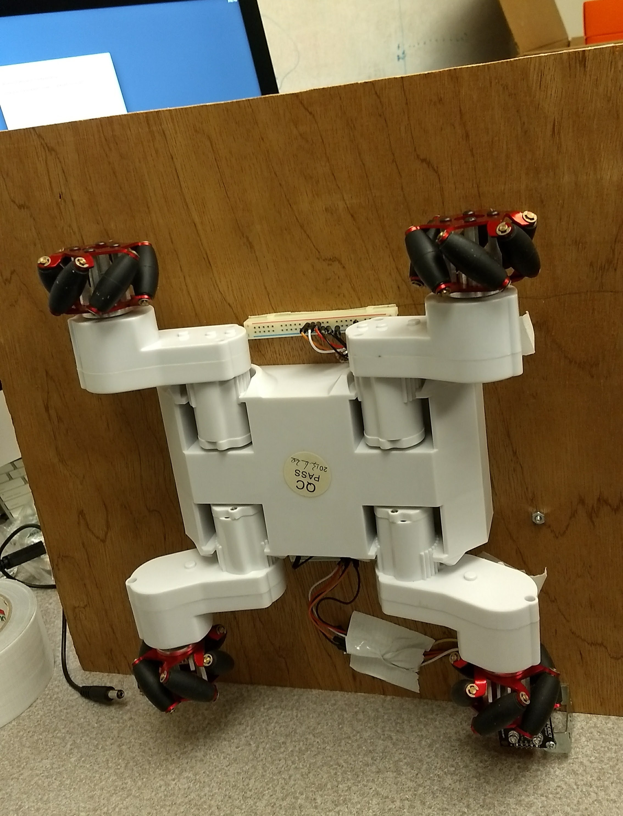
How?
The robot uses
Wheeled navigation
Ability to grab and drop
Color reading
Path following abilities

Slide 5
Components List
Arduino Braccio Arm
RC-7 Rover chassis
Arduino Adafruit microcontroller
RGB color sensor
Line follower sensor
A bag of mints
12V DC battery power supply
5V DC power from wall
Notes:
This could be a different type of SmartArt list, for instance with thumbnail pictures of the components.

Slide 6
Operational Flow
Line follower finds the path
Robot moves along path
RBG sensor detects order and arm activates
Arm moves to grab mints
Robot reverses at the end of the table

Slide 7
Demo
Video link

Slide 8
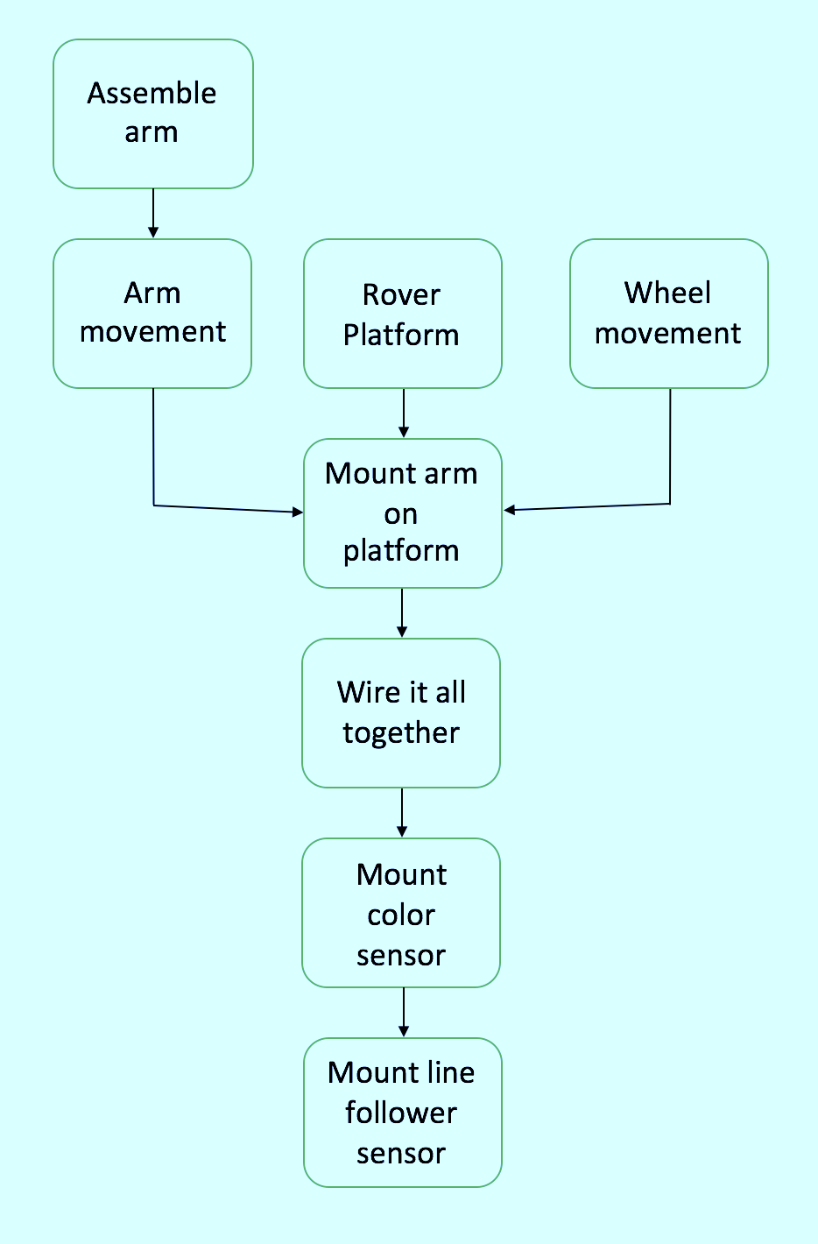
Development
Physical
Software
Notes:
Could be two different slides unless we need to make direct comparisons.

Slide 9
What’s left?
Further development of the line follower sensor
Optimize the performance of the robotic system based upon discrete performance measures
Measure delivery speed
Measure percentage of successful deliveries

Slide 10
References

