Slide 1
XFM Vending Machine
Joseph Olin
Michael Roark
Branden Wagner
Notes:
X to the F to the M to the V.

Slide 2
Purpose
Demonstrate how a familiar task, such as tending bar, can be handled by a low cost intelligent robot

Slide 3
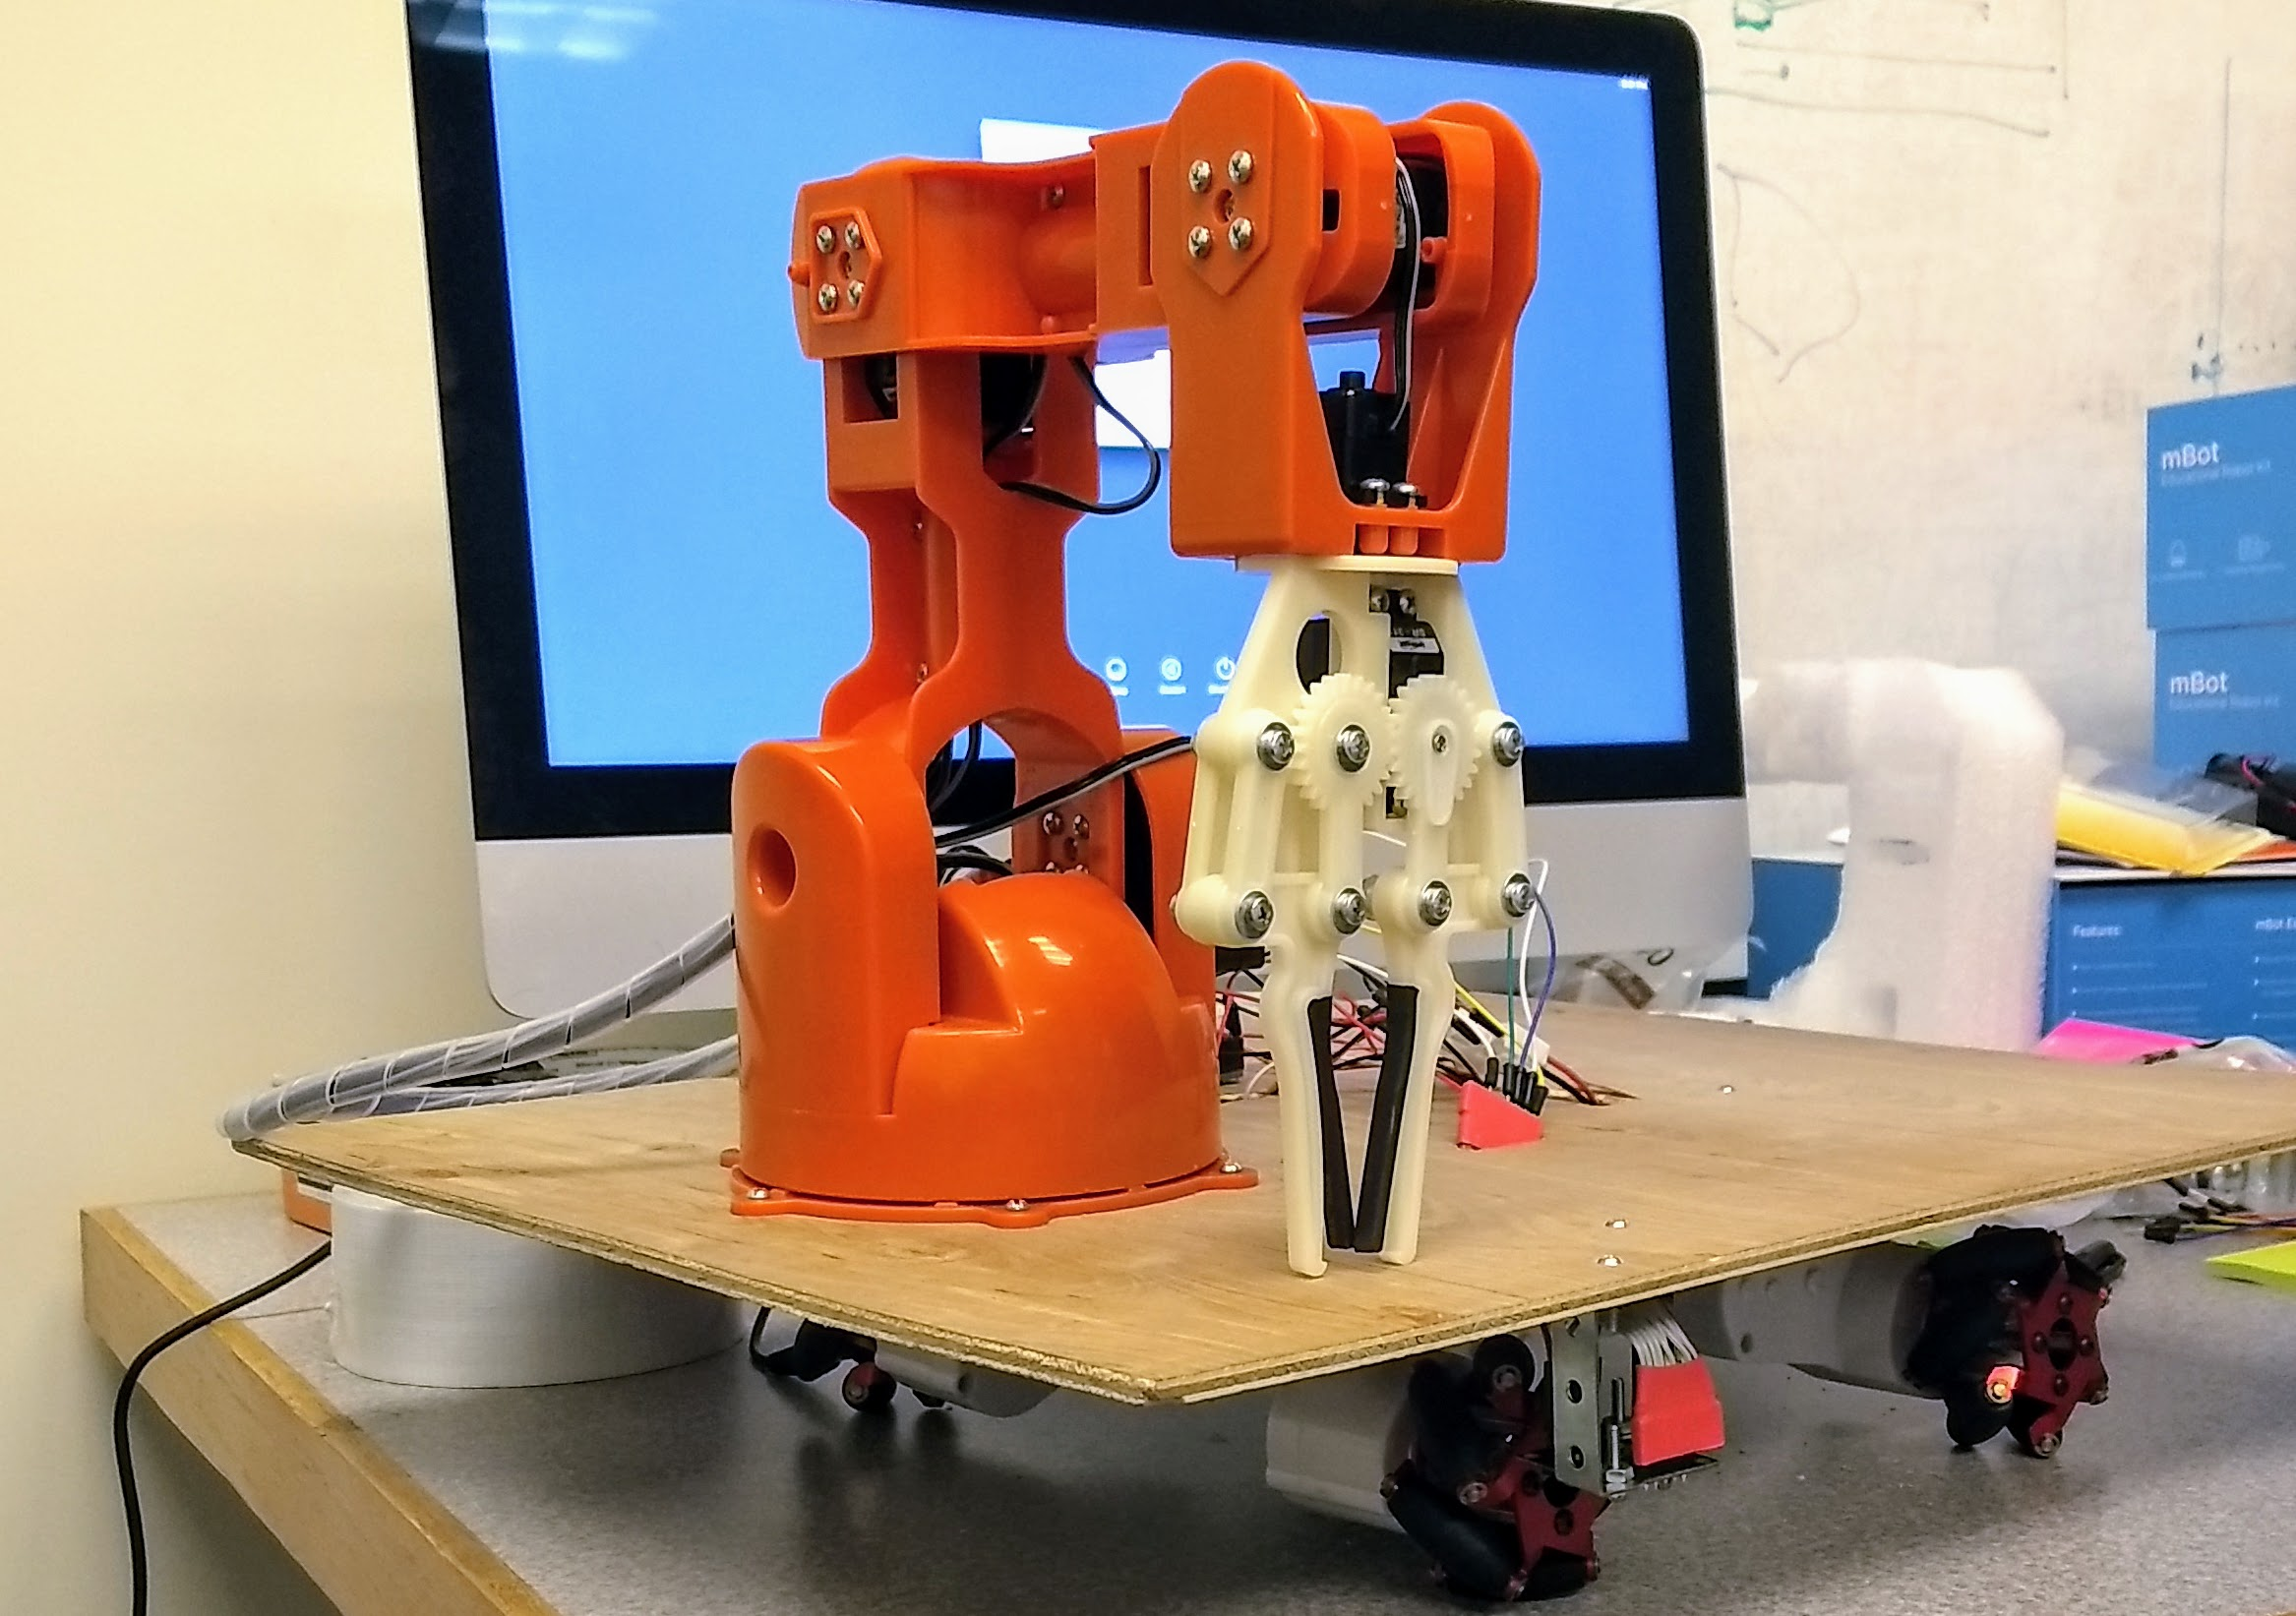
What is XFM Vending Machine?
A robot that delivers
food items to customers
sitting at a counter
Notes:
A robot that delivers mint patties to customers sitting at a counter

Slide 4
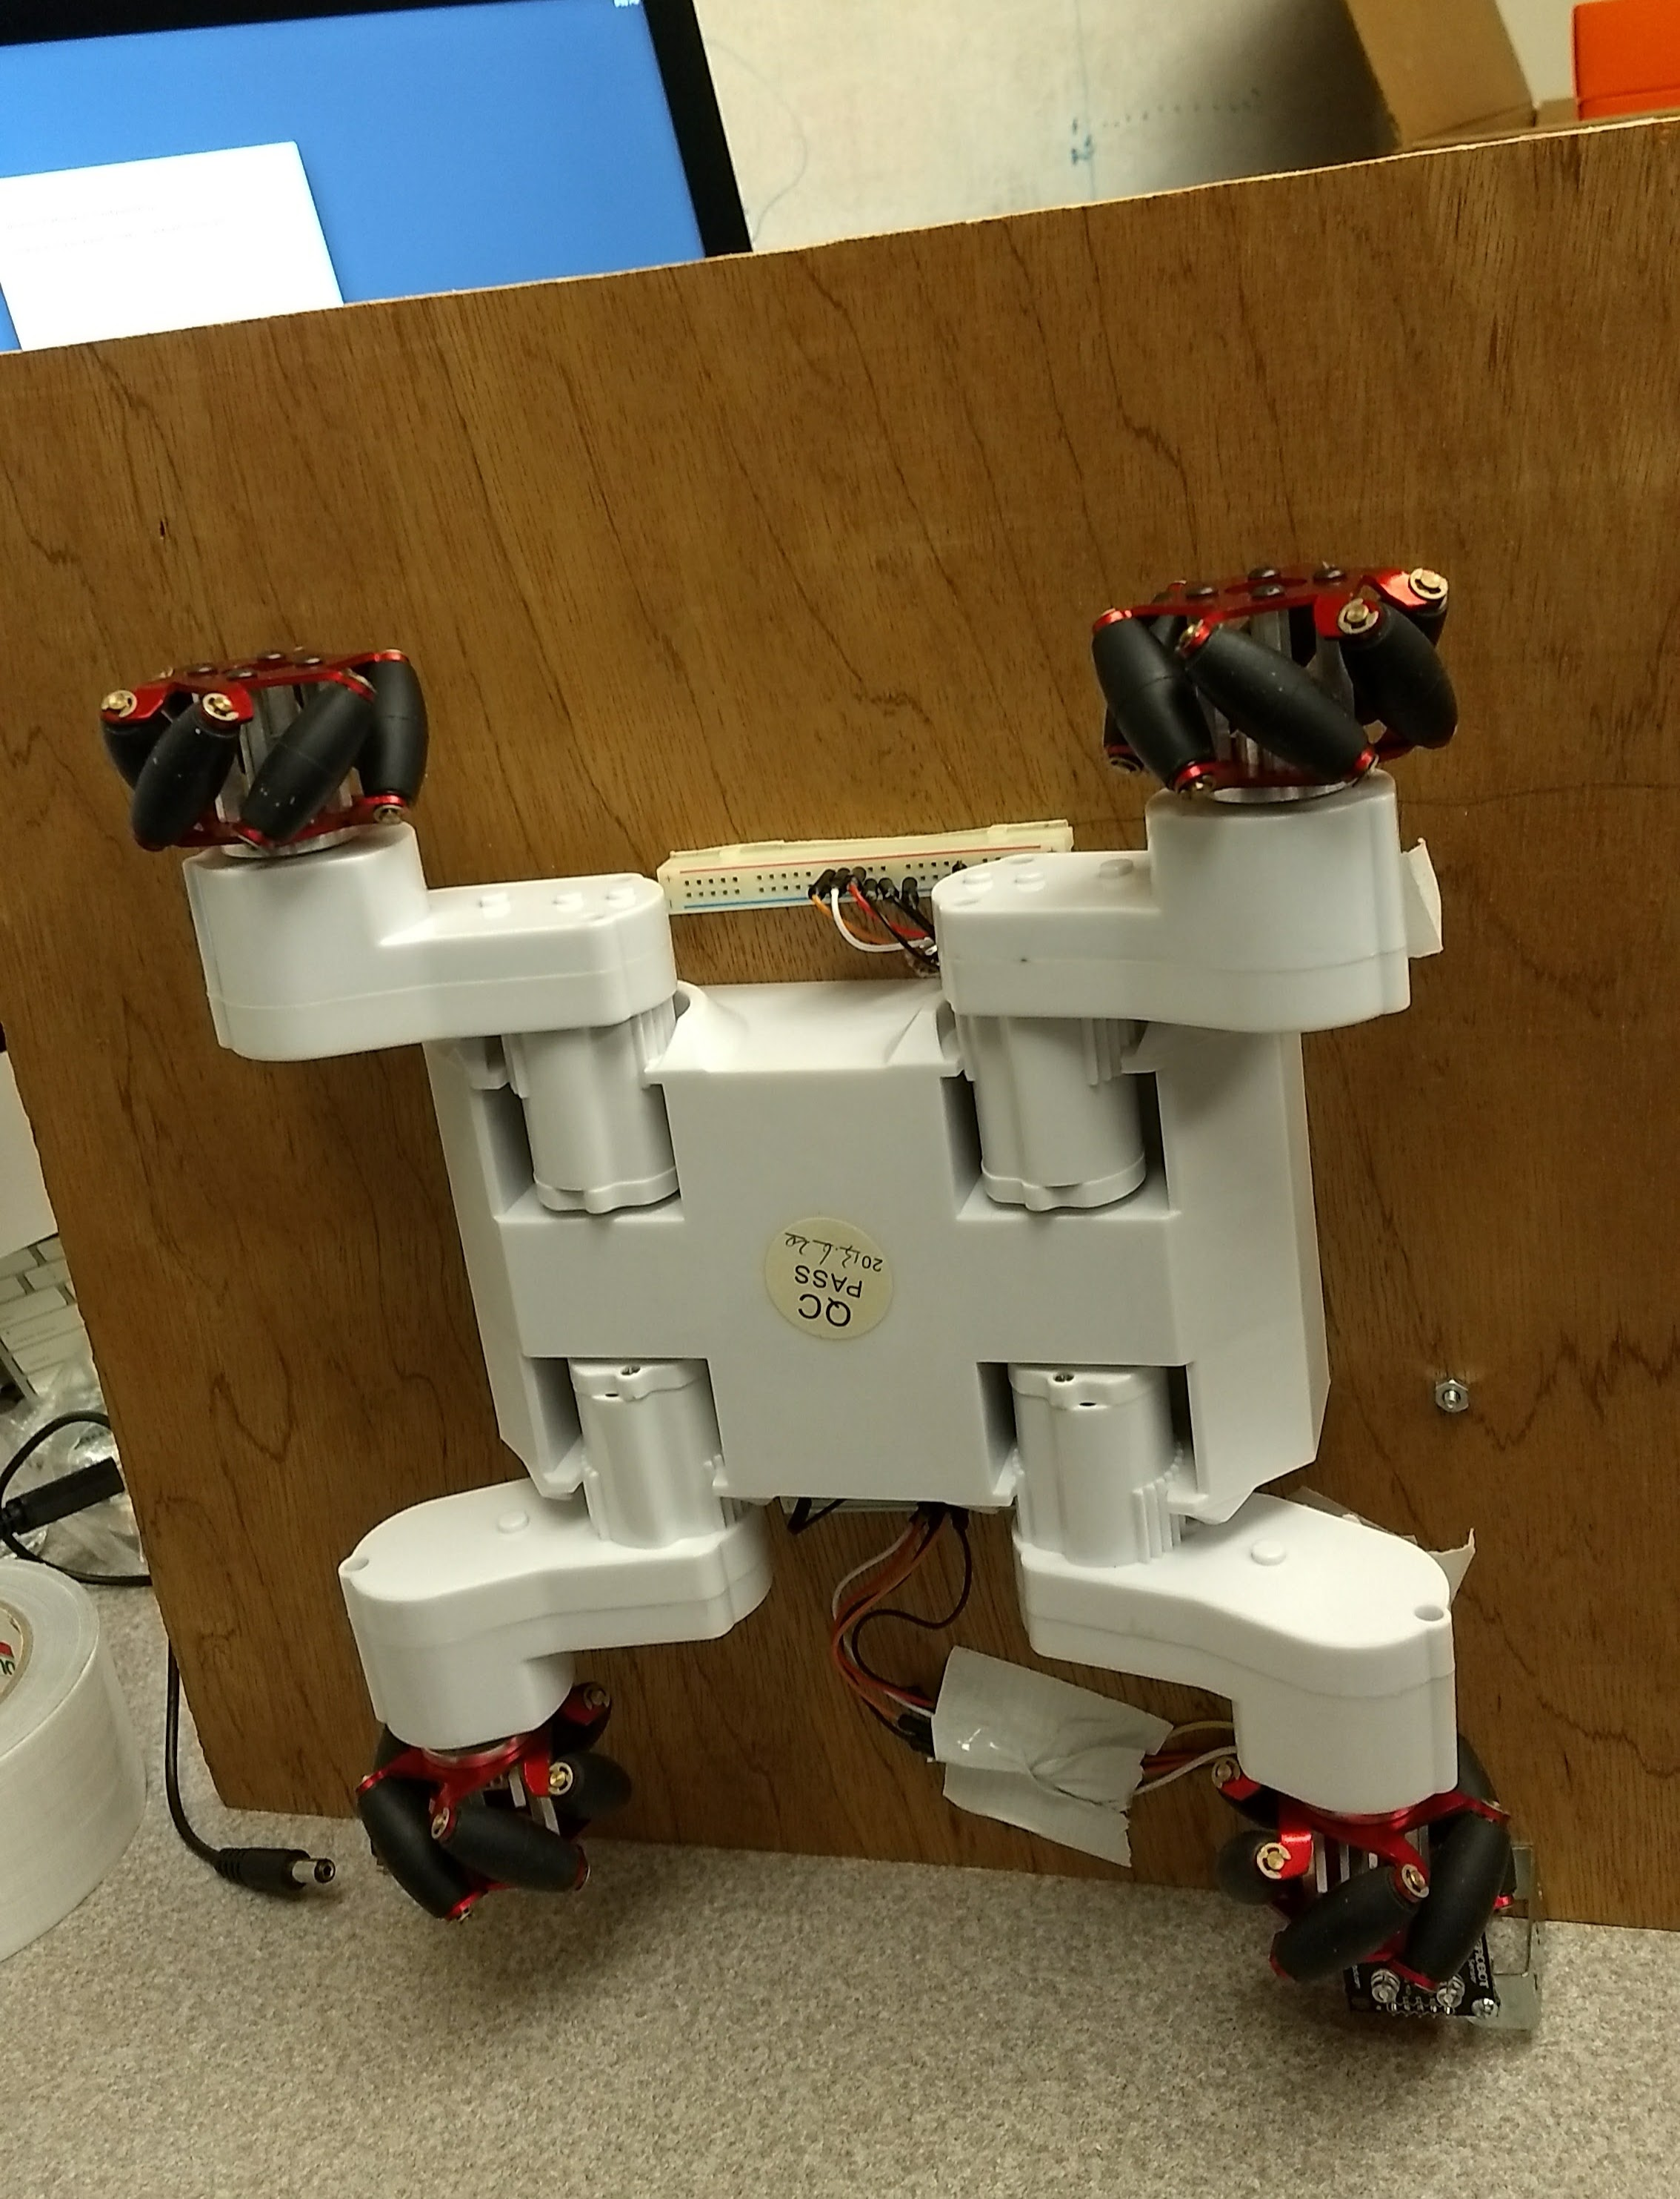
How?
The robot uses
Wheeled navigation
Ability to grab and drop
Color reading
Path following abilities

Slide 5
Demo
Video link

Slide 6
Components List
Arduino Braccio Arm
RC-7 Rover chassis
Arduino Adafruit microcontroller
RGB color sensor
Line follower sensor
A bag of mints
12V DC battery power supply
5V DC power from wall
Notes:
This could be a different type of SmartArt list, for instance with thumbnail pictures of the components.

Slide 7
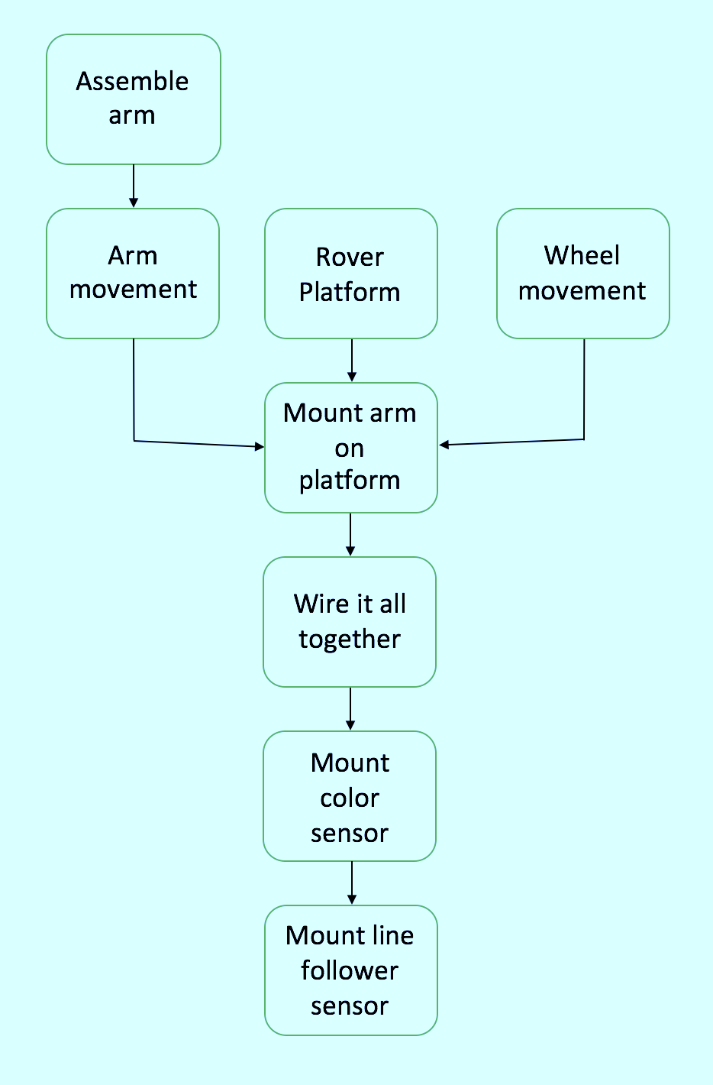
Development
Physical
Software
Notes:
Could be two different slides unless we need to make direct comparisons.

Slide 8
What’s left?
Further development of the line follower sensor
Optimize the performance of the robotic system based upon discrete performance measures
Measure delivery speed
Measure percentage of successful deliveries

Slide 9
References
W. I. O. T. Made by Windows IoT (Windows IoT, Aparajita Dutta et al), “What Color is it?,” Hackster.io, 25-Sep-2015. [Online]. Available: https://www.hackster.io/windows-iot/what-color-is-it-578fdb. [Accessed: 14-Apr-2017].
“Braccio,” Arduino Open Source Hardware and Software for electronic projects. [Online]. Available: http://www.arduino.org/products/tinkerkit/arduino-tinkerkit-braccio. [Accessed: 14-Apr-2017].
“Pololu - QTR-8RC Reflectance Sensor Array,” Pololu Robotics & Electronics. [Online]. Available: https://www.pololu.com/product/961. [Accessed: 14-Apr-2017].

