Slide 1
XFM Vending Machine
Joseph Olin
Michael Roark
Branden Wagner

Slide 2
Purpose
Demonstrate how a familiar task, such as tending bar, can be handled by a low cost intelligent robot

Slide 3
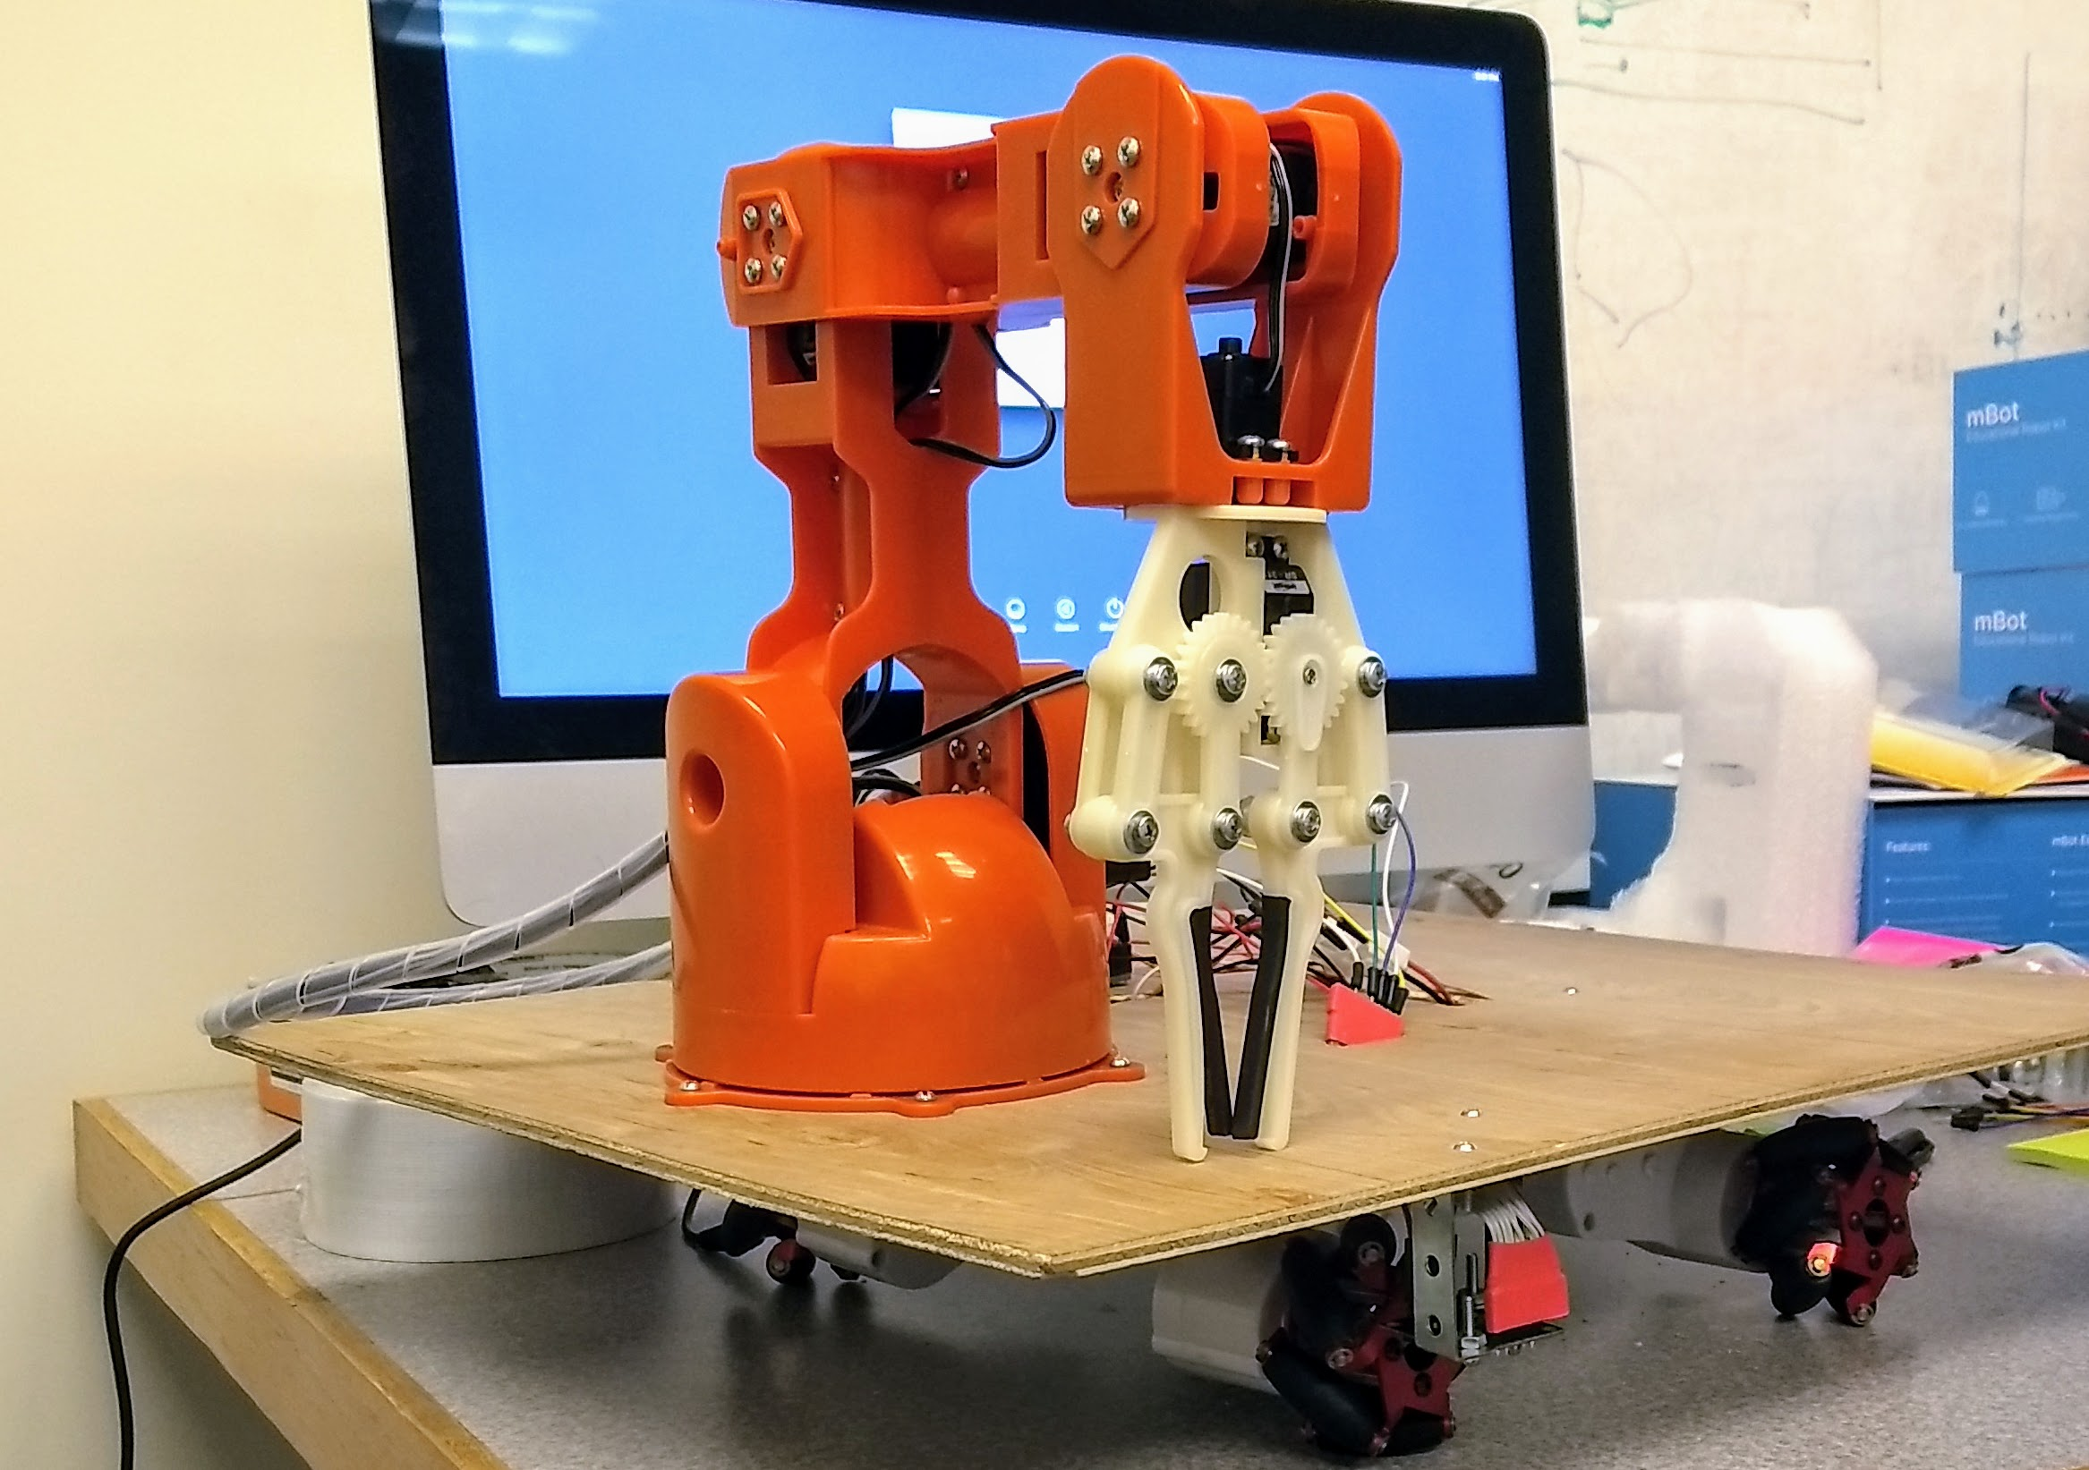
What is XFM Vending Machine?
A robot that delivers food items to customers sitting at a counter
Notes:
A robot that delivers mint patties to customers sitting at a counter

Slide 4
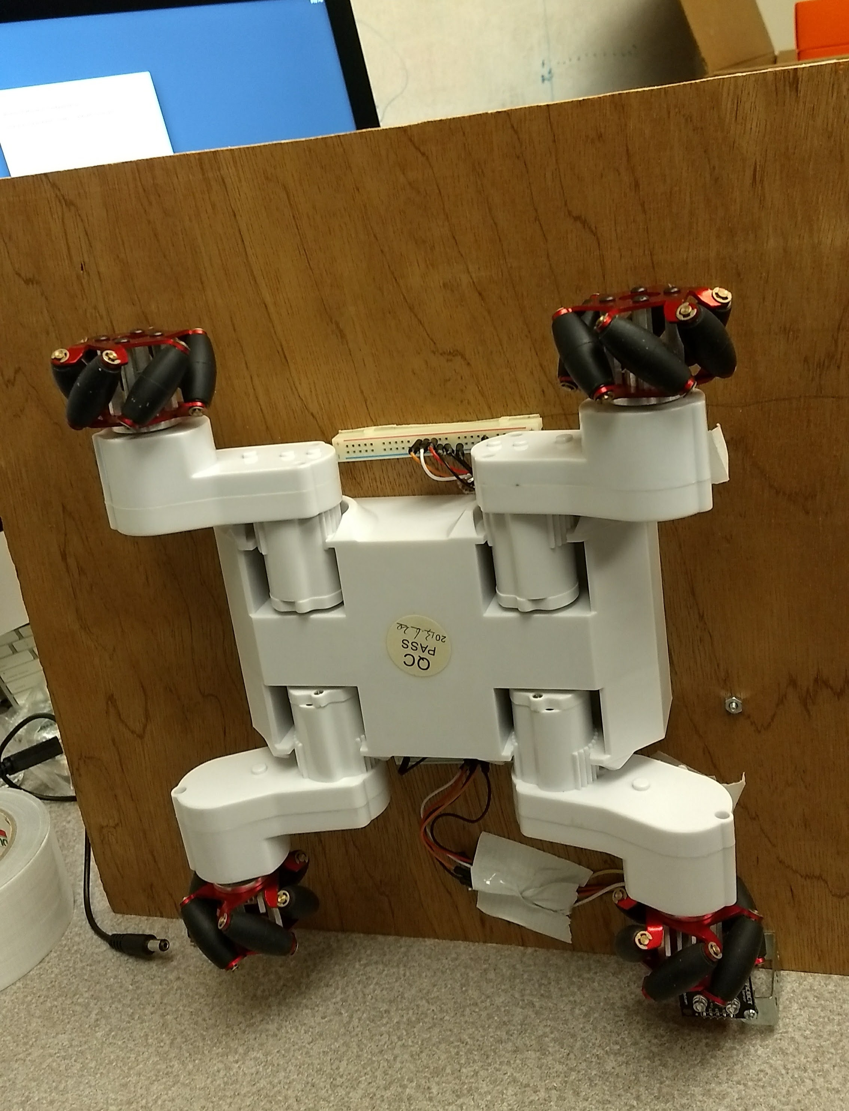
How?
The robot uses
Wheeled navigation
Ability to pick up and drop objects
Color reading
Path following abilities

Slide 5
Operational Flow
Line follower finds the path
Rover moves along path
RBG sensor detects order and arm activates
Arm moves to grab mints
Robot reverses at the end of the table

Slide 6
Demo
Video link

Slide 7
Components List
Arduino Braccio Arm
RC-7 Rover chassis
Arduino Adafruit microcontroller
RGB color sensor
Line follower sensor
A bag of mints
12V DC battery power supply
5V DC power supplied from wall
Notes:
This could be a numbered list with for a diagram on another slide.

Slide 8
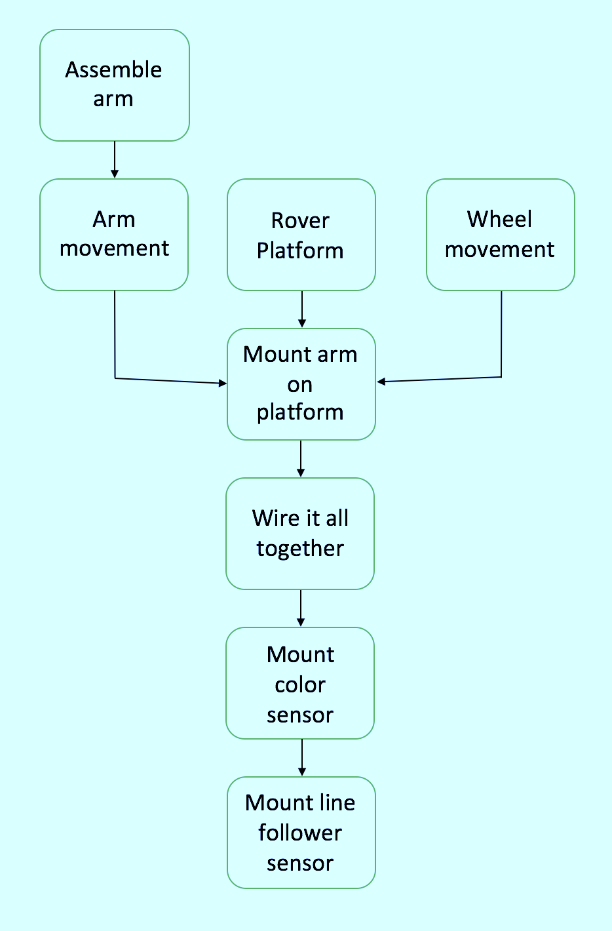
Development
Physical
Software
Notes:
Two examples of diagram picture styles.

Slide 9
What’s left?
Further development of the line follower sensor
Optimize the performance of the robotic system based upon discrete performance measures
Measure delivery speed
Measure percentage of successful deliveries

Slide 10
References

