Slide 1
XFM Vending Machine
Joseph Olin
Michael Roark
Branden Wagner

Slide 2
Purpose
Demonstrate how a familiar task, such as tending bar, can be handled by a low cost intelligent robot

Slide 3
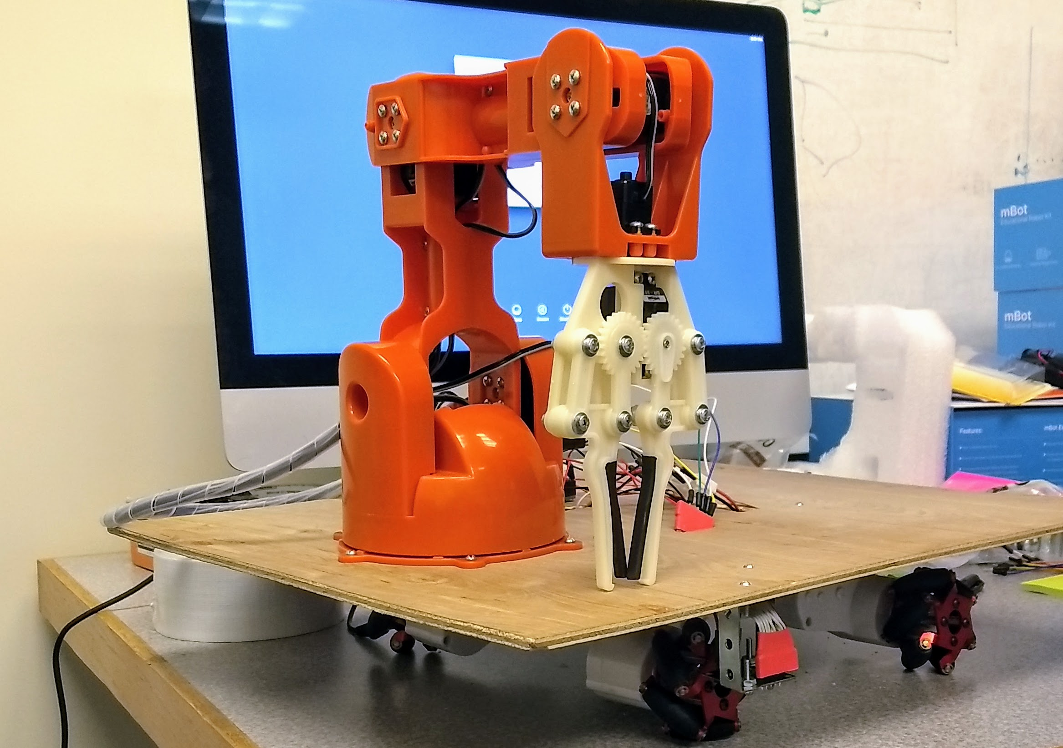
What is XFM Vending Machine?
A robot that delivers food items to customers sitting at a counter
Notes:
A robot that delivers mint patties to customers sitting at a counter

Slide 4
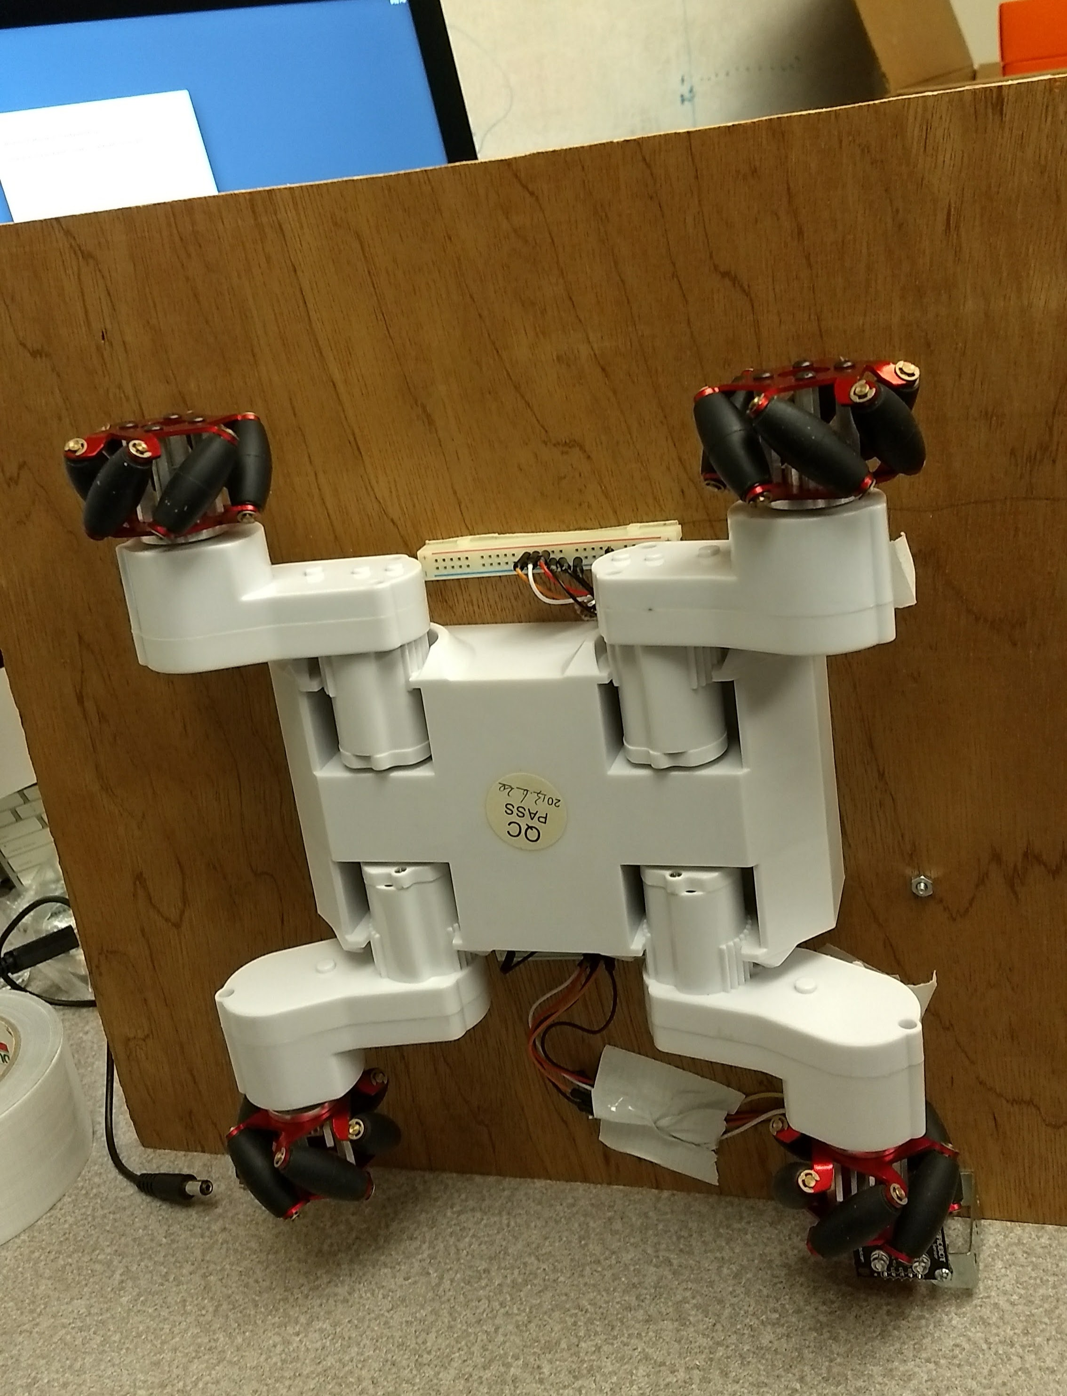
How?
The robot uses
Wheeled navigation
Ability to pick up and drop objects
Color reading
Path following abilities

Slide 5
Demo
Video link

Slide 6
Components List
Arduino Braccio Arm
RC-7 Rover chassis
Arduino Adafruit microcontroller
RGB color sensor
Line follower sensor
A bag of mints
12V DC battery power supply
5V DC power supplied from wall
Notes:
This could be a numbered list with for a diagram on another slide.

Slide 7
Development
Physical
Software
Notes:
Two examples of diagram picture styles.

Slide 8
What’s left?
Further development of the line follower sensor
Optimize the performance of the robotic system based upon discrete performance measures
Measure delivery speed
Measure percentage of successful deliveries

Slide 9
References

