Slide 1
Global Brand Protection Illicit Trade Fingerprinting
January 2016

Slide 2
Objectives
Develop a data driven approach to analyzing illicit online listings of Ethicon products.
Quantify the similarity of a online listings and their sellers by way of a “digital fingerprint”.
Identify key players in the illicit trade market to improve allocation of Global Brand Protection resources.

Slide 3
Analysis Strategy
Develop “fingerprints” for sellers based on their listings
How are their listings formatted?
What kind of words do they use in the title and description?
What images do they use for their listings?
By creating “fingerprints” for each seller, it is then possible to compare different sellers

Slide 4
Overview
Listing URLs
Extract Data from URL
Seller Analysis
Title Analysis
Text Analysis
Image Analysis
Create Network
Identify Clusters

Slide 5
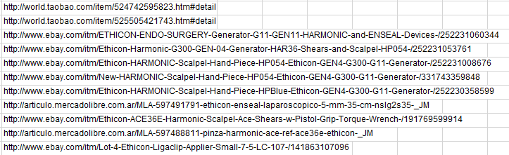
Original Data
Started with vendor data including a list of URLs of illicit listings

Slide 6
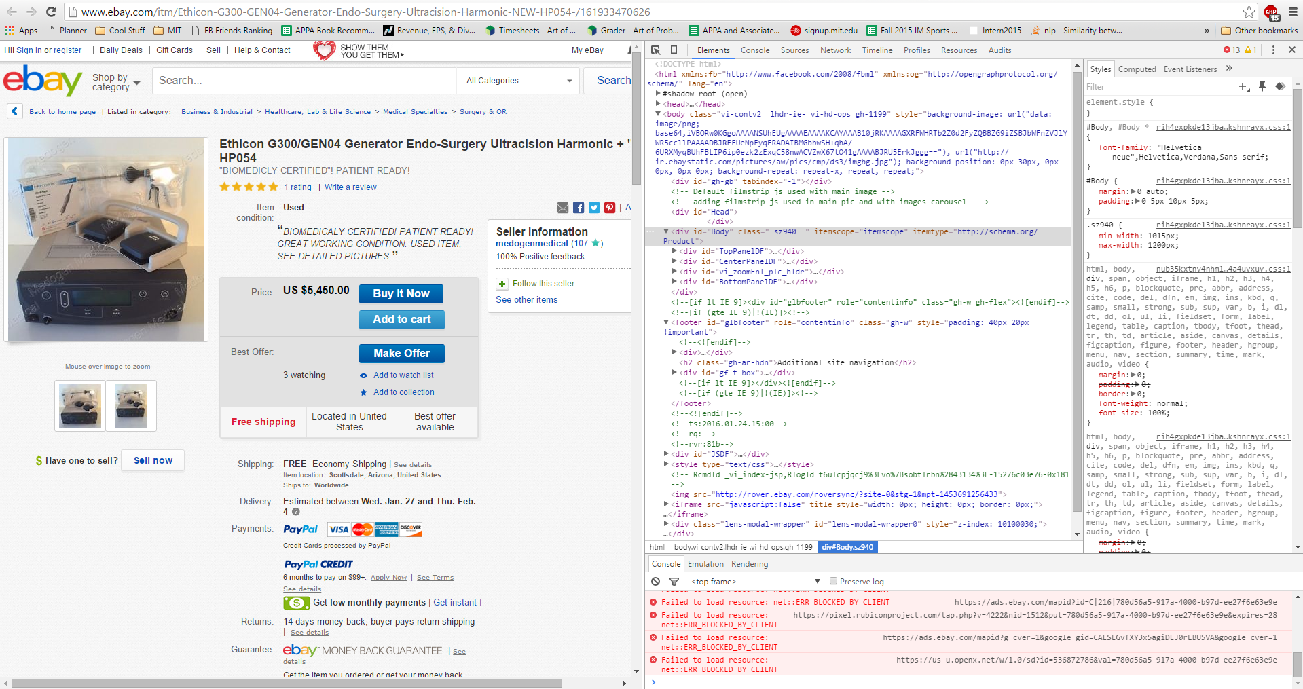
Extracting Information
Scraped useful information from each URL’s webpage

Slide 7
Username Analysis
Listings with the same sellers are related
Provides a preliminary understanding of the illicit trade network
Next step is to relate the sellers using text and image analysis

Slide 8
Text Analysis
Text from the title and description of the listing are analyzed by finding the document distance.
Sellers using multiple accounts are likely to reuse similar titles or descriptions for their listings
A score close to one means the two texts are similar
This is a random sentence of words This is also a random sentence of words | Score : .935
This is a random sentence of words I don’t know what you’re talking about | Score : 0
This is a random sentence of words That’s so random! | Score : .21

Slide 9

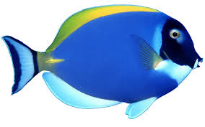
Image Analysis
Images from different listings are compared by hashing the pixels to see if they are identical
Comparison method employed allows for small differences between images
Listings which have identical images are likely to be related
=
≠

Slide 10
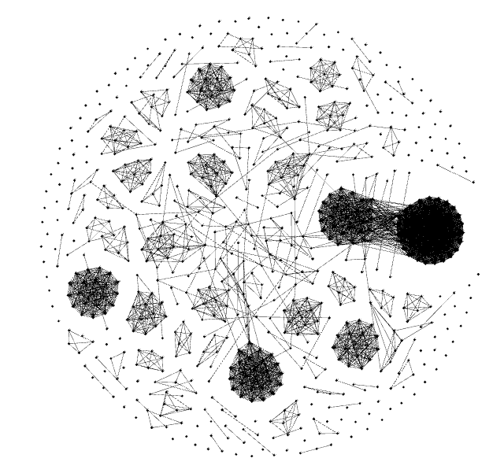
The Ebay Network

Slide 11
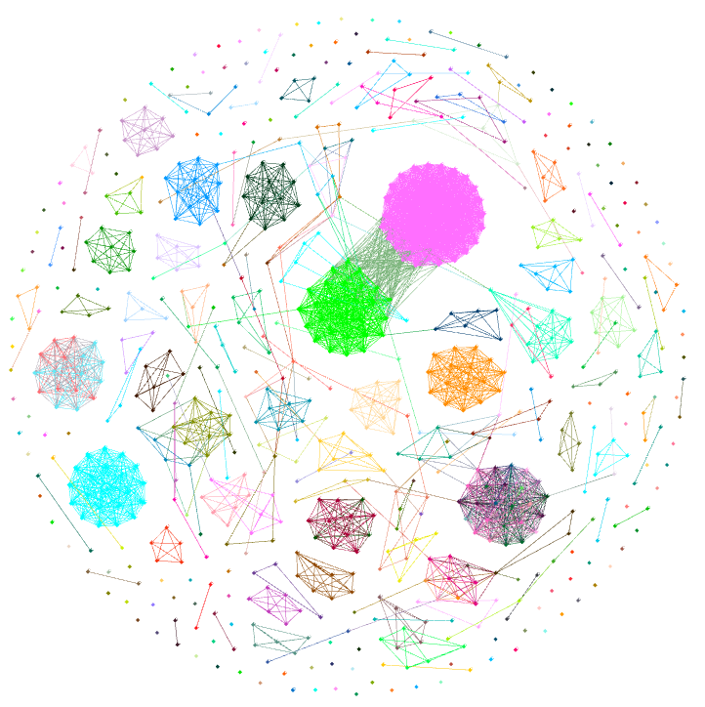
Findings – Seller Analysis
Each color represents a different seller
Clustering algorithm employed which groups listings of the same seller together

Slide 12
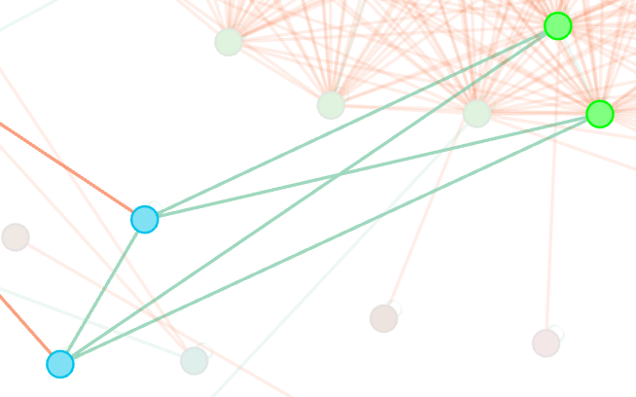
Findings – Title Analysis
Green lines mean that the listings are related by title
Listings with extremely similar titles are a sign that they originate from the same source
In the example, djenky99 and surgical-overstock appear to be the same source
http://www.ebay.com/itm/ACE36E-Ethicon-Harmonic-Ace-Curved-Shears-ea-x-R-/262195246325
http://www.ebay.com/itm/ACE36E-Ethicon-Harmonic-Ace-Curved-Shears-ea-x-/121843954996

Slide 13
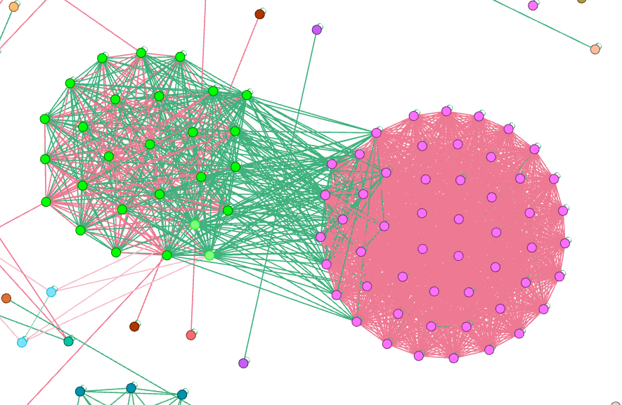
Findings – Text Analysis
Green lines indicate that the listings are related by text
Example suggests that the two biggest sellers, tridentmedical-llc and surgical-overstock are from the same source
http://www.ebay.com/itm/NSLG2C35A-Ethicon-Enseal-G2-Curved-Tissue-Sealer-5mm-x-35cm-x-/161675995100
http://www.ebay.com/itm/ACE23E-Ethicon-Harmonic-Ace-Curved-Shears-23cm-ea-x-R-/262145000128?hash=item3d090f42c0:g:Le0AAOSwu4BV3eWe

Slide 14
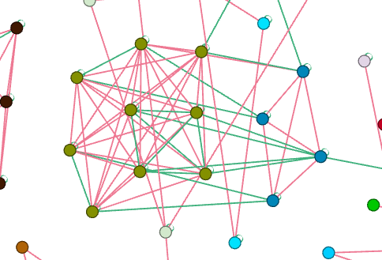
Findings – Image Analysis
Green lines represent listings with identical images
In the example, this analysis suggests that medi.surgical and themoreforu are from the same source
http://www.ebay.com/itm/Laprascopy-Needle-Holder-carbide-Tip-curved-TC-Ethicon-5-mm-/181722655501
http://www.ebay.com/itm/New-SS-Laparoscopic-Surgery-Needle-Holder-carbite-Tip-curved-TC-Ethicon-Type-5mm-/111849135478

Slide 15
Moving Forward
Scale – Collect information and perform analysis on more marketplaces – Alibaba, MercadoLibre, etc.
Complexity – Implement different more advanced algorithms to determine similarity in order to reduce the number of false positives
Scope – Automatically detect high probability clusters and create simple interface for relevant users.

Slide 16
Technologies Used
Python
xlrd to pull data from Excel files
scrapy to scrape data from website listings
pymongo, bson to manipulate MongoDB
nltk to calculate tf-idf matrix for text analysis
httplib2, urllib, cStringIO to pull online images
distance to calculate levenshtein distance
pandas to create a dataframe for Tableau
networkx to create a network for Gephi
MongoDB
Gephi
Tableau

Slide 17
Thank You!

