Slide 1
Navigate the Microsoft Graph API with PowerShell
Bradley Wyatt
Manager DevOps Cloud Automation @ BDO Digital
Author at The Lazy Administrator
Microsoft MVP
Notes:
Welcome to Navigate the Microsoft Graph API with PowerShell
My name is Bradley Wyatt
I am a Manager of DevOps Cloud Automation at BDO Digital. I also blog on my Website, The Lazy Administrator where I write about many different topics but mostly PowerShell.
And finally, I am a Microsoft MVP in Cloud and Datacenter Management
We have a lot of content to cover today, So with that, lets get started

Slide 2
Agenda
What is Microsoft Graph
What is in Microsoft Graph
API Reference Docs
Graph Explorer
PowerShell SDK
Invoke-RestMethod and the Graph API
Notes:
For Todays agenda, we will be going over What is the Microsoft Graph. Why should we use it and how is it valuable to you and your company.
Next, we will then discover what kinds of data can be found within the Microsoft Graph.
After that we will look at the API reference docs, where we'll learn how to find the endpoints for our API calls and what permissions are needed for each one.
Then I will show you a quick glance at the Graph Explorer, a helpful tool from Microsoft that allows us to learn by doing within the Microsoft Graph, but also allows us to work with sample data.
Following that is the PowerShell Graph SDK. A more powershell-friendly way to work within the API
and finally, we will use the Invoke-RestMethod cmdlet to make API calls and view the responses

Slide 3
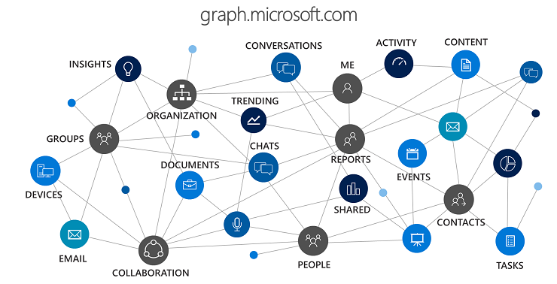
What is Microsoft Graph?
REST API that you can use to interact with data in Microsoft 365
Single Endpoint (https:/graph.microsoft.com)
Allows incoming data delivered from external sources (Box, Google Drive, Jira and Salesforce)
Notes:
So first, What is the Microsoft Graph?
Microsoft Graph is a REST API that we can use to interact with our data that’s in Microsoft 365
REST stands for Representation State Transfer. And a REST API uses HTTP requests to GET, PUT, POST, PATCH, and DELETE data.
We will be learning more those API methods in our upcoming demo
Microsoft 365 is a suite of services that goes from Office 365, so think Exchange Online with email, contacts and calendar. to even Teams, SharePoint, Azure Active Directory, OneDrive, OneNote, Yammer, etc. As well as Enterprise Mobility and Security and even the Windows 10 family of services. All the data that is exposed in those different services, are also exposed within the API.
Microsoft Graph also allows us to bring in 3rd party data with Microsoft Graph Connectors. So we can bring in data from outside vendors like Box, Google Drive, Jira and Salesforce.

Slide 4
What is in Microsoft Graph?
Users
Users
Calendar
Contacts
Directory Objects
Mail
Notes
To-Do Tasks
Org Hierarchy
Outlook Settings
Mail
Drive
Photo
Planner
Teamwork
Folders
Attributes
Events
Presence
Communication
Calls
Call Records
Online Meeting
Presence
Chats
Emails
Reports
Azure AD Activity Reports
Microsoft 365 Usage Reports
Identity and Access Reports
Security
Alerts
Secure Scores
Threat Intelligence Indicators
Security Actions
Information Protection
SharePoint
Sites
Lists
List Items
Subsites
Permissions
Pages
Followed Sites
Drive
Thumbnails
Check in and out files
Restore Item
Download Item
Track Changes
Item Analytics
Drive Items
Child Items
File Properties
Teams
Groups
Members
Chat
Messages
Apps
Calendar
Shifts
Drive
Plans
Notes
Membership
Permissions
Channels
Devices
Application Management
Device Management
Device Configuration
Notes:
Next, what exactly is in Microsoft Graph?
So like I said, anything within the Microsoft 365 suite of products can be found in the Graph API.
We can get events from our users calendars, make changes to those events, and even create new events.
We can view someones organization hierarchy, who their manager is and who reports to them, get their presence information, and even download files from their OneDrive.
We can send also send emails, Teams messages, and view organization security alerts.
Microsoft Graph also includes built in reports out of the box like Azure AD Activity Reports, Microsoft 365 Usage Reports, and Identity and Access Reports.
This list you see here is just a small subset of items that are exposed within the Graph API.

Slide 5
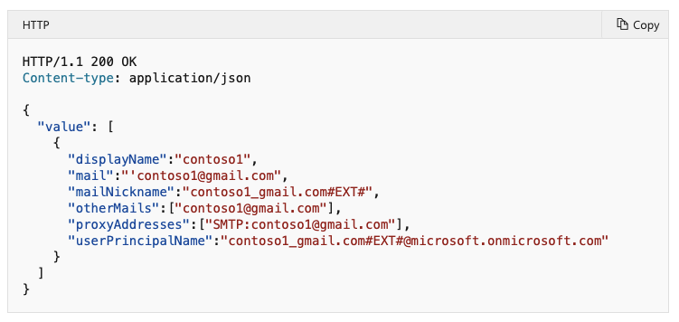
API Reference Docs
API reference docs will show you endpoint, HTTP request, permissions (least to most privileged), request headers, request body, response and Examples
aka.ms/graphapiref
Run query in Graph Explorer with a sample tenant
Notes:
Microsoft provides rich detailed API documentation that lets us see what endpoints we need to send requests to, and also what permissions are needed to make the call. Permissions are always ordered from least privlidged to most privlidged.
We can access the API docs by going to aka.ms/GRAPHapiREF
The documentation also allows us to run sample queries using the Graph explorer that by default uses a sample tenant with test data.
So with talking about the Graph Explorer...lets see what makes it so valuable when working within this API
[NEXT SLIDE]

Slide 6
Graph Explorer
aka.ms/ge
By default, uses a sandbox tenant with sample data
Make API calls, view access token, permissions, responses and more
Perform GET, POST, DELETE, and PATCH
Notes:
The Microsoft Graph explorer is a web-based tool that lets us make requests and see responses against the Microsoft Graph API.
By default is uses a sample tenant that is filled with test data, but we can also sign in and work with data from our own tenant.
We can access the Graph Explorer by going to aka.ms/GE
GO AND DO "GET TASK LISTS IN TO DO"

Slide 7
PowerShell SDK
Provides a convenient way for PowerShell users to call the Graph API
Cmdlets have a prefix of MG (example: Get-MgUser, Connect-MgGraph, Find-MgUserMeetingTime)
Cmdlet follows our verb-noun format
API Query Parameters using –Select Parameter
Notes:
Next, we have the PowerShell SDK
The SDK provides a more powershell friendly way to connect and work within Microsoft Graph
Instead of having to deal with endpoints and API query parameters, we are working with more friendly PowerShell syntax like parameters and cmdlets that do most of the heavy lifting behind the scenes for us.
The SDK cmdlets all have a prefix of MG, this was chosen so none of the cmdlets clashed with any others from other PowerShell modules.

Slide 8
Invoke-RestMethod
Introduced in Windows PowerShell 3.0
Can Interact with the API directly without having to wait for SDK updates
Full detailed documentation with the API ref
Converts JSON to friendly PowerShell Objects
Notes:
A more traditional method of connecting and working with APIs is Invoke-RestMethod.
A benefit of using Invoke-RestMethod cmdlet is Once you learn how to use Invoke-RestMethod, you can use it on other RESTful API’s. No need to figure out what cmdlets to use or parameters like with an SDK.
You Just need to look at the endpoints and permissions required
When new items are added to the API you dont need to wait for the SDK to finish adding the new functionality and rolling it out. You can begin working with it immediately.
And with that, lets get started on a demo and dig into the actual code!

Slide 9
Demo!

Slide 10

Connect
GitHub: github.com/bwya77/PowerShellSummit
Twitter: @bwya77
Blog: TheLazyAdministrator.com
Email: brad@thelazyadministrator.com

Slide 11
Thank You!

