Slide 1
Navigate the Microsoft Graph API with PowerShell
Bradley Wyatt
Manager DevOps Cloud Automation @ BDO Digital
Author at The Lazy Administrator
Microsoft MVP
Notes:
Welcome to Navigate the Microsoft Graph API with PowerShell
My name is Bradley Wyatt
I am a Manager of DevOps Cloud Automation at BDO Digital. I also blog on my Website, The Lazy Administrator where I write about many different topics but mostly PowerShell.
And finally, I am a Microsoft MVP in Cloud and Datacenter Management
So with that, lets get started

Slide 2
Agenda
What is Microsoft Graph
What is in Microsoft Graph
API Reference Docs
Graph Explorer
PowerShell SDK
Invoke-RestMethod and the Graph API
Notes:
Todays agenda, first we will go over What is the Microsoft Graph. Why should we use it and how is it valuable to me and my company.
Next, we will then discover what kinds of data can be found in Microsoft Graph.

Slide 3
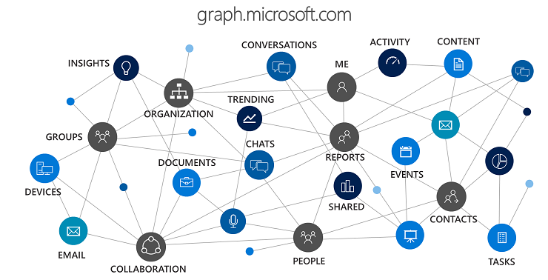
What is Microsoft Graph?
REST API that you can use to interact with data in Microsoft 365
Single Endpoint (https:/graph.microsoft.com)
Allows incoming data delivered from external sources (Box, Google Drive, Jira and Salesforce)
Notes:
Microsoft Graph is a REST API that we can use to interact with our data that’s in Microsoft 365
REST stands for Representation State Transfer. And a REST API uses HTTP requests to GET, PUT, POST, PATCH, and DELETE data.
Microsoft 365 is a suite of services that goes from Office 365, so Exchange Online with email, contacts and calendar. Teams, SharePoint, Azure Active Directory, OneDrive, OneNote, Yammer, and so on. As well as Enterprise Mobility and Security and even the Windows 10 family of services. All the data that is exposed in those different services, are also exposed within the API.
Microsoft Graph also allows us to bring in 3rd party data with Microsoft Graph Connectors. 864553 5390

Slide 4
What is in Microsoft Graph?
Users
Users
Calendar
Contacts
Directory Objects
Mail
Notes
To-Do Tasks
Org Hierarchy
Outlook Settings
Mail
Drive
Photo
Planner
Teamwork
Folders
Attributes
Events
Presence
Communication
Calls
Call Records
Online Meeting
Presence
Chats
Emails
Reports
Azure AD Activity Reports
Microsoft 365 Usage Reports
Identity and Access Reports
Security
Alerts
Secure Scores
Threat Intelligence Indicators
Security Actions
Information Protection
SharePoint
Sites
Lists
List Items
Subsites
Permissions
Pages
Followed Sites
Drive
Thumbnails
Check in and out files
Restore Item
Download Item
Track Changes
Item Analytics
Drive Items
Child Items
File Properties
Teams
Groups
Members
Chat
Messages
Apps
Calendar
Shifts
Drive
Plans
Notes
Membership
Permissions
Channels
Devices
Application Management
Device Management
Device Configuration

Slide 5
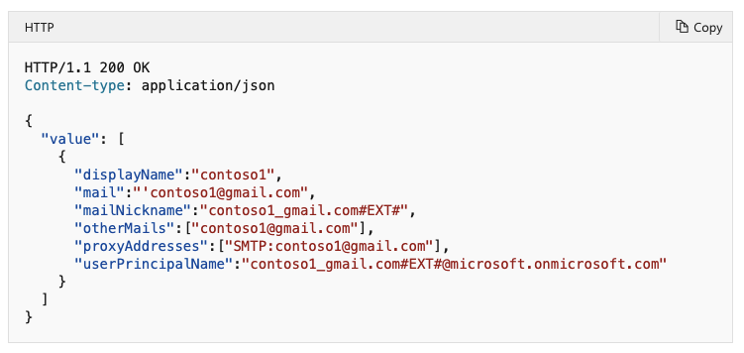
API Reference Docs
API reference docs will show you endpoint, HTTP request, permissions (least to most privileged), request headers, request body, response and Examples
aka.ms/graphapiref
Run query in Graph Explorer with a sample tenant
Notes:
List users - Microsoft Graph v1.0 | Microsoft Docs

Slide 6
Graph Explorer
aka.ms/ge
By default, uses a sandbox tenant with sample data
Make API calls, view access token, permissions, responses and more
Perform GET, POST, DELETE, and PATCH
Notes:
The Microsoft Graph explorer is a tool that lets you make requests and see responses against the Microsoft Graph API. By default is uses a sample tenant that is filled with sample data you can work against, but you can also sign in and work with data from your tenant.
List users - Microsoft Graph v1.0 | Microsoft Docs

Slide 7
PowerShell SDK
Provides a convenient way for PowerShell users to call the Graph API
Cmdlets have a prefix of MG (example: Get-MgUser, Connect-MgGraph, Find-MgUserMeetingTime)
Cmdlet follows our verb-noun format
API Query Parameters using –Select Parameter
Notes:
The Microsoft Graph explorer is a tool that lets you make requests and see responses against the Microsoft Graph API. By default is uses a sample tenant that is filled with sample data you can work against, but you can also sign in and work with data from your tenant.
List users - Microsoft Graph v1.0 | Microsoft Docs

Slide 8
Invoke-RestMethod
Notes:
The Microsoft Graph explorer is a tool that lets you make requests and see responses against the Microsoft Graph API. By default is uses a sample tenant that is filled with sample data you can work against, but you can also sign in and work with data from your tenant.
List users - Microsoft Graph v1.0 | Microsoft Docs

Slide 9
Thank You!

