Slide 1

Unified Tenant Configuration Management APIs in Microsoft Graph
Bradley Wyatt

Slide 2
About Me
6x Microsoft MVP in Azure and Microsoft 365
Blog at The Lazy Administrator
Co-Organizer of the Chicago PowerShell Users Group
Co-Organizer of the Chicago PowerShell Conference
Given talks at PowerShell & DevOps Global Summit, Microsoft Technology Center, and many other user groups.

Slide 3
Agenda
What is UTCM and why is it important
Current limitations
Supported Workloads
The Five APIs that make up UTCM
Future state / roadmap
Management and Configuration

Slide 4
What is UTCM and why is it important

Slide 5
What is UTCM and why is it important
Set of API’s to help admins monitor and alert on configuration changes across one or more workloads within an organization.
Maintain a secure and consistent tenant configuration
Easily extract and understand current configuration states, great for auditing, reviews or troubleshooting
Notes:
As the Microsoft 365 ecosystem grows, keeping tenant settings aligned with the desired configuration of an organization becomes increasingly complex.
The TCM APIs enable automated monitoring of tenant settings. You can ensure your configurations remain secure and consistent, and quickly identify any deviations from the desired state.
The snapshot APIs in TCM simplify the process of retrieving the current configuration across multiple workloads within a tenant. Administrators can use these snapshots to get a clear, declarative view of how settings are currently applied, which makes audits, reviews, and troubleshooting much easier.
Very similar to DSC

Slide 6


What is UTCM and why is it important
Microsoft365 DSC: PowerShell based, led by Microsoft engineers and maintained by the community.
Inforcer: Great paid product, more mature and feature filled.
CIPP: New in v8.3, Runs every 12hrs
Notes:
Microsoft DSC is a little more complex or involved but it also allows you to compare configurations of 2 or more tenants

Slide 7
Current Limitations

Slide 8
Current Limitations
Currently in Beta, subject to change
Monitor only, does not auto-resolve
Create the UTCM service principal and assign permissions
Limit | Value
Monitors per tenant | 30
Daily monitored resources | 800
Monitoring cycle interval | 6 hours
Visible snapshot jobs | 12
Snapshot retention | 7 days
Notes:
https://graph.microsoft.com/beta

Slide 9
Supported Workloads

Slide 10
Supported Workloads
Microsoft Entra
Exchange Online
Microsoft Intune
Microsoft Defender
Microsoft Purview
Microsoft Teams
Notes:
TODO: LETS ADD EXAMPLES TO EACH

Slide 11
The Five APIs that make up UTCM

Slide 12
Snapshot
Extract the current tenant configuration settings. This process allows administrators to get a baseline that represents the desired tenant configuration and serves as the foundation for periodic tenant monitoring.
Resource: configurationSnapshots
What it does:
Captures the current state of your tenant.
Used to:
Build baselines
Compare against future state
Think: “What does my environment look like right now?”

Slide 13
Snapshot
@baseUrl = https://graph.microsoft.com/beta
@access_token = YOUR_ACCESS_TOKEN_HERE
POST {{baseUrl}}/admin/configurationManagement/configurationSnapshots/createSnapshot
Content-type: application/json
Authorization: Bearer {{access_token}}
{
"displayName": "Snapshot Demo",
"description": "This is Snapshot Description",
"resources": [
"microsoft.entra.user"
]
}
Notes:
Take a snapshot of my Entra User configuration including group membership

Slide 14
Snapshot
{"resources": [
{
"displayName": "AADUser-Harry Potter",
"resourceType": "microsoft.entra.user",
"properties": {
"LastName": "Potter",
"UserPrincipalName": "HPotter@aliciamarie.net",
"PasswordNeverExpires": false,
"Ensure": "Present",
"DisplayName": "Harry Potter",
"UserType": "Member",
"FirstName": "Harry",
"Department": "IT",
"LicenseAssignment": [],
"Roles": []
}
},
{
"displayName": "AADUser-William Cool",
"resourceType": "microsoft.entra.user",
"properties": {
"Department": "IT",
"LastName": "Cool",
"UserPrincipalName": "WCool@thelazyadministrator.com",
"PasswordNeverExpires": false,
"Ensure": "Present",
"DisplayName": "William Cool",
"UserType": "Member",
"UsageLocation": "US",
"FirstName": "William",
"LicenseAssignment": [
"FLOW_FREE"
],
"Roles": []
}
},

Slide 15
Baseline
Represents a resource and its desired configuration
Often built from a snapshot
Can also be manually defined
Resource: configurationMonitors/[id]/baseline
What it does:
Defines the desired state
Often built from a snapshot
Used to:
Defines the desired state of your tenant (your “gold standard” config).
Think: “What should my environment look like?”
Notes:
https://learn.microsoft.com/en-us/graph/api/resources/configurationbaseline?view=graph-rest-beta

Slide 16
Baseline
{
"@odata.context": "https://graph.microsoft.com/beta/$metadata#admin/configurationManagement/configurationMonitors('fb708914-be65-4fda-a01e-77c4b2b7c403')/baseline/$entity",
"id": "5fccac97-3903-40ac-9293-dcc95912f7c1",
"displayName": "Demo Baseline",
"description": "This is a baseline with User resources",
"parameters": [],
"resources": [
{
"displayName": "Config Drift Bradley Wyatt Entra User",
"resourceType": "microsoft.entra.user",
"properties": {
"DisplayName": "Bradley Wyatt",
"UserPrincipalName": "brad@thelazyadministrator.com",
"Ensure": "Present",
"LicenseAssignment": [
"Microsoft_365_E5_(no_Teams)"
],
"Roles": [
"Global Administrator"
]
}
}
]
}
Notes:
https://learn.microsoft.com/en-us/graph/api/resources/configurationbaseline?view=graph-rest-beta

Slide 17
Monitors
Monitors the resources current configuration and compares it to the desired (from the baseline) configuration.
Runs every 6 hours
Compares current state to baseline
Resource: configurationMonitors
What it does:
Runs recurring checks (every 6 hours) comparing:
Baseline vs Current config
Used to:
Monitor resource configurations
Think: “Does the current resource configuration match the desired configuration”

Slide 18
Monitors
@baseUrl = https://graph.microsoft.com/beta
@configurationMonitor_id = fb708914-be65-4fda-a01e-77c4b2b7c403
@access_token = {{accessToken}}
GET {{baseUrl}}/admin/configurationManagement/configurationMonitors/{{configurationMonitor_id}}
Authorization: Bearer {{access_token}}

Slide 19
Monitors
{
"id": "fb708914-be65-4fda-a01e-77c4b2b7c403",
"displayName": "Demo Monitor",
"description": "This is a Demo Monitor for Entra Users",
"tenantId": "6438b2c9-54e9-4fce-9851-f00c24b5dc1f",
"status": "active",
"monitorRunFrequencyInHours": 6,
"mode": "monitorOnly",
"createdDateTime": "2026-01-27T20:18:25.8899114Z",
"lastModifiedDateTime": "2026-01-28T02:30:42.1846562Z",
"runAsUTCMServicePrincipal": true,
"inactivationReason": null,
"createdBy": {
"user": {
"id": null,
"displayName": null
},
"application": {
"id": "584fce90-fe3e-4795-8d3e-2c8c1487ac2c",
"displayName": "584fce90-fe3e-4795-8d3e-2c8c1487ac2c"
}
},
"runningOnBehalfOf": {
"user": null,
"application": {
"id": "03b07b79-c5bc-4b5e-9bfa-13acf4a99998",
"displayName": "Unified Tenant Configuration Management"
}
},
"lastModifiedBy": {
"user": {
"id": null,
"displayName": null
},
"application": {
"id": "584fce90-fe3e-4795-8d3e-2c8c1487ac2c",
"displayName": "584fce90-fe3e-4795-8d3e-2c8c1487ac2c"
}
},
"parameters": {}
}

Slide 20
Monitoring Results
Allows administrators to view monitor run details. They can determine whether the monitor is running successfully. If it isn't, they can identify the reasons for the failure. The resource also reports the number of drifts found in each monitor run.
Resource: configurationMonitoringResults
What it does:
Stores results from monitor runs:
What was checked
What passed/failed
Used to:
Review a resources current and expected properties
Think: “What happened during each scan?”

Slide 21
Monitoring Result
@baseUrl = https://graph.microsoft.com/beta
@configurationMonitoringResult_Id = ae0dc157-6377-4be8-ba49-60ce49481c6d
@access_token = {{accessToken}}
GET {{baseUrl}}/admin/configurationManagement/configurationMonitoringResults/{{configurationMonitoringResult_Id}}
Authorization: Bearer {{access_token}}

Slide 22
Monitoring Result
{
"@odata.context": "https://graph.microsoft.com/beta/$metadata#admin/configurationManagement/configurationMonitoringResults/$entity",
"id": "ae0dc157-6377-4be8-ba49-60ce49481c6d",
"monitorId": "fb708914-be65-4fda-a01e-77c4b2b7c403",
"tenantId": "6438b2c9-54e9-4fce-9851-f00c24b5dc1f",
"runInitiationDateTime": "2026-03-19T12:01:28.3040728Z",
"runCompletionDateTime": "2026-03-19T12:04:01.276011Z",
"runStatus": "successful",
"driftsCount": 1,
"driftsFixed": 0,
"runType": "monitor"
}

Slide 23
Drifts
Allows admins to get granular details about all active drifts across all existing monitors.
Resource: configurationDrifts
What it does:
Extracted from monitoring results
Only Includes:
Failures / deviations
Used to:
Show you properties that do not match our desired value
Think: “What’s wrong right now”

Slide 24
Drifts
@baseUrl = https://graph.microsoft.com/beta
@configurationDrift_Id = 1e7e0347-e7a5-4294-abab-c28b52e889e7
@access_token = {{accessToken}}
GET {{baseUrl}}/admin/configurationManagement/configurationDrifts/{{configurationDrift_Id}}
Authorization: Bearer {{access_token}}

Slide 25
Drifts
{
"@odata.context": "https://graph.microsoft.com/beta/$metadata#admin/configurationManagement/configurationDrifts/$entity",
"id": "1e7e0347-e7a5-4294-abab-c28b52e889e7",
"monitorId": "fb708914-be65-4fda-a01e-77c4b2b7c403",
"tenantId": "6438b2c9-54e9-4fce-9851-f00c24b5dc1f",
"resourceType": "microsoft.entra.user",
"baselineResourceDisplayName": "Config Drift Bradley Wyatt Entra User",
"firstReportedDateTime": "2026-03-03T06:02:05.3556422Z",
"status": "active",
"resourceInstanceIdentifier": {
"UserPrincipalName": "brad@thelazyadministrator.com"
},
"driftedProperties": [
{
"propertyName": "LicenseAssignment",
"currentValue": [
"CCIBOTS_PRIVPREV_VIRAL",
"Microsoft_365_E5_(no_Teams)"
],
"desiredValue": [
"Microsoft_365_E5_(no_Teams)"
]
}
]
}

Slide 26
Future State

Slide 27
Future State
Come out of Beta
Auto creation of the service principal
Auto-remediation
More schedules besides every 6hrs
Increase monitors per tenant from 30
Alerting or notifications

Slide 28
Management & Configuration

Slide 29
Management and Configuration
TenantBaseline PowerShell Module
REST Clients (VSCode REST Client, Postman, etc)
Microsoft Graph PowerShell SDK

Slide 30
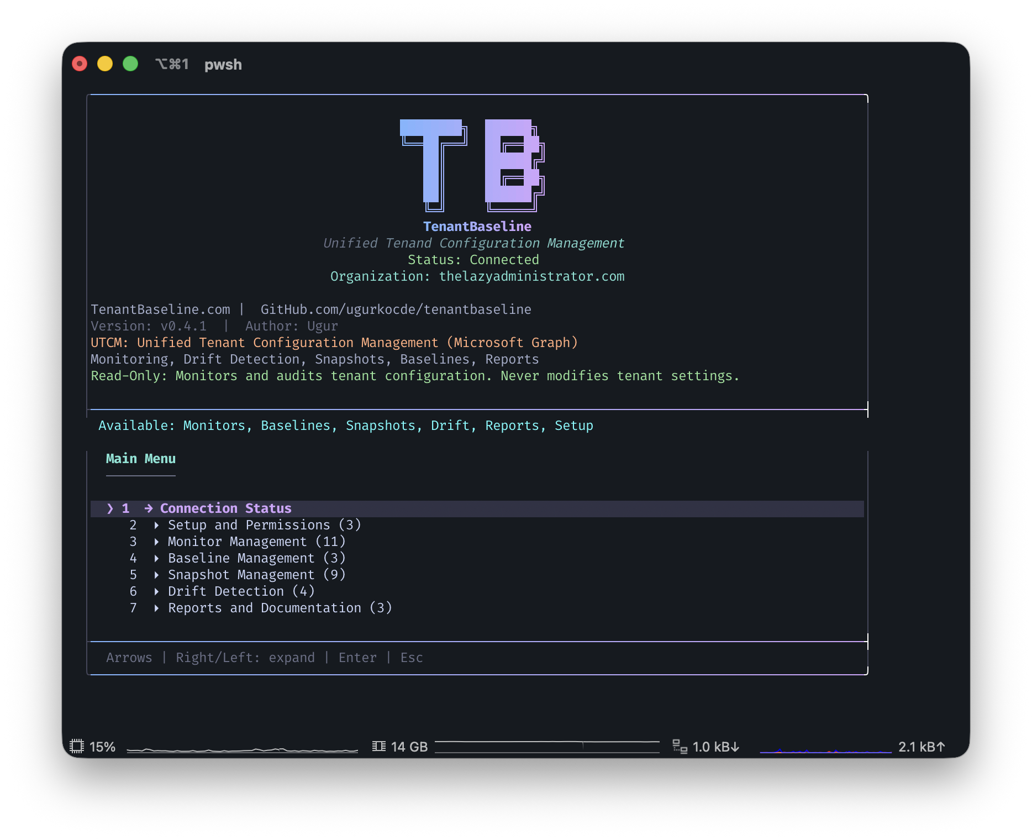
Management and Configuration
Import/Export Configurations
Create Dashboards
Create monitors based on Maester
Auto set up permissions
Integrate with Automation
Clone monitors

Slide 31
Management and Configuration
Github.com/bwya77/UTCM_Presentation
https://office365itpros.com/2026/02/03/utcm-beta/

Slide 32
Thank You

