Slide 1

AndroCop: One click forensic investigation &
data extraction tool
Abhinand N | Aswin M Guptha | Varun Nair
Traboda CyberLabs

Slide 2

Introduction
1. Forensic Analysis
Enables to gain various insights from the data available from the device automatically
Making the process of data extraction &
forensic investigation
on Android
phones easier
2. Data Extraction
Extract from various data sources. Export necessary data in multiple ways
3. Compatible
Devices running Android 6 Marshmellow and above. Supports almost all vendor OEMs such as Samsung, Xiaomi, OPPO, Pixel etc.

Slide 3
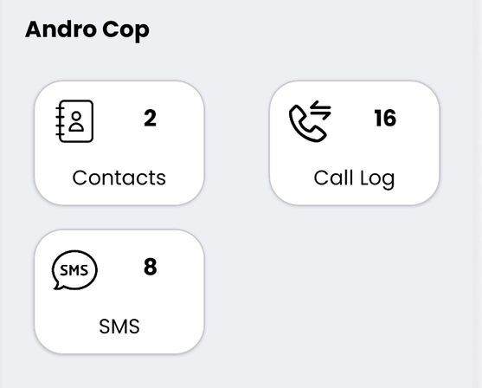
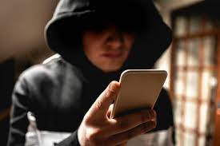
Streamline the process
eliminating the need for external utilities
Process
Install the application on a device.
Provide necessary permission to retrieve data.
View samples of relevant data.
Export what is needed in multiple formats.
AndroCop can process a wide range of data, thereby eliminating the need to rely on manual forensic analysis

Slide 4
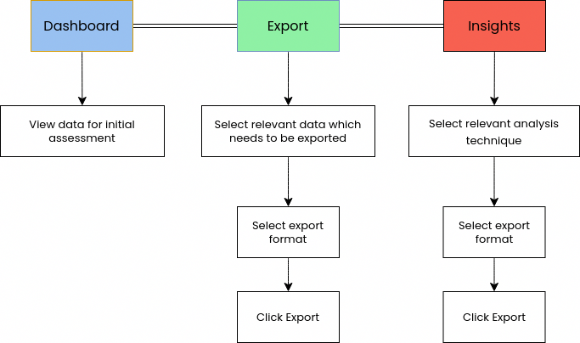
Userflow

Slide 5



Export As?
per your analysis requirement
PDF / XLSX
Images and videos will be exported as ZIP file
Saved to AndroCop folder in Internal Storage

Slide 6
What to export?
Call History
Call history with details such as call type (incoming, outgoing or missed call), number, date, time, duration etc
Text messages
Details of messages send and received including message content, date and time, sending application etc.
Contacts
Name, number and associated email address
Device Information
Device name, model, Android version, Android ID, manufacturer details, build number etc.

Slide 7
What to export?
Media & Screenshots
Images and videos taken with the phones camera. Screenshots taken by the user from the phone
Accounts
Information about accounts such as Social media, email etc
Installed apps
Third party apps installed by the user
App Usage Statistics
Usage time of each application, last used time etc

Slide 8
Insights
Find close contacts
With the number of incoming and outgoing call, find out who contacted the most and least
Folder Structure
Folder tree structure of the internal storage
Visited locations
Possible location of the phone user using geo tags

Slide 9
DEMO

Slide 10
Future Work
Incorporating ML models
Adding ML models for various analysis and classifications of images such as drugs, crime scenes etc
Forensics framework
Convert the tool into a full-fledged forensics framework
Locked device support
Add support to unlock devices with PIN bruteforce

Slide 11
Thank you!
For queries contact: abhinand@traboda.com

