Slide 1
ALPHA MODEL WITH
CNN-LSTM-Attention
Professional Backtesting & Alpha Signal Generation on S&P 500
ELENE 4904 — Statistical Learning in Quantitative Trading
Group 9 | April 28, 2026

Slide 2
AGENDA
01
Project Overview & Motivation
05
Backtesting Framework
Why alpha factors? Why deep learning on equities?
Long-short construction · risk budgeting · transaction costs
02
Data & Feature Engineering
06
Performance Metrics & Results
S&P 500 universe · 24 alpha features · cross-sectional normalization
Period · trade · risk/exposure metrics · IC analysis
03
Model Architecture: CNN-LSTM-Attention
07
Further Studies & Improvements
LSTM theory – CNN-LSTM rationale – architecture walkthrough
Identified weaknesses · proposed enhancements
04
Training & Baselines
Ridge regression · XGBoost · momentum · mean reversion

Slide 3
Project Overview & Motivation
The Alpha Generation Problem
What We Built
Markets are informationally competitive — pure price prediction is near-impossible
Cross-sectional alpha: rank stocks by expected relative return, not absolute
Classic factors (momentum, value) have decayed — ML can discover non-linear combinations
Challenge: overfitting, lookahead bias, transaction costs erode edge
496 S&P 500 stocks, 10+ years of data
24 engineered alpha features
CNN-LSTM-Attention neural network
Full long-short portfolio backtest
Risk budgeting + transaction cost model
Benchmarks: Ridge, XGBoost, Momentum, Mean Reversion
496
24
10+
~1.1M
Stocks in Universe
Alpha Features
Years of Data
Training Sequences

Slide 4
Data & Feature Engineering
Returns
Volatility
Price / Technical
Volume / Liquidity
ret_1d, ret_5d, ret_10d
ret_21d, ret_63d
excess_ret_1d/5d vs SPY
ret_5d/21d/63d cross-rank
vol_5d, vol_21d, vol_63d
vol_21d cross-sectional z
vol_21d_rank (percentile)
beta_63 vs SPY
price_to_sma_10/21/63
Cross-sectional z-score
daily_range, close_position
close_open_ret
volume_chg_1d
volume_to_sma_21
dollar_volume_to_sma_21
dollar_volume_sma_21
Target: 5-day forward return with 1-day execution lag | Normalization: StandardScaler fit on train set only · Cross-sectional z-score at each date

Slide 5
Model Architecture: CNN-LSTM-Attention
Input
Conv1D
LSTM
Attention
Dense
Output
60 × 24
(lookback × features)
32 filters, kernel=3
ReLU + LayerNorm
64 units
return_sequences=True
Dropout 0.2
Dense(1) + tanh
Softmax weights
Weighted sum
32 units, Swish
Dropout 0.1
1 (predicted
alpha score)
▶
▶
▶
▶
▶
Design Rationale
◈ Conv1D captures local short-term patterns in the 60-day sequence (momentum pulses, volatility regimes)
◈ LSTM retains long-range temporal dependencies — remembers context from weeks ago
◈ Attention mechanism weights each time step differently, highlighting the most predictive days in the lookback window
◈ Huber loss (δ-insensitive) reduces sensitivity to outlier return observations common in equity data
◈ Adam optimizer (lr=0.0005) + EarlyStopping (patience=5) prevents overfitting to train set

Slide 6
LSTM & CNN-LSTM Theory — Why It Fits This Project
What an LSTM Adds
Why CNN + LSTM + Attention?
Memory cell: keeps useful information across many trading days
Input / forget gates: decide what new signals to store and what stale signals to drop
Output gate: translates the hidden state into today’s alpha score
Conv1D: detects local motifs: price bursts, volatility spikes, reversal patterns
LSTM: models how those motifs persist or fade through the 60-day window
Attention: lets the model focus on the most relevant days instead of treating all days equally
xₜ
→
gates
→
cₜ / hₜ
→
score
Fit for this project: equity alpha is sequential, noisy, non-linear, and regime-dependent — exactly the setting where sequence models can improve on one-day tabular regressions.

Slide 7
Training Setup & Baseline Models
Train
Validation
Test (OOS)
Jan 2014 – Dec 2020
Jan 2021 – Dec 2022
Jan 2023 – Apr 2026
773,072 sequences
218,521 sequences
379,241 sequences
Baseline Models Compared
CNN-LSTM Training Details
Ridge Regression
α=10
Epochs: 30 max (early stop at epoch 6, best: epoch 1)
Batch size: 512 · Optimizer: Adam (lr=0.0005)
Loss: Huber · EarlyStopping patience=5
Train loss went from 0.356 → 0.340 (epoch 6)
Val loss: 0.372 at epoch 1 (best) — overfits quickly
Input shape: (batch, 60 timesteps, 24 features)
Tabular (last timestep only) · linear baseline
XGBoost / HistGBR
n=400
Gradient boosted trees on tabular features
Momentum
21d ret
Buy past winners — classical factor
Mean Reversion
−5d ret
Buy past losers — contrarian factor

Slide 8
Rank IC Diagnostics — Signal Quality
Rank IC = Spearman correlation between predicted and realized 5-day returns, computed cross-sectionally each day
Metric | CNN-LSTM-Attn | Ridge | XGBoost | Momentum | Mean Rev.
Mean Rank IC | 0.0362 ★ | 0.0109 | 0.0223 | −0.0004 | 0.0006
IC Std | 0.1831 | 0.1812 | 0.1542 | 0.1792 | 0.1683
IC t-stat | 5.46 ★ | 1.66 | 4.00 | −0.06 | 0.10
Positive IC % | 57.0% ★ | 51.2% | 54.1% | 51.6% | 47.4%
IC Count | 765 | 765 | 765 | 825 | 825
Key Takeaways
CNN-LSTM has the strongest ranking signal in the test period: IC t-stat 5.46
Ridge is marginal; XGBoost is solid, indicating non-linear structure in the features
Momentum and mean reversion are near zero in this setup
Important: Rank IC measures cross-sectional signal quality, not pure portfolio alpha

Slide 9
Backtesting Framework
Signal Generation
Normalization
1
4
Model predicts 5-day alpha score for every stock each rebalance day
Iterative capping-and-renormalization
Dollar-balanced, but beta still monitored
Stock Selection
Transaction Costs
2
5
Long: top 10% by predicted score
Short: bottom 10% by predicted score
0.1% one-way on all weight changes
Rebalance every 5 trading days
Risk-Weighted Sizing
P&L Attribution
3
6
Weight = 1 / vol_21d
Cap at MAX_POSITION = 8% per stock
Per stock contribution tracked
Sector, beta, long/short decomposition

Slide 10
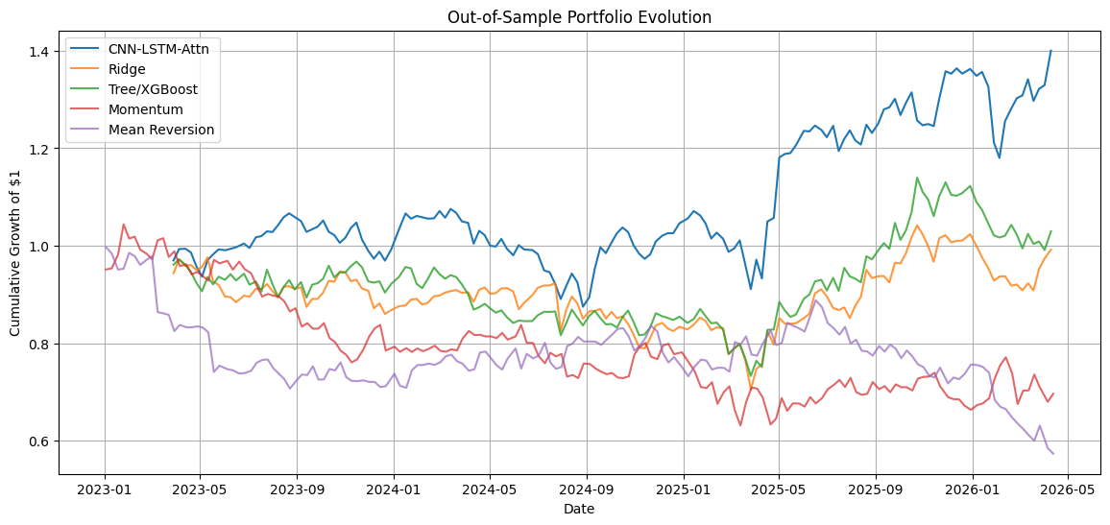
Out-of-Sample Portfolio Evolution (2023–2026)
+40.0%
11.7%
0.61
vs weak baselines
Total Return (CNN-LSTM)
Annualized Return
Sharpe Ratio
Baselines Underperform

Slide 11
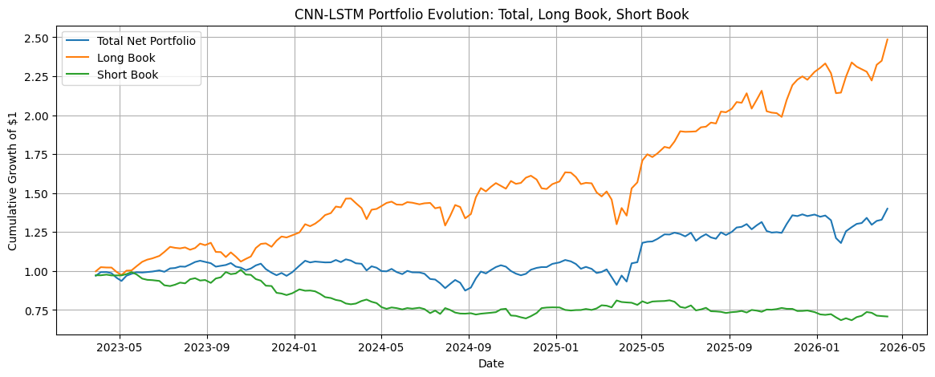
Long / Short Book Decomposition
Interpretation
Long book is the main return driver, especially during the 2025 growth/technology rally. The short book is less consistent, so the result should be interpreted as a strong ranking signal with room for better beta and sector control.

Slide 12
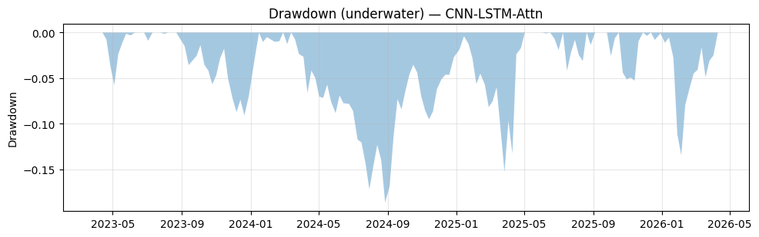
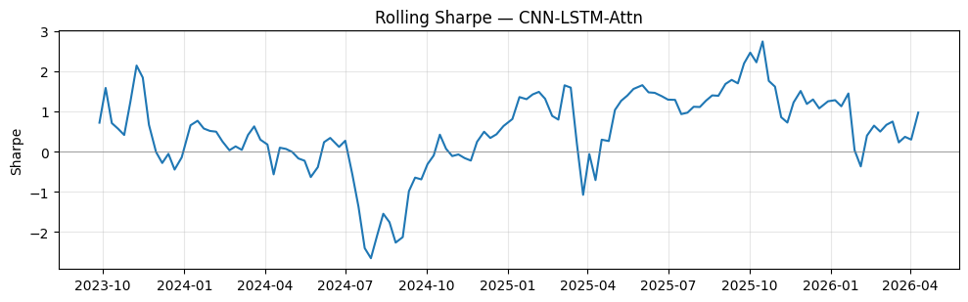
Drawdown & Rolling Sharpe Ratio
−18.7%
248 days
0.63
1.17
−18.7%
Max Drawdown
248 days
Recovery Period
0.63
Calmar Ratio
1.17
Sortino Ratio
Max Drawdown
Recovery Period
Calmar Ratio
Sortino Ratio

Slide 13
Comprehensive Performance Metrics
§ Period Metrics
§ Trade Metrics
§ Risk / Exposure
Metric | Value
Total Return | 40.0%
Ann. Return | 11.7%
Ann. Volatility | 19.3%
Sharpe Ratio | 0.67
Sortino Ratio | 1.17
Max Drawdown | −18.7%
Calmar Ratio | 0.63
Skewness | 0.89
Excess Kurtosis | 4.39
Ulcer Index | 0.059
Metric | Value
# Trades | 3,478
Win Rate | 54.9%
Avg Win | +0.163%
Avg Loss | −0.156%
Win / |Loss| | 1.045x
Profit Factor | 1.271
Avg Hold (days) | 29.8
Avg Turnover | 1.77x
Metric | Value
Gross Exposure | 2.0x
Net Exposure | ≈ 0
Net Beta | 0.519
HHI Conc. | 0.021
Top-5 Share | 19.8%
Ann. Alpha | 13.2%
Track. Error | 23.4%
VaR 95% | −3.65%
CVaR 95% | −5.10%

Slide 14
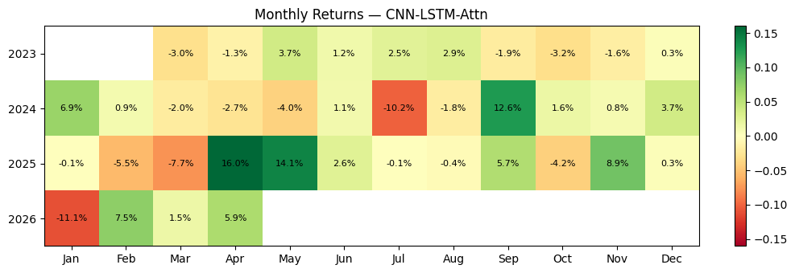
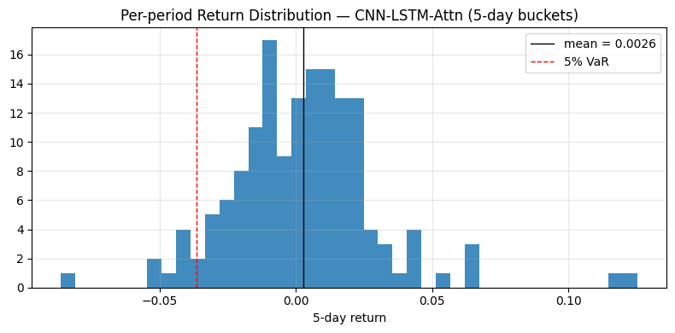
Monthly Returns Heatmap & Distribution
Observations
2025 was the strongest year — Sharpe ≈ 1.28
Jan 2026 drawdown was quickly followed by recovery
Distribution is positively skewed but fat-tailed
Most losses cluster near the 5% VaR line

Slide 15
Sector Attribution & Top Ticker P&L
Most Held Stocks
Ticker | Times Held | Cum. PnL
CVNA | 137 | +1.95%
PLTR | 128 | +1.65%
APP | 124 | +1.98%
FIX | 106 | +4.21%
FSLR | 93 | +2.80%
MU | 80 | +3.31%
MRNA | 84 | −2.71%
FISV | — | −3.29%
Key Insight: Information Technology is the largest P&L contributor, but this also reveals sector concentration. A production version should add sector-neutral constraints before claiming pure alpha.

Slide 16
Feature Importance Analysis
Takeaway: Volatility, excess-return, and cross-sectional momentum variables carry most of the signal in the baselines. This supports the idea that the neural model is learning non-linear versions of economically meaningful factors.

Slide 17
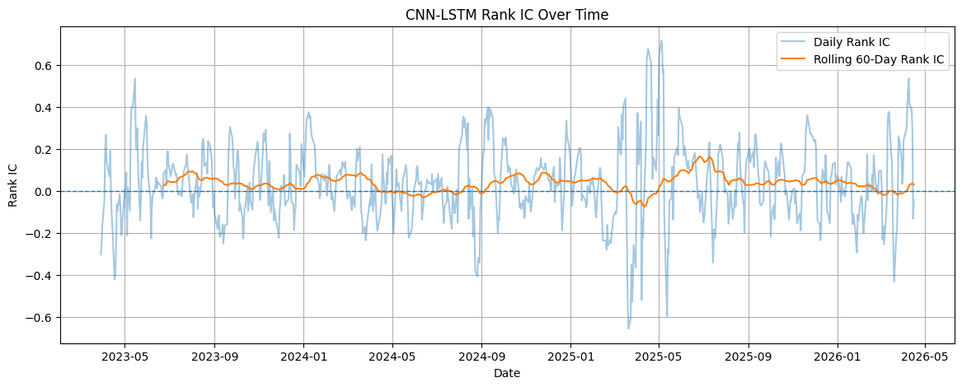
Yearly Performance & Rank IC Over Time
Annualized portfolio performance by year
Year | Ann. Return | Ann. Vol | Sharpe | Max DD | Hit Rate
2023 | -0.96% | 12.0% | -0.08 | -9.1% | 56.4%
2024 | +5.44% | 16.6% | 0.33 | -18.7% | 44.0%
2025 | +30.5% | 23.9% | 1.28 | -15.0% | 58.0%
2026 YTD | +10.3% | 26.8% | 0.39 | -13.0% | 64.3%
Rank IC over time: signal quality is persistent but noisy
Takeaway
• 2025 is the strongest year.
• Positive OOS result is not uniform over time.
• Rank IC confirms a real ranking signal, but it still needs risk controls.

Slide 18
Further Studies & Research Diagnostics
Overfitting (Early Stop at Epoch 1)
→ Stronger regularization (L2 weight decay, more Dropout), smaller LSTM, reduce lookback from 60→30
⚠ Val loss rises immediately — model generalizes poorly on longer sequences
Net Beta ≈ 0.52 (Not Market-Neutral)
→ Explicitly hedge residual beta using SPY futures overlay; add beta_63 constraint to optimizer
⚠ Portfolio carries unintended long-market exposure, especially in 2026
Negative Information Ratio (−0.28)
→ Re-define target as market-residual return (alpha); add macro regime signal (VIX, yield curve) as features
⚠ Benchmark-adjusted performance is weaker than raw total return
IT Sector Concentration
→ Add sector-neutral constraint: enforce equal gross exposure per GICS sector
⚠ 38.6% of PnL from tech alone — sector risk not diversified
High Kurtosis / Fat Tails (4.4)
→ Train with CVaR-adjusted loss; implement position circuit breakers during high-volatility regimes
⚠ Occasional extreme loss events — VaR/CVaR may underestimate tail risk

Slide 19
CONCLUSIONS
CNN-LSTM-Attention Finds
a Strong OOS Ranking Signal
✓ IC t-stat of 5.46 shows statistically meaningful cross-sectional ranking power
✓ 40% total return, 11.7% annualized, Sharpe 0.61 over the OOS period
✓ Portfolio result is positive, but not yet cleanly beta-neutral or sector-neutral
✓ CNN-LSTM outperforms simple factor baselines in this experimental setup
✓ Main next step: market-residual target + beta/sector constraints + stronger validation
ELENE 4904 · Group 9 · April 28, 2026

