Slide 1
Prediction of Lab Origins From Feature Analysis of Sequencing Read Data
———Bowen Xue/Andy Lin/Fan Zhang

Slide 2
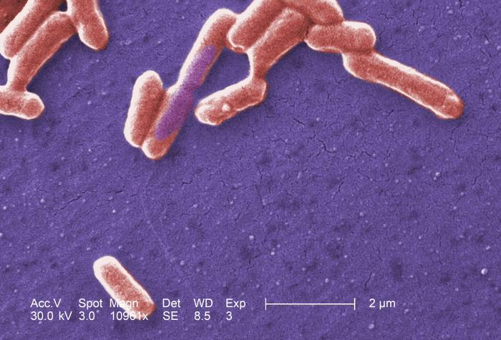
Background
For forensic investigation, it’s important to determine where a DNA sample was sequenced
Datasets from different sequencing institutions may have informative features which makes it possible to use machine learning to do the classification
We will focus on institutions that have sequenced E.coli using Illumina MiSeqs

Slide 3
Project Scheme
Target: Classification From Feature Analysis of The Reads Data
Data: Sequence Read Archive (SRA) database hosted by the National Center for Biotechnology Information (NCBI).
Raw Data: 359 fastQ datasets, each with around 200-500M bases.

Slide 4
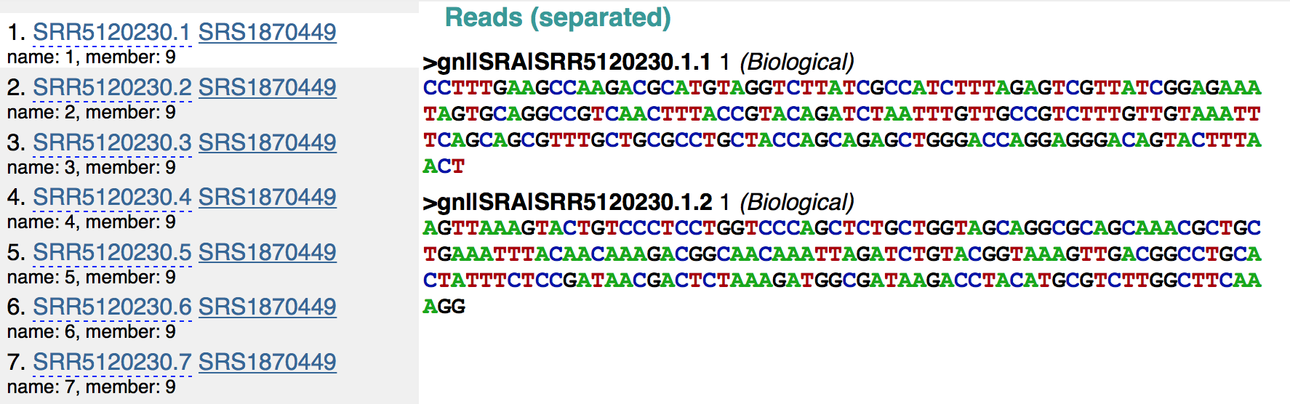

Slide 5
Project Scheme
Target: Classification From Feature Analysis of The Reads Data
Data: SRA
Features: three types of features were taken into account
1. Distribution of fragment size (length of the reads)
2. 4-mers with/without N (5^4=625)
3. Distribution of quality scores

Slide 6
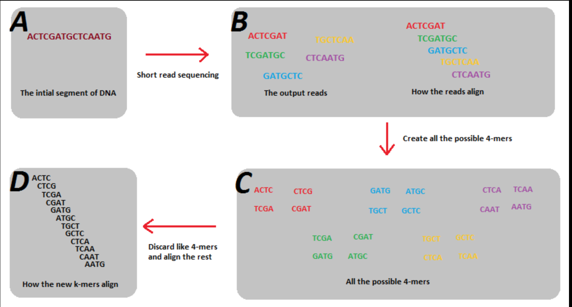
intro to 4-mers:
4^4=256 without N
5^4=625 with N

Slide 7
Project Scheme
Target: Classification From Feature Analysis of The Reads Data
Data:
Features: three types of features taken into account
1. length of the reads
2. 4-mers (5^4=625)
3. quality scores distribution

Slide 8
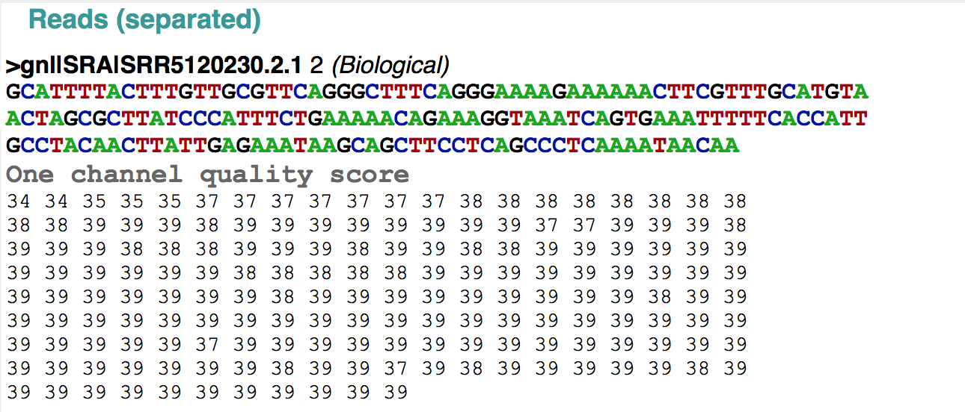
Quality distribution

Slide 9
Project Scheme
Target: Classification From Feature Analysis of The Reads Data
Data: SRA
Features: three types of features
Methodology: 60% train, 20% validation, 20% test
1. Supervised learning: Logistic regression & SVM
2. Semi-supervised learning: Graphcut & Kmean++

Slide 10
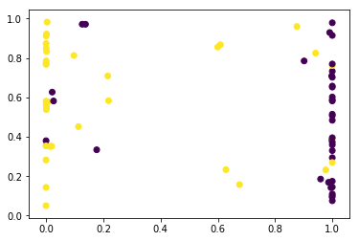
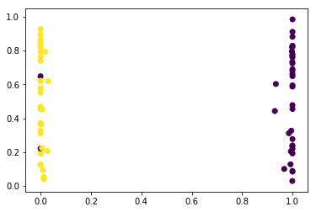
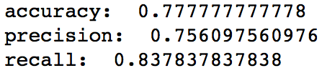
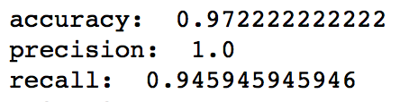
Project Results
Supervised learning: Logistic regression:
quality distribution feature
4-mer features

Slide 11
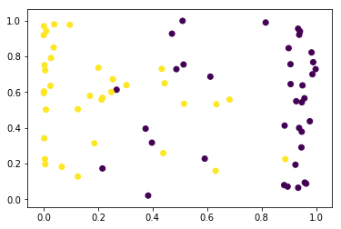
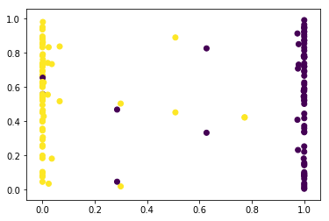
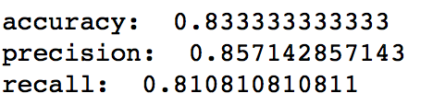
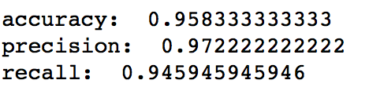
Project Results
Supervised learning: with combined features
logistic regression
SVM

Slide 12
Data clustering unsupervised\semi-supervised approach
Purpose: separate the data into two clusters, where in each cluster, most of data come from a single source.

Slide 13
Unsupervised/(semi-supervised) learning Scheme
Metrics
Dimension Reduction algorithm
t-SNE (chosen)
SIMLR
Dimension reduction Result
Problem analysis– solve an easier problem, a semi-supervised
New algorithm
Graphcut
Kmean++
Results
Evaluation

Slide 14
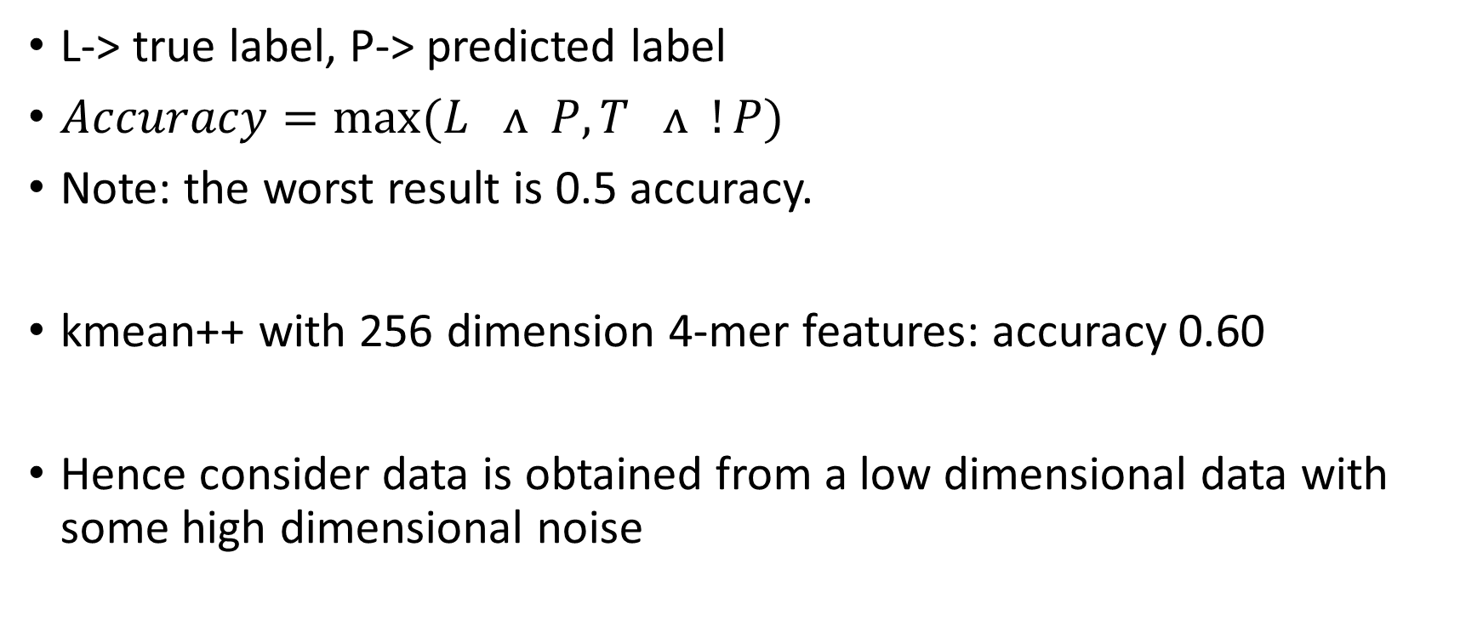
Metrics definition:

Slide 15
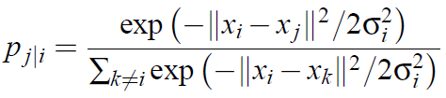

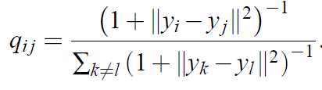

Dimension reduction
dimension reduction algorithm: to preserve as much of the important structure of the high dimension data within the low dimension data.
t-SNE: each single point has a distribution of potential neighbors on all other points, defined as Pj|i which translates as probability that j is I’s neighbor, which means each data has its internal view about all other points

Slide 16
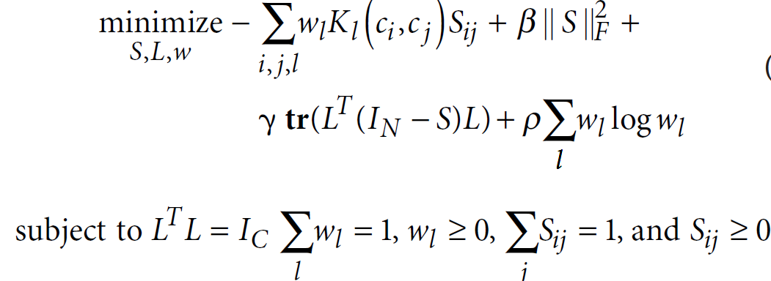

SIMLR
SIMLR is currently the state of the art dimension reduction technique. As the name implies, it uses multiple kernels to give the best estimate the dimension reduction result.
It tries to minimize the following cost function:
w is the weight vector for each kernel
L is a matrix to enforce the number of clusters (this result comes from spectral clustering theorem)
S is the similarity matrix

Slide 17
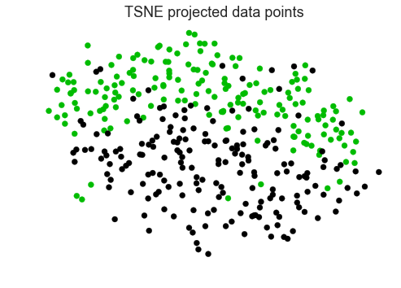
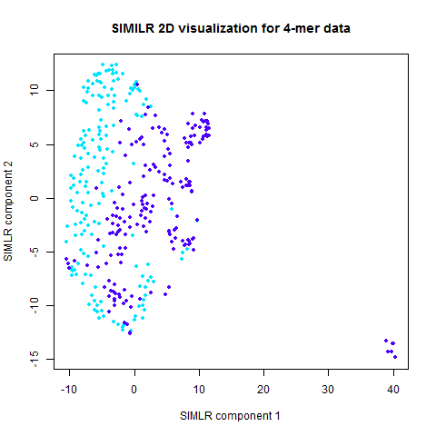
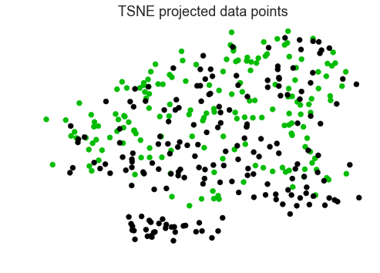
Reduction result
4-mer feature
Quality features
Good news is that there is internal structure in the data which makes clustering possible.

Slide 18
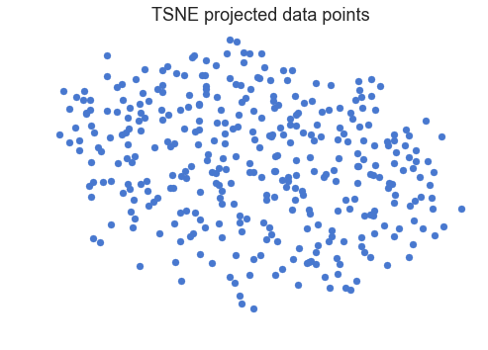
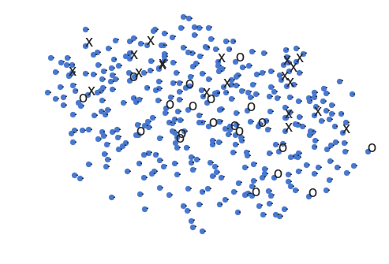
Problem analysis
we try to solve an easier problem, that given some points has known label, and the task is to classify another unlabeled node.
Say, we take a random sample, and able to know the data label by some Oracle.
This problem formulation is like the supervised learning framework, but the number of known data is not required to be many.
Old problem
New problem

Slide 19

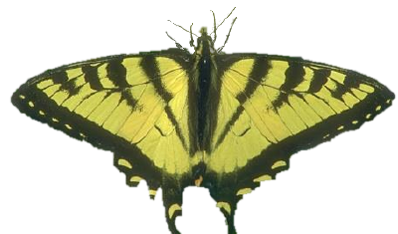
Two approaches to new problems: (assumed some nodes are given ground truth label)
GraphCut : borrowed technique from image segmentation
Kmeans++

Slide 20
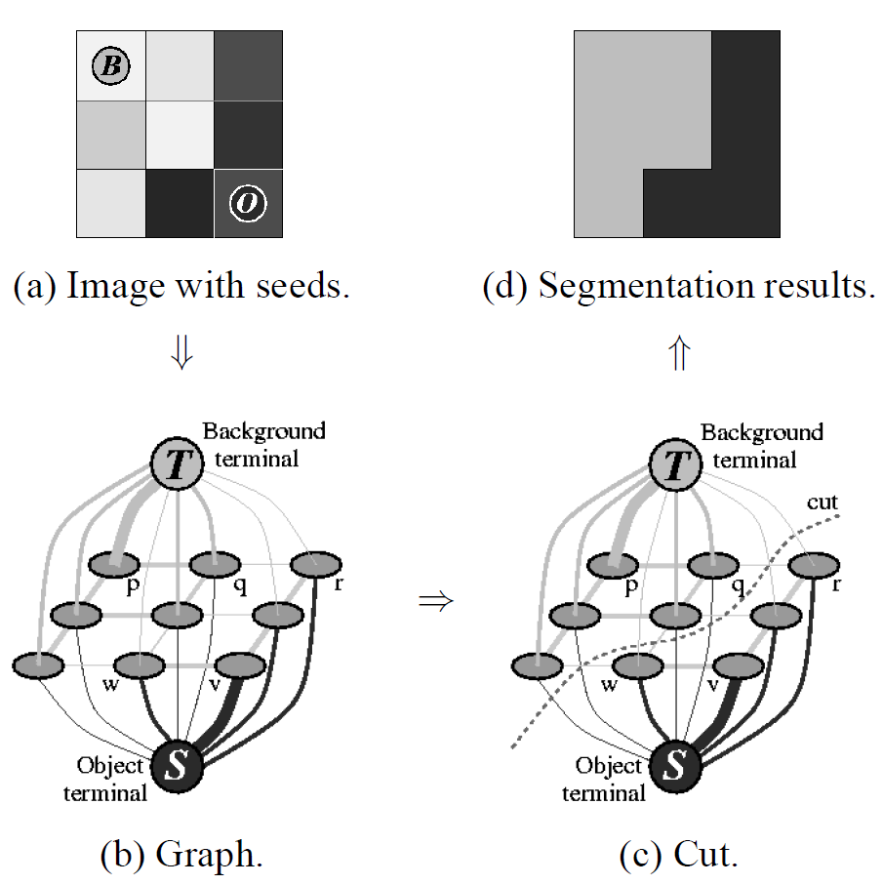
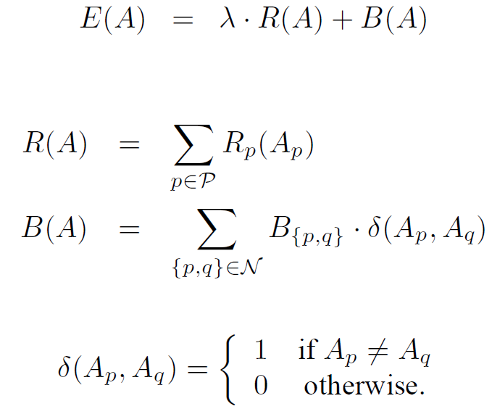
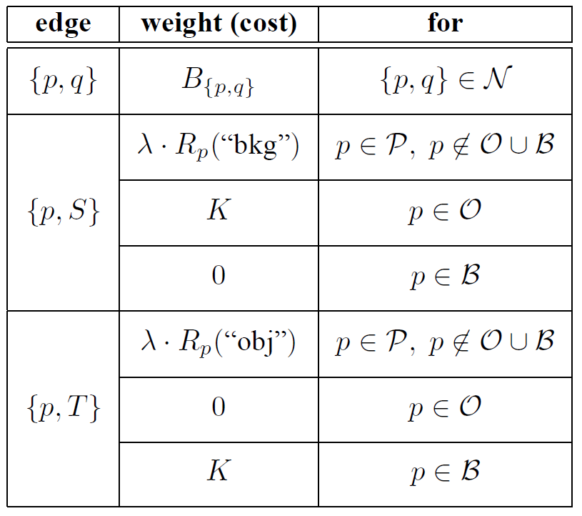
Graphcut
A : a vector with each element being a node, and the node is either an object or a background;
P : all pixels in an image
R : a metrics which measures the fitness of a node, P(p| object) or P(p| background)
B : a metrics which measures the similarity between nodes, usually defined by some kernel

Slide 21
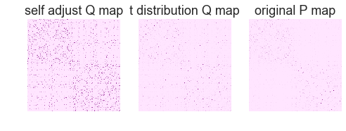
Reformulation
Define a fully connected graph first, with cost equal to neighbor probability learned using high dimensional data.
we only take highest 20 probable neighbor for each node.
Compute a 2d histogram with low dimension data using its x y location. (potential issue here)

Slide 22
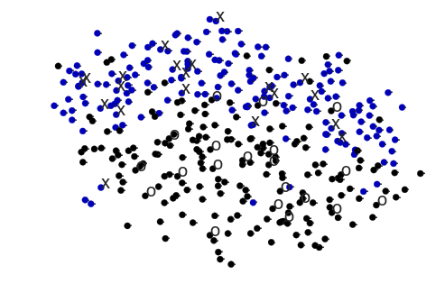
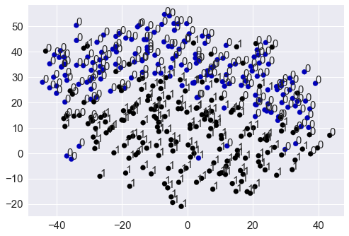
GraphCut
Benefit: there is a unique global optimal solution based on the cost function
Result: 0.877 accuracy
O and X represents labelled data
Color indicates the ground truth

Slide 23
Kmeans
Accuracy: 84.7%
Advantage: susceptible to wrong label
 | Graphcut | Kmeans
0 mistake | 87.7% | 84.7%
1 mistake | 86.7% | 81%
2 mistake | 84.9% | 77%

Slide 24
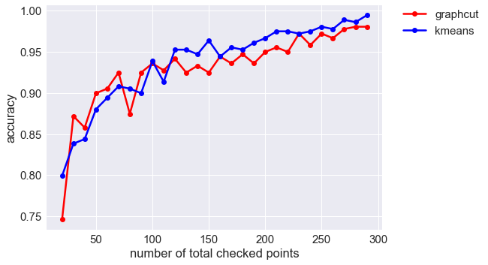
Accuracy comparison between kmeans++ and graphcut

Slide 25
Evaluation
Why graphcut algorithm does not work well in this setting compared to its image segmentation setting?
Unlike image segmentation, edges are defined in a natural ways with its adjacent pixels.
In our setting, both edges weight and region weight come from high dimensional data. We equivalently use the data twice.

Slide 26
Future work
The graphcut algorithm generates a min-cut score which might be helpful to formalize a decision rule for choosing sampled points.
Ideally, the segmentation output with lower cost corresponds to a better initial settings

Slide 27

Thank you!
Questions?

