Slide 1
Prediction of Lab Origins From Feature Analysis of Sequencing Read Data
———Bowen Xue/Andy Lin/Fan Zhang

Slide 2
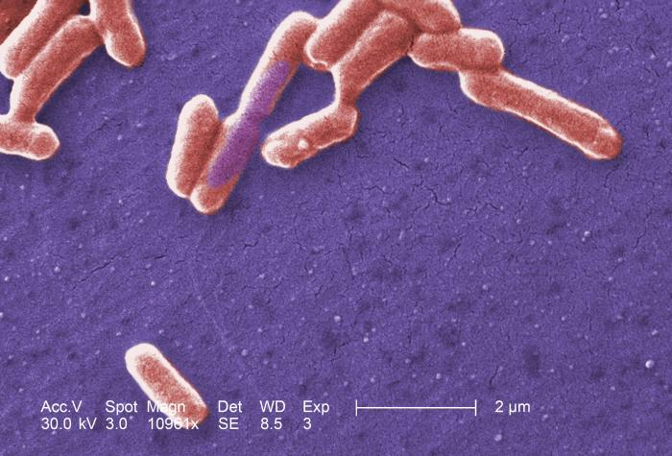
Background
For forensic investigation, it’s important to determine where a DNA sample was sequenced
Datasets from different sequencing institutions may have informative features which makes it possible to use machine learning to do the classification
We will focus on institutions that have sequenced Escherichia coli using Illumina MiSeqs

Slide 3
Project Scheme
Target: Classification From Feature Analysis of The Reads Data
Data: Sequence Read Archive (SRA) database hosted by the National Center for Biotechnology Information (NCBI).
Sequenced Escherichia coli using Illumina MiSeqs.
Raw Data: 359 fastQ datasets, each with around 200-500M bases.

Slide 4
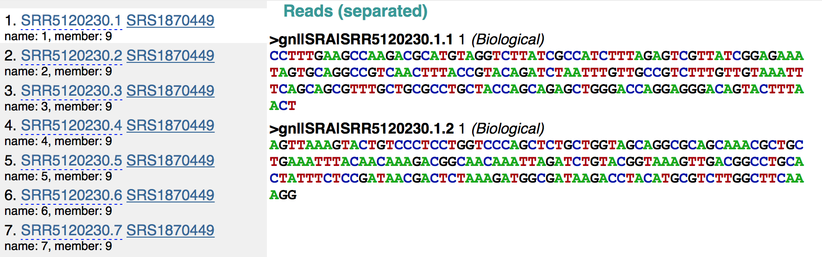

Slide 5
Project Scheme
Target: Classification From Feature Analysis of The Reads Data
Data: SRA
Features: three types of features taken into account
1. Distribution of fragment size
2. 4-mers with/without N (4^5=512 why?)
3. Distribution of quality scores

Slide 6
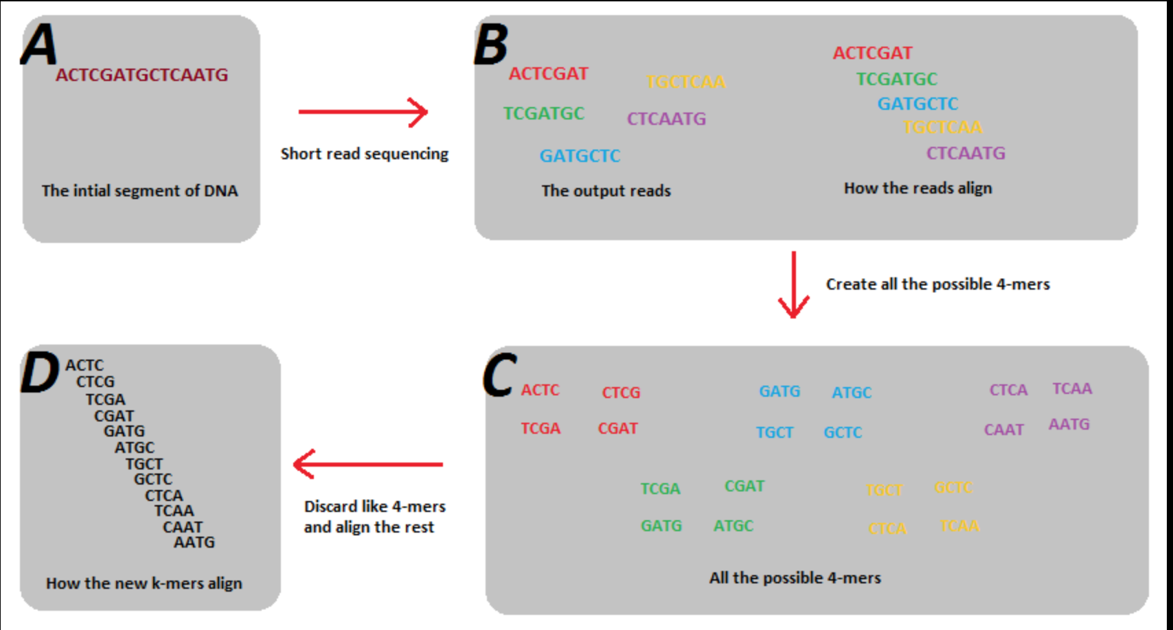
intro to 4-mers with N
4^4=256 without N
5^4=625 with N

Slide 7
Project Scheme
Target: Classification From Feature Analysis of The Reads Data
Data:
Features: three types of features taken into account
1. length of the reads
2. 4-mers (5^4=625)
3. quality scores distribution

Slide 8
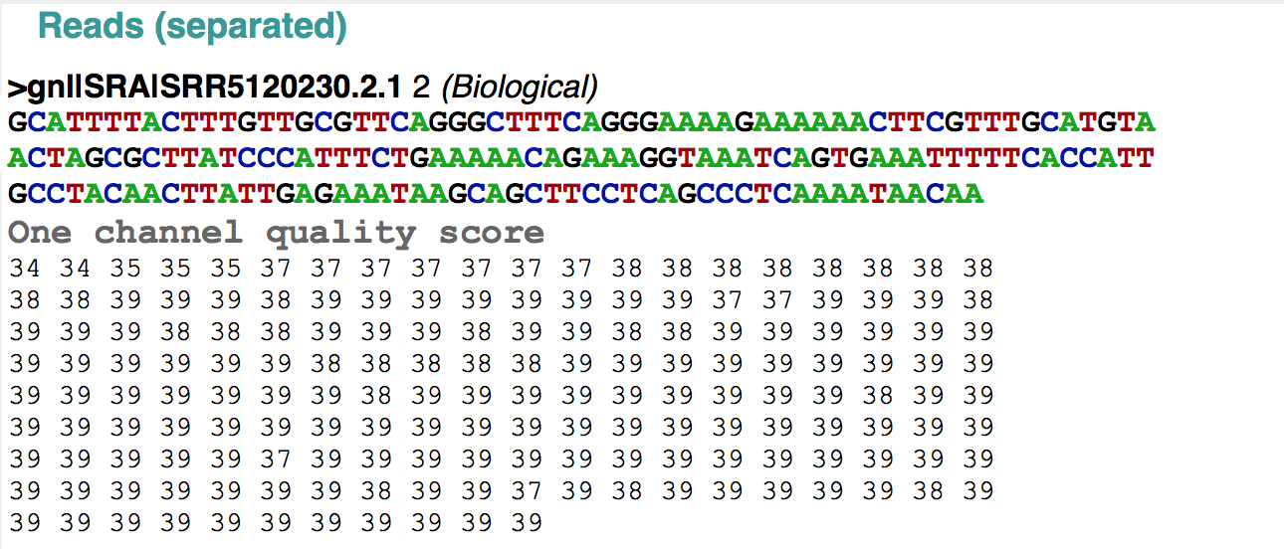
Quality distribution

Slide 9
Project Scheme
Target: Classification From Feature Analysis of The Reads Data
Data: SRA
Features: three types of features
Methodology: 60% train, 20% validation, 20% test
1. Supervised learning: Lasso & SVM
2. Unsupervised learning

Slide 10
Project Results
Supervised learning
Lasso:
SVM:
<result pic>
<result pic>

Slide 11
Project Results
Supervised learning
Lasso:
SVM:
Unsupervised learning:
<result pic>

Slide 12
<picture of the classification effect>

Slide 13
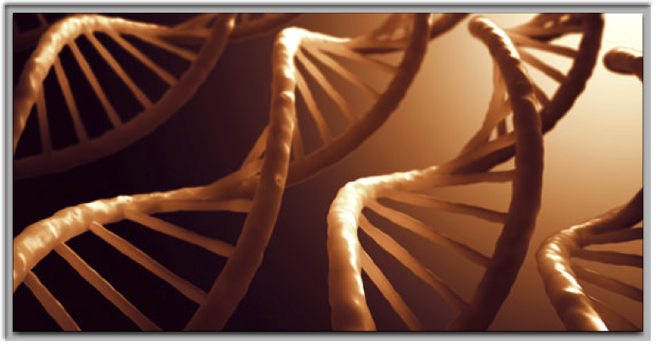
Thank you!
Questions?

