Slide 1
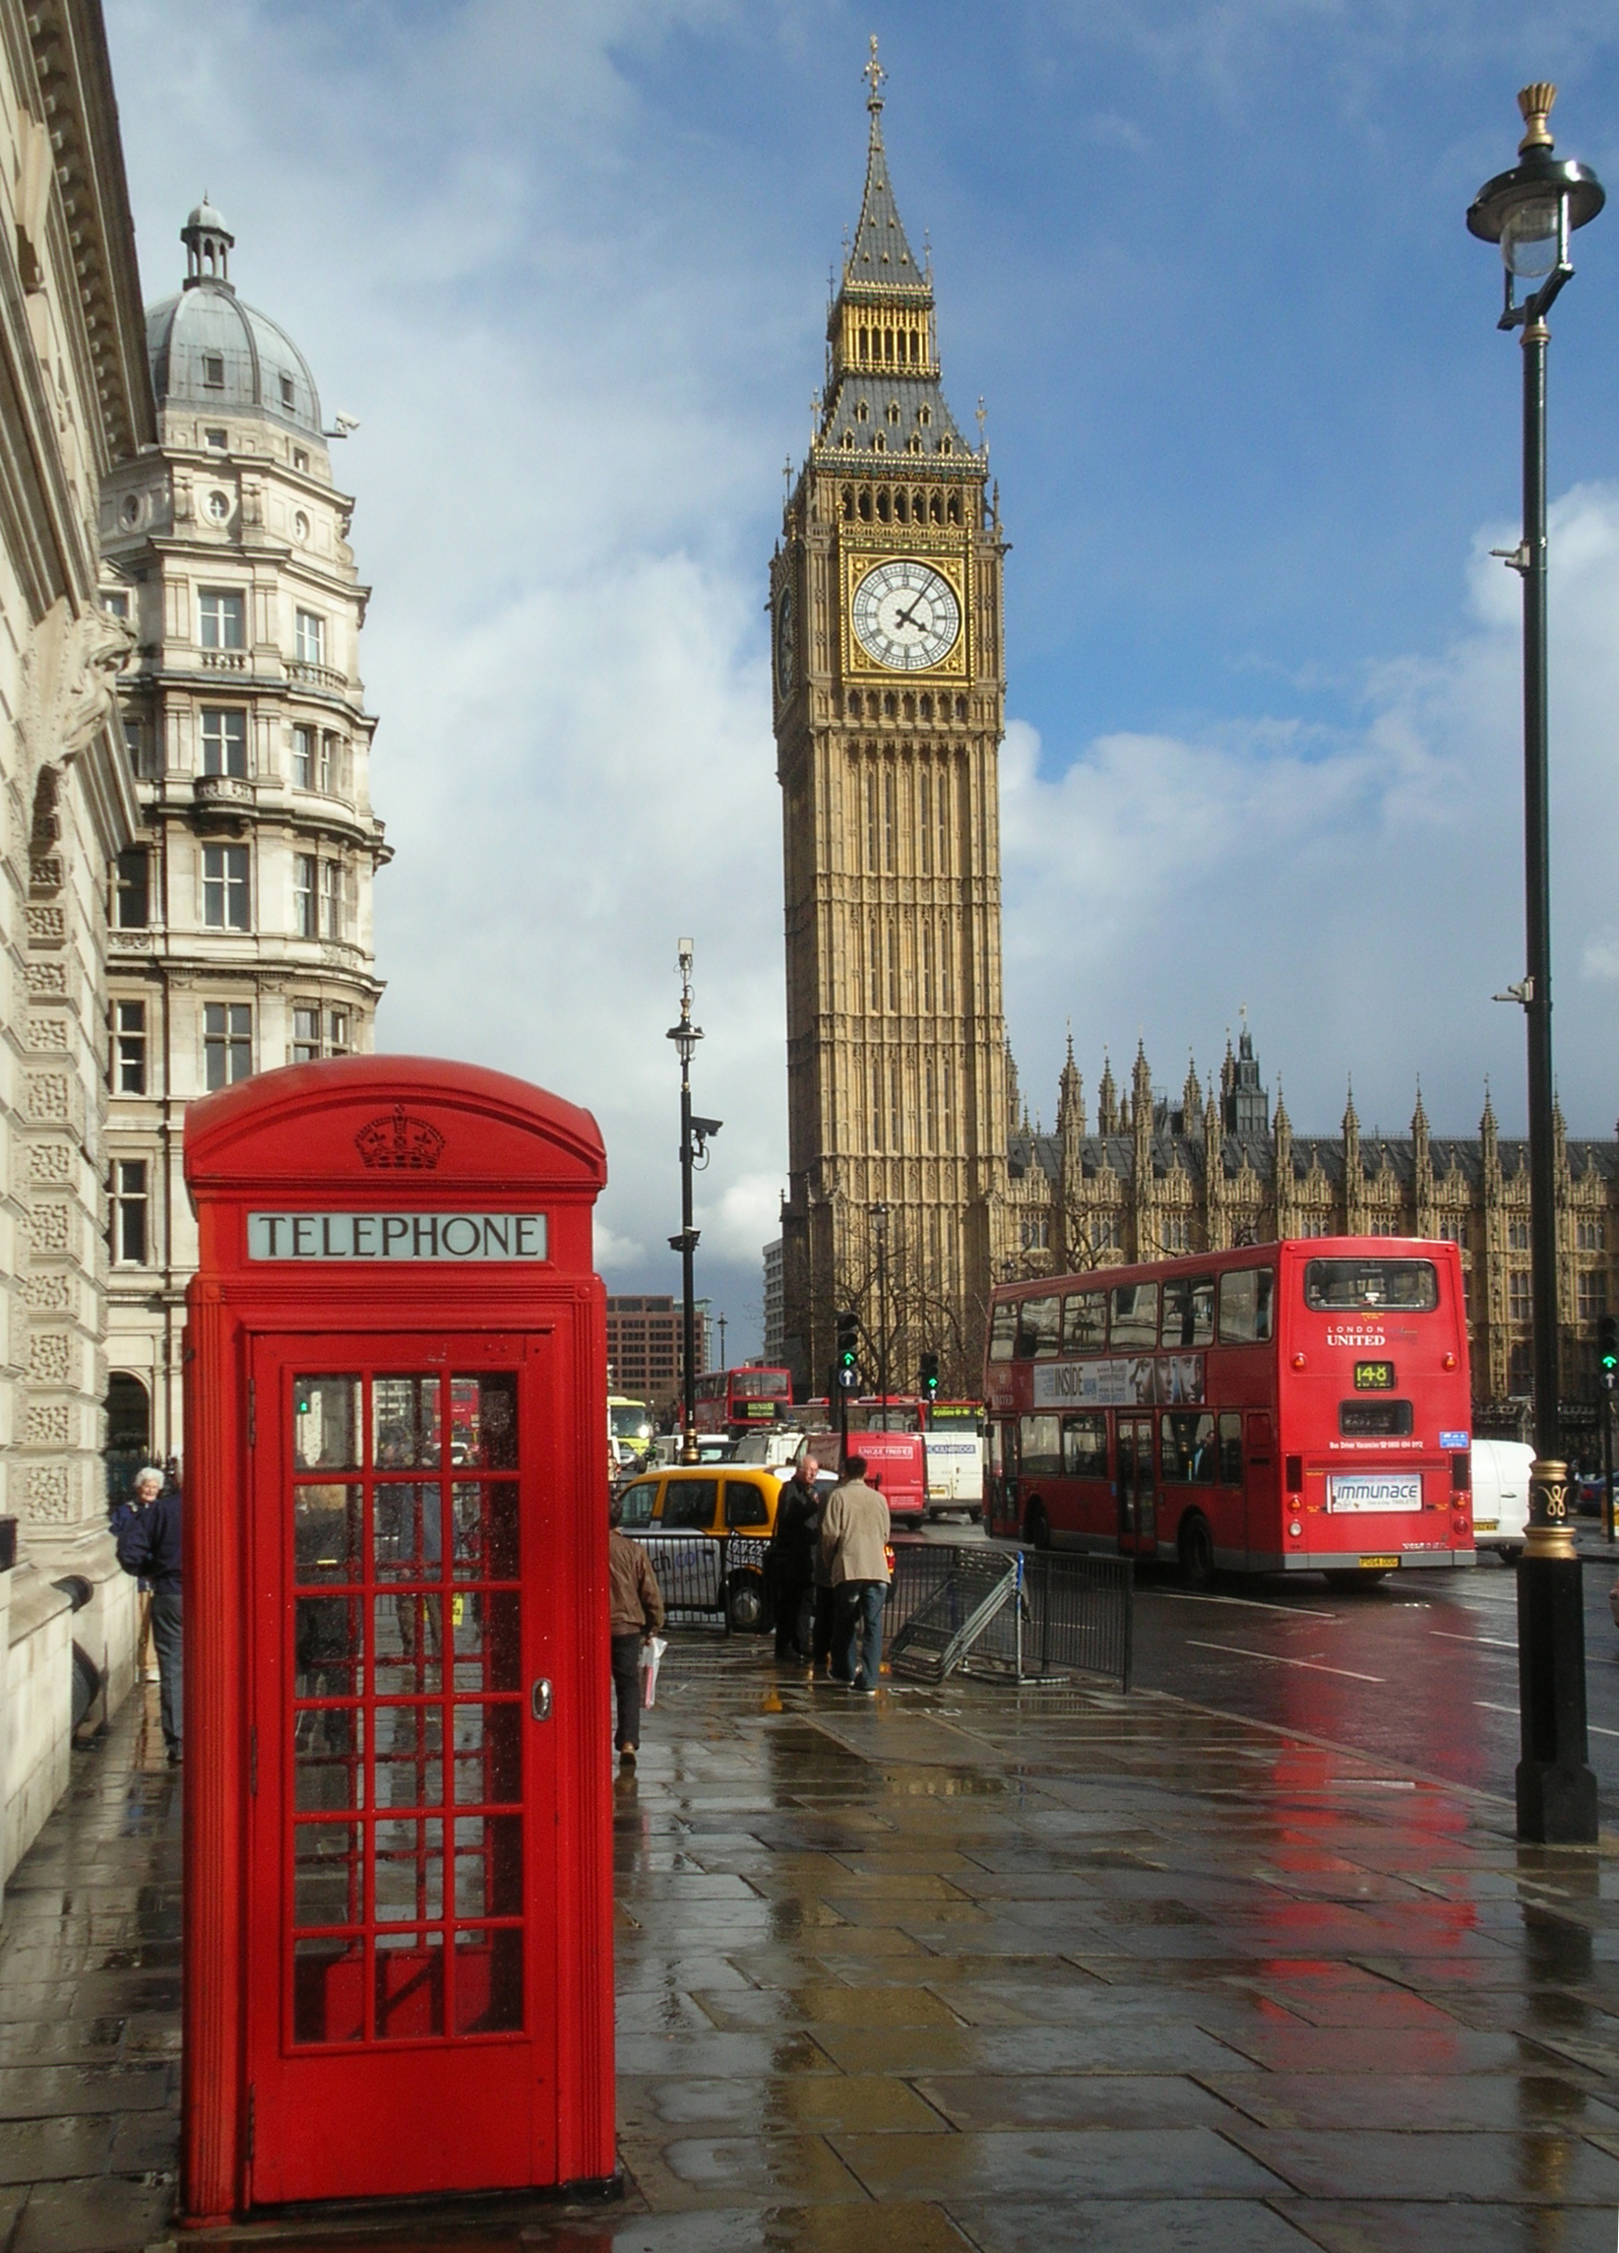
London Hype Sign up/in Contact Us News
http://images5.fanpop.com/image/photos/31700000/London-England-great-britain-31748867-1600-1200.jpg

