Slide 2

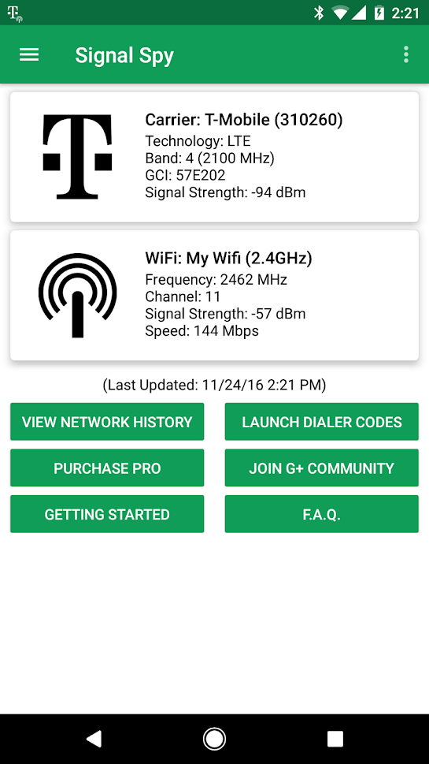
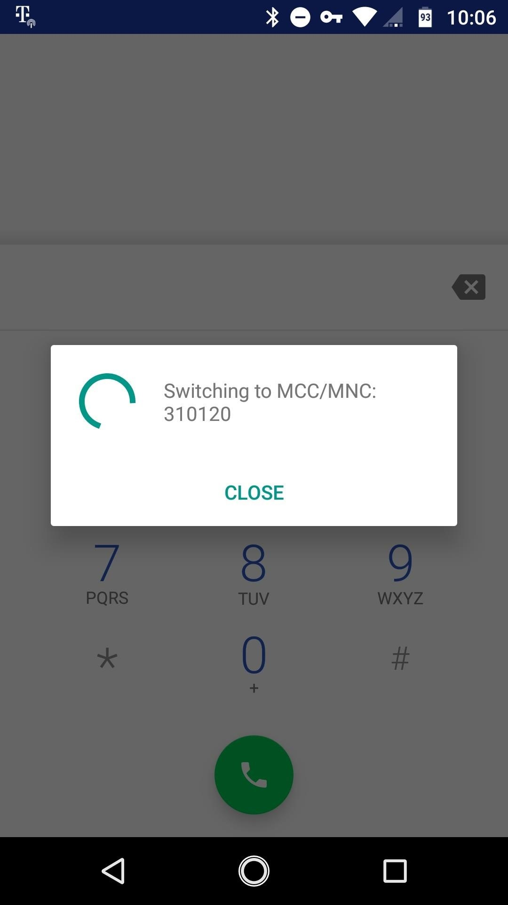
Third Party Carrier Switching Apps (SignalSpy)
Provides debugging codes to manually type into your dialer app to force a change of carrier.

Slide 3
